Slide 1
Small-Horizon Approximation as Double Integrator with Drag
a_{x,}
a_{y},
a_{z}
u_{1,} u₂, u₃, u₄
p_{x,}
p_{y},
p_{z}
v_{x,}
v_{y},
v_{z}
Inner-loop
attitude + thrust controller
12-state Quadrotor
plant
(30 Hz)
IMU attitude estimate
(200+ Hz)

Slide 2
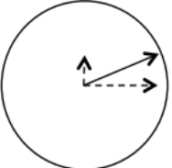
a_{max}
0.6 * a_{max}
0.3 * a_{max}
a_{y}
a_{max}
a_{x}

