Slide 1
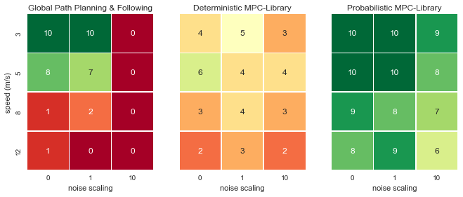
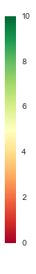
# success
(out of 10)

Slide 2
Global Path Planning
and Following
Mapless Deterministic
MPC-Library
Mapless Probabilistic
MPC-Library
# success
(out of 10)
3
Speed (m/s)
5
8
12
0
0.1
1
0
0.1
1
0
0.1
1
Noise (st. dev)
Noise (st. dev)
Noise (st. dev)

Slide 3
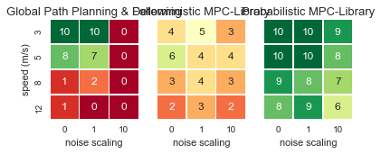

Slide 4
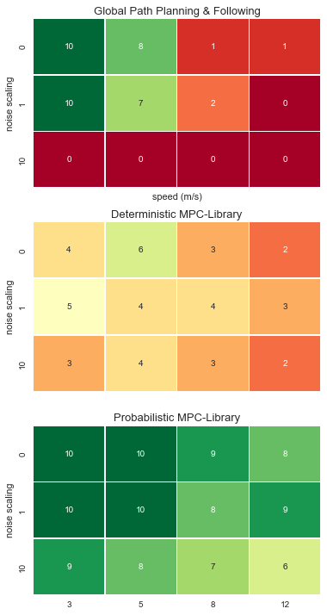
Global Path Planning and Following
# success
(out of 10)
Deterministic
MPC-Library
Probabilistic
MPC-Library

Slide 5
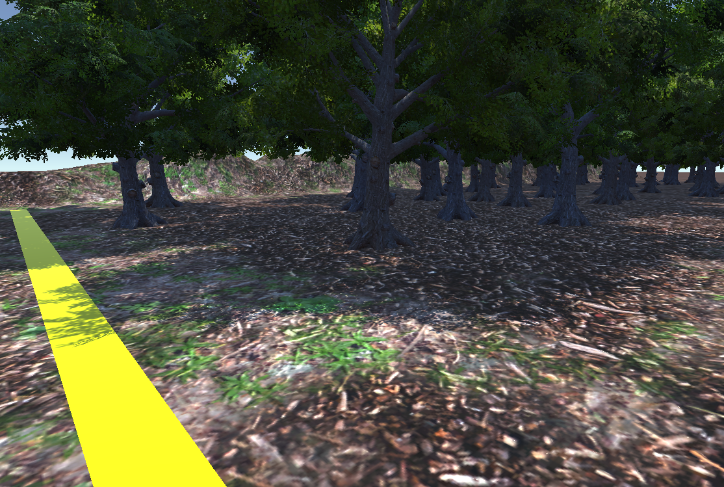
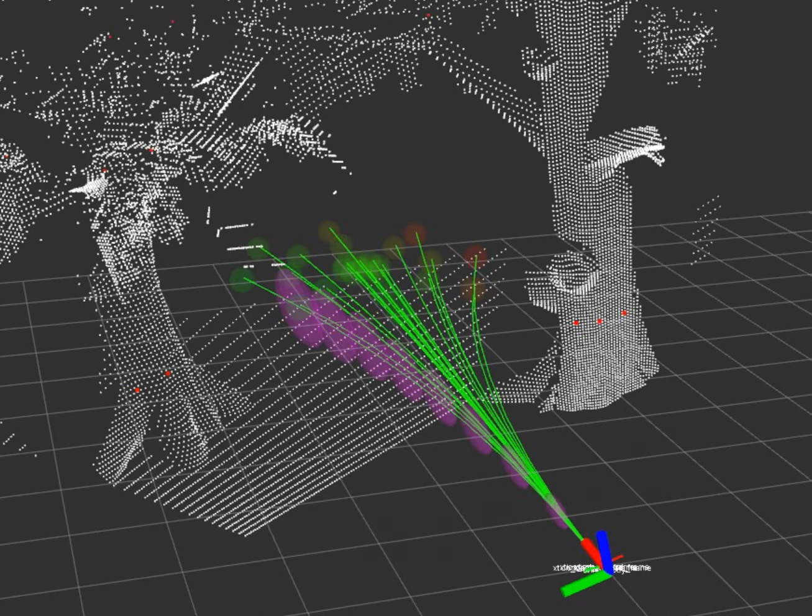
(a)
(b)

