Slide 1
Cognitive Services in Azure
Peter Johansson

Slide 2
/aboutme

Slide 3
Times
10:15 – 10:35 Coffee
12:00 - 13:00 Lunch
14:30 – 14:50 Coffee

Slide 4
Download the Workshop files
https://github.com/petejoha-sog/cognitive-workshop
Or
https://tiny.cc/cogws

Slide 5
AI/Machine Learning/Cognitive Services
IBM started 2015
The rest started in 2016

Slide 6
Service Catalogue
https://azure.microsoft.com/en-us/services/cognitive-services/directory/

Slide 7


Image classification vs Object classification
Cat
Cars

Slide 8


Slide 9
CustomVision
Docs: https://docs.microsoft.com/en-us/azure/cognitive-services/custom-vision-service/
Portal: https://customvision.ai

Slide 10
LUIS
Docs: https://docs.microsoft.com/en-us/azure/cognitive-services/luis/
Portal: http://luis.ai
NLP started in the 50s: https://en.wikipedia.org/wiki/Natural_language_processing

Slide 11
QnA Maker
Docs: https://docs.microsoft.com/en-us/azure/cognitive-services/qnamaker/
Portal: https://qnamaker.ai

Slide 12
Azure Search
Docs: https://docs.microsoft.com/en-us/azure/search/
JFK Files: https://jfk-demo.azurewebsites.net/#/

Slide 13




2.5
quintillion bytes
$14,209
80%
Productivity lost per knowledge worker each year due to information searches
Data created in the world per day
Percentage of unstructured data
Notes:
This problem isn’t specific to this one customer.
The reality of the world today is that information is constantly generated--Forbes recently estimated that the world creates over 2.5 quintillion bytes of new data per day.
It’s also coming in more “unstructured” formats like PDFs, images, videos, audio files, and powerpoints decks. Around 80% of this data in businesses is estimated to be unstructured.
As a result, it can cost time and money. Internally, decisions are less informed, take longer to make, work is done manually, Externally, user experience on apps can be difficult to naviate, and customers may not be able to find relevant content and products.
Information has the potential to become an asset or a burden, depending on how you use it. So we’re all faced with a similar challenge: how do we apply our information meaningfully to our products and businesses?
The reality of the world today is that information is constantly generated--Forbes recently estimated that the world creates over 2.5 quintillion bytes of new data per day. Data is coming in “unstructured” formats like PDFs, images, videos, audio files, and Powerpoints decks. In fact, around 80% of data in businesses is estimated to be unstructured.
As a result, it can cost time and money. Internally, decisions are less informed, take longer to make, work is done manually, Externally, user experience on apps can be difficult to navigate, and customers may not be able to find relevant content and products.
Information has the potential to become an asset or a burden, depending on how you use it. So how do we apply our information meaningfully to our products and businesses?
1. https://www.ricoh.nl/Images/IDC_Executive_Insights_January2011_t_76-4420.pdf
2. http://www.marketingpilgrim.com/2014/12/in-the-next-60-seconds-300-hours-of-video-will-be-uploaded-to-youtube.html

Slide 14
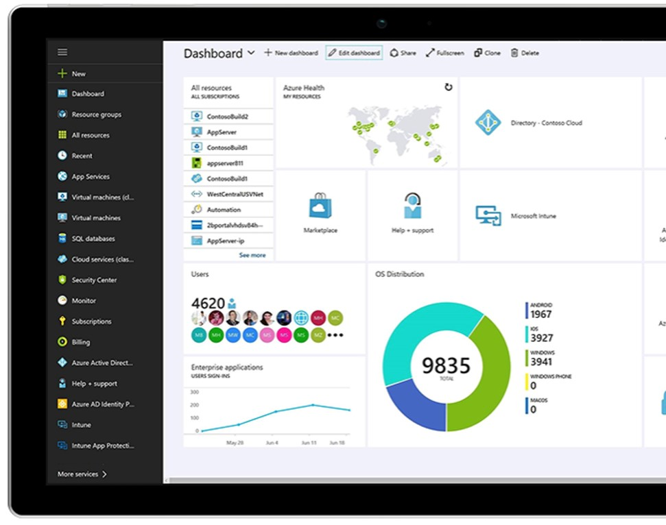
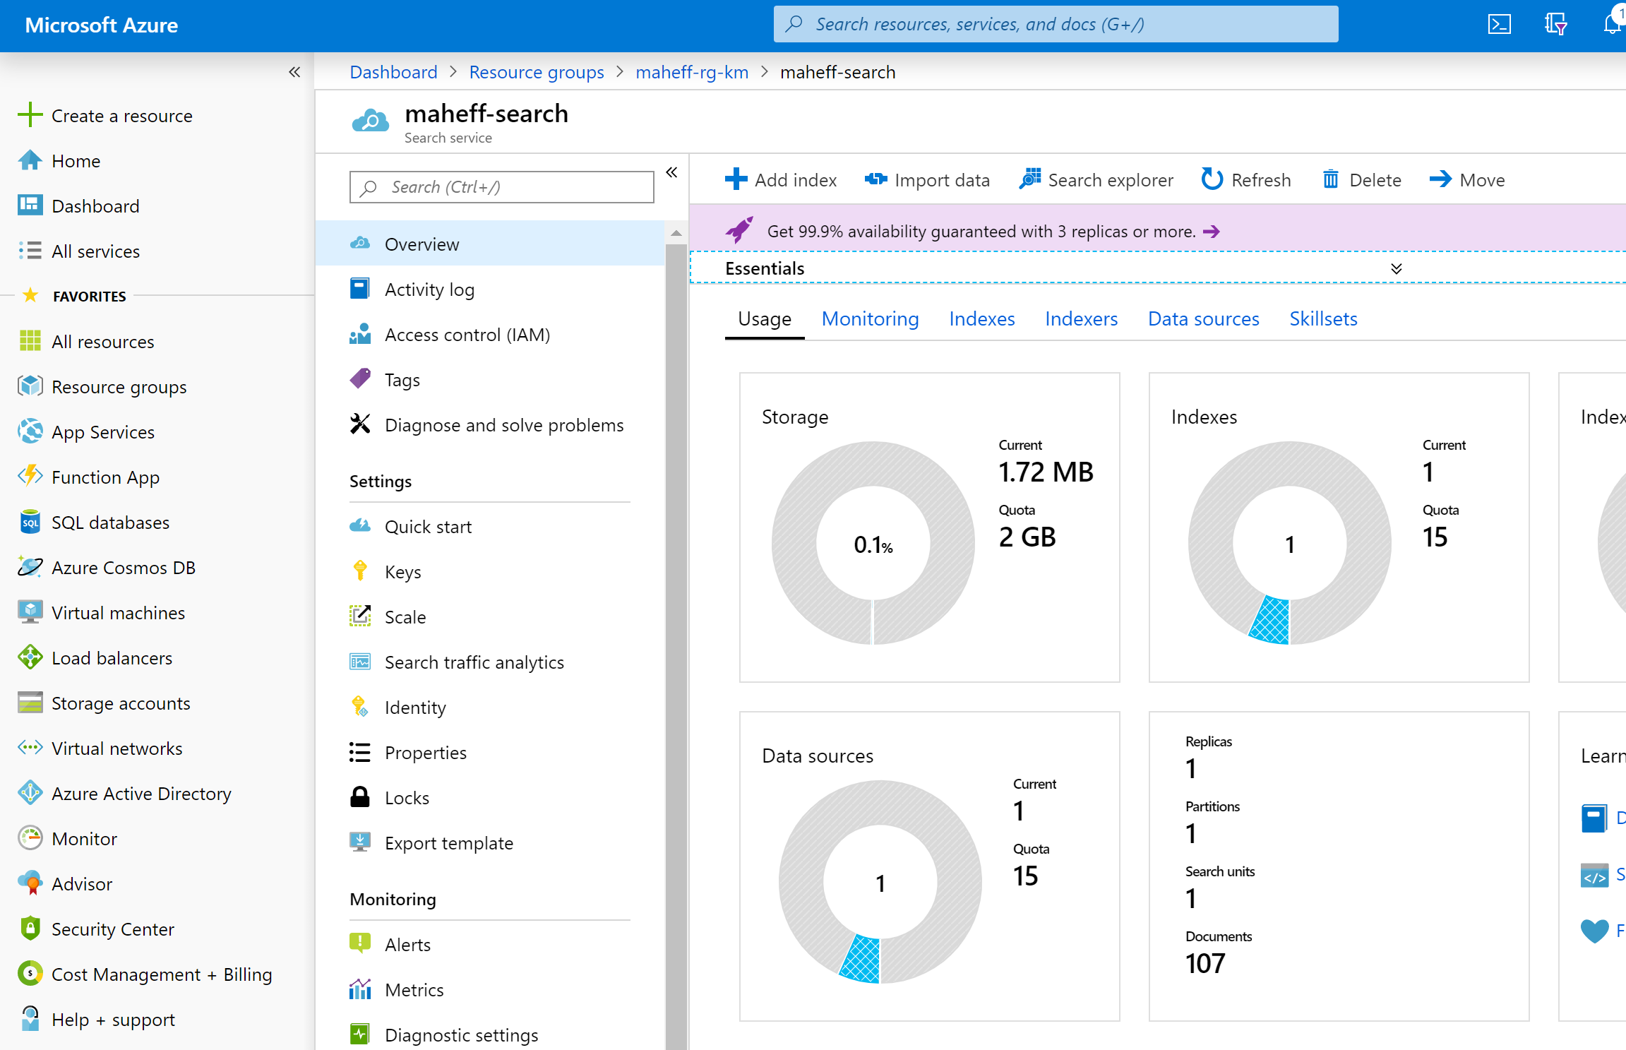
management free keyword search faceting language analyzers geospatial support suggestions/auto-complete customizable scoring proximity search synonyms complex types etc.
Azure Search Search-as-a-Service
Notes:
We started this journey with Azure Search, a down-to-earth search as a service product with all the capabilities that you would expect from a search service.
You connected your data source to our service, we would index the information in the data source. We were able to tell when the data sources changed to keep your search index up to date.
It supports different data sources such as CosmosDB, Blob storage and Azure SQL.
We received some clear feedback that files were not all structured (like JSON files). Our customers wanted us to be able to read a variety of documents.

Slide 15
Cognitive Search Pattern
Ingest
Enrich
Explore
Data in any format, any Azure store
Skillset
Search
Annotations
Notes:
Even as we take in all of this complexity, as we looked at these challenges, we saw a common pattern emerge:
INGEST (Understanding documents in a variety of format)
AUGMENT (Extract “information”, Create structure out of the unstructured.)
EXPLORE (Search)
INGEST (Understanding documents in a variety of formats)
ENRICH (Extract “information”, Create structure out of the unstructured, find patterns, gain understanding across multiple document types)
EXPLORE (Search intelligently to create knowledge from disparate documents, and structured and unstructured data)

Slide 16

Cognitive Search A new capability of Azure Search
IEnricher
IEnricher
Cognitive Skill
Document Cracking
Skillset:
Extensible enrichment
pipeline
Source Data
Enriched Documents
Search Index
INGEST
ENRICH
EXPLORE
Notes:
New!!
As you saw, the Cognitive Search pipeline contains a number of AI-driven capabilities (image extraction, entity and key phrase extraction, language detection and more) not just extracting information, but enriching it with additional metadata.
But we know that you business scenario may have unique needs beyond these core skills, so we also provide you with the ability to add custom skills…..

Slide 17
Built-in Skills in Multiple Languages
Natural Language Processing
Key Phrase Extraction Sentiment Analysis Organization Entity Extraction Location Entity Extraction Persons Entity Extraction Language Detection Text Translation
Image Processing
Face Detection Tag Extraction Celebrity Recognition Landmark Detection Handwriting Recognition Printed Text Recognition
Utilities
Complex Type Shaping Text Merging Text Splitting Conditional Skill

Slide 18




Cognitive skills
Built-in skills
Custom skills
Key Phrase extraction
Location entity extraction
Sentiment analysis
Your custom skill goes here!
Organization entity extraction
Persons entity extraction
Language detection
Face detection
Celebrity recognition
Image tag extraction
Text Utilities
Landmark detection
Printed text recognition
Azure Databricks
Azure Machine Learning
Machine Learning VMs

Slide 19
Text Analytics
Demo: https://text-analytics-demo-dev.azurewebsites.net/

