Slide 1
Kognitiva tjänster i Azure
Peter Johansson

Slide 2
Tjänstekatalog
https://azure.microsoft.com/en-us/services/cognitive-services/directory/

Slide 3
CustomVision
Docs: https://docs.microsoft.com/en-us/azure/cognitive-services/custom-vision-service/
Portal: https://customvision.ai

Slide 4
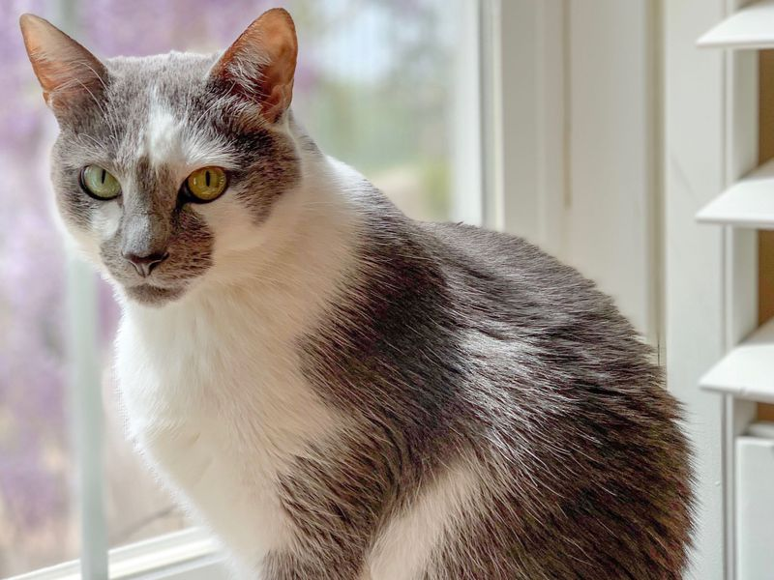
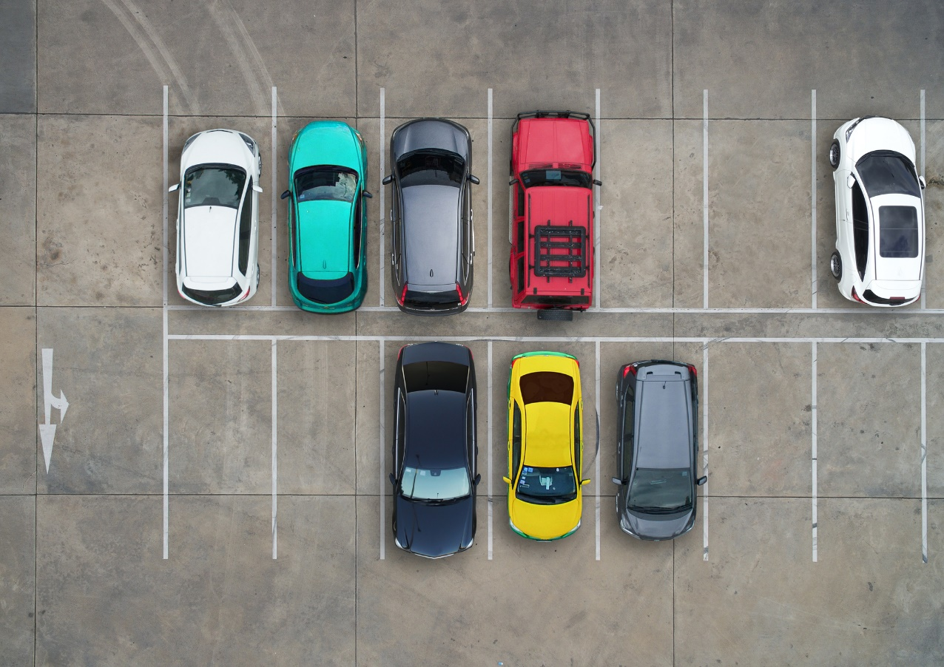
Image classification vs Object classification
Cat
Upptagna platser

Slide 5
LUIS
Docs: https://docs.microsoft.com/en-us/azure/cognitive-services/luis/
Portal: http://luis.ai

Slide 6
QnA Maker
Docs: https://docs.microsoft.com/en-us/azure/cognitive-services/qnamaker/
Portal: https://qnamaker.ai

Slide 7
Azure Search
Docs: https://docs.microsoft.com/en-us/azure/search/
JFK Files: https://jfk-demo.azurewebsites.net/#/

Slide 8
Text Analytics
Demo: https://text-analytics-demo-dev.azurewebsites.net/

