Slide 1


Workshop in information security
powered by Ori Petel

Slide 2


IPS – Intrusion prevention system
Metasploit Module

Slide 3


Apache zookeeper
Centralized service for maintaining configuration information
Implements an interface of a very small directory tree structure of file systems.
Relive distributed applications the responsibility of implementing coordination service from scratch.
Basis for the construction of more complicated services. Therefore Provides very simple API

Slide 4
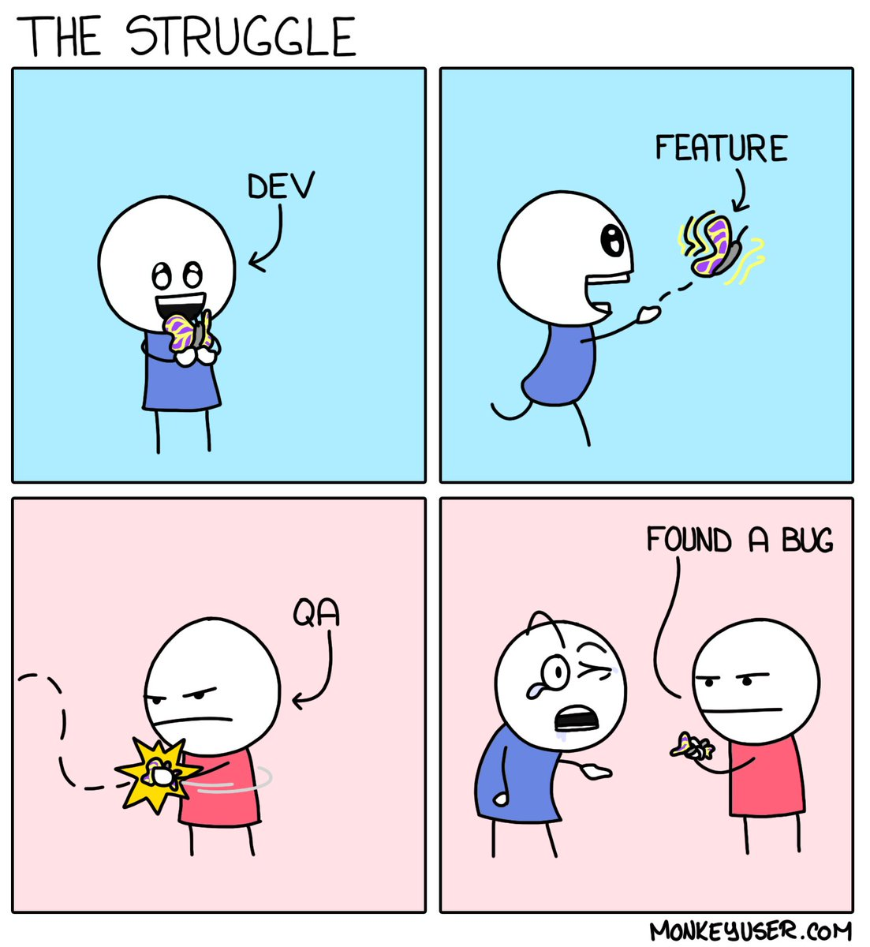


It’s not a bug, It’s a feature!
Apache Zookeeper is used by default over the port 2181.
This service exposes an interface of small set of monitoring commands called ‘The 4 letter words’.
Those commands can be sent without any authentications via telnet or ‘plain’ TCP.
By default 4-letter-word commands are disabled – you must enable them when configuring the ZooKeeper.
Juushya G.

Slide 5
Vulnerability. But why?
You may ask yourself why would ZooKeeper expose such a bare interface in the first place?
As mentioned above this service is used at the early construction phases, where the system isn’t functioning well.
Thus simplicity & accessibility are crucial.
Examples:
stat - Lists brief details for the server and connected clients.
mntr - Outputs a list of variables that could be used for monitoring the health of the cluster.

Slide 6
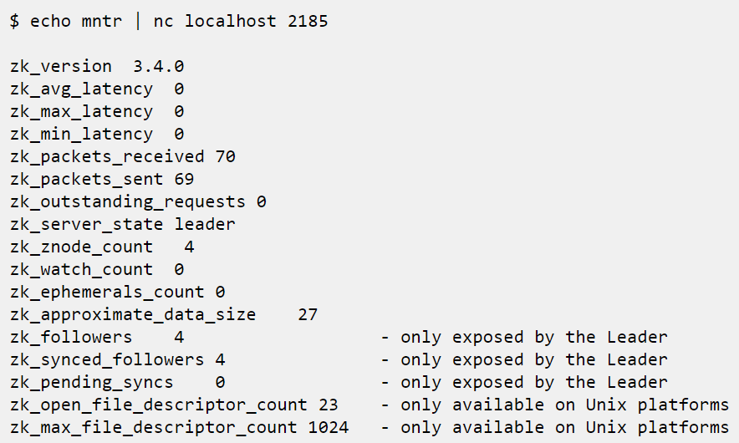
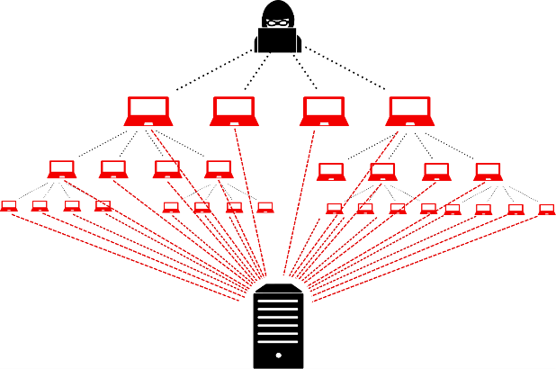
Exploitation - Information Disclosure
If not used carefully this "feature" can be exploited by malicious causes.
An attacker can use such innocent command as a base of intentional DDOS attacks on the server.

Slide 7
Protection – FEW “blades”
There are different approaches (blades) for protecting Zookeeper service.
We can classify them into 3 different kinds:
User level (internal server) – editing the zookeeper.properties file
Transport layer (Firewall) – blocking any incoming traffic to the server from the outside world.
Application layer (Firewall MITM) – blocking specific commands from the outside network (by either whitelist or blacklist).

Slide 8

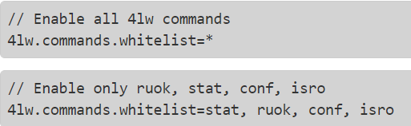
Protection – user level
zookeeper.properties
Pros:
Supported by the API
Doesn't require external tools
Cons:
Cannot distinguish between “good” users and “bad” users
Cannot allow risky commands
Suggestions for improvements:
Integrating an authentication mechanism in ZooKeeper API

Slide 9
Protection – transport layer
Blocking based on the packet’s header and not its content.
Using the stateless packet inspection which we implemented in exercise 3.
Adding the following rule to the rules table:
Action | Ack | Dst_port | Src_port | protocol | dst_ip | src_ip | direction | name
drop | any | 2181 | any | TCP | any | any | in | ZooKeeper
Pros:
Distinguishes between internal (good) users and external (bad) users.
Very small delay since we decide the packet’s verdict right away.
Cons:
High granularity filtering
Does not allow specific commands
Blocks any communication between the server to the outside world

Slide 10
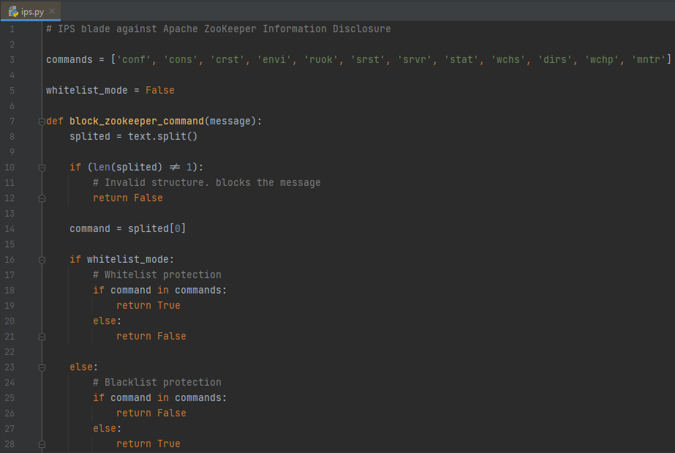
Protection – application layer
Blocking based on the packet’s content.
Using the statefull packet inspection (MITM proxy) which we implemented in exercise 4.
Pros:
Low granularity filtering
Distinguishes between internal (good) users and external (bad) users.
Allows specific traffic from the outside world.
Cons:
High delay because the traffic passes through the proxy
Best solution so far !

Slide 11


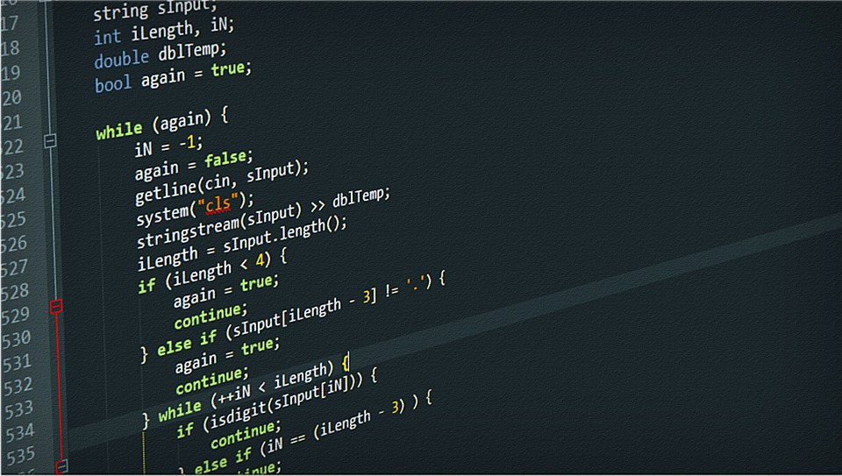
DLP – Data leak prevention

Slide 12
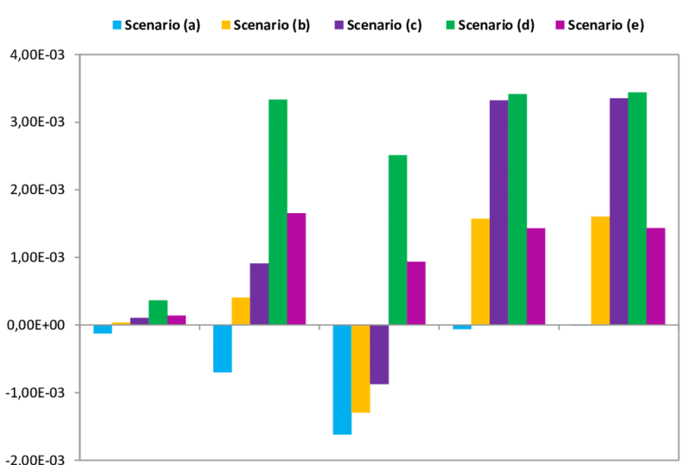
C detection - Properties
When I first faced the challenge of detecting C code I had many different ideas. Most of them were related to C language properties:
C keywords
‘char’, ‘int’, ‘short’, ‘for’, ‘while’, ‘return’, ‘goto’
Loops, conditional blocks and namespaces
for { }, while { }, if { }
Preprocessors starting with #
#define, #ifdef, #include
Semicolons ; at the end of each statement
a += 3; z = x * y
Idea: detect each property separately and combine them into a normalized result in [0,1].

Slide 13
c detection - Problems
This approach caused some problems in the detection:
Semicolons in plain text have managed to confuse my algorithm.
Dependencies - some properties are strongly related to one another. For example: - Declaration of variable and assignment to the same variable - Textual Macro uses #define and the usage of this macro throughout the code
Double counting – some properties can hold for the same line. Therefore it will be counted twice (one in each measure). For example: - If statement that combines an assignment

Slide 14


c detection – Solution
As a result I realized it's not sufficient to verify that each property holds separately.
We should relate each line as part of a wide context.
We should analyze the structure of the text.
We need to change the point of view.

Slide 15

c detection – the algorithm
As a rule of thumb, the algorithm premise the text is a C code, unless it proves otherwise.
MACROS – detect all the MACROS of the form (#define, #ifdef…) and substitute the value in all their instances in the text (imitating the preprocessor functionality)
Comments – detect comment lines in the code
Semicolons – split the code into lines by the semicolons and remove redundant whitespaces.
Declaration – detect variables & functions declarations using the by the following predecessor keywords: (store the variables for later use)

Slide 16
c detection – the algorithm
5. Control blocks – detect loops, if statements, and commands that affect the linearity of the code
6. Assignments – detect any assignments to variables (from the list obtained in stage 3)
7. Functions – detect function calls (from the list obtained in stage 3)
* Notice that early stages assist to the operation of the later stages.

Slide 17
c detection – labeling
Each line we parsed, gets a label corresponding to one of the stages (or None)
A line with a label is considered as C line.
Every successive group of C lines is considered as C block
(The minimum size for a block decided by a threshold variable)

Slide 18
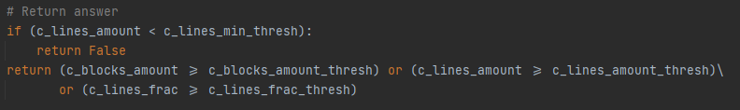
C detection - verdict
After we collect all this data, we apply heuristic based thresholds.
Those are based on some research I have done and many code & text examples.
If one of the thresholds are crossed, we report ‘C code’.
Consequently we block the text.

Slide 19
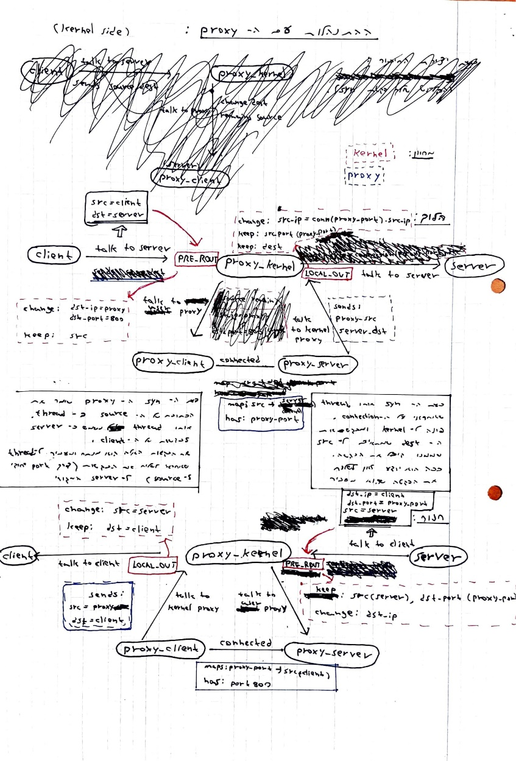
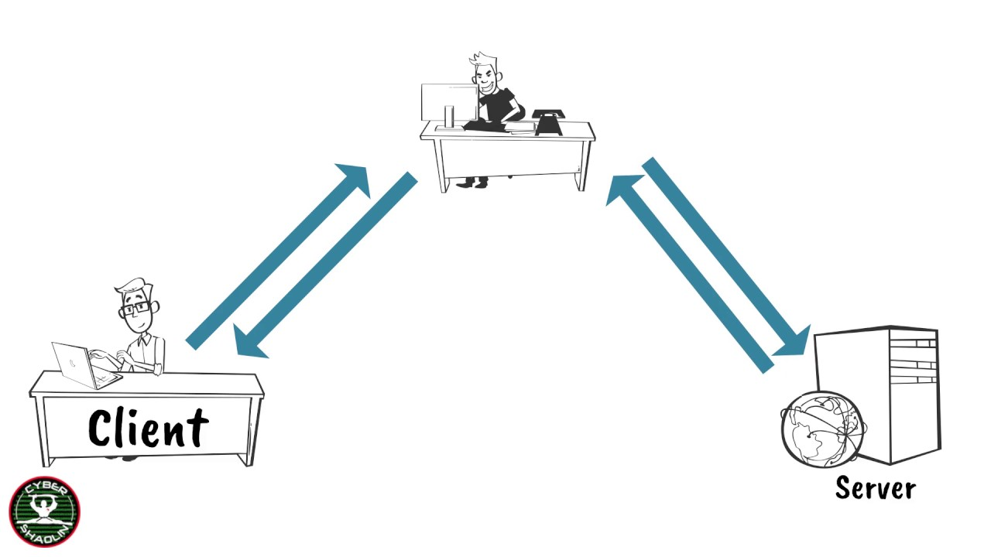
MY biggest challenge during the workshop
Constructing the Proxy !
IP S / Port 80
IP C / Port Y
IP C / Port X
IP S / Port 80

Slide 20

Questions

