Slide 1
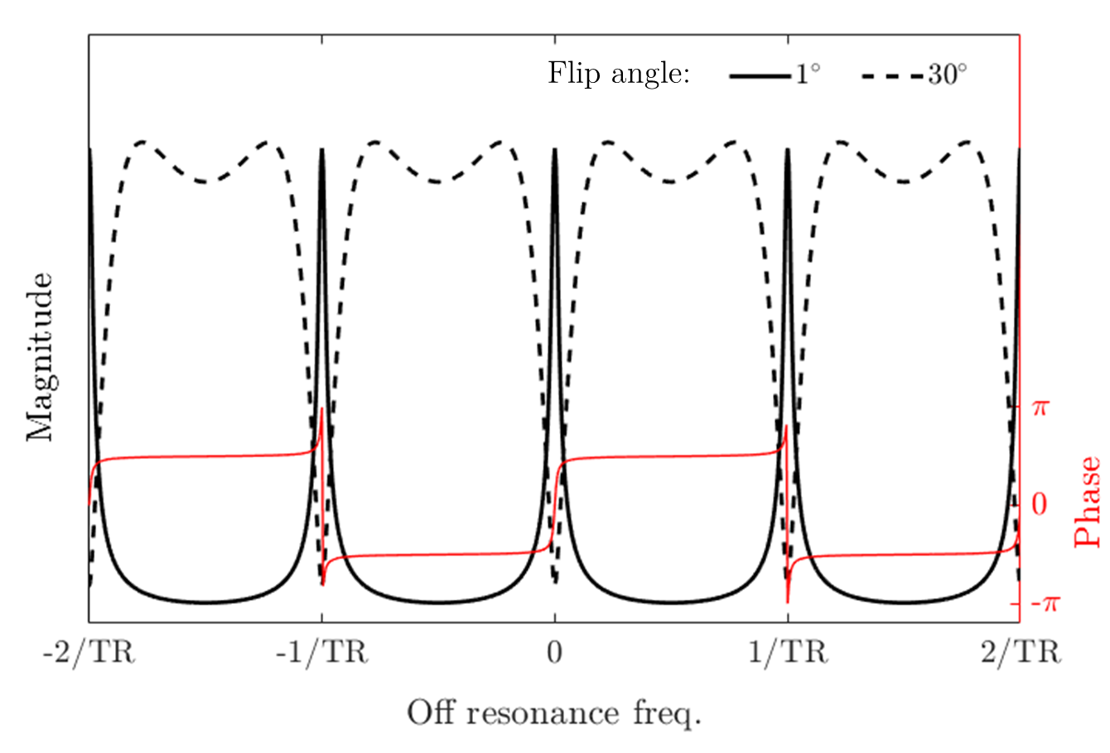
bSSFP off-resonance profile

Slide 2
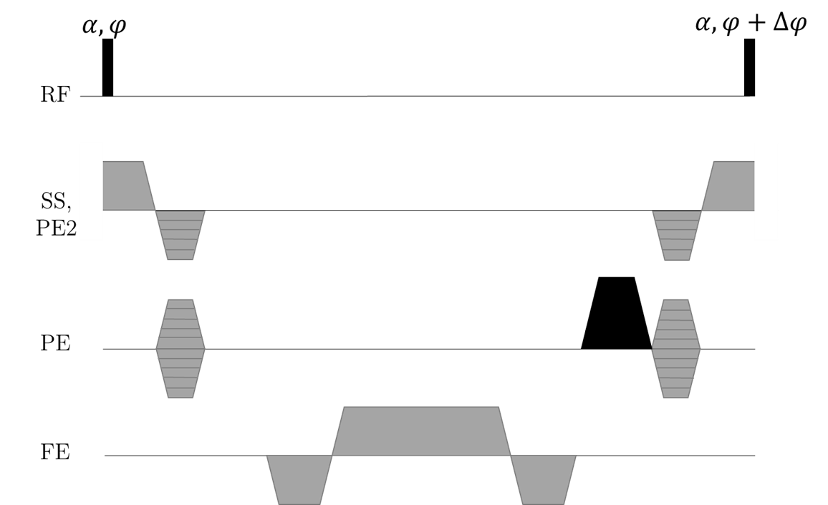
Modified bSSFP sequence: add an unbalanced gradient (here in PE direction)

Slide 3
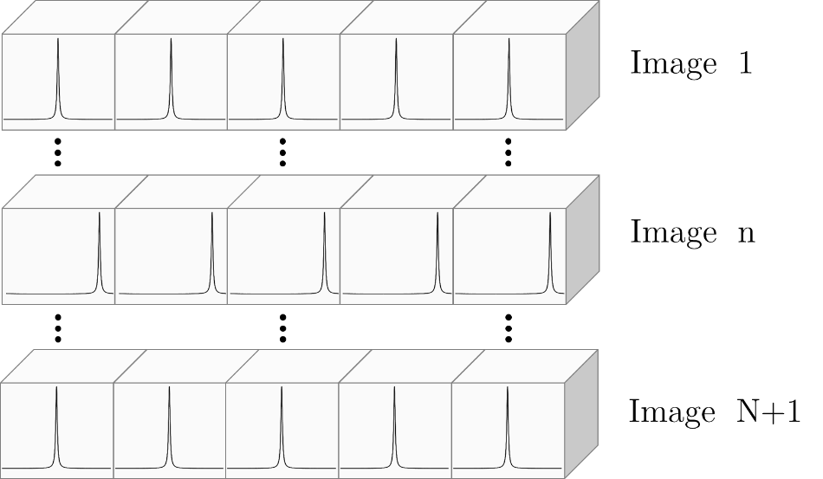
Depending on the linear RF phase cycling increment, the off-res pattern is shifted along the unbalanced gradient direction

Slide 4
289 x 289 voxels
289 x 17 voxels
Series of images with off-res modulation in up-down direction, and increasing phase increments
We can fix modulation periodicity to voxel spacing, so that we have the same information on a low-res grid

Slide 5
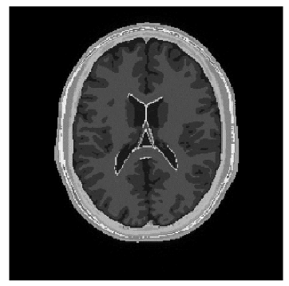
17x increase in AP direction
Then we just need to reorder the imaging data onto a high-res grid

Slide 6
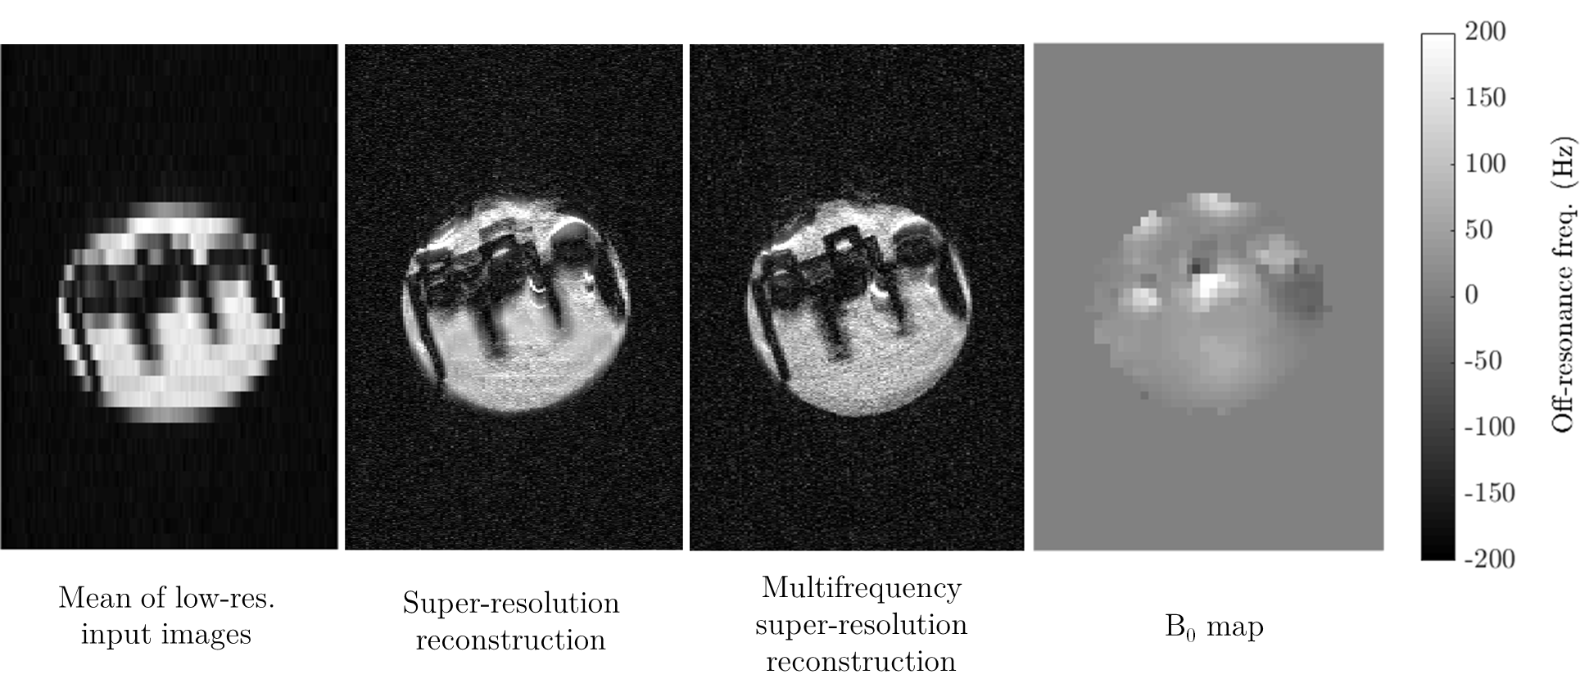
Lego brick on 9.4T Bruker Biospec

