Slide 1
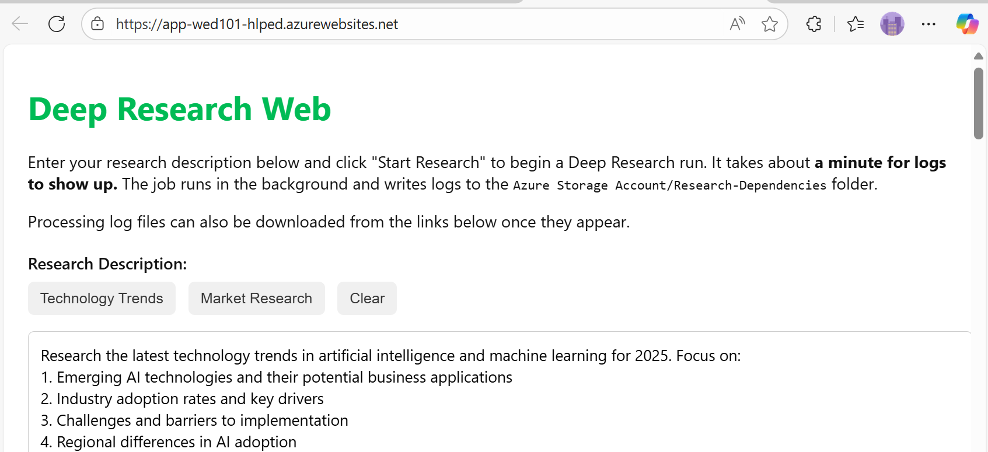



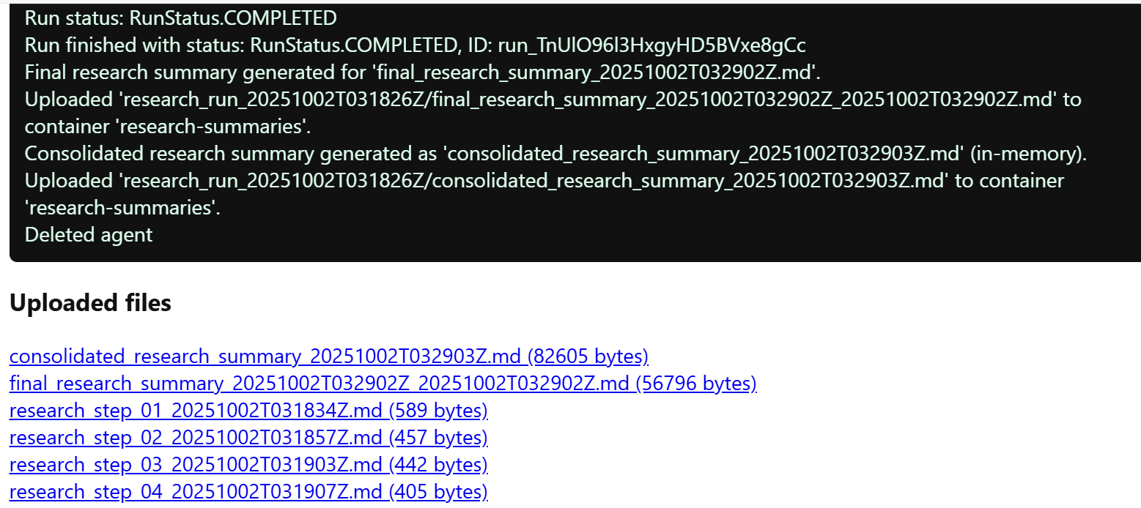

Standard agent setup
Azure AI Project
Azure AI Agent Service
Azure Key Vault
Azure AI Search
Azure Storage
Notes:
The bicep templates mentioned in the slide are available at https://github.com/Azure/azure-quickstart-templates/tree/master/quickstarts/microsoft.azure-ai-agent-service

