Slide 1
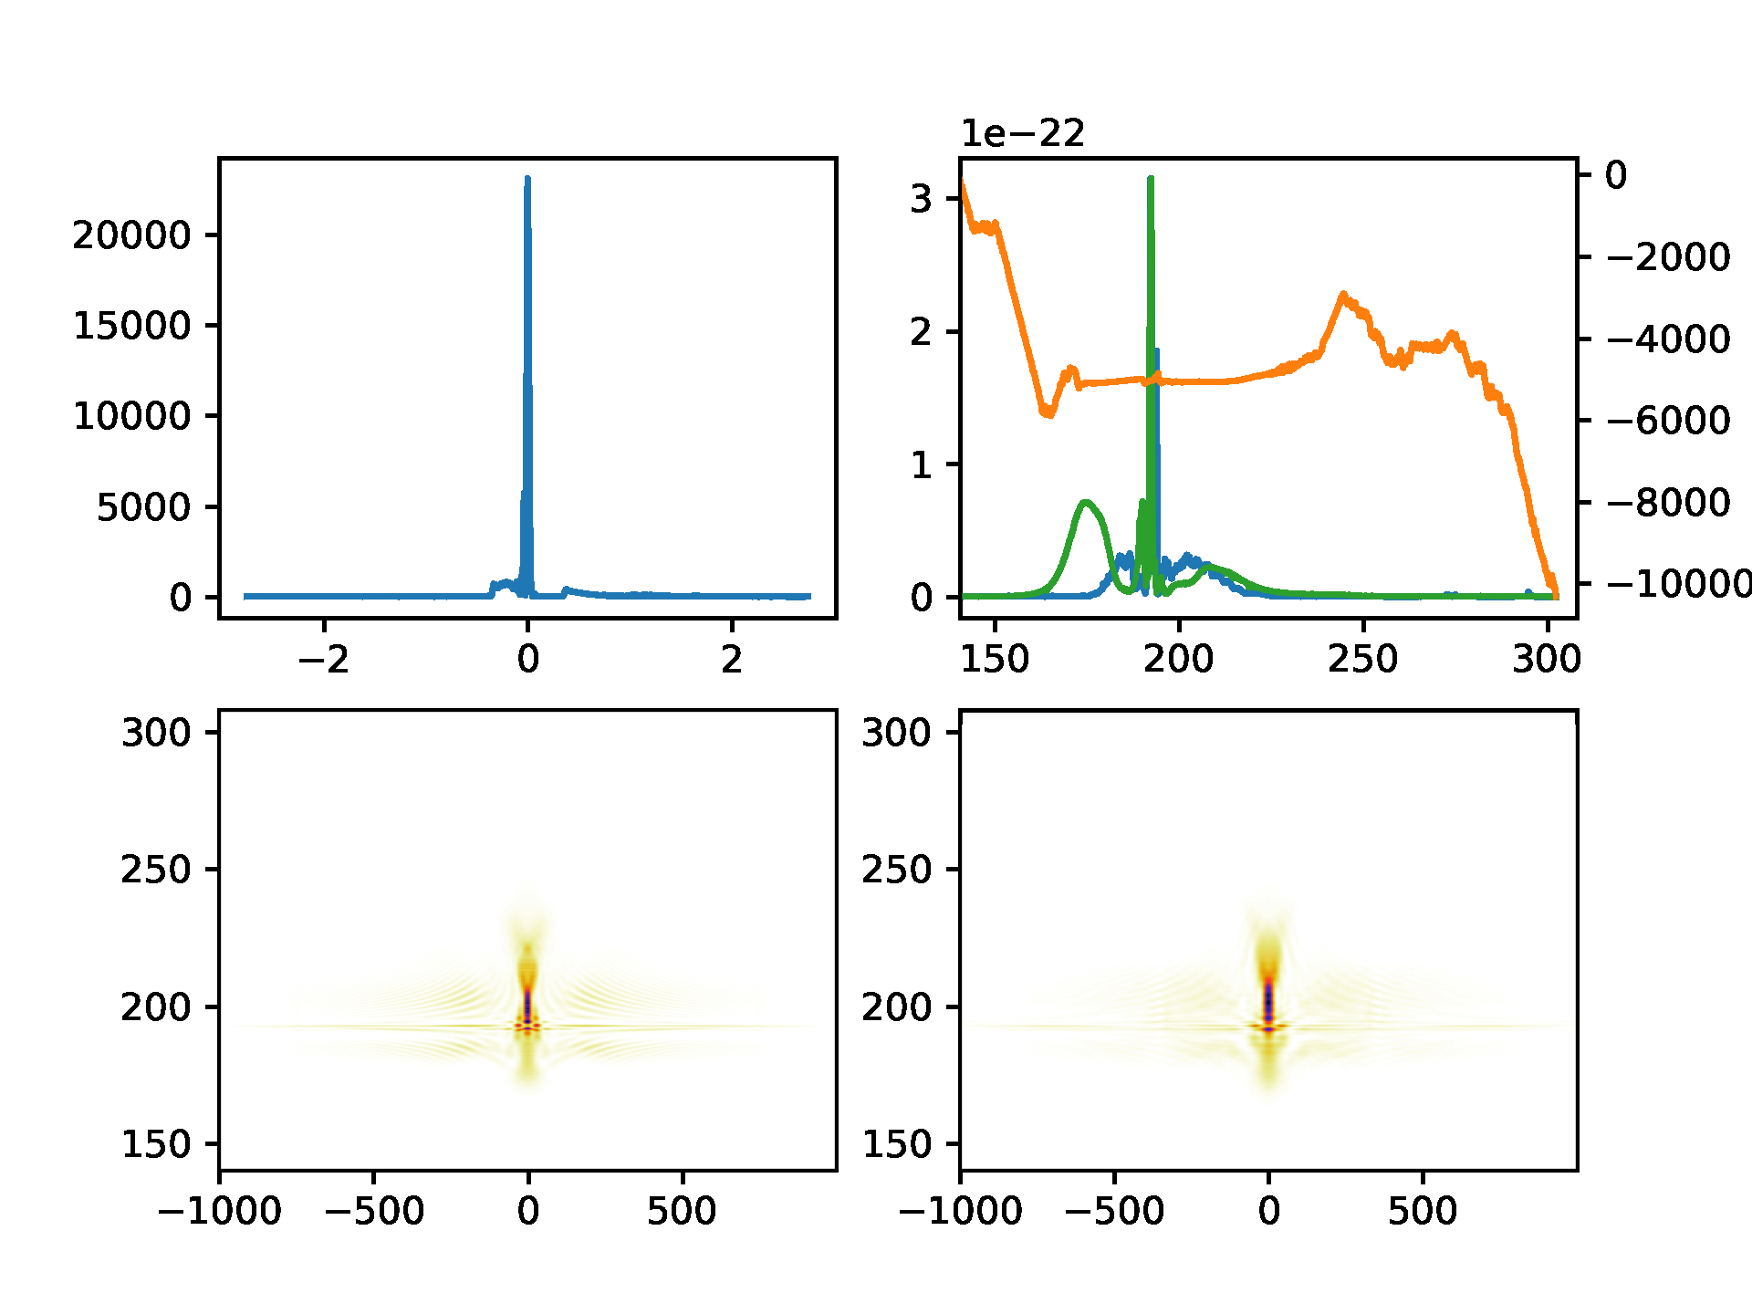
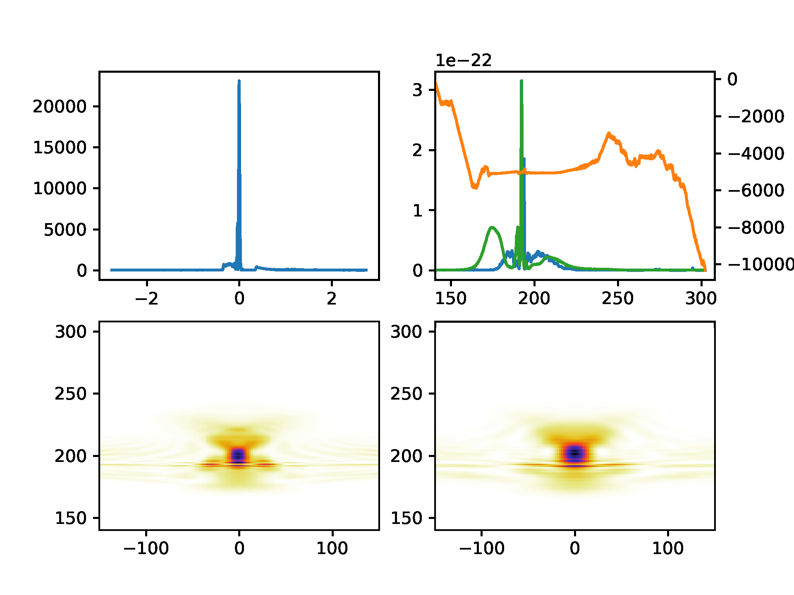
Notes:
Look’s like a sub-30 fs pulse. I don’t think the crystal can phase-match out to the longer wavelength side (the simulations show that the sfg light is very long wavelength).

