Slide 1
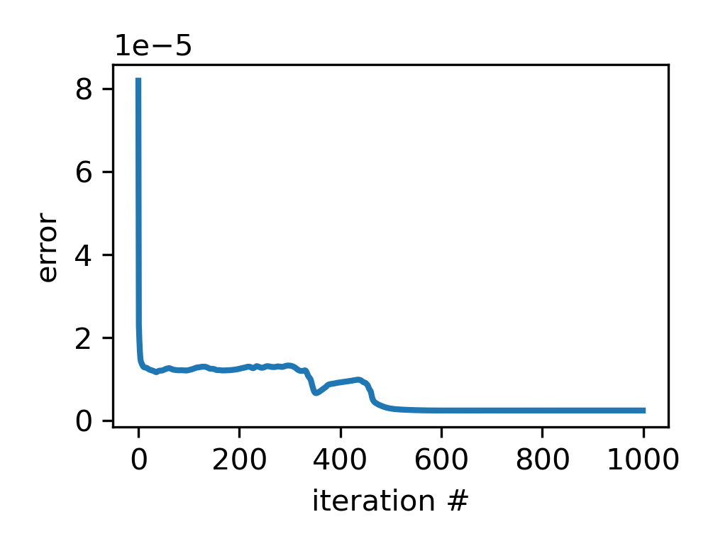
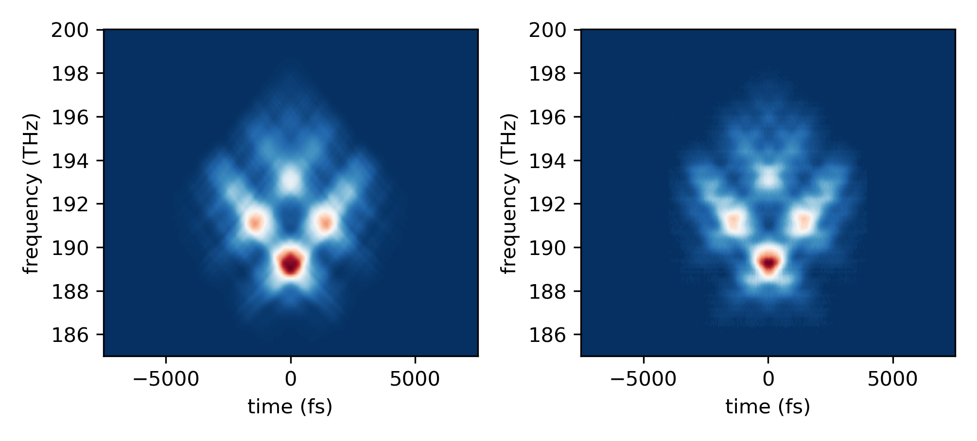
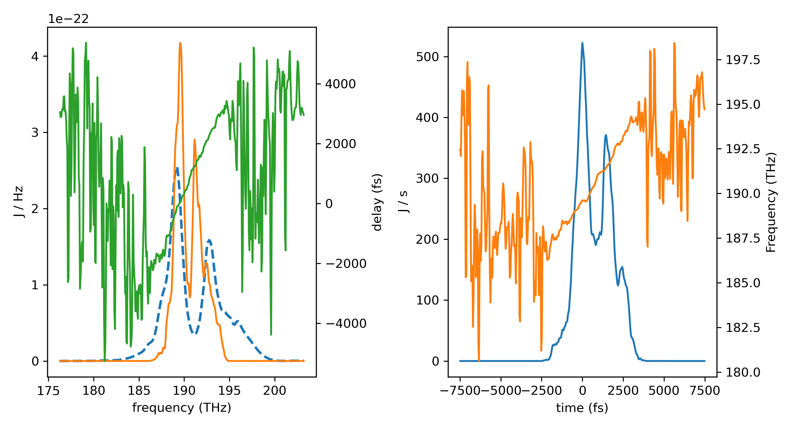

Slide 2
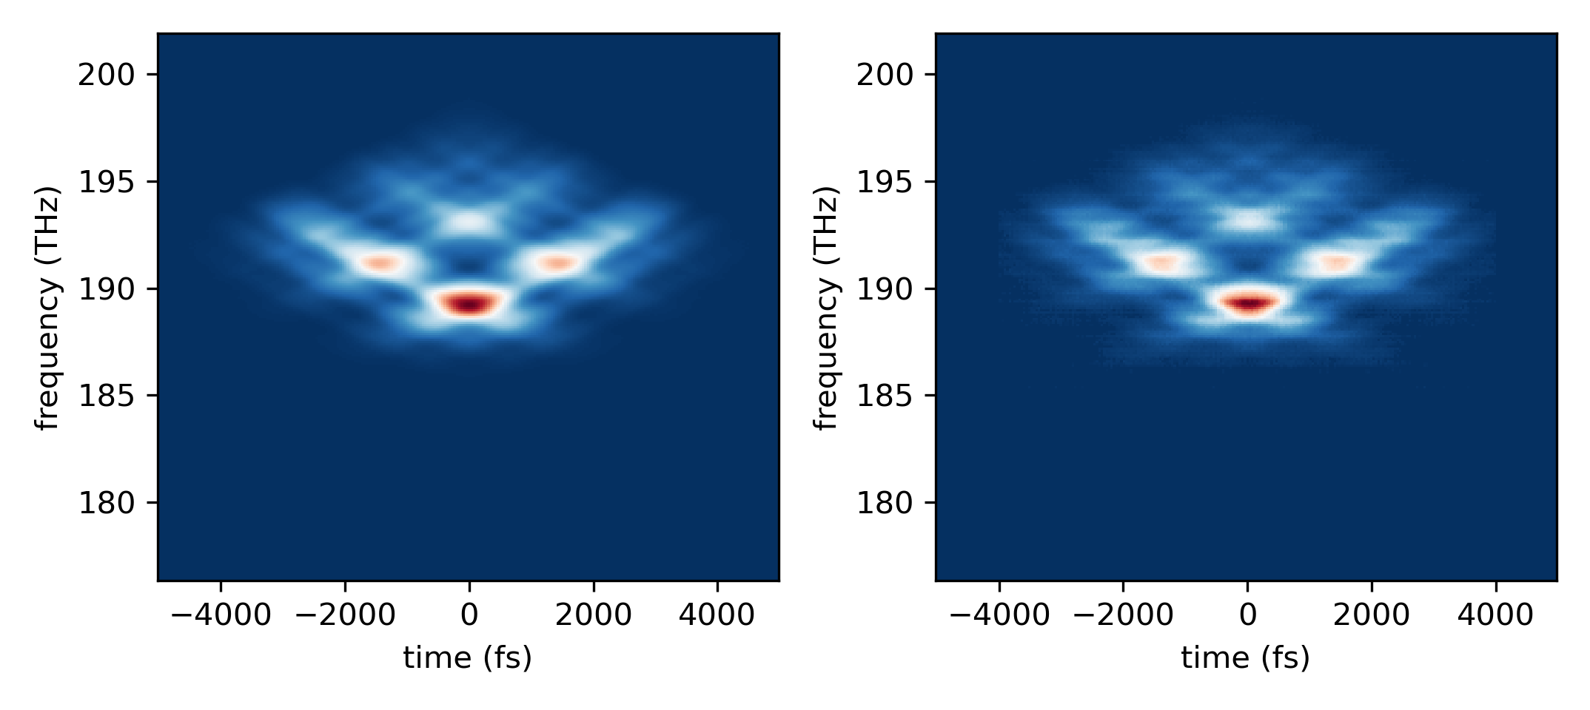
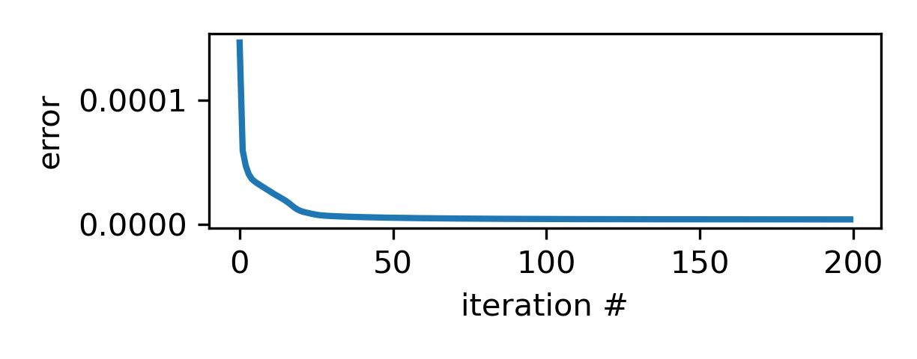
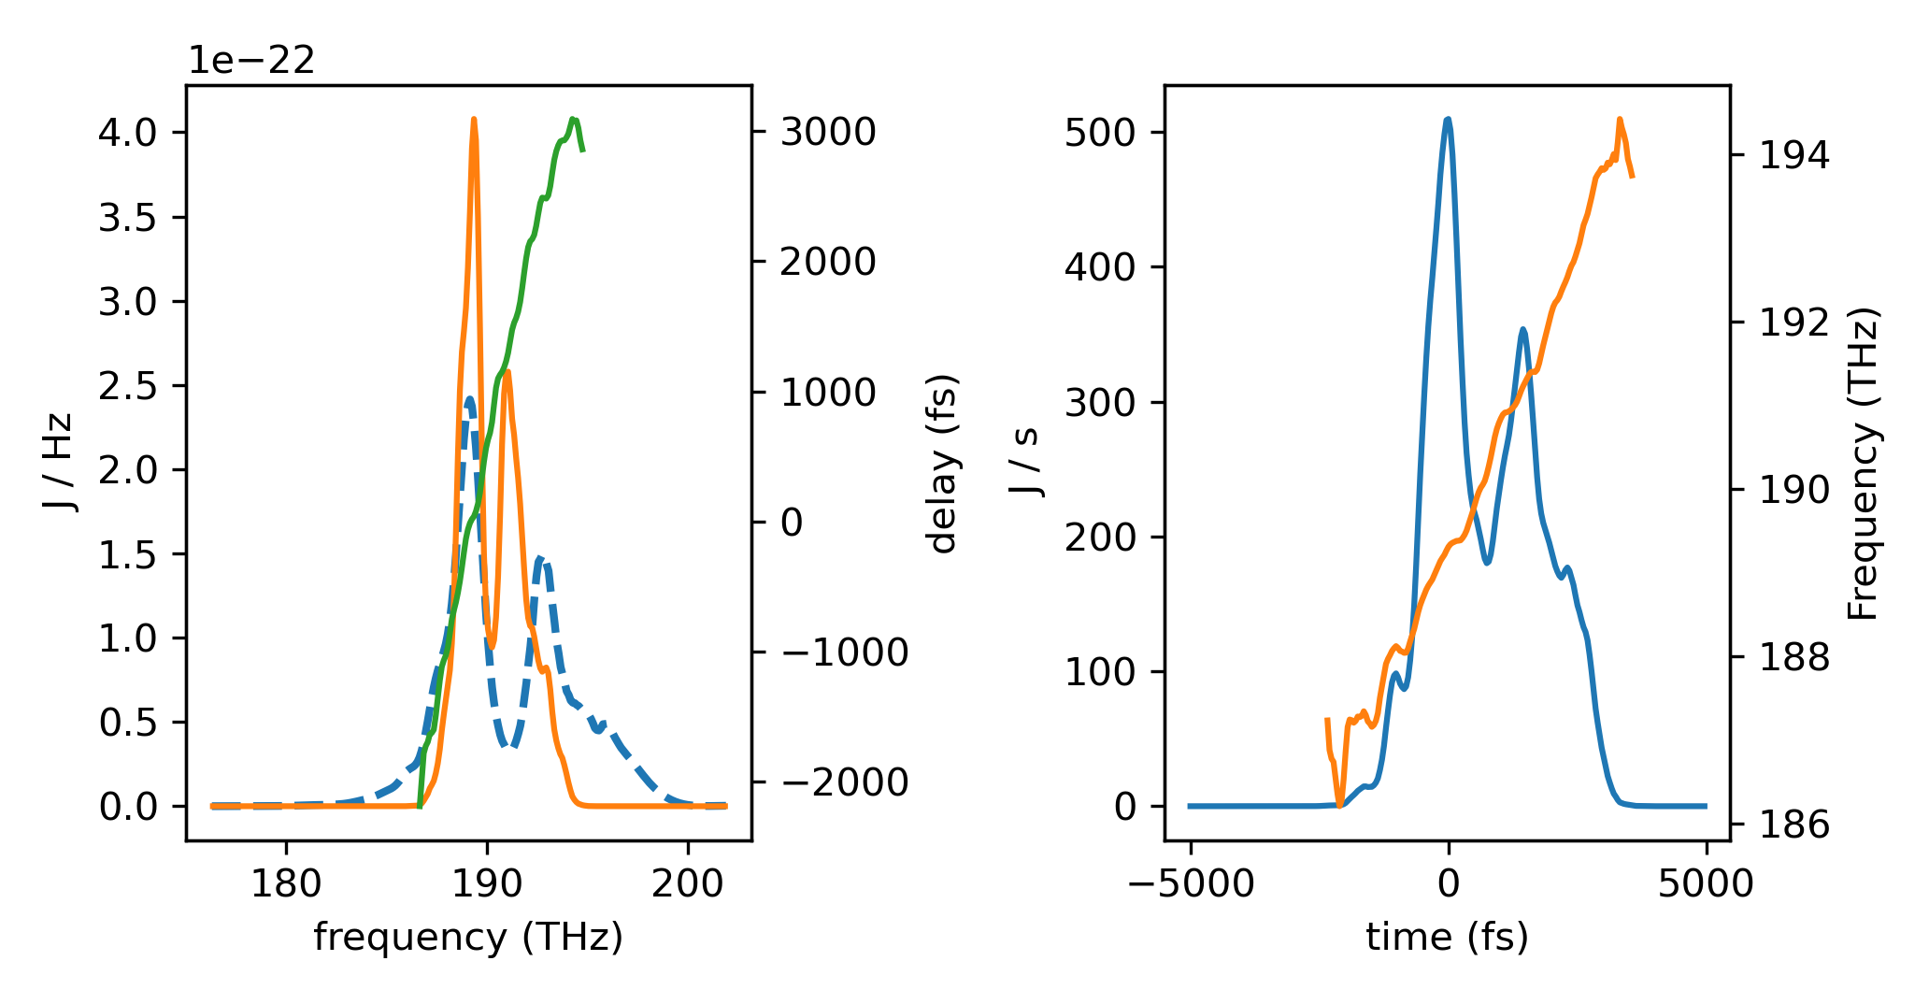
Looking at the simulated FROG, the power method has issues with stability. Because it will always push the pulse always from its current value, even if just slightly. So, I went with a true principal projection, by using jax.scipy.linalg.svd

Slide 3
Setting v0 and bandwidth automatically

Slide 4
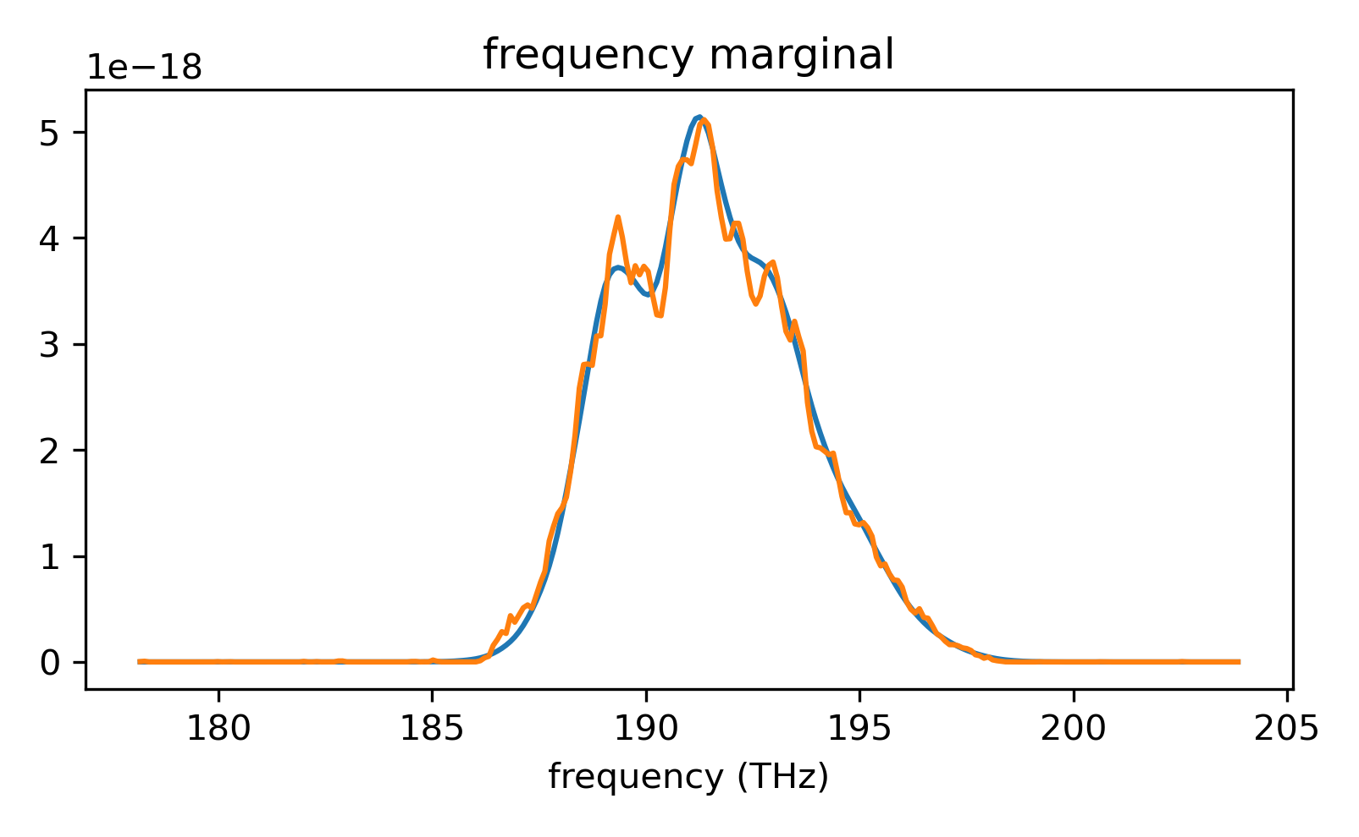
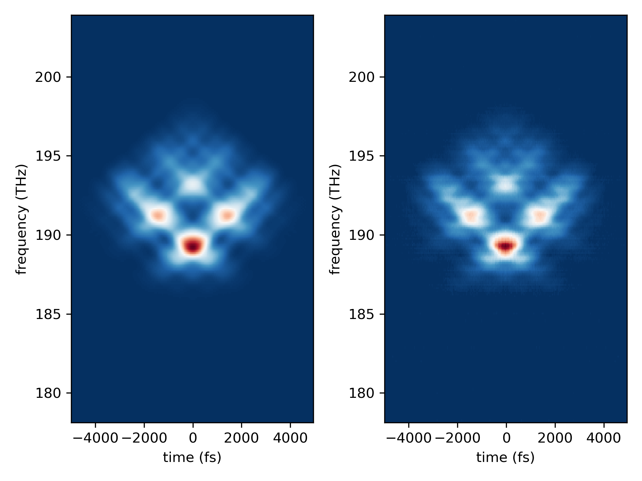
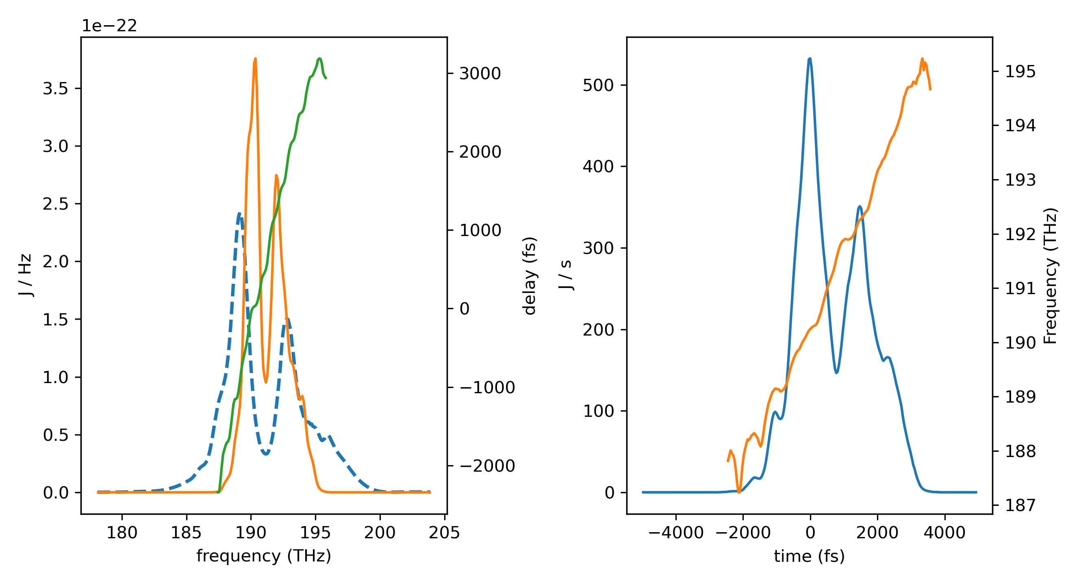

Slide 5
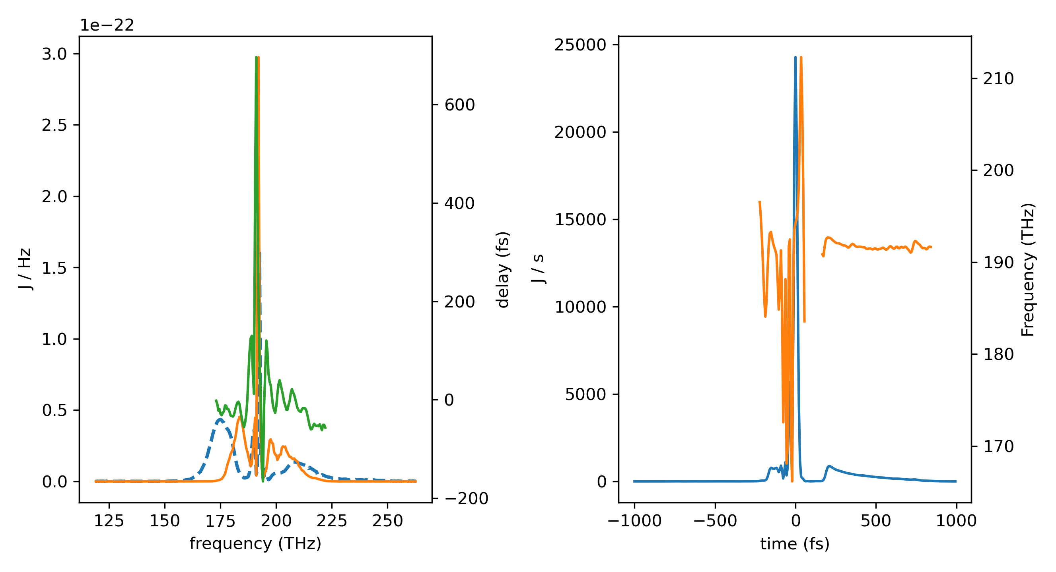
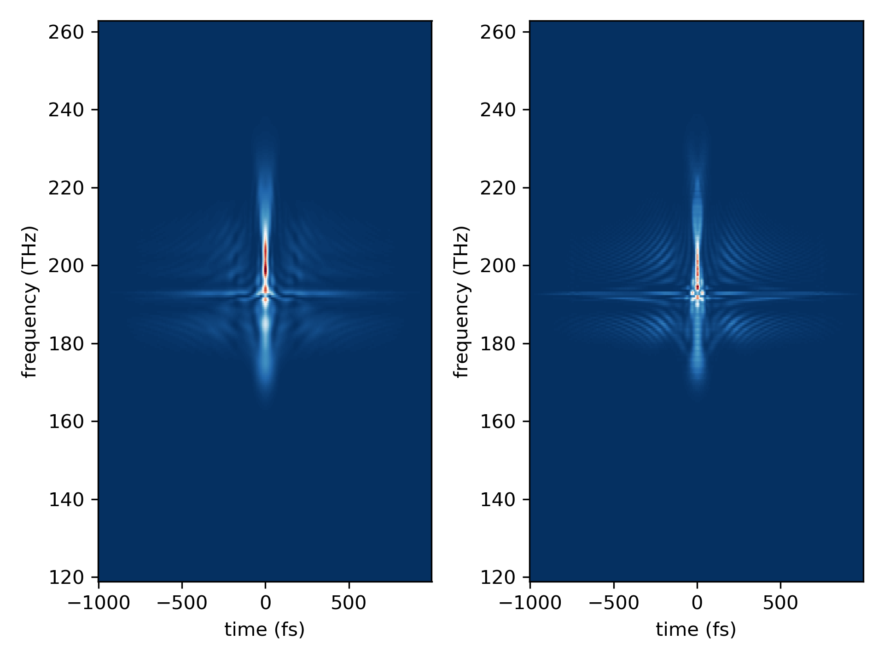
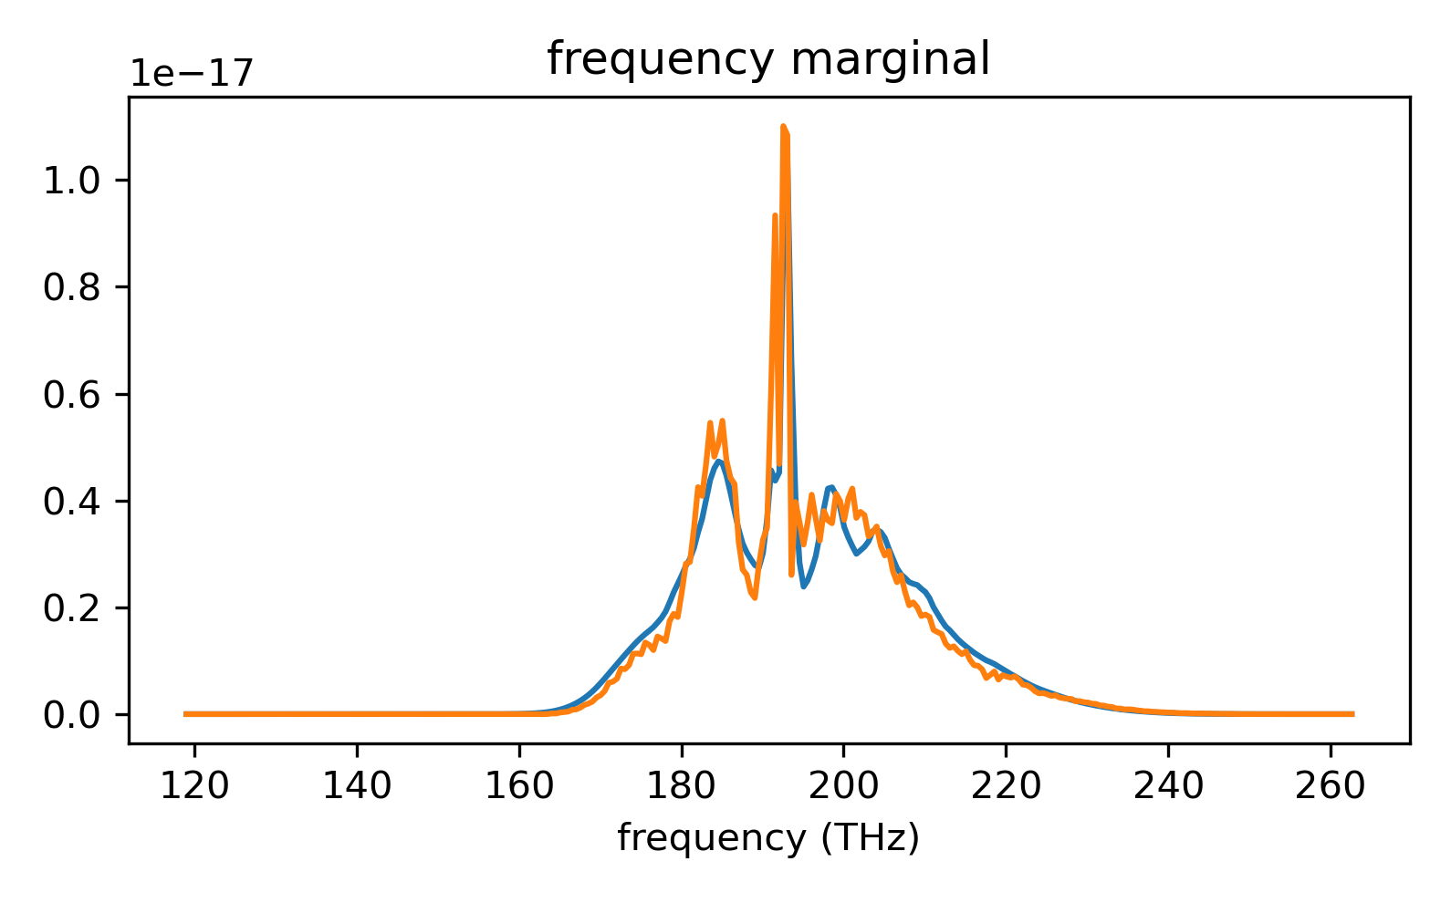

Slide 6
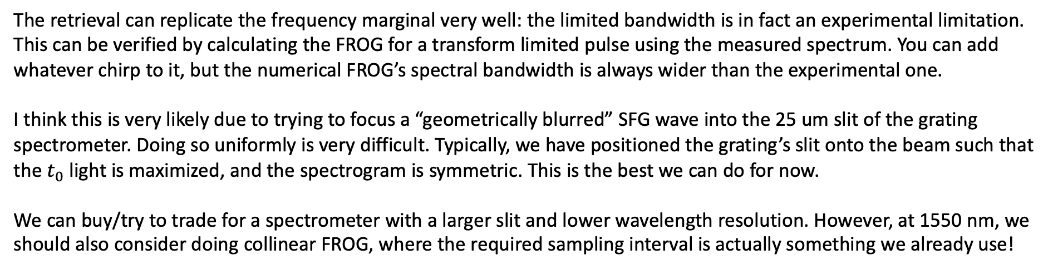
The retrieval can replicate the frequency marginal very well: the limited bandwidth is in fact an experimental limitation. This can be verified by calculating the FROG for a transform limited pulse using the measured spectrum. You can add whatever chirp to it, but the numerical FROG’s spectral bandwidth is always wider than the experimental one.
I think this is very likely due to trying to focus a “geometrically blurred” SFG wave into the 25 um slit of the grating spectrometer. Doing so uniformly is very difficult. Typically, we have positioned the grating’s slit onto the beam such that the $t_{0}$ light is maximized, and the spectrogram is symmetric. This is the best we can do for now.
We can buy/try to trade for a spectrometer with a larger slit and lower wavelength resolution. However, at 1550 nm, we should also consider doing collinear FROG, where the required sampling interval is actually something we already use!

Slide 7
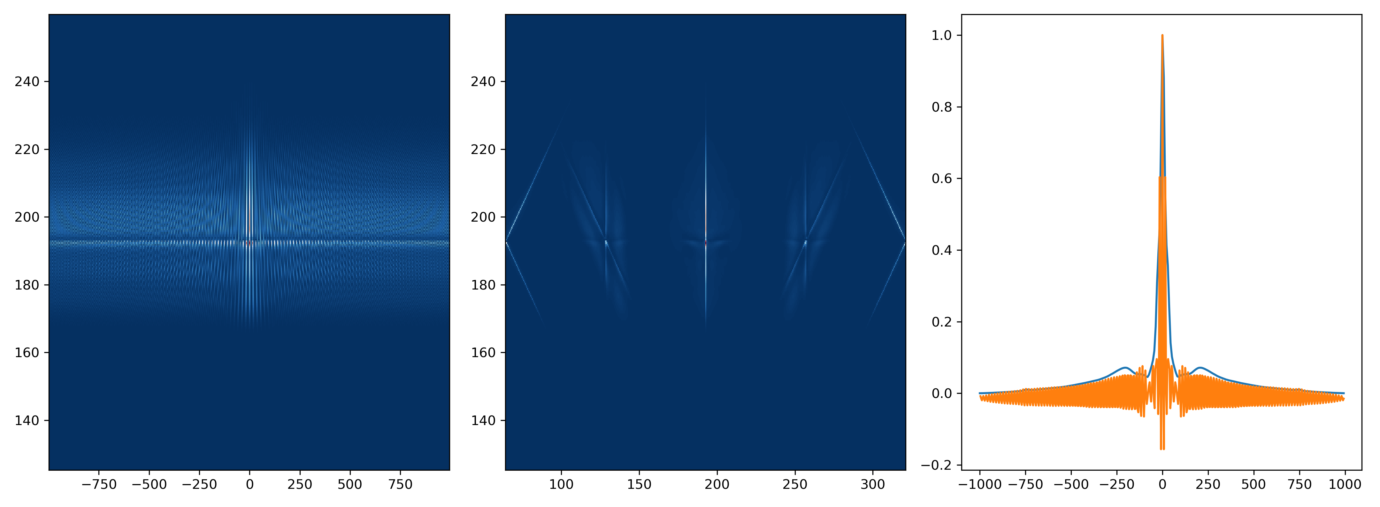
The calculated collinear FROG based off the retrieval of Garrett’s pulse
$\sim 4−5$ fs sampling can resolve the fringes well enough that we can implement a low pass filter in the Fourier domain to recover the non-collinear FROG.

