Slide 1
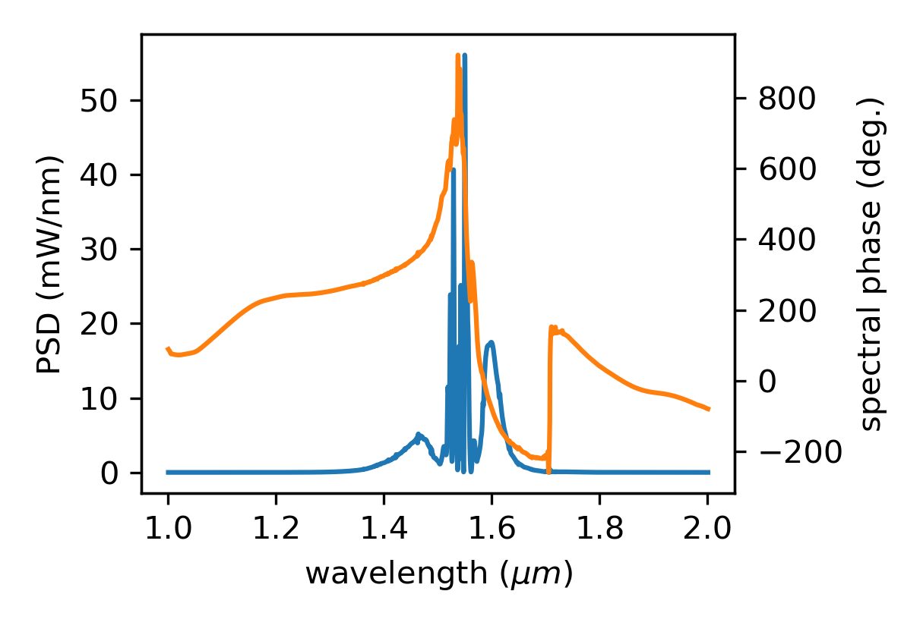
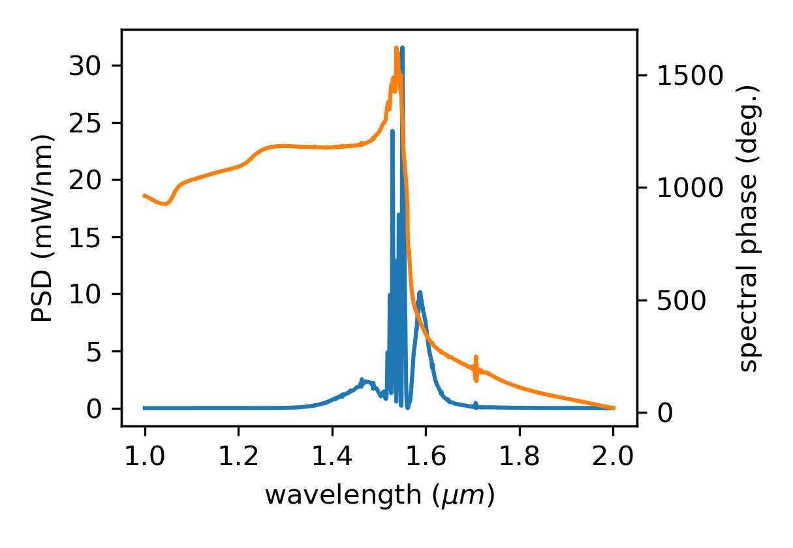
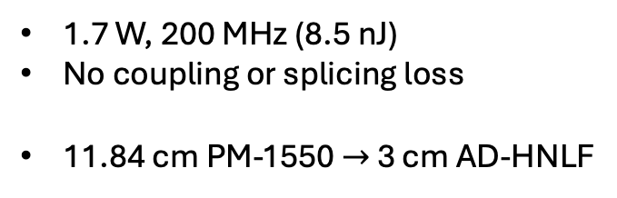
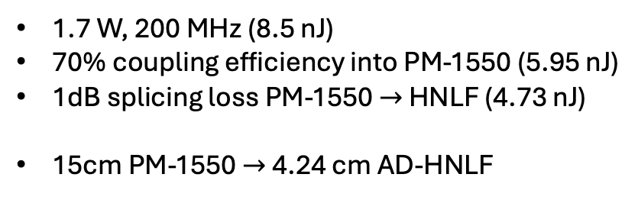
Simulation Examples
1.7 W, 200 MHz (8.5 nJ)
No coupling or splicing loss
11.84 cm PM-1550 $→$ 3 cm AD-HNLF
1.7 W, 200 MHz (8.5 nJ)
70% coupling efficiency into PM-1550 (5.95 nJ)
1dB splicing loss PM-1550 $→$ HNLF (4.73 nJ)
15cm PM-1550 $→$ 4.24 cm AD-HNLF

Slide 2
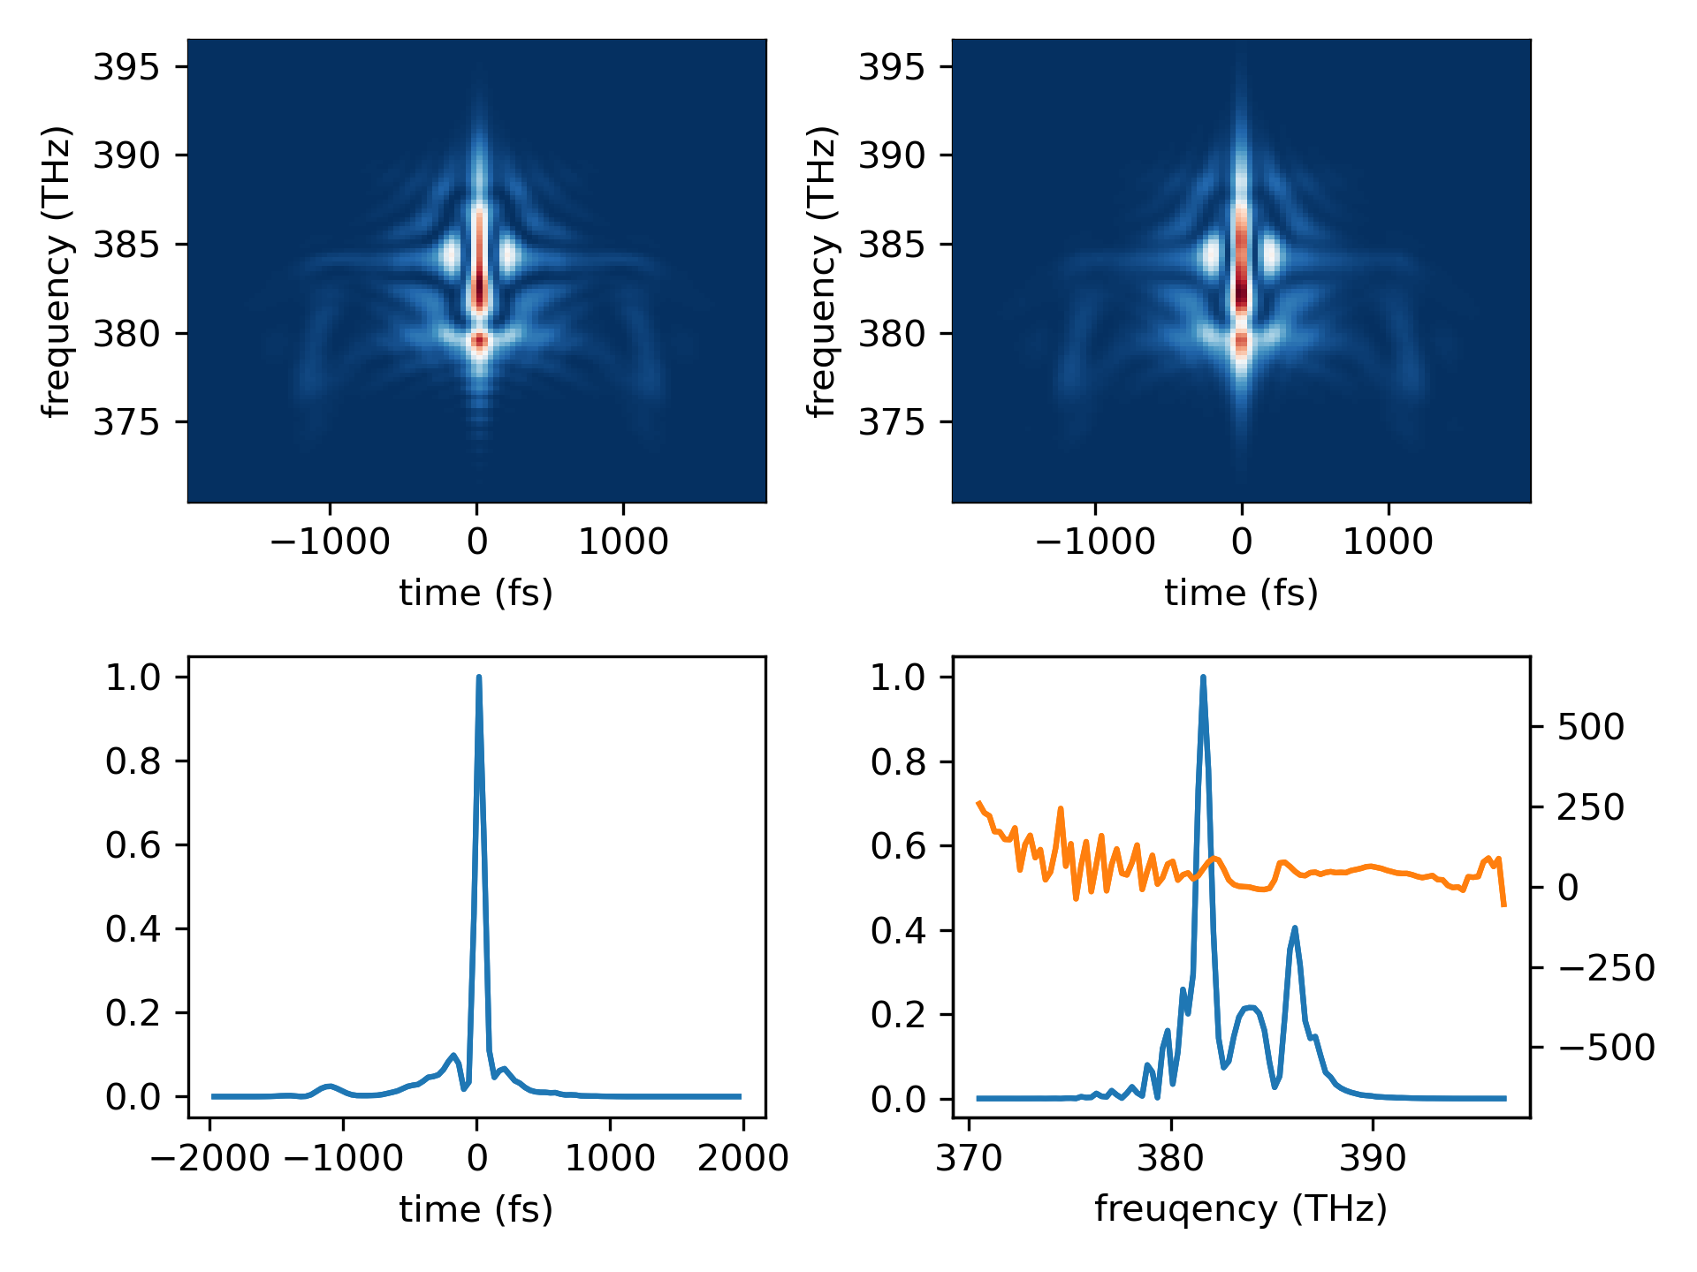
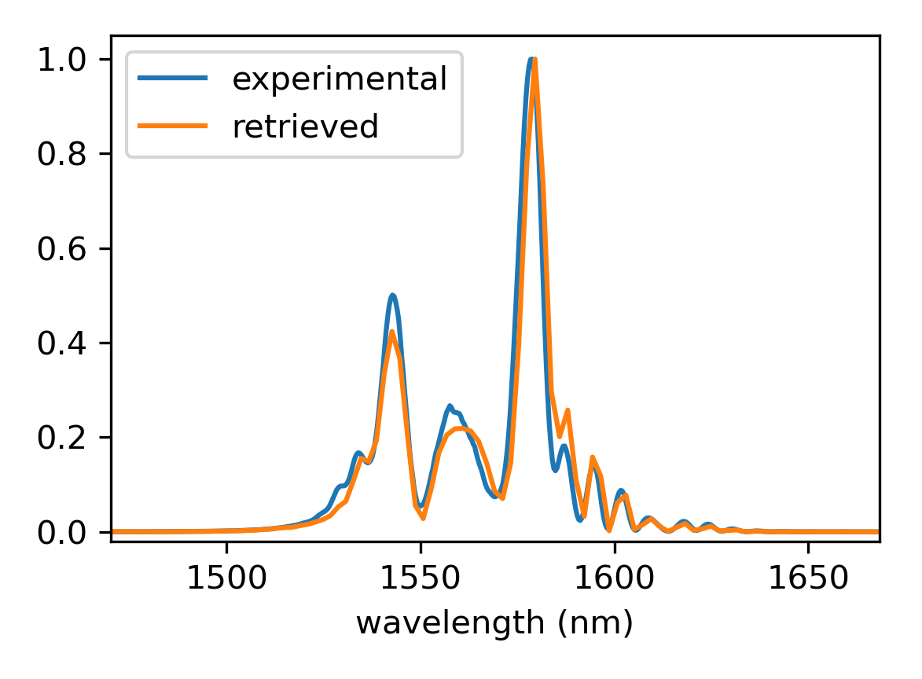
Phase Retrieval Example
Retrieved vs. experimental spectrum
retrieved
experimental

