Slide 1
20 nJ pulse (100 MHz, 2W)

Slide 2
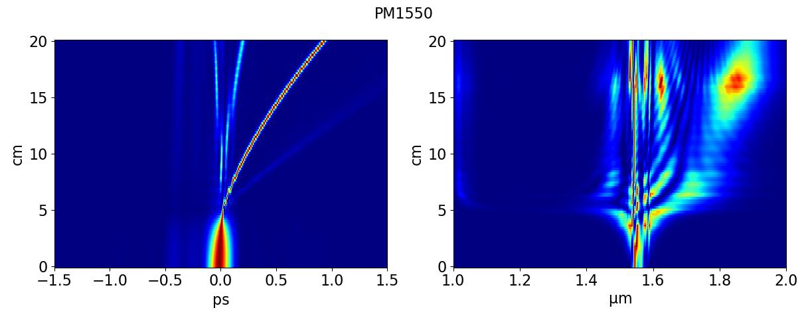

Slide 3
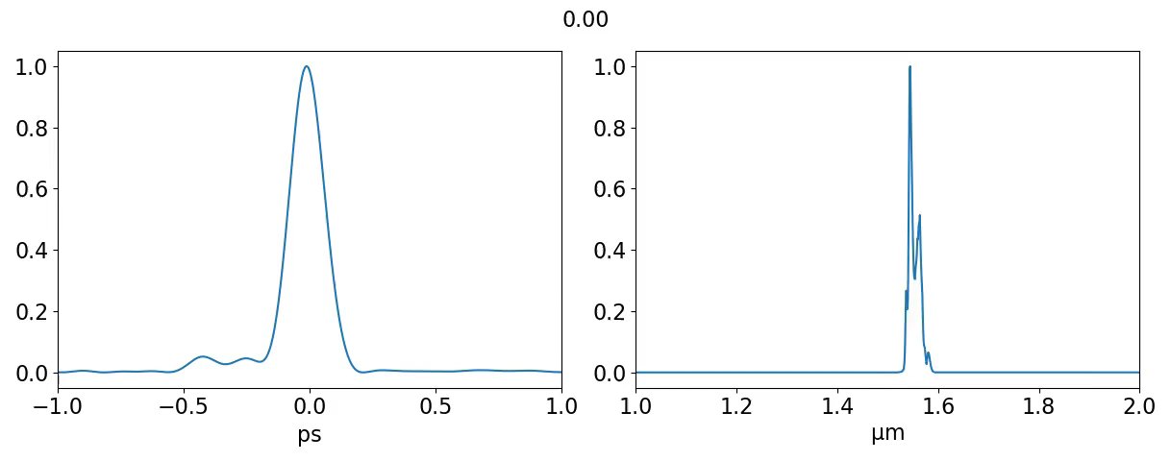
PM1550

Slide 4
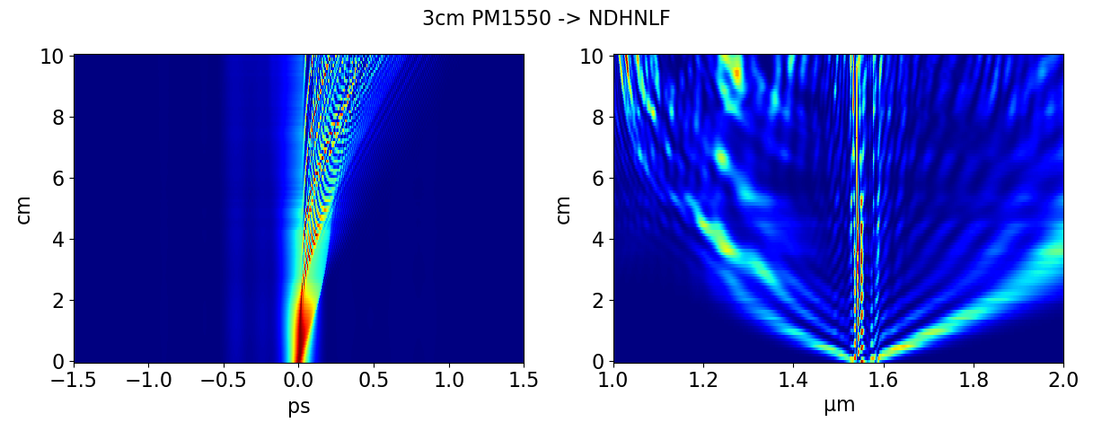

Slide 5
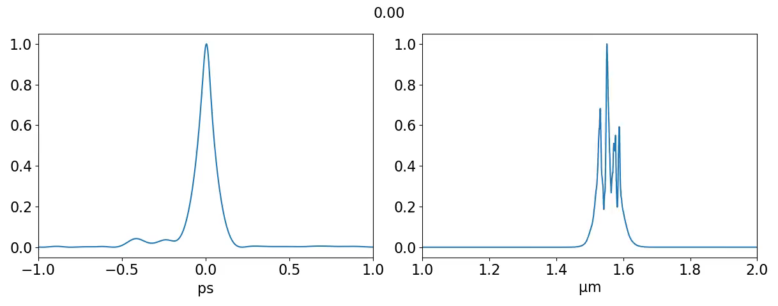

3cm PM1550 $→$ NDHNLF

Slide 6
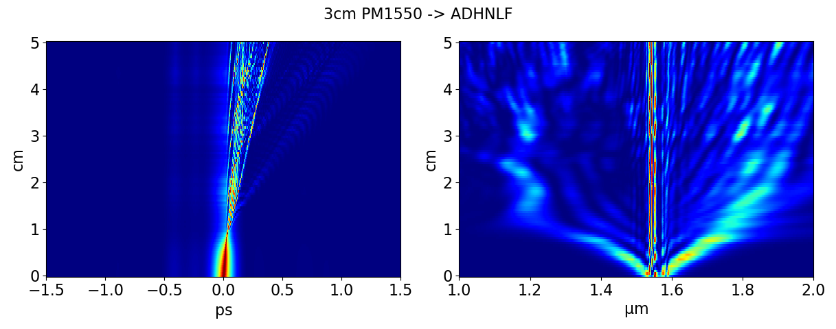

Slide 7


3cm PM1550 $→$ ADHNLF

Slide 8
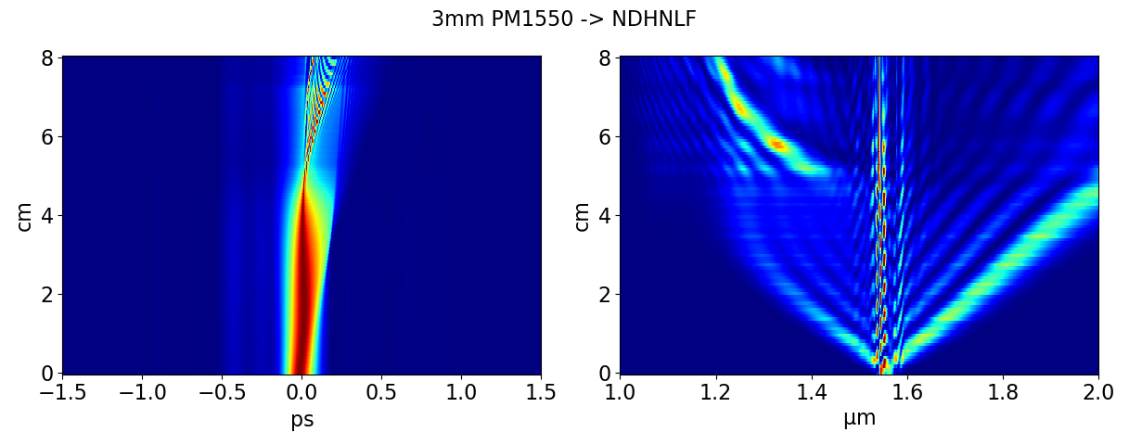

Slide 9
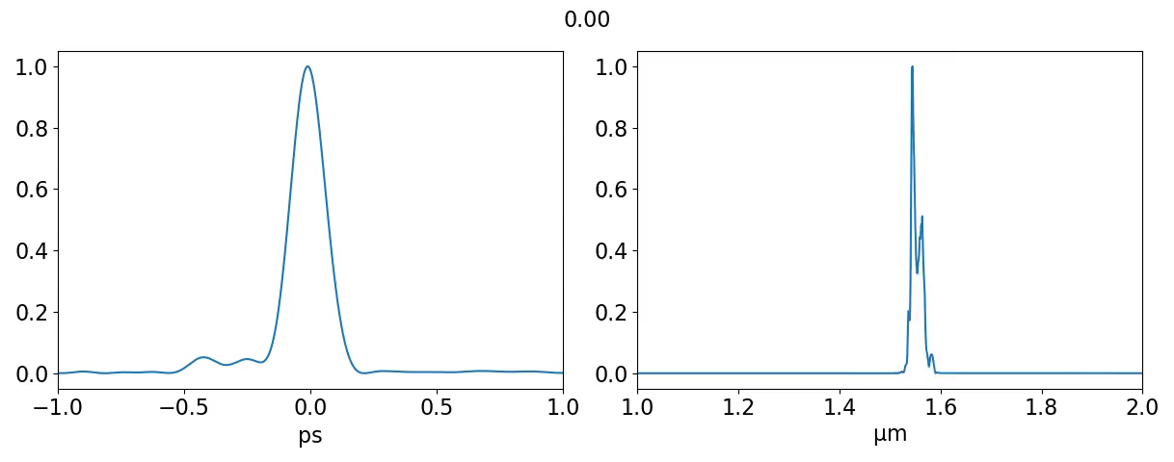

3mm PM1550 $→$ NDHNLF

Slide 10
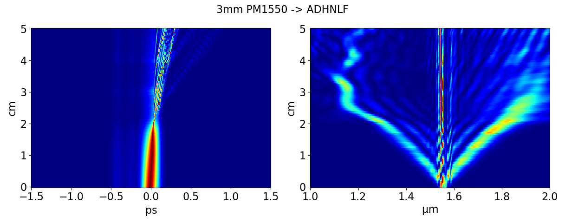

Slide 11
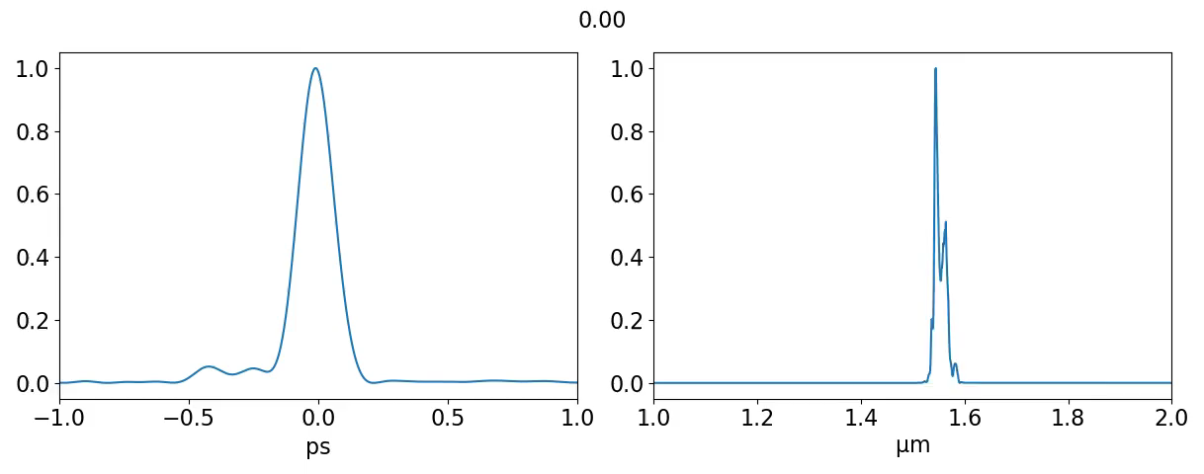

3mm PM1550 $→$ ADHNLF

