Slide 1
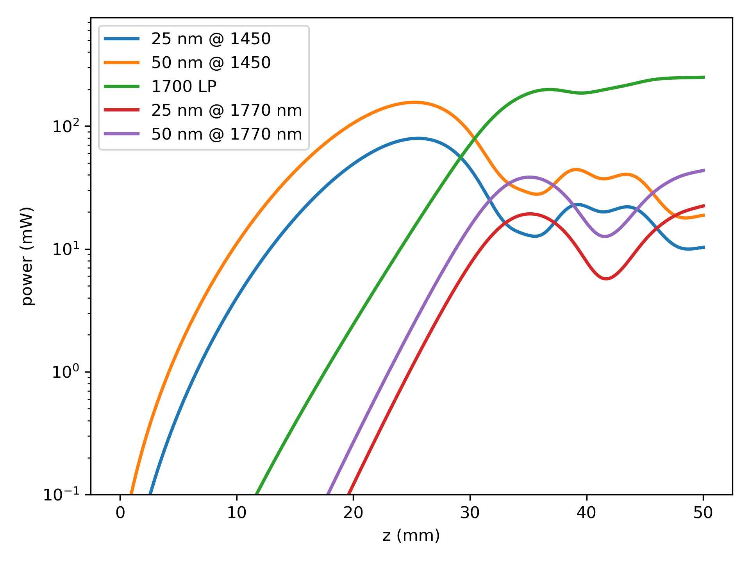
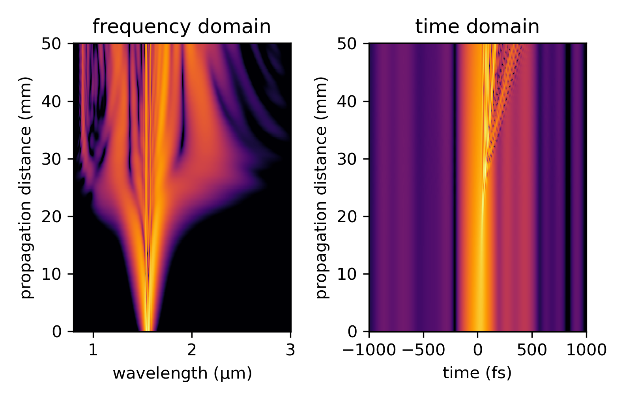
An estimate for the current patch cord
Power evolution within:
Power within 25 & 50 nm bandpass around 1450 & 1770 nm
Power after 1700 nm long pass
Notes:
The plot on the left shows the power evolution inside 25 and 50 nm bandpass windows around 1450 and 1800 nm, along with the power after a 1700 nm long pass.
The plot on the right shows the spectral and temporal evolution (also on a log scale) as a function of propagation distance, assuming 1.176 W in fiber. If the coupling efficiency is a little different, a good approximation is that the evolution occurs slower or faster but is otherwise quite similar.

Slide 2
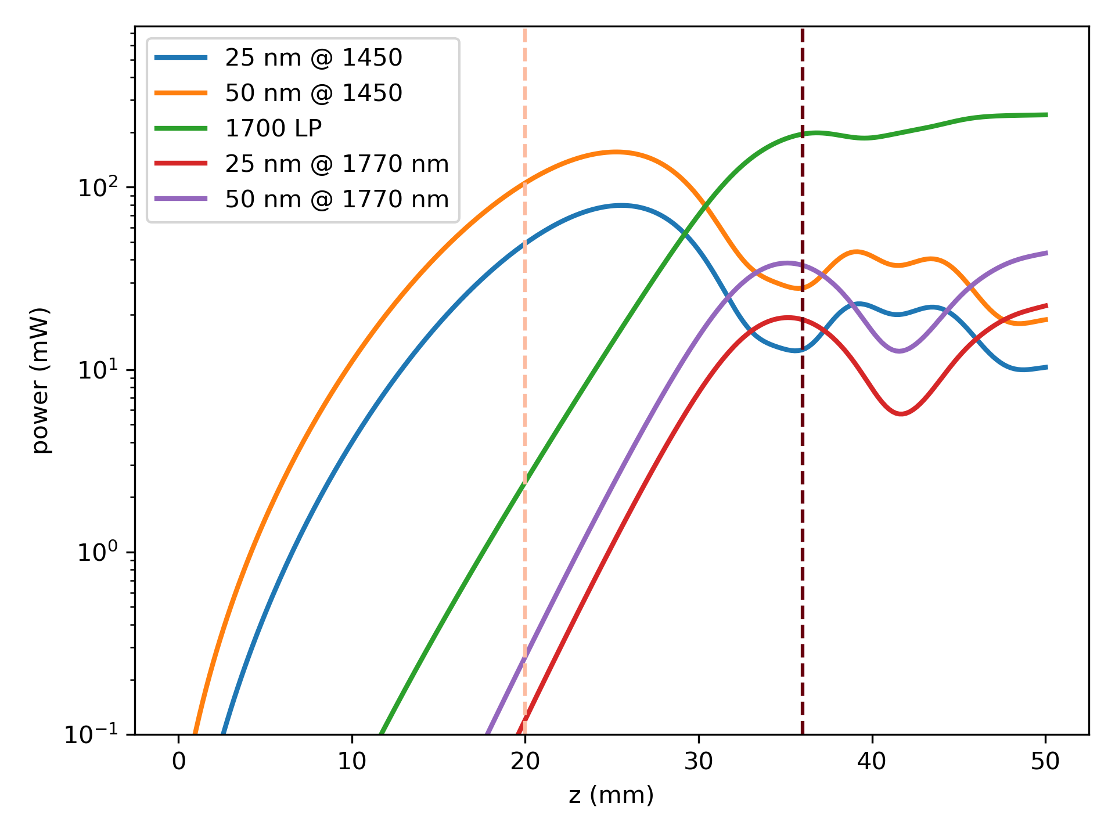
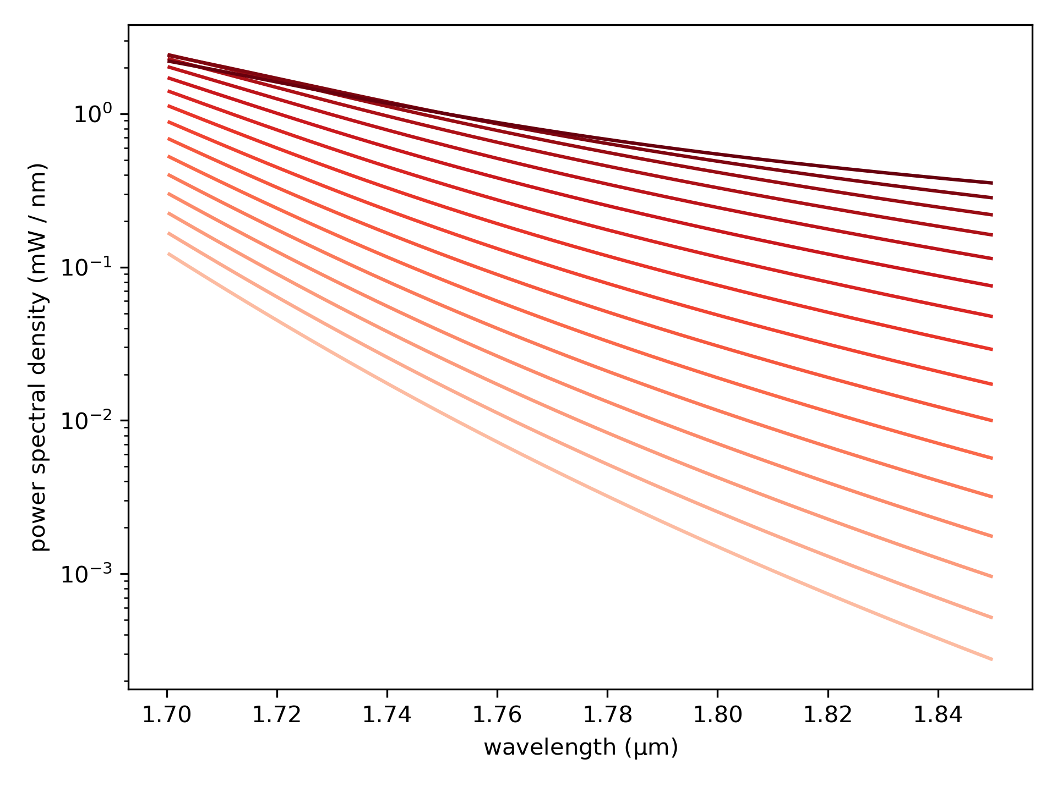
PSD around 1770 nm
PSD from dashed line to dashed line in 1 mm steps

Slide 3
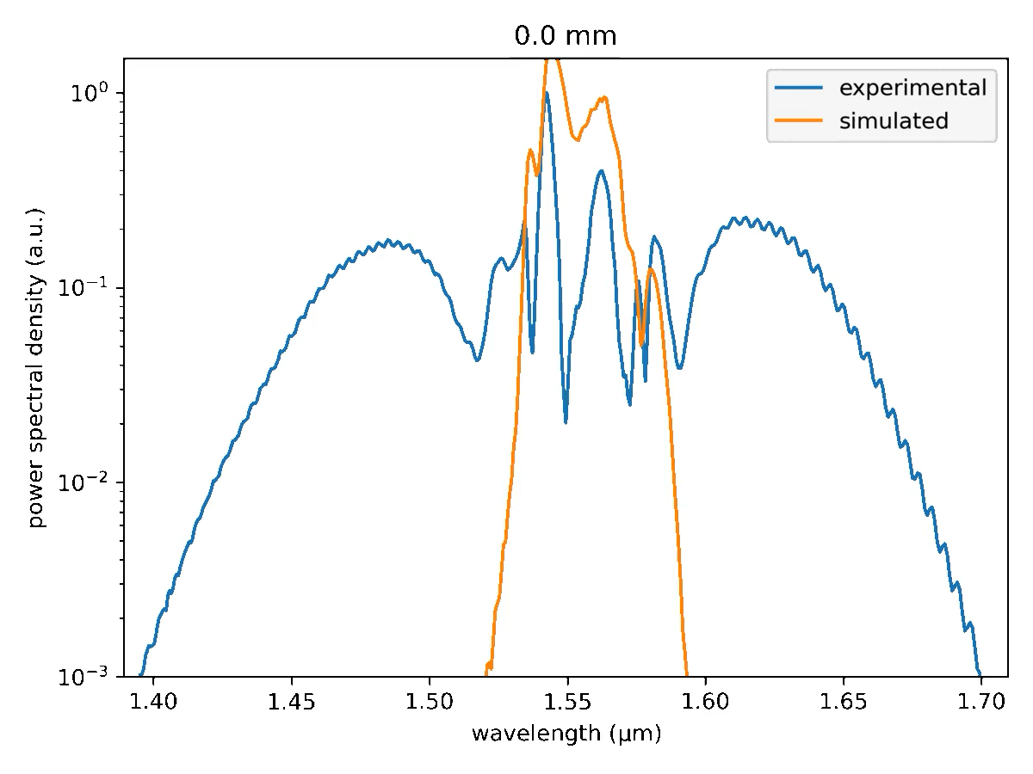
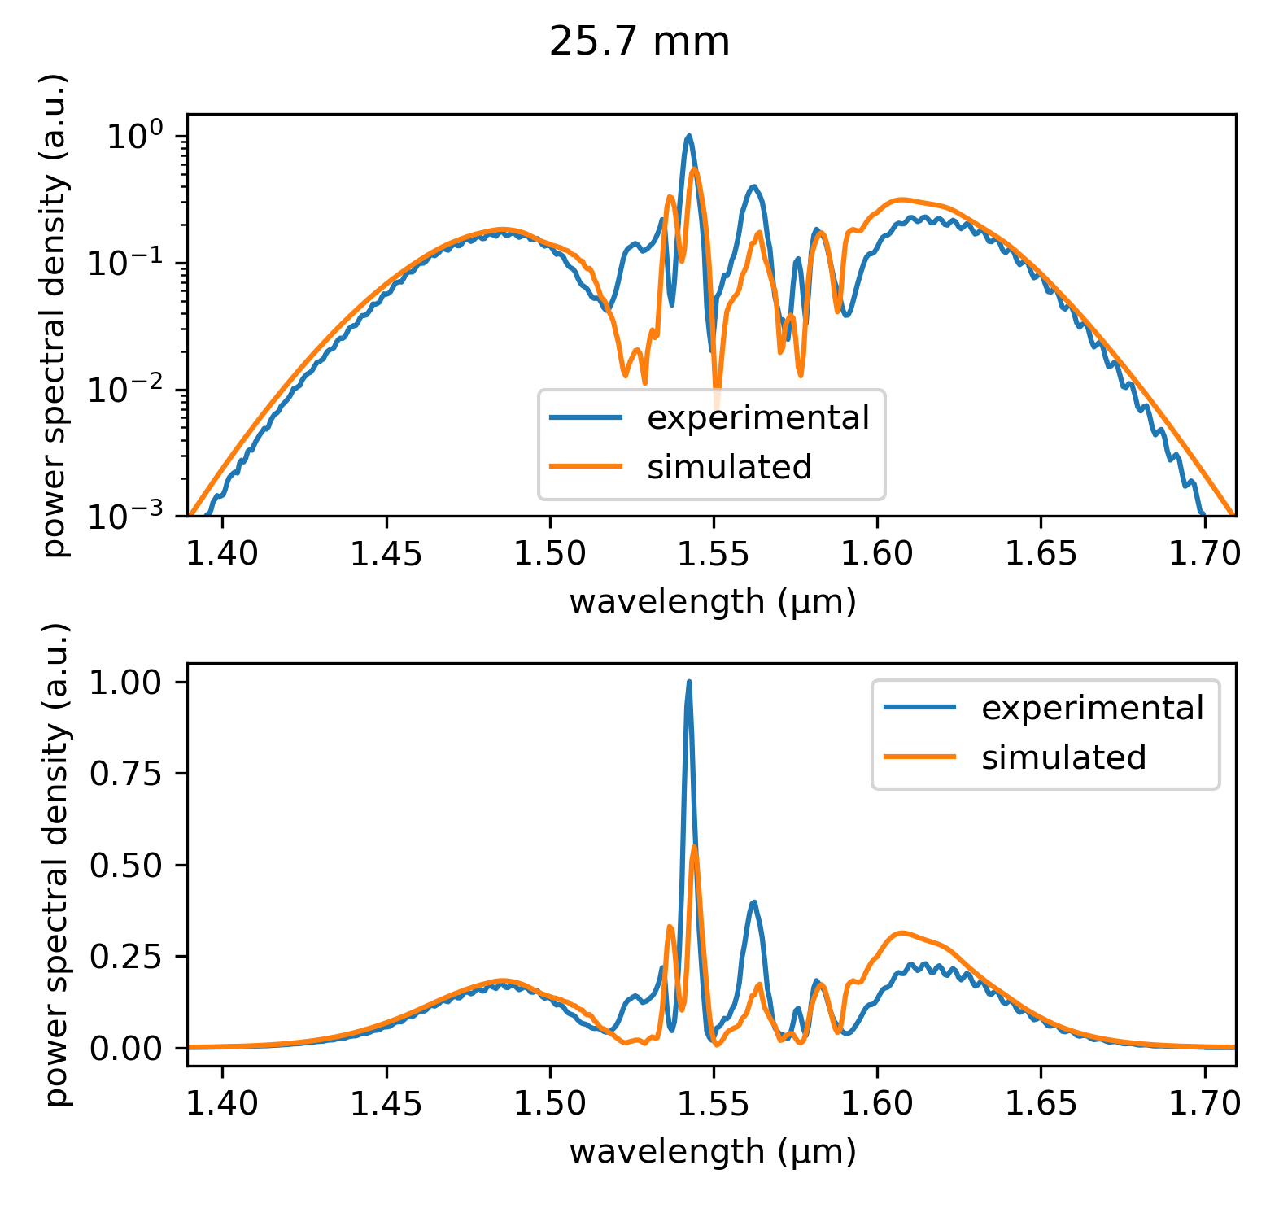
Matching simulation to experiment (previous patch cord)
Best Match
(click play below to start the video)
Notes:
In case this was helpful, April had made a comparison between simulated and experimental spectra for a different patch cord that was used earlier.
This patch cord had no pm-1550 splice, and has different dispersion so the simulation is different, but it serves to give an idea of how well simulations typically match experiment if you have a good FROG trace to start out with (such as the one given by Toptica).
The stacked plots on the right show that spectra tend to line up quite well on a log scale, although as one can see it is not a perfect overlap, which is more evident on the linear scale.

