Slide 1
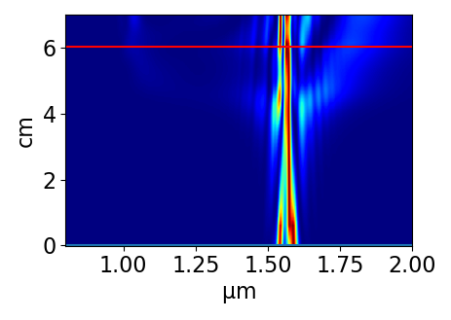
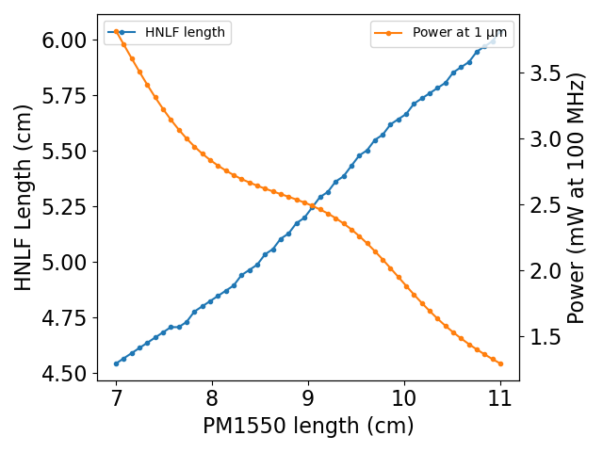
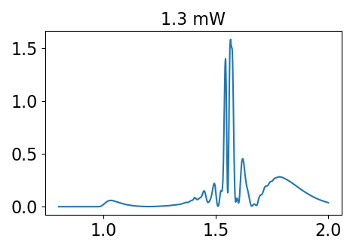
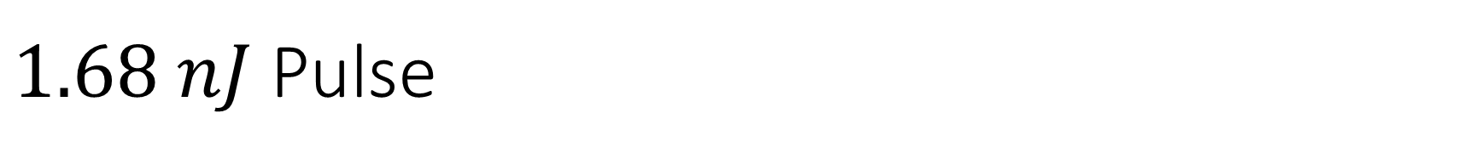
$1.68 nJ$ Pulse
Pm1550 -> HNLF, power calculated at 100 MHz repetition rate (for a different rep-rate just re-scale the y-axis)

Slide 2
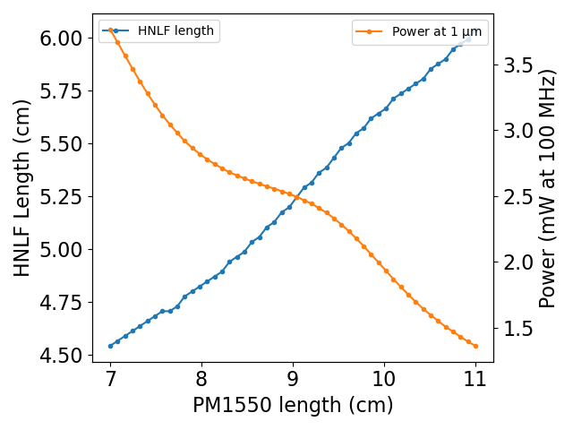
$1.68 nJ$ Pulse
Pm1550 -> HNLF -> 17 cm PM1550, power calculated at 100 MHz repetition rate (for a different rep-rate just re-scale the y-axis)
You were right in that it’s mostly linear propagation in PM1550 (I used it to estimate PM980), so I think it’s okay to go through a long PM980 pig tail afterwards. The pulse would be a lot longer (in time), but that doesn’t matter.

