Slide 1
2 Level rate equations

Slide 2
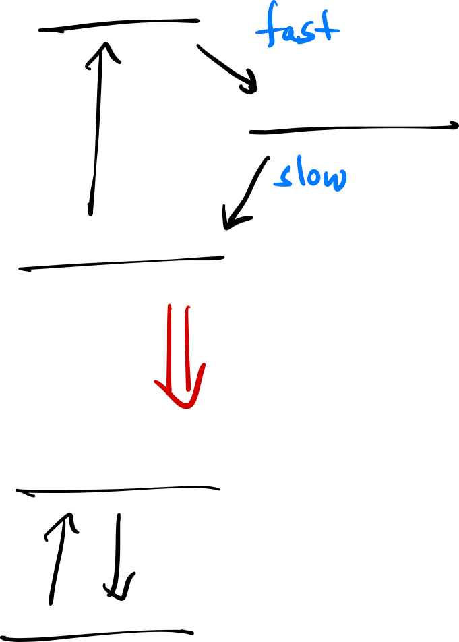



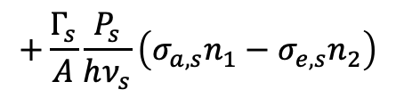
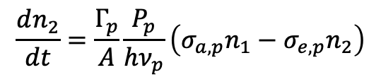

Modeling an EDFA
$$τ_{p}≪τ_{metastable}$$
Assume pump transition undergoes non-radiative decay immediately to the metastable state → can model as a two-level system:
$$\frac{dn_{2}}{dt}=\frac{Γ_{p}}{A}\frac{P_{p}}{hν_{p}}\left(σ_{a,p}n_{1}−σ_{e,p}n_{2}\right)$$
Pump term
$$+\frac{Γ_{s}}{A}\frac{P_{s}}{hν_{s}}\left(σ_{a,s}n_{1}−σ_{e,s}n_{2}\right)$$
Signal term
$$−\frac{n_{2}}{τ}$$
Spontaneous decay
If the $\frac{1}{f_{r}}≫τ$ → $n_{2}$ will reach steady state
Set ${\dot{n}}_{2}=0$ and solve for $n_{2}/n$

Slide 3
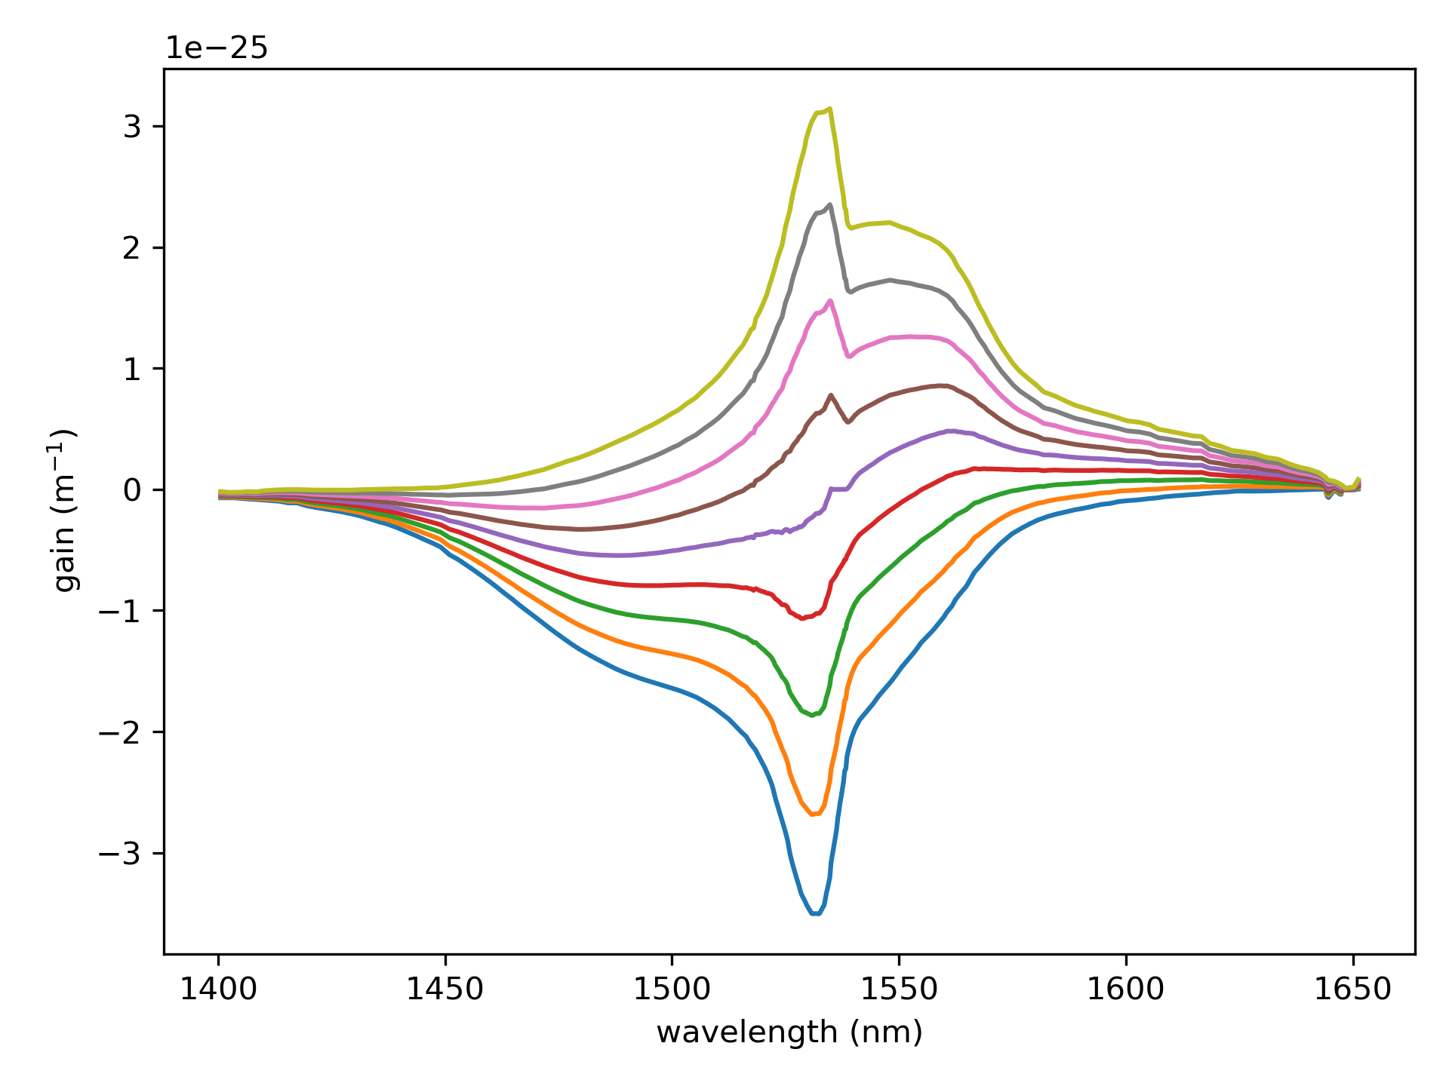
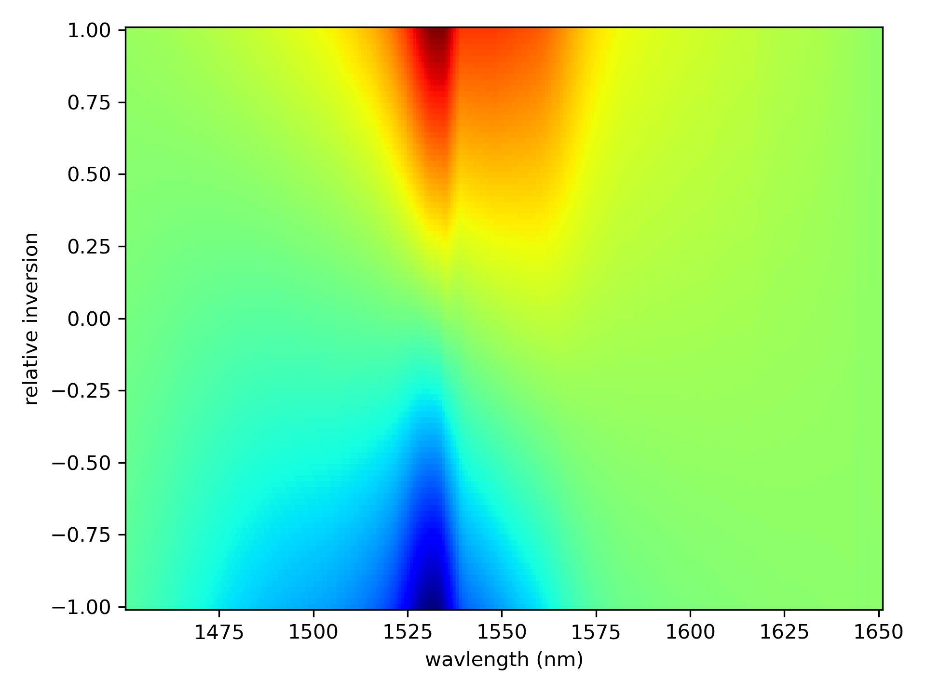



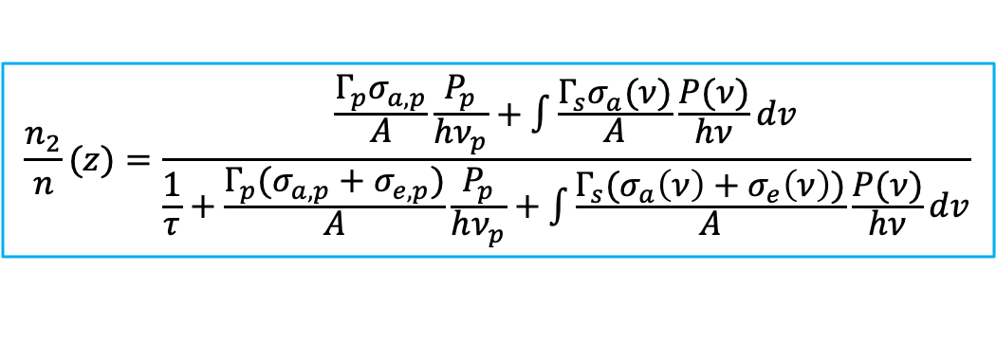
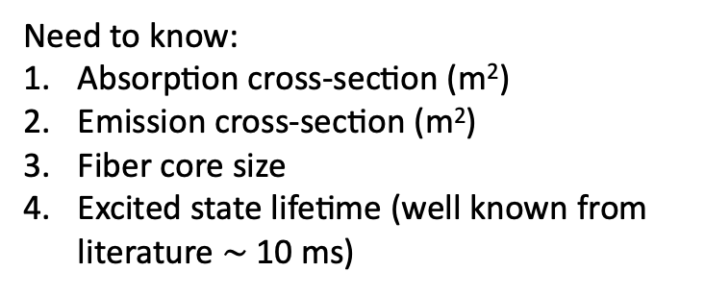

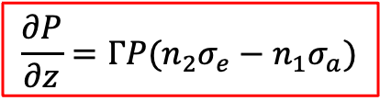


Rate Equations
Steady state
Need to know:
Absorption cross-section (m²)
Emission cross-section (m²)
Fiber core size
Excited state lifetime (well known from literature $\sim$ 10 ms)
$$\frac{n_{2}}{n}(z)=\frac{\frac{Γ_{p}σ_{a,p}}{A}\frac{P_{p}}{hν_{p}}+\int{\frac{Γ_{s}σ_{a}(ν)}{A}\frac{P(ν)}{hν}dv}}{\frac{1}{τ}+\frac{Γ_{p}(σ_{a,p}+σ_{e,p})}{A}\frac{P_{p}}{hν_{p}}+\int{\frac{Γ_{s}(σ_{a}\left(ν\right)+σ_{e}\left(ν\right))}{A}\frac{P(ν)}{hν}dv}}$$
$$\frac{∂P}{∂z}=ΓP(n_{2}σ_{e}−n_{1}σ_{a})$$
$e^{−Γσnz}$ = small signal absorption $→$ $n$ is known
where:
$$n_{2}=\left(\frac{n_{2}}{n}\right)n$$
$$n_{1}=n−n_{2}$$
cross-sections:
The gain coefficient is:
$$σ_{e}$$
$$g\left(ν,z\right)=Γ_{s}(σ_{e}\left(ν\right)n_{2}\left(z\right)−σ_{a}\left(ν\right)n_{1}\left(z\right))$$
$$σ_{a}$$

Slide 4
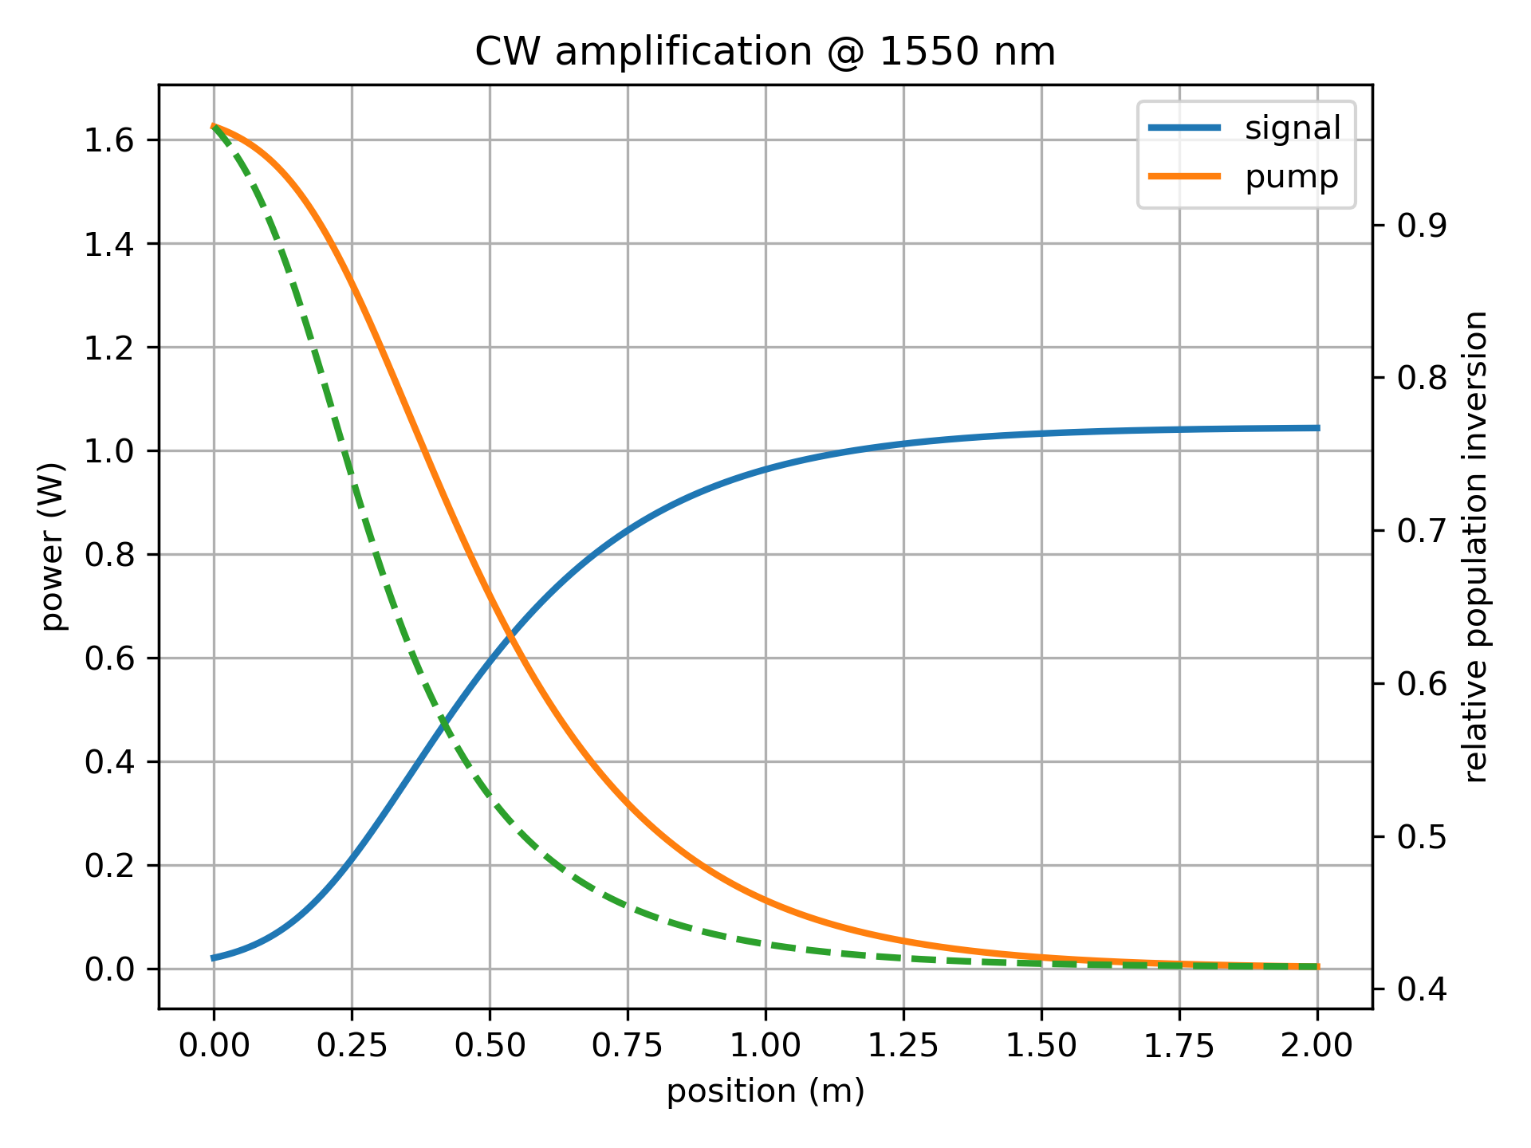
2W pump, 2 m of ER 80
Unphysically high conversion efficiency!
Used: 0.7 dB insertion loss, 0.2 dB splicing loss
Since seed power is quite high, this likely isn’t due to unaccounted ASE?
So, the next step to try is to account for excited state absorption, since after all green fluorescence is always observed.

Slide 5
Accounting for excited state absorption

Slide 6
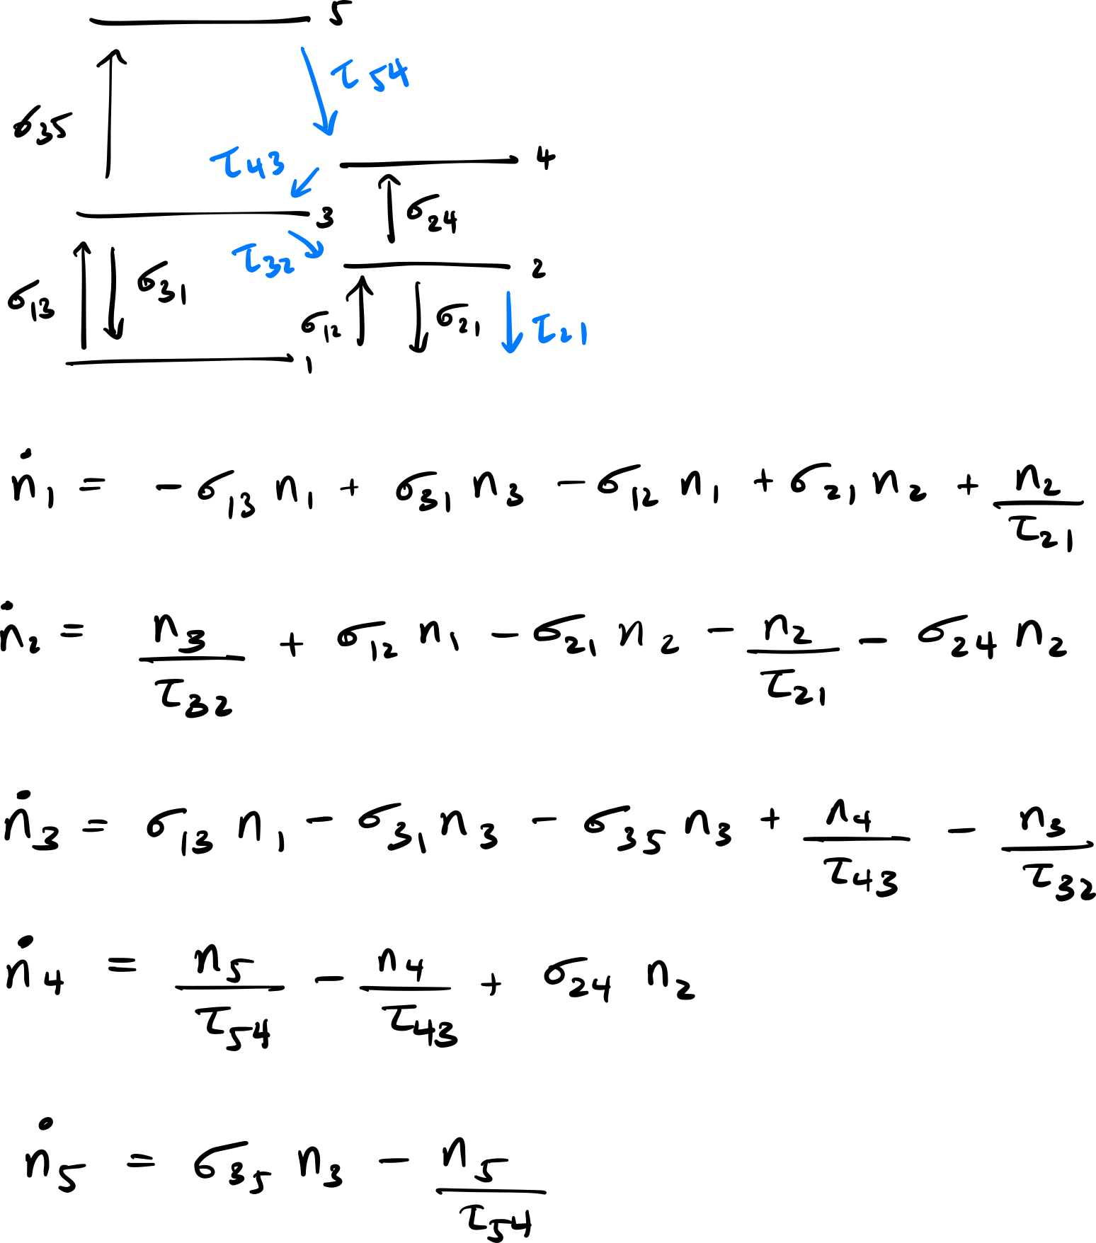
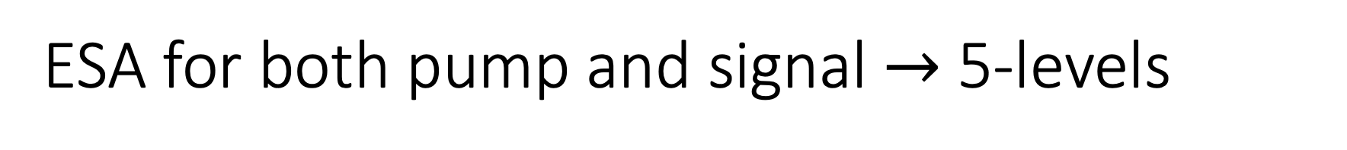
ESA for both pump and signal $→$ 5-levels
You need to include lifetimes to “close” the circuit if you want to apply steady state (i.e. electron number needs to be conserved)
You can isolate population to the laser excited state (2), pump level (3), and pump excited state (5) which is responsible for the green fluorescence.
Done by making the lifetime of (4) much smaller than the others (e.g. ns)
Solve for n₁ n₂ n₃ n₄ n₅ in terms of n_{tot} = n₁ + n₂ + n₃ + n₄ + n₅
Computed in Mathematica and then copied to Python using Sympy
Yu. O. Barmenkov, et al., Journal of Applied Physics 106, 083108 (2009).

Slide 7
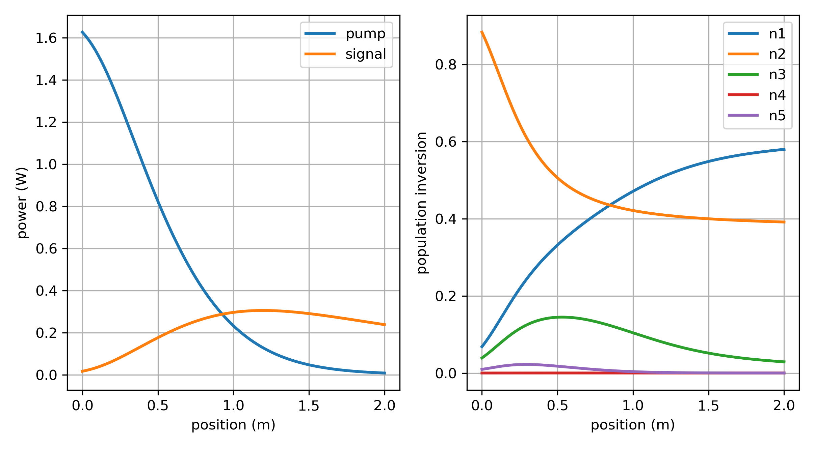
2W pump, 2 m of ER 80
Not perfect, but much more realistic power evolution, maybe actually a little too lossy.
Used: 0.7 dB insertion loss, 0.2 dB splicing loss
Better match to experiment can be achieved by varying 5-level parameters, although the ones obtained from Barmenkov et al. are not too bad. Their numbers are similar to other older papers.

Slide 8
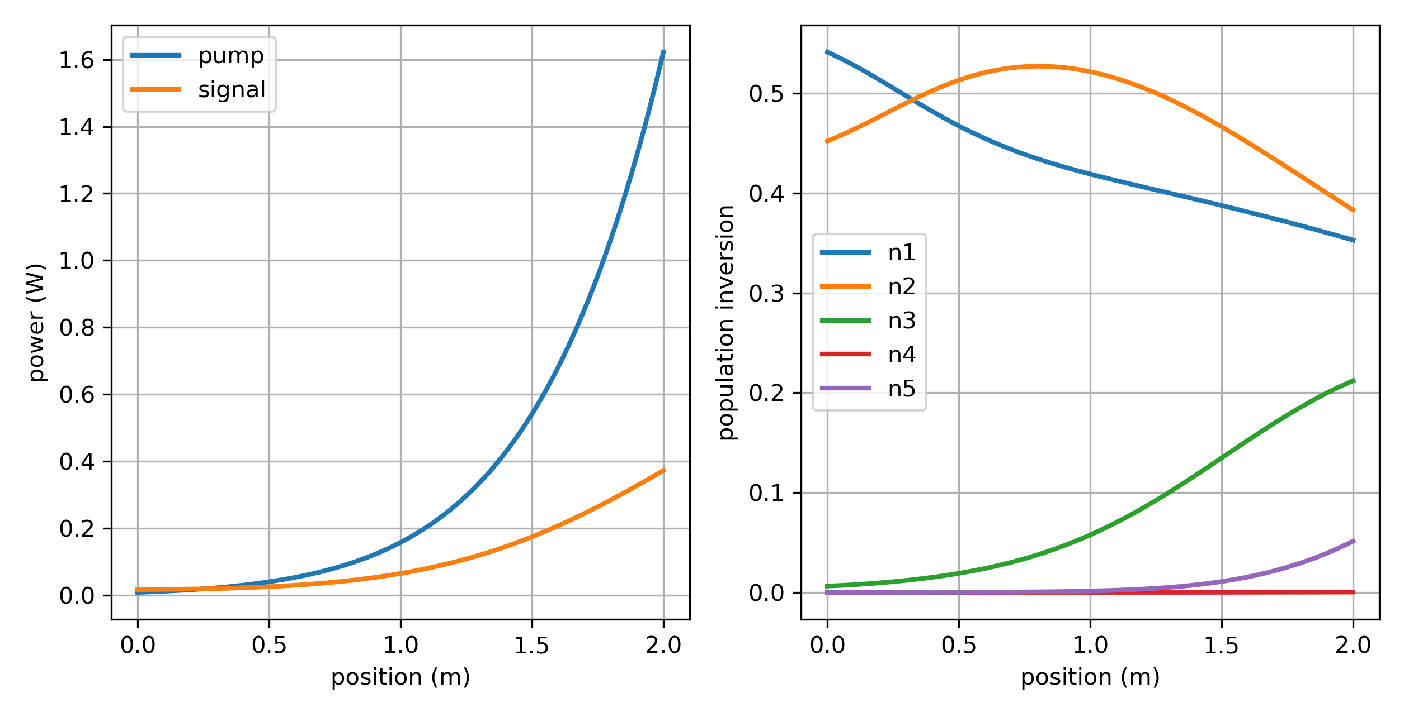
2W pump, 2 m of ER 80
Backward pumping also matches experiment better.
Calculated using shooting method
Used: 0.7 dB insertion loss, 0.2 dB splicing loss

Slide 9
Figure 9 cavity

Slide 10
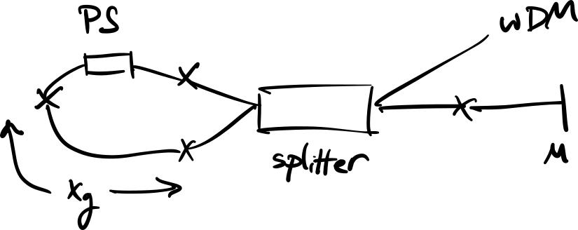
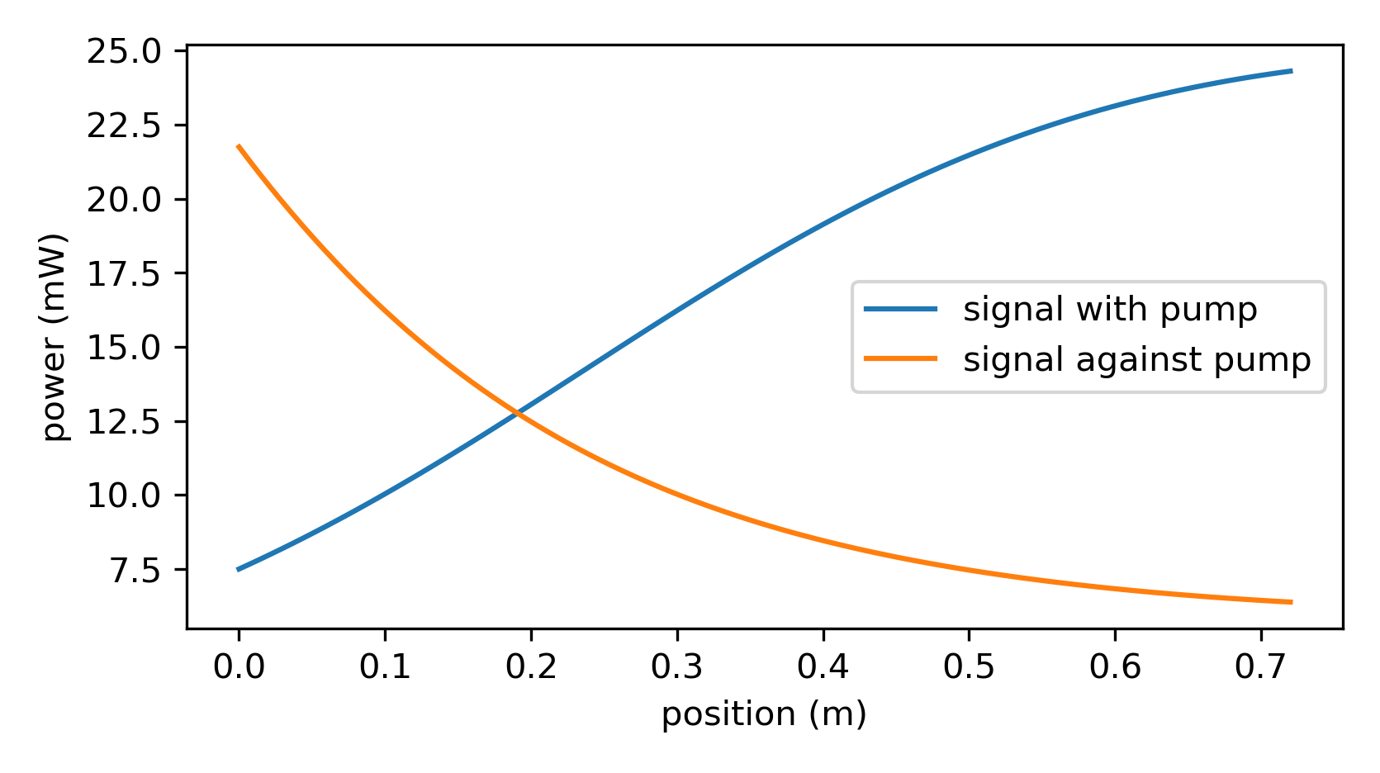
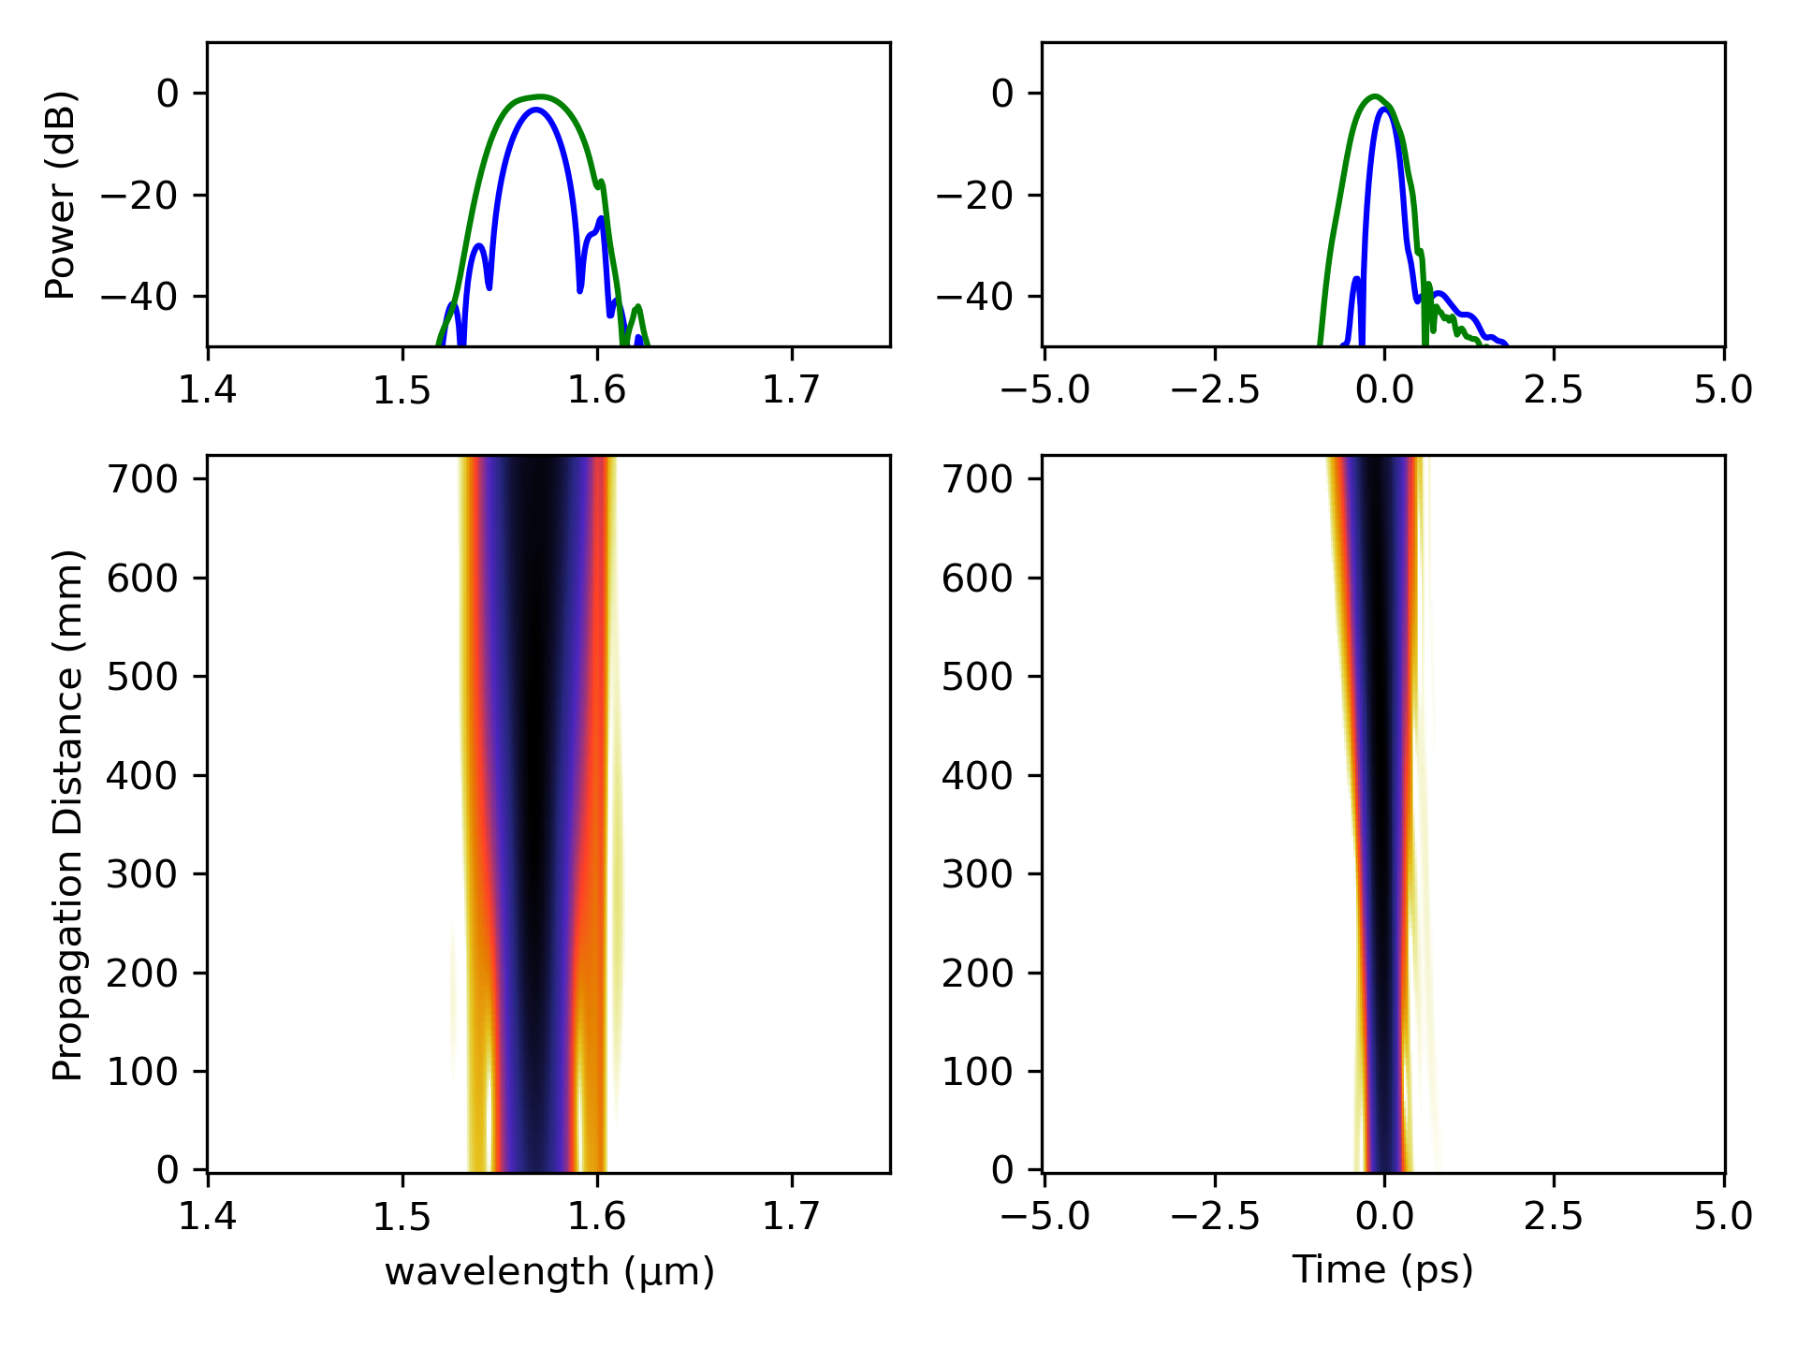
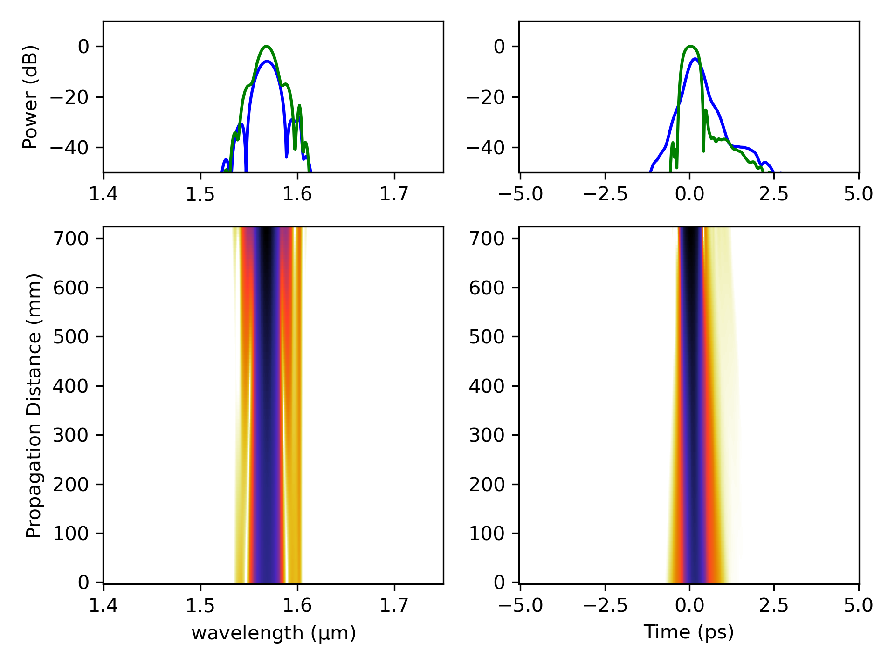
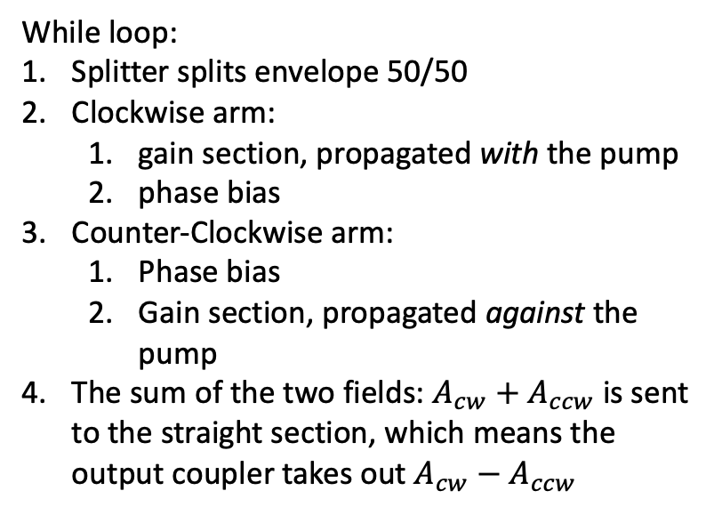

Setup
While loop:
Splitter splits envelope 50/50
Clockwise arm:
gain section, propagated with the pump
phase bias
Counter-Clockwise arm:
Phase bias
Gain section, propagated against the pump
The sum of the two fields: $A_{cw}+A_{ccw}$ is sent to the straight section, which means the output coupler takes out $A_{cw}−A_{ccw}$
Simultaneous forward and backward seeding is calculated using shooting method
With pump in EDF
Against pump in EDF
I haven’t checked this, but most of the difference in nonlinear phase shift should be acquired by the difference in forward vs backward seeding. So, I haven’t tested placing the gain section closer to center vs. one side of the loop
Using: $γ_{pm1550}=1.2,$ $γ_{edf}=6.5$

Slide 11
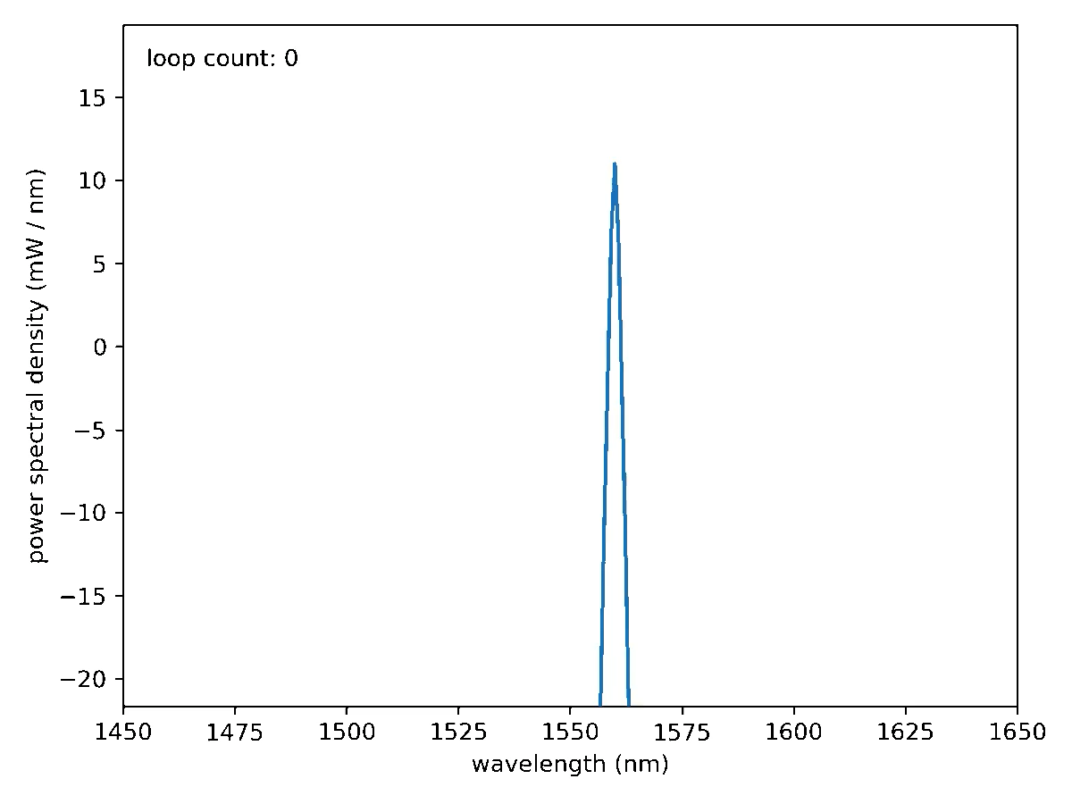
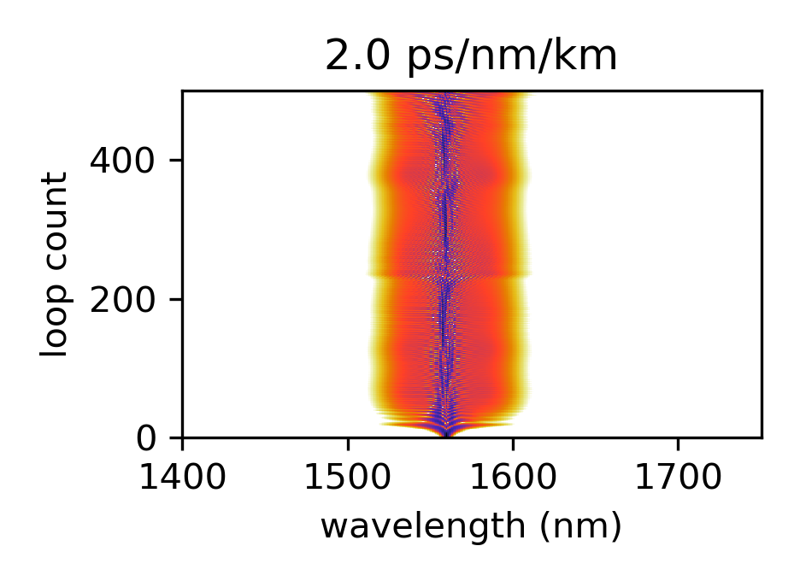
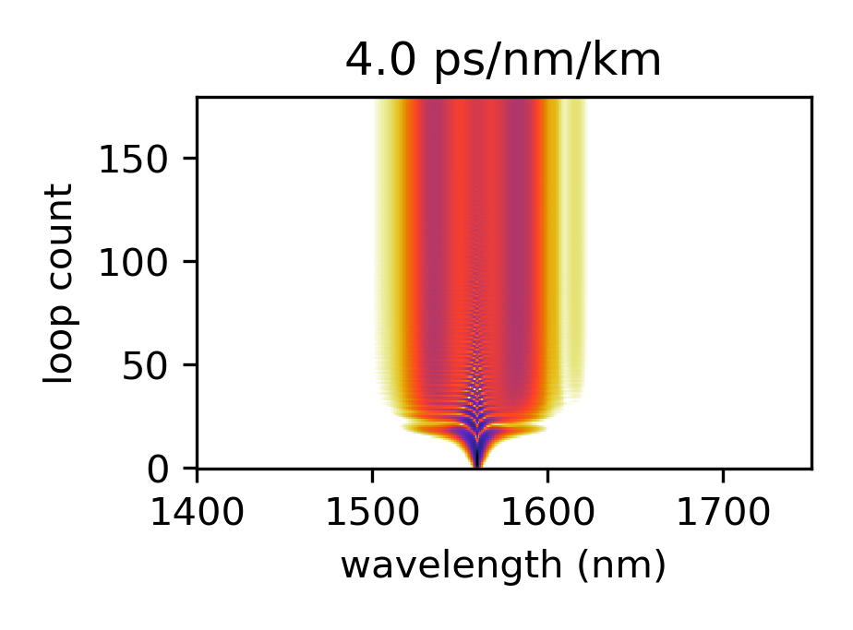
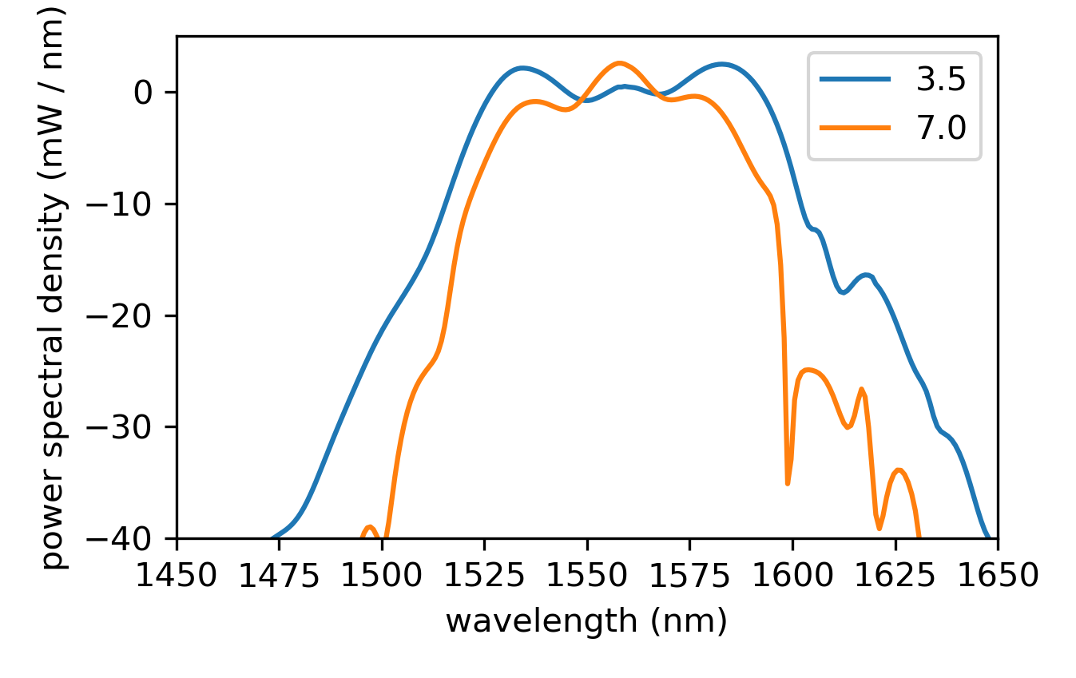
Looking for stability
Output spectrum for 200 MHz, 11 cm straight section, 4 ps/nm/km round trip dispersion
Run simulation until output spectrum doesn’t differ from the previous by more than some threshold
Seed with a 1 mW 2ps pulse. (So, kind of skip to the middle where you already have quasi-CW?)
If loop counts exceed 500, then cavity is deemed unstable.
not
stable
stable
Being too normal doesn’t work. However, too anomalous is not good either as a higher pump current is needed to reach the same bandwidth.

Slide 12
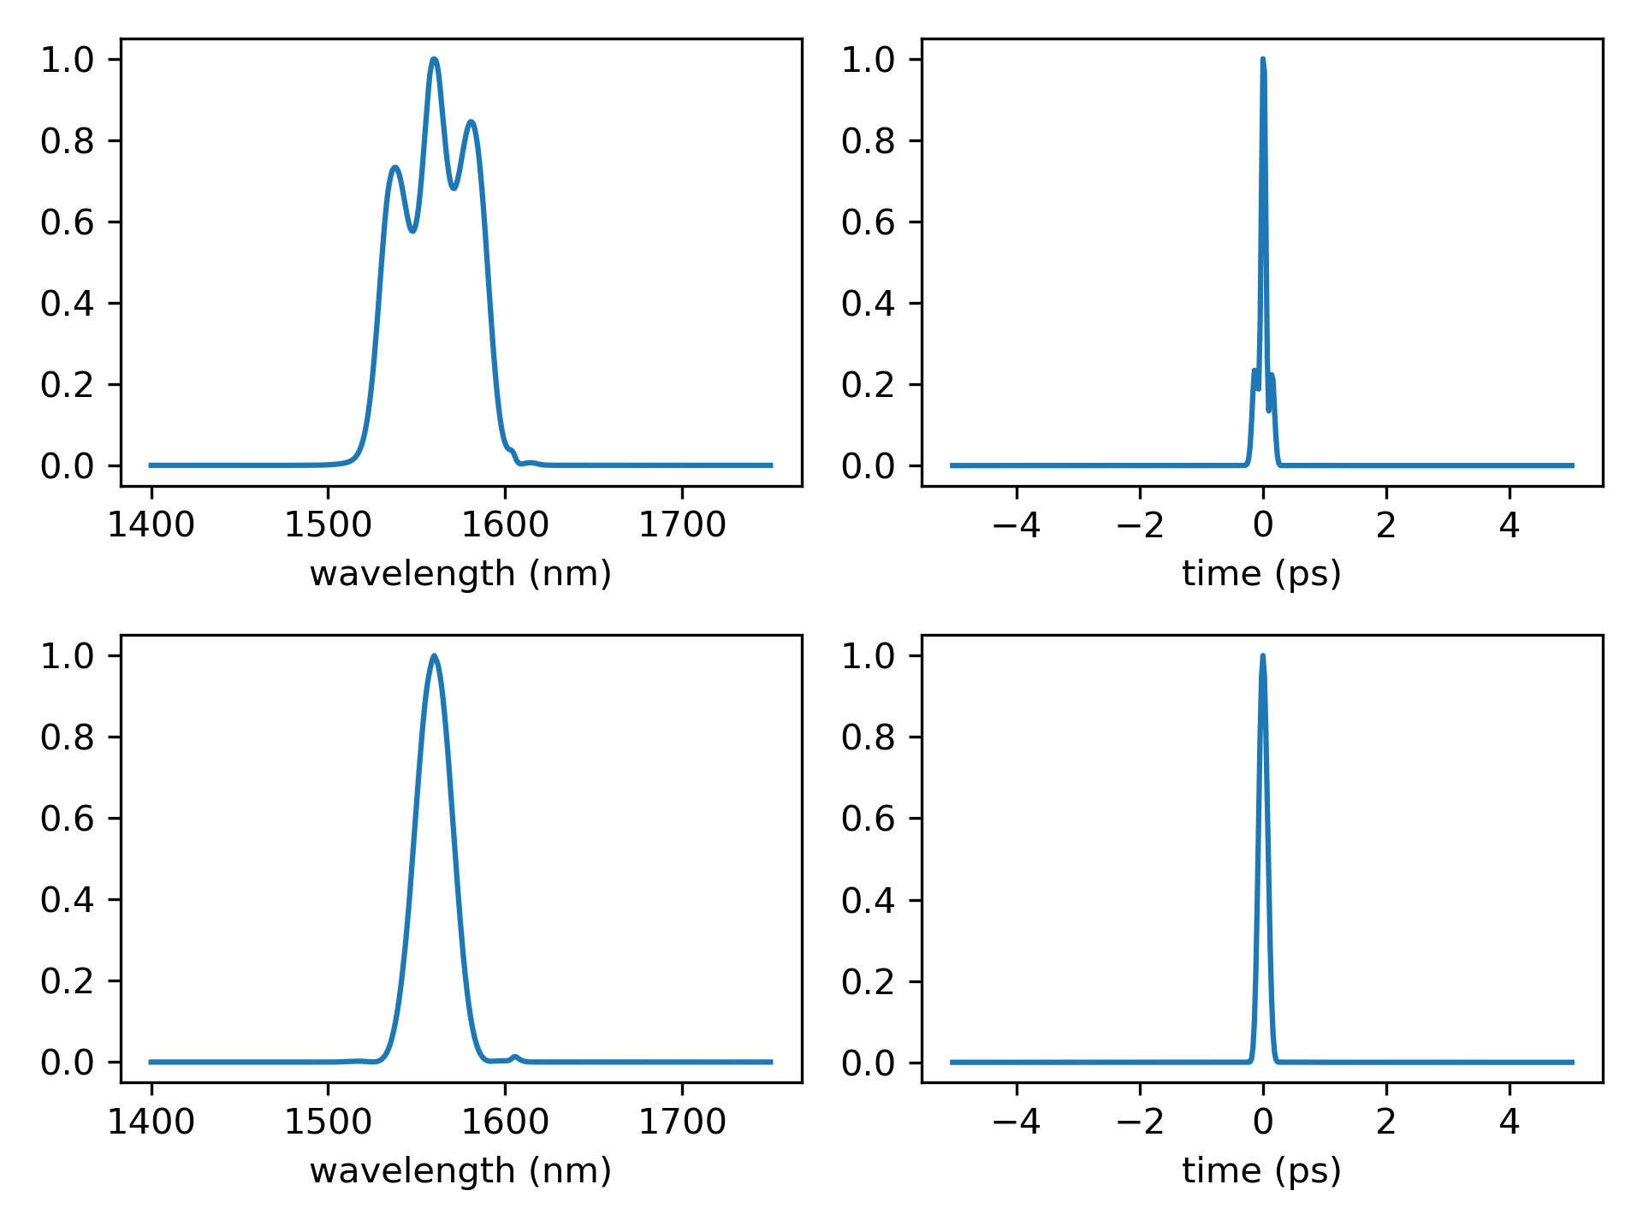
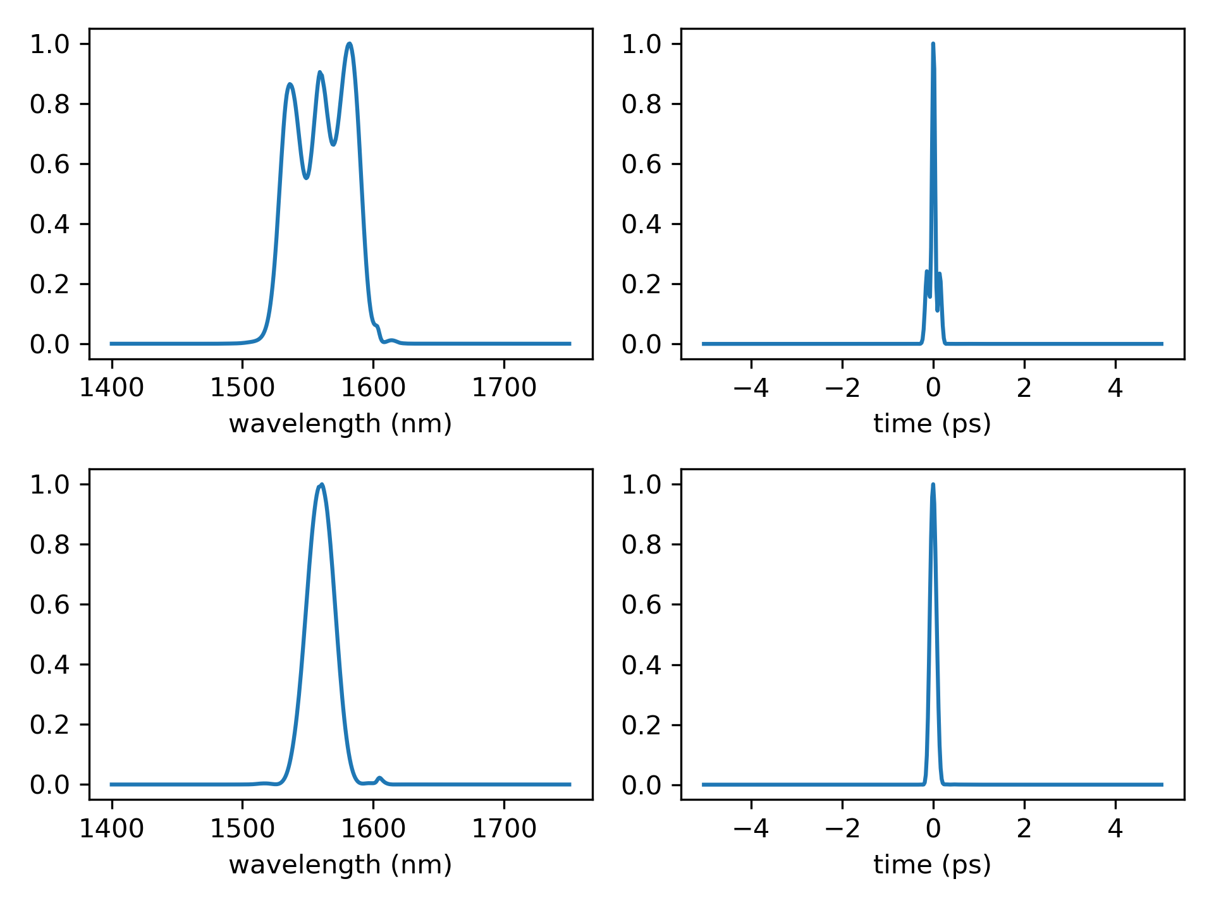
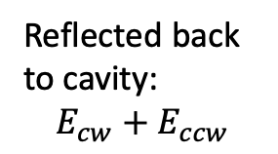
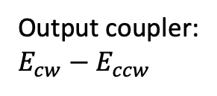
200 MHz
400 mW pump
450 mW pump
Output coupler:
$E_{cw}−E_{ccw}$
Reflected back to cavity:
$$E_{cw}+E_{ccw}$$
200 MHz, 4.5 ps/nm/km round trip
11 cm straight arm
accounting for: 0.7 dB insertion loss and 0.7 dB splicing loss

Slide 13
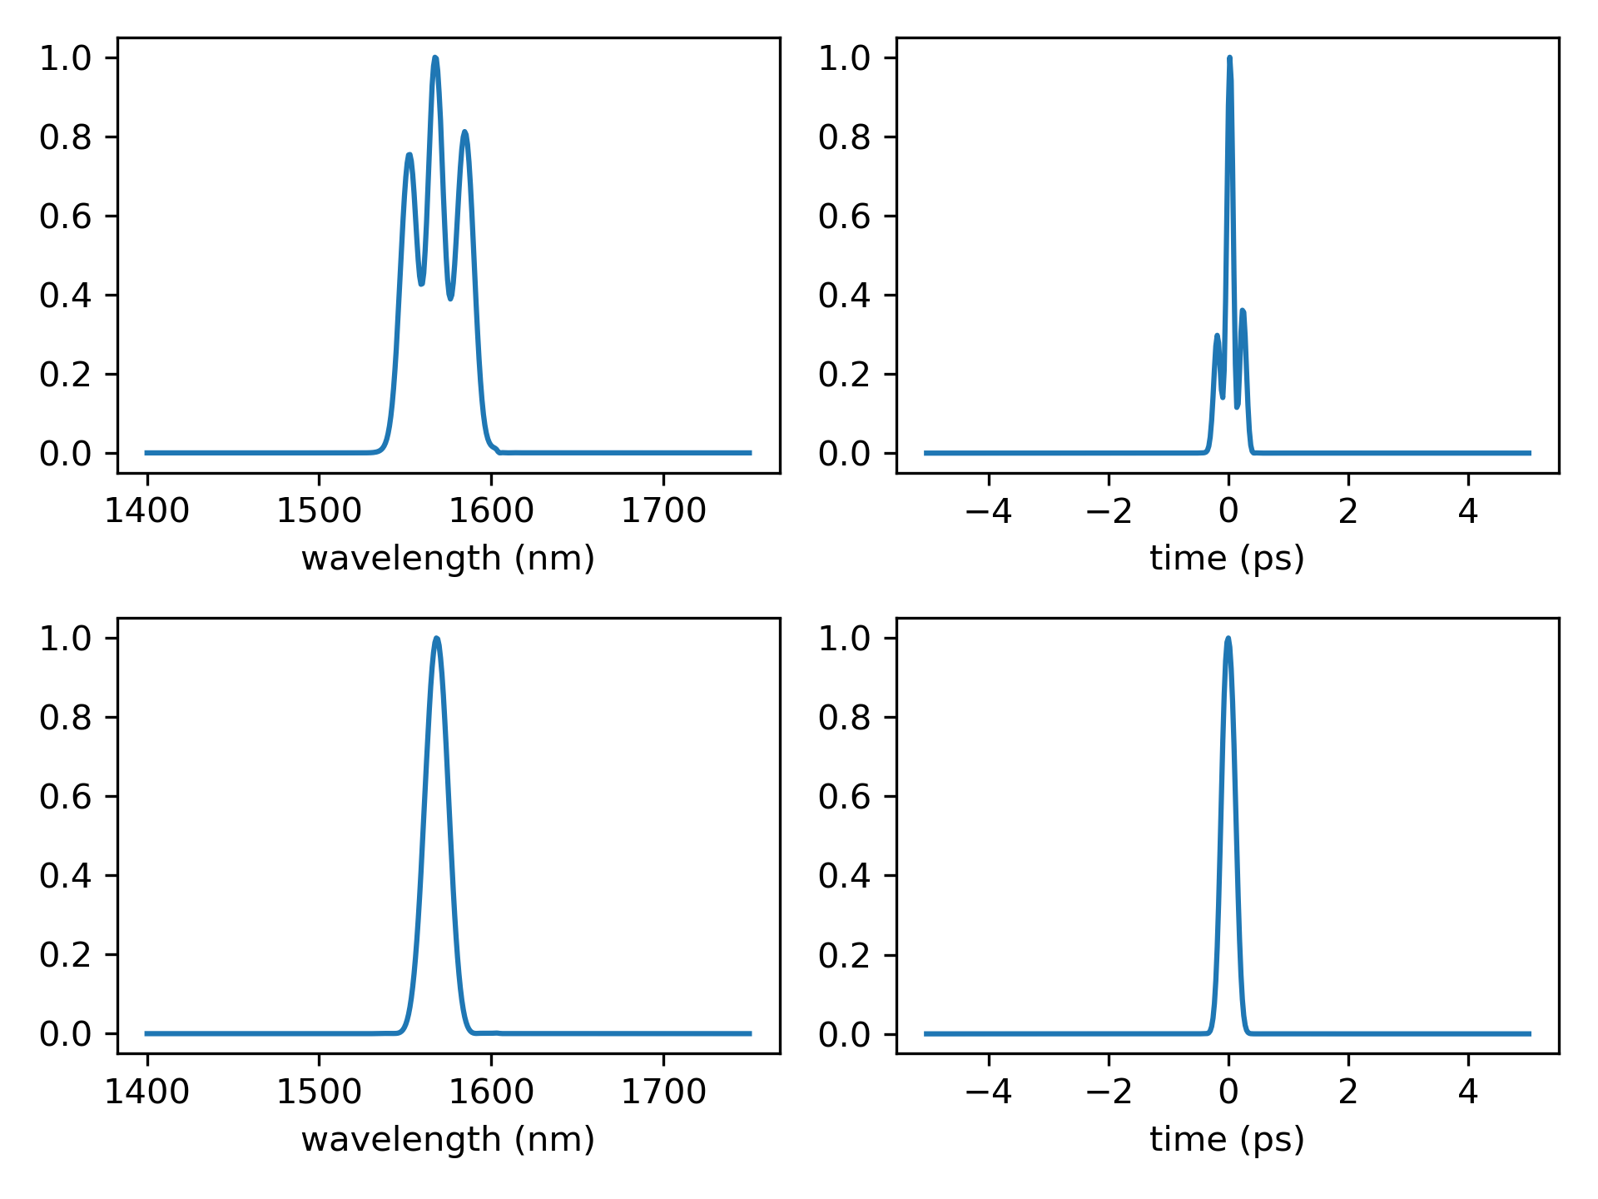
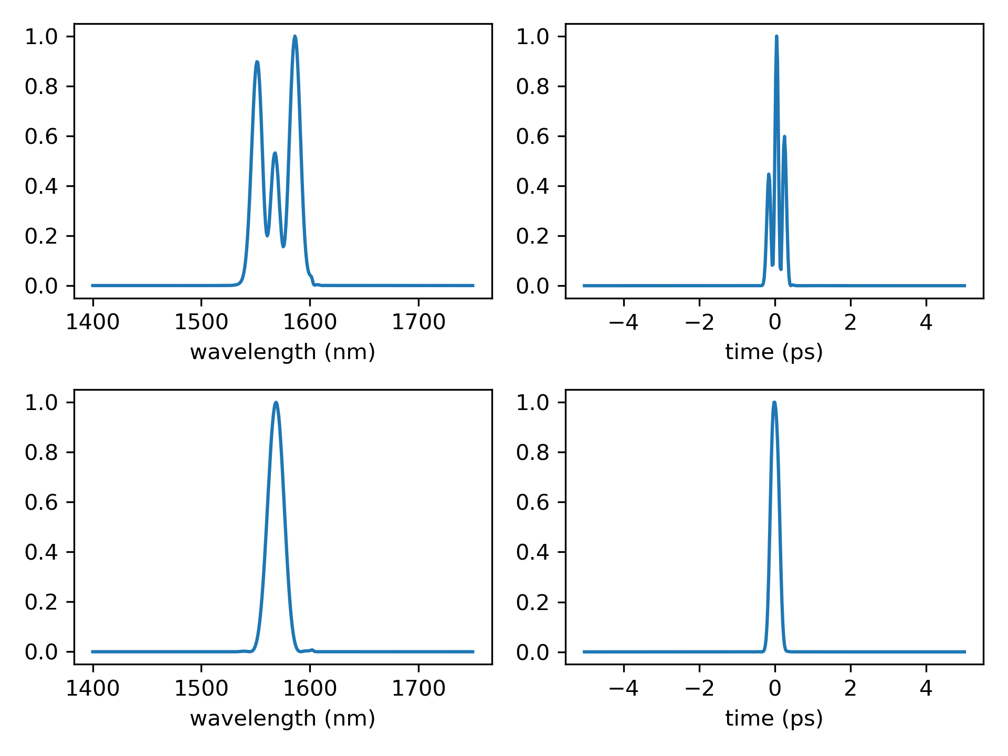
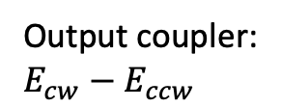
100 MHz
60 mW pump
75 mW pump
Output coupler:
$E_{cw}−E_{ccw}$
Reflected back to cavity:
$$E_{cw}+E_{ccw}$$
100 MHz, 3.5 ps/nm/km round trip
15 cm straight arm
accounting for: 0.7 dB insertion loss and 0.7 dB splicing loss

Slide 14
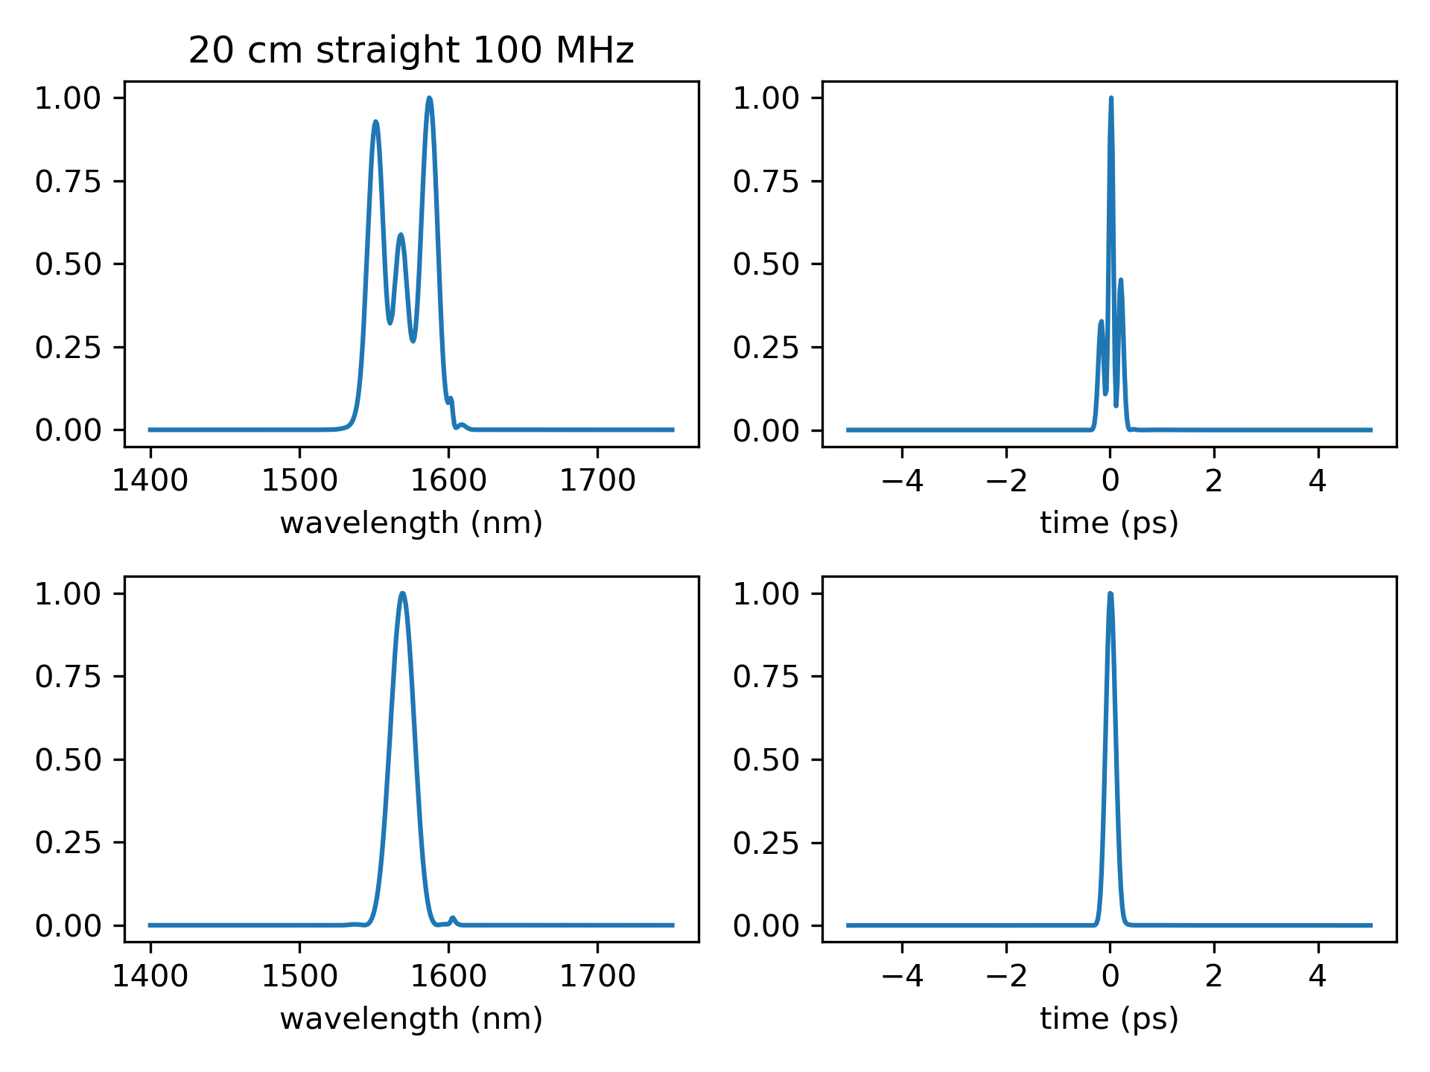
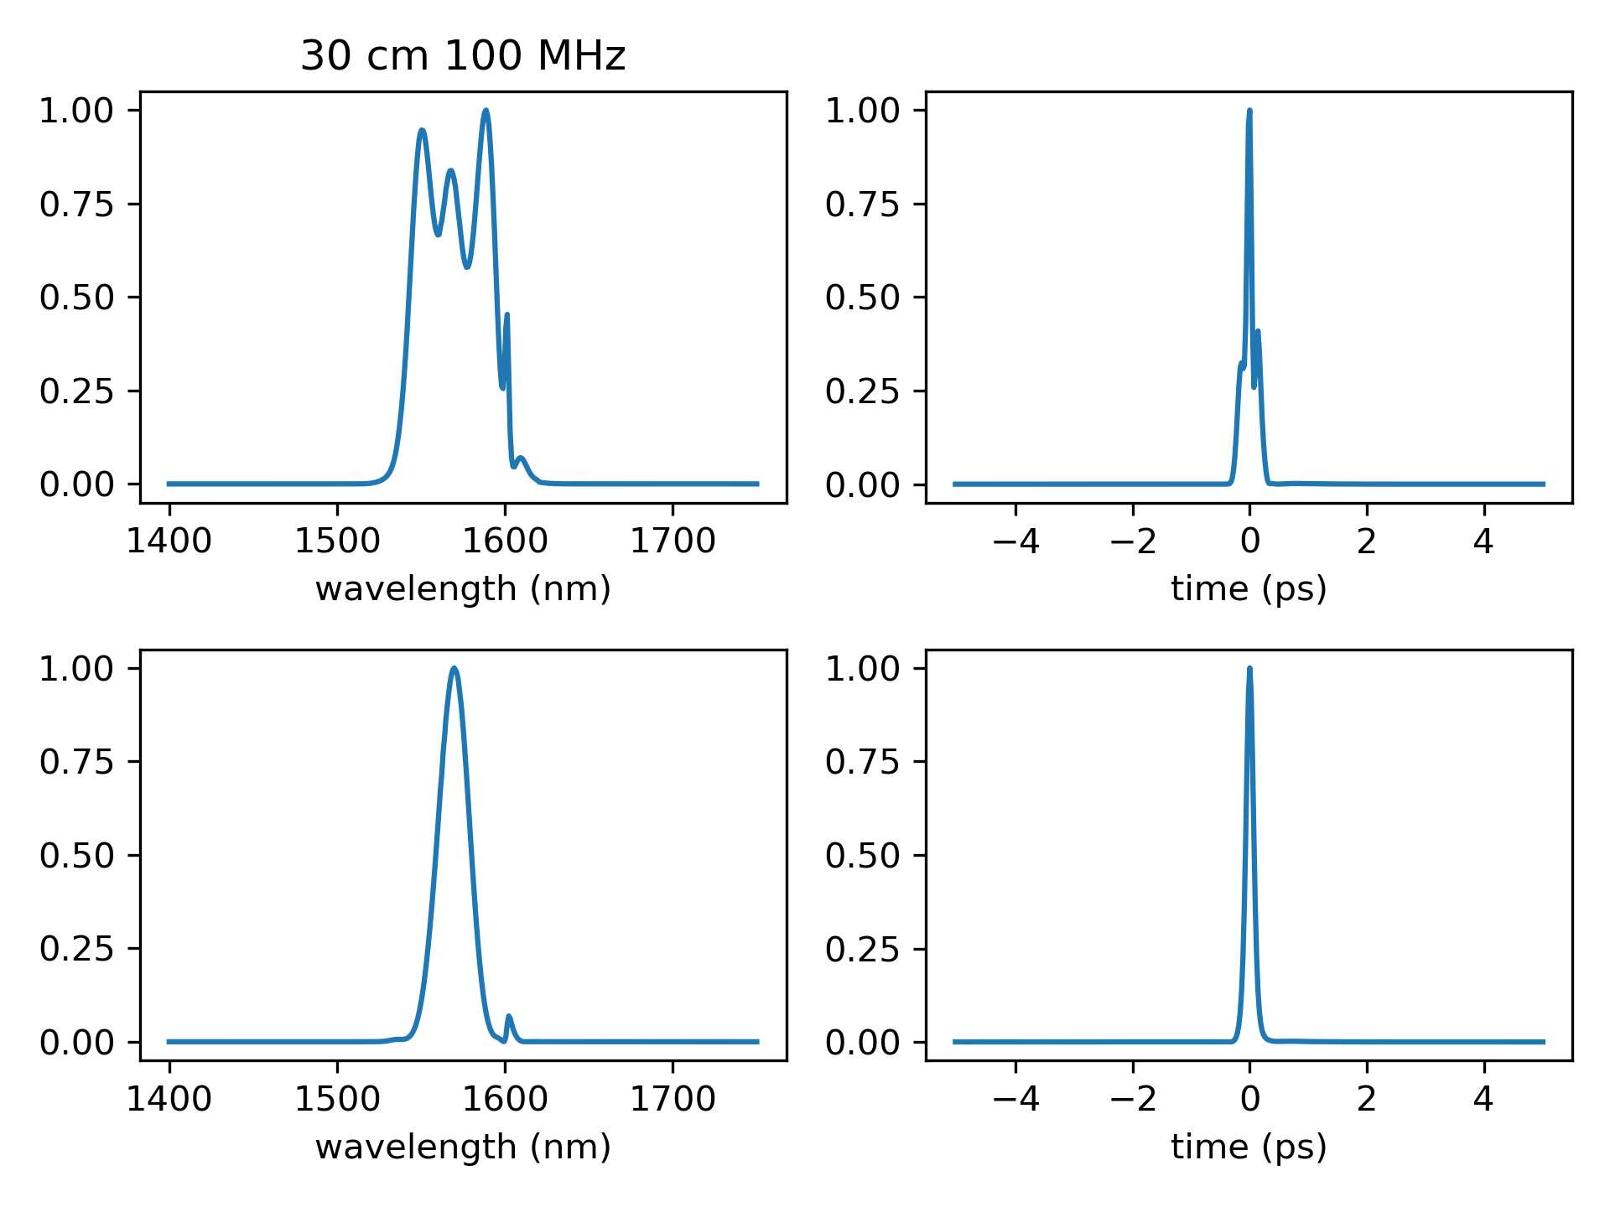
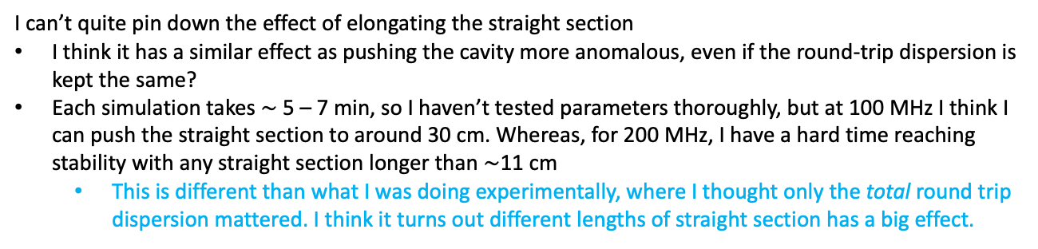
Length of straight section is important
15 cm straight section @ 100 MHz
20 cm straight section @ 100 MHz
30 cm straight section @ 100 MHz
I can’t quite pin down the effect of elongating the straight section
I think it has a similar effect as pushing the cavity more anomalous, even if the round-trip dispersion is kept the same?
Each simulation takes $\sim$ 5 – 7 min, so I haven’t tested parameters thoroughly, but at 100 MHz I think I can push the straight section to around 30 cm. Whereas, for 200 MHz, I have a hard time reaching stability with any straight section longer than $\sim$11 cm
This is different than what I was doing experimentally, where I thought only the total round trip dispersion mattered. I think it turns out different lengths of straight section has a big effect.

