Slide 1
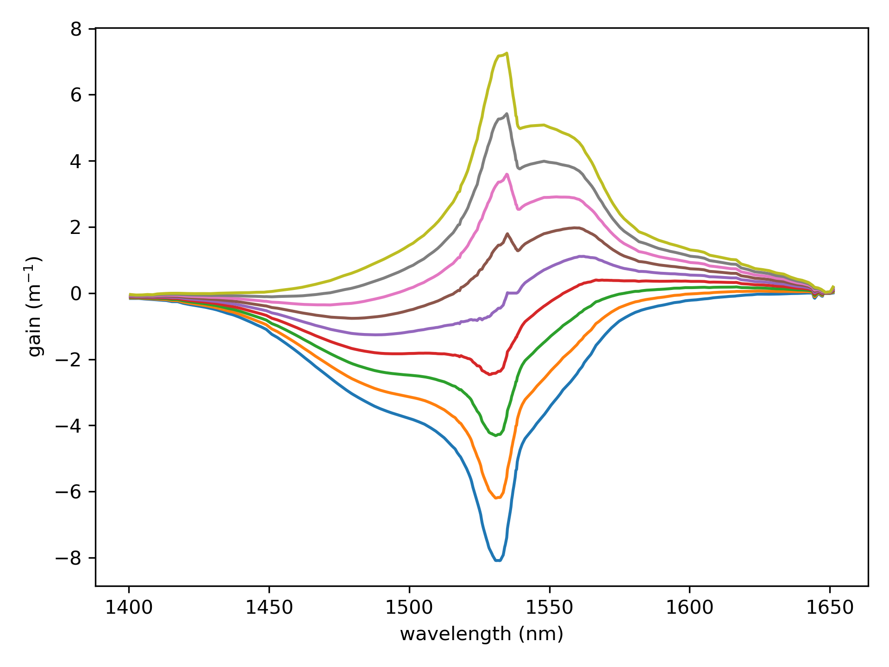
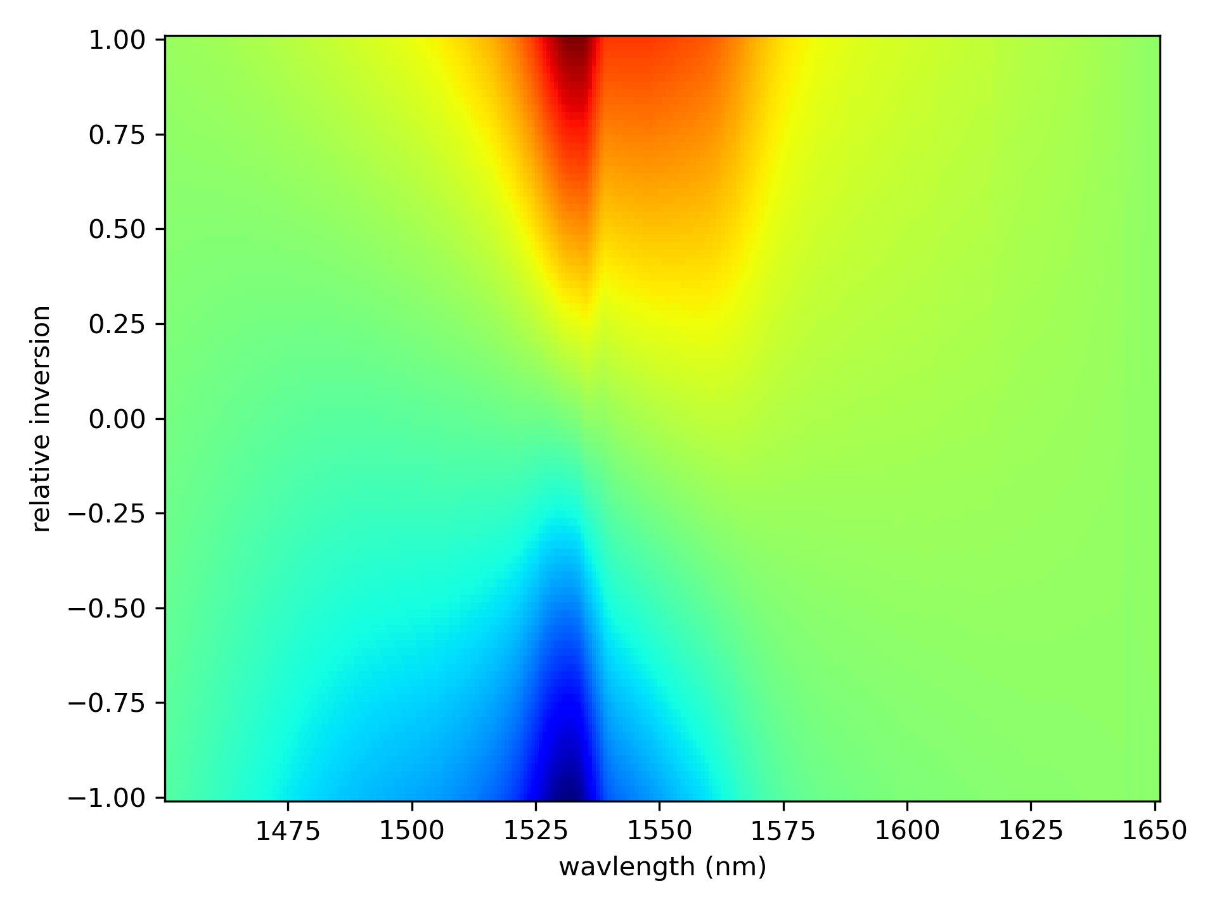
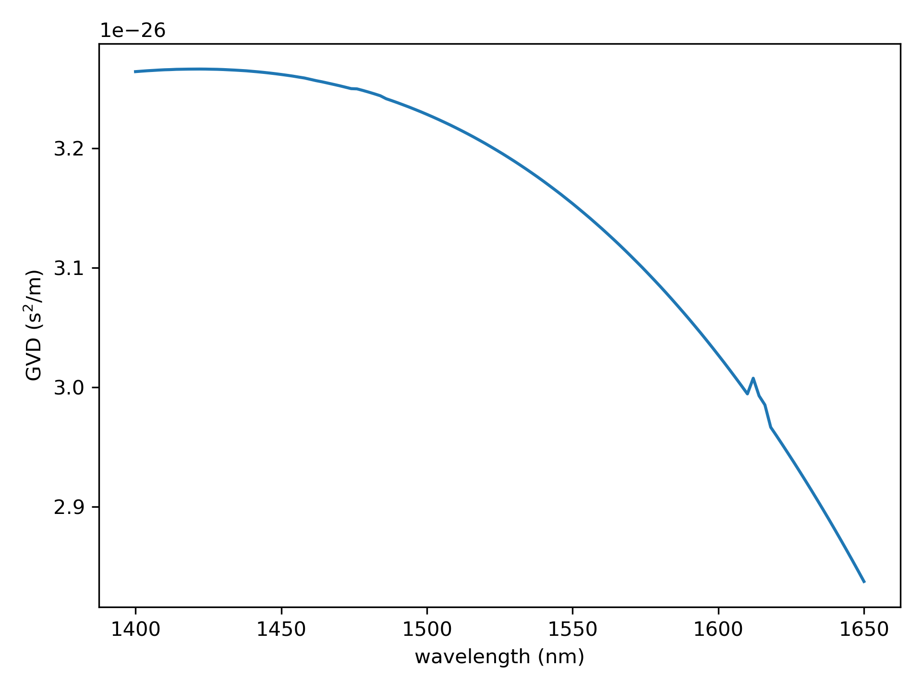


Input Parameters
$$g∝σ_{e}\left(1+D\right)−σ_{a}(1−D)$$
GVD for ER 110 4/125
where
$$−1< D=N_{2}−N_{1}<1$$

Slide 2
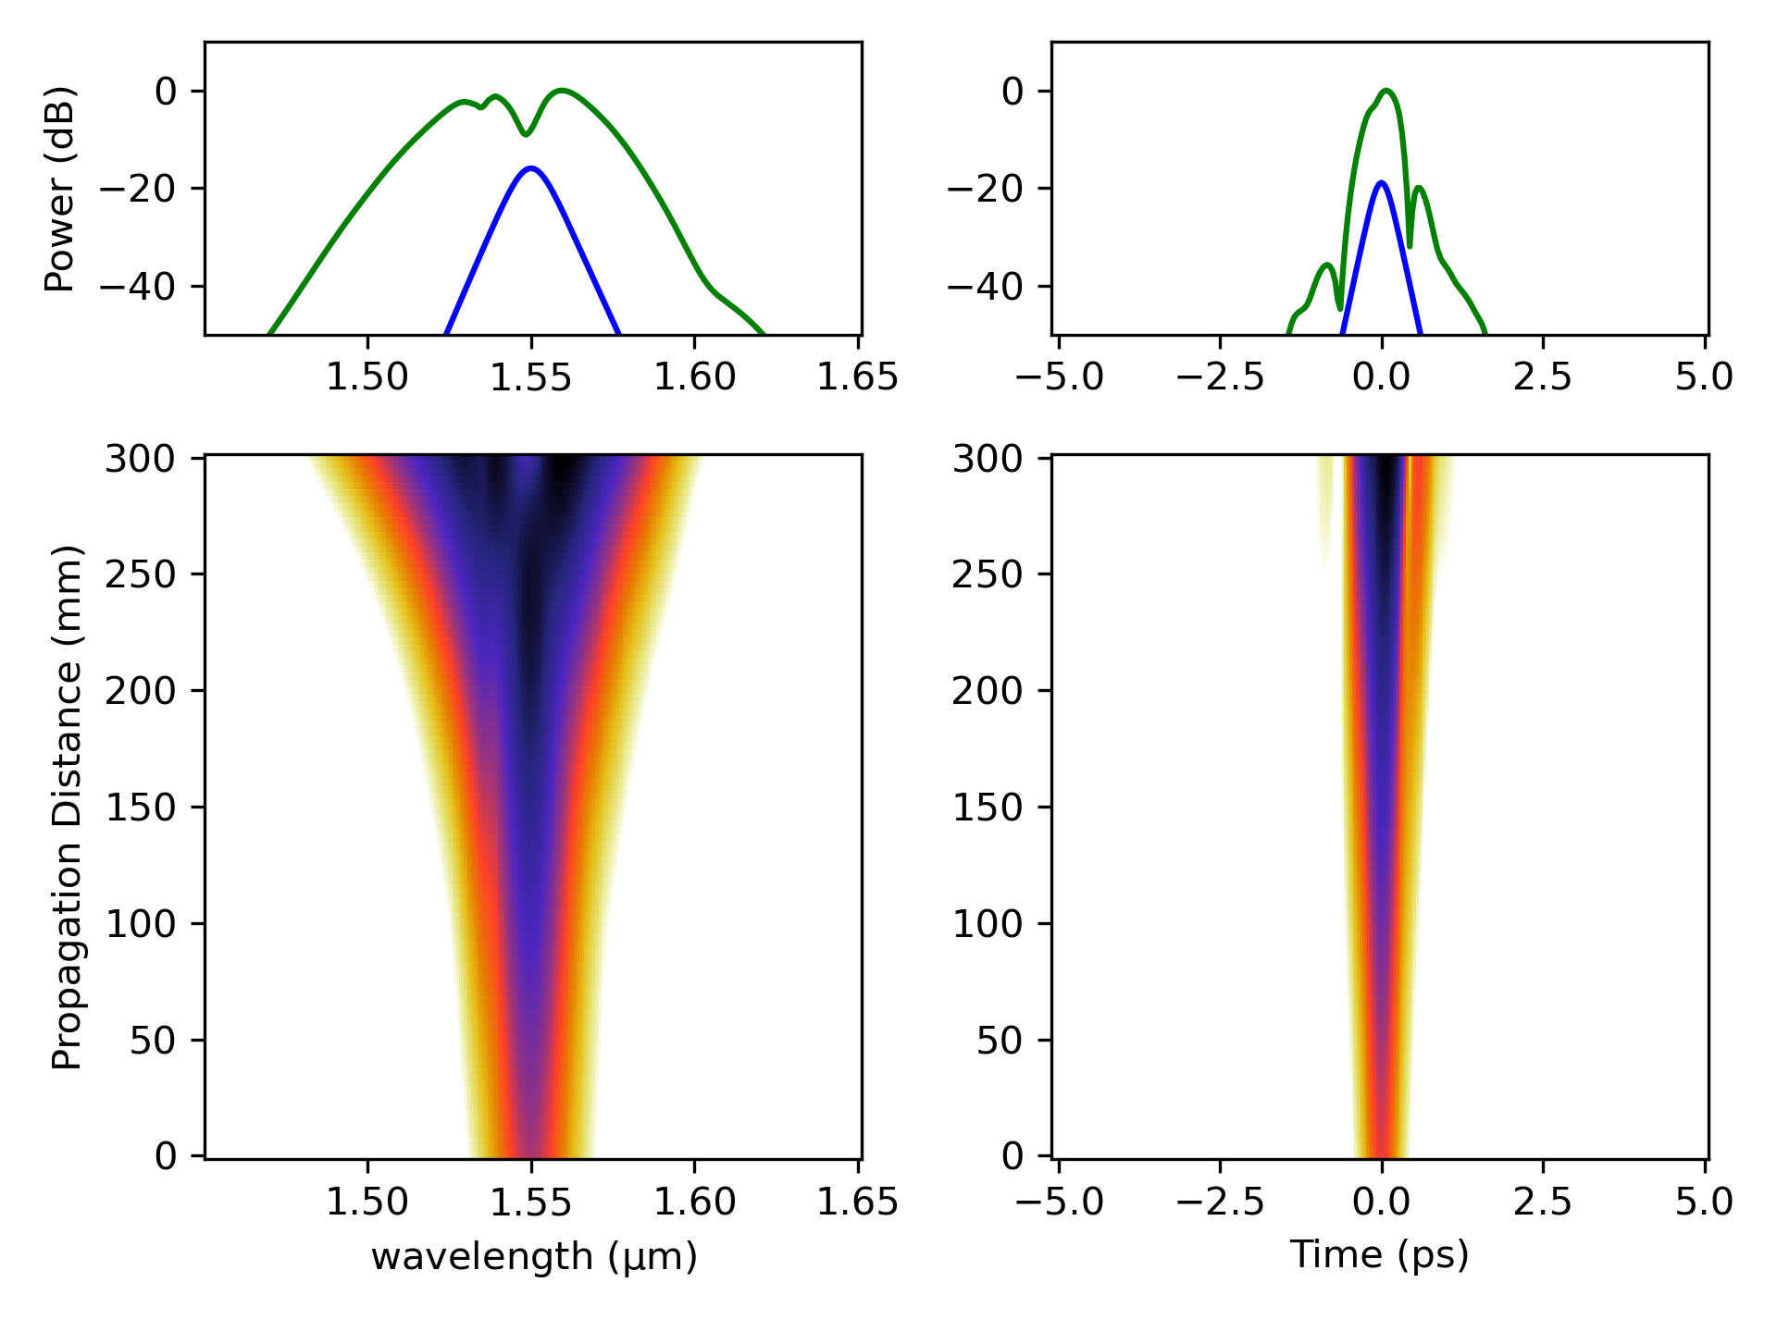
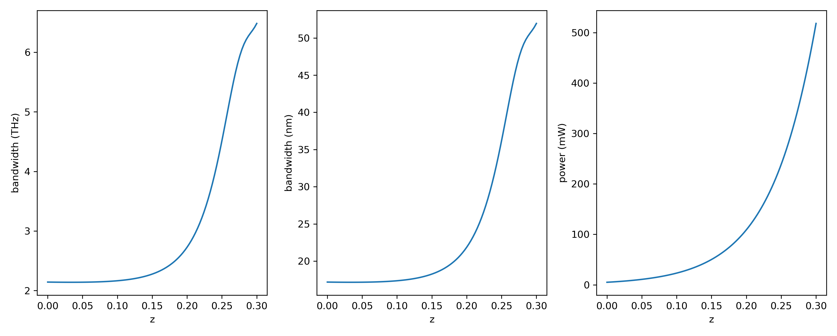
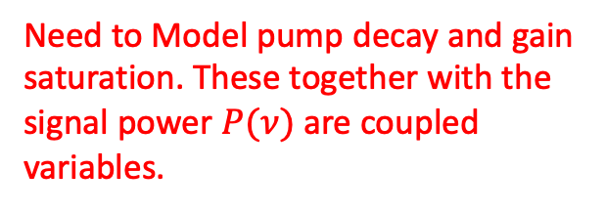
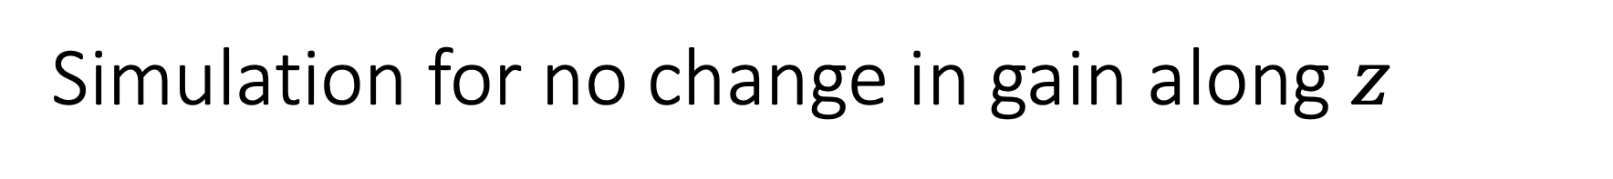
Simulation for no change in gain along $z$
Using a gain peak of 110 dB/m at 1530 nm
No pump decay or gain saturation → fails to capture important features!
Need to Model pump decay and gain saturation. These together with the signal power $P(ν)$ are coupled variables.

Slide 3
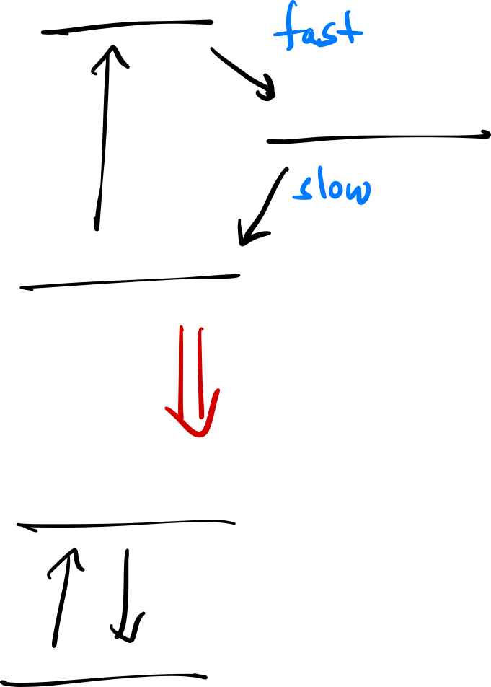



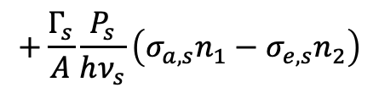
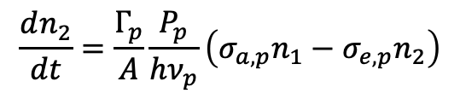
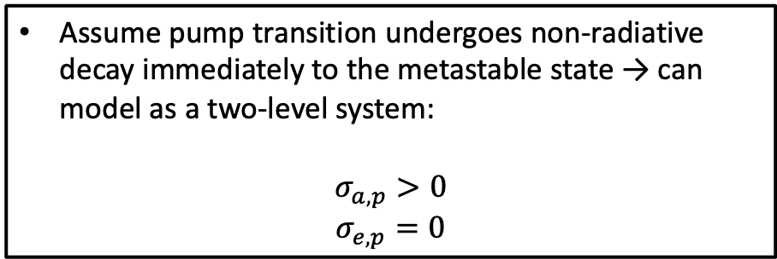
$$τ_{p}≪τ_{metastable}$$
Assume pump transition undergoes non-radiative decay immediately to the metastable state → can model as a two-level system:
$$σ_{a, p}>0$$
$$σ_{e,p}=0$$
$$\frac{dn_{2}}{dt}=\frac{Γ_{p}}{A}\frac{P_{p}}{hν_{p}}\left(σ_{a,p}n_{1}−σ_{e,p}n_{2}\right)$$
$$+\frac{Γ_{s}}{A}\frac{P_{s}}{hν_{s}}\left(σ_{a,s}n_{1}−σ_{e,s}n_{2}\right)$$
$$−\frac{n_{2}}{τ}$$
If the $\frac{1}{f_{r}}≫τ$ → $n_{2}$ will reach steady state!

Slide 4



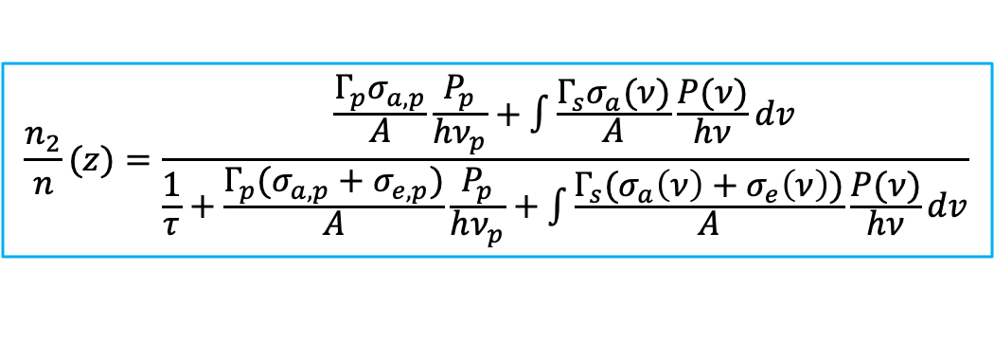
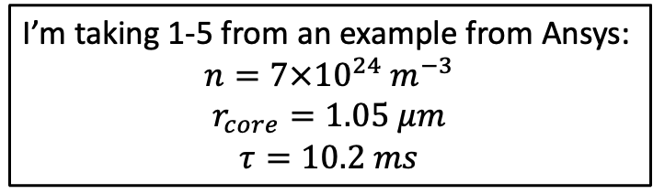

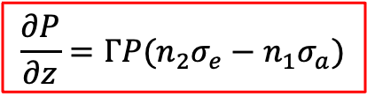


Rate Equations
Need to know:
Total doping concentration (ions / m³)
Absorption cross-section (m²)
Emission cross-section (m²)
Fiber core size
Excited state lifetime
Steady state
$$\frac{n_{2}}{n}(z)=\frac{\frac{Γ_{p}σ_{a,p}}{A}\frac{P_{p}}{hν_{p}}+\int{\frac{Γ_{s}σ_{a}(ν)}{A}\frac{P(ν)}{hν}dv}}{\frac{1}{τ}+\frac{Γ_{p}(σ_{a,p}+σ_{e,p})}{A}\frac{P_{p}}{hν_{p}}+\int{\frac{Γ_{s}(σ_{a}\left(ν\right)+σ_{e}\left(ν\right))}{A}\frac{P(ν)}{hν}dv}}$$
$$\frac{∂P}{∂z}=ΓP(n_{2}σ_{e}−n_{1}σ_{a})$$
I’m taking 1-5 from an example from Ansys:
$$n=7×{10}^{24} m^{−3}$$
$$r_{core}=1.05 μm$$
$$τ=10.2 ms$$
where:
$$n_{2}=\left(\frac{n_{2}}{n}\right)n$$
$$n_{1}=n−n_{2}$$
cross-sections:
The gain coefficient is:
$$σ_{e}$$
$$g\left(ν,z\right)=Γ_{s}(σ_{e}\left(ν\right)n_{2}\left(z\right)−σ_{a}\left(ν\right)n_{1}\left(z\right))$$
$$σ_{a}$$

Slide 5
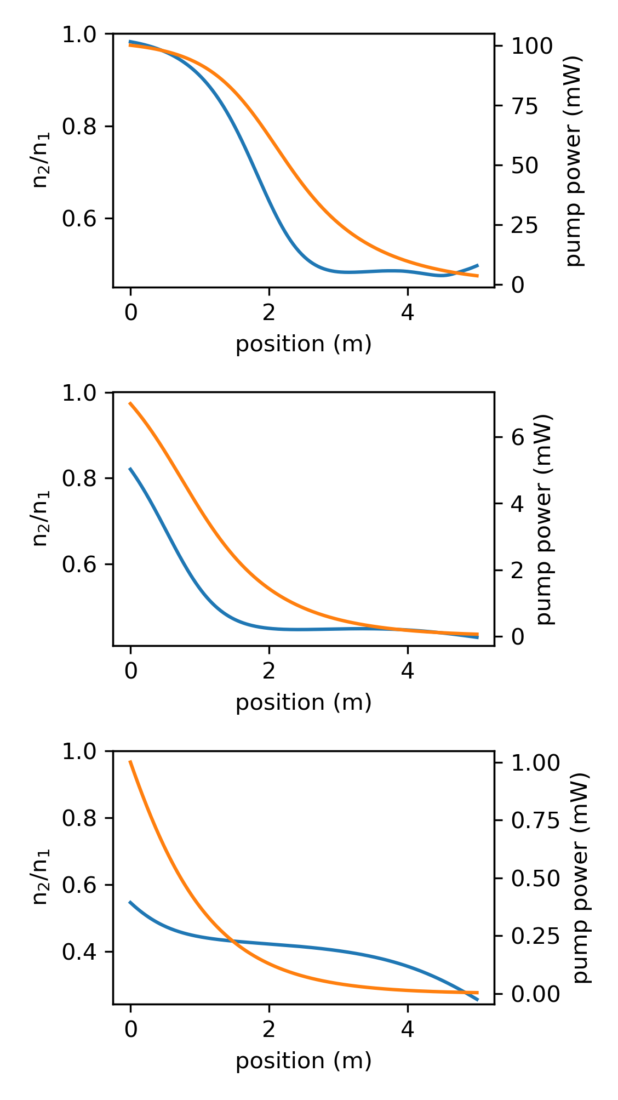
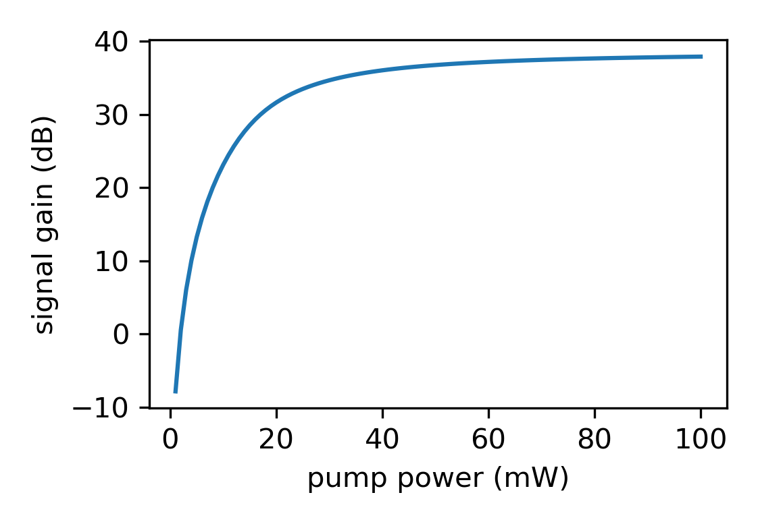



Forward Pumping
pump
$$n_{2}/n_{1}$$
pump
$$n_{2}/n_{1}$$
pump
$$n_{2}/n_{1}$$

Slide 6
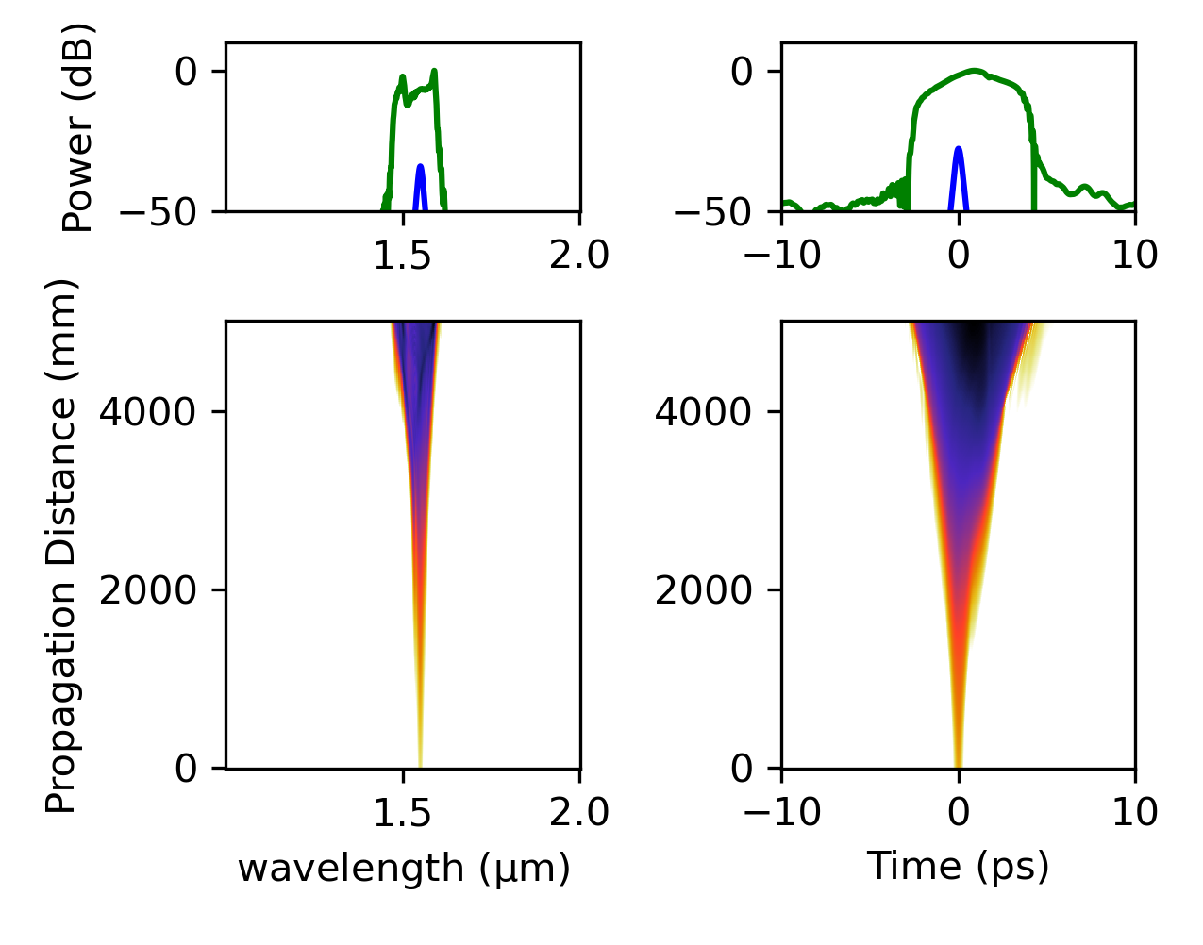
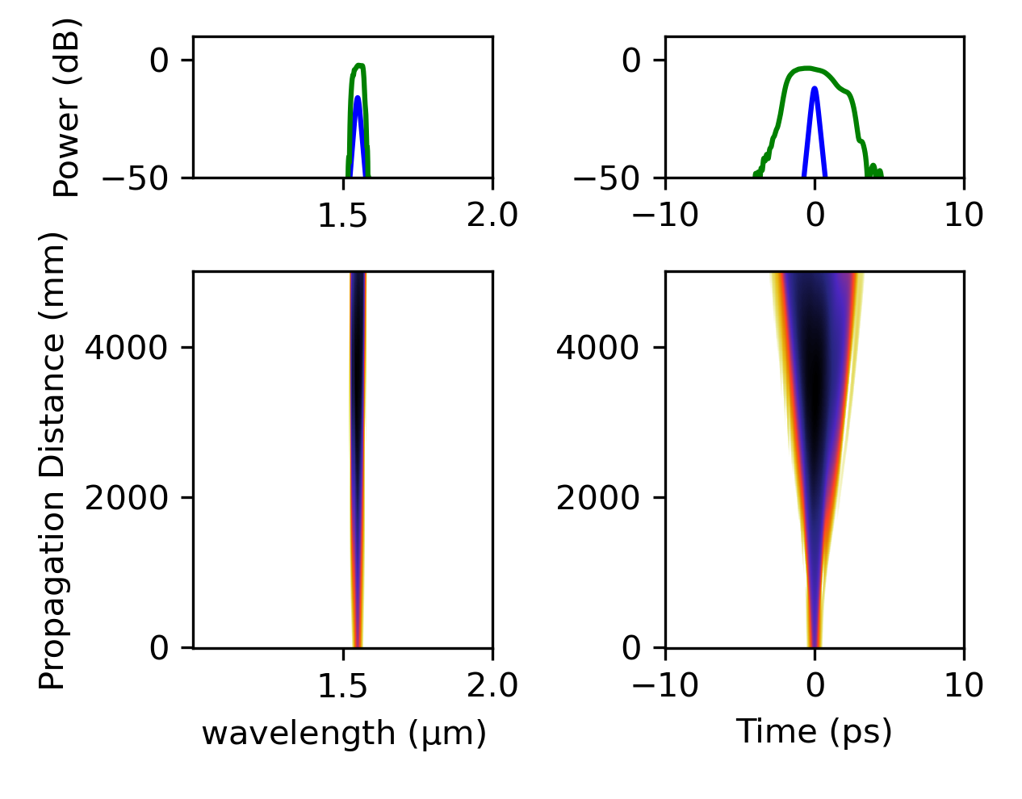
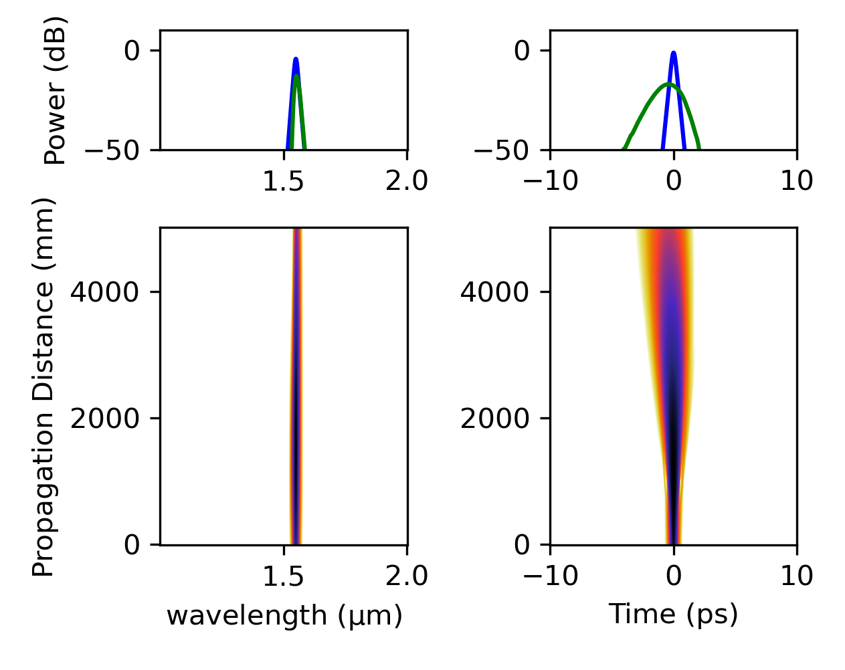
Forward Pumping

Slide 7
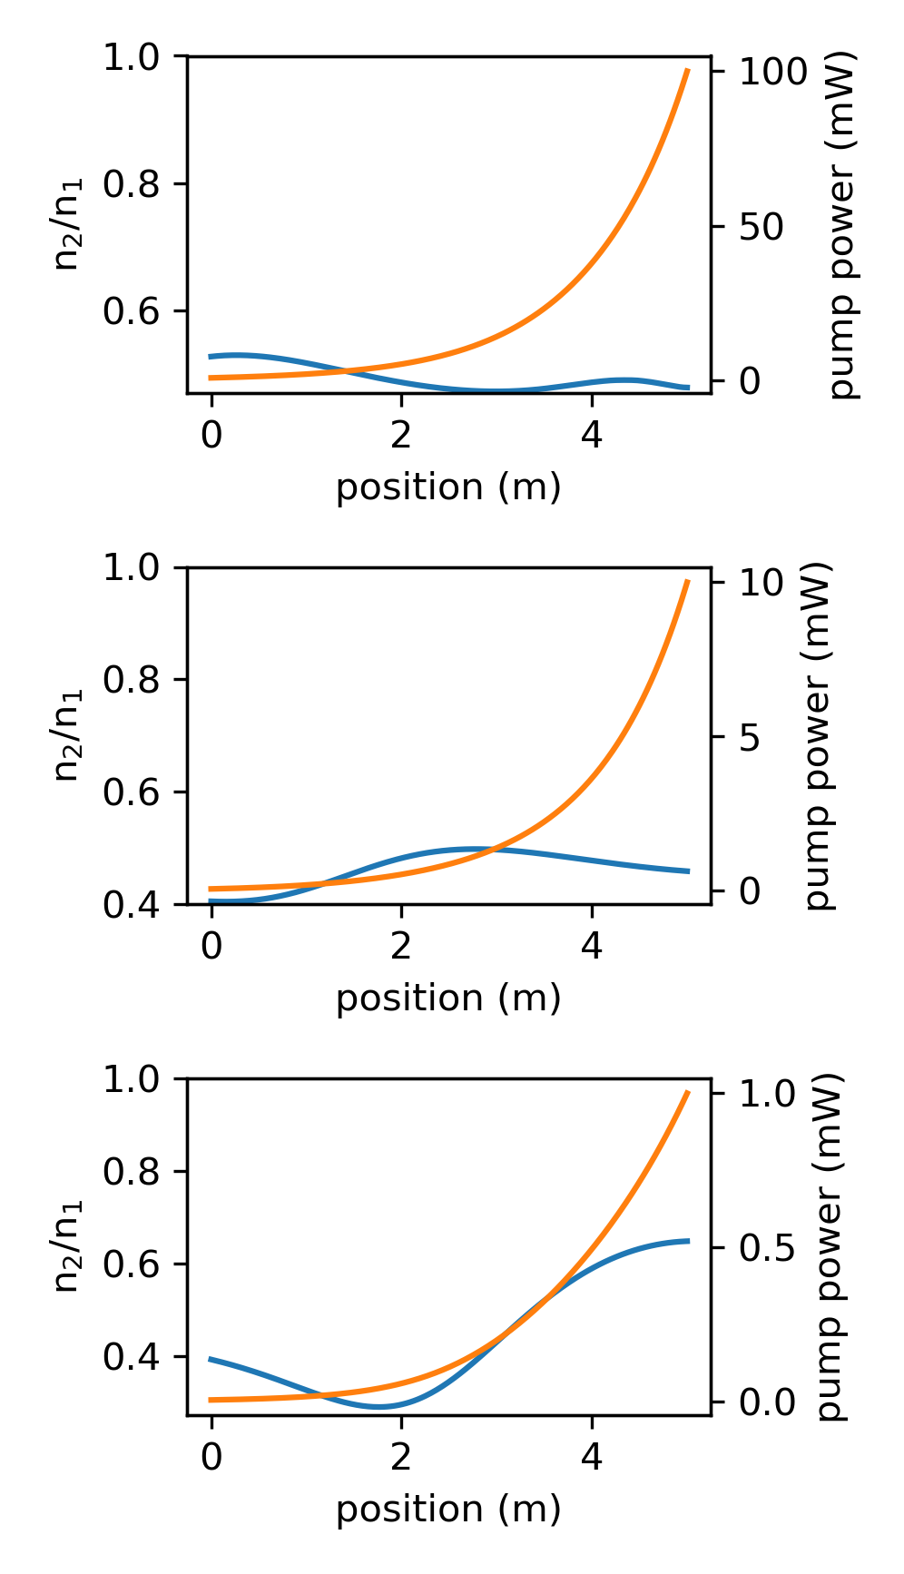
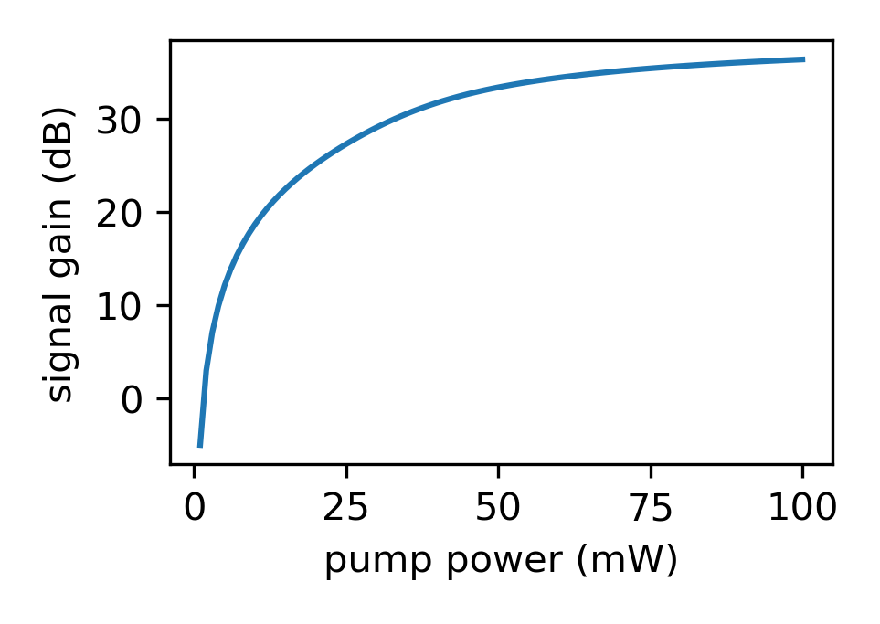
Backward Pumping

Slide 8
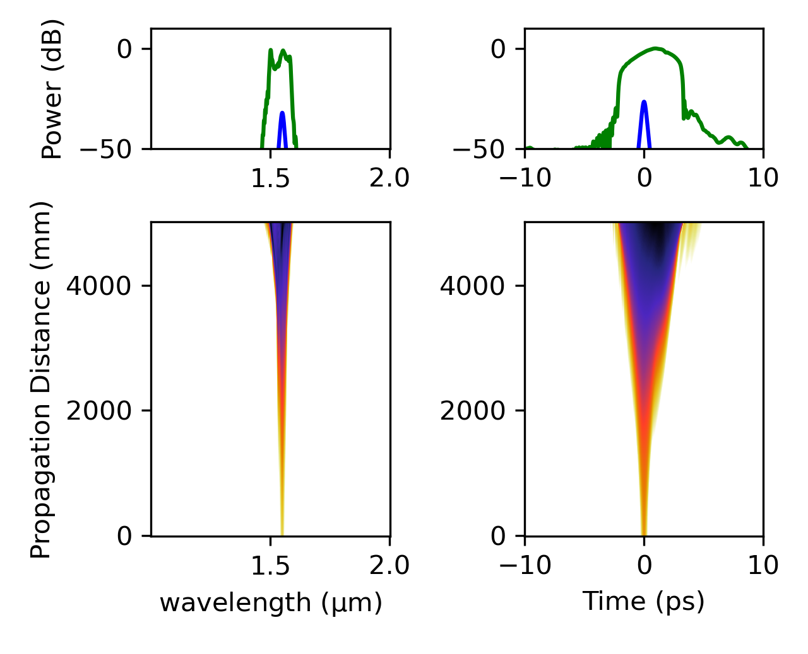
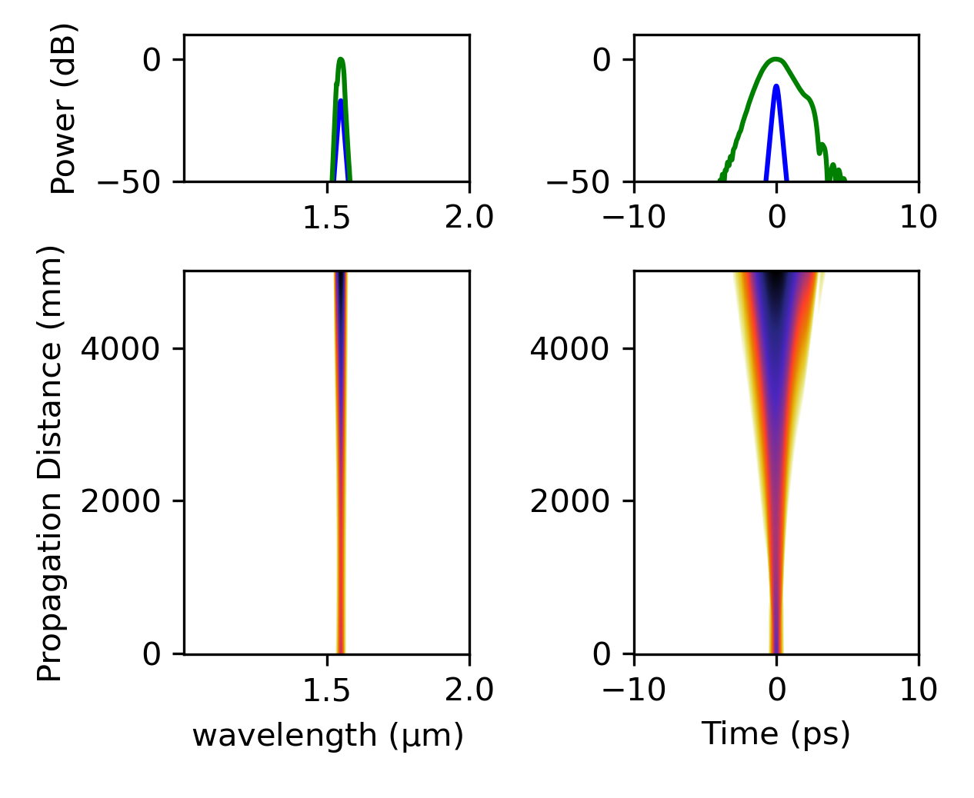
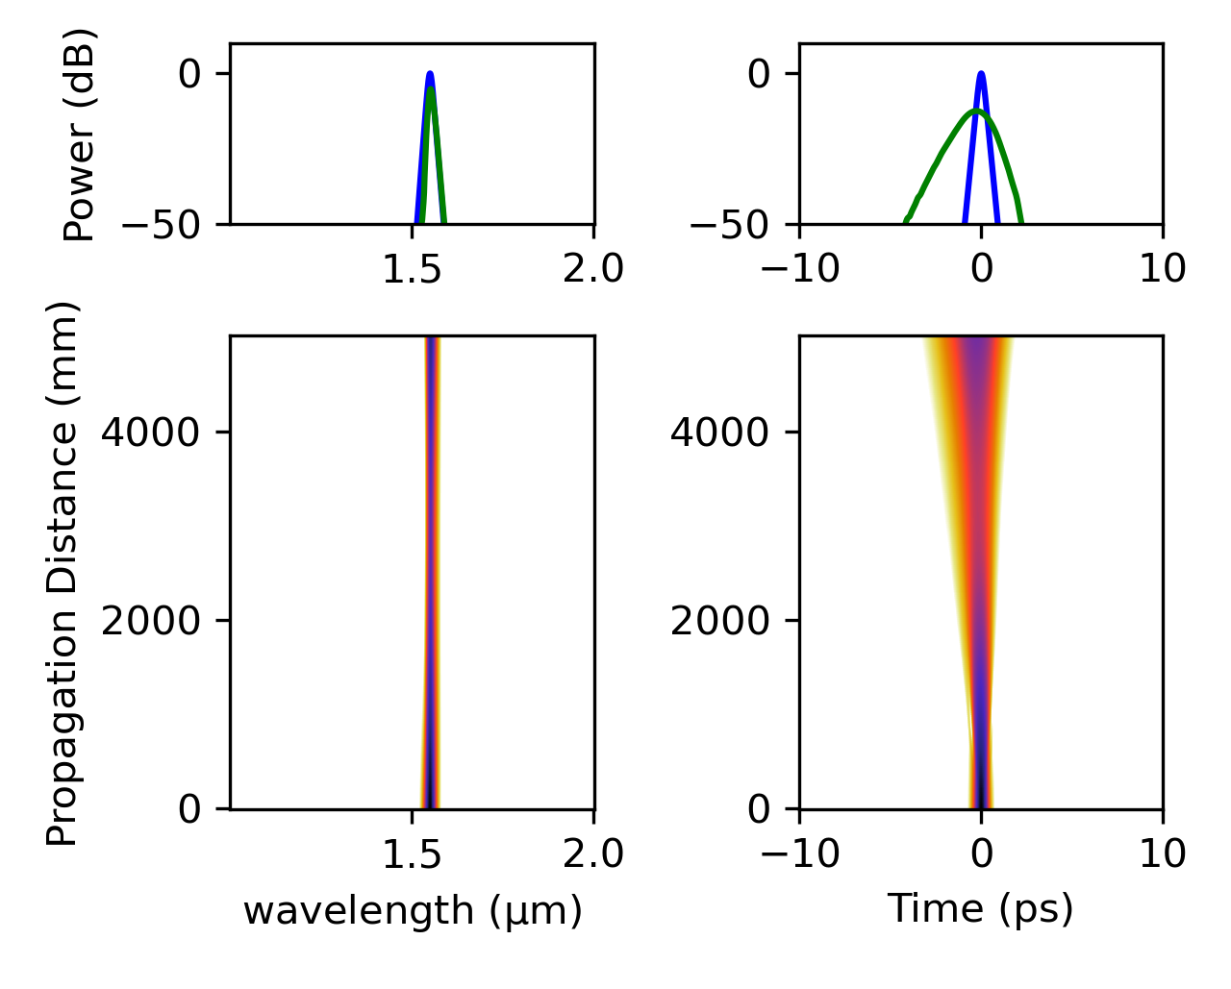
Backward Pumping

Slide 9
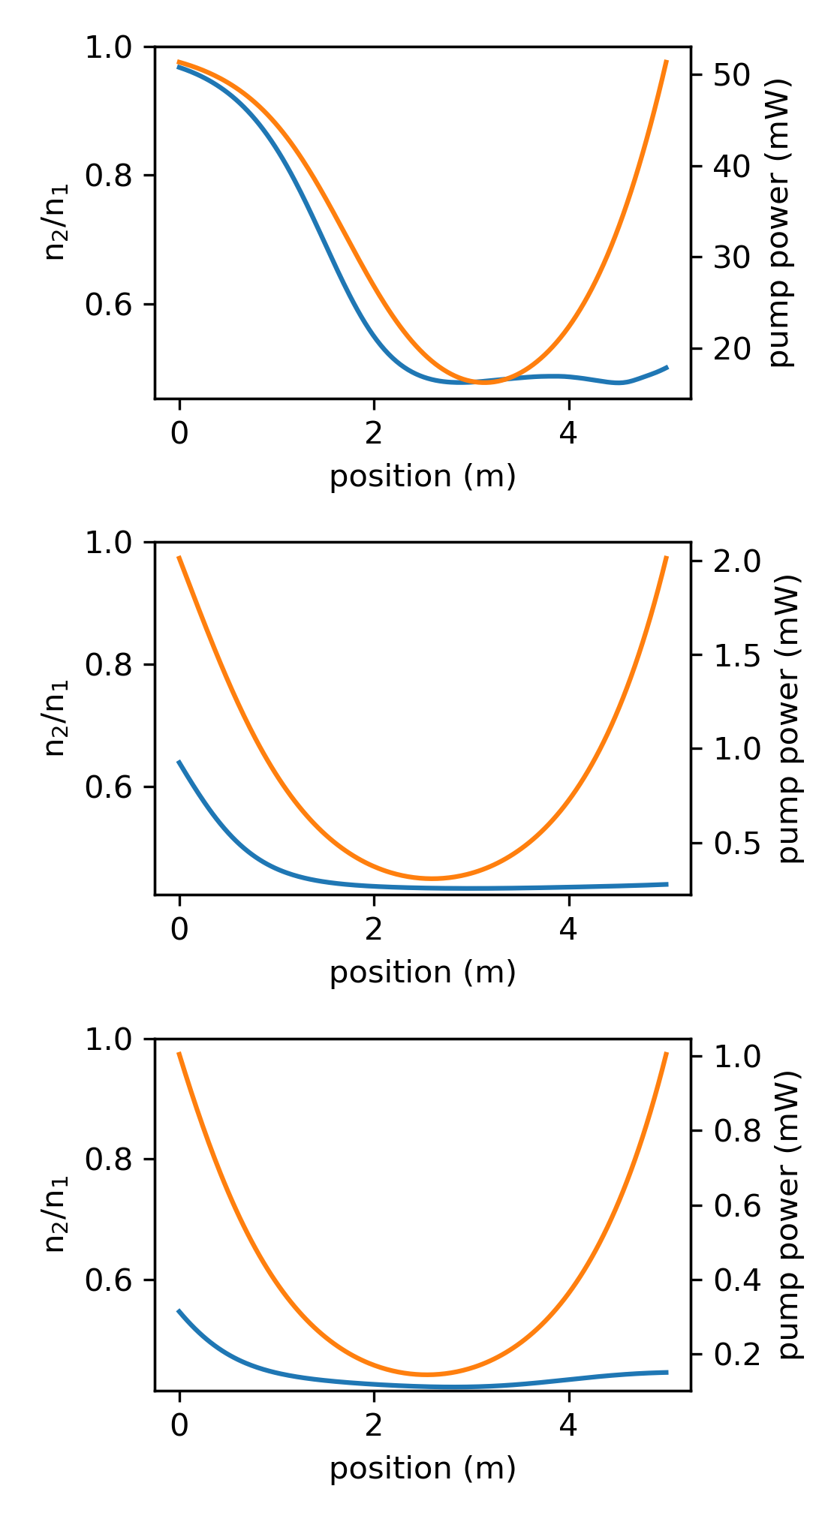
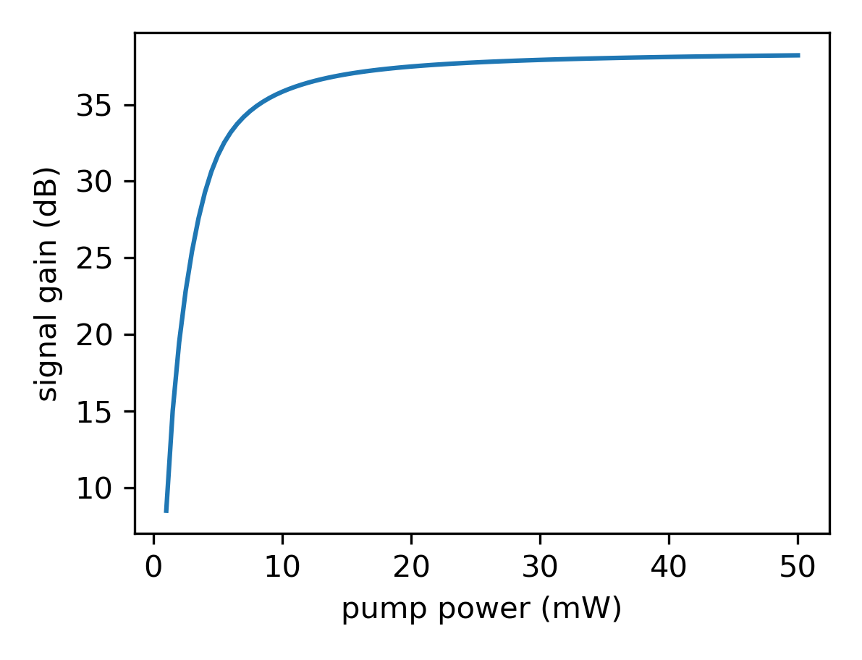
Fwd + Bckwd Pumping

Slide 10

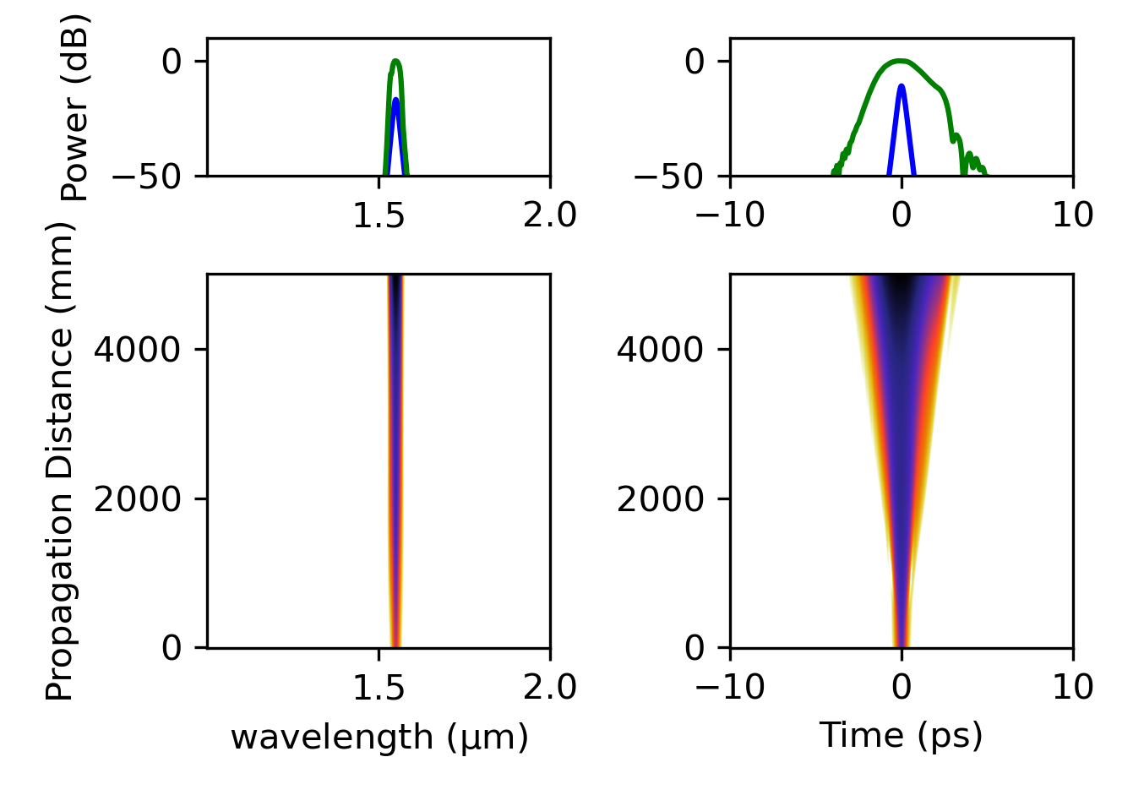
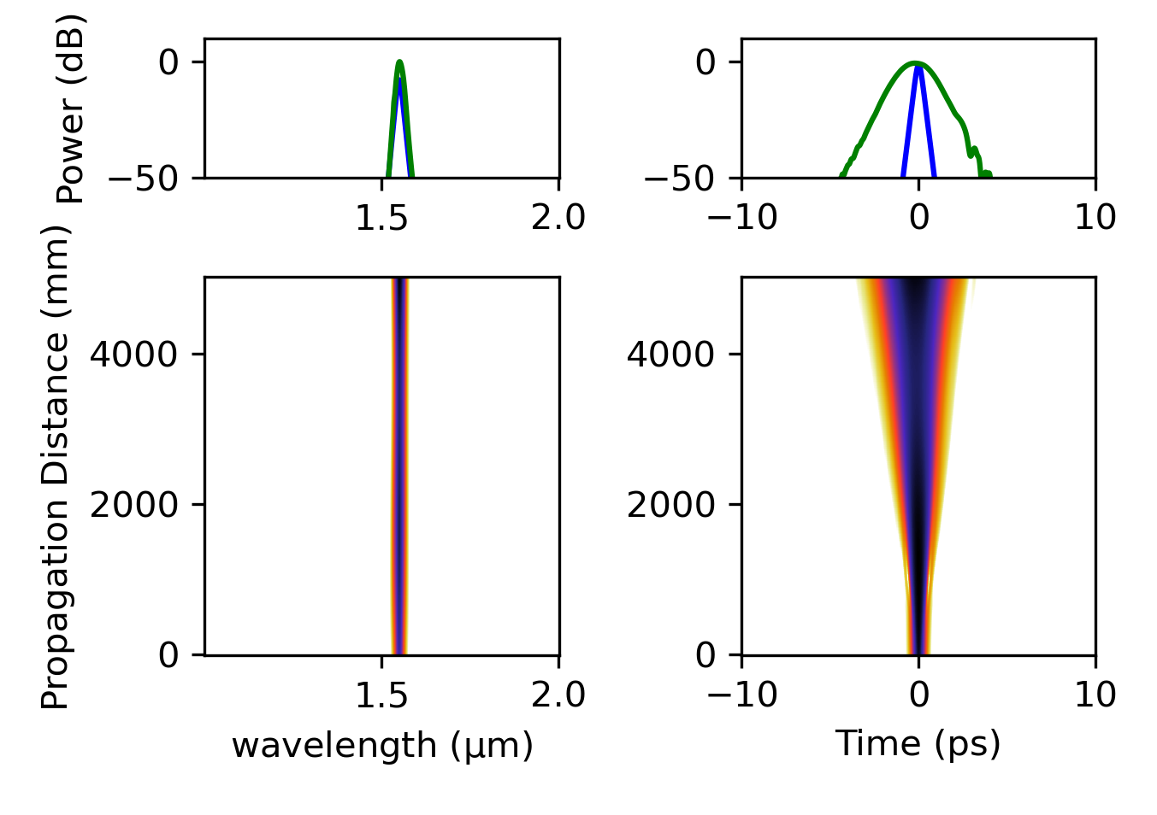
Fwd + Bckwd Pumping

Slide 11
Things to Note
The power curves more or less match what Ansys provides, so nothing alarming there
However, the results are unrealistic: Watt output with <100 mW pump. I hope it’s fixed by using “correct” fiber parameters (Nlight’s instead of Ansys default example EDF parameters)
I did not include ASE
My understanding is that ASE is basically a rise of the PSD between all the comb-lines, so if ASE is a dominant power contribution that would be bad. But I don’t know if the purpose of the simulation is to address / diagnose that kind of situation?
Did not include counter-propagating pulses, that is the next step.

