Slide 1
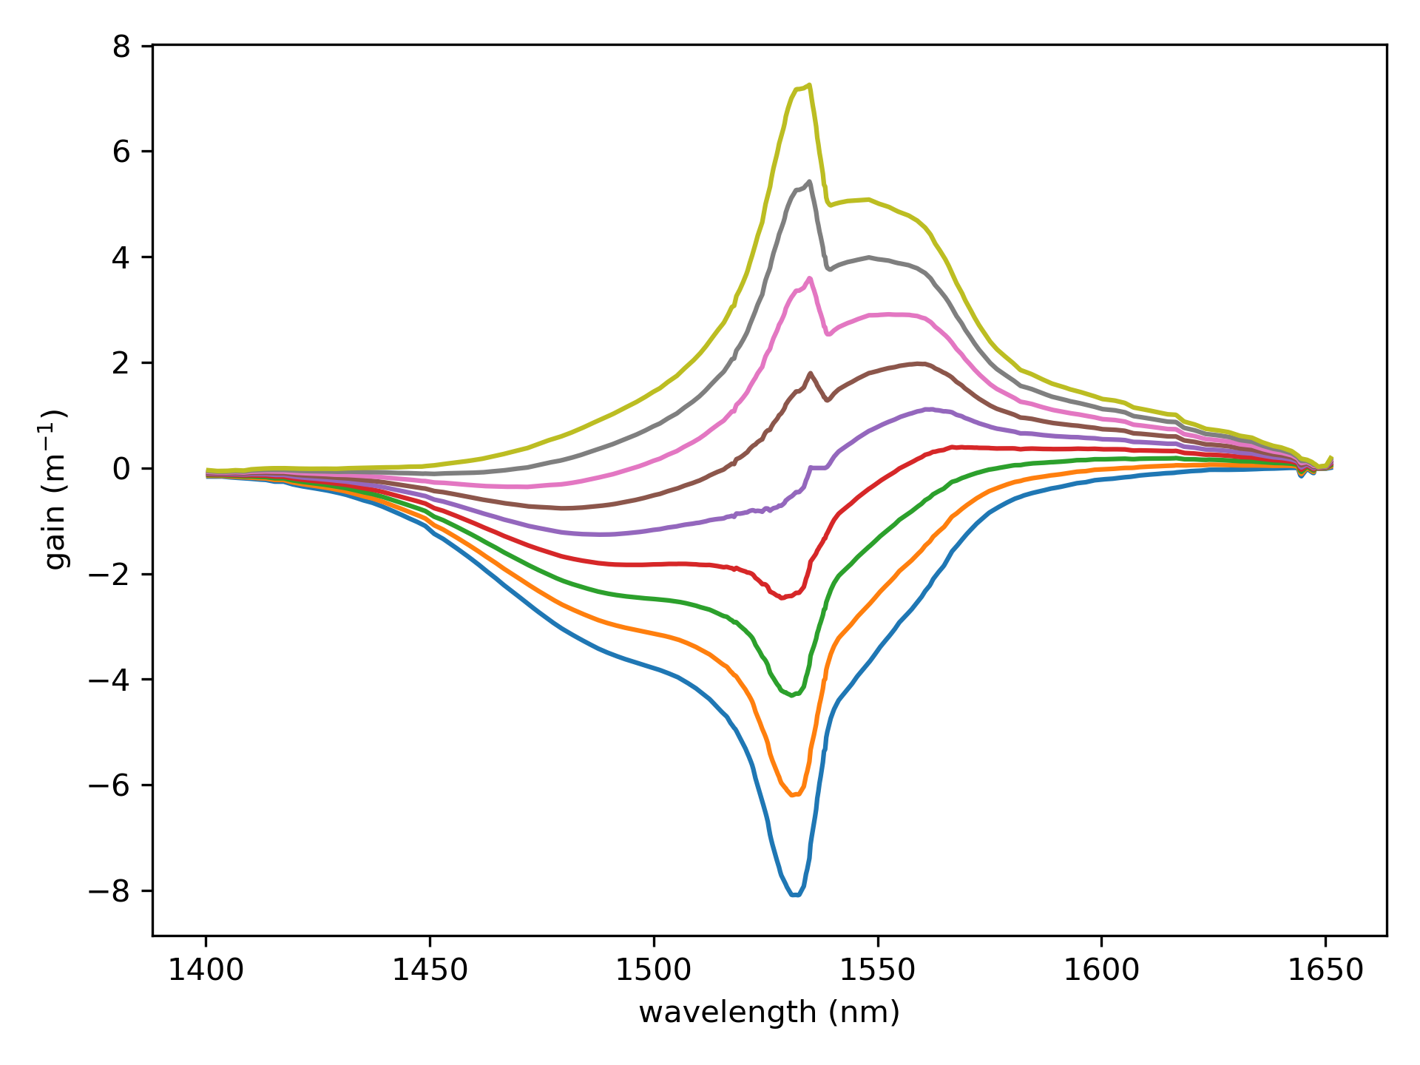
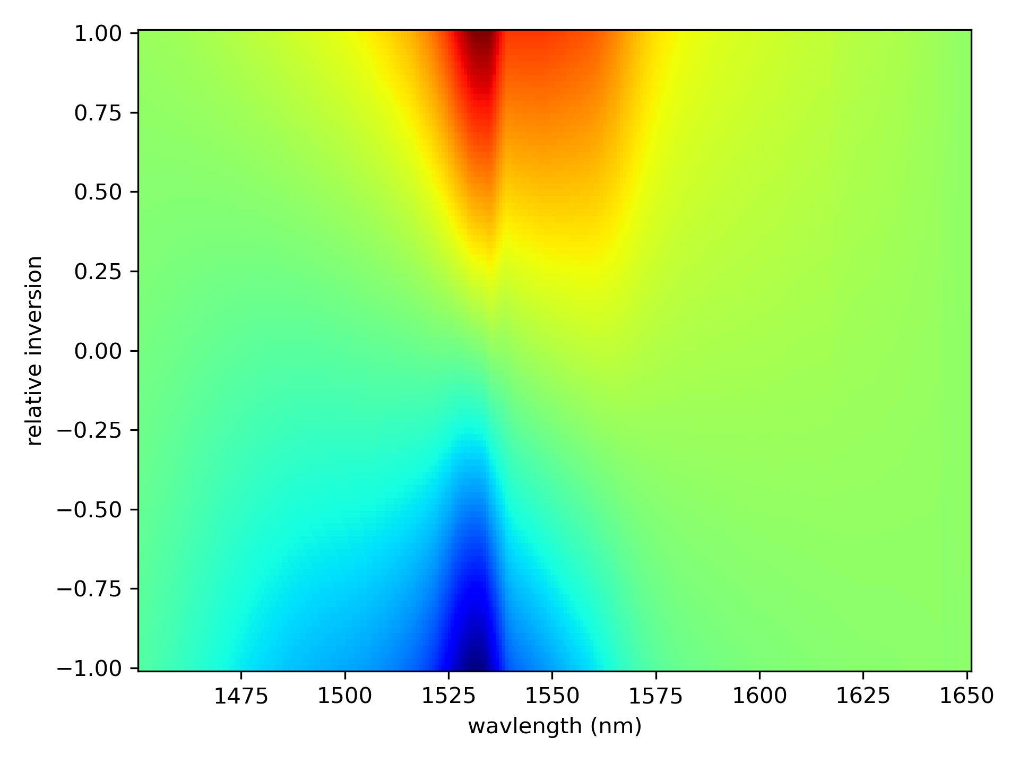
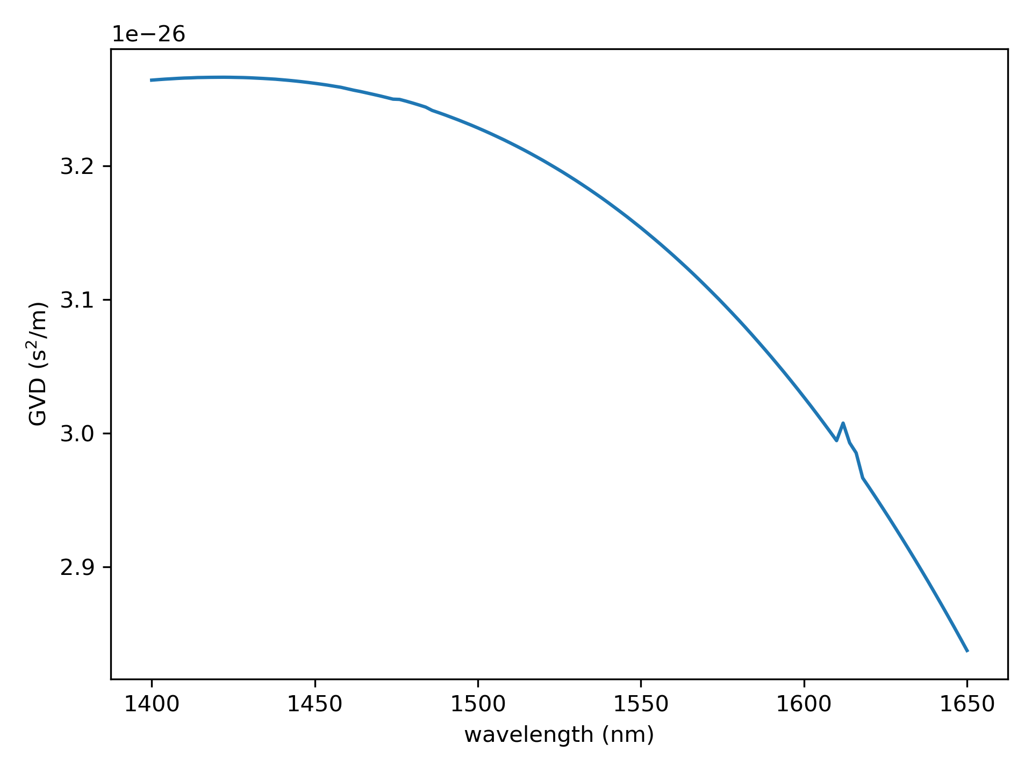


Input Parameters
$$g∝σ_{e}\left(1+D\right)−σ_{a}(1−D)$$
GVD for ER 110 4/125
where
$$−1< D=N_{2}−N_{1}<1$$

Slide 2
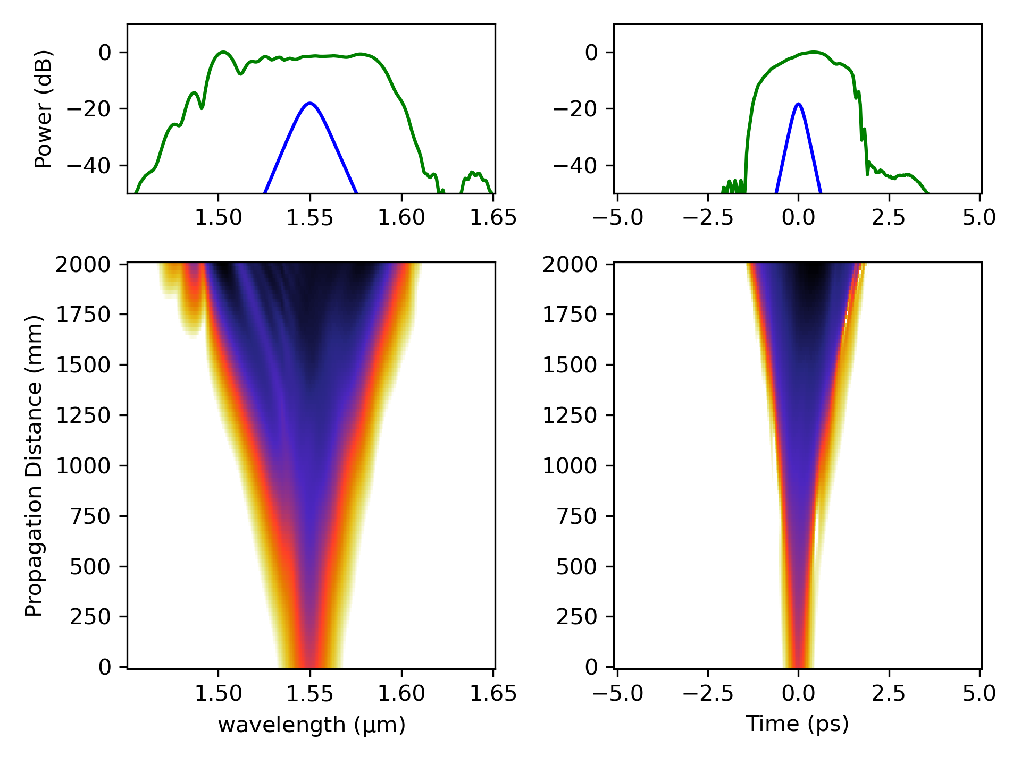
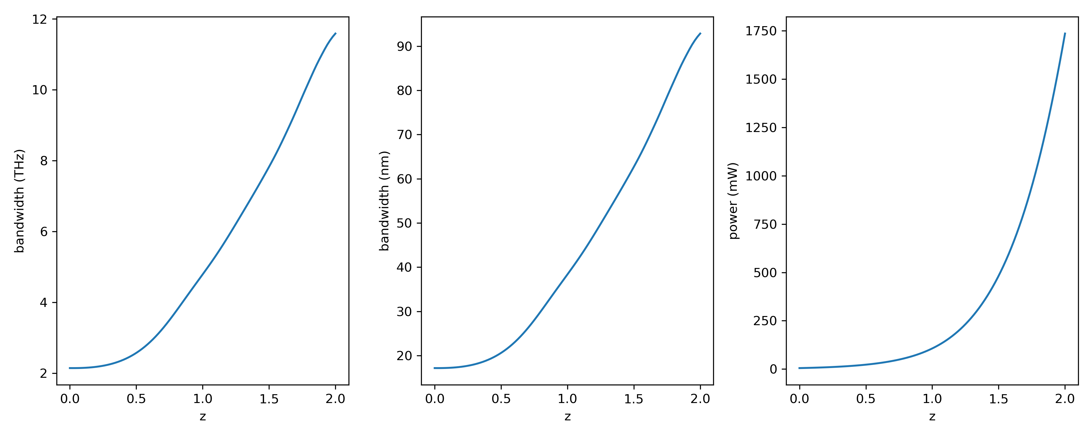

Simulation for no change in gain along $z$
Using a peak gain of 5 / m
No pump decay or gain saturation leads to very high power

