Slide 1
2 Level rate equations

Slide 2
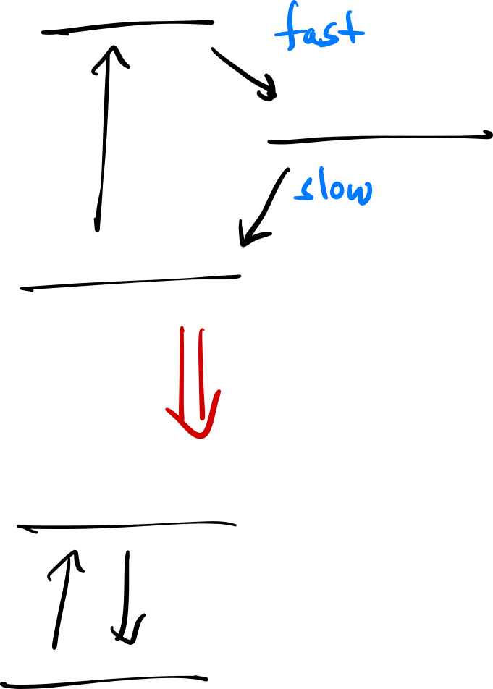



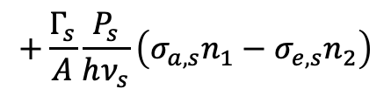
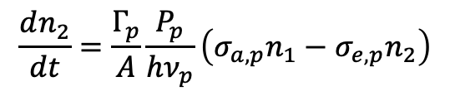
Modeling an EDFA
$$τ_{p}≪τ_{metastable}$$
Assume pump transition undergoes non-radiative decay immediately to the metastable state → can model as a two-level system:
$$\frac{dn_{2}}{dt}=\frac{Γ_{p}}{A}\frac{P_{p}}{hν_{p}}\left(σ_{a,p}n_{1}−σ_{e,p}n_{2}\right)$$
$$+\frac{Γ_{s}}{A}\frac{P_{s}}{hν_{s}}\left(σ_{a,s}n_{1}−σ_{e,s}n_{2}\right)$$
$$−\frac{n_{2}}{τ}$$
If the $\frac{1}{f_{r}}≫τ$ → $n_{2}$ will reach steady state!

Slide 3
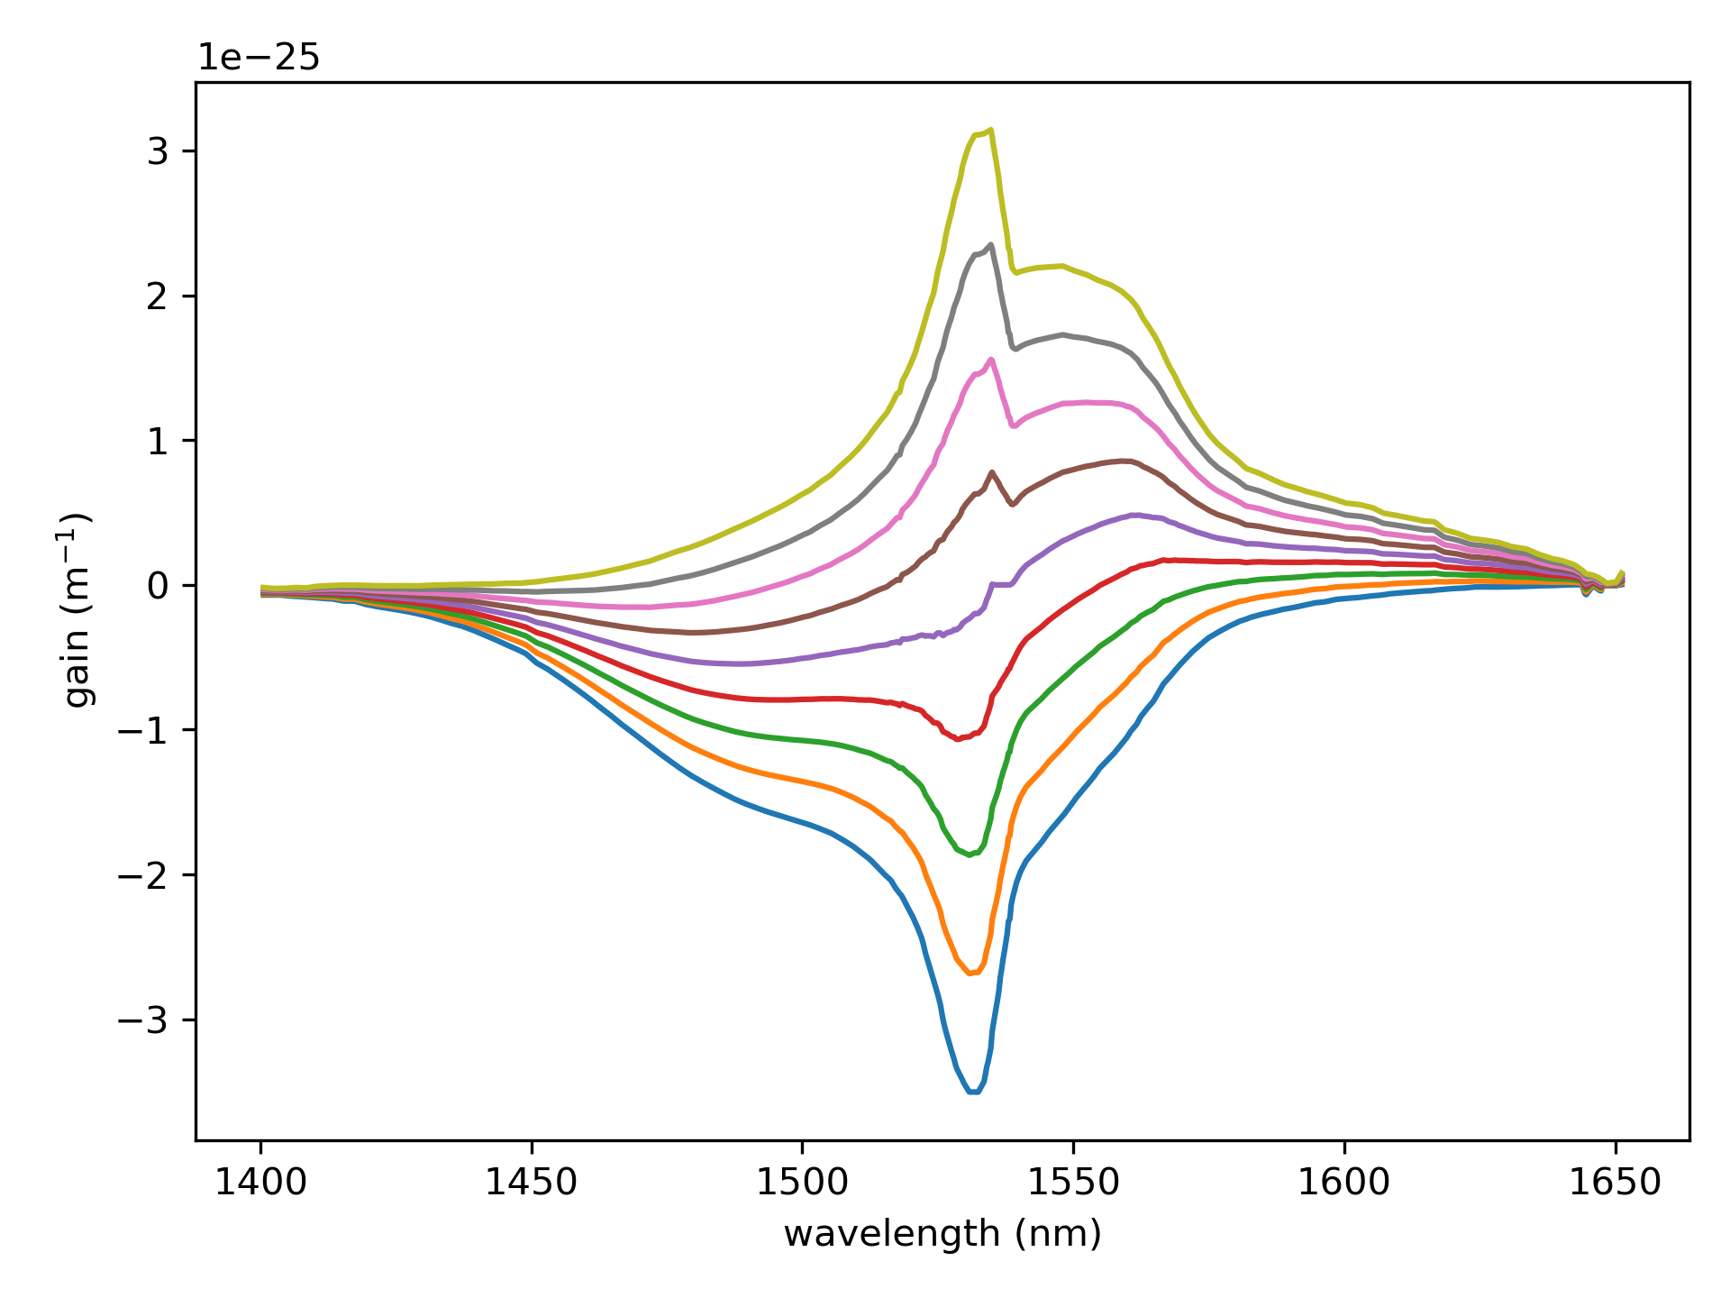
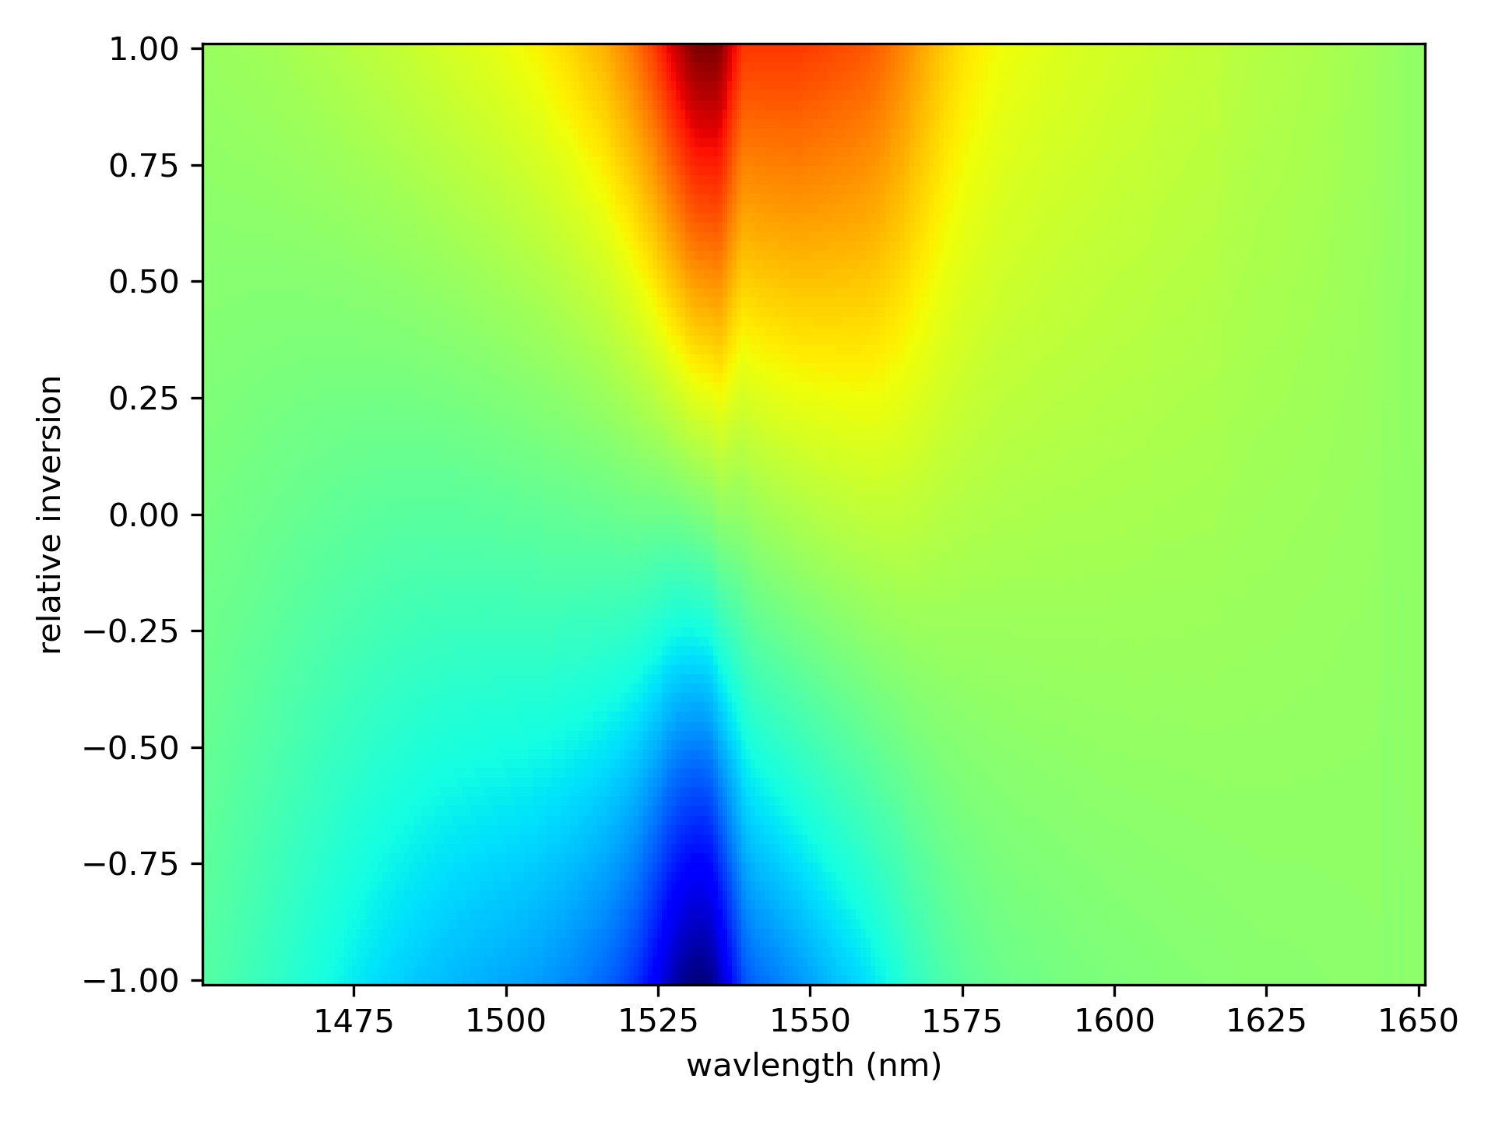



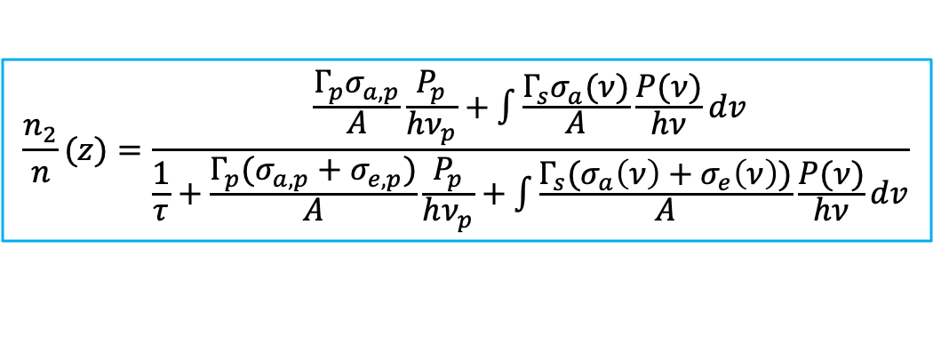
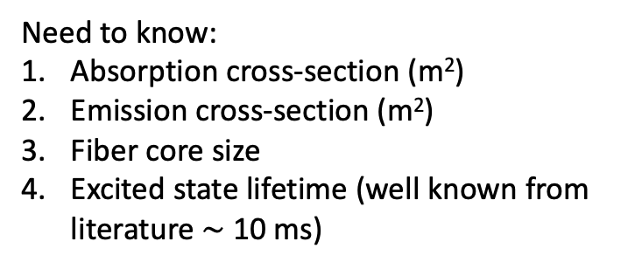

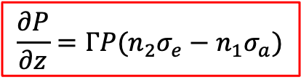


Rate Equations
Steady state
Need to know:
Absorption cross-section (m²)
Emission cross-section (m²)
Fiber core size
Excited state lifetime (well known from literature $\sim$ 10 ms)
$$\frac{n_{2}}{n}(z)=\frac{\frac{Γ_{p}σ_{a,p}}{A}\frac{P_{p}}{hν_{p}}+\int{\frac{Γ_{s}σ_{a}(ν)}{A}\frac{P(ν)}{hν}dv}}{\frac{1}{τ}+\frac{Γ_{p}(σ_{a,p}+σ_{e,p})}{A}\frac{P_{p}}{hν_{p}}+\int{\frac{Γ_{s}(σ_{a}\left(ν\right)+σ_{e}\left(ν\right))}{A}\frac{P(ν)}{hν}dv}}$$
$$\frac{∂P}{∂z}=ΓP(n_{2}σ_{e}−n_{1}σ_{a})$$
$e^{−Γσnz}$ = small signal absorption $→$ $n$ is known
where:
$$n_{2}=\left(\frac{n_{2}}{n}\right)n$$
$$n_{1}=n−n_{2}$$
cross-sections:
The gain coefficient is:
$$σ_{e}$$
$$g\left(ν,z\right)=Γ_{s}(σ_{e}\left(ν\right)n_{2}\left(z\right)−σ_{a}\left(ν\right)n_{1}\left(z\right))$$
$$σ_{a}$$

Slide 4
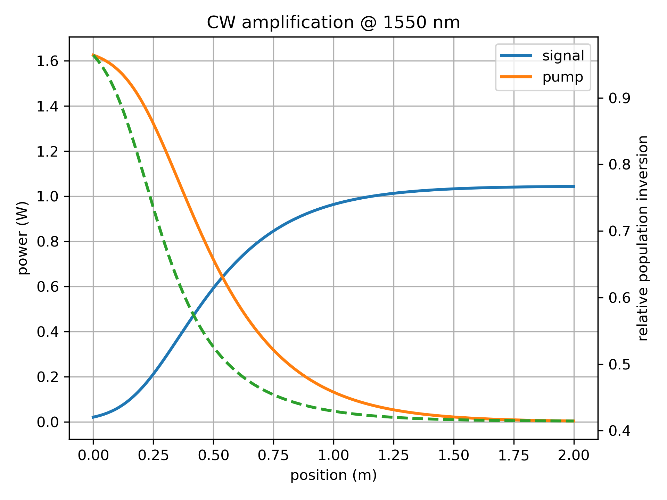
2W pump, 2 m of ER 80
Unphysically high conversion efficiency!
Used: 0.7 dB insertion loss, 0.2 dB splicing loss
Since seed power is quite high, this likely isn’t due to unaccounted ASE?
So, the next step to try is to account for excited state absorption, since green fluorescence is always observed.

Slide 5
Accounting for excited state absorption

Slide 6
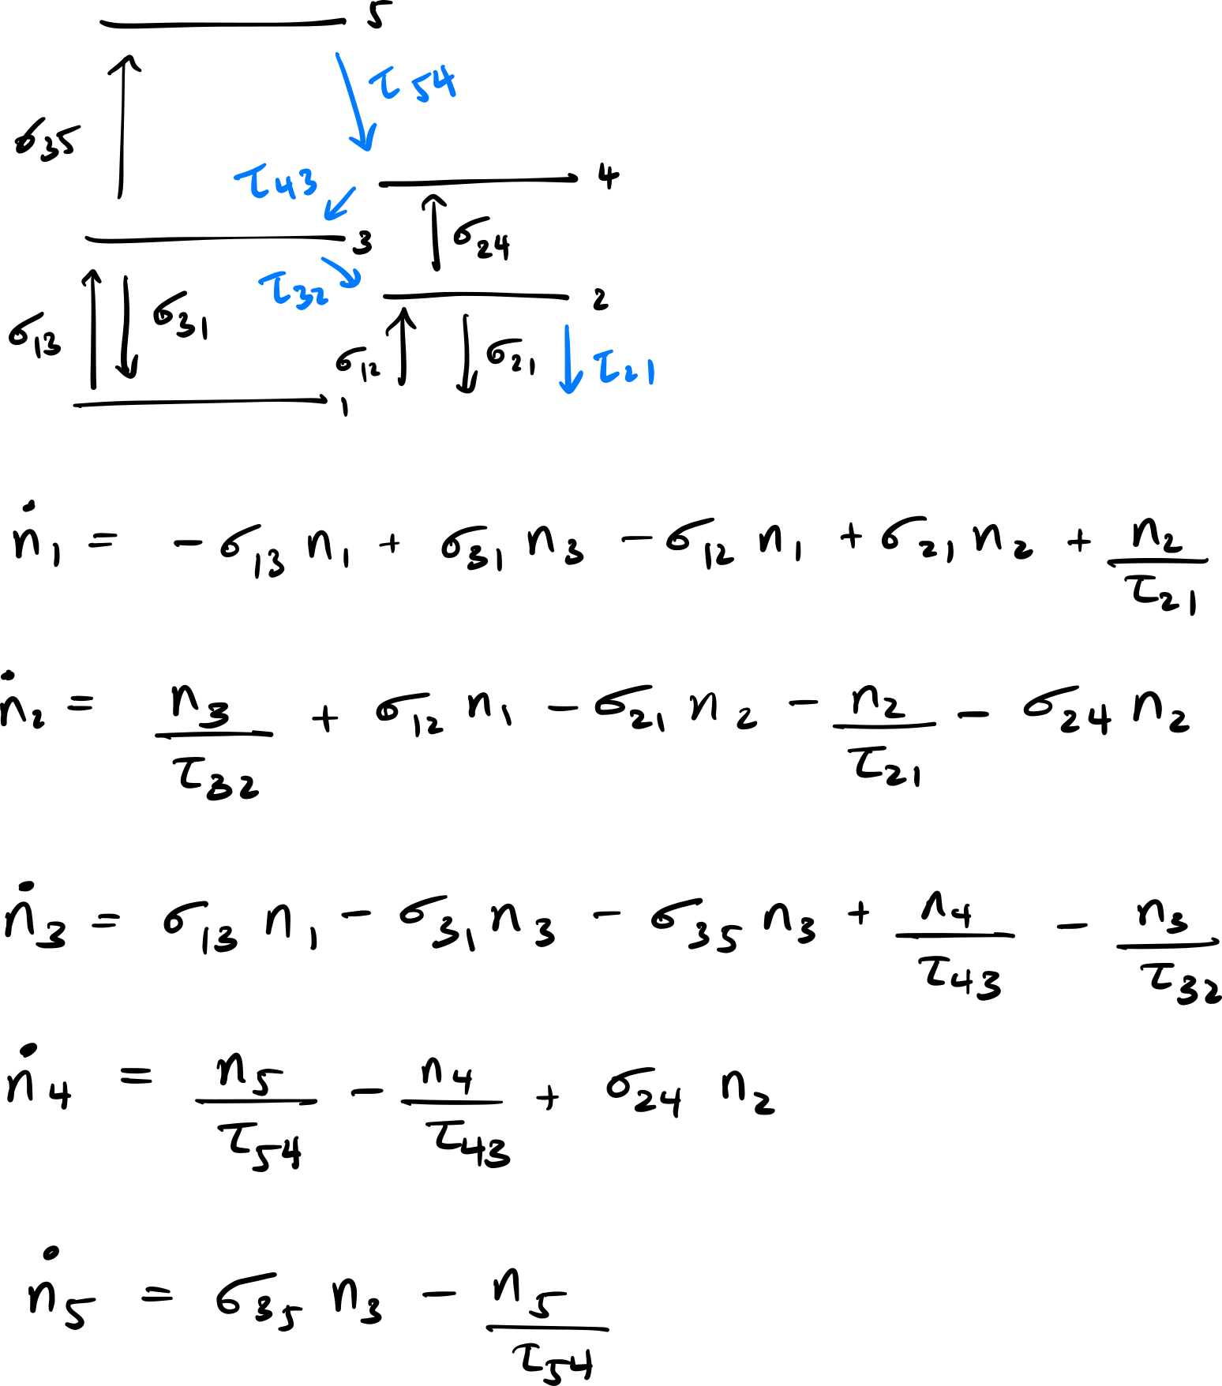

ESA for both pump and signal $→$ 5-levels
You need to include lifetimes to “close” the circuit if you want to apply steady state (i.e. electron number needs to be conserved)
You can isolate population to the laser excited state (2), pump level (3), and pump excited state (5) which is responsible for the green fluorescence.
Done by making the lifetime of (4) much smaller than the others (e.g. ns)
Solve for n₁ n₂ n₃ n₄ n₅ in terms of n_{tot} = n₁ + n₂ + n₃ + n₄ + n₅
Yu. O. Barmenkov, et al., Journal of Applied Physics 106, 083108 (2009).

Slide 7
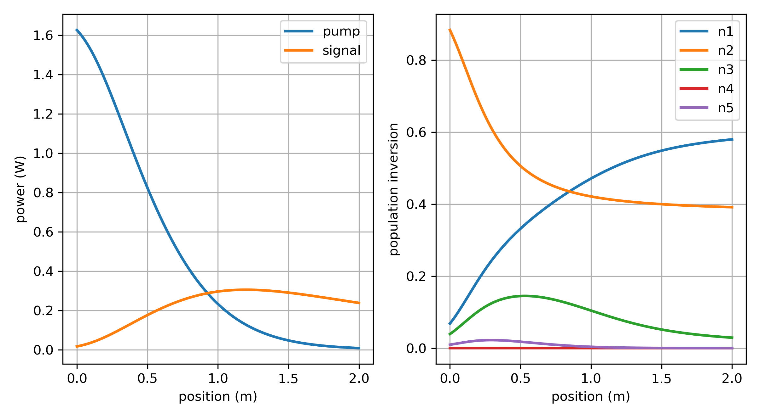
2W pump, 2 m of ER 80
More realistic power evolution!
Used: 0.7 dB insertion loss, 0.2 dB splicing loss

Slide 8
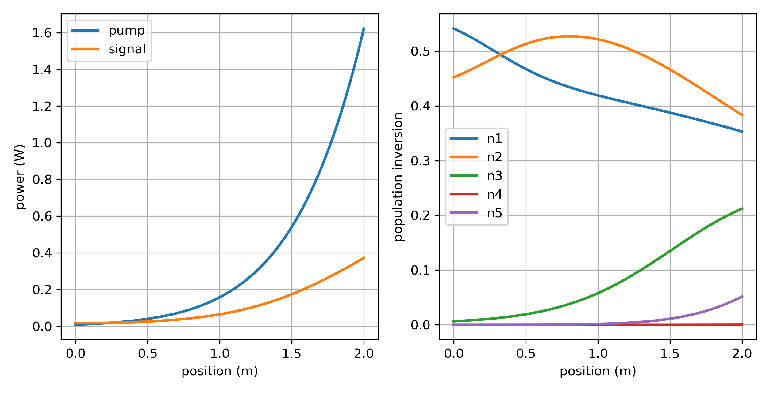
2W pump, 2 m of ER 80
Backward pumping also matches experiment okay.
Calculated using shooting method
Used: 0.7 dB insertion loss, 0.2 dB splicing loss

Slide 9
Figure 9 cavity

