Slide 1
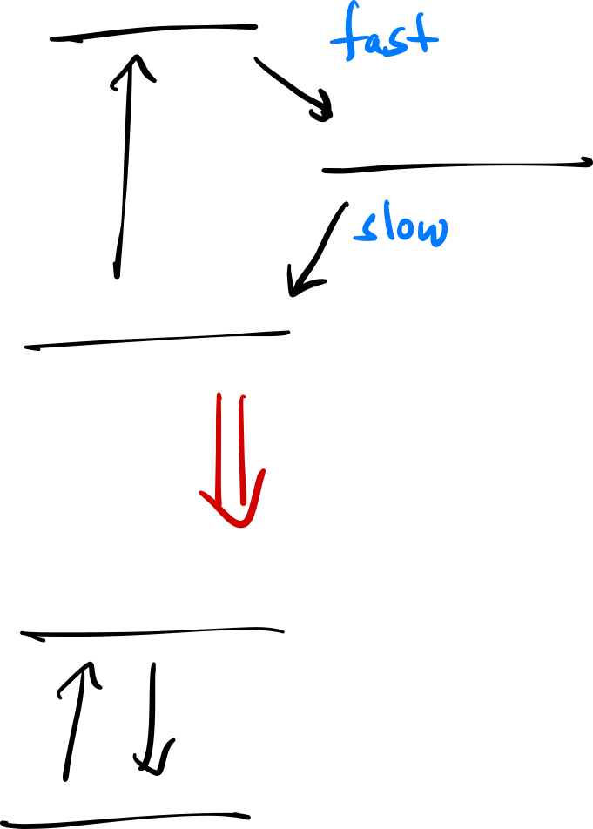



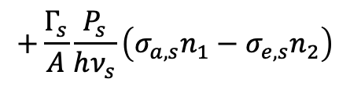
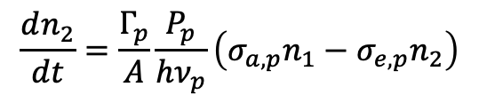
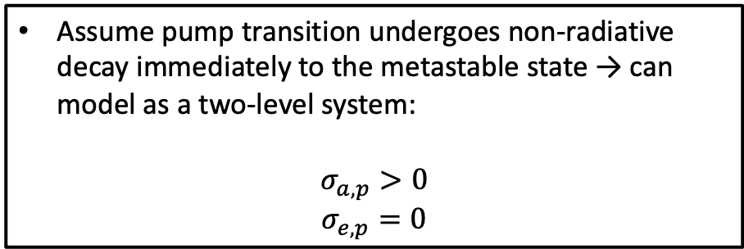
Modeling an EDFA
$$τ_{p}≪τ_{metastable}$$
Assume pump transition undergoes non-radiative decay immediately to the metastable state → can model as a two-level system:
$$σ_{a, p}>0$$
$$σ_{e,p}=0$$
$$\frac{dn_{2}}{dt}=\frac{Γ_{p}}{A}\frac{P_{p}}{hν_{p}}\left(σ_{a,p}n_{1}−σ_{e,p}n_{2}\right)$$
$$+\frac{Γ_{s}}{A}\frac{P_{s}}{hν_{s}}\left(σ_{a,s}n_{1}−σ_{e,s}n_{2}\right)$$
$$−\frac{n_{2}}{τ}$$
If the $\frac{1}{f_{r}}≫τ$ → $n_{2}$ will reach steady state!

Slide 2
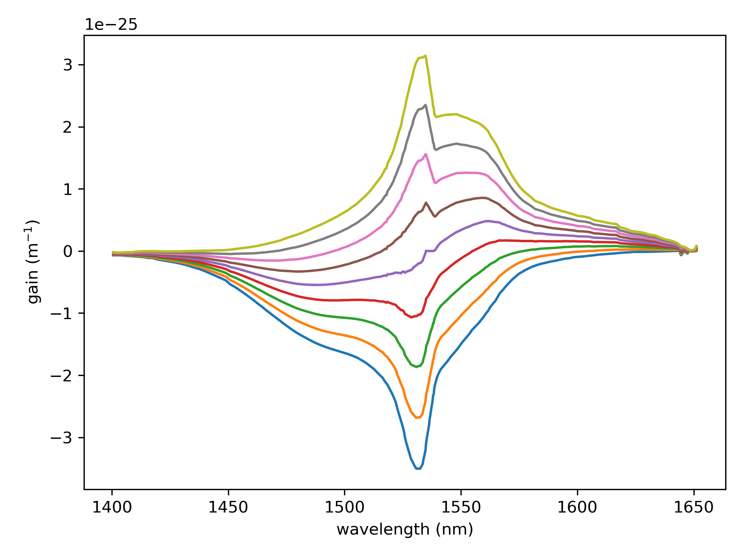
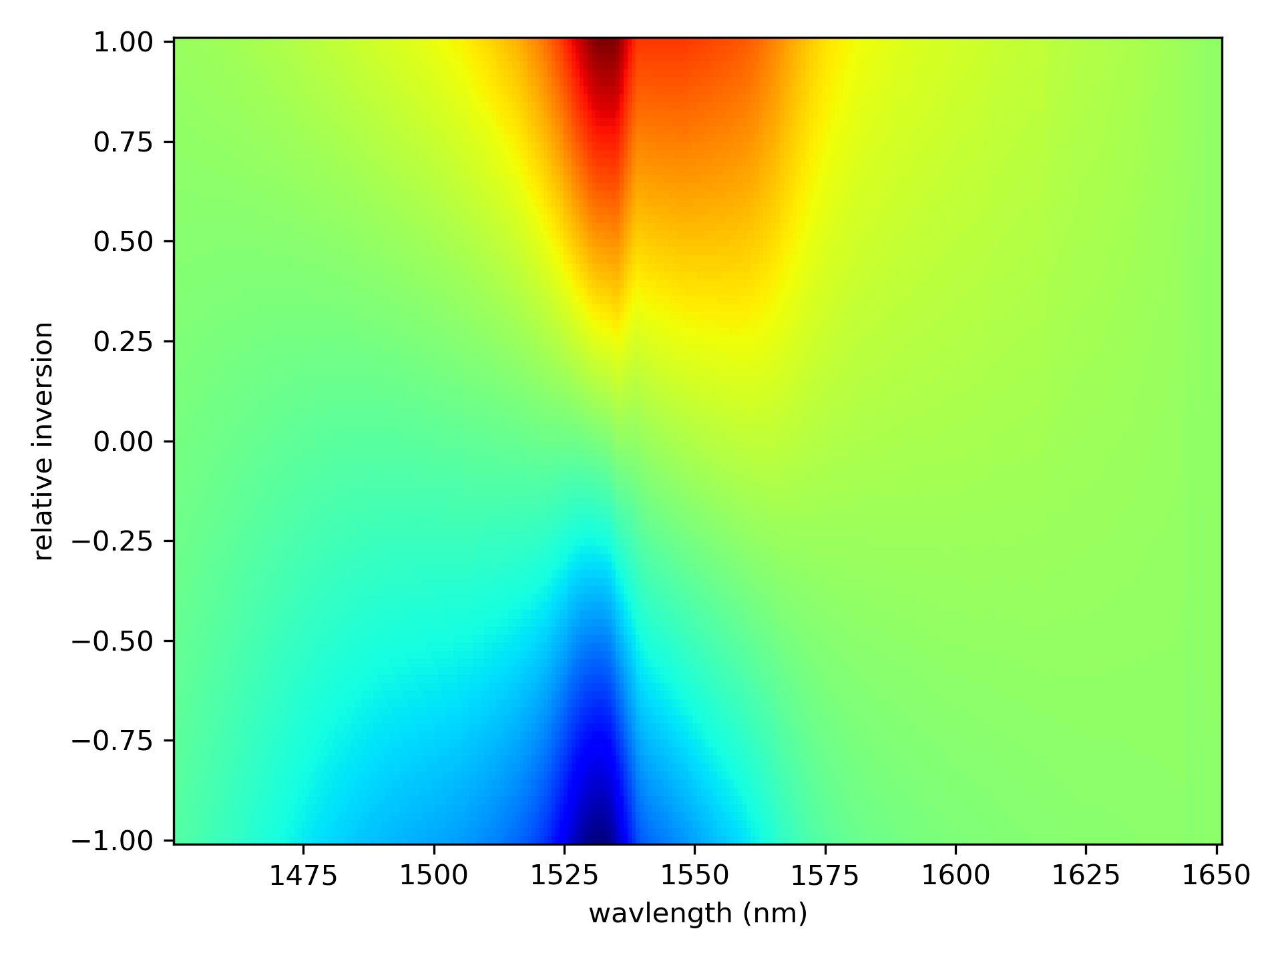


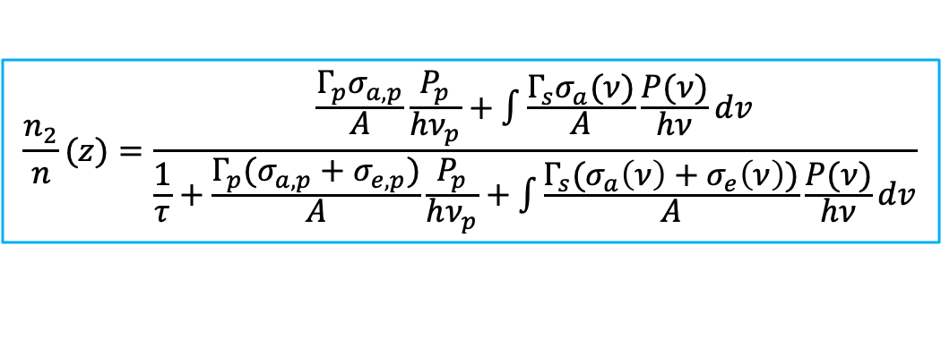
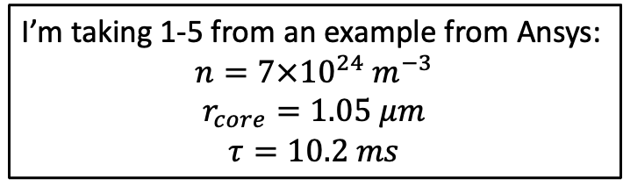

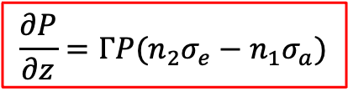


Rate Equations
Need to know:
Total doping concentration (ions / m³)
Absorption cross-section (m²)
Emission cross-section (m²)
Fiber core size
Excited state lifetime
Steady state
$$\frac{n_{2}}{n}(z)=\frac{\frac{Γ_{p}σ_{a,p}}{A}\frac{P_{p}}{hν_{p}}+\int{\frac{Γ_{s}σ_{a}(ν)}{A}\frac{P(ν)}{hν}dv}}{\frac{1}{τ}+\frac{Γ_{p}(σ_{a,p}+σ_{e,p})}{A}\frac{P_{p}}{hν_{p}}+\int{\frac{Γ_{s}(σ_{a}\left(ν\right)+σ_{e}\left(ν\right))}{A}\frac{P(ν)}{hν}dv}}$$
$$\frac{∂P}{∂z}=ΓP(n_{2}σ_{e}−n_{1}σ_{a})$$
I’m taking 1-5 from an example from Ansys:
$$n=7×{10}^{24} m^{−3}$$
$$r_{core}=1.05 μm$$
$$τ=10.2 ms$$
where:
$$n_{2}=\left(\frac{n_{2}}{n}\right)n$$
$$n_{1}=n−n_{2}$$
cross-sections:
The gain coefficient is:
$$σ_{e}$$
$$g\left(ν,z\right)=Γ_{s}(σ_{e}\left(ν\right)n_{2}\left(z\right)−σ_{a}\left(ν\right)n_{1}\left(z\right))$$
$$σ_{a}$$

Slide 3
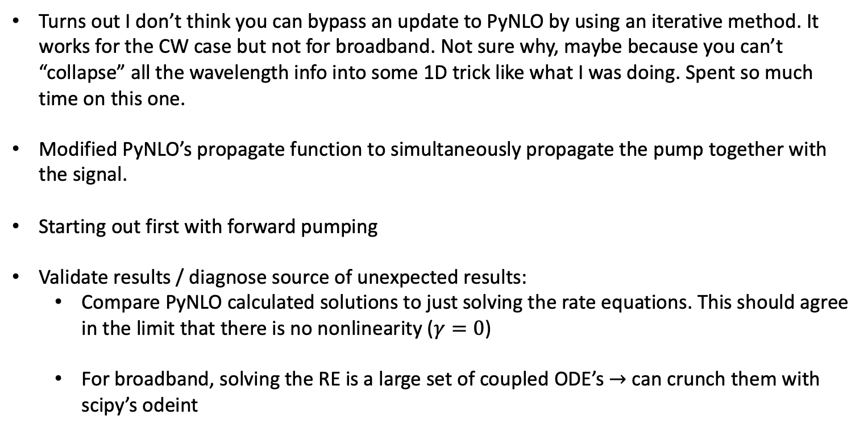
Diagnosing unphysical results
Turns out I don’t think you can bypass an update to PyNLO by using an iterative method. It works for the CW case but not for broadband. Not sure why, maybe because you can’t “collapse” all the wavelength info into some 1D trick like what I was doing. Spent so much time on this one.
Modified PyNLO’s propagate function to simultaneously propagate the pump together with the signal.
Starting out first with forward pumping
Validate results / diagnose source of unexpected results:
Compare PyNLO calculated solutions to just solving the rate equations. This should agree in the limit that there is no nonlinearity ($γ=0$)
For broadband, solving the RE is a large set of coupled ODE’s $→$ can crunch them with scipy’s odeint

Slide 4
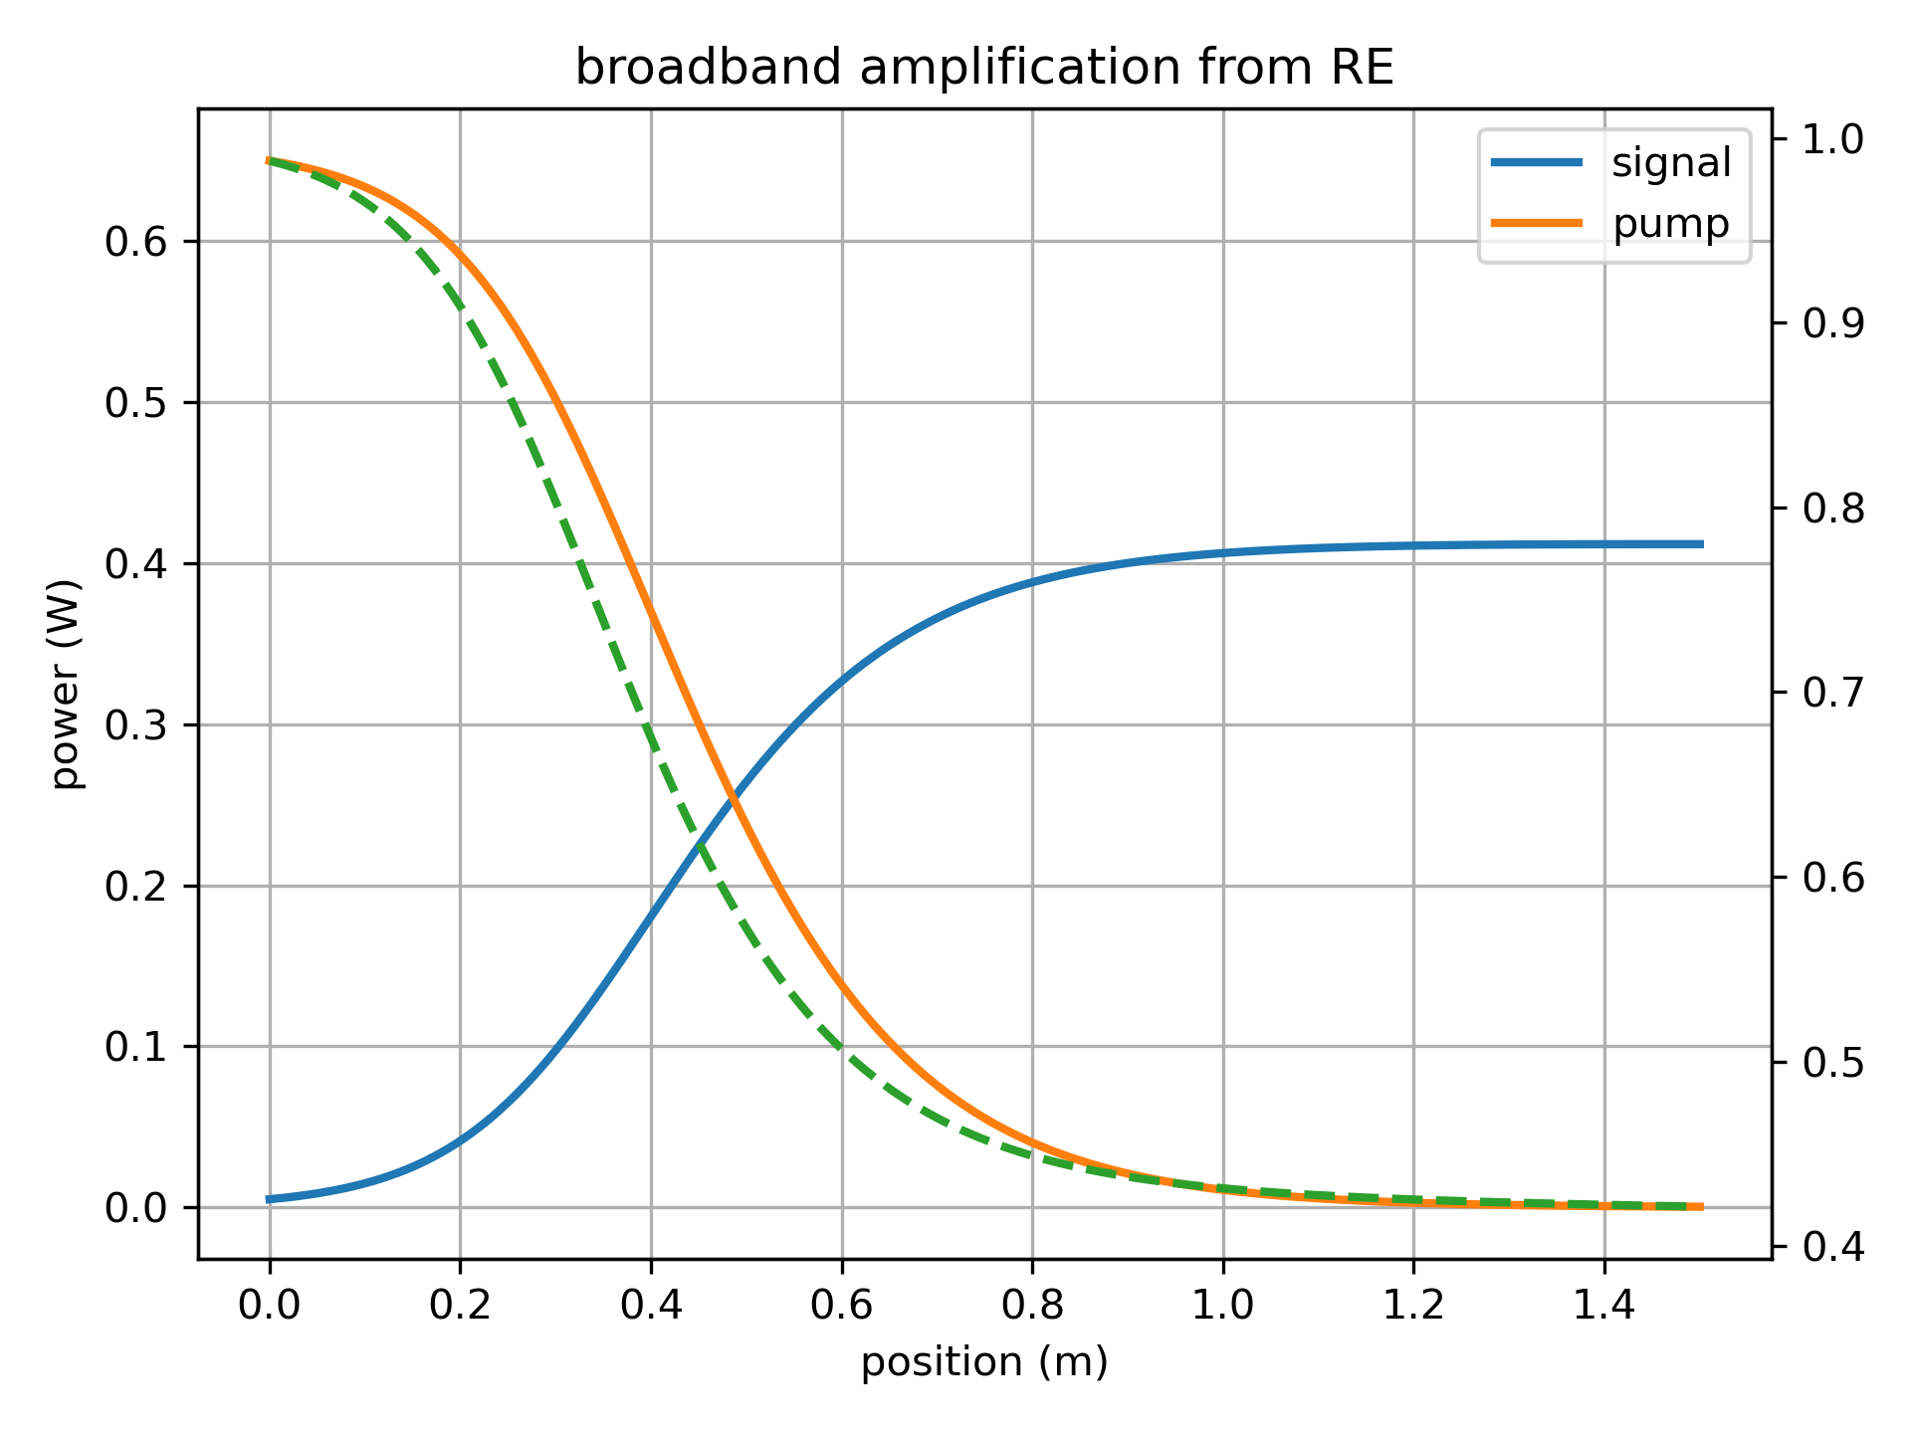
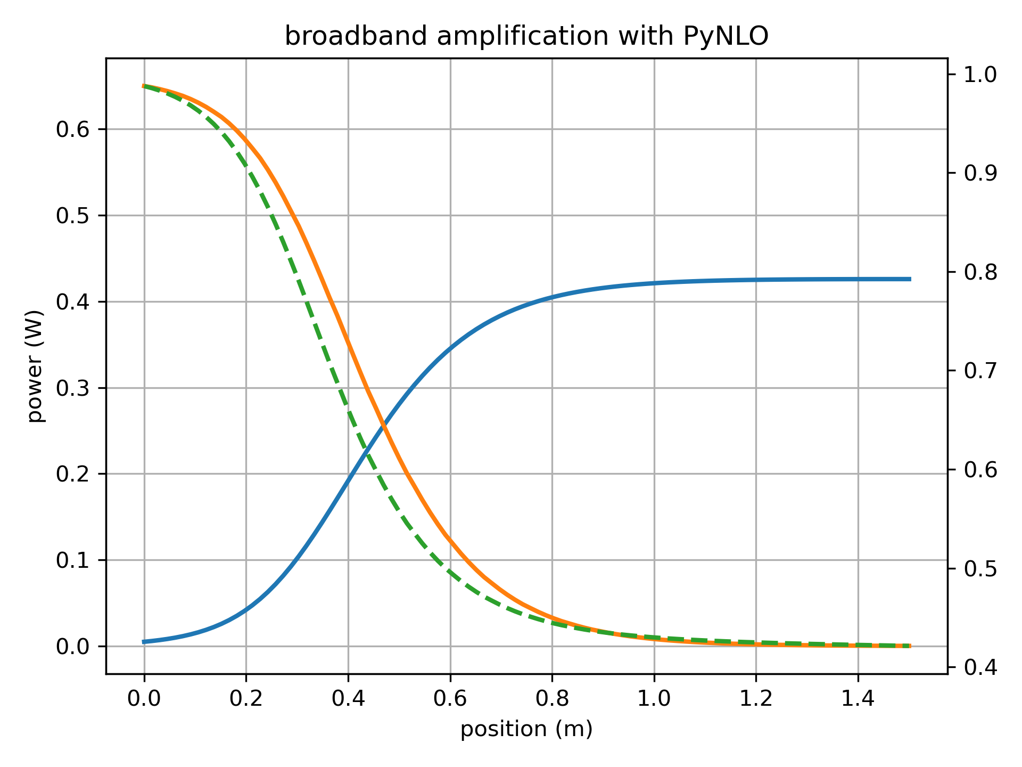
650 mW pump, 1.5 m of ER 80

