Slide 1
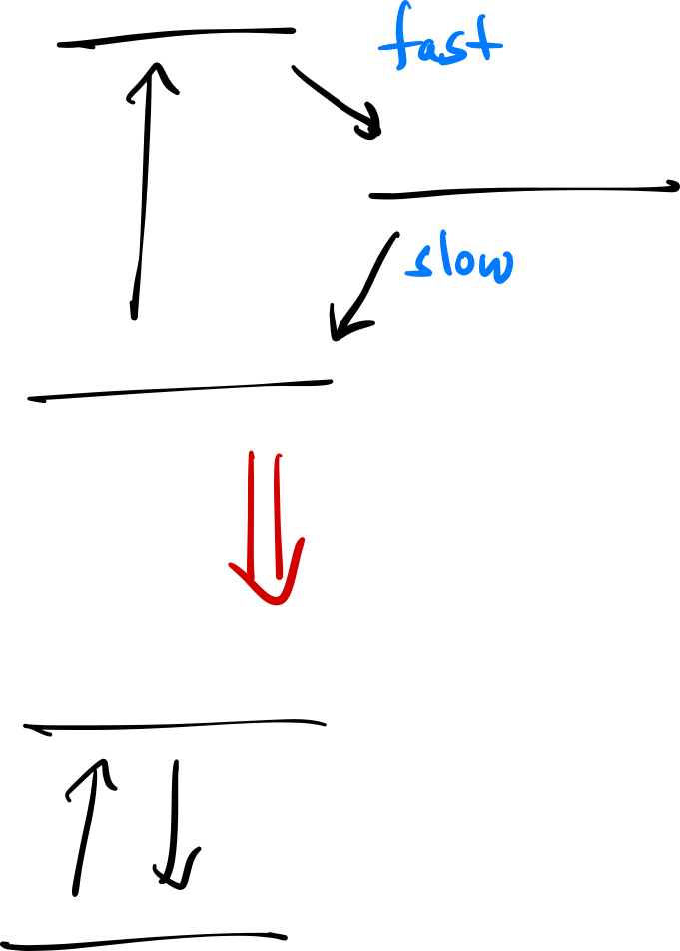



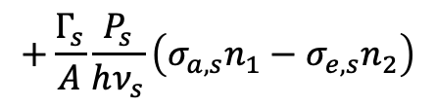
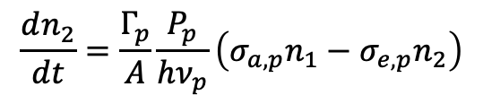
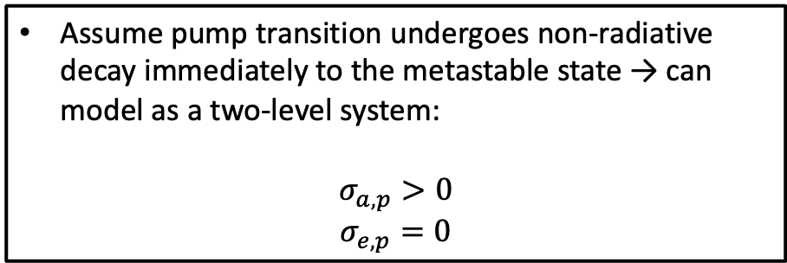
Modeling an EDFA
$$τ_{p}≪τ_{metastable}$$
Assume pump transition undergoes non-radiative decay immediately to the metastable state → can model as a two-level system:
$$σ_{a, p}>0$$
$$σ_{e,p}=0$$
$$\frac{dn_{2}}{dt}=\frac{Γ_{p}}{A}\frac{P_{p}}{hν_{p}}\left(σ_{a,p}n_{1}−σ_{e,p}n_{2}\right)$$
$$+\frac{Γ_{s}}{A}\frac{P_{s}}{hν_{s}}\left(σ_{a,s}n_{1}−σ_{e,s}n_{2}\right)$$
$$−\frac{n_{2}}{τ}$$
If the $\frac{1}{f_{r}}≫τ$ → $n_{2}$ will reach steady state!

Slide 2
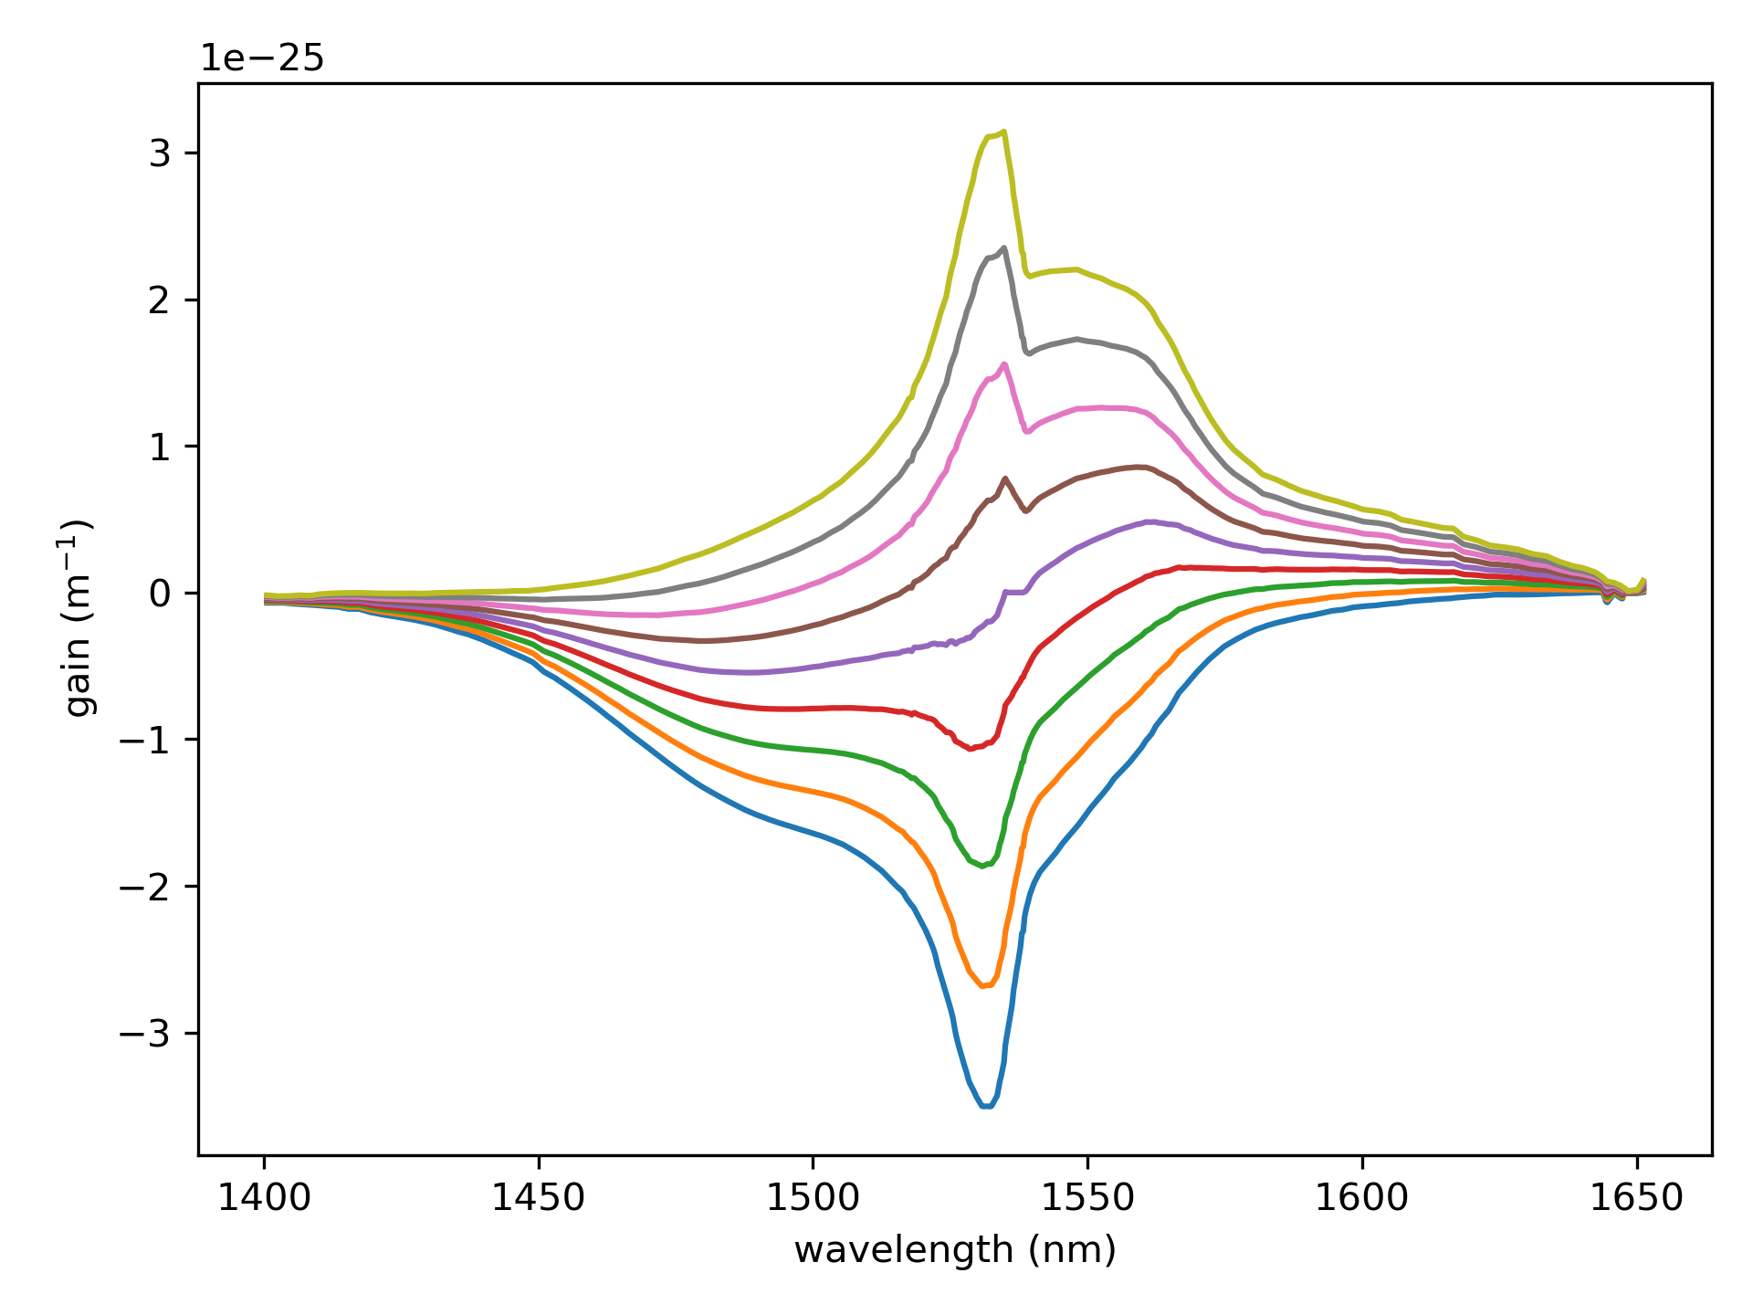
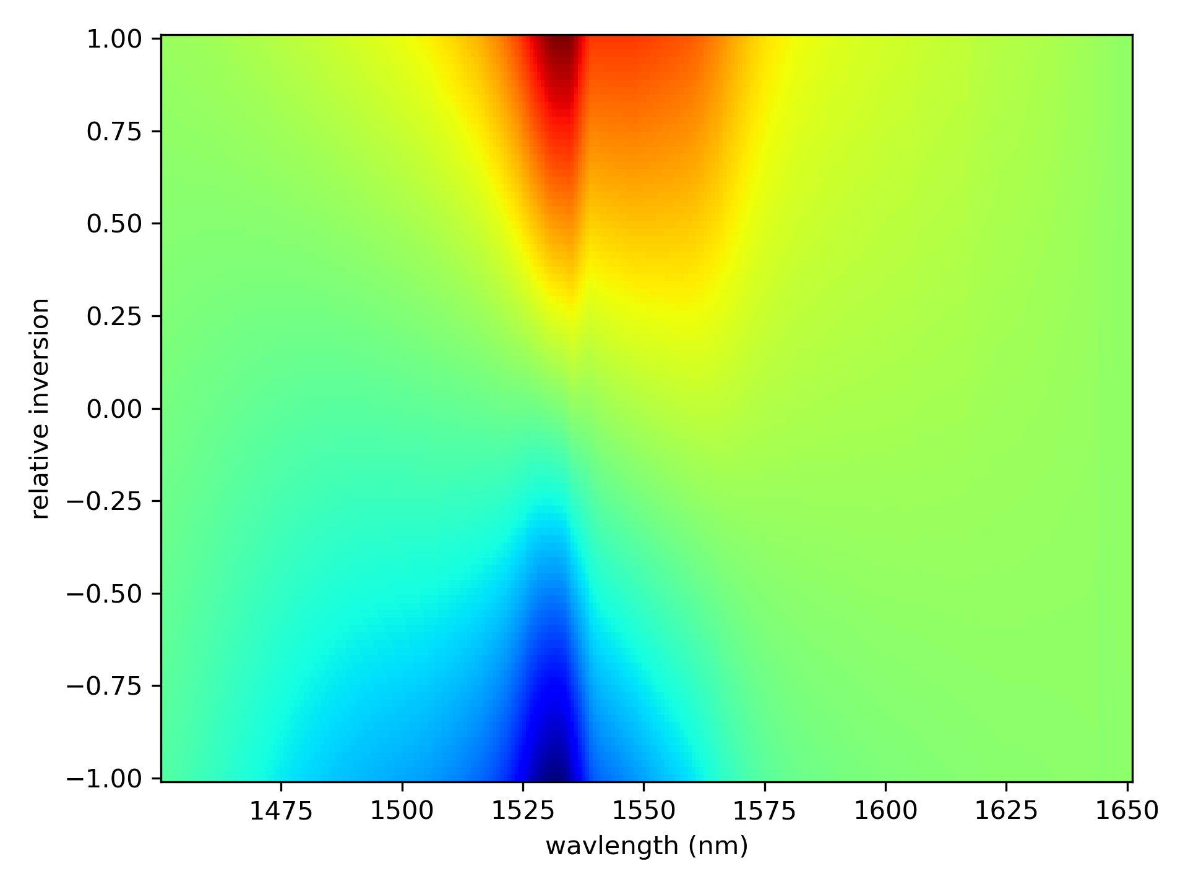



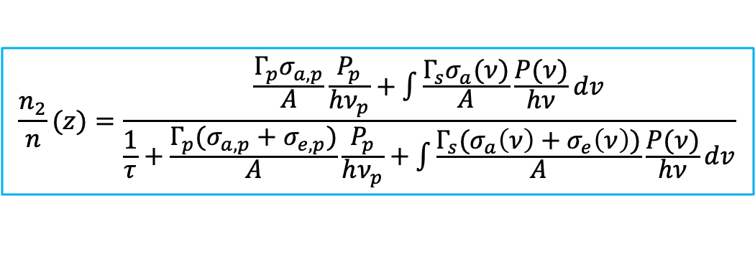

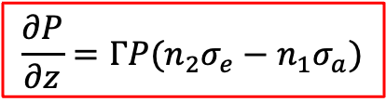


Rate Equations
Steady state
$$\frac{n_{2}}{n}(z)=\frac{\frac{Γ_{p}σ_{a,p}}{A}\frac{P_{p}}{hν_{p}}+\int{\frac{Γ_{s}σ_{a}(ν)}{A}\frac{P(ν)}{hν}dv}}{\frac{1}{τ}+\frac{Γ_{p}(σ_{a,p}+σ_{e,p})}{A}\frac{P_{p}}{hν_{p}}+\int{\frac{Γ_{s}(σ_{a}\left(ν\right)+σ_{e}\left(ν\right))}{A}\frac{P(ν)}{hν}dv}}$$
Need to know:
Absorption cross-section (m²)
Emission cross-section (m²)
Fiber core size
Excited state lifetime
$$\frac{∂P}{∂z}=ΓP(n_{2}σ_{e}−n_{1}σ_{a})$$
$e^{−Γσnz}$ = small signal absorption $→$ $n$ is known
where:
$$n_{2}=\left(\frac{n_{2}}{n}\right)n$$
$$n_{1}=n−n_{2}$$
cross-sections:
The gain coefficient is:
$$σ_{e}$$
$$g\left(ν,z\right)=Γ_{s}(σ_{e}\left(ν\right)n_{2}\left(z\right)−σ_{a}\left(ν\right)n_{1}\left(z\right))$$
$$σ_{a}$$

Slide 3
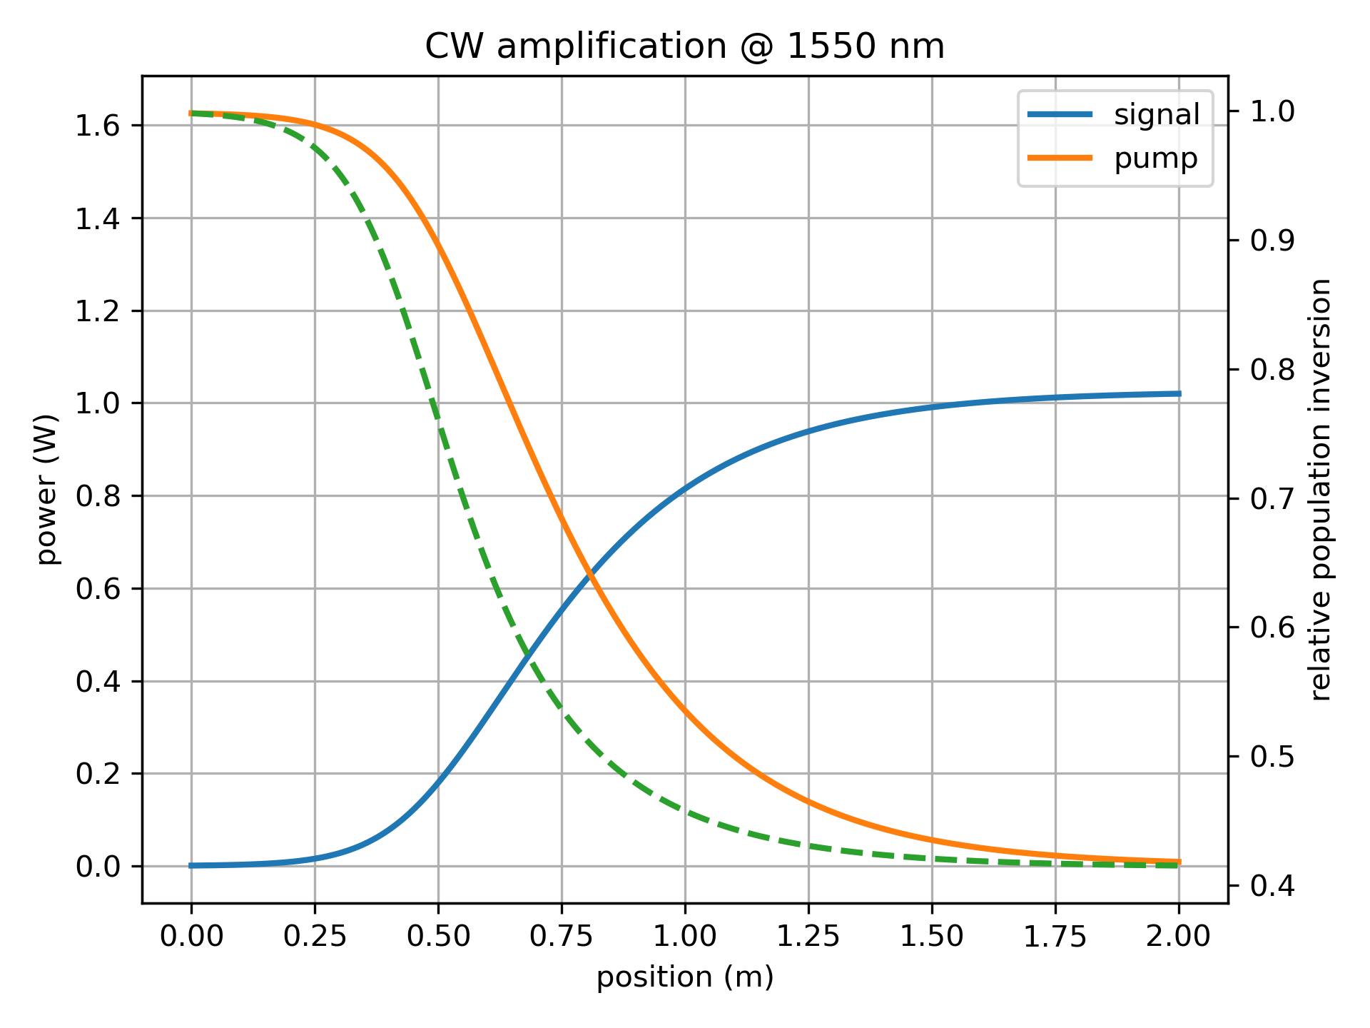
2W pump, 2 m of ER 80
Unphysically high conversion efficiency!
Used: 0.7 dB insertion loss, 0.2 dB splicing loss

Slide 4
Accounting for excited state absorption

Slide 5
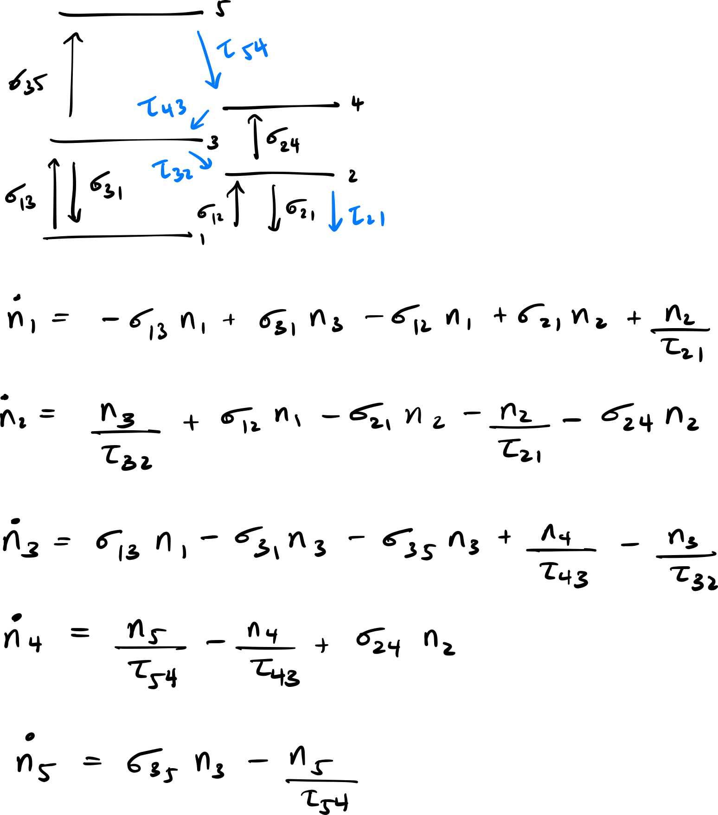
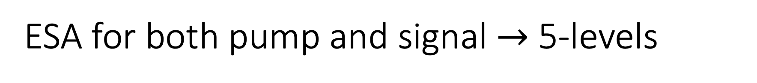
ESA for both pump and signal $→$ 5-levels
You need to include lifetimes to “close” the circuit if you want to apply steady state (i.e. energy needs to be conserved).
You can isolate population to the pump level (3), laser excited state (2), and (5) which is responsible for the green fluorescence.
Done by making the lifetime of (4) much smaller than the others (e.g. ns)
Solve for n₁ n₂ n₃ n₄ n₅ in terms of n_{tot} = n₁ + n₂ + n₃ + n₄ + n₅
Yu. O. Barmenkov, et al., Journal of Applied Physics 106, 083108 (2009).

Slide 6
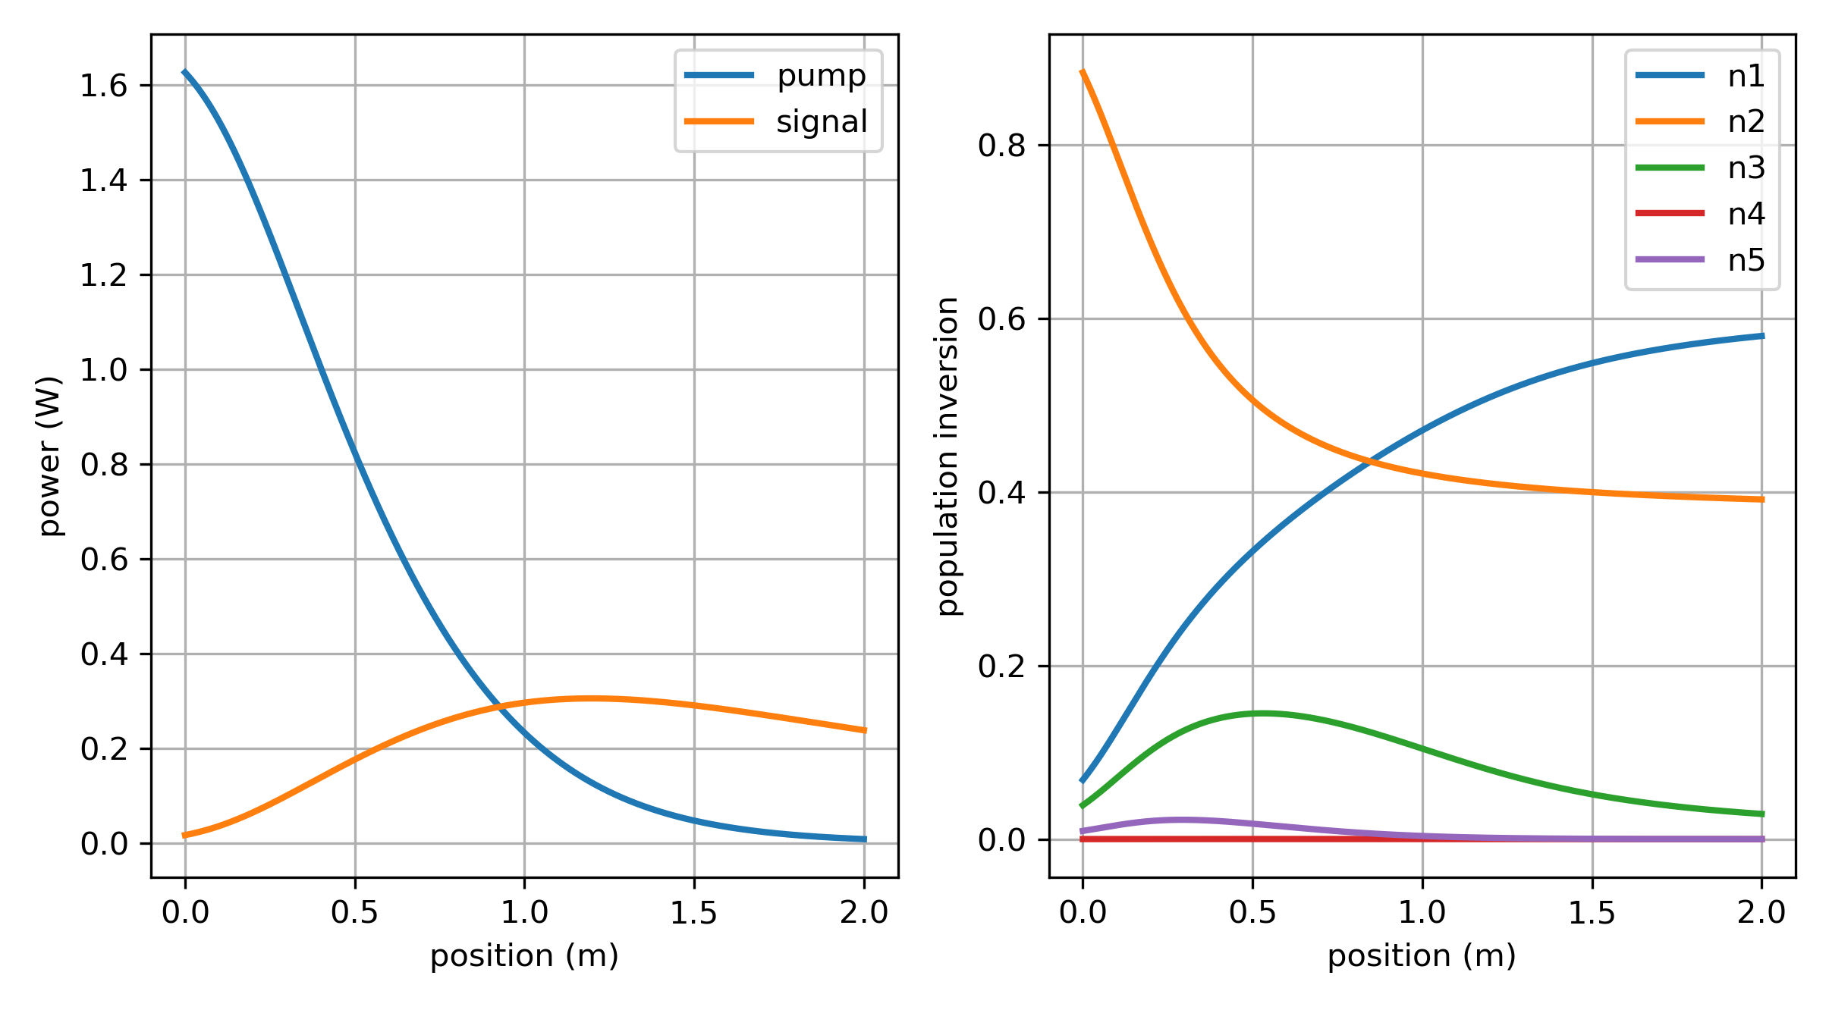
2W pump, 2 m of ER 80
More realistic power evolution!
Used: 0.7 dB insertion loss, 0.2 dB splicing loss

Slide 7
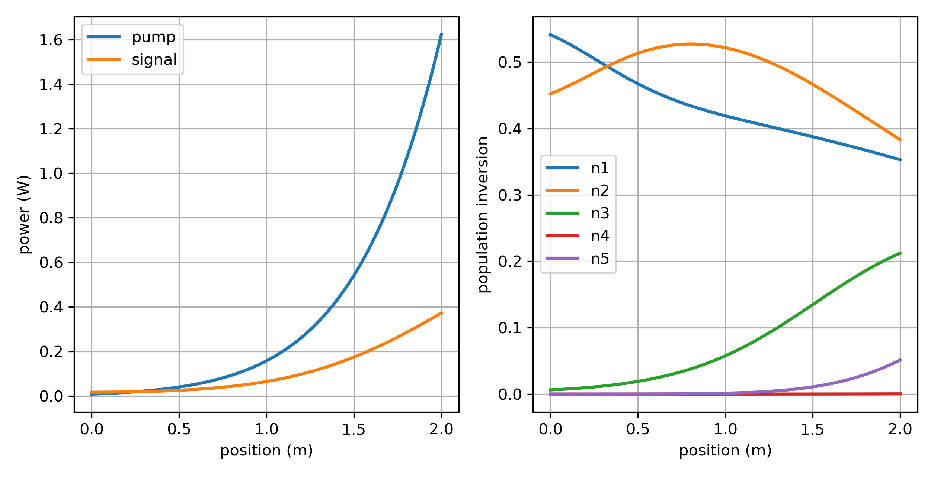
2W pump, 2 m of ER 80
Backward pumping using shooting method
Used: 0.7 dB insertion loss, 0.2 dB splicing loss

