Slide 1
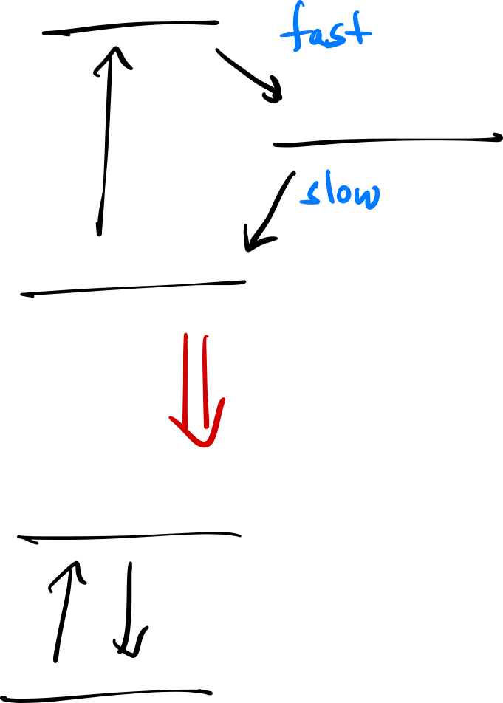



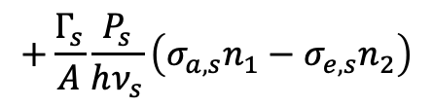
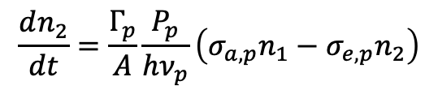
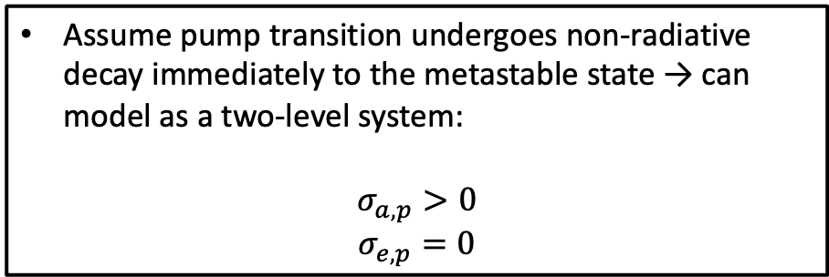
Modeling an EDFA
$$τ_{p}≪τ_{metastable}$$
Assume pump transition undergoes non-radiative decay immediately to the metastable state → can model as a two-level system:
$$σ_{a, p}>0$$
$$σ_{e,p}=0$$
$$\frac{dn_{2}}{dt}=\frac{Γ_{p}}{A}\frac{P_{p}}{hν_{p}}\left(σ_{a,p}n_{1}−σ_{e,p}n_{2}\right)$$
$$+\frac{Γ_{s}}{A}\frac{P_{s}}{hν_{s}}\left(σ_{a,s}n_{1}−σ_{e,s}n_{2}\right)$$
$$−\frac{n_{2}}{τ}$$
If the $\frac{1}{f_{r}}≫τ$ → $n_{2}$ will reach steady state!

Slide 2
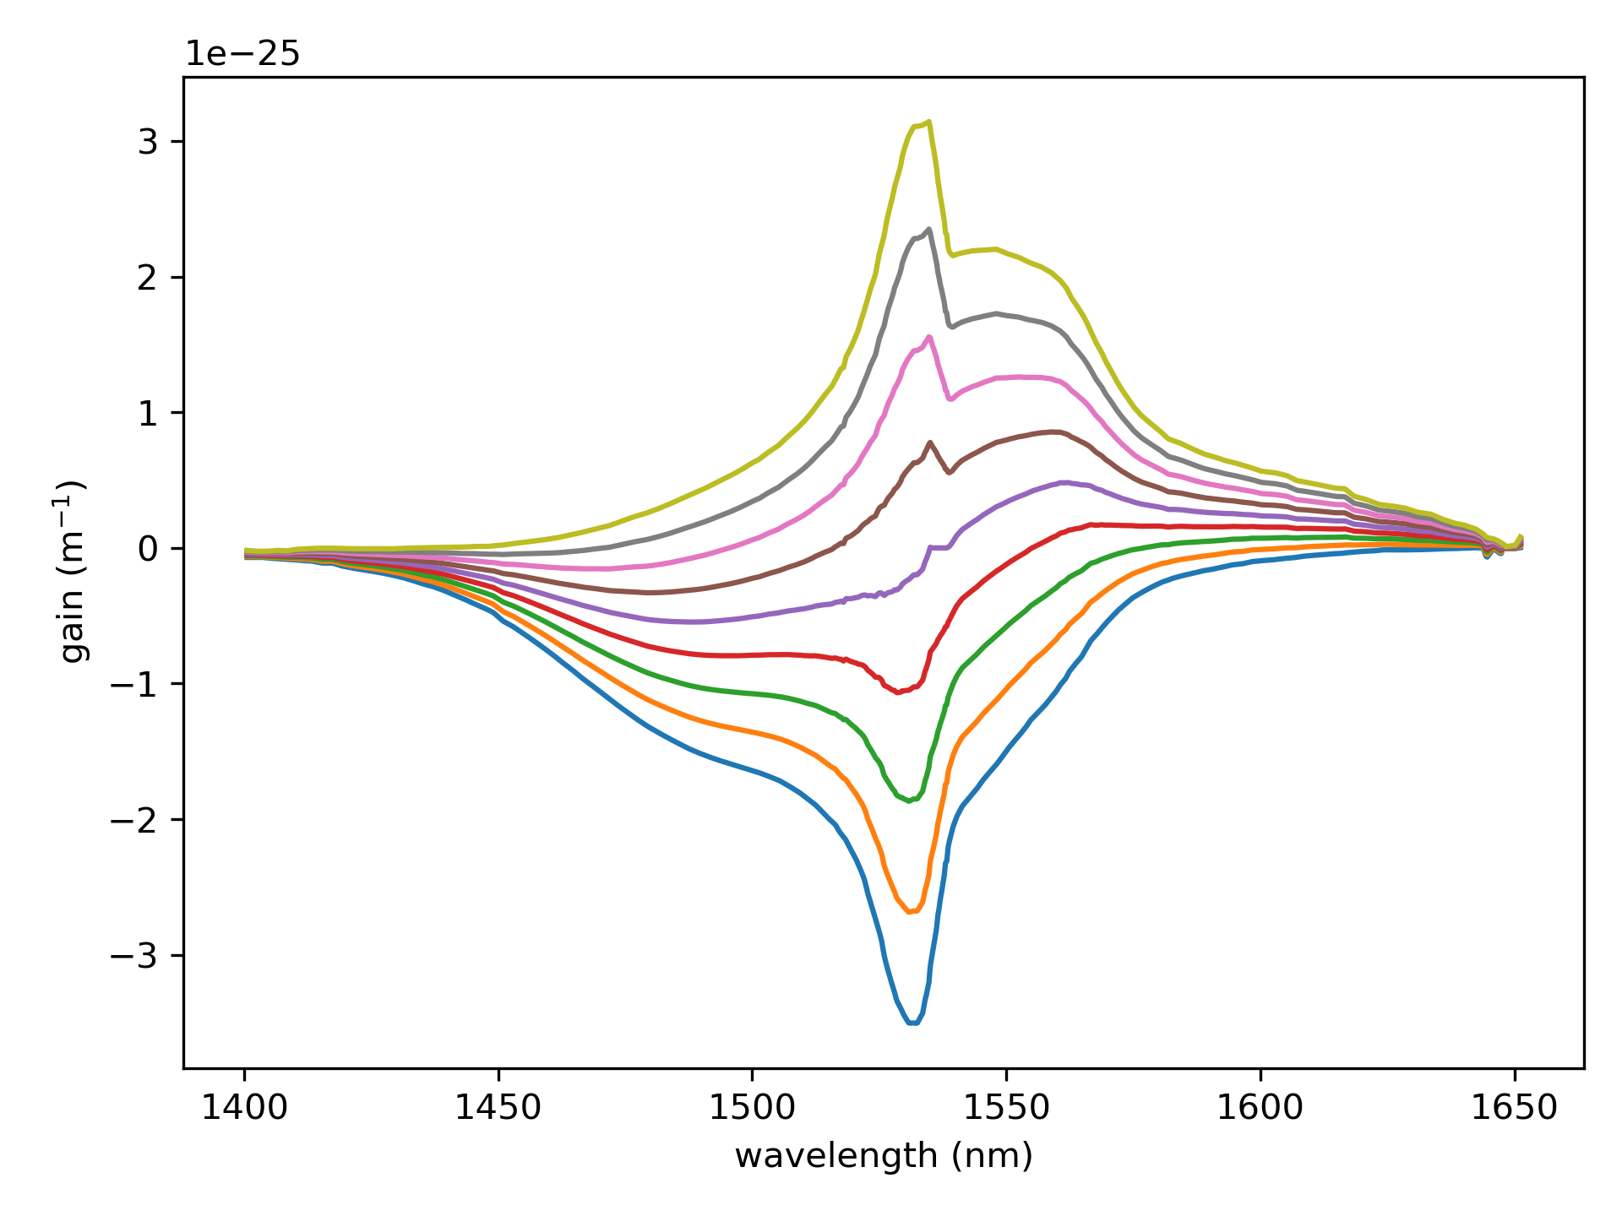
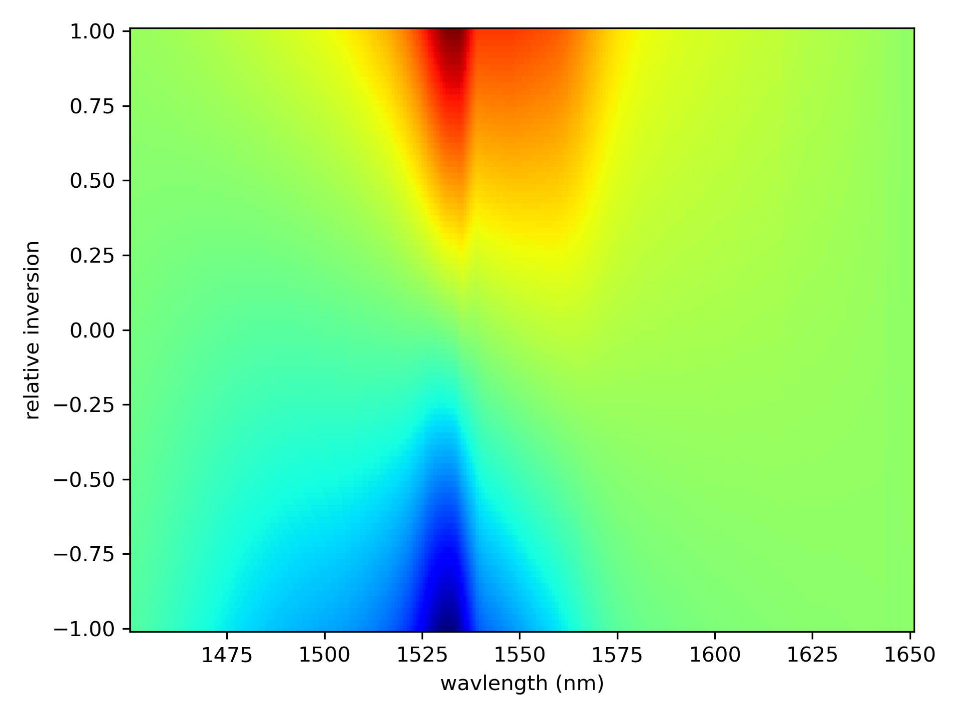



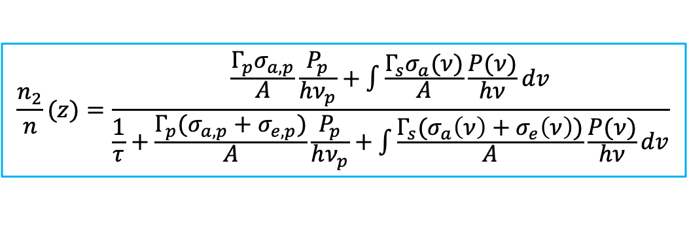

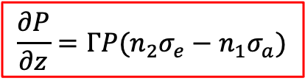


Rate Equations
Steady state
$$\frac{n_{2}}{n}(z)=\frac{\frac{Γ_{p}σ_{a,p}}{A}\frac{P_{p}}{hν_{p}}+\int{\frac{Γ_{s}σ_{a}(ν)}{A}\frac{P(ν)}{hν}dv}}{\frac{1}{τ}+\frac{Γ_{p}(σ_{a,p}+σ_{e,p})}{A}\frac{P_{p}}{hν_{p}}+\int{\frac{Γ_{s}(σ_{a}\left(ν\right)+σ_{e}\left(ν\right))}{A}\frac{P(ν)}{hν}dv}}$$
Need to know:
Absorption cross-section (m²)
Emission cross-section (m²)
Fiber core size
Excited state lifetime
$$\frac{∂P}{∂z}=ΓP(n_{2}σ_{e}−n_{1}σ_{a})$$
$e^{−Γσnz}$ = small signal absorption $→$ $n$ is known
where:
$$n_{2}=\left(\frac{n_{2}}{n}\right)n$$
$$n_{1}=n−n_{2}$$
cross-sections:
The gain coefficient is:
$$σ_{e}$$
$$g\left(ν,z\right)=Γ_{s}(σ_{e}\left(ν\right)n_{2}\left(z\right)−σ_{a}\left(ν\right)n_{1}\left(z\right))$$
$$σ_{a}$$

Slide 3
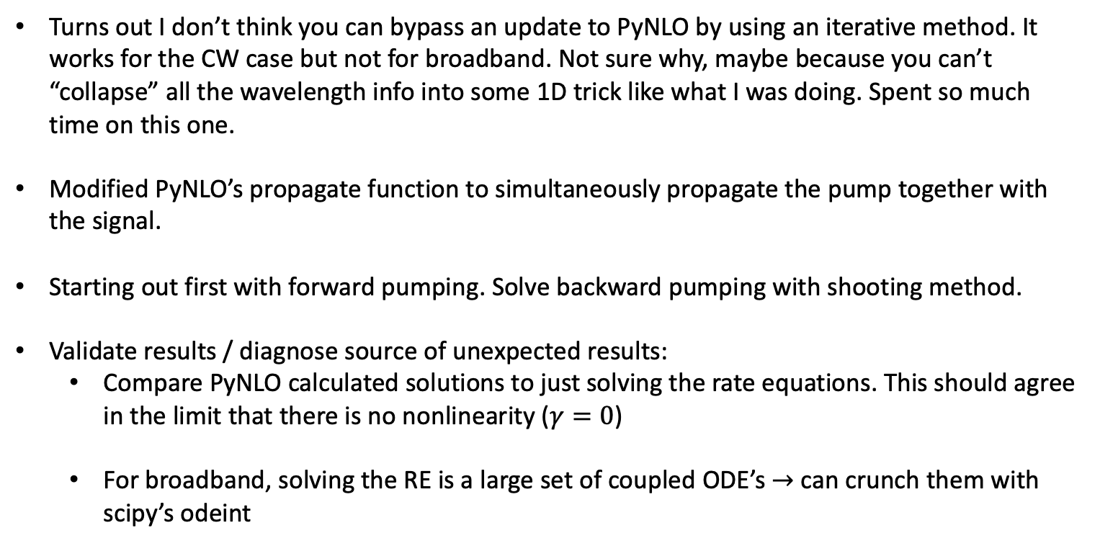
Diagnosing unphysical results
Turns out I don’t think you can bypass an update to PyNLO by using an iterative method. It works for the CW case but not for broadband. Not sure why, maybe because you can’t “collapse” all the wavelength info into some 1D trick like what I was doing. Spent so much time on this one.
Modified PyNLO’s propagate function to simultaneously propagate the pump together with the signal.
Starting out first with forward pumping. Solve backward pumping with shooting method.
Validate results / diagnose source of unexpected results:
Compare PyNLO calculated solutions to just solving the rate equations. This should agree in the limit that there is no nonlinearity ($γ=0$)
For broadband, solving the RE is a large set of coupled ODE’s $→$ can crunch them with scipy’s odeint

Slide 4
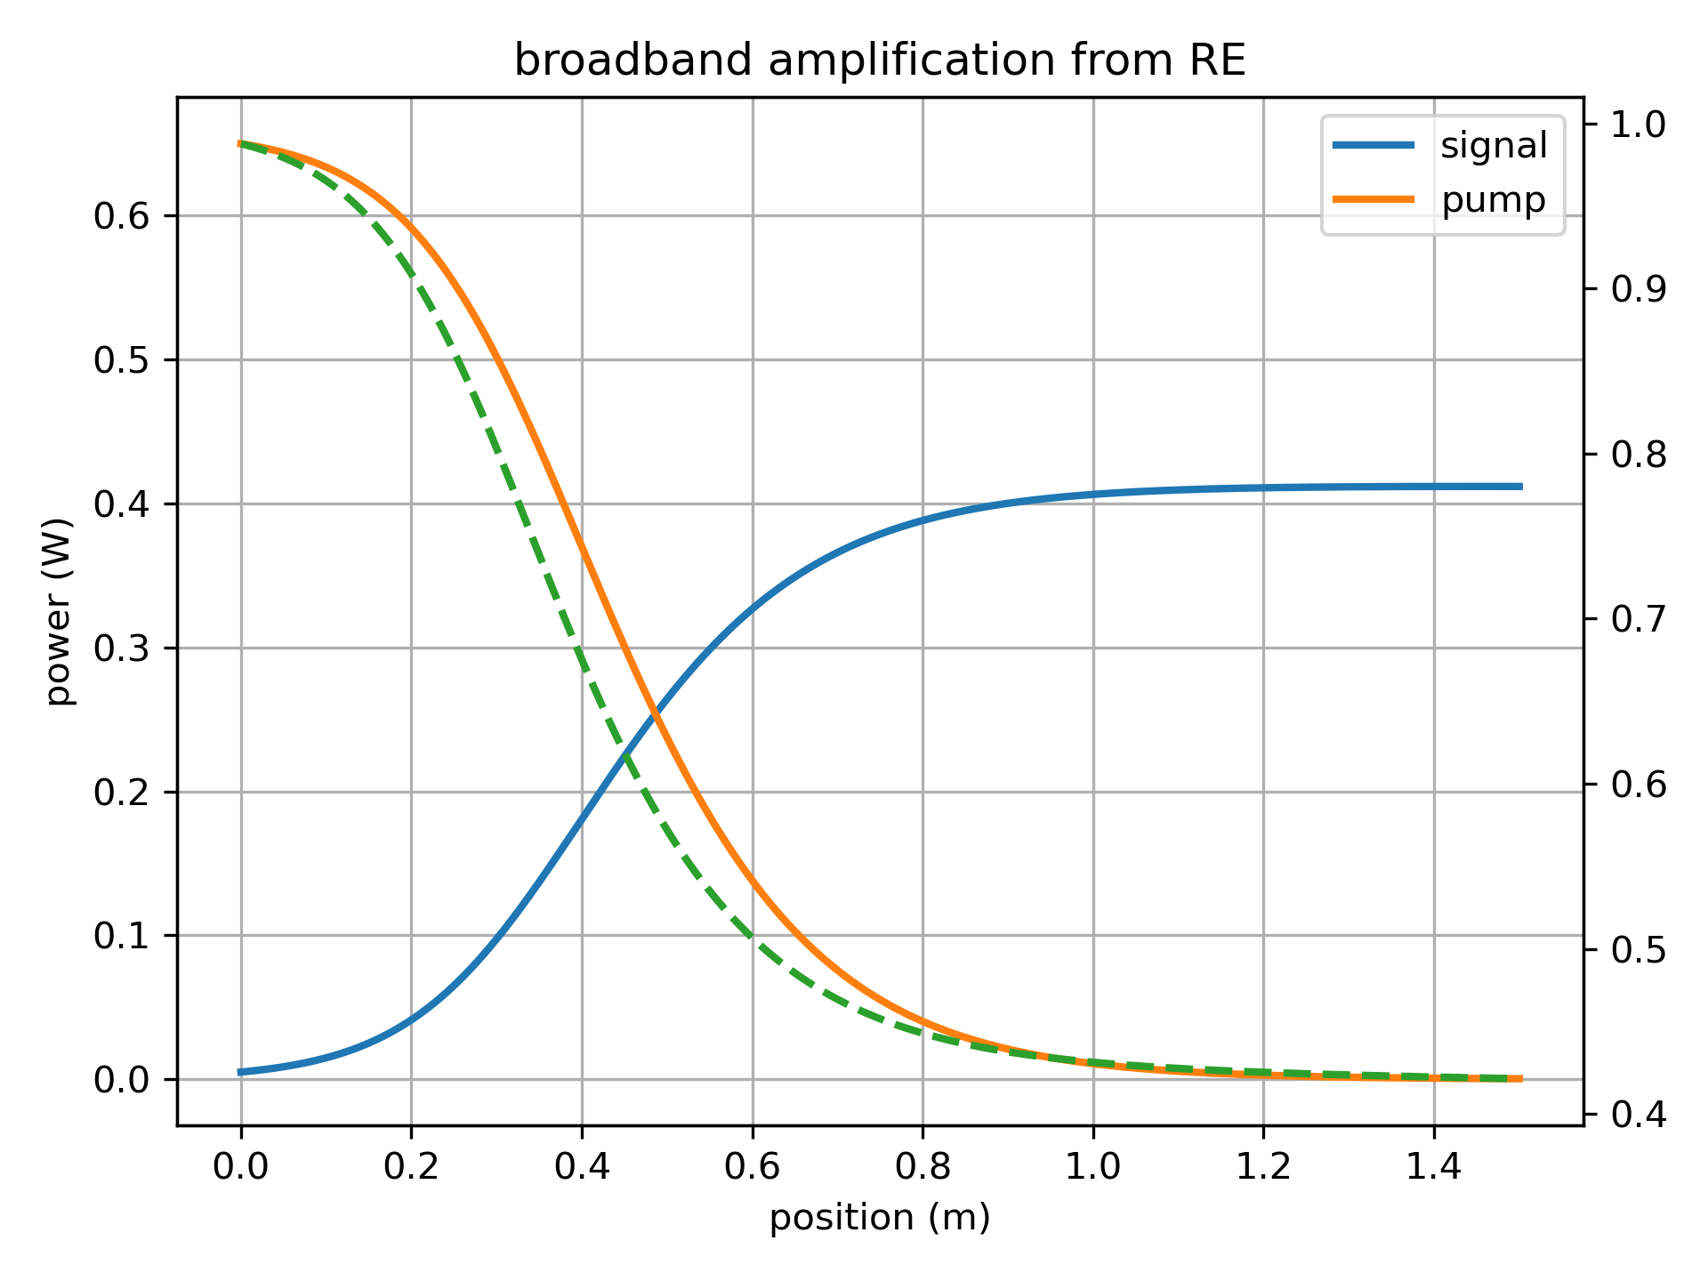
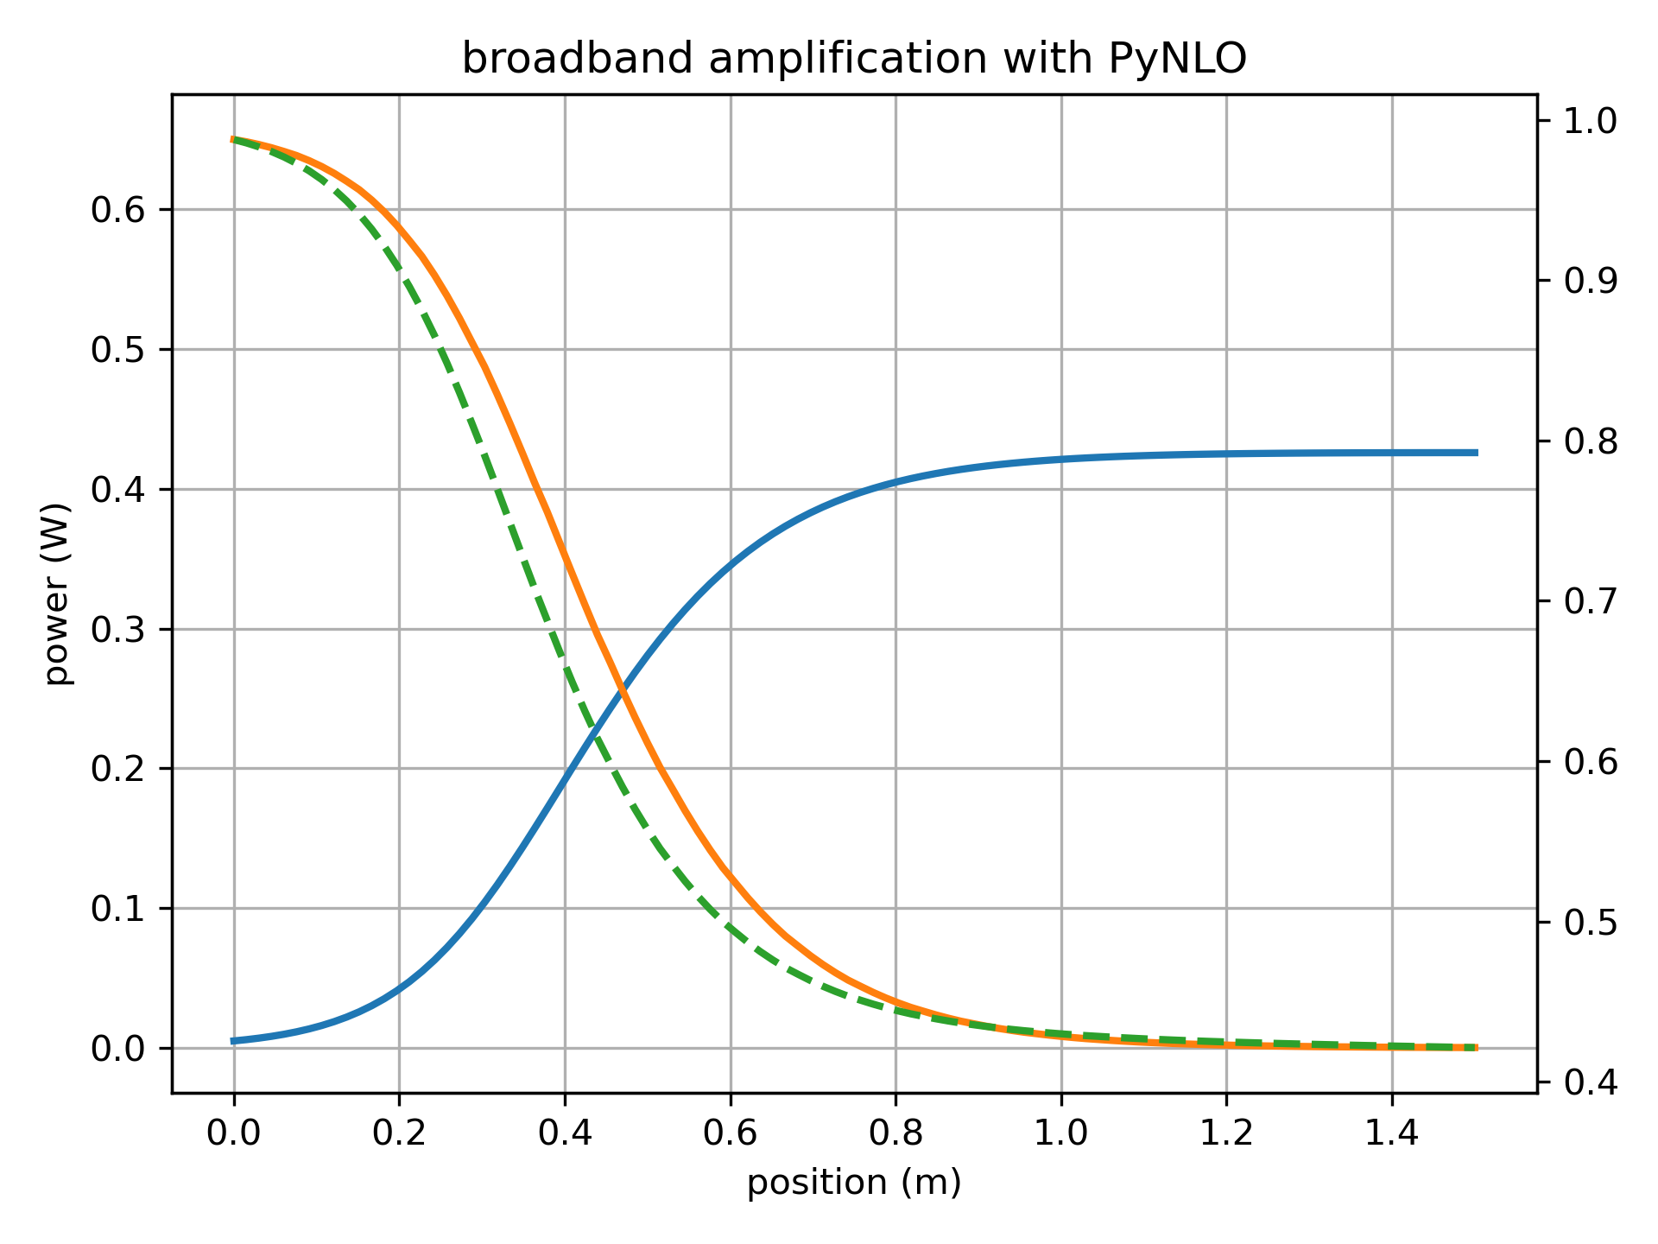
650 mW pump, 1.5 m of ER 80

Slide 5
Accounting for excited state absorption

Slide 6
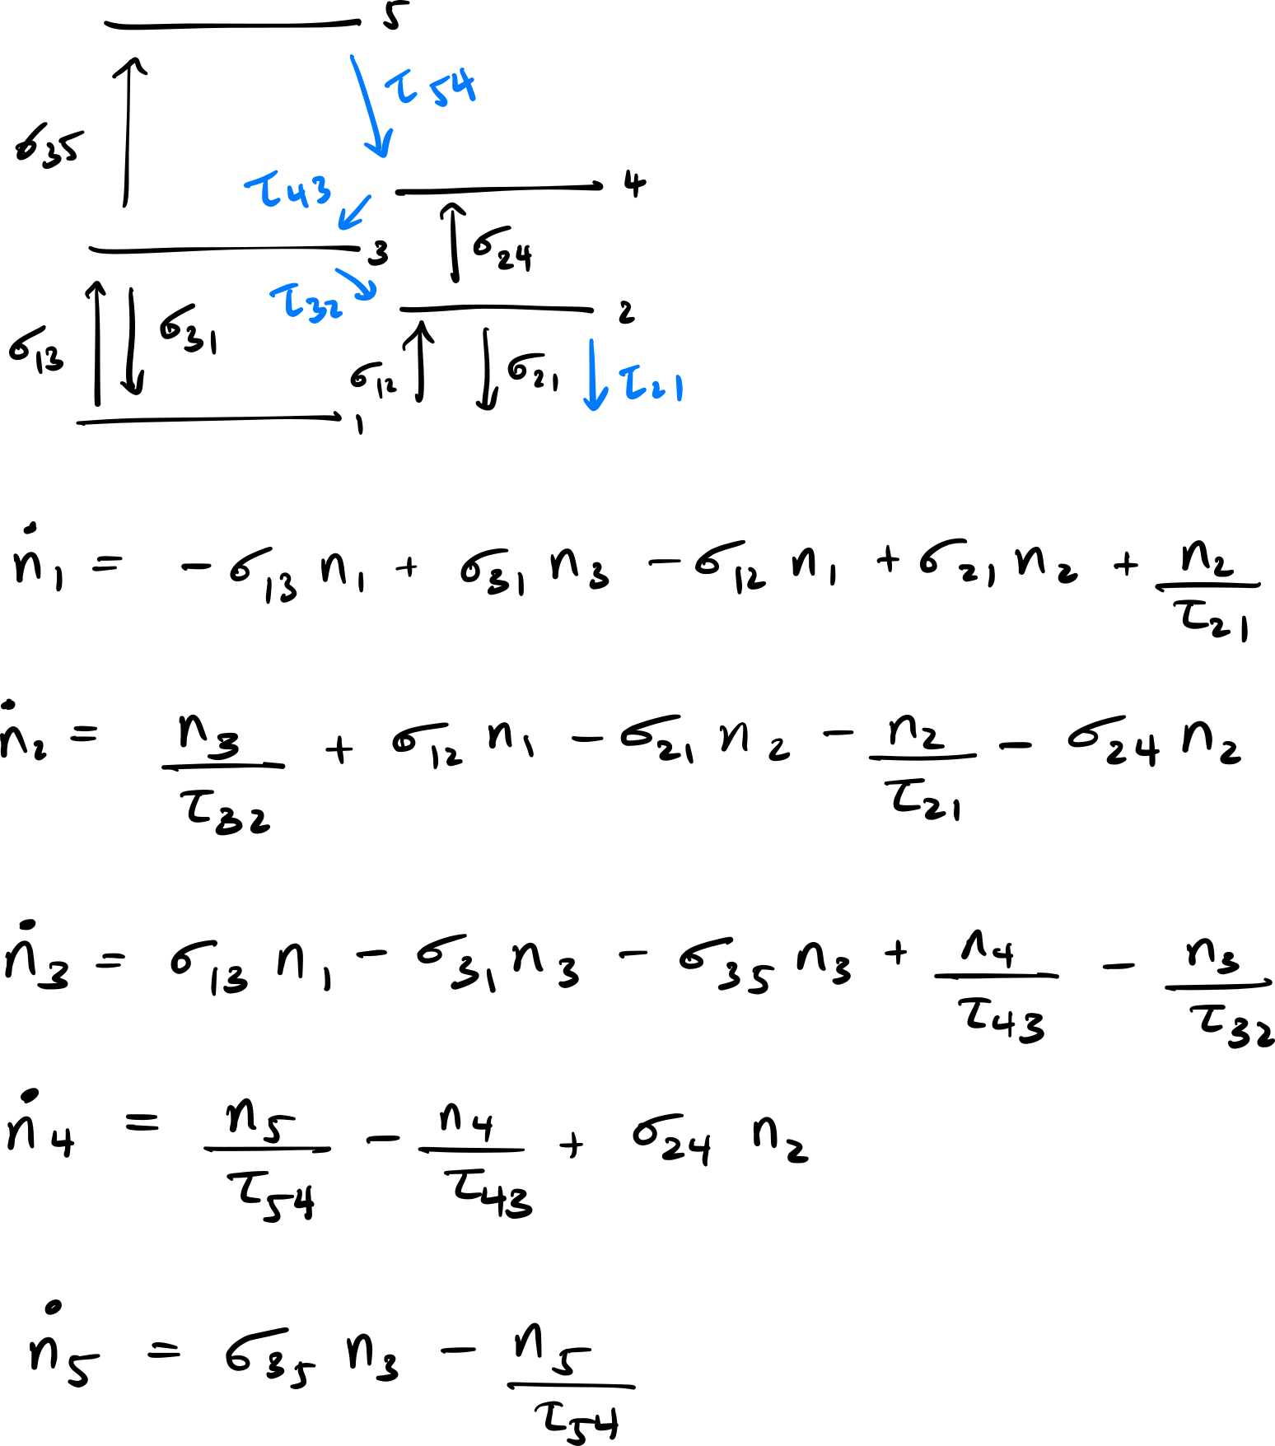

ESA for both pump and signal $→$ 5-levels
You need to include lifetimes to “close” the circuit if you want to apply steady state (i.e. energy needs to be conserved).
You can isolate population to the pump level (3), laser excited state (2), and (5) which is responsible for the green fluorescence.
Done by making the lifetime of (4) much smaller than the others (e.g. ns)
Solve for n₁ n₂ n₃ n₄ n₅ in terms of n_{tot} = n₁ + n₂ + n₃ + n₄ + n₅
Yu. O. Barmenkov, et al., Journal of Applied Physics 106, 083108 (2009).

