Slide 2
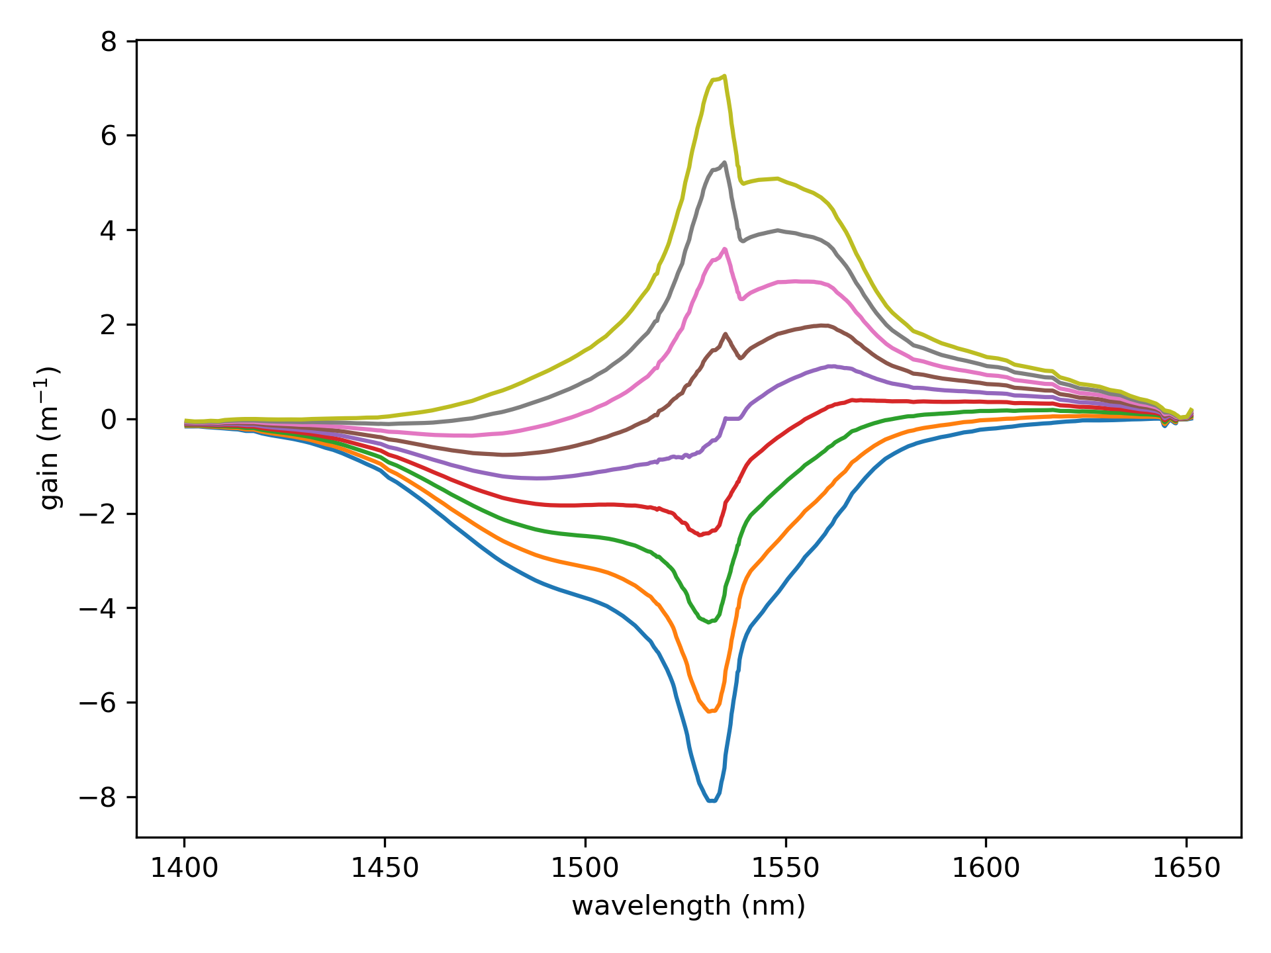
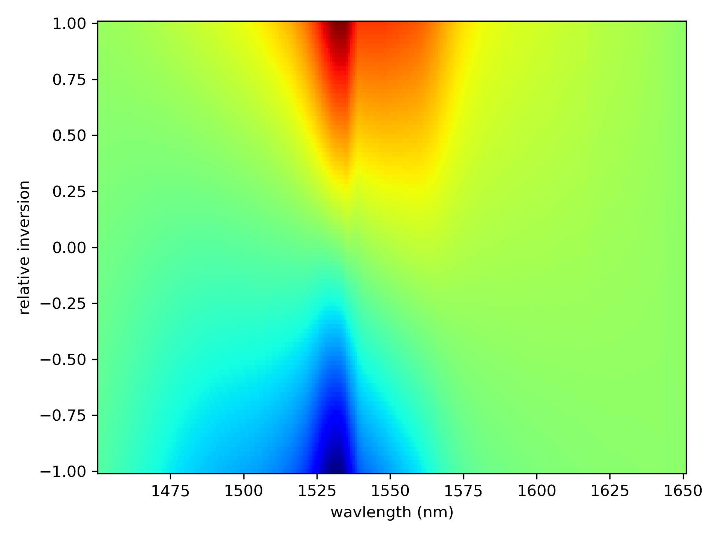
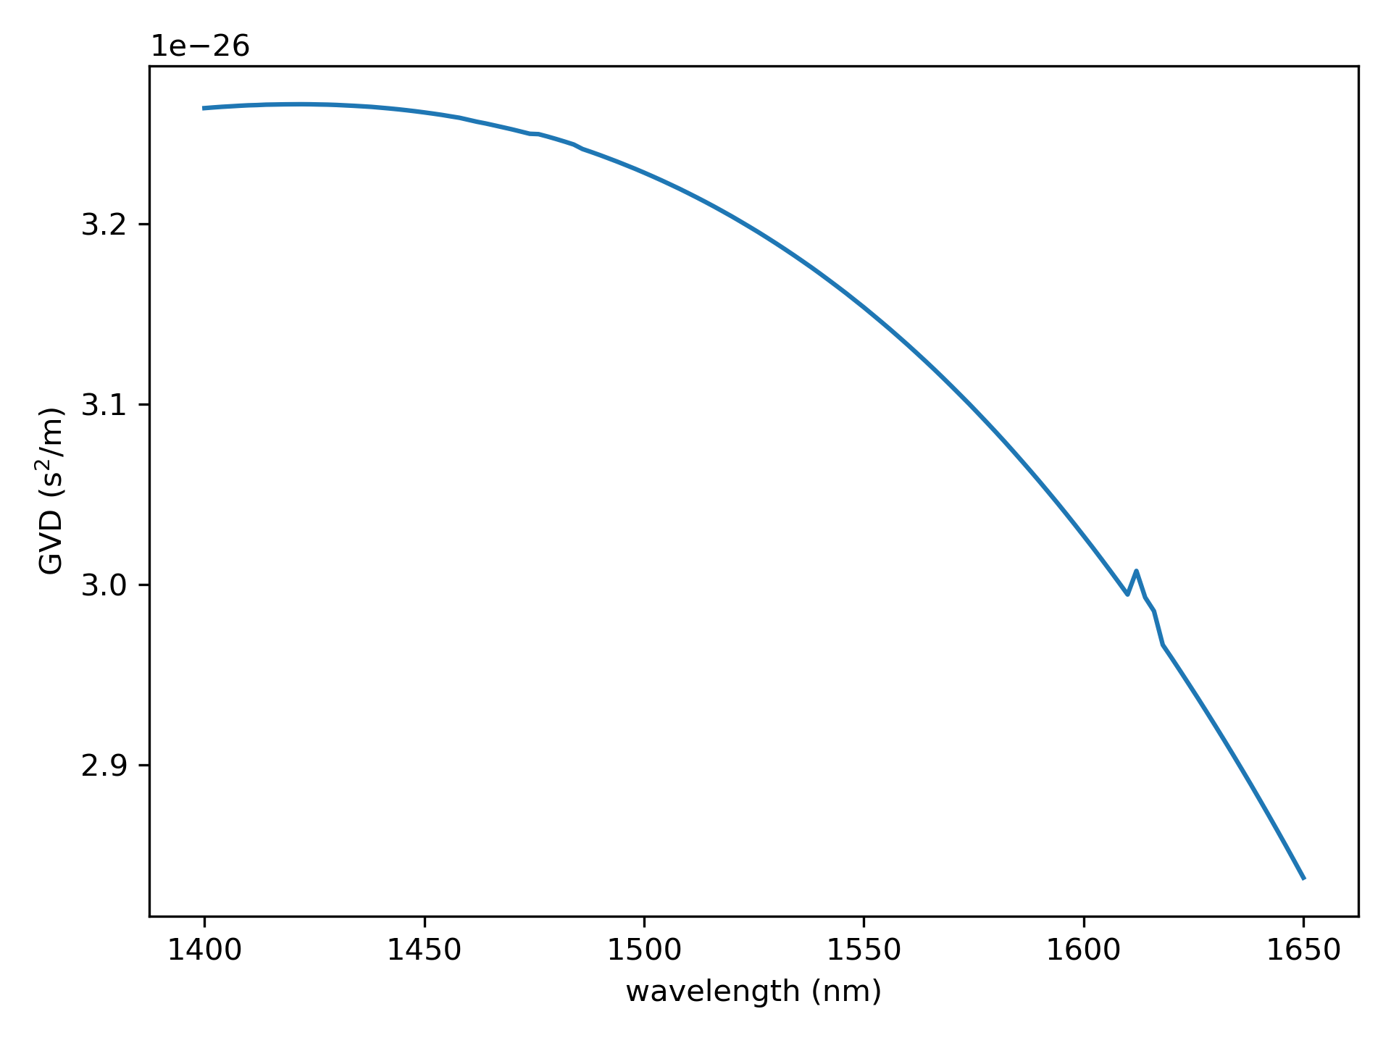


$$g∝σ_{e}\left(1+D\right)−σ_{a}(1−D)$$
$$−1< D=N_{2}−N_{1}<1$$

