Slide 1
1
2
3
4
1GHz mode-locked laser
Grating compressor
HNLF
DCF
Pre-amplifier
Power amplifier
PPLN
MIR Comb
LPF
MIR Comb 1
VIGO
GaGe DAQ
MIR Comb 2
5
6
7
8
Notes:
Experimental Setup Schematic

Slide 2
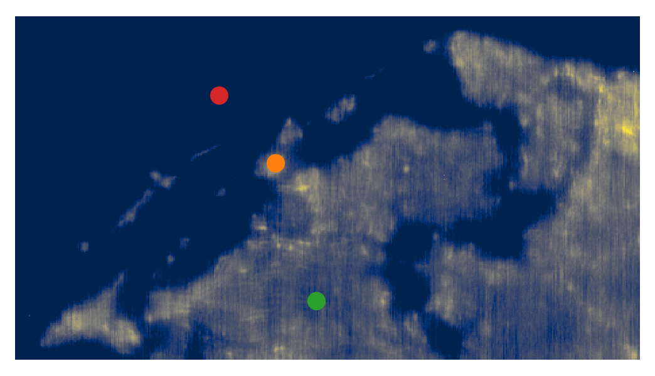
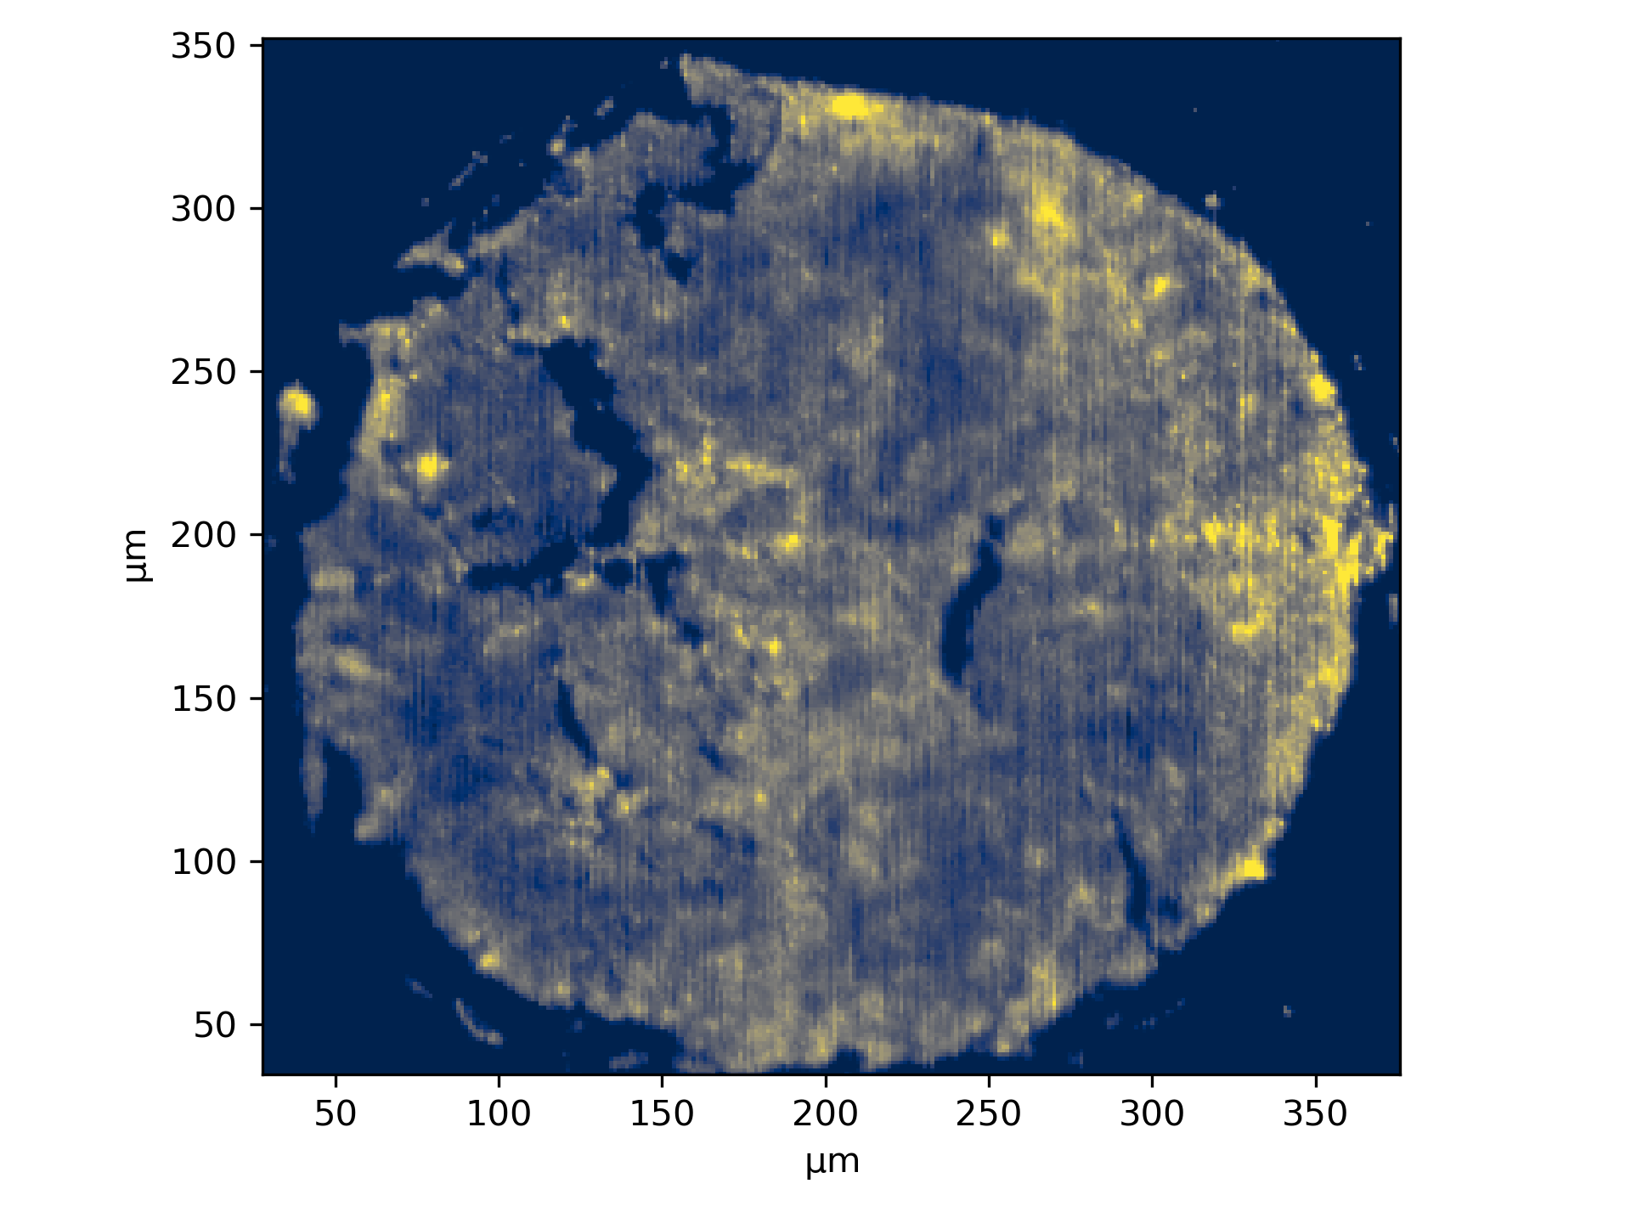
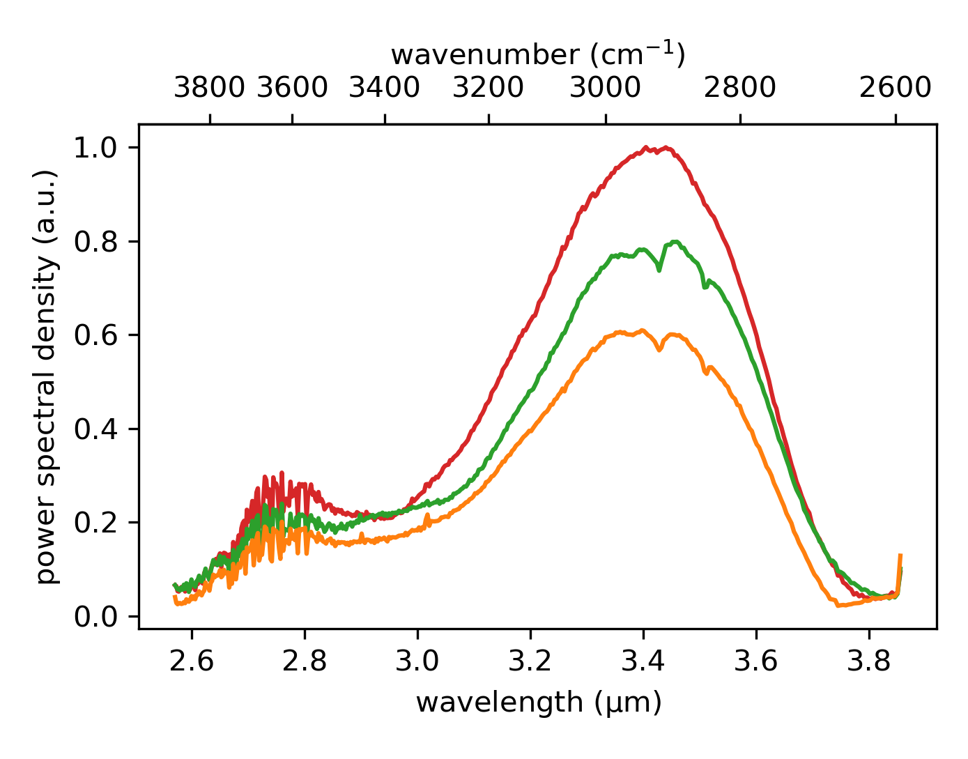

Slide 3
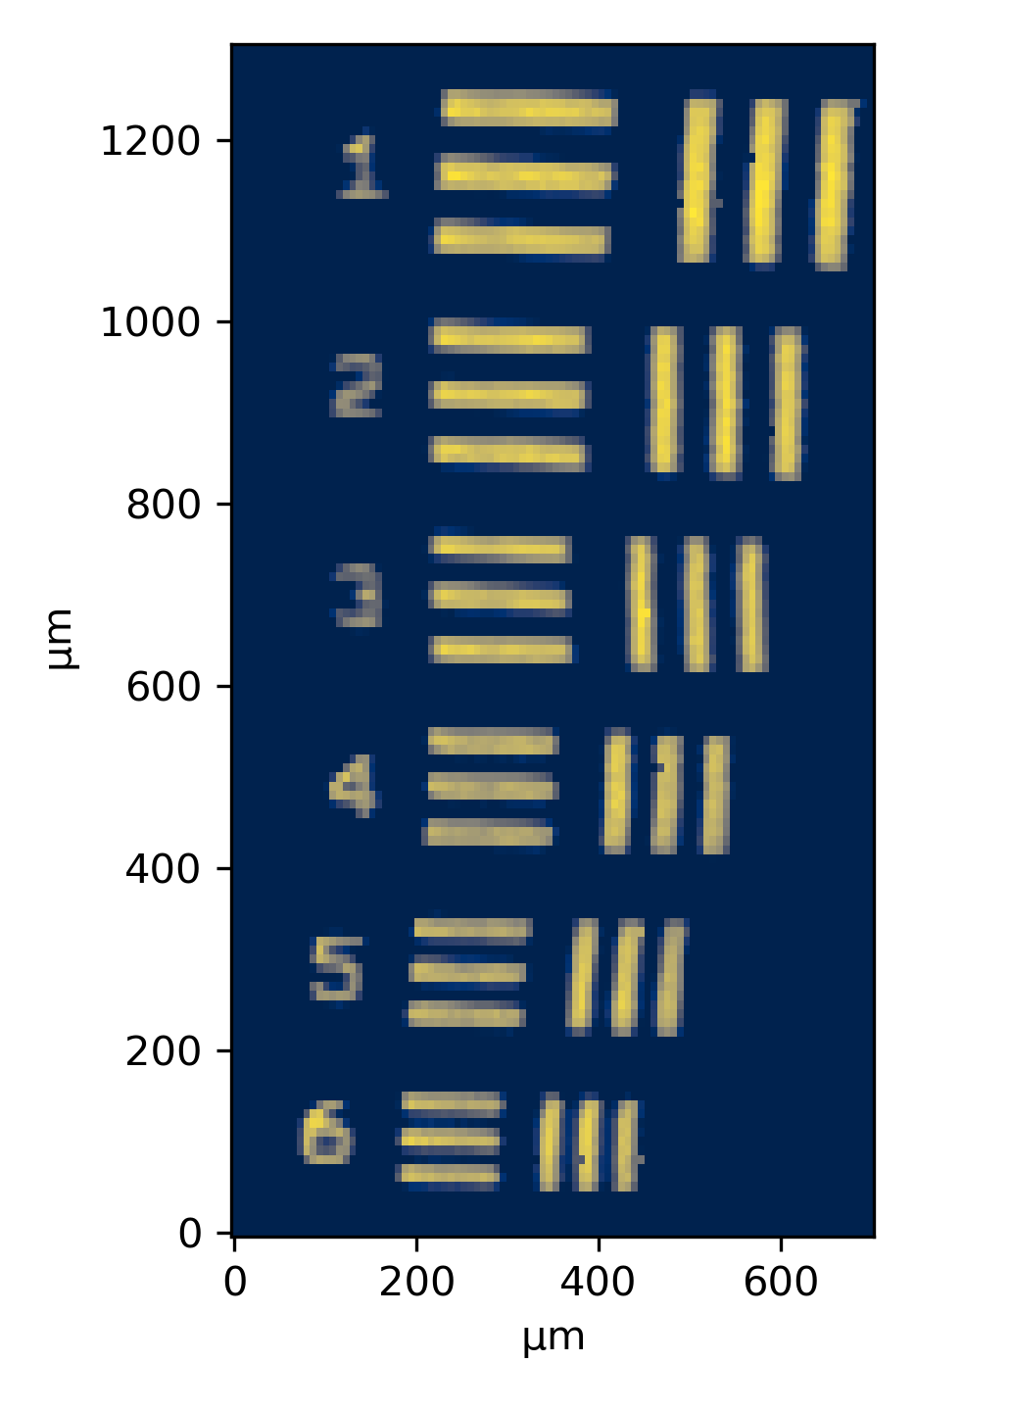
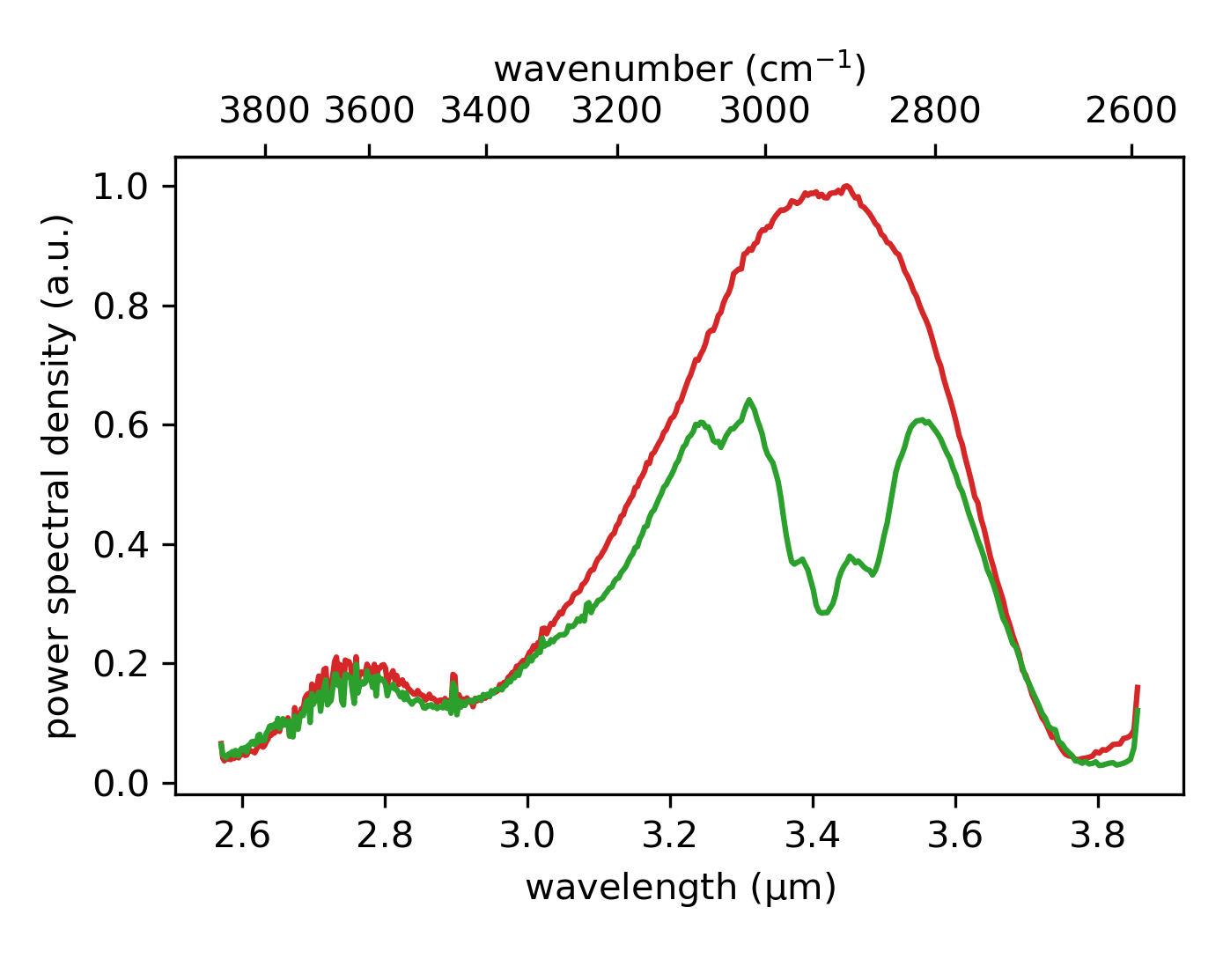
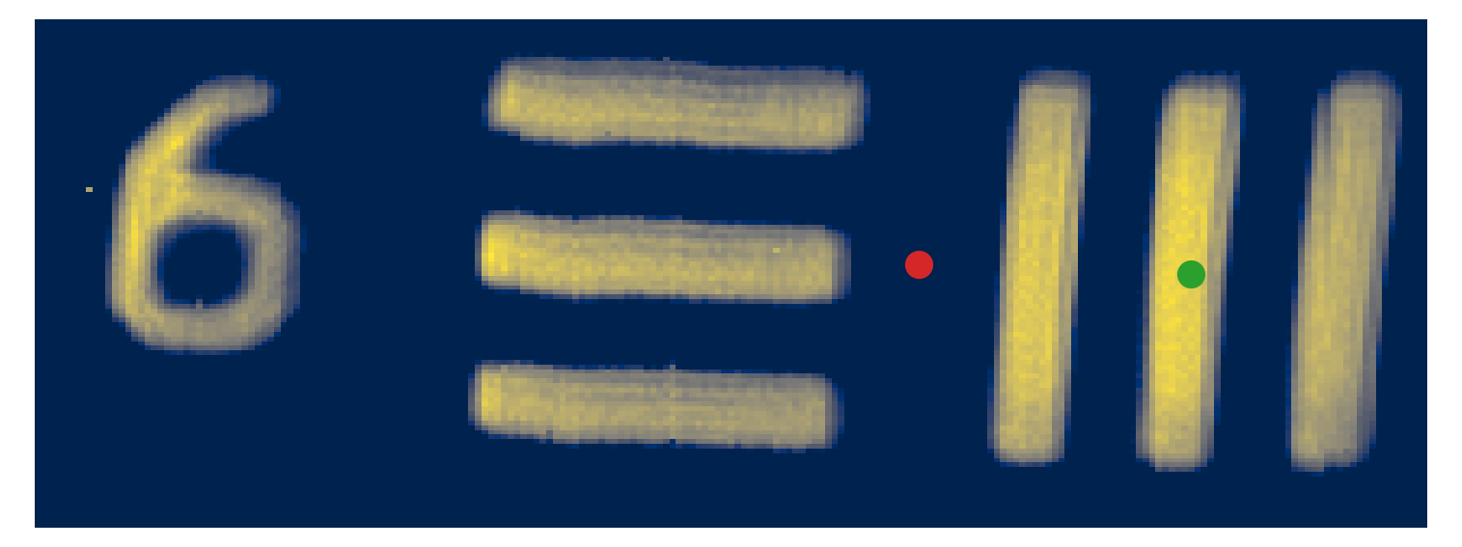

Slide 4
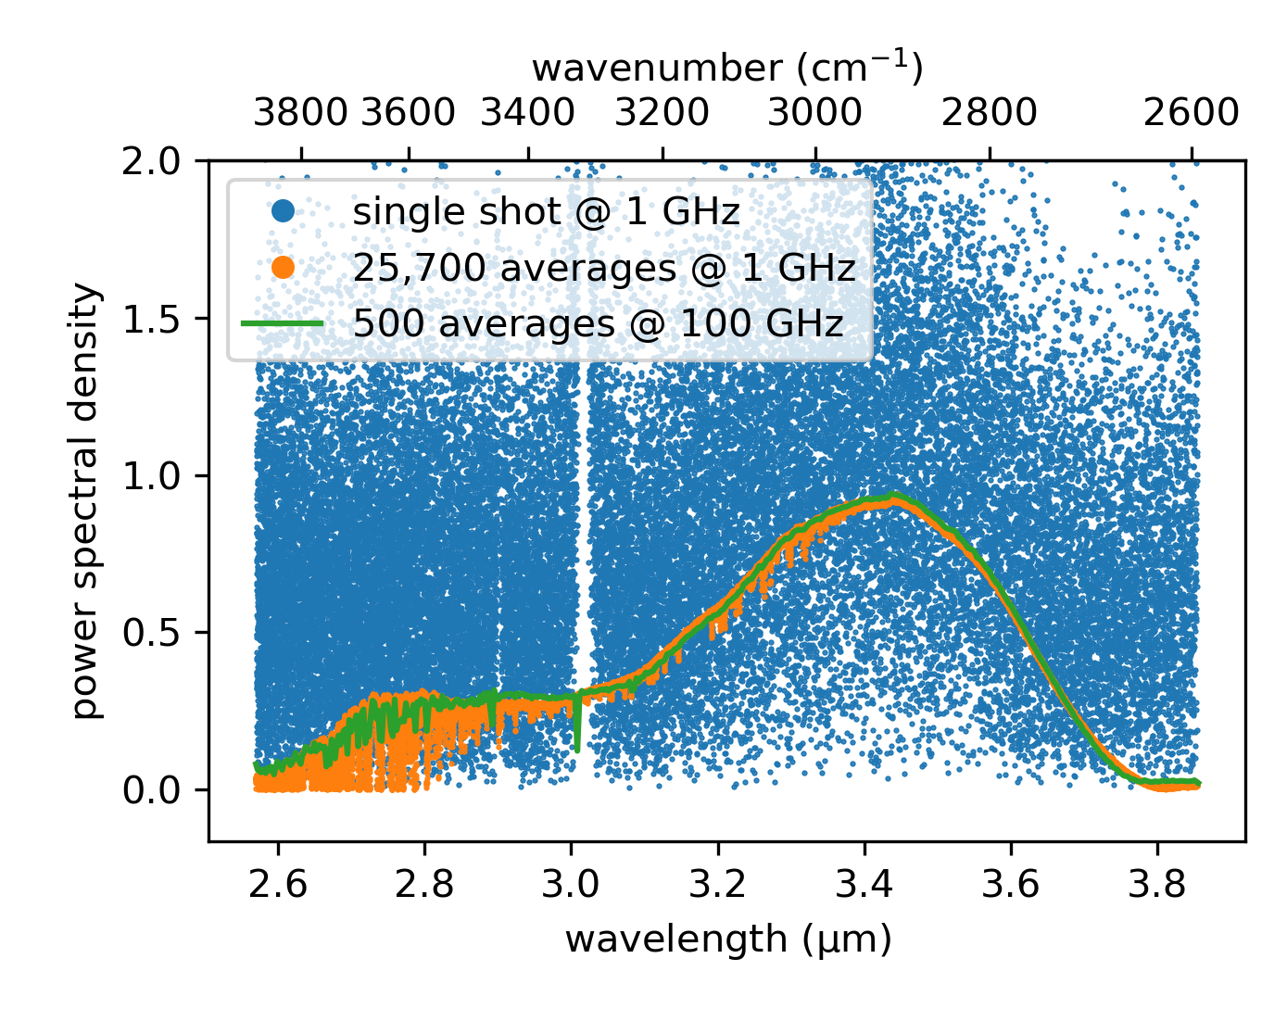
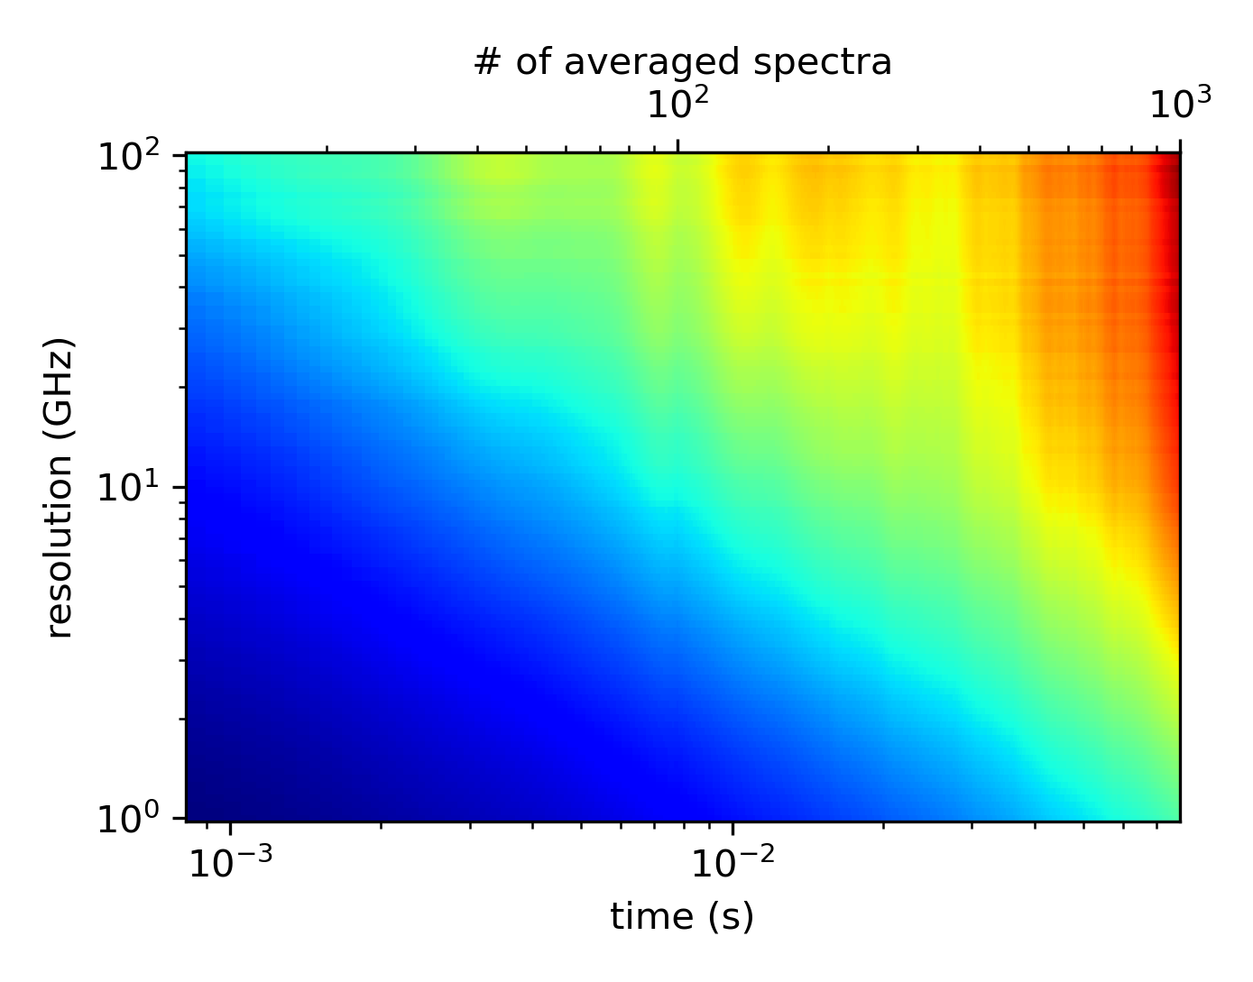

Slide 5
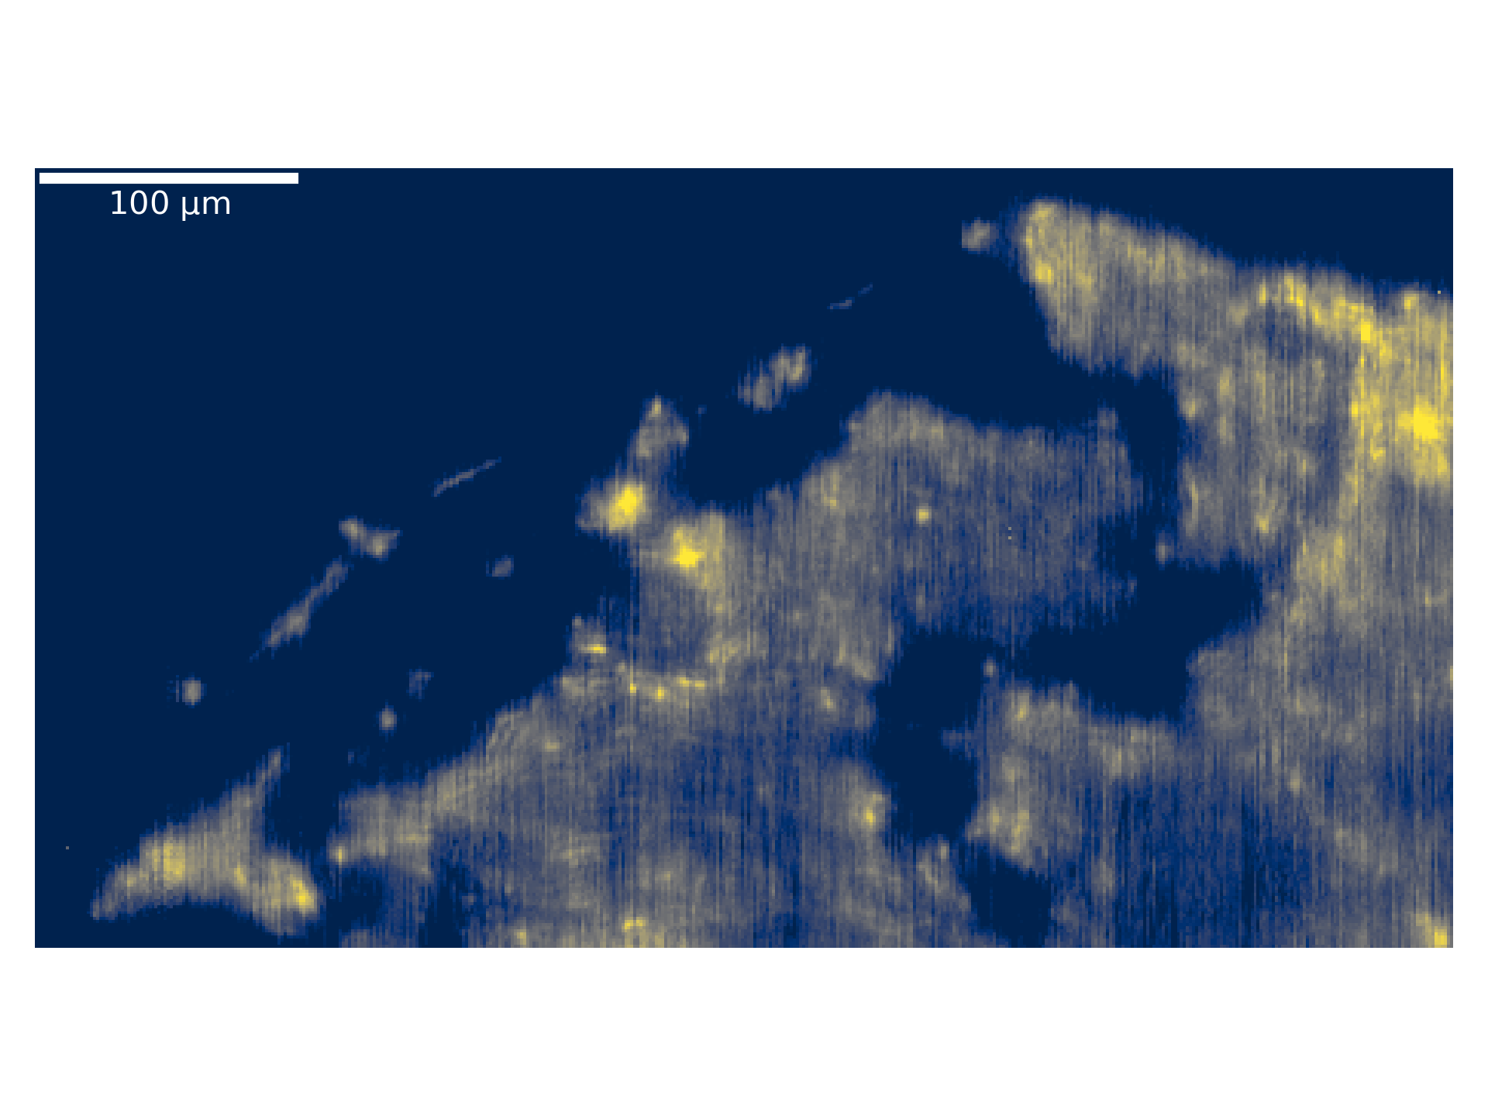
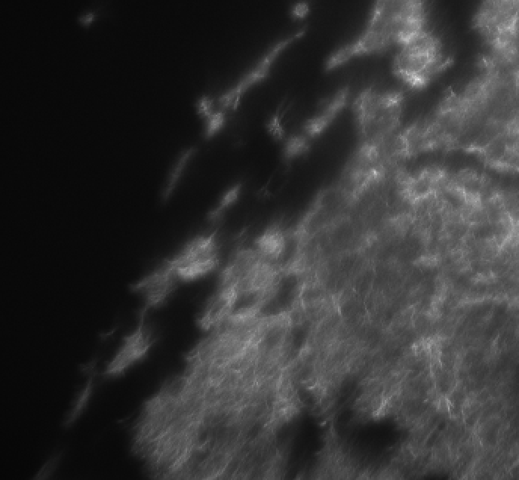
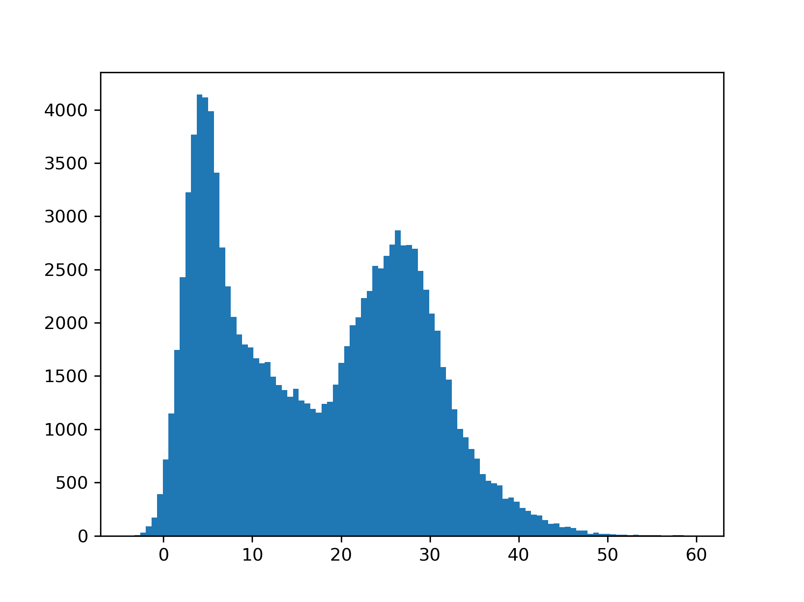
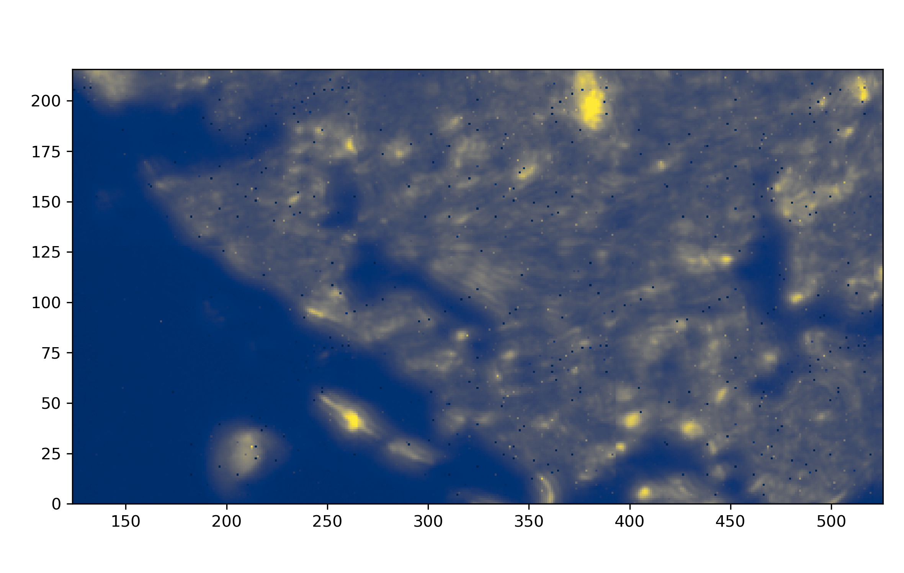
Basler Camera Image
background
signal
FTIR Image
Notes:
It’s difficult to do background subtraction here to completely remove the noise because the overlap between background and signal is heavier

