Slide 1
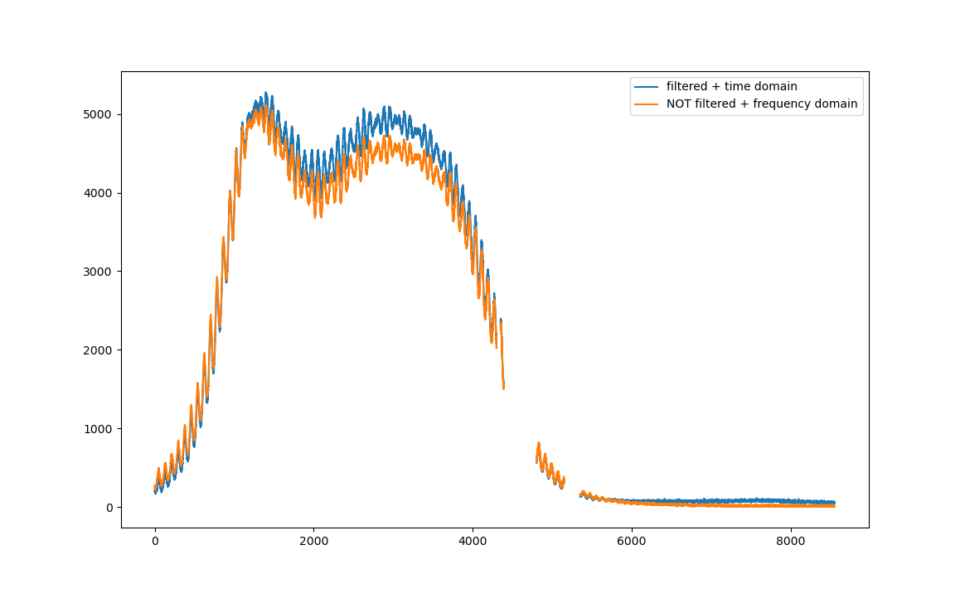

Slide 2
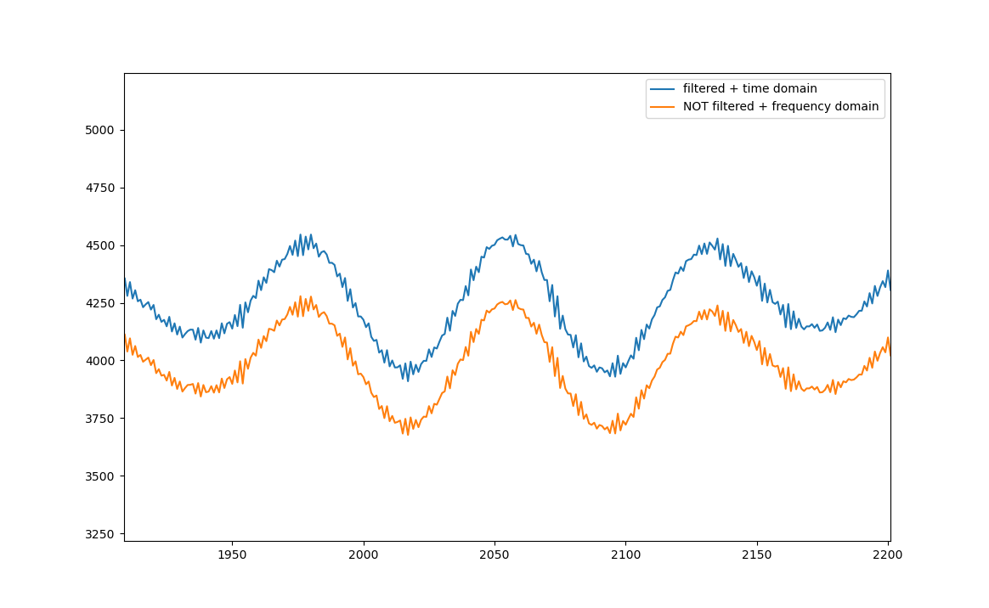
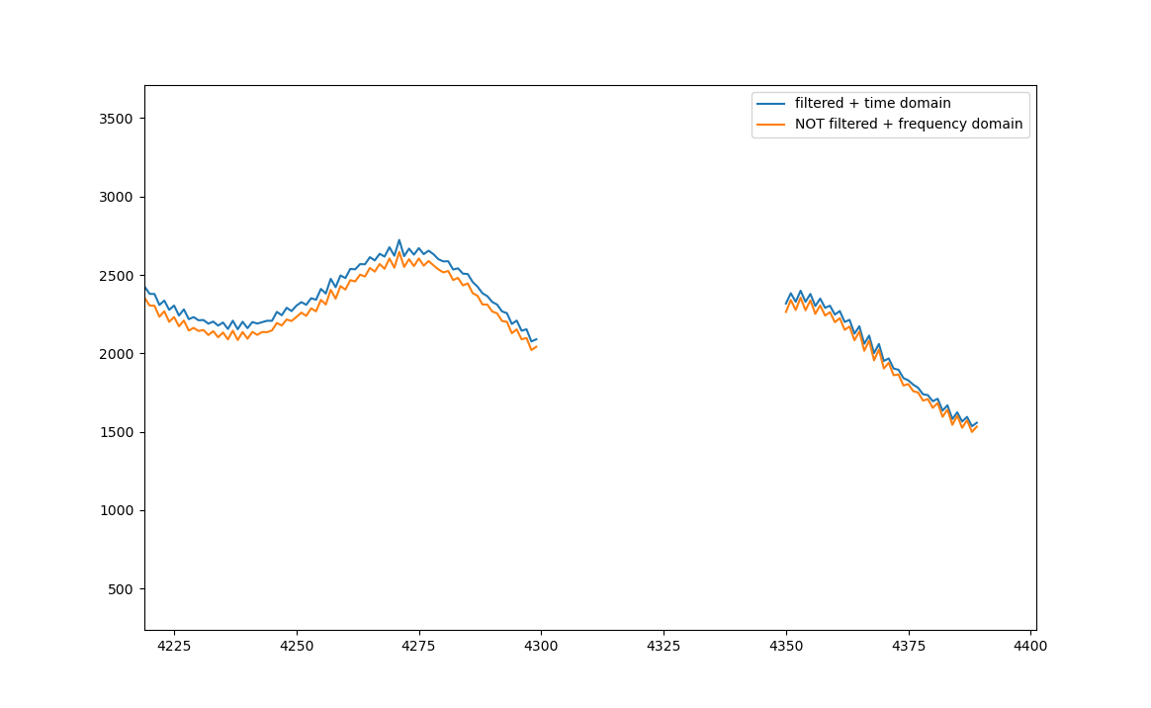
Apart from the scaling issue, the noise and local structure is completely the same …
So, it’s really only an issue that arises with apodization…

