Slide 1
1
2
3
4
1GHz mode-locked laser
Grating compressor
HNLF
DCF
Pre-amplifier
Power amplifier
PPLN
MIR Comb
LPF
MIR Comb 1
VIGO
GaGe DAQ
MIR Comb 2
5
6
7
8
Notes:
Figure: Experimental set-up

Slide 2
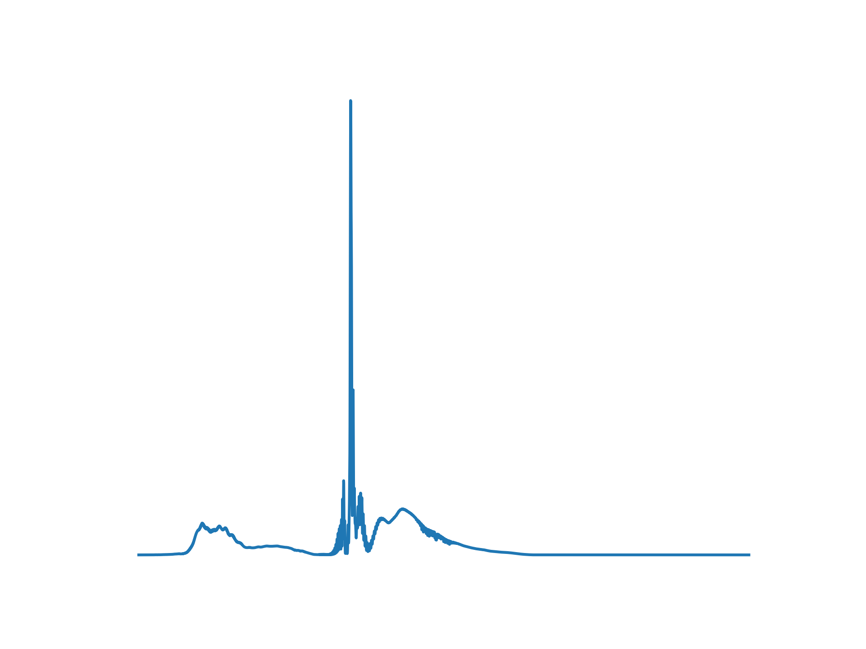
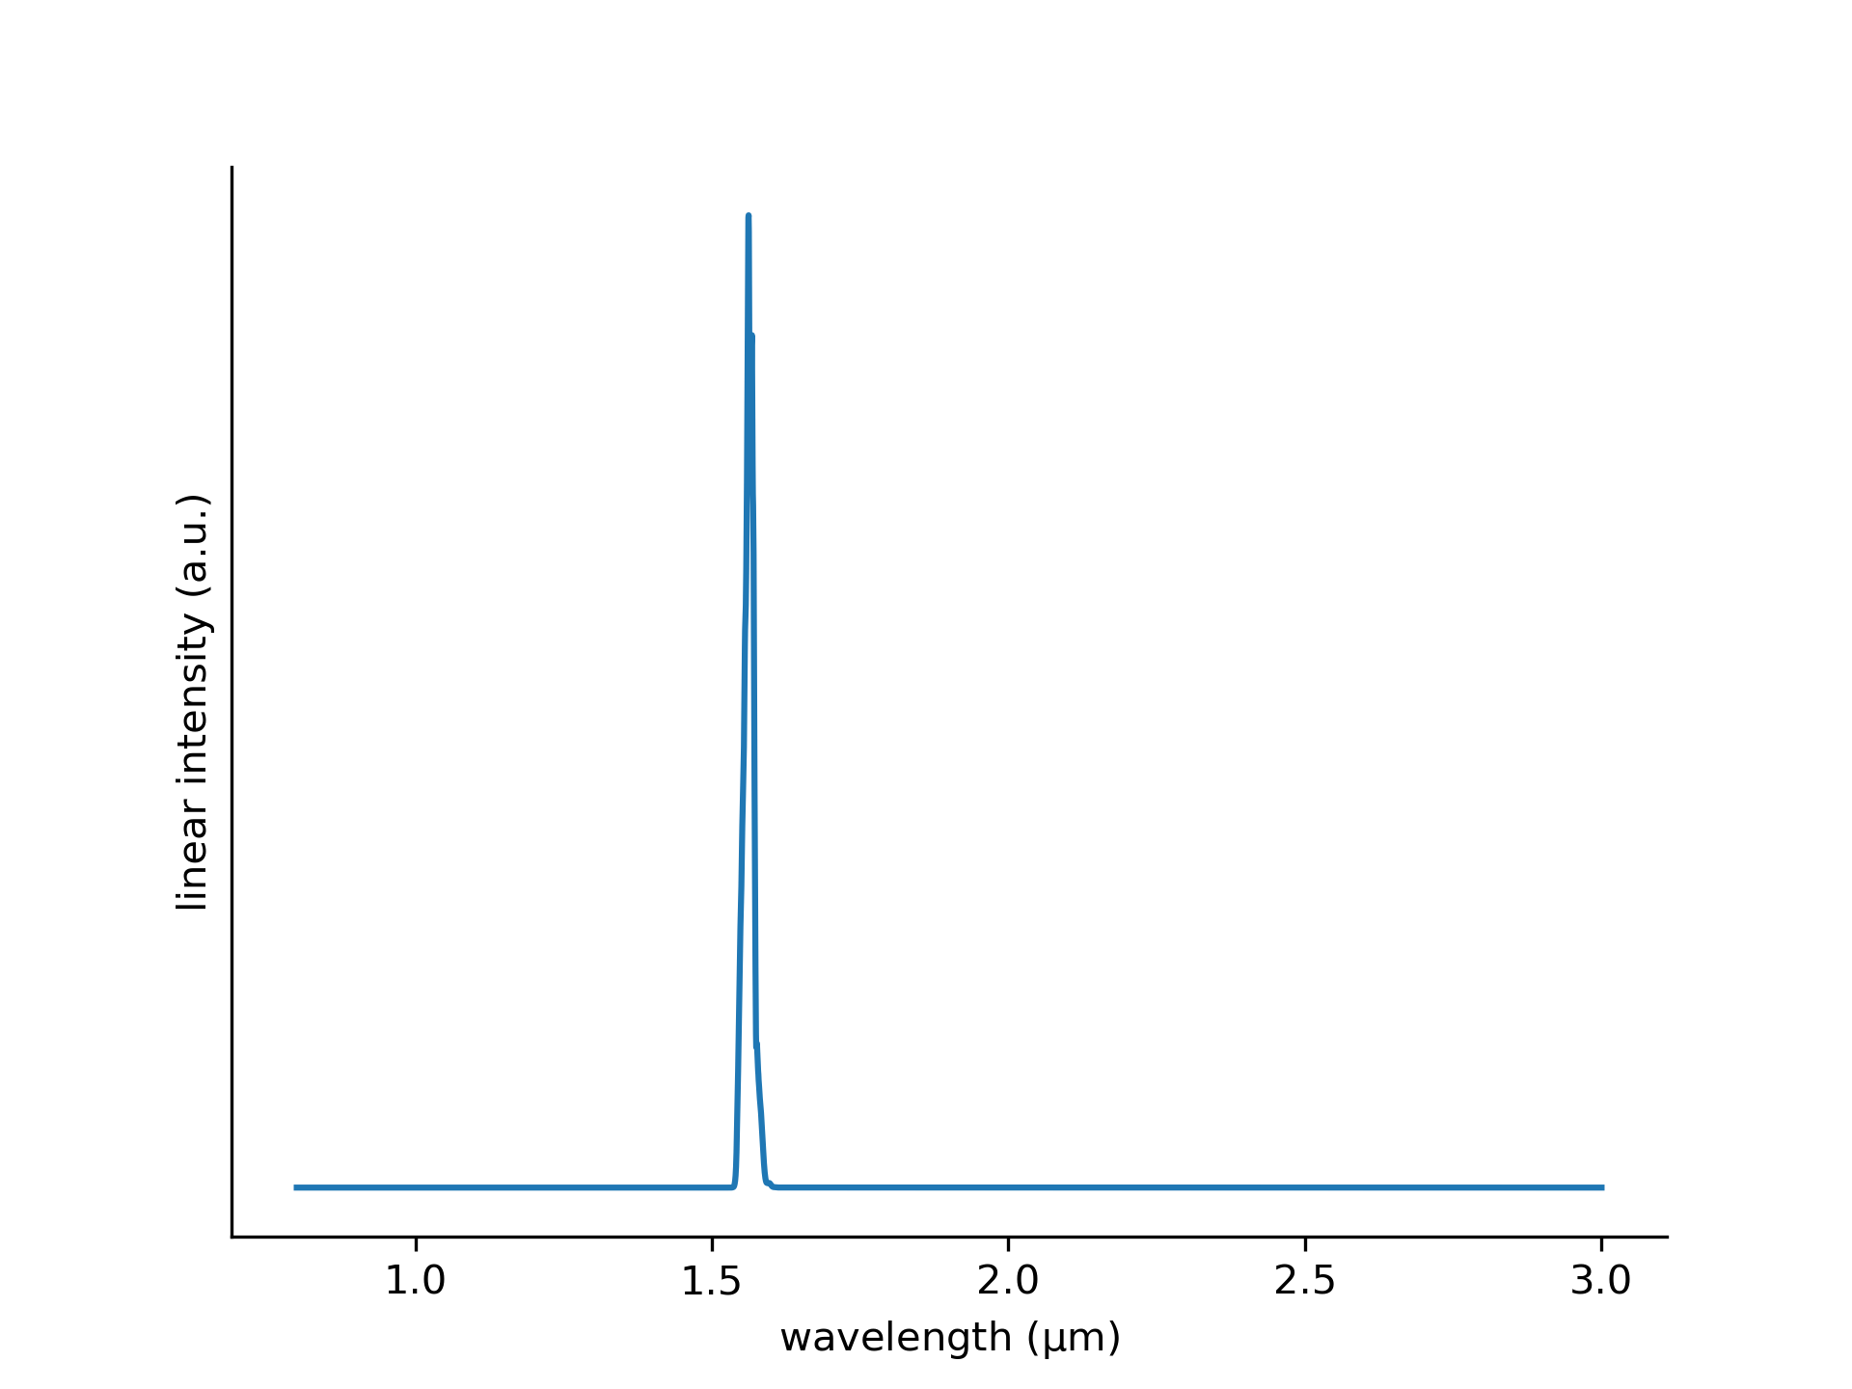
4
3

Slide 3
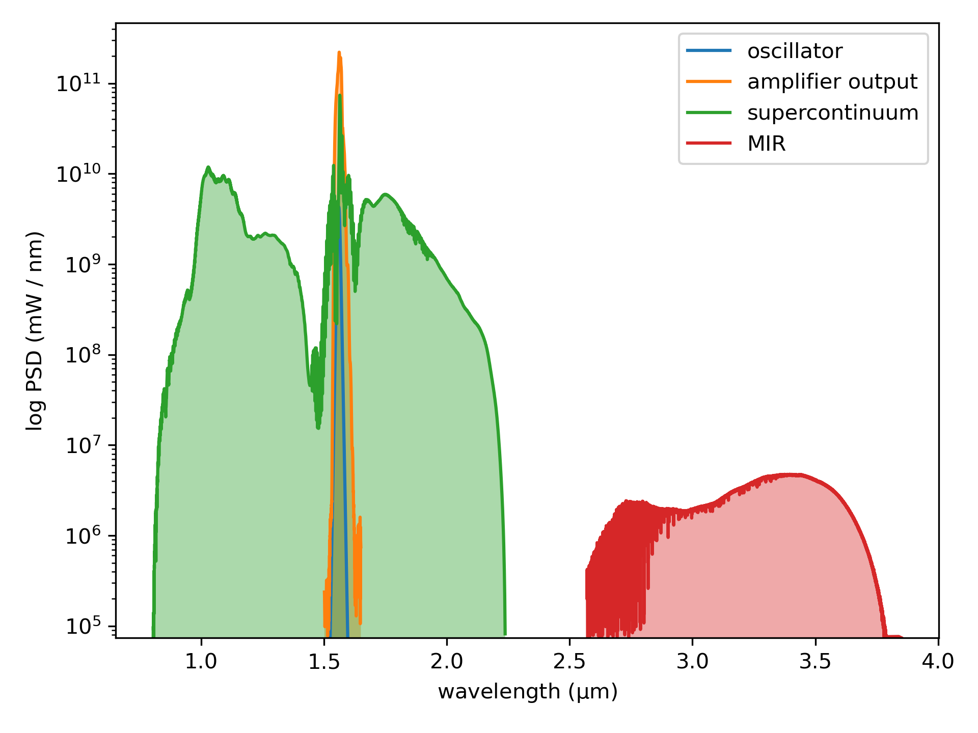
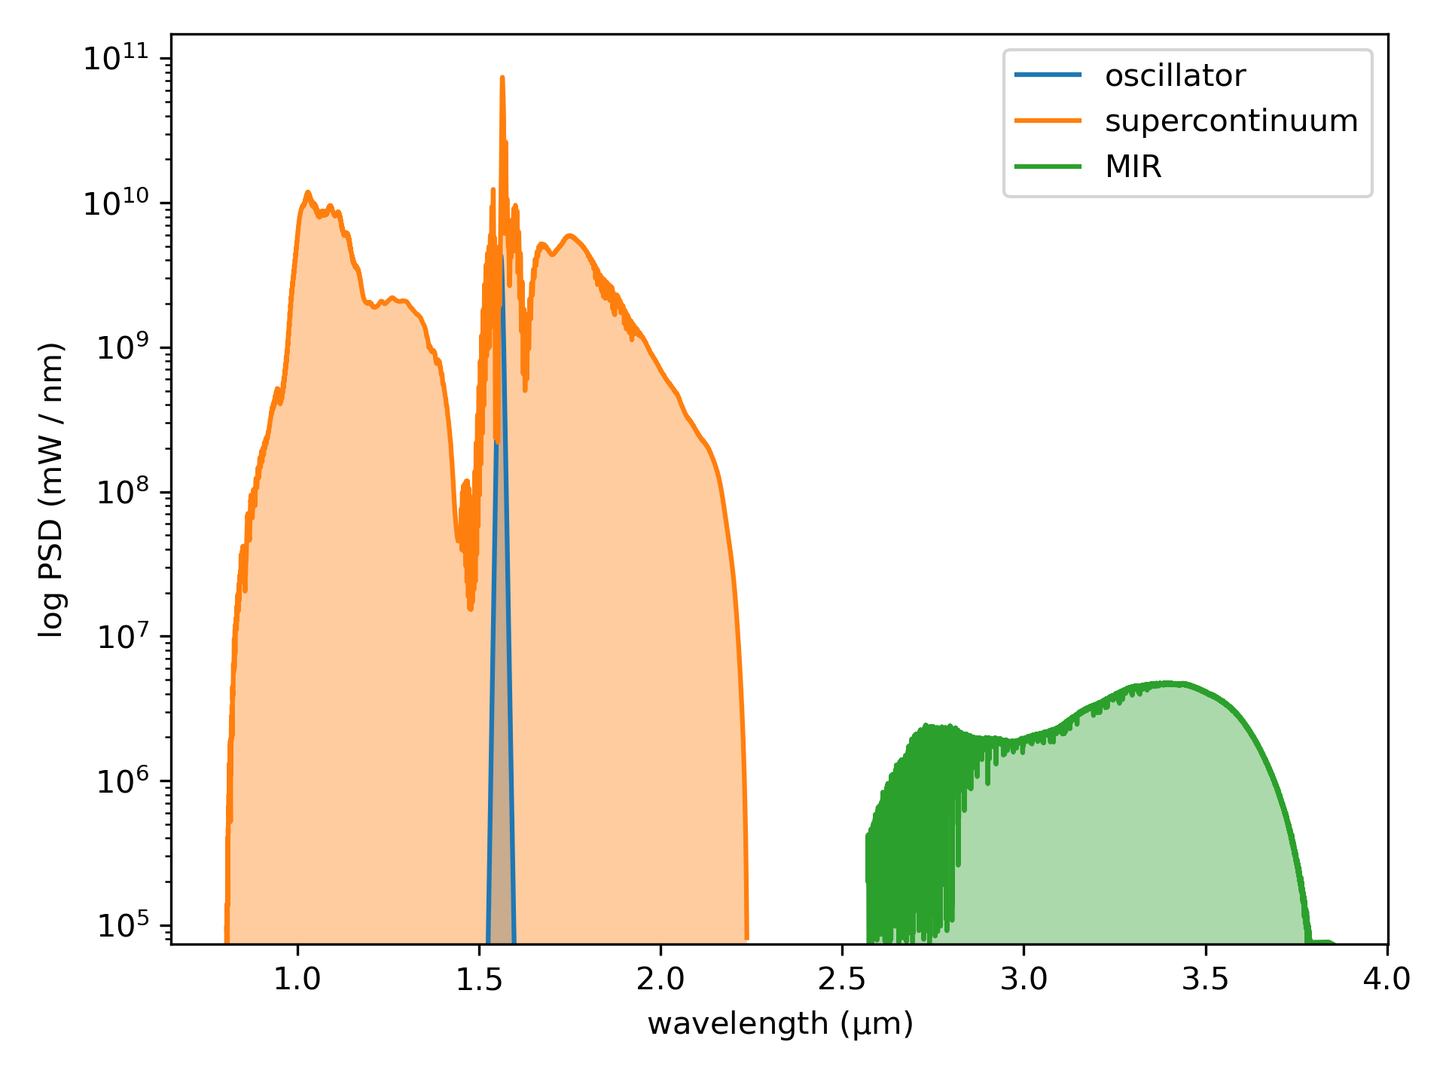

Slide 4
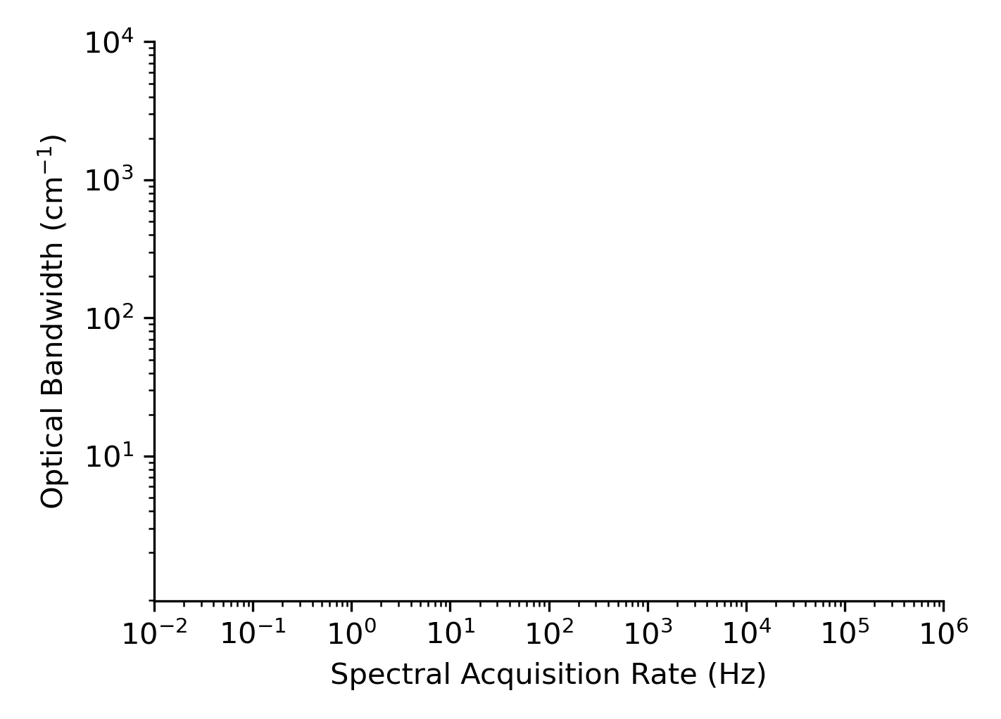
300 THz
H. Timmers et al., Optica 5, 727 (2018).
1 GHz (this work)
Future?
100 MHz DCS
1 GHz DCS
10 GHz DCS
Fourier Transform Spectroscopy
Scanned QCL
Raman Spectroscopy
Coherent Raman Spectroscopy
QCL DCS
300 GHz

Slide 5
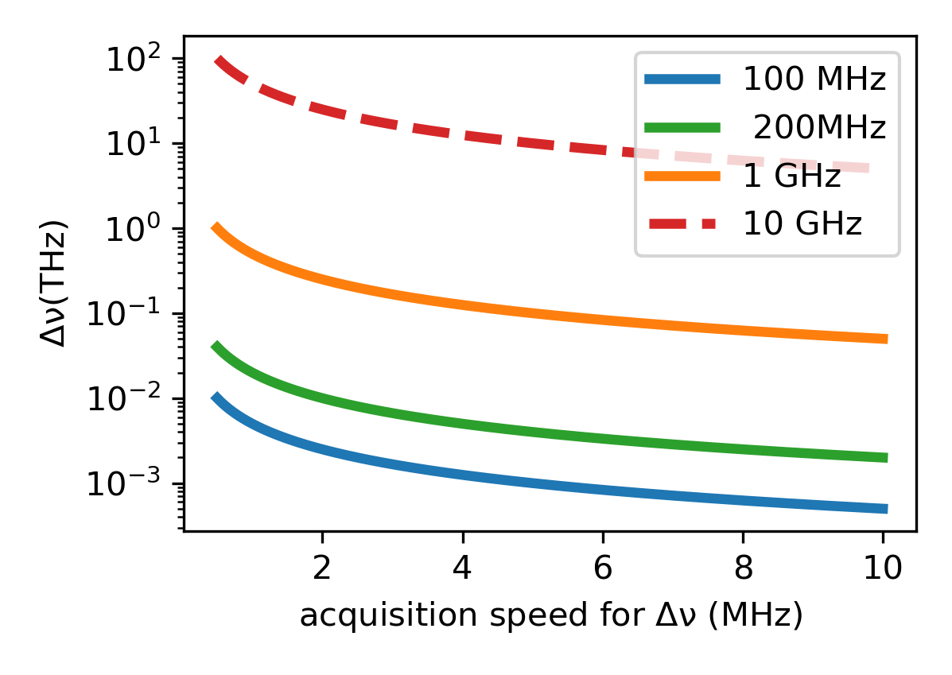
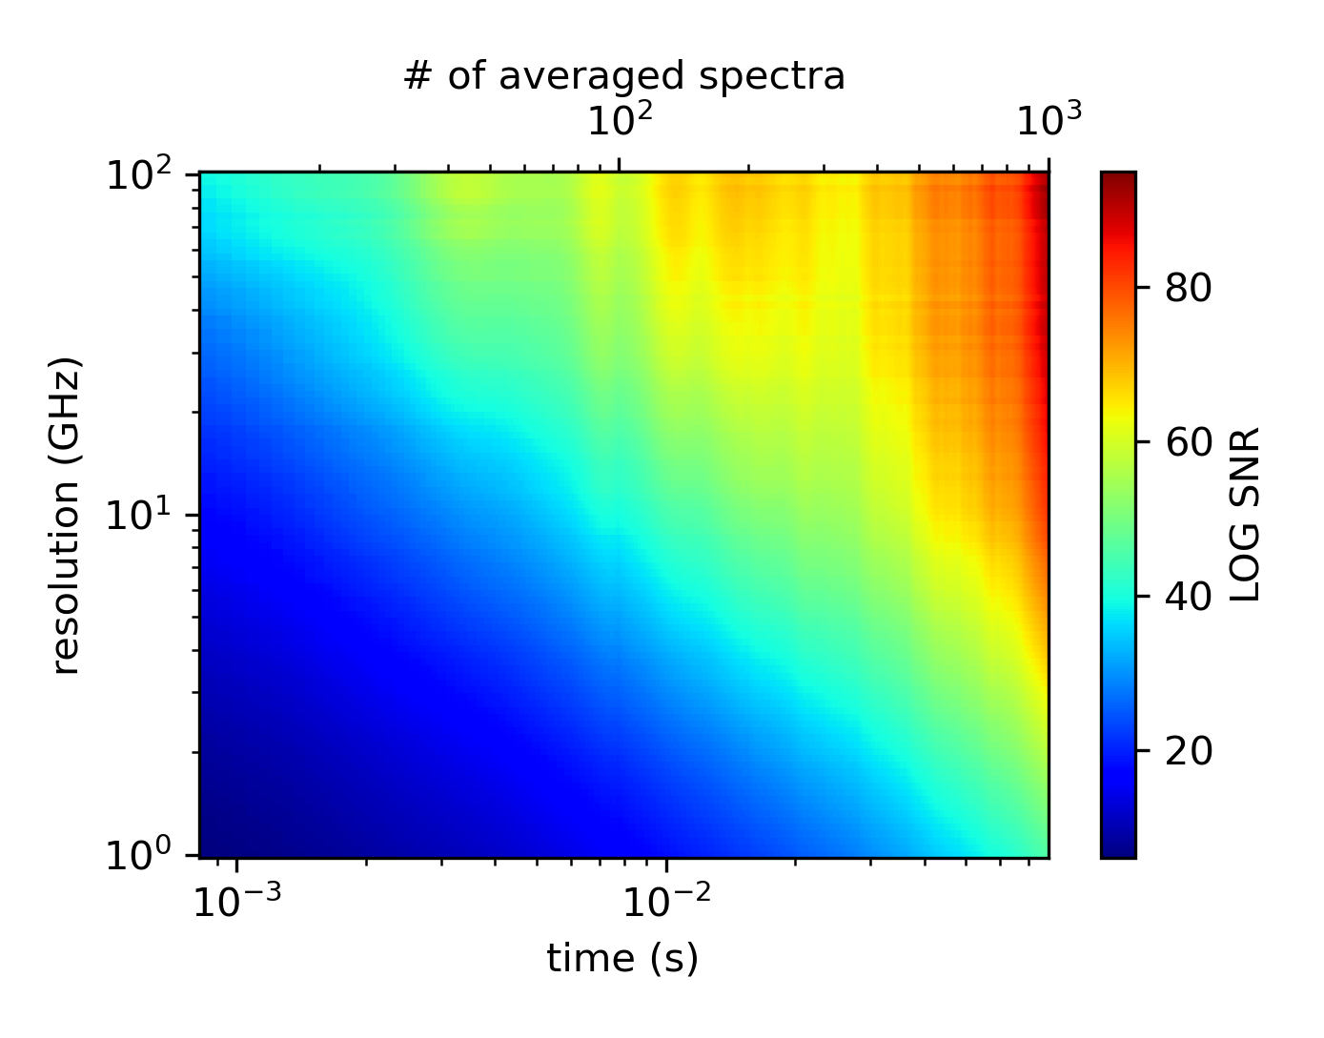
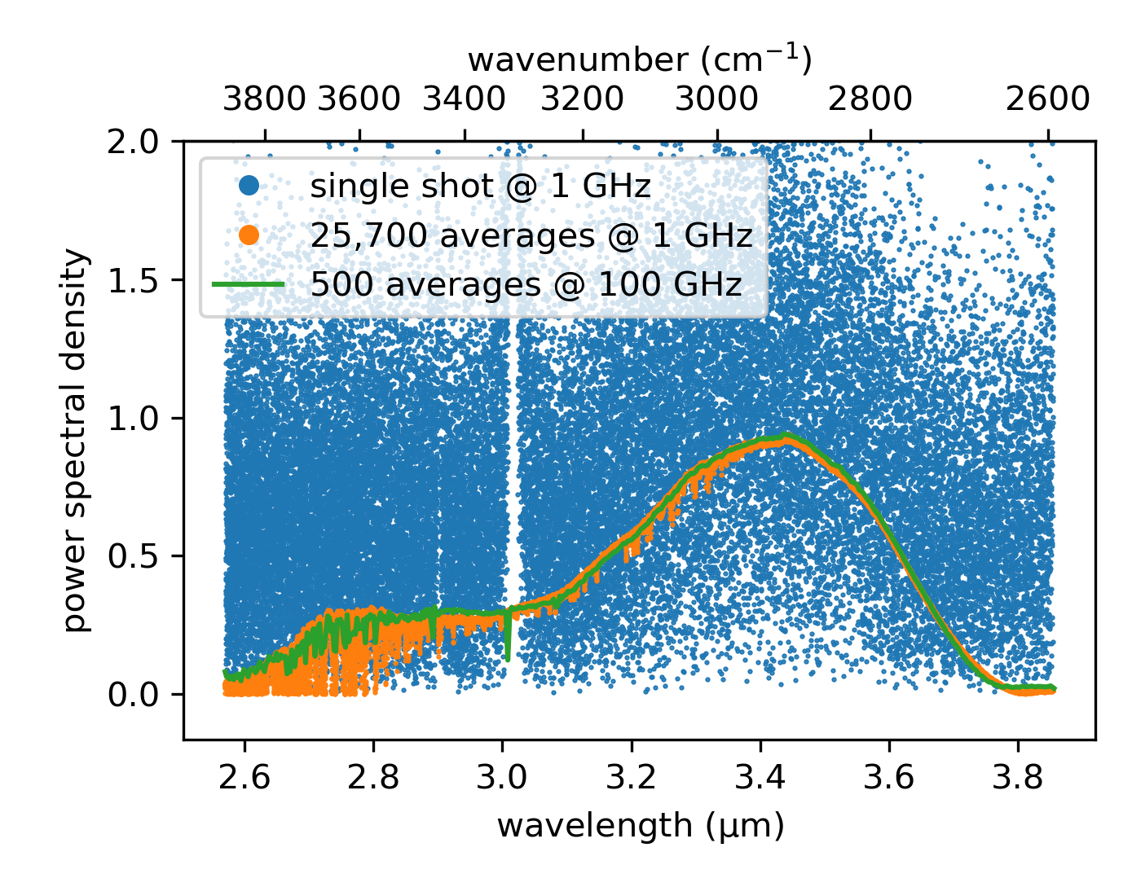
Notes:
Figure: Imaging speed in DCS Microscopy

Slide 6
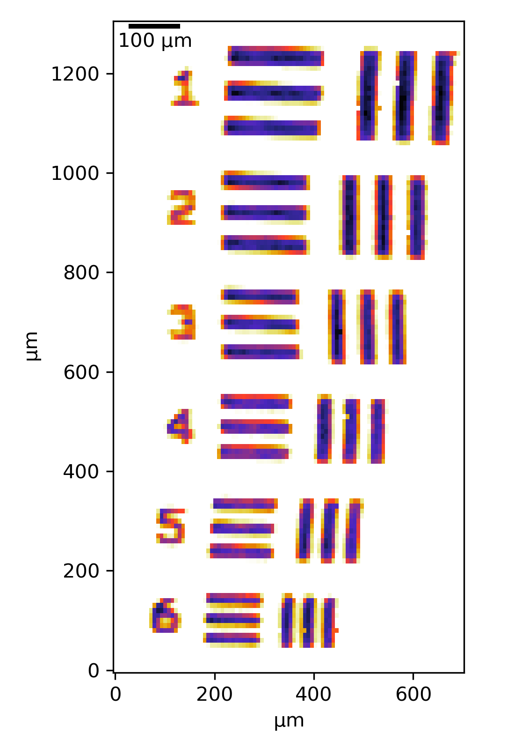
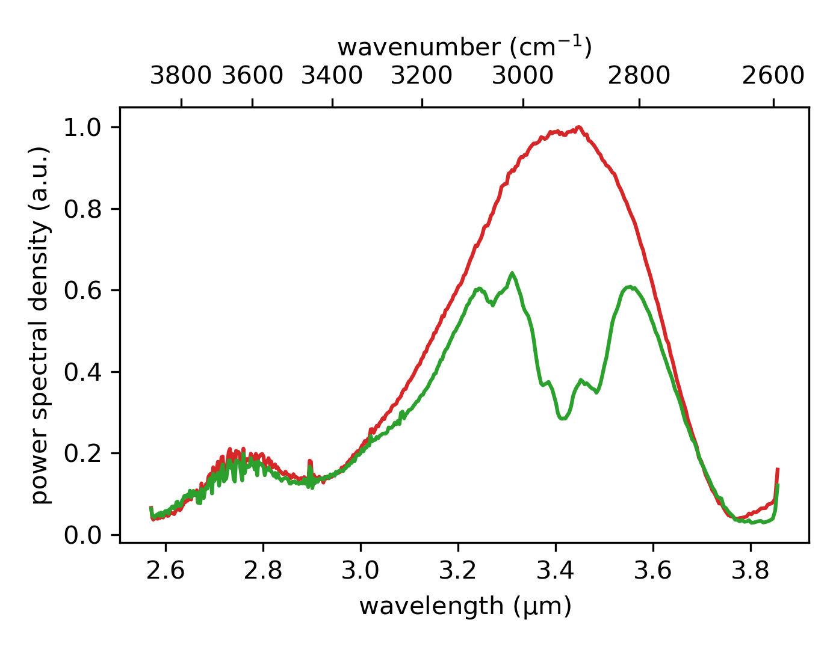
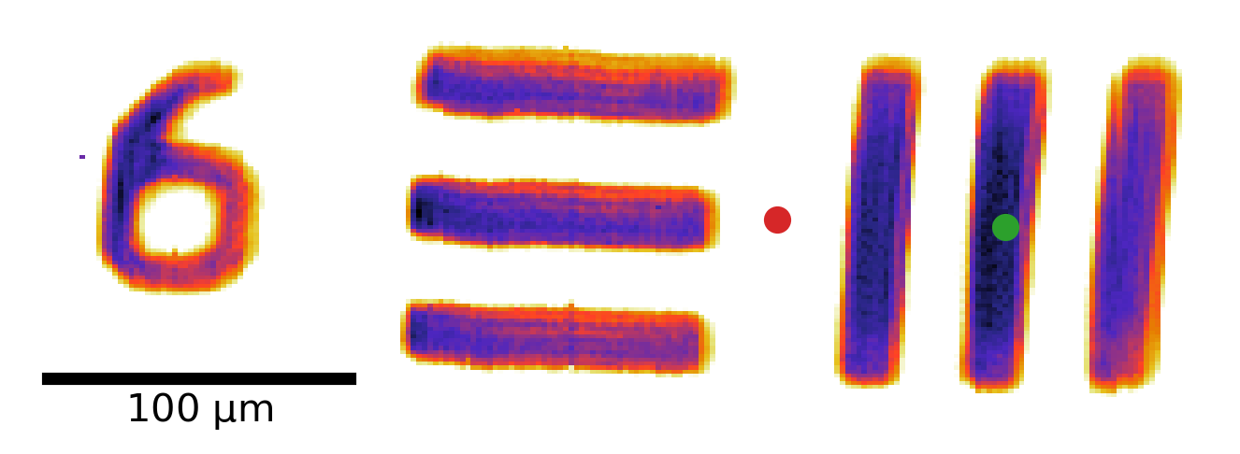
Notes:
Figure: DCS Microscopy of the USAF test pattern (SU-8 on Silicon)
(or use the original color map?)

Slide 7
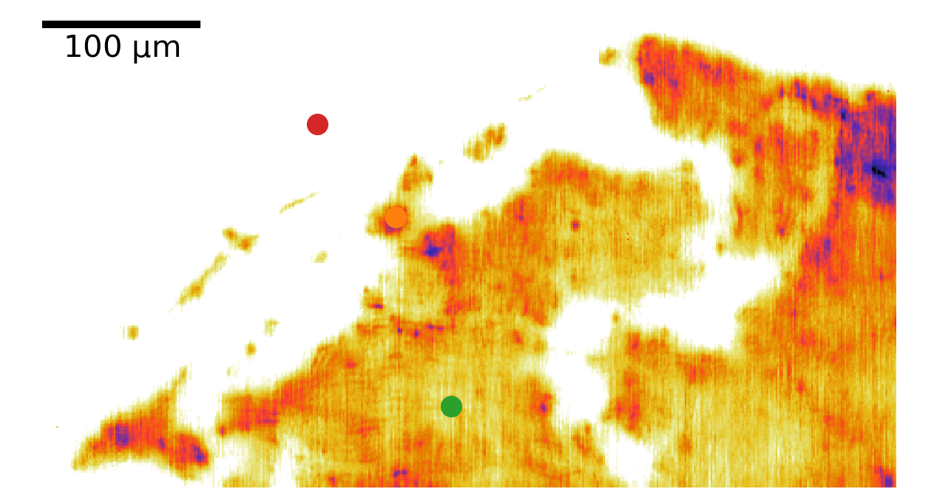
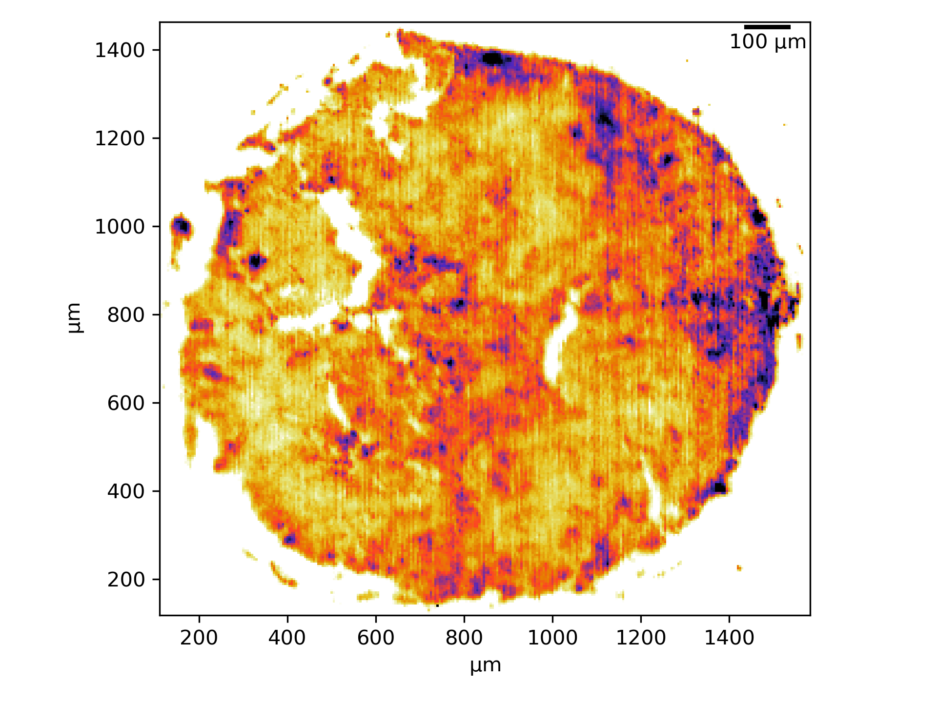
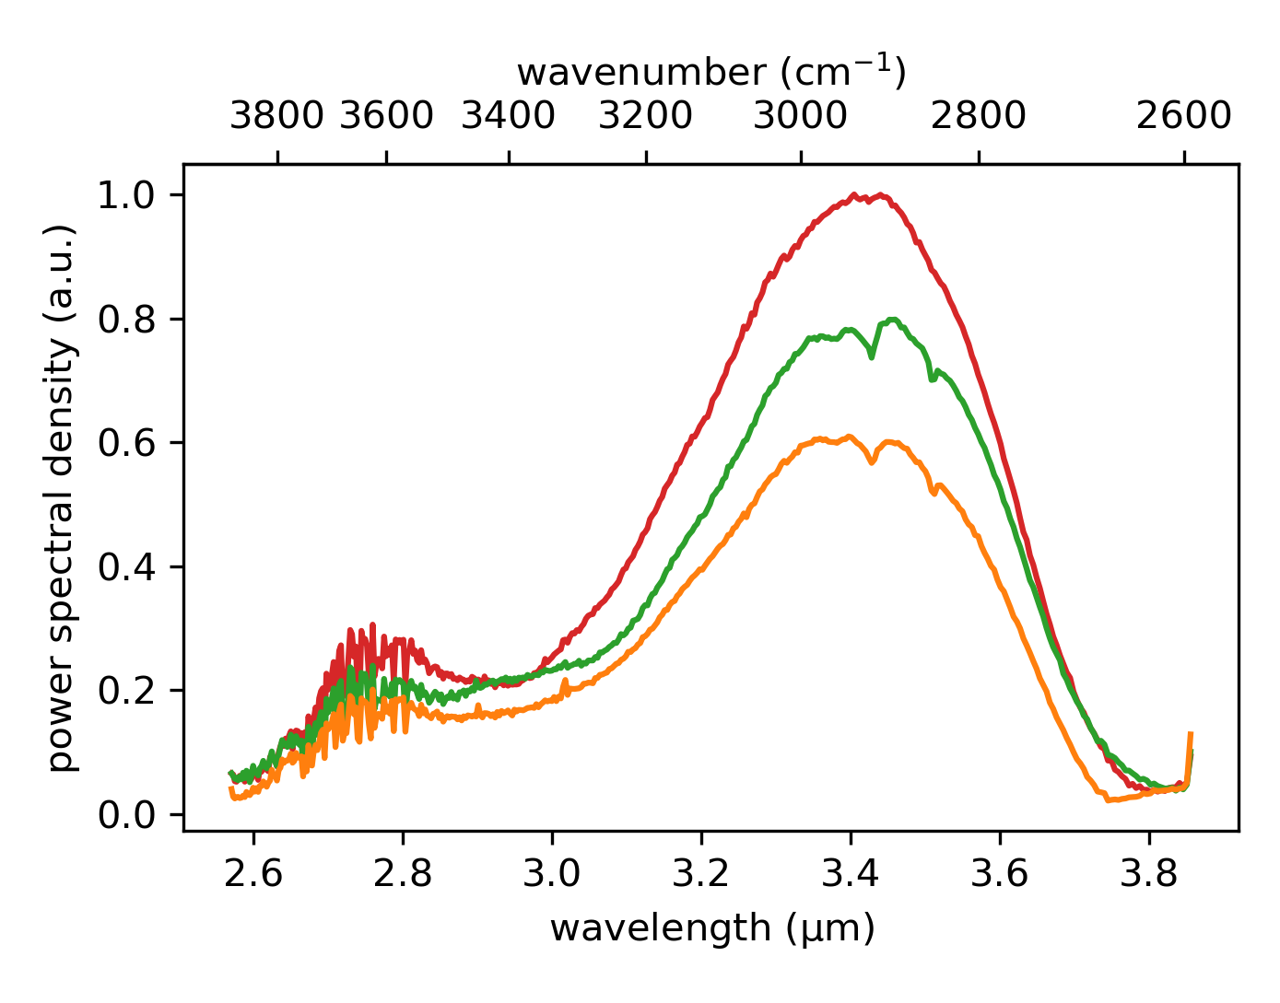
Notes:
Figure: DCS Microscopy on Ovarian cancer tissue
(Consider this color map?)

Slide 8
Ongoing

Slide 9
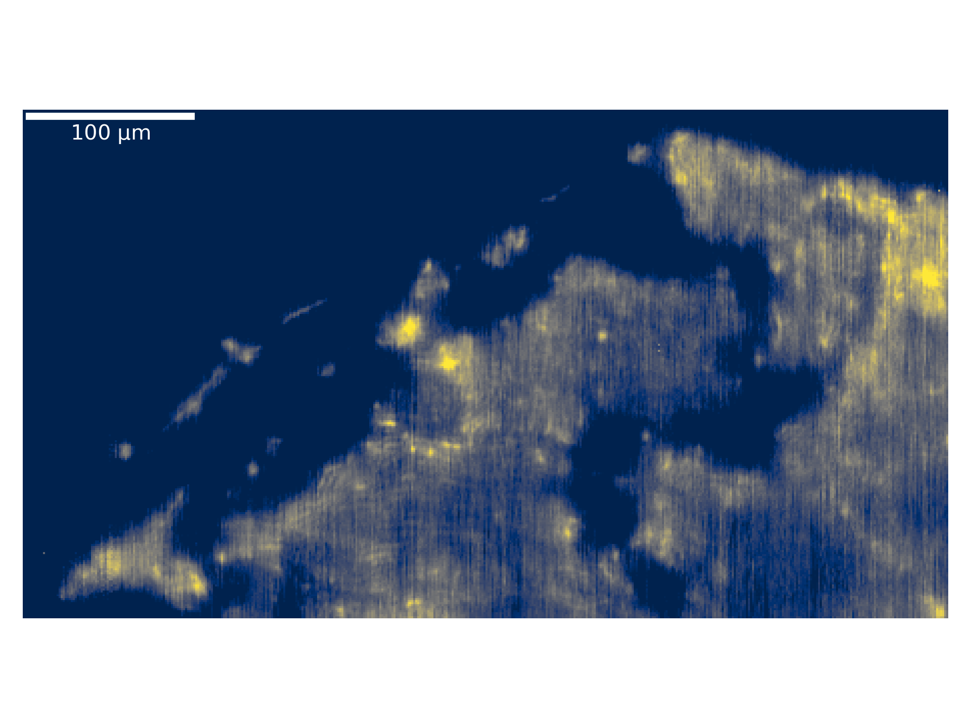
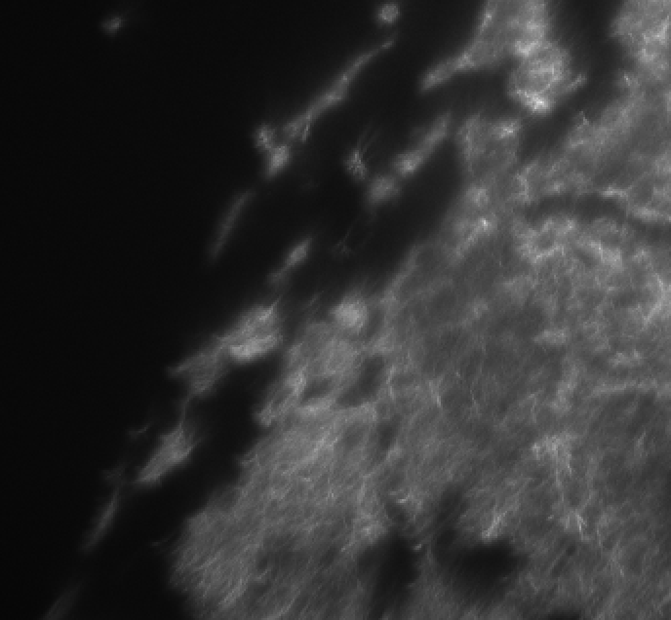
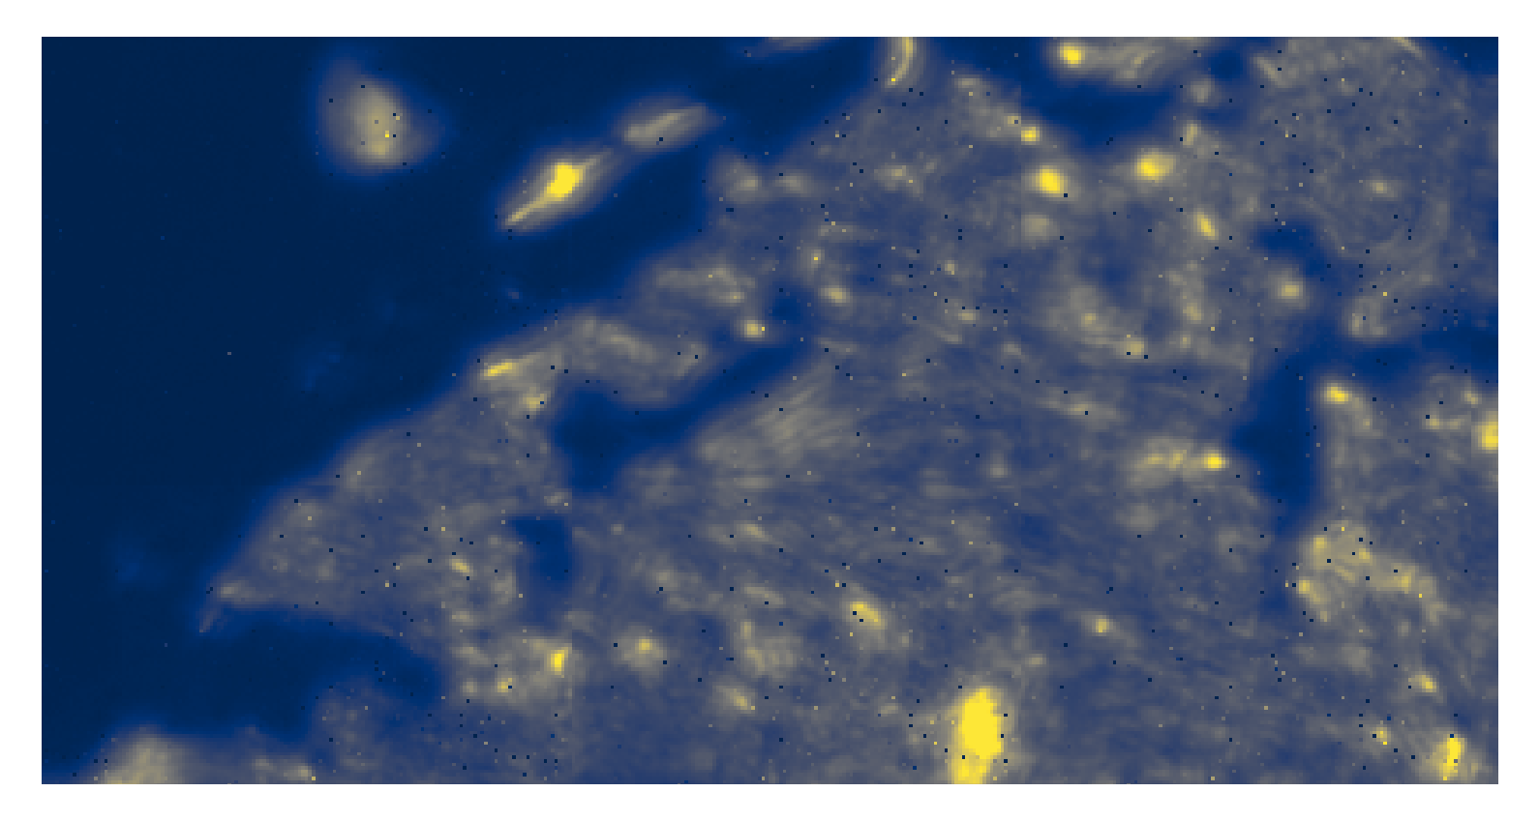
DCS – M Point Scanning
Camera Image
FTIR - FPA

Slide 10
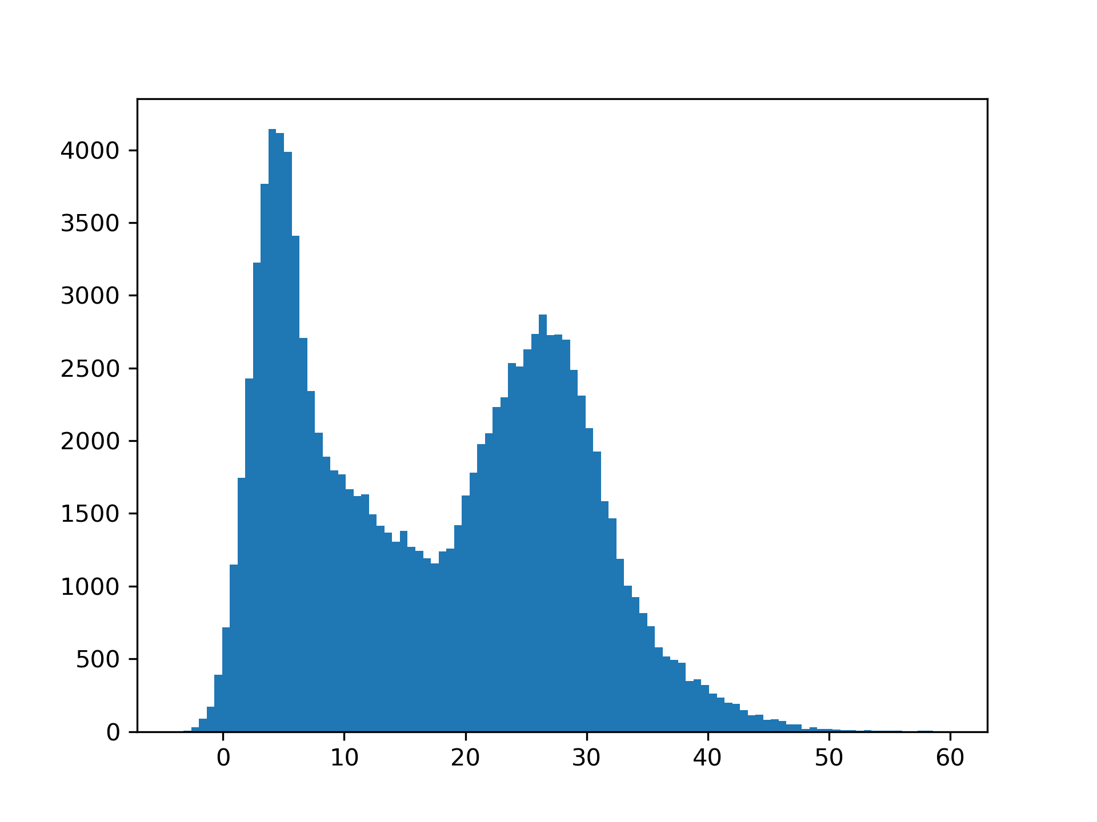
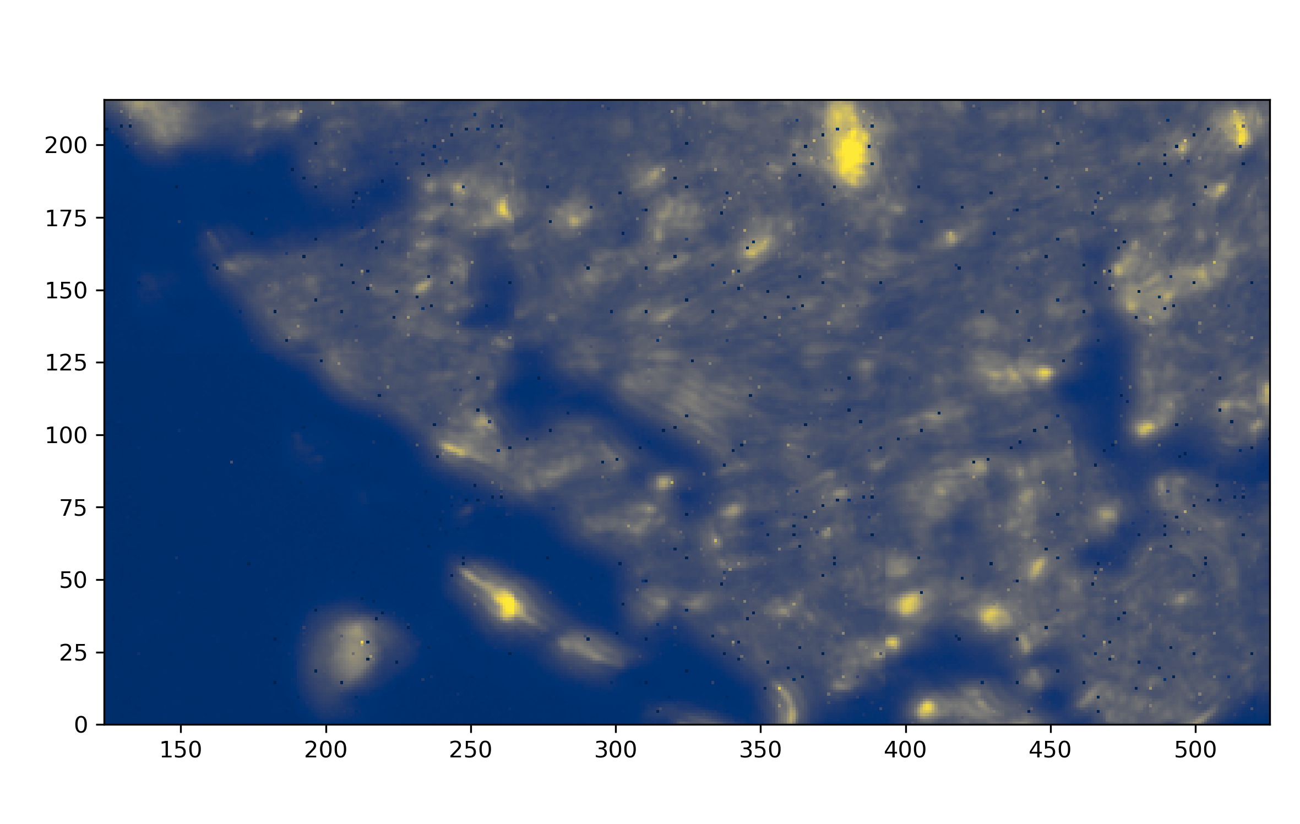
Basler Camera Image
background
signal
FTIR Image
Notes:
It’s difficult to do background subtraction here to completely remove the noise because the overlap between background and signal is heavier

