Slide 1
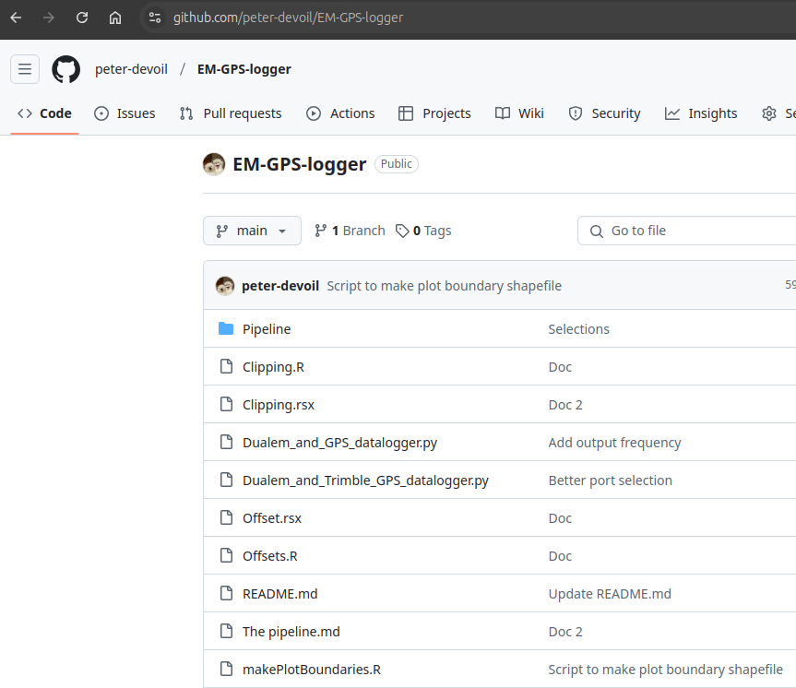
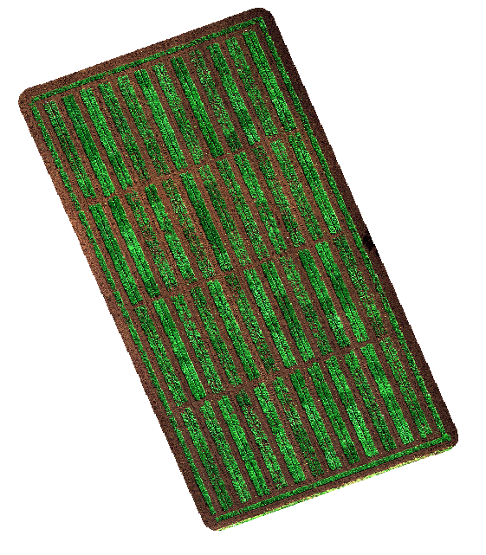


NE & SE edge

Slide 2
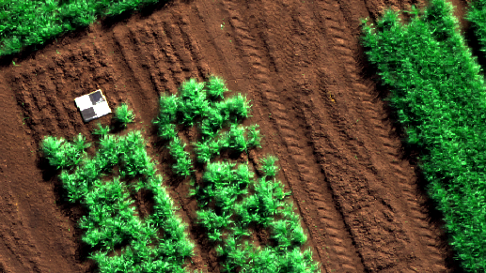
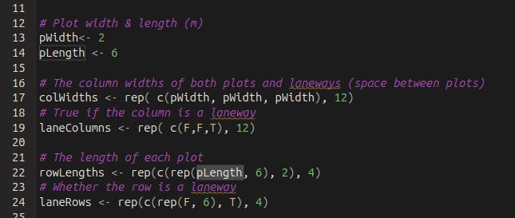
Size of each plot

Slide 3
Design of experiment - widths

Slide 4
Design of experiment - laneways

Slide 5

Design of experiment - along rows

Slide 6
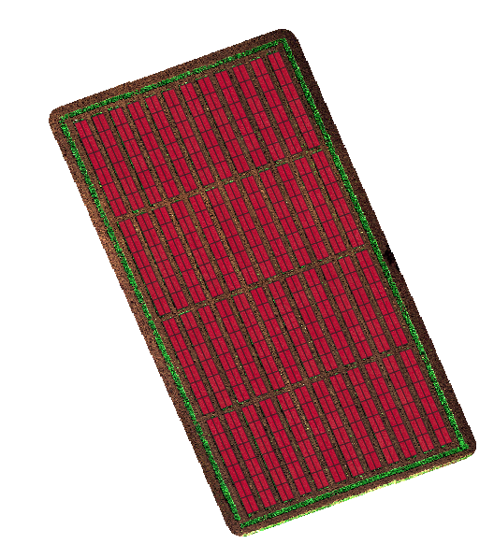

Your name here..

