Slide 1
Connecting to the Rootbot

Slide 2
GPS1
PyBoard
Orange Cube
FC
GPS2
Radio/Mavlink
I2C?
USB
4G
Wifi
Pi5
Ethernet
Router
Serial/USB
EM
Charging
(Victron)
BT

Slide 3
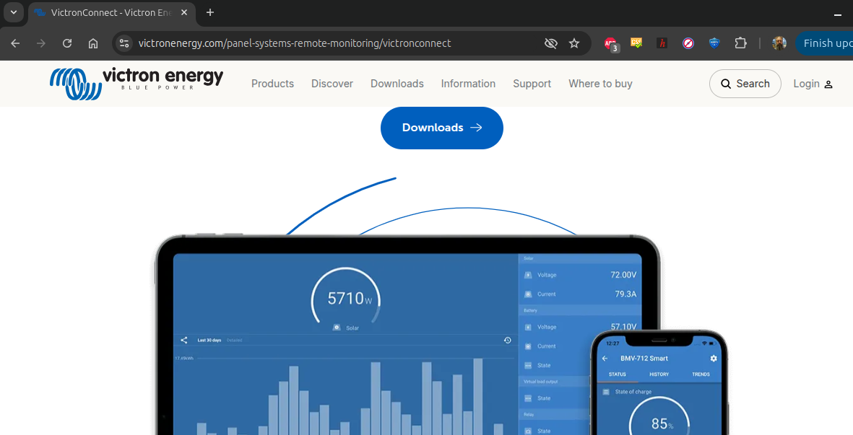
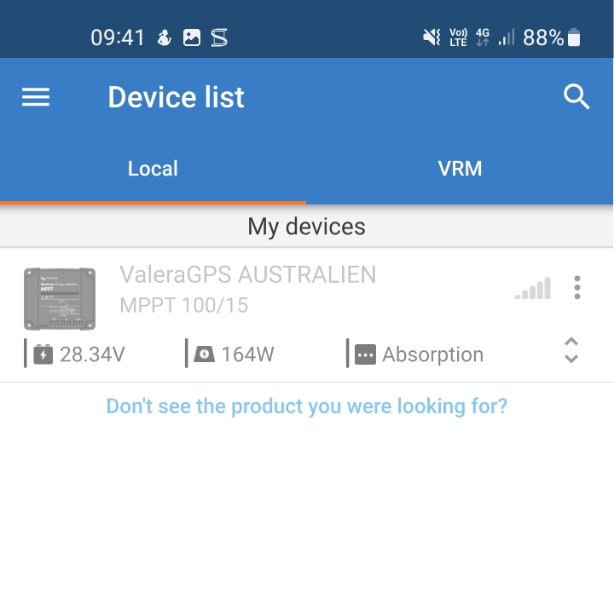
Charging unit ( victronenergy.com )

Slide 4
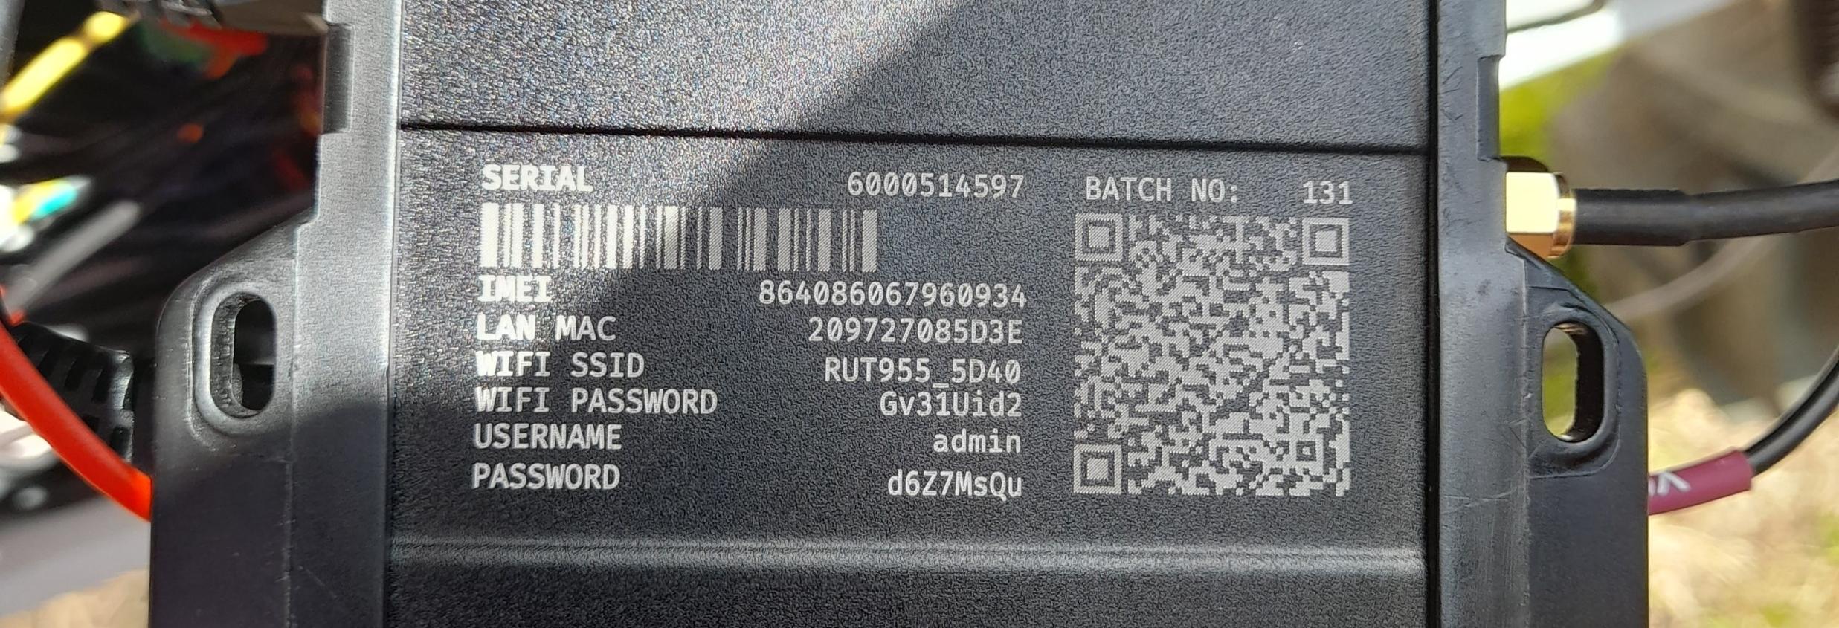
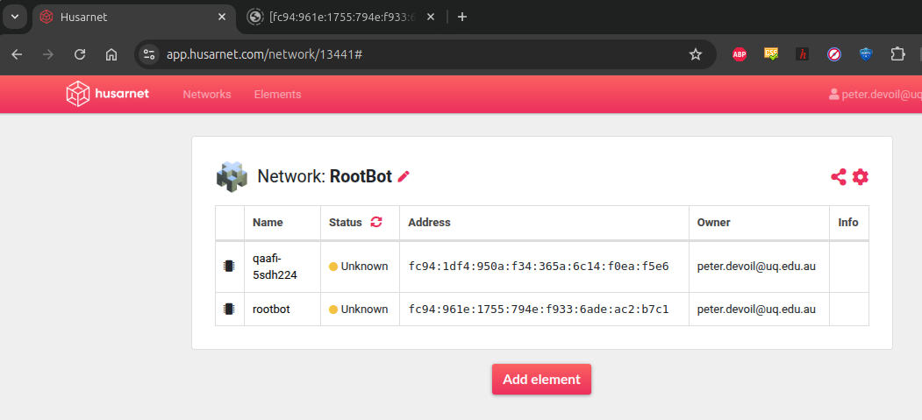
Router
Connect via WiFi RUT955_5D40, password = Gv31Uid2
Admin @ 192.168.1.1
User admin
Pass d6Z7MsQu
Pi companion 192.168.1.126
user qaafi
pass qaafi
Vpn (husarnet)

Slide 5
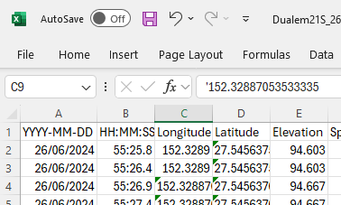
Monitor
Python app, starts at boot
Access through
WiFi: http://rootbot:8080/
VPN: http://[fc94:961e:1755:794e:f933:6ade:ac2:b7c1]:8080/
ssh: qaafi@rootbot (pass qaafi)
EM
GPS
Pi5

