Slide 1
Operation System Program 1
Kernel-Mode Multi-Process Programming

Slide 2
Introduction
In multitasking operating systems, processes (running programs) need a way to create new processes,
e.g. to run other programs. Fork and its variants are typically the only way of doing so in Unix-like systems.
For a process to start the execution of a different program, it first forks to create a copy of itself.
Then, the copy, called the “child process", calls the exec system call to overlay itself with the other program
it ceases execution of its former program in favor of the other.

Slide 3
Child Process
Processes are the primitive units for allocation of system resources. Each process has its own address space and one or more thread of control.
A process executes a program; you can have multiple processes executing the same program
But each process has its own copy of the program within its own address space and executes it independently of the other copies.

Slide 4
Process Creation Concept
Each process is named by a process ID number.
A unique process ID is allocated to each process when it is created. The lifetime of a process ends when its termination is reported to its parent process;
at that time, all of the process resources, including its process ID, are freed.
Processes are created with the fork system call (so the operation of creating a new process is sometimes called forking a process).
The child process created by fork is an exact clone of the original parent process, except that it has its own process ID.

Slide 5
Process Creation Concept
After forking a child process, both the parent and child processes continue to execute normally. If you want your program to wait for a child process to finish executing before continuing, you must do this explicitly after the fork operation, by calling wait or waitpid.
These functions give you limited information about why the child terminated for example, its exit status code.
The fork function is the primitive for creating a process. It is declared in the header file `unistd.h'.
Function: pid_t fork (void)

Slide 6
Executing a File
This slides describes the exec family of functions, for executing a file as a process image. You can use these functions to make a child process execute a new program after it has been forked.
int execl (const char *filename, const char *arg0, ...)
int execve (const char *filename, char *const argv[], char *const env[])
int execle (const char *filename, const char *arg0, char *const env[], ...)
int execvp (const char *filename, char *const argv[])
int execlp (const char *filename, const char *arg0, ...)
You need to verify the difference.

Slide 7
Process Completion
The functions described in this slide are used to wait for a child process to terminate or stop, and determine its status.
These functions are declared in the header file `sys/wait.h'.
pid_t waitpid (pid_t pid, int *status_ptr, int options)
pid_t wait (int *status_ptr)

Slide 8
Process Completion Status
If the exit status value of the child process is zero, then the status value reported by waitpid or wait is also zero.
You can test for other kinds of information encoded in the returned status value using the following macros
int WIFEXITED (int status)
int WIFSIGNALED (int status)
int WIFSTOPPED (int status)
For more information check the header file `sys/wait.h'.

Slide 9
Standard signals
Linux supports the standard signals listed below.
SIGQUIT 3
SIGKILL 9
SIGTERM 15
…etc
Several signal numbers are architecture-dependent.
For more information , please check the header file ‘signal.h’

Slide 10
Program 1-1
In this program, you have to write a user mode process monitor that oversees its own child process.
First this monitor forks a child process to execute the test program
When child process finish executing , the child process will enter zombie status. And the parent process halt and receive(block receiving) the SIGCHLD signal by wait() function.

Slide 11
Program 1-1
After receiving the SIGCHLD signal , you will know exit state of child process by checking the SIGCHLD signal
If normal termination, print normal termination
If not normal termination, print the situation of child process
Hint: checking the WEXITSTATUS and WTERMSIG …etc
You have to print the parent process id and following error message on the screen.

Slide 12
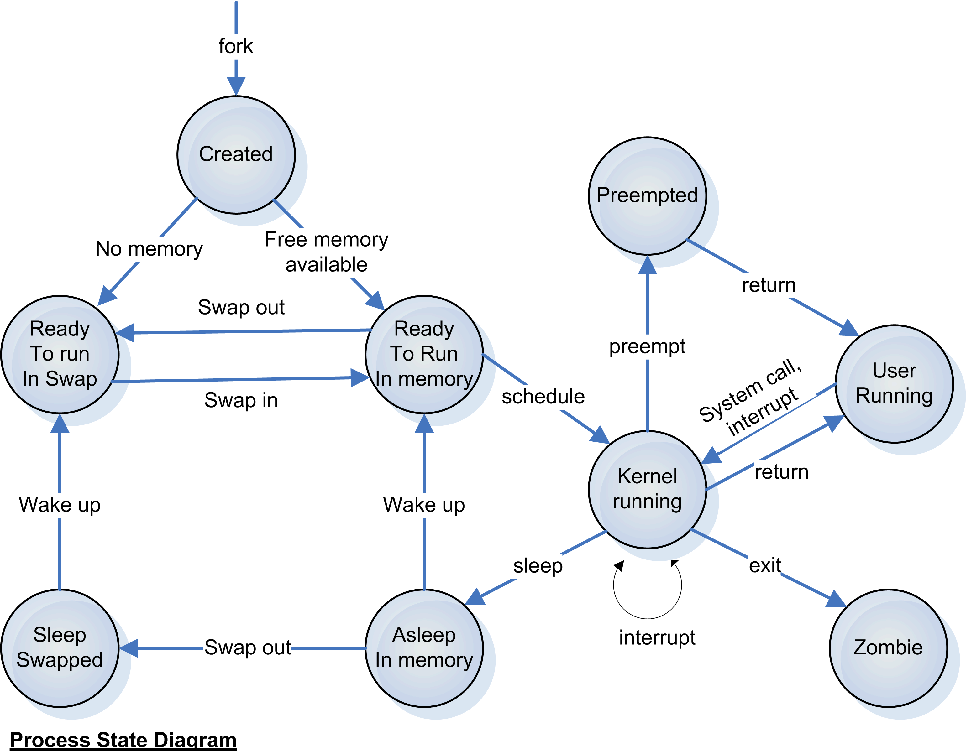
Process state diagram

Slide 13
monitor
fork
Child process
Wait until child process finish
Execute
Check the return signal
Test program
Finish
Print normal termination or the following error message
Return status signal

Slide 14
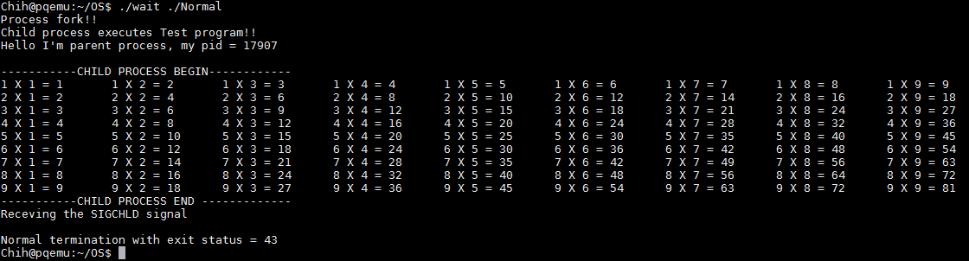
DEMO
Path of test program.
YOU can see that the child process was terminated normally.

Slide 15
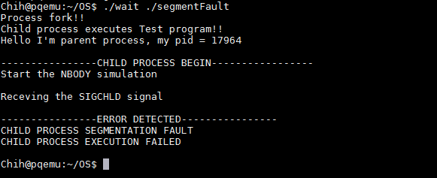
DEMO
Segmentation fault detected!!

Slide 16
Program 1-2
In this program, we also want you to implement a fork function and wrap your program into a kernel object (.ko file) that insert into your OS kernel
In next slide, we will show you how to insert an kernel object into your own OS kernel.

Slide 17
Program 1-2
We will give you an template, you need to create an kernel thread and run a function name call my_fork to implement your fork function.
We will give you a makefile to compile your program to kernel object.
$make (to compile your program)
$make clean(to delete the files that generated by makefile)

Slide 18
Kernel Object
A loadable kernel module (or LKM) is an object file that contains code to extend the running kernel, or so-called base kernel
LKMs are typically used to add support for new hardware and/or filesystems, or for adding system calls.
Most current Unix-like systems support loadable kernel modules, although they might use a different name for them,
such as kernel loadable module (kld), kernel extension (kext) in and kernel-mode driver

Slide 19
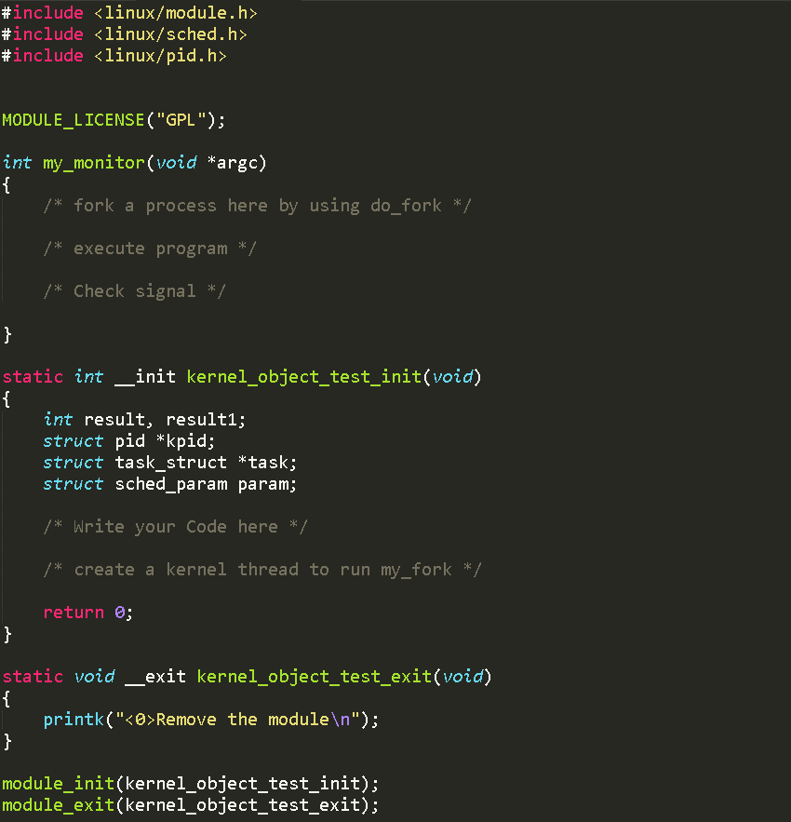

Slide 20
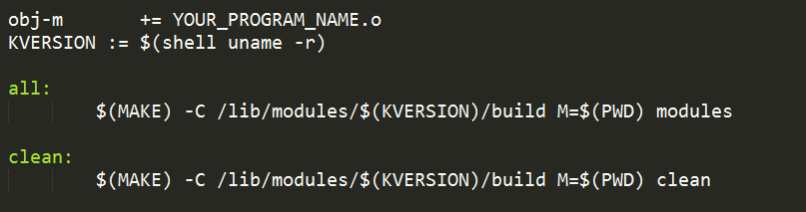
Modify here to match your program name

Slide 21
How to insert module
Before insert the kermel object, you have to sign in the root account.
$ sudo su
And type the command to insert your module
$insmod MODULE_NAME.ko
How to list all the module you insert
$ Ismod (小寫 L)
This command will remove your module
$rmmod MODULE_NAME.ko
Always remember to remove your module!!!

Slide 22
Create Kernel thread
The first step in creating a kernel thread is to define a "thread function" which will contain the code to be executed;
int thread_function(void *data);
A kernel thread is created with:
struct task_struct *kthread_create(int (*threadfn)(void *data), void *data, const char *namefmt, ...);
The data argument will simply be passed to the thread function.
The thread will not start running immediately;
to get the thread to runpass the task_struct pointer returned by kthread_create() to wake_up_process().

Slide 23
Create Kernel thread
There is also a convenience function which creates and starts the thread:
struct task_struct *kthread_run(int (*threadfn)(void *data), void *data, const char *namefmt, ...);

Slide 24
Steps in fork
Calls dup_task_struct(), which creates a new kernel stack, thread_info structure, and task_struct for the new process.
calls get_pid() to assign an available PID to the new task.
copy_process() then either duplicates or shares open files, filesystem information, signal handlers, process address space, and namespace.
For more details
http://www.makelinux.net/books/lkd2/ch03lev1sec2 (fork steps)
http://lxr.free-electrons.com/source/kernel/fork.c (do_fork)

Slide 25
Steps to execute program
First you have to understand data structure struct linux_binprm.
http://lxr.free-electrons.com/source/include/linux/binfmts.h
And use prepare_bprm_creds API to initialize the struct.
Open your program file and assign corresponding values into struct linux_binprm
And use the bprm_mm_init and prepare_binprm to prepare execute your binary program

Slide 26
Steps to execute program
Read the file content and copy corresponding information into your struct linux_binprm.
Search_binary_handler to execute your binary program
For more detail information:
Binary format header
http://lxr.free-electrons.com/source/include/linux/binfmts.h
Execve implementation in linux kernel
http://lxr.free-electrons.com/source/fs/exec.c

Slide 27
Catch the signal
After execve succeeded, you have to call acct_update_integrals and free the binary program by calling free_brpm
And check the signal struct which is one of the member in task struct.

Slide 28
Bonus
Create the executable file, named myfork
Execute “./myfork testprogram” will show the signal message that child process execute testprogram.
We can add many executable files as the argument of myfork, such as “./myfork testprogram1 testprogram2 testprogram3”, the testprogram2 is the child of testprogram1, the testprogram3 is the child of testprogram2, and so on.

Slide 29
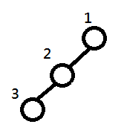
Bonus
Create the executable file, named watproc
Execute “./watproc myfork” after myfork execute that show the message of process state of myfork process and its descendants.
For example :
1 -> 2 -> 3 (number is the pid of each process)

Slide 30
Grading policy
User mode monitor : 8
Kernel mode my_fork : 10
Bonus : 11

Slide 31
Reference
Process API
http://www.cs.utah.edu/dept/old/texinfo/glibc-manual-0.02/library_23.html
http://man7.org/linux/man-pages/man7/signal.7.html
Unix process state diagram
http://www.ksvali.com/wp-content/uploads/2009/09/processstate.gif

Slide 32
Reference
How to compile .ko file
http://www.cyberciti.biz/tips/compiling-linux-kernel-module.html
Kernel thread
http://tuxthink.blogspot.tw/2011/02/kernel-thread-creation-1.html
Insert Kernel module
http://www.tldp.org/HOWTO/Module-HOWTO/x197.html

Slide 33
Reference
Fork implementation
http://www.makelinux.net/books/lkd2/ch03lev1sec2
http://lxr.free-electrons.com/source/kernel/fork.c
Process Descriptor and the Task Structure
http://www.makelinux.net/books/lkd2/ch03lev1sec1

