Slide 1
Operation System Program 2
Multi-Thread Programming

Slide 2
Program 2
In this program, we want you to write a Pthread program to implement the “River and Frog” game.
A river has logs floating on it, and a frog must cross the river by jumping on the logs as they pass by.

Slide 3
Program 2
You win if the frog makes it to the opposite side of the river
You lose if the frog lands in the river or the log reach the left(right) side of the river and the frog still on it.
You have to print win or lose message.

Slide 4
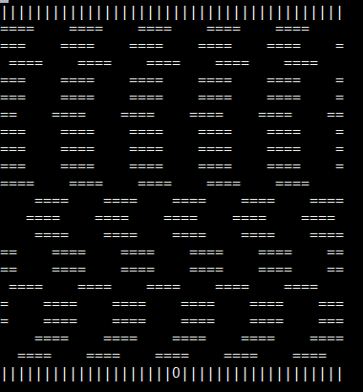
Program 2
log
frog

Slide 5
Program 2
The user control the frog jumps by keyboards
W : up
S : down
A : left
D : right
Q : quit the game

Slide 6
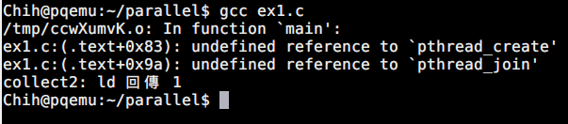
Program 2
If you meet the following situation, when you compile your program
Try to compile your program with following
$ gcc YOUR_PROGRAM -lpthread

Slide 7
Bonus
You have to implement a graphical output of your river and frog game.
You can use any library you like to show your graphical output
The length of log must be different by random generating.
You need to design a slide bar to adjust the speed of floating logs.

Slide 8
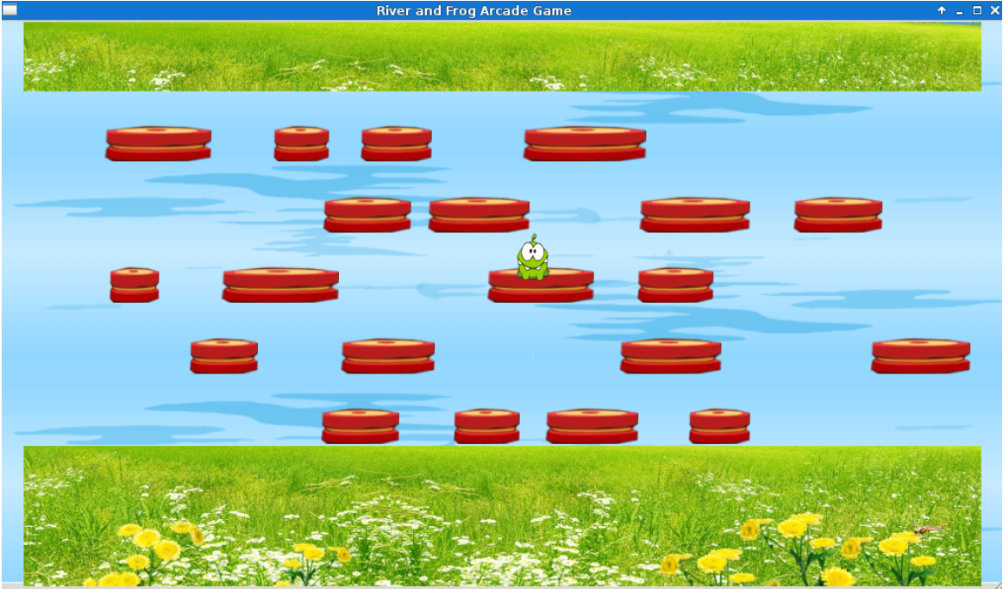
Bonus example

Slide 9
Reference
Pthread document
http://www.cs.nthu.edu.tw/~ychung/slides/para_programming/pthread.pdfUnix process state diagram
Data parallelism
http://en.wikipedia.org/wiki/Data_parallelism

