Slide 1
Operation System Program 4
File-System

Slide 2
Project Introduction
File systems provide efficient and convenient access to the disk by allowing data to be stored, located, and retrieved easily. A file system poses two quite different design problems. The first problem is defining how the file system should look to the user. This task involves defining a file and its attributes, the operations allowed on a file, and the directory structure for organizing files. The second problem is creating algorithms and data structures to map the logical file system on to the physical secondary-storage devices.

Slide 3
Project Introduction
The file-organization module knows about files and their logical blocks, as well as physical blocks. By knowing the type of file allocation used and the location of the file, the file-organization module can translate logical block address to physical block address for the basic file system to transfer.

Slide 4
Project Introduction
Each file’s logical blocks are numbered from 0 (or 1) through N. Since the physical blocks containing the data usually do not match the logical numbers, a translation is needed to locate each block. The file-organization module also includes the free-space manager, which tracks unallocated blocks and provides these blocks to the file-organization module when requested.

Slide 5
Project Introduction
The logical file system manages metadata information.
Metadata includes all of the file-system structure except the actual data (or contents of the files).

Slide 6
Project Introduction
The logical file system manages the directory structure to provide the file-organization module with the information the latter needs, given a symbolic file name. It maintains file structure via file-control blocks. A file-control block (FCB) (an inode in UNIX file systems) contains information about the file, including ownership, permissions, and location of the file contents.
Because there have no OS in GPU to maintain the mechanism of the logical file system, we can try to implement a simple one.

Slide 7
Project Objective
Implement a simple file system in a kernel function of GPU that have single thread, limit global memory as volume.

Slide 8
About GPU
In this project, we use CUDA API to access GPU. CUDA (Compute Unified Device Architecture) is a parallel computing platform and programming model.
We don’t consider any parallel computing technique in this project, only use single thread to serial access that let us focus our file system implementation.
Don’t worry about the syntax of CUDA, that just a extension of C language.

Slide 9
About GPU
There are many kinds of memory in CUDA GPU, we only introduce two memory (global memory and shared memory) that relate to our project.
Global memory
Typically implemented in DRAM
High access latency: 400-800 cycles
Shared memory
Extremely fast
Configurable cache
Memory size is small (16 or 48 KB)

Slide 10
Implementing GPU file system
Implement a simple file system in CUDA GPU.
In this project, we take the global memory as a volume (logical drive) from a hard disk.
No directory structure stored in volume, only one root directory, no subdirectory in this file system.
A set of file operations that may be implemented.
In this project, we use only one of GPU memory, the global memory as a volume. We don’t create the shared memory as physical memory for any data structures stored in, like system-wide open file table in memory. In this simple file system, we just directly take the information from a volume (in global memory) by single thread.

Slide 11
Volume control block (super block)
Volume
Directory structure
FCB
contents of the files
1085440 bytes
1048576 bytes

Slide 12
Specification
All the file operations must in kernel function.
Allocate volume in global memory, the size of volume is 1085440 bytes.
The size of the files total 1048576 bytes.
Load a binary file, named “data.bin” to input buffer before kernel launch. The size of “data.bin” is 1048576 bytes.
Save a binary file, named “snapshot.bin” for output buffer after kernel launch.

Slide 13
Specification
The maximum number of files is 1024.
The maximum size of a file is 1024 bytes.
The maximum size of a file name is 20 bytes.
Theoretically, you should allocate only 1085440 byes on global memory. In this project, we allow you to allocate extra 128 bytes on global memory for some system temporary values.
You should implement the free-space management.
E.g., bit vector/bit map

Slide 14
Specification
Implement a set of file and directory operations called in the kernel function.
open
read
write
rm
ls

Slide 15
Specification
open
Open a file.
Give a file pointer to find the file’s location.
Space in the file system must be found for the file.
An entry for the new file must be made in the directory.
Also accept access-mode information: read/write
When to use write mode, if no such file name can be found, create a new zero byte file.
Return a write/read pointer.

Slide 16


Specification
You must follow these format to implement:

Slide 17
Specification
You must follow these format to implement:
Write pointer
Read pointer
File name, add the end of the string with a null-terminated for implement easily.
access-mode information: G_READ/G_WRITE

Slide 18
Specification
write
To write a file.
A write pointer to the location in the file.
If the file have existed, cleanup the older contents of the file and write the new contents.
Take the input buffer to write bytes data to the file .

Slide 19
Specification
You must follow these format to implement:

Slide 20
Specification
You must follow these format to implement:
write pointer
write bytes data to the file
point to input buffer

Slide 21
Specification
read
To read contents from a file.
A read pointer to the location in the file.
To read bytes data from the file to the output buffer.
The offset of the opened file associated with the read pointer is 0 (always read the file from head.)

Slide 22
Specification
You must follow these format to implement:

Slide 23
Specification
You must follow these format to implement:
read pointer
read bytes data from the file to output buffer.
point to output buffer

Slide 24
Specification
rm
To delete a file and release the file space.
Search the directory for the named file.
Implement gsys() to pass the RM command.

Slide 25
Specification
You must follow these format to implement:

Slide 26
Specification
You must follow these format to implement:
RM is a delete command
Search the named file will be deleted.

Slide 27
Specification
ls
List information about files.
Implement gsys() to pass the LS_D/LS_S commands.
LS_D list all files name in the directory and order by modified time of files.
LS_S list all files name and size in the directory and order by size.
If there are several files with the same size, then first create first print.

Slide 28

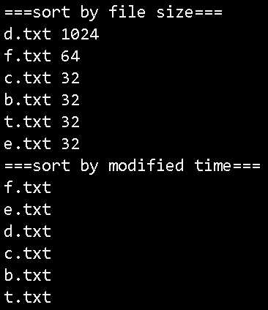
Specification
You must follow these format to implement:
file name
Print the messages:
size

Slide 29
Specification
You have to write two patterns to limit a region as file operation code section in your code:
“//####kernel start####”
“//####kernel end#### ”
All the file operations (open, write, read and gsys) are only written between file operation code section.
Note that the executable should be named “fs”

Slide 30
CUDA File System sample

Slide 31
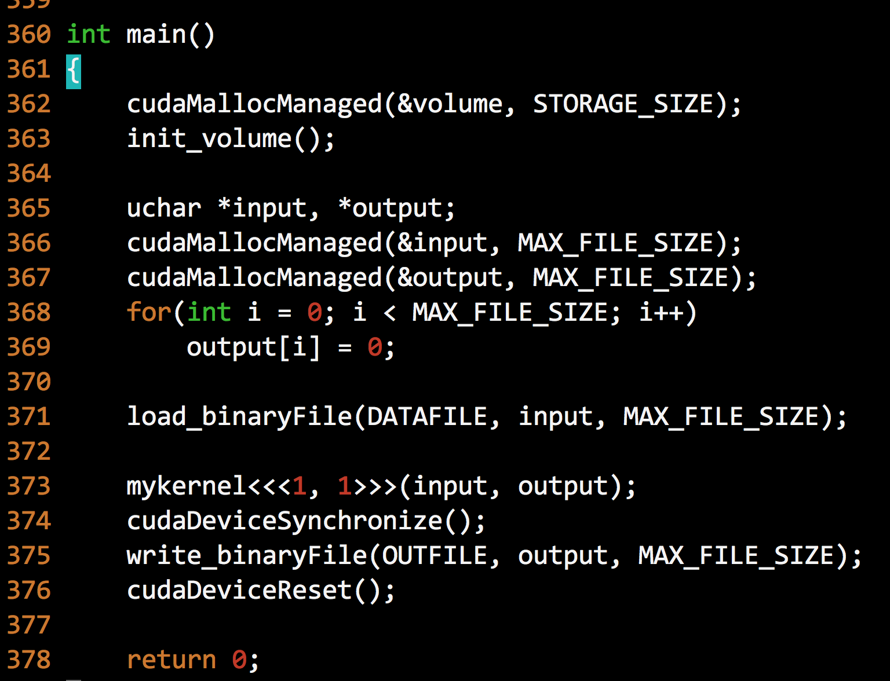
1085440
1048576
data.bin
snapshot.bin

Slide 32
__device__ __managed__ uchar *volume;

Slide 33
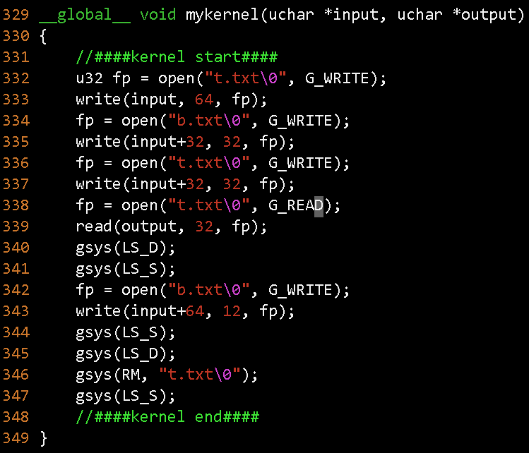
TA will replace your code here.

Slide 34
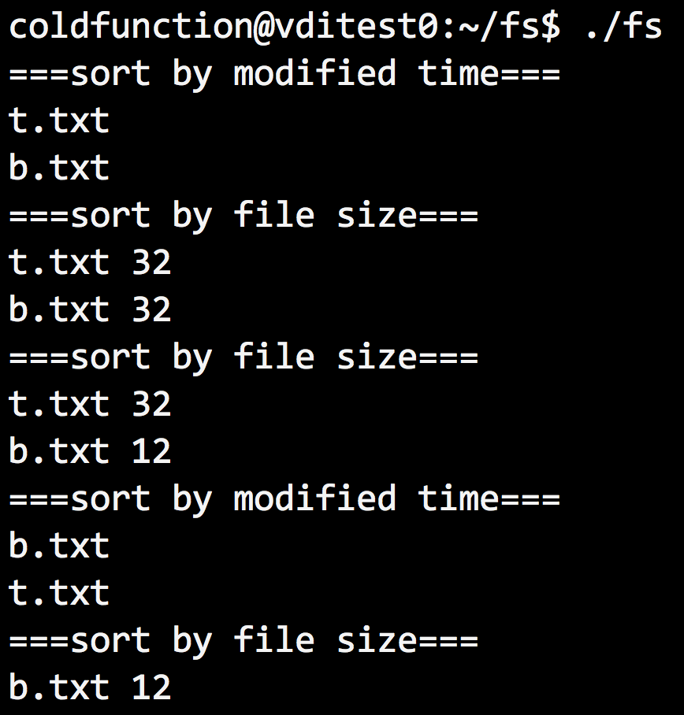
Output file

Slide 35
Compile CUDA code
nvcc -arch=sm_30 main.cu –o fs

Slide 36
Bonus
Follow most specification of homework 4.
In homework 4, the file system only have one root directory. In bonus, you must implement tree-structured directories.
A directory (or subdirectory) contains a set of files or subdirectories.
A directory is simply another file.

Slide 37
Bonus
There are at most 50 files (include subdirectories) in a directory.
The size of a directory is the sum of character bytes of all files name (include subdirectories).
E.g., the directory root/ have theses files:
“A.txt\0” “b.txt\0” “c.txt\0” “app\0”
The size of directory root/ is 22 bytes.
The maximum number of files (include directory) is 1024.
The maximum depth of the tree-structured directory is 3.
Note that the executable should be named “ffs”

Slide 38
Bonus
gsys(MKDIR, “app\0”);
create app directory.
gsys(CD, “app\0”);
enter app directory (only move a subdirectory).
gsys(CD..);
move you up one directory.
You cannot delete a directory by
gsys(RM, “app\0”); // cannot remove `app': Is a directory
gsys(RM_RF, “app\0”);
remove the app directory and all its subdirectories and files recursively.
gsys(PWD);
print path name of current, eg., “/app/soft”

Slide 39
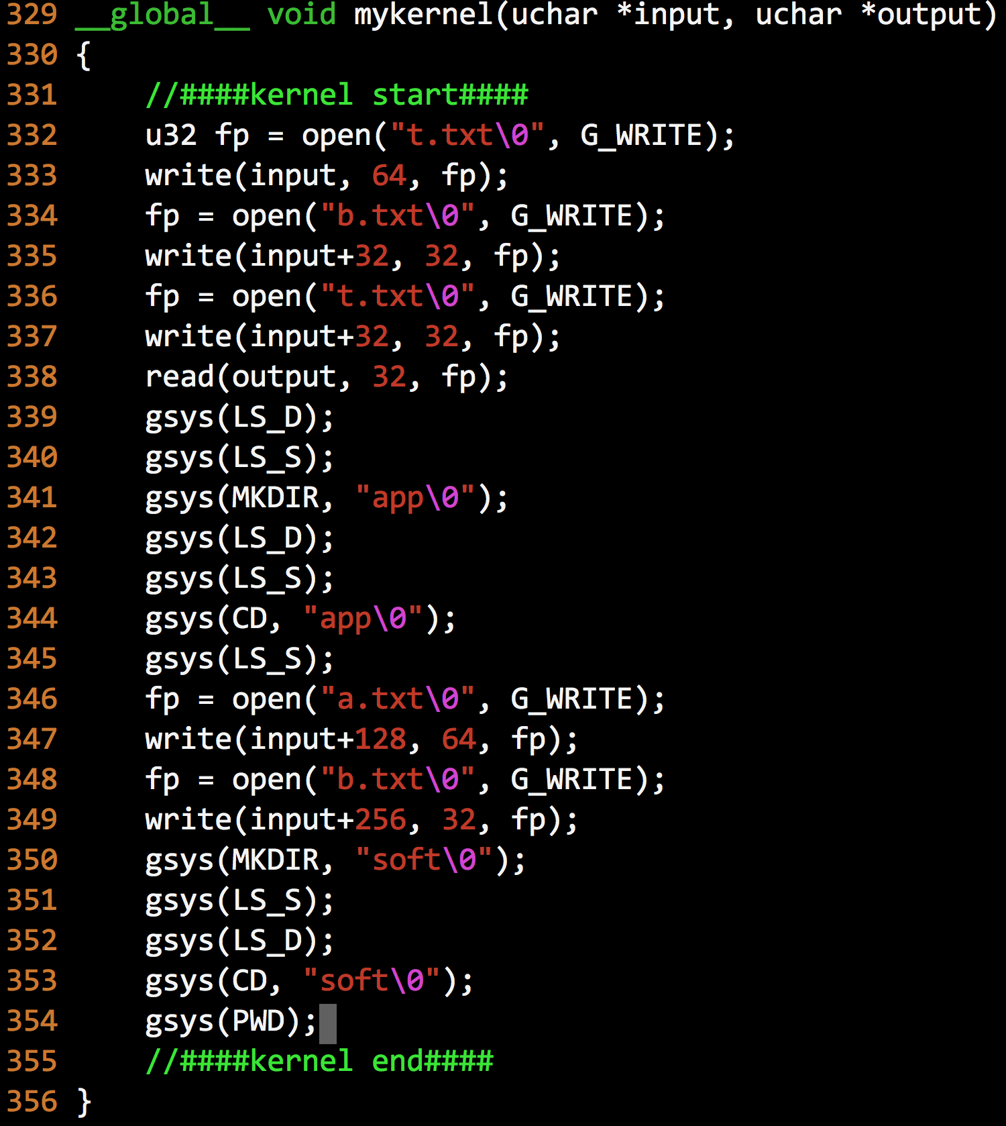

Slide 40
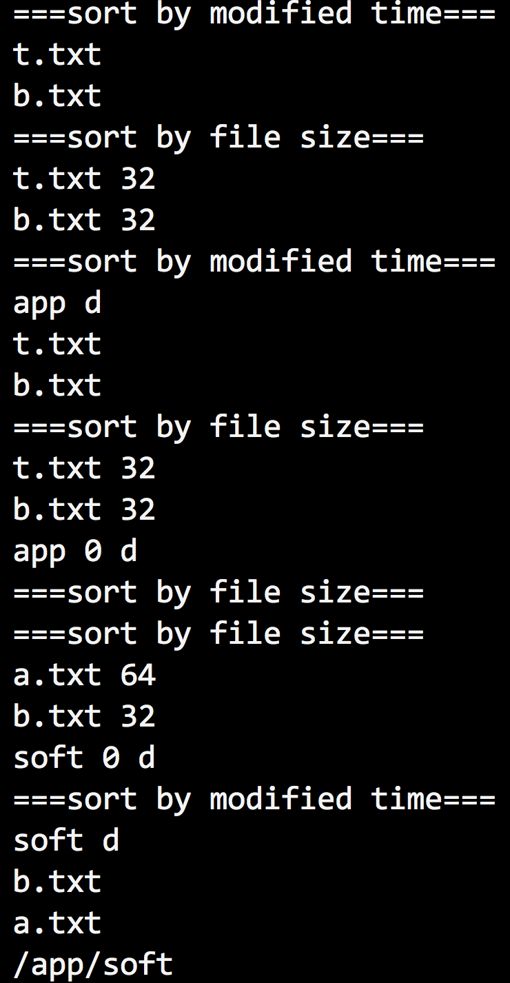

Slide 41
If the file entry is directory, add “ d” to identify.

Slide 42
GPU ID
cudaSetDevice(ID);
ID = (your student ID) % 6;
E.g., my student ID is 101062811
101062811 % 6 = 5
cudaSetDevice(5);

Slide 43
Submit format
Please put all of your source codes, Makefile and README.txt into a folder named OS_homework4, compress the folder OS_homework4 into OS_homework4.tar.gz, and upload OS_homework4.tar.gz to iLMS system.
If you write the bonus, put the bonus files (source codes, Makefile and README.txt) to other folder, named OS_homework4_bonus, compress the folder OS_homework4_bonus into OS_homework4_bonus.tar.gz, and upload OS_homework4_bonus.tar.gz to iLMS system.

Slide 44
Submit format
The README.txt should tell us how to compile your program and execute it. We will follow the instruction of your README.txt to compile and run your program.
We recommend that you should write a Make file.
We also design many test cases to verify your program, if your program cannot pass our test cases, you will get zero points. Don't copy others work, or both of you will get 0 points.

Slide 45
Attention
We will recompile and execute your program in our programming environment (140.114.91.162), if your program fail to execute, we don’t test it again in other platform.
Usually, you don’t have to install any extra library to finish this work, if you really need some extra package install, please discuss it with TA.
We don’t accept any incorrect format in this homework. If you don’t follow our rules, you will get 0 points.

