Slide 1
10320 CS410001 Computer Architecture
Project #1 Tutorial
First submission date: 4/4
Second submission date: 4/11

Slide 2
Project #1 Overview
Development Environment
Demonstration

Slide 3
Project #1 Overview

Slide 4
Objective
Design a single-cycle, functional processor simulator based on MIPS ISA
More details in Appendix A
Design your own test case

Slide 5
Single Cycle Processor Simulator
Simulator
Simulation steps:
(1) Fetch Instruction → (2) Decoding → (3) Execution(translation/emulation)
Fetch Instruction:
Big-endian / Little-endian (memory/register )
Decoding
R-type
I-type
J-type
MIPS Processor
Register File
Read/Write
Read (Fetch)
Data Memory
Instruction Memory
dimage
(binary file)
iimage
(binary file)

Slide 6
Big-endian format
Register 0 is constant 0.
Both memory sizes are 1K bytes.
Execution terminates after “halt”.
An error handler is needed.
More details in Appendix D
Name the exe file as single_cycle, and no more cmd-line arguments.
Input files and output files are in the same directory.

Slide 7
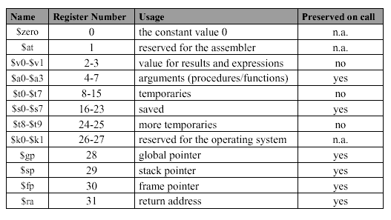
MIPS Register Conventions

Slide 8
$sp, $fp, $gp
high address
incoming args
callee-save space
local variables
outgoing args
stack frame
for foo()
(dynamic data) Stack
Heap (dynamic data)
Data (static data)
Text (Instructions)
$fp
stack frame
for bar()
$sp
int foo (int i)
{
return bar (i);
}
int bar (int n)
{
int a = n+1, b = n-1;
return (a*b);
}
Free Stack
dimage
$gp
iimage
low address

Slide 9
Input Format
For each test case, all registers, except PC and $sp, are initialized to 0’s.
iimage.bin
dimage.bin
More details in Appendix B

Slide 10
Example code
andi $t0, $0, 0
andi $t1, $0, 0
loop: slti $t2, $t1, 3
beq $t2, $0, end
add $t0, $t0, $t1
addi $t1, $t1, 1
j loop
end: sw $t0, 0($0)
halt
halt
halt
halt
halt
sum = 0;
for( i = 0; i < 3; i++ ) {
sum += i;
}

Slide 11
iimage.bin
00000000
0000000D
30080000
30090000
292A0003
11400003
01094020
21290001
08000002
AC080000
FFFFFFFF
FFFFFFFF
FFFFFFFF
FFFFFFFF
FFFFFFFF
initial value of PC # of words to be loaded into I memory
andi $t0, $0, 0
andi $t1, $0, 0
loop: slti $t2, $t1, 3
beq $t2, $0, end
add $t0, $t0, $t1
addi $t1, $t1, 1
j loop
end: sw $t0, 0($0)
halt
halt
halt
halt
halt

Slide 12
dimage.bin
00000400 initial value of $sp
00000003 # of words to be loaded into D memory
12345678 content of D memory begins
9ABCDEF0
13572468

Slide 13
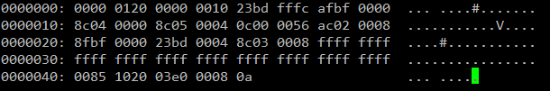

Slide 14
Output Requirement
snapshot.rpt : contains all register values at each cycle.
error_dump.rpt : contains error messages.
More details in Appendix C-1 and Appendix D

Slide 15
Test Case Design
Both iimage.bin and dimage.bin should be placed under a folder named testcase.
The test case should run no more than 500,000 cycles.

Slide 16
Submission
Create a folder named studentID_01 under /home/archi/studentID
In the folder, please provide the following two folders and corresponding files required:
simulator : contains your「Makefile」,「README」, and source code files.
Your Makefile should support the following two functions: make – to build your simulation environment make clean – to erase from the build tree the files built by make all.
testcase : contains your test case files.

Slide 17
Finally, compress the folder studentID_01 as studentID_01.tar.gz, and upload studentID_01.tar.gz and studentID_report.pdf to the iLMS system.
Each project has two due dates. The second due date is one week after the first one.

Slide 18
Development Environment

Slide 19
Connect to a Remote Server
Secure Shell (SSH) is a cryptographic network protocol
secure data communication (sftp)
remote command-line login
remote command execution
other secure network services

Slide 20
Remote command execution
OpenSSH
ssh [user_name]@140.114.75.140
PieTTY / PuTTY
Secure data communication
OpenSSH
sftp [user_name]@140.114.75.140
ls, cd, get
scp
Upload: scp local_file [user_name@140.114.75.140]: remote_directory
Download: scp [user_name@140.114.75.140]:remote_directory local_file

Slide 21
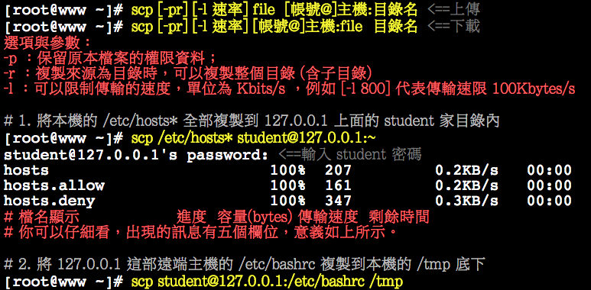
scp
scp source destination
I Love 鳥哥之SCP

Slide 22
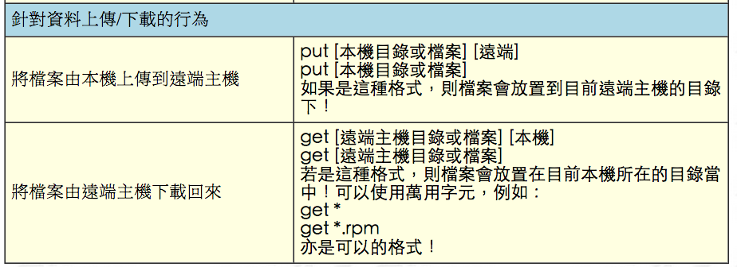
sftp
sftp username@140.114.75.140
I Love 鳥哥之 SFTP

Slide 23
IDE
Editor
Vim – VI improvement
Notepad++/ Sublime
Compiler
GCC: GNU Compiler Collection
Build Automation Utility
GNU make
Debugger
GDB: GNU Debugger
Version Control System
git

Slide 24
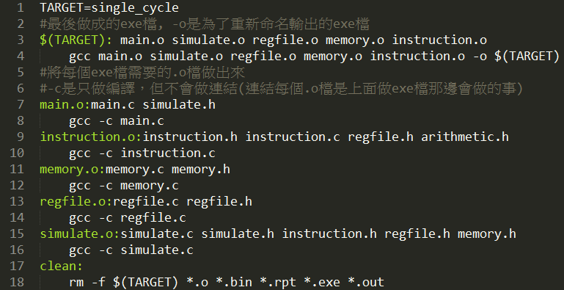
Makefile
Example

Slide 25
Demonstration

Slide 26
Related Links
Linux所有資訊都在鳥哥!!!
http://linux.vbird.org/
Vim (editor)入門圖解
http://blog.vgod.tw/2009/12/08/vim-cheat-sheet-for-programmers/
GDB (debugging)入門
http://www.study-area.org/goldencat/debug.htm
版本控制 Git 輕鬆上手
http://gogojimmy.net/2012/01/17/how-to-use-git-1-git-basic/
http://backlogtool.com/git-guide/tw/intro/intro2_1.html

Slide 27
Related Links
Makefile簡易教學
http://goo.gl/nPKhGQ
GCC指令筆記
http://goo.gl/LWX3uk

