Slide 1
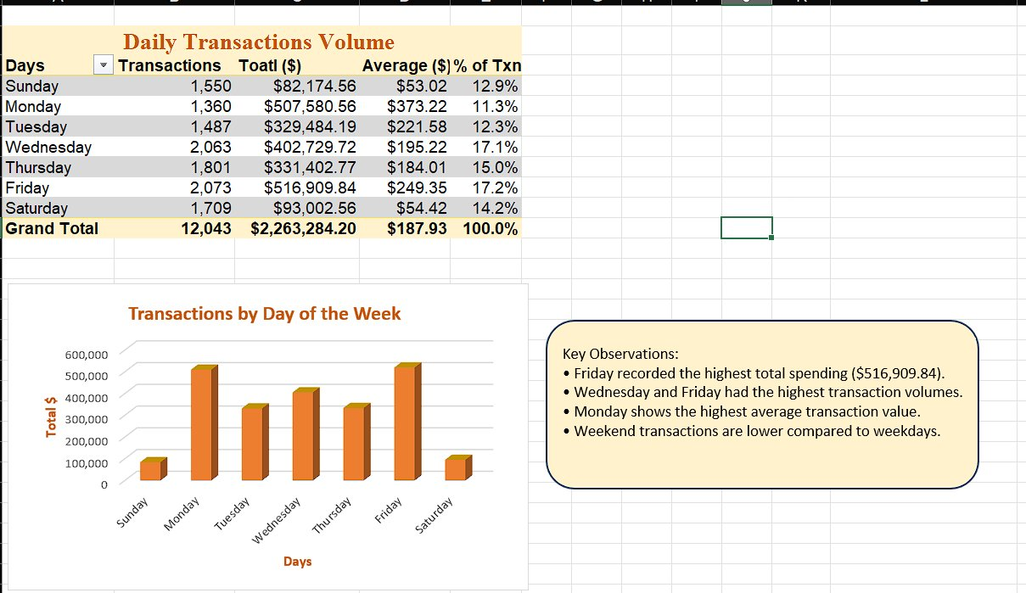
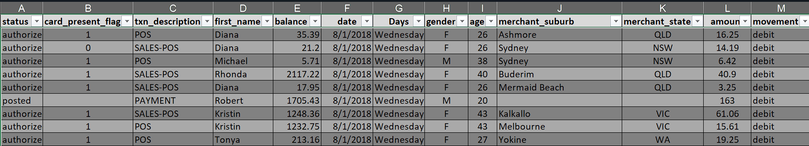
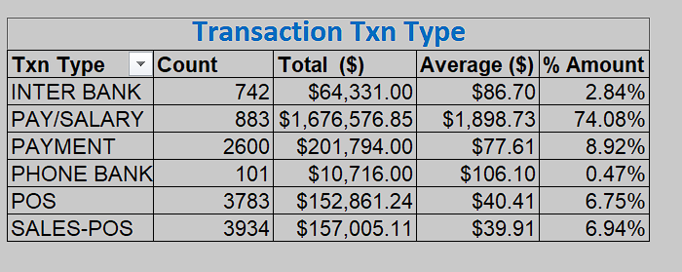
TRANSACTION PATTERNS, CHANNELS & DATA QUALITY
INSIGHT 1 — Missing Timestamps
No transaction timestamps exist in the dataset, preventing hourly spend pattern analysis. Future datasets must include time data to unlock deeper behavioural insights.
INSIGHT 2 — Data Completeness Warning (35.9%)
35.9% of records (all 'posted' rows) lack merchant location and card presence data. Insights from these fields derive from only ~64% of the dataset — interpret with caution.
📅 Daily Transaction Volume & Day-of-Week Patterns
INSIGHT 4 — In-Store vs Online Preference
80% of authorised transactions are card-present (physical), confirming a strong customer preference for in-store shopping over online channels.
INSIGHTS 5 & 6 — Payroll & Revenue Concentration
PAY/SALARY avg $1,899/txn (highest of all types). Top 3 clients — Michael (22.49%), Kenneth & Jessica — account for 45.5% of total revenue ($632,795 from top 10). High concentration risk demands client diversification.
Transaction Type

Slide 2
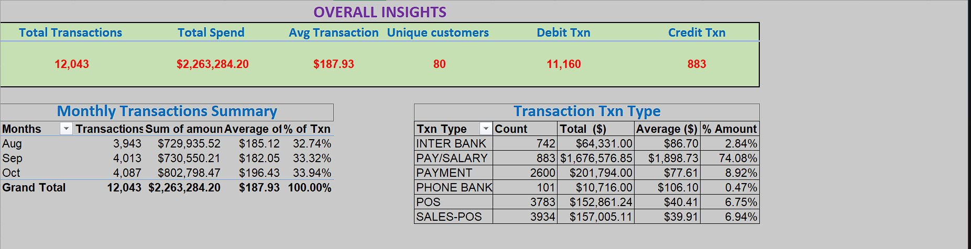
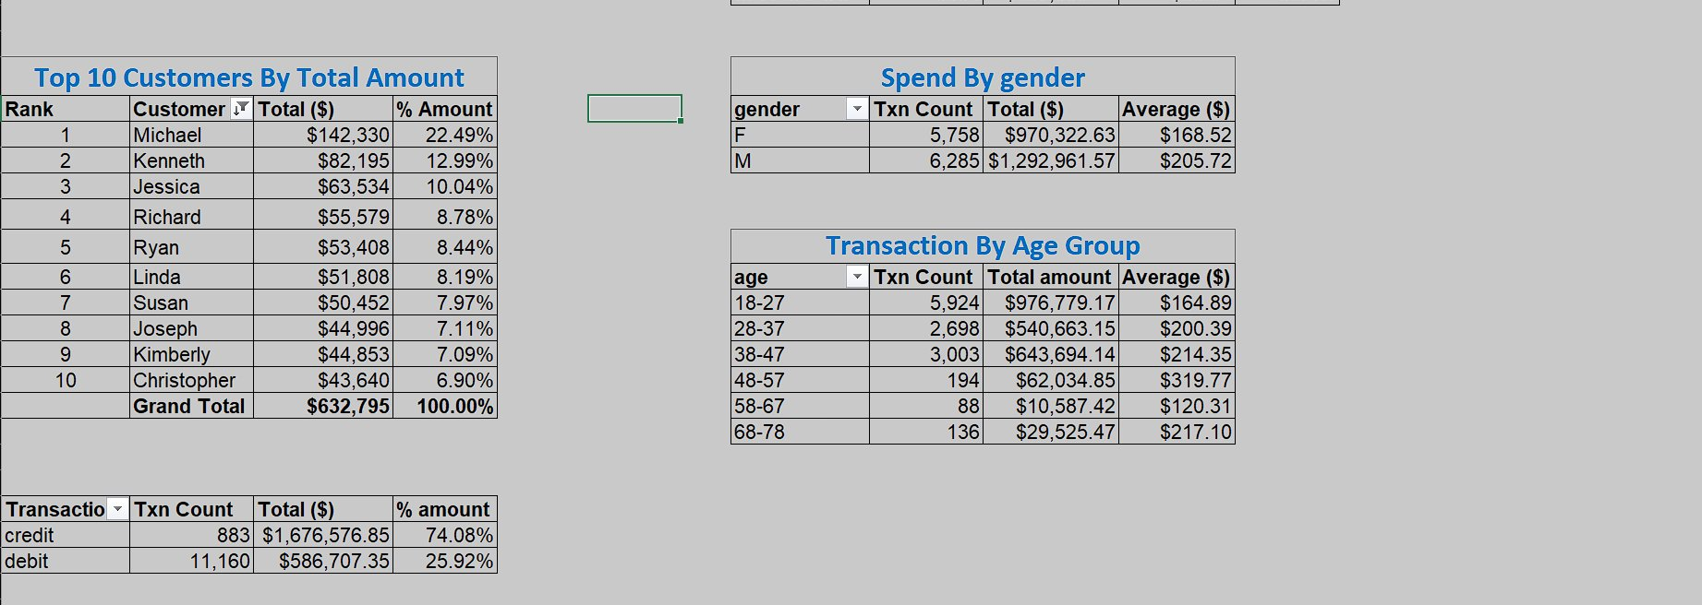
CUSTOMER BEHAVIOUR & SPEND ANALYSIS
INSIGHT 3 — Age Group Spending
Customers aged 18-28 drive the most transactions (5,924), yet the 48-57 age group leads in avg spend at $319.77 per transaction — older customers transact less but spend significantly more per visit.
INSIGHT 7 — Gender Spend Patterns
Men average $205.72/txn ($1.29M total) vs women at $168.52/txn ($970K total). Despite fewer transactions, women form a sizeable spend volume — highlighting focused upselling opportunities for both demographics.
📊 Overall KPIs & Transaction Type Breakdown
INSIGHT 8 — Credit vs Debit Transactions
Credit txns (883) represent 74.08% of total value ($1.67M) — high-value purchases. Debit txns (11,160) are frequent but low-value. These distinct spending modes require different engagement strategies.
👥 Top Customers, Gender & Age Group Spend

