Slide 1
CAT CHASER 3000
An autonomous cat-pursuit robot — field report, 2026-09-05 → 07
Yahboom RASPBOT-V2 · Raspberry Pi 5 · YOLOv8n/COCO · PID mecanum control · PyBullet-validated · one unimpressed Bengal
PI 5 AARCH64 · DETECTOR 15 HZ · 239 TESTS GREEN · CATS HARMED: 0

Slide 2
// 01 · MISSION ARCHITECTURE
One loop, five links, zero mercy
camera 640x480 BGR
|
YOLOv8n ONNX @320px -> cat boxes (COCO class 15), conf >= 0.50
|
centroid -> heading error err = (cx - W/2)/(W/2) in [-1, +1]
|
PID (KP=40 KI=0 KD=6, hardware-calibrated) -> turn
|
mecanum mix drive(forward, turn) -> 4 wheel speeds, cap 120
|
safety: ultrasonic HOLD @200mm · IR kill · Ctrl+C · runtime limit
Same controller runs on real hardware and the PyBullet twin — the sim caught the design bugs, the carpet caught the physics bugs.

Slide 3
// 02 · THE PLATFORM
Yahboom RASPBOT-V2 + Raspberry Pi 5
▸ Compute Pi 5 Model B rev 1.1 · aarch64 · Python 3.11
▸ MCU bridge I2C bus 1 @ 0x2B — motors, servos, LEDs, buzzer
▸ Drive 4x mecanum wheels, ±255, no encoders — "motor commands are suggestions"
▸ Camera USB 640x480, fixed focus (~0.4 m to infinity)
▸ Ranging forward ultrasonic, mm resolution
▸ Status 14x WS2812B LEDs + buzzer + IR remote (kill switch)
vendor API archaeology (on-device):
docs promised: Ctrl_WS2812B(id, r, g, b)
hardware ships: Ctrl_WQ2812_ALL(state, idx)
red=0 green=1 blue=2 yellow=3
buzzer: Ctrl_BEEP_Switch(state)
IR idle byte: 0xFF (not 0 — kill switch
fired instantly until fixed)

Slide 4
// 03 · THE NEURAL NET · PROVENANCE
YOLOv8-nano, COCO-raised, cat-filtered
▸ Origin Ultralytics YOLOv8n, pretrained on COCO 2017 (118k images, 80 classes). We keep exactly one: class 15, cat.
▸ Export yolov8n.pt -> ONNX · 320px input · opset 12 · simplified · 12.1 MB · ~3.2M params
▸ Runtime pure onnxruntime + OpenCV on the robot — no ultralytics, no torch. Letterbox -> NCHW -> NMS in ~150 lines.
▸ Threshold conf >= 0.50, field-calibrated: real cat always >= 0.53, false positives 0.41–0.45
▸ Fine-tune? Not yet — 99.5% precision over 244 triaged frames, 0 false positives. Pipeline ready.
VALIDATION LADDER
x86 sanity real-cat photo conf 0.94 ✓
x86 bench 21 ms/frame 47 Hz ✓
pi5 bench 54 ms inference 16.6 Hz ✓
pi5+camera 66 ms end-to-end 15.1 Hz ✓
field live Bengal @3m conf 0.63 ✓
target >= 1 Hz 15x margin

Slide 5
// 04 · THE RASPBERRY PI PORT
Dependency minefield, cleared
▸ cv2 corrupted on arrival ImportError naming a library called 'y'; ldd showed garbage ELF entries. Damaged binary + dueling opencv installs.
▸ The pin matrix onnxruntime 1.18.1 needs numpy<2; opencv 5.x drags in numpy 2.4. Landed: numpy 1.26.4 + opencv-headless 4.11 + ort 1.18.1.
▸ 64-bit dividend aarch64 confirmed on-device -> onnxruntime wheels just work; the feared Pi-3/TFLite fallback never happened.
PI 5 BENCHMARK · catchaser.benchmark
mode inference e2e rate
synthetic frame 54.1 ms 60.3 ms 16.6 Hz
camera in loop 57.2 ms 66.2 ms 15.1 Hz
--threads 4 56.1 ms — 15.9 Hz
# auto-threading already optimal
# x86 -> pi5 scaling factor: x2.6

Slide 6
// 05 · MOTION CONTROL
Mecanum math + a PID tamed by telemetry
# wheel mix — forward, clockwise turn, strafe
l1 = forward + strafe + turn # front-left
l2 = forward - strafe + turn # rear-left
r1 = forward - strafe - turn # front-right
r2 = forward + strafe - turn # rear-right
err = (cat.cx - W/2) / (W/2) # normalized
turn = KP*err + KD*d_err # KP 80 -> 40
fwd *= clamp((us-200)/400, .35, 1) # taper
THE OVERSHOOT, CAUGHT IN TELEMETRY
f0582 TRACKING err=+0.38 turn=+44.4
f0586 TRACKING err=-0.27 turn=-31.8 <- flipped!
f0588 LOST ...and the cat is gone
sim said KP=80; the carpet said KP=40.
plus: D-term now needs 2 tracked frames
(fresh-acquisition kick was a bug)

Slide 7
// 06 · BEHAVIOR STATE MACHINE · LED = MOOD RING
Four states, visible from the couch
● TRACKING
Cat in frame: steer to center, drive forward. Full speed centered; turn-in-place past |err| 0.5; deadband ±0.06.
● LOST
Cat vanished: hold 3 grace frames — a dropped detection shouldn't trigger a panic spin.
● SEARCHING
Spin-and-stare: 2 frames rotating toward last-seen side, 3 parked for sharp frames. Continuous spin outran the detector.
● HOLD
Ultrasonic < 200mm: stop advancing, keep aiming. The no-boop guarantee.
Kill switches: any IR-remote key · Ctrl+C · software callback · runtime limit. Motors stop in a finally block no matter how the loop dies.

Slide 8
// 07 · SIMULATION FIRST
PyBullet twin: crash here, not there
▸ Digital twin same controller, simulated camera/ultrasonic/motors; a physical 'cat' box the ray-cast ultrasonic genuinely sees.
▸ Synthetic detector projects the cat's true bearing through the camera model — validates the control loop, the part that was new.
▸ approach scenario acquire -> center -> drive -> HOLD @238mm, no collision ✓
▸ search scenario out-of-frame cat -> grace -> spin -> acquire -> HOLD @231mm ✓
TEST LEDGER
239 passed, 2 xfailed (documented)
chase controller units 29
dataset harvester 8
label review tool 10
pybullet end-to-end 2
slam suite (inherited) 190
# first full-suite completion ever —
# an IMU deadlock had hung it forever

Slide 9
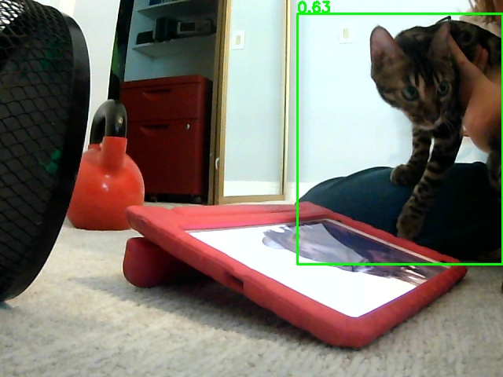
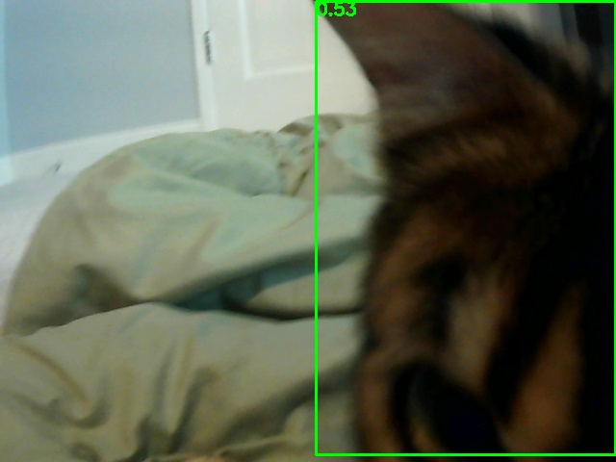
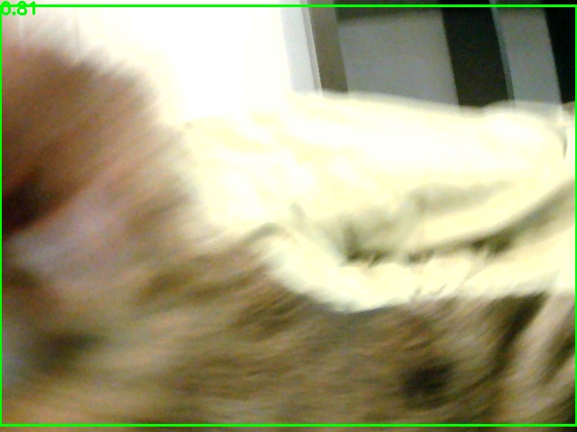
// 08 · FIELD RESULTS · LIVE BENGAL
Run 2 ended in HOLD at the actual cat
LIVE CAT · EDGE ACQUISITION 0.63
FINAL APPROACH 0.53
POINT BLANK · COMPLETE 0.61
Two 120 s untethered WiFi runs. Auto-saved detection snapshots turned debugging from guesswork into evidence — every claim in this deck traces to a frame or a log line.

Slide 10
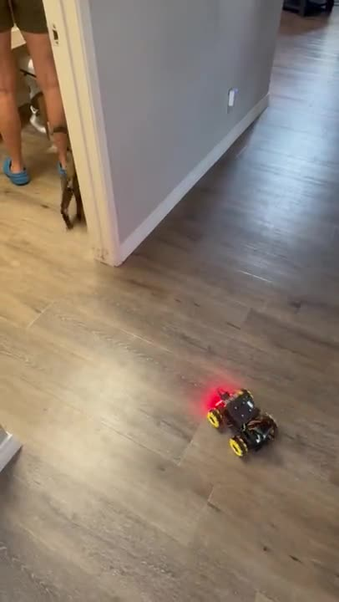
// 08B · THE CHASE · UNCUT · IPHONE TAPE
Roll the footage
THE CHASE · IMG_3375
source 1080p · 112 MB
encoded 720p H.264 · 2.6 MB
embedded right here in this deck
the loop from the slides, running
for real: acquire, center, approach,
and the cat's considered response.
verdict cat: unbothered

Slide 11
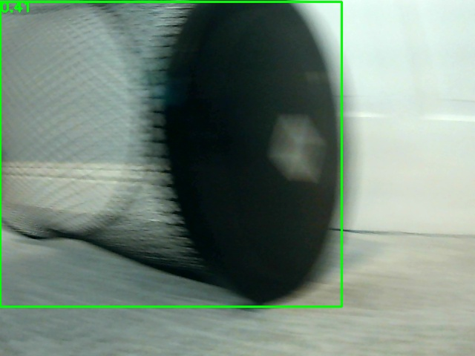
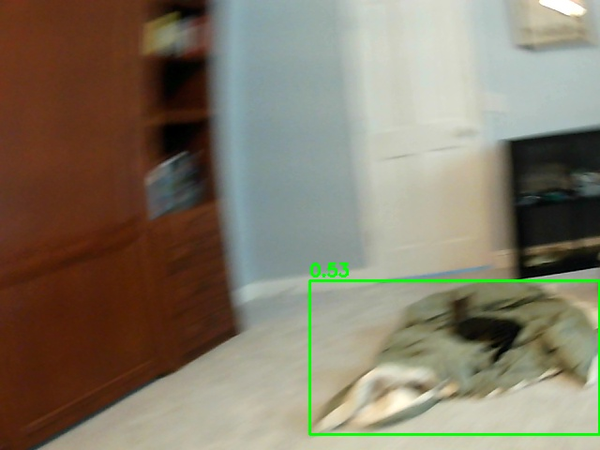
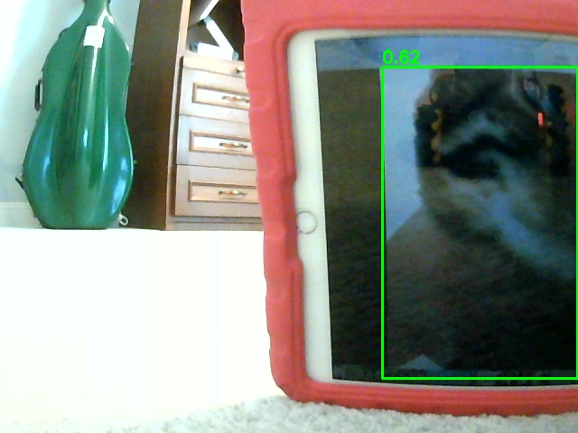
// 09 · THE BLOOPER REEL · WHAT THE ROBOT THOUGHT WAS A CAT
Failure analysis, with receipts
TRASH CAN + MOTION BLUR 0.41 ✗
CRUMPLED JACKET 0.63 ✗
IPAD DECOY (intentional) 0.62 ✓
Lessons burned in: rotation blur is the enemy (spin-and-stare) · dim screens defeat decoys (max brightness) · every config threshold now cites the field frame that set it · and the "unreachable robot" was a stale WiFi profile broadcasting a dead address — trust nmcli, not the OLED.

Slide 12
// 10 · DATASET PIPELINE · COUCH-DRIVEN ML-OPS
Chase -> harvest -> thumb-triage
PHONE WORKFLOW
$ ./harvest.sh # chase + collect (<=1/s dets,
# 1/10s negatives, cap 300)
$ ./review.sh # triage web server :5000
g = Good keep detector's box
n = No cat force clean negative
f = Fix route to real box editor
u = Undo lossless, resume anytime
244
FRAMES TRIAGED · 2 SESSIONS
100%
PRECISION · 0 FP
90%
RECALL · 23 MISSES
94.5%
F1 SCORE
Triaging by thumb also measures the detector — every tap is a confusion-matrix cell (next slide). It surfaced 23 missed cats hiding as negatives. Fine-tuning waits for ~500 varied positives; these become the eval set to beat.

Slide 13
// 10B · EVALUATION · CONFUSION MATRIX · 244 REVIEWED FRAMES
Precision 100% · Recall 90%
 | actual: CAT | actual: NO CAT
pred: CAT | TP 198 | FP 0
pred: NO CAT | FN 23 | TN 23
METRICS
precision 198/198 = 100.0%
recall 198/221 = 89.6%
F1 = 94.5%
accuracy 221/244 = 90.6%
0 false positives — the 0.50 threshold
earns its keep. ~10% misses, all hard:
blur, close-ups, dark-under-furniture.
finding: the 23 misses were mislabeled
as negatives — re-box before fine-tune.

Slide 14
// 11 · ROADMAP
Next sorties + the SLAM campaign
▸ Pan-servo search sweep the camera, not the chassis: sharp frames, 3x coverage, zero blur. One servo-sign check away.
▸ Exposure control shorter shutter to cut rotation blur at the source.
▸ Lead pursuit centroid velocity prediction, for when the Bengal stops going easy.
▸ IR kill verification the last unchecked box before unsupervised roaming.
SLAM CAMPAIGN (separate track)
external review: no metric map possible yet
(VO counts frames not metres; EKF never
sees a real camera measurement)
phase 1 honest measurement (de-anchor sim)
phase 2 keyframe VO
phase 3 metric scale <- the crux
phase 4 real EKF updates
phase 5 IMU fusion
phase 6 record-replay + hardware ladder

Slide 15
// 12 · END OF TRANSMISSION
Built in two days, debugged with evidence
13+
COMMITS, CLOUD + LOCAL
239
TESTS GREEN
15 Hz
DETECTOR ON PI 5
1
CAT, CORNERED GENTLY
▸ Stack Python · onnxruntime · OpenCV · PyBullet · Flask · one very patient Bengal
▸ Repo github.com/peter-m-mayer/rover — catchaser/ package, full history
▸ Method sim before hardware · telemetry before tuning · snapshots before speculation
The cat, when reached, was found to be unbothered. Recommend continued observation.

