Slide 1
A Data-based Approach to Improving My Chess Strategy
Peter Ni

Slide 2
Goal
In this project, I will analyze 2385 of my chess games that I have played on the Lichess online platform to see how I can improve the way I play chess.

Slide 3
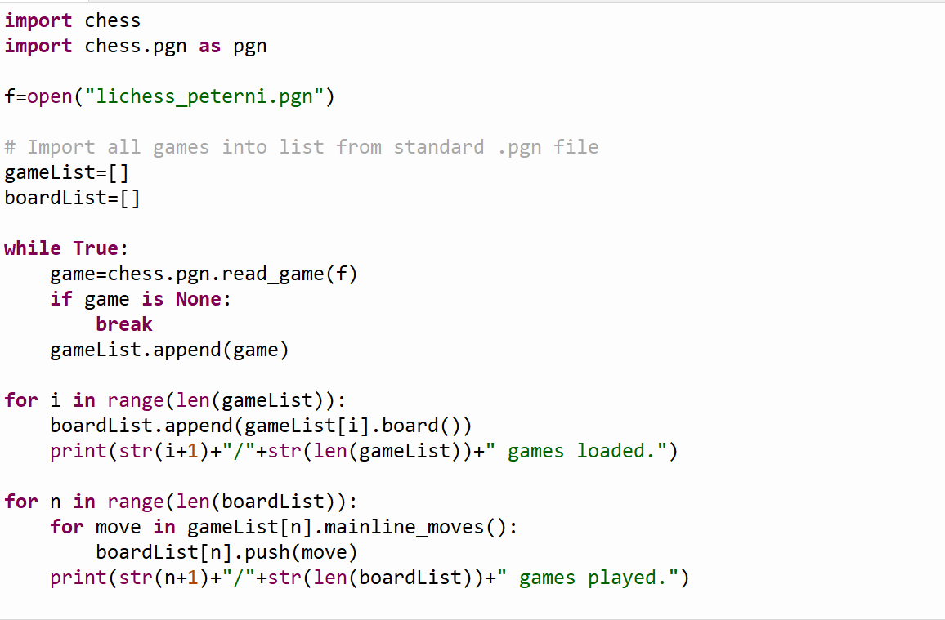
Importing the Data Into Python

Slide 4
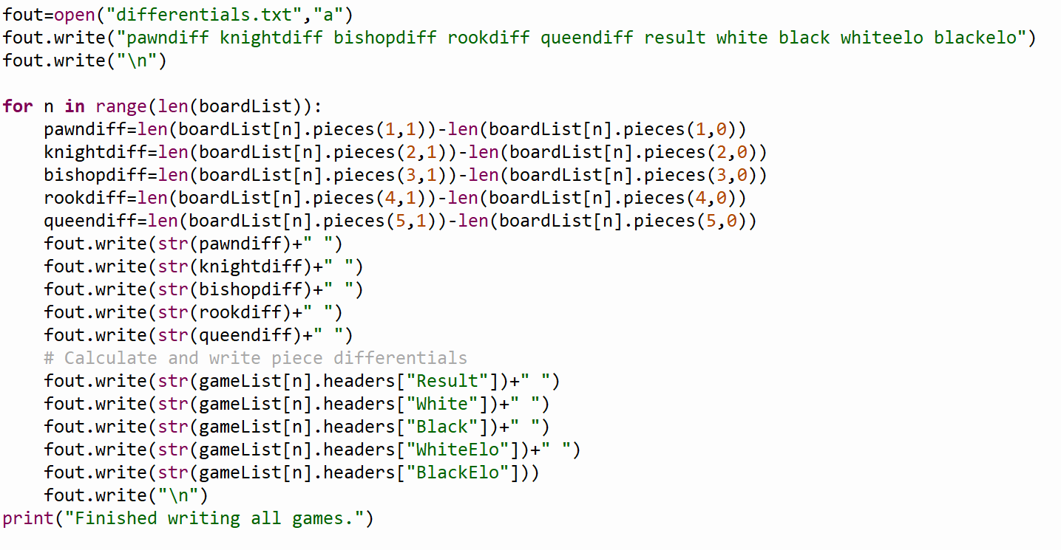
Calculating piece differences in each game’s end state and outputting the file for use in R

Slide 5
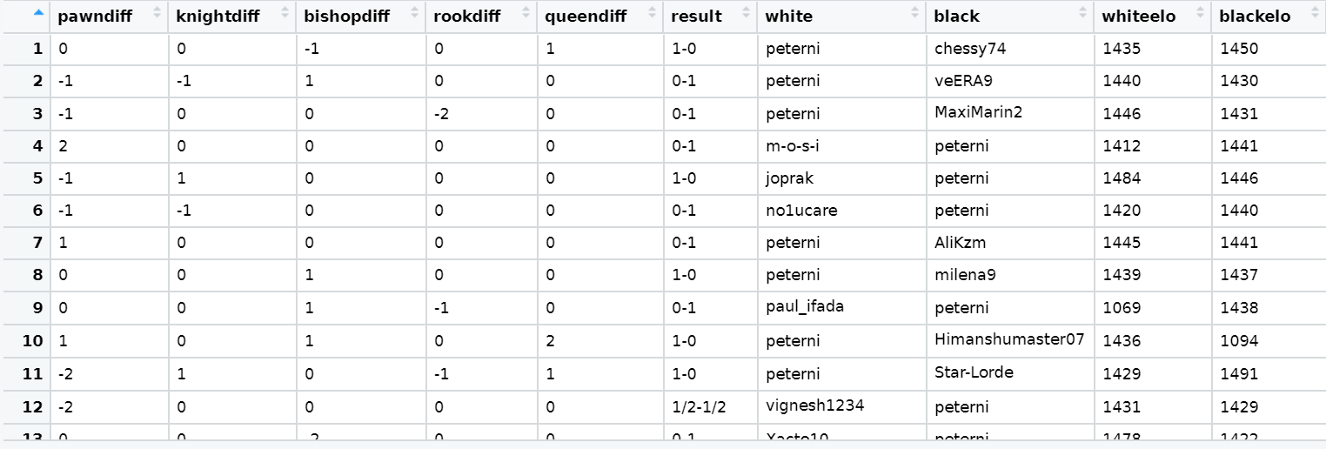
Resulting piece differential dataset imported into r

Slide 6
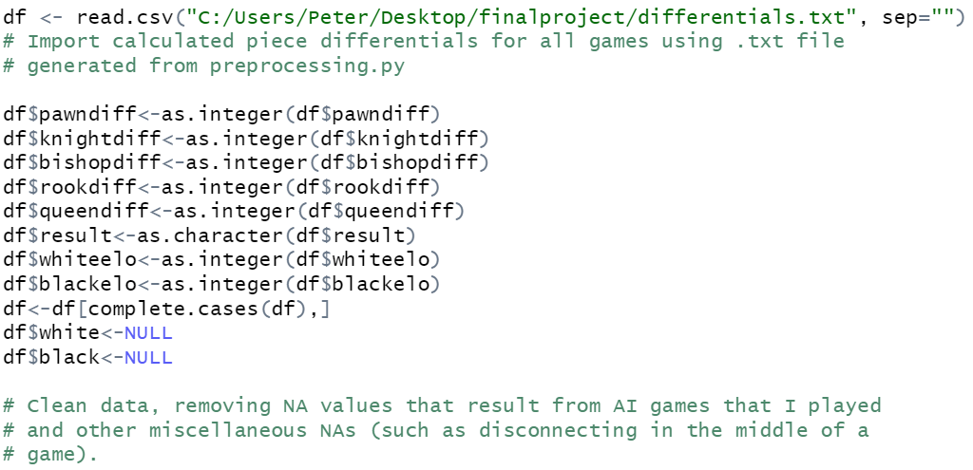
CLEANing the dataset in R

Slide 7
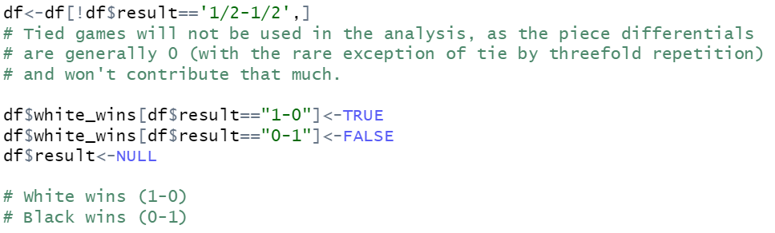
More data cleaning

Slide 8
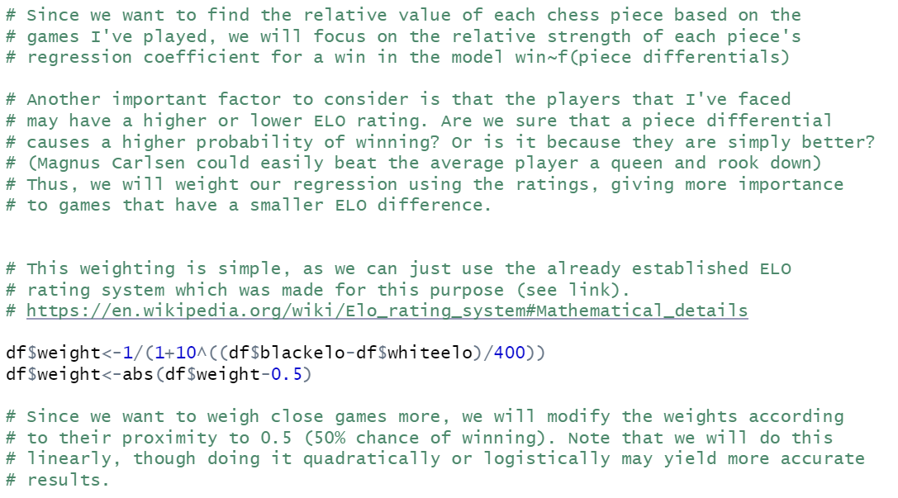
Rank weighting PROCESS AND RATIONALE

Slide 9
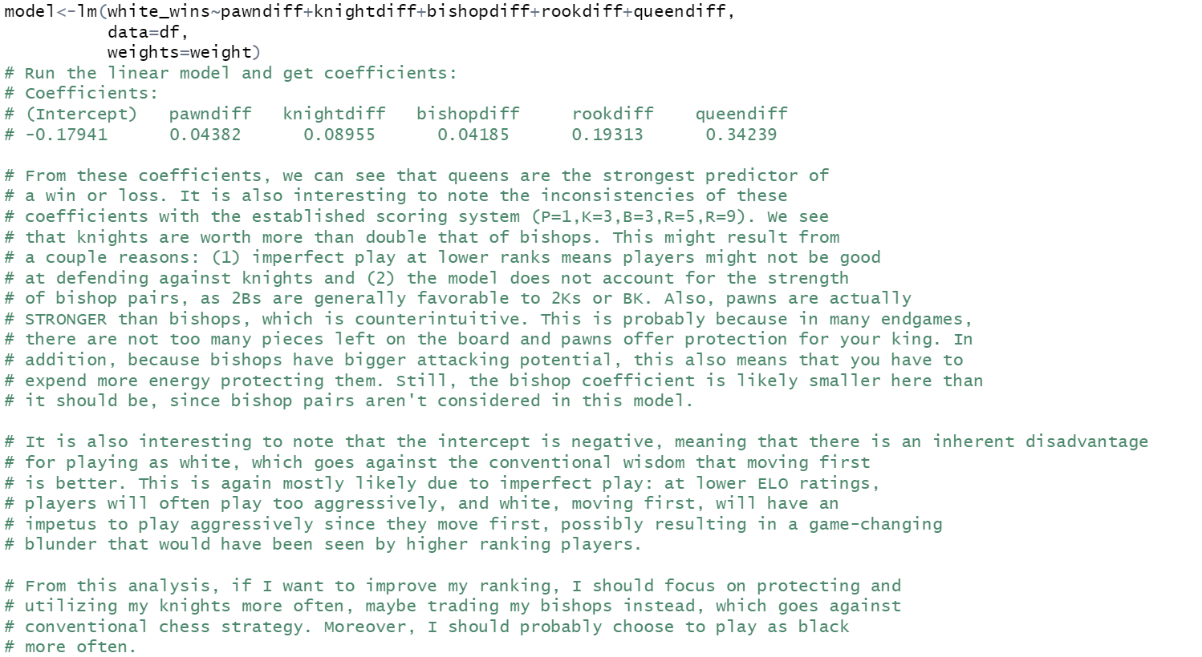
Model, analysis, and ending conclusions

