Slide 1
Progress on BTF linking and deduplication using the toolchain
Nick Alcock
Bruce McCulloch
LSF/MM 04 May 2026
Notes:
Bruce: Good <morning/afternoon> everyone, thank you for coming to our presentation on BTF linking and deduplication. I’m Bruce McCulloch, and we are joined virtually by my colleague Nick Alcock.
Nick: Hello everyone!

Slide 2
Overview
CTFv4
Overview
New Features
CTFv4 ELF Layout
CTFv4 & BTF
Experimental extensions
libctf Changes
Archive & Linking Changes
pahole & kernel
Overview
GCC generated BTF
Linking (vmlinux & modules)
pahole changes
Compatibility
Transition & Maintenance
Notes:
Nick: To begin, I’d like to give a brief overview of what we’ll be discussing today, which as you can see is split into two sections: changes to CTF and libctf in v4, and additions to pahole.
Nick: We’ll begin with a recap of CTF, followed by a discussion of features newly added since last year. Following this, I will go over the new layout of the .CTF section, the relationship between CTFv4 and BTF, as well as some potential experimental extensions to the format. Finally, I’ll discuss the core changes to libctf, as well as the changes to the archive format and linking procedures.
Bruce: After Nick’s slides, I will cover how these changes were integrated into pahole and the kernel build process as a proof of concept. First, I’ll cover what sort of BTF information GCC provides, then I’ll cover the linking procedures from libctf that pahole utilizes, which will lead into an overview of the changes made to pahole. We’ll end with some housekeeping, namely the benefits that this integration will provide, questions around compatibility, and a plan for maintenance.

Slide 3
Motivation
Provide consumers of BTF with the utility of libctf
Implicit BTF deduplication at link time
Greater availability of type info in userland as well as the kernel
(Ultimately, for userland) automatic runtime ABI conflict detection
Notes:
Nick: CTFv4 has been quite the undertaking, and for good reason – There are a number of benefits to adoption of the format.
Namely, libctf has a vast suite of querying functionality available in the API, which is something that BTF tools are missing in a unified way.
Additionally, libctf’s deduplicator runs implicitly at link time <not sure what to say here>.
Libctf also allows for much greater availability of type information if properly integrated, to the point of potential runtime ABI conflict detection – something we have already seen demonstrated in part from some tools utilizing libctf and libabigail.

Slide 4
CTFv4

Slide 5
CTF Overview
Compact Type Format
BTF was originally derived from CTF
Greatly improved from Solaris:
  bigger type sizes
  symbol->type mapping
  link-time dedup with ambiguously-defined type detection
BTF did similar things at similar times.
Notes:
Nick: So if you’re here at this presentation, chances are that you already know what CTF is.
Simply, it’s a format for describing the types in a compiled program, with mappings to symbol and string tables.
Despite the similarities between the two formats, you might not have realized that CTF is actually the predecessor of BTF. With the advent of CTFv4, CTF can easily do everything BTF can: <list specifics if you’d like>.
If you’re only familiar with CTF from the Solaris days, you should be aware that the modern CTF has a number of improvements, namely bigger type sizes, mappings from the symbol to its type, and importantly link-time deduplication with flexible ambiguously defined type detection.
You’re also probably aware that BTF has a similar set of features – given this, it only seems natural that the two formats begin to converge a bit.

Slide 6
New in CTFv4
All type kinds renumbered to match BTF
BTF kinds added
CTFv4-specific type kinds exist:
  (for userspace floats, etc)
  <list>
Type formats identical to BTF for all kinds in common
Dict layout compatible with BTF: additional info will be new ELF sections.
Archive format designed to be concatenated easily
Incompatibilities can be eliminated with vlen and kind resizings
Notes:
Nick: So what’s new in CTFv4?
First, with regard to BTF compatibility, all type kinds have been renumbered to match their BTF counterparts. CTFv4 also now contains the BTF specific types like type and decl tags, datasecs and their constituent vars.
There are also some new CTFv4 specific type kinds, namely userspace floats which BTF does not have appropriate representation for, as well as <list>.
Suffice it to say, for all type kinds present in BTF, CTFv4 represents them accurately.
Additionally, as will be covered in the next slide, the CTFv4 dictionary is fully compatible with BTF – all additional dictionary information will be contained in new ELF sections.
We also have a new archive format for grouping dictionaries that involves just a simple concatenation – something that was discussed at this year’s Cauldron.
As for incompatible types <LIST>, these can be easily dealt with by modifying vlen and kind resizings.

Slide 7
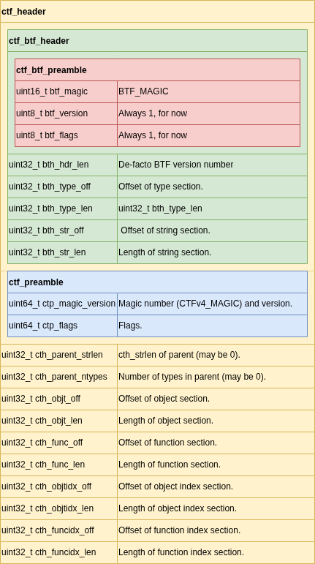
CTFv4 Layout
Notes:
Nick: <Discuss as you please>

Slide 8
CTFv4 and BTF
CTFv4 is a strict superset of BTF
All valid BTF is also valid CTFv4
Kind layout section support will let BTF readers skip new CTF type kinds
CTFv4 is more expressive for userspace but the expressiveness is in areas users of BTF aren’t likely to care about. The additions largely benefit userspace (ELF symbol lookup, etc).
Usually stored in compressed ELF sections (not yet implemented).
Notes:
Nick: As previously mentioned, CTFv4 is strictly a superset of BTF. All valid BTF is valid CTFv4.
With the addition of kind layout support, existing BTF readers can simply skip new CTF types if provided with a CTFv4 section, so there is minimal transitional work needed there.
CTFv4 is of course much more expressive than BTF, but the features that BTF is missing are likely more useful in userspace contexts. Features like ELF symbol lookup have much more obvious userspace implications – especially when kallsyms is available.
I’d also like to mention at this time some future plans for compression: CTFv3 had fully featured systems for compressing the CTF section, and I would like to get that up and running again for CTFv4 – and perhaps even for BTF.

Slide 9
CTFv4 experimental extensions
CTFv3 has some potentially useful features CTFv4 and BTF do not:
  Strings with the high bit on reference strings in some other strtab: ELF dynstrtab, kallsyms, etc, to save space
  <list>
Currently CTFv4 cannot implement these
Reason for a possible ‘experimental CTF’ format which can add incompatible features freely
  Non-BTF magic number
For experiments, never expected to become the default.
Notes:
Nick: Something I’d like to mention at this time is the possibility of some extensions for CTFv4 – a sort of dev mode for enabling non-compatible features.
CTFv3 had a number of useful features that are not yet implemented in CTFv4 for compatibility reasons, namely the use of an external string table. The implications for compactness are obvious: references could be made to the dynamic string table or kallsyms to save space in the type section, as these string sections will already be present in the ELF.
For this reason, I’d like to add a non-BTF compatible magic number both to indicate that the section has experimental features enabled, and to prevent any BTF readers from attempting to load what will end up being interpreted as corrupt information.
Rest assured, this will not be the default and will have no impact on the availability of BTF information.

Slide 10
libctf changes
libctf can read, emit, and dedup both BTF and CTF
libctf prefers to write out BTF unless doing so would cause data loss
ctf_version() lets the caller force BTF or CTF emission
Emission of particular kinds can be restricted or replaced with BTF_KIND_UNKNOWN
Size change:
  173 files changed
  17771 insertions(+)
  8301 deletions(-)
Massive API simplifications
Notes:
Nick: As you would expect, libctf can read, emit, and deduplicate both BTF and CTF.
On writeout, libctf emits BTF by default – unless the dictionary to be emitted contains type kinds that can not be represented by BTF. The default emission format can be specified by calling ctf_version().
Additionally, if need be, any kind can be emitted as BTF_KIND_UNKNOWN or not emitted at all. This could be useful in cases where <list>.
This comes with massive changes to libctf itself, with 173 files changed, and certainly more insertions than deletions. With that said, there was a concerted effort to simplify the libctf API, so new users should find using libctf to be more approachable than ever.

Slide 11
libctf changes (cont.)
Massive regularity improvements in function naming
New API functions covering addition and querying of the entire BTF type kind surface:
  datasecs and vars
  decl and type tags
  function prototypes
Ability to get raw BTF data corresponding to any type
Error and warning messages much improved via a new ctf_errwarning_next() iterator
Transitioning to the new API takes a few minutes at most.
Notes:
Nick: Additional changes include some improvements in function naming for clarity, as well as additions to the API for new BTF-specific types.
These include next type iterators for datasecs and their vars, iterators and bi-directional mapping for type and decl tags, and querying for function prototypes. It should be clear at this point that libctf is a fantastically useful tool for reading BTF in any capacity the user requires.
For applications that require the raw BTF data – pahole in some cases – functions for getting that information have also been added.
Emission of warnings and errors has also been greatly improved with the addition the ctf_errwarning_next() iterator.
For those of you working on projects that implement CTFv3, don’t worry about the transition! Most of these changes just require a simple find and replace – you shouldn’t run into too much trouble.

Slide 12
Archive and Linking Changes
New concatenation-based BTF archive format
  Old format still readable
The libctf deduplicator (as used by ld) puts ambiguously-defined types in child dicts named after the CU
BTF has no header fields for CU names
  Solved by putting an array of strings after the archive, preceded by a magic number
libctf works without this being present: compatible with other emitters, including non-BTF-aware linkers
  members are treated as just being numbered
Notes:
Nick: Moving on to changes to the archive format and linker, we have the highly anticipated update to the archive format. As mentioned previously, BTF dictionaries can simply be concatenated – separated by magic numbers – in order to form archives. With that said, the old archive format is still perfectly readable with libctf.
Moving on to deduplication and linking changes: the standard behavior for the libctf deduplicator is to put ambiguously-defined types in child dictionaries named after the compilation unit in which they were found. The only problem with this is that BTF has no header field for the CU name. In order to solve this, <I don’t understand how this works and you should write this part>

Slide 13
pahole & kernel

Slide 14
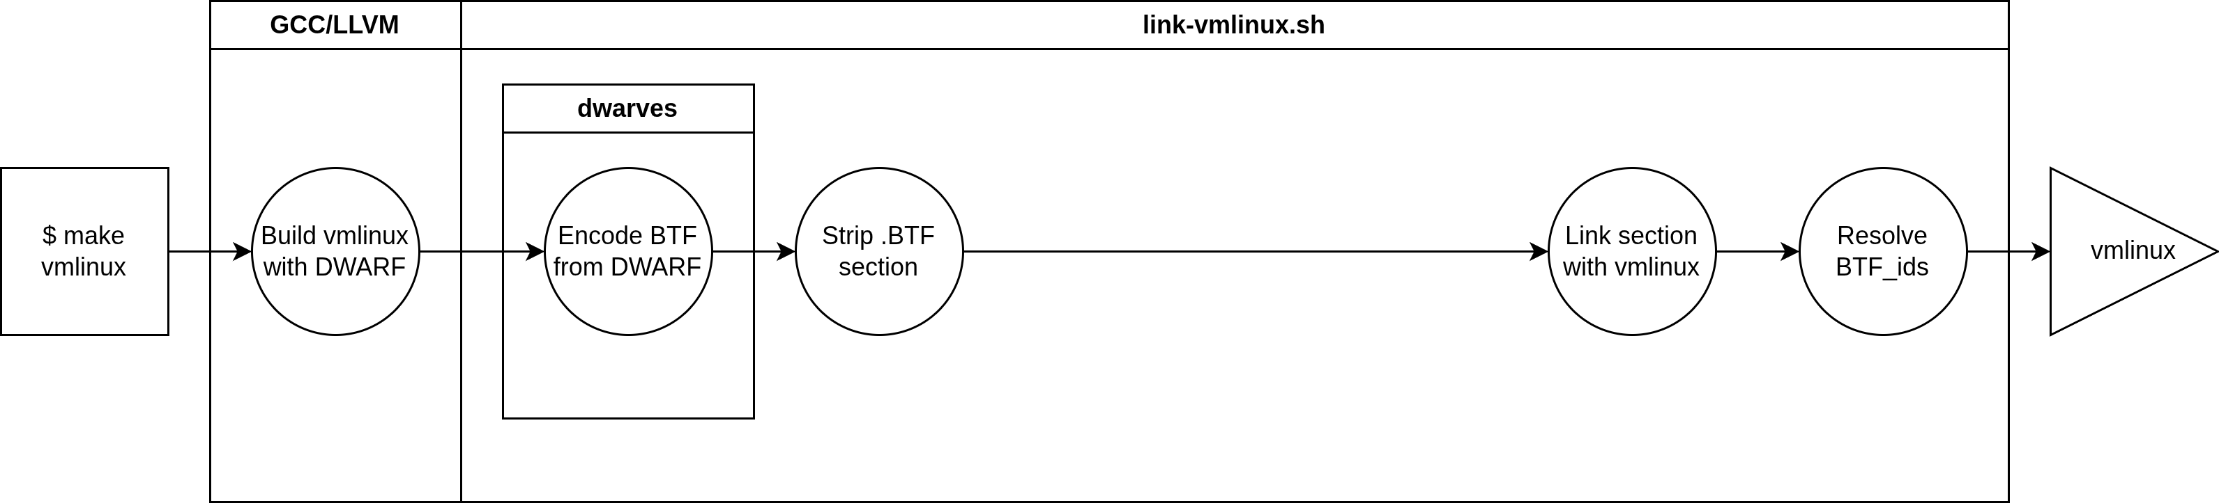
Current State of BTF Generation
Overview (vmlinux)
Notes:
Bruce: To begin, I’ve put together some charts to describe how all of this fits into pahole and the kernel build process.
I’m sure a lot of you are familiar with this process, so please bare with me here.
We’ll start with the current state of BTF generation for vmlinux in the kernel.
When you run make vmlinux, your compiler will generate the DWARF for vmlinux, which is read by link-vmlinux.sh.
This script calls on pahole to encode BTF information from the provided DWARF, a process that we’ll discuss more in detail in later slides.
From here, link-vmlinux strips the .BTF section created by pahole and links just that section with vmlinux.o, then resolve btf ids is called to resolve the BTF ids.
I am leaving out information about the linking of kallsyms, because although it also happens in link-vmlinux.sh, it is not relevant at this time.

Slide 15
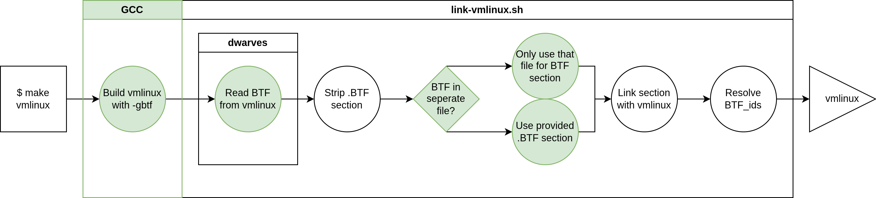
Proposed BTF Generation
Overview (vmlinux)
Notes:
Bruce: And here is what we’ve been working on in the kernel build pipeline.
We begin by building vmlinux with (minus) gbtf, so the BTF information is generated by the compiler rather than by pahole.
Because of this, pahole no longer reads in the DWARF to generate a .BTF section. <NOTE: is this still true with kfuncs now?>
Then most of the pipeline remains the same: the BTF section is stripped and sent to the linking process, though we have added in a check to see if the entirety of the BTF information is in a single file: if so, we will only use that file.
Following this, the section is linked, and BTF ids are resolved just as before.

Slide 16
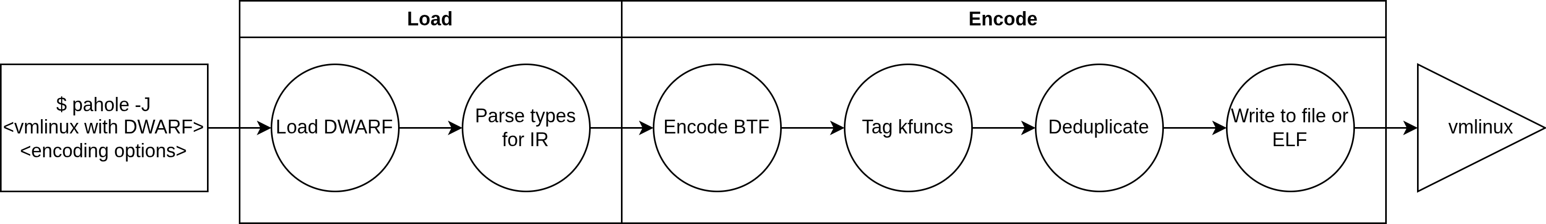
Current State of BTF Generation pahole (vmlinux)
Notes:
Bruce: Moving on, let’s talk about pahole.
Currently, as I mentioned, pahole uses raw DWARF to encode a BTF section for vmlinux.
First, pahole loads the DWARF, then processes the types into an internal IR.
This IR is then handed off to the btf encoder, which will encode that IR into valid BTF, as well as tag all encountered kfuncs.
At this point, pahole deduplicates the BTF it has just encoded, and then writes out either raw to a file, or to an ELF section.

Slide 17
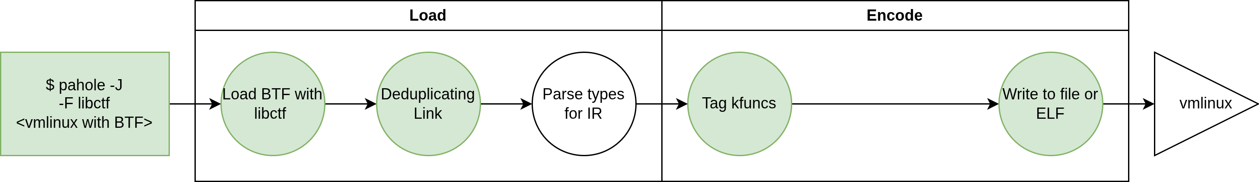
Proposed BTF Generation pahole (vmlinux)
Notes:
Bruce: Now here is the libctf version of this process.
Instead of calling the DWARF loader, pahole now calls the new libctf loader, which reads the BTF generated by GCC.
As Nick mentioned, the libctf-enabled linking process has implicit deduplication, so the deduplication happens at the loading phase instead of the encoding phase. This has no real implications for the output.
The loader then converts this information for the pahole IR as if we were going to encode BTF.
Now while we are not encoding BTF, we do still need to tag kfuncs. At the moment, this work has yet to be completed.
Following this, we write out the processed BTF using libctf.

Slide 18
GCC Generated BTF
GCC supports generating type & decl tags in GCC 16
-gbtf generates BTF information without writing DWARF (still goes through DWARF IR)
-gbtf generates duplicated BTF that needs special handling for linking
-gbtf does not handle kfunc tagging
Notes:
Bruce: If you were in attendance at my other colleagues talks this morning, you already know all about compiler-generated BTF, so I will keep this brief.
Thanks to the work of David Faust, GCC now supports generating type and decl tags for BTF in version 16.
With the advent of compiler-generated BTF, we now require a linker which can both link and deduplicate BTF. This is where libctf comes in, as I have mentioned.
As I have also mentioned, kfunc tagging still needs to be handled by pahole.

Slide 19
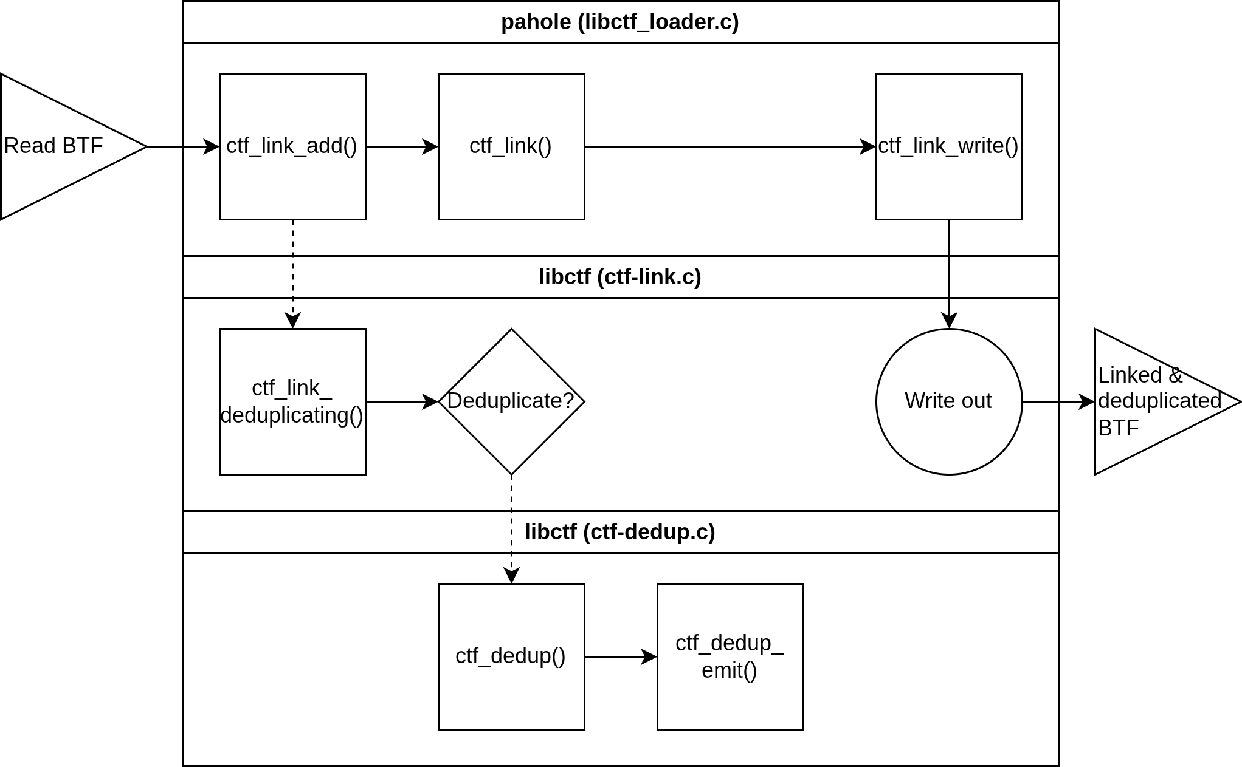
Linking BTF (vmlinux)
Notes:
Bruce: Here is a diagram with a quick overview of how a deduplicating link of vmlinux BTF works – specifically as it pertains to pahole.
Once we have read the vmlinux BTF into a libctf dictionary, we add this to the link. We then call ctf_link_deduplicating(), which – if deduplication is required – invoked libctf’s deduplicator and emits the deduplicated BTF section. After this, we proceed with the link as usual, and then write out.

Slide 20
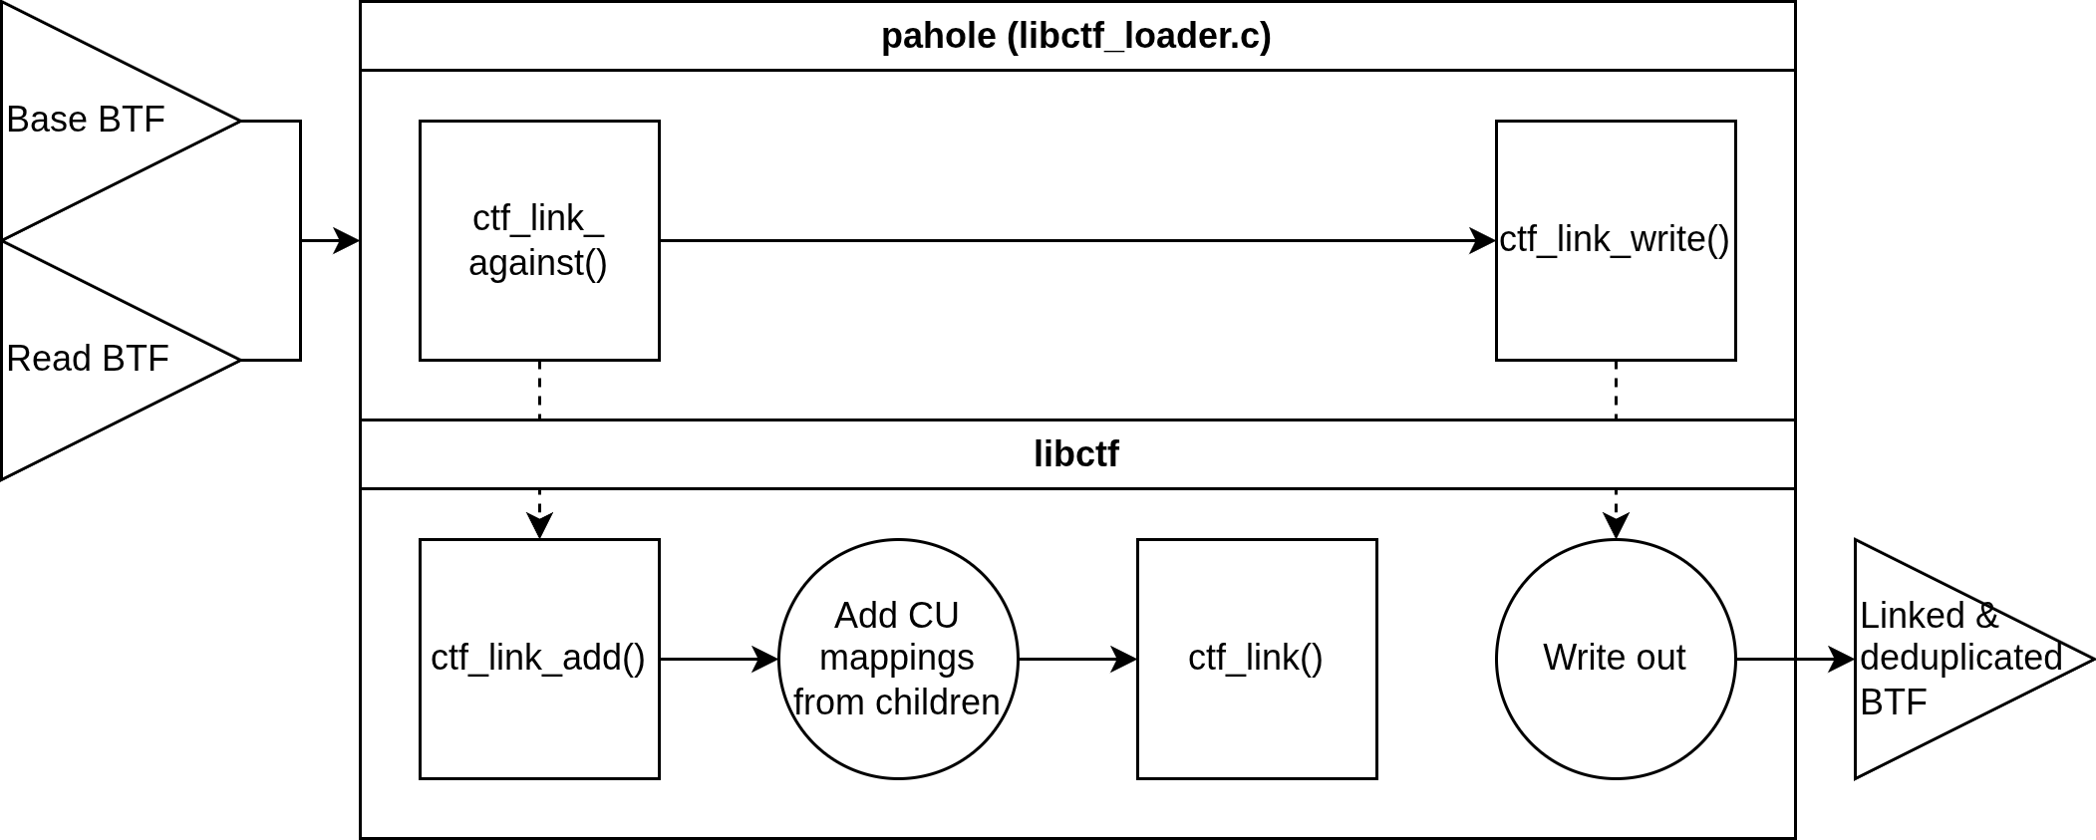
Linking BTF (modules)
Special “Against Types” mode
Notes:
Bruce: In the case of linking modules, pahole needs to be provided with both the module BTF to link as well as the base btf to be informed.
From here, pahole calls ctf_link_against(), which adds both the BTF base archive and the module BTF dictionary to the link, adds the CU mappings of any child dictionaries, and then follows the same linking procedure as in the last slide.

Slide 21
Changes to pahole
New loader pathway: libctf
Modified encoding is required to handle kfuncs and writeout
1:1 parity with BTF loader pathway
Removed dead Solaris CTF pathways
Notes:
Bruce: So what has changed in pahole at this time?
First, as mentioned, there is a new loader pathway for utilizing libctf’s BTF reading functionality.
This loader utilizes the exact same IR as the existing BTF loader, which allows users to utilize pahole’s hole detection without modification.
In addition, I have removed the dead code relating to solaris CTF encoding and reading. It was not being used, and there were a number of comments asking to implement libctf, so we finally did that.
As I mentioned before, there is still a bit of work to be done in tagging kfuncs as part of porting the encoder pathway.

Slide 22
Compatibility
Drop-in alternative for other loaders in pahole
Old pathways remain if you want them
New kernel config check: CONFIG_HAVE_BTF_TOOLCHAIN
Notes:
<not sure if needed ?>

Slide 23
Transition and Maintenance
As BTF evolves, so will libctf
Adding new type kinds is trivial
Notes:
<help>

Slide 24
Where to find it
GCC 16+
binutils
  https://sourceware.org/git/binutils-gdb.git
  users/nalcock/road-to-ctfv4
dwarves:
  https://github.com/peter-shoes/dwarves
  bcm/libctf
linux:
  https://github.com/peter-shoes/linux-gccbtf/
  libctf

