Slide 1

{HACKATON}
[ topic 6 : content discovery ]
NEWSMATICS x DEADLOCK
MARCH 01, 2025

Slide 2
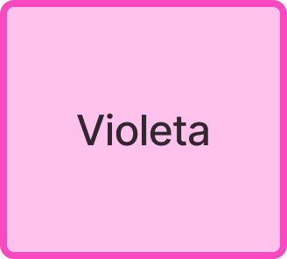





article output, based on vector similarity of user query search using embedding systems

Slide 3



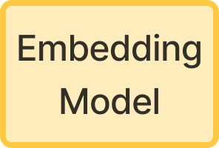

Slide 4








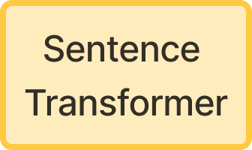

Slide 5
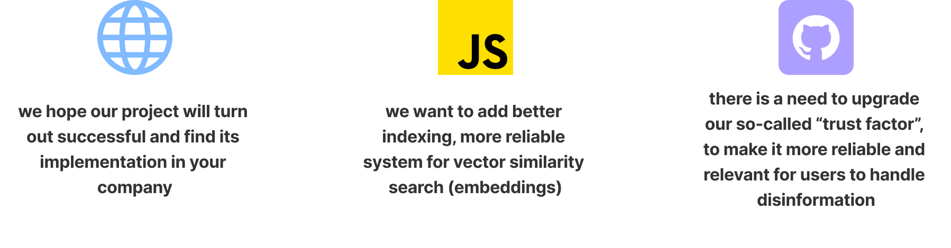

Slide 6


Slide 7


