Slide 1

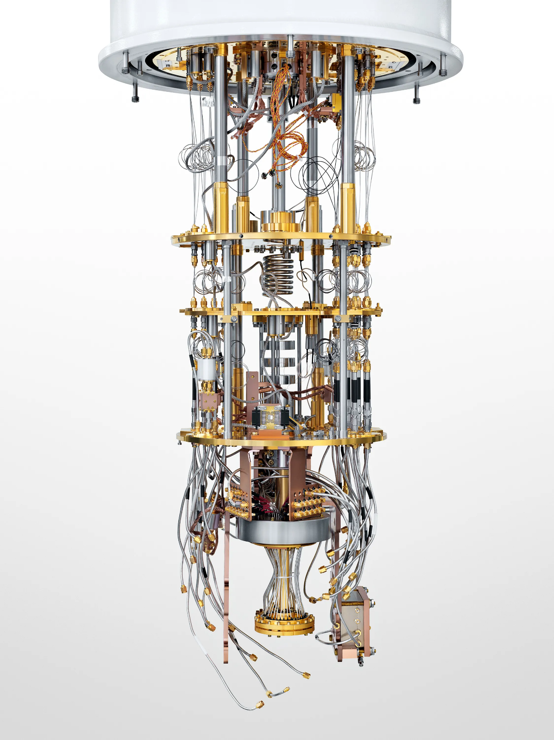
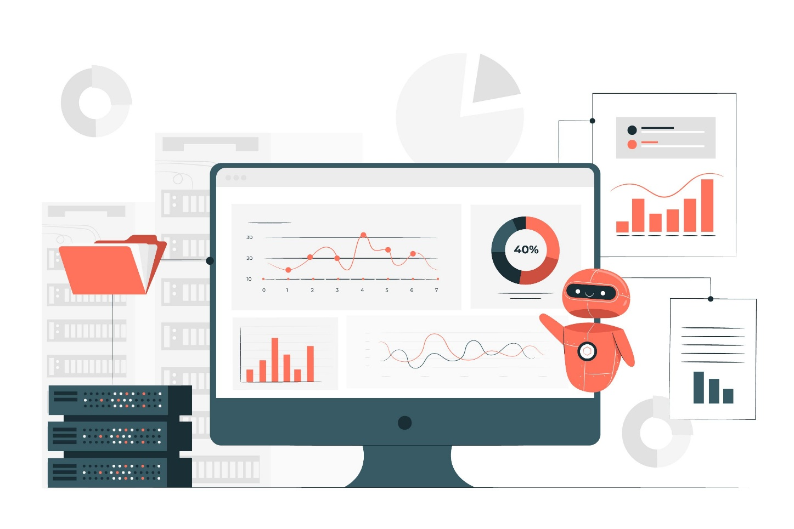
INTRODUCTION
QUANTUM COMPUTING
NEW ERA OF COMPUTAION
TAMILNADU COLLEGE OF ENGINEERING
Basil V
Gokul S V
Lohith M M

Slide 2
BASICS MECHANICS
INTRODUCTION
On small scales, physical matter exhibits properties of both particles and waves,
and quantum computing leverages this behavior using specialized hardware.
Why is it important
It has the potential to revolutionize problem-solving in ways that classical computers simply cannot match.
It offers exponential speedups for certain problems, enabling breakthroughs in science, cryptography, AI, and beyond.
How it differs from classical computing ?
Quantum computing differs from classical computing by using qubits, which can exist in multiple
states at once (superposition) and interact through entanglement. This allows quantum
computers to perform certain complex calculations exponentially faster than classical computers.

Slide 3
INTRODUCTION
BASICS MECHANICS
QUIBIT
QUANTUM INTERFERENCE
A qubit (quantum bit) is the fundamental unit of quantum computing, similar to a classical bit but with unique quantum properties.
It can exist in superposition, meaning they can be both 0 and 1 simultaneously.
It is used to amplify correct solutions and reduce incorrect ones, making quantum algorithms more efficient than classical methods.
ENTANGLEMENT
It is a phenomenon where two or more qubits become interconnected, meaning the state of one qubit is instantly correlated with the state of another, regardless of the distance between them. This unique property allows quantum computers to process and transfer information in ways that classical computers cannot.

Slide 4

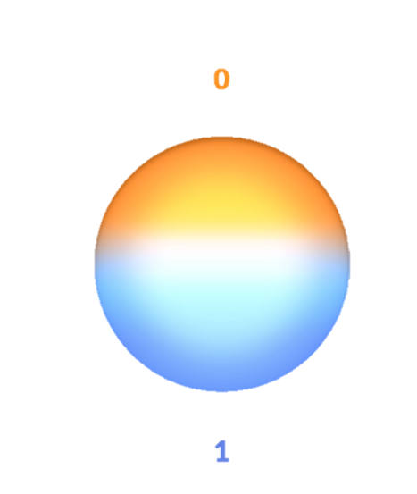
QUBITS VS CLASSICAL BITS
BITS | QUANTUM BITS
The device computes by manipulating those bits with the help of logical gates (AND, OR, NOT). | The device computes by manipulating those bits with the help of quantum logic gates.
A classical computer has a memory made up of bits where each bit hold either a one or zero. | A qubits (quantum bits) can hold a one, a zero or crucially a superposition of these.
Bits are used in classical computers. | Qubits(Quantum bits) are use in quantum computer
Bits are slow. | Qubits are faster.
Its circuit behaviour based on classical physics. | Its circuit behaviour based on quantum mechanics.

Slide 5
APPLICATIONS
Cryptography – Breaking and creating secure encryption methods
Drug Discovery & Material Science – Simulating molecules for new medicines
Optimization Problems – Supply chain, logistics, and financial modeling
Artificial Intelligence (AI) & Machine Learning – Enhancing data processing and pattern recognition
Climate Modeling – More accurate weather and environmental predictions
Financial Services – Risk analysis, fraud detection, and portfolio optimization
Quantum Simulation – Understanding complex quantum systems in physics and chemistry
Cybersecurity – Developing quantum-resistant cryptographic techniques
Aerospace & Defense – Navigation systems and secure communication
Search Algorithms – Faster data retrieval using quantum search methods

Slide 6
CHALLENGES
1. Error Correction
Quantum computers are extremely sensitive to noise and errors caused by interactions with their environment.
This can cause errors to accumulate and degrade the quality of computation.
2. Scalability
Scaling up quantum computers to hundreds or thousands of qubits while maintaining high levels of coherence and low error rates remains a major challenge.
3. Hardware Development
Developing high-quality quantum hardware, such as qubits and control electronics, is challenging.
4. Software Development
Quantum algorithms and software development tools are still in their infancy, and there is a need for new
programming languages, compilers, and optimization tools that can effectively utilize the power of quantum computers.
7. Trained Talent
The number of people properly educated and trained to enter the quantum workforce is small and spread across the world.
8. Overall Expense
expense remains a huge roadblock .Quantum talent is expensive. Quantum
hardware is expensive. Supply chains are complex, vulnerable and — you guessed it — expensive to establish and maintain.

Slide 7
CURRENT STATE OF QUANTUM COMPUTING
Several tech giants are interested in quantum computing
IBM:
IBM quantum Experience allow the user to access real quantum computers via cloud
Google:
developing superconducting qubit processor
focused on quantum error correction
Intel:
developing spin qubits based silicon technology, which can be integrated with existing semi conductor
AWS brake:
provide cloud access to quantum processors from multiple vendors

Slide 8
CONCLUSION
While challenges like error correction , scalability, and stability remain, quantum computing has the potential to revolutionize fields such as cryptography, drug discovery, AI, and optimization. As research progresses, we are moving closer to unlocking its full potential, shaping the future of computing.

