Slide 1



SLEEP TRACKING APPLICATION
: FOR BETTER NIGHT’S REST
USING ANDROID STUDIO – KOTLIN
Basil V Mathew
M.Inbarasu
M.Koushick GV
A.Lokesh

Slide 2




Introduction:
Abstraction:
Sleep is a vital aspect of human life, essential for physical and mental rejuvenation. However, millions worldwide struggle with sleep disorders, impacting their overall well-being, productivity, and quality of life. With the rise of mobile health applications, tracking and improving sleep quality has become more accessible.
Dream Well is an innovative sleep tracking app designed to help individuals monitor, analyze, and optimize their sleep patterns for a better night's rest. Using cutting-edge technology and can be also integrated with machine learning algorithms in future, Dream Well tracks sleep duration, quality, and stages, providing personalized insights and recommendations to improve sleep hygiene.

Slide 3

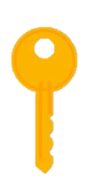
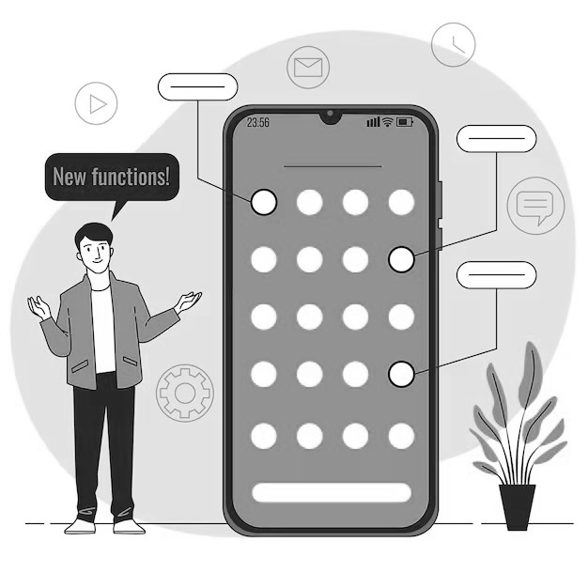

Key Features:
Advantages:
User Authentication
Users can register and log in
using email/password credentials via
Firebase Authentication.
Modern UI/UX
Material Design principles guide
the app’s look and feel.
Real time update
Users can see the Realtime data
via firebase cloud services
Better Sleep Awareness
Understand your sleep patterns,
duration, and overall habits for
improved health.
Personalized Insights
Receive tailored recommendations
based on your sleep data to enhance
sleep hygiene.
Early Detection of Sleep Disorders
Spot irregularities like insomnia
or sleep apnea for early intervention.
Enhanced Productivity and Mood
Improve mental clarity and mood by
achieving consistent, quality sleep.

Slide 4
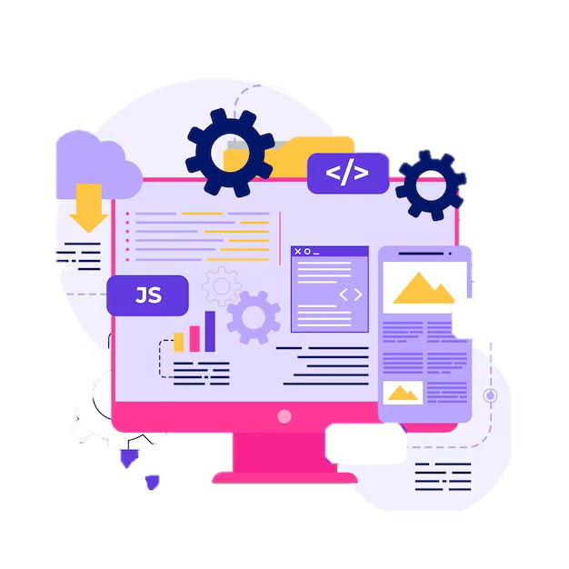
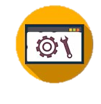

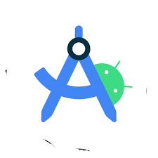
Software Requirements:
Existing System:
Android Studio
Version: Latest stable version
Kotlin
Integrated within Android Studio as the primary programming language.
Ensure Kotlin is enabled in the project setup.
Firebase
Authentication: For secure user registration and login.
Battery Drain
Continuous tracking can drain phone battery.
Privacy Concerns
Sensitive data may be mishandled.
User Discomfort
Some wearing devices can disturb natural sleep.
Generic Recommendations
Insights are often not deeply personalized.

Slide 5
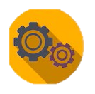
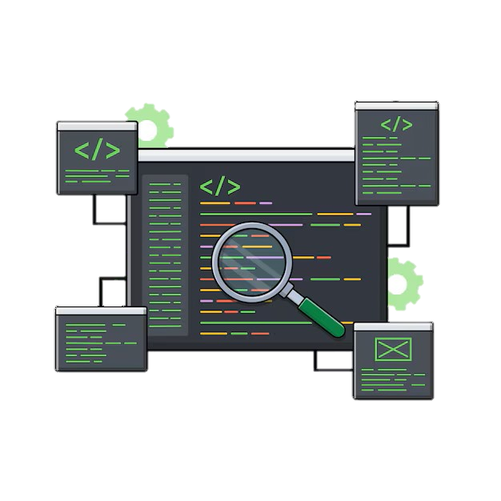
Program:
1. User Data Class:
This class represents a user and their details, like their first name, last name, email, and password. It's marked as a "Room Entity," meaning it will be saved in the database as a table.
2. UserDatabase Class:
This class sets up the Room database. It connects to the database and allows you to access the User data. It makes sure only one instance of the database is used throughout the app.
3. UserDatabaseHelper Class:
This class uses the older way of managing databases in Android, called SQLiteOpenHelper. It manually creates the database and handles inserting and getting user data with SQL queries.
4. Room vs. SQLiteOpenHelper:
  Room: A modern, easier way to work with databases in Android. It automatically handles most tasks and reduces errors.

Slide 6

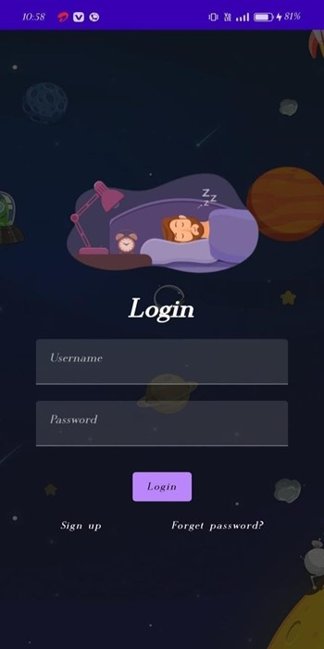
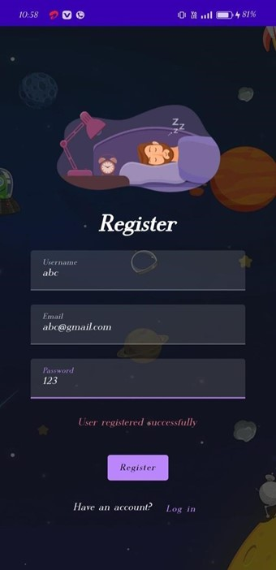
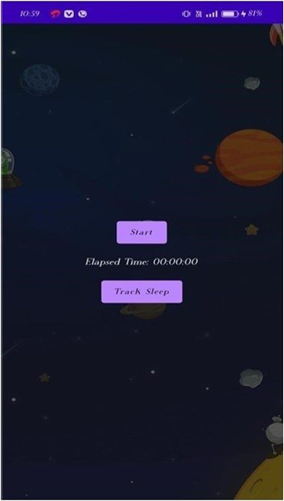
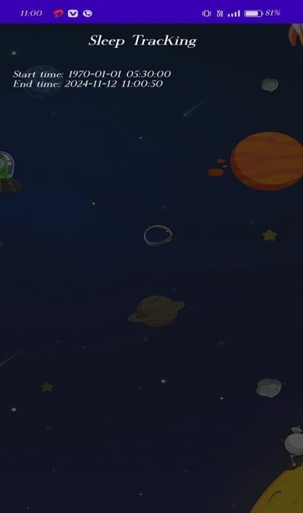
Output:

Slide 7


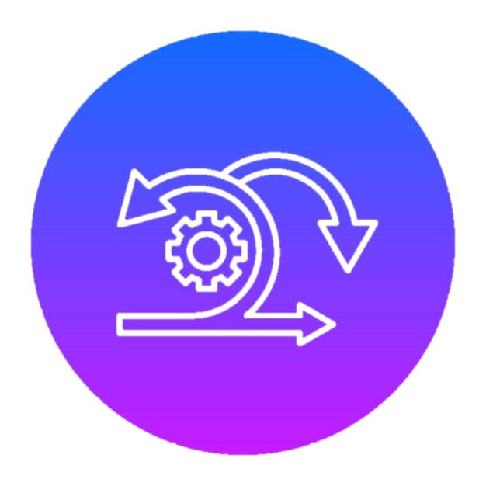

Conclusion:
Future scope:
A sleep tracking app aims to help users achieve better sleep by monitoring sleep patterns, identifying issues, and providing personalized recommendations.
By offering insights and tracking progress, a sleep tracking app can guide users toward healthier sleep habits, potentially leading to more restful nights and overall well-being.
The future scope of a sleep tracking app project is vast, with potential for advancements in
personalized health insights and integration with smart devices.

Slide 8
THANK YOU

