Slide 1
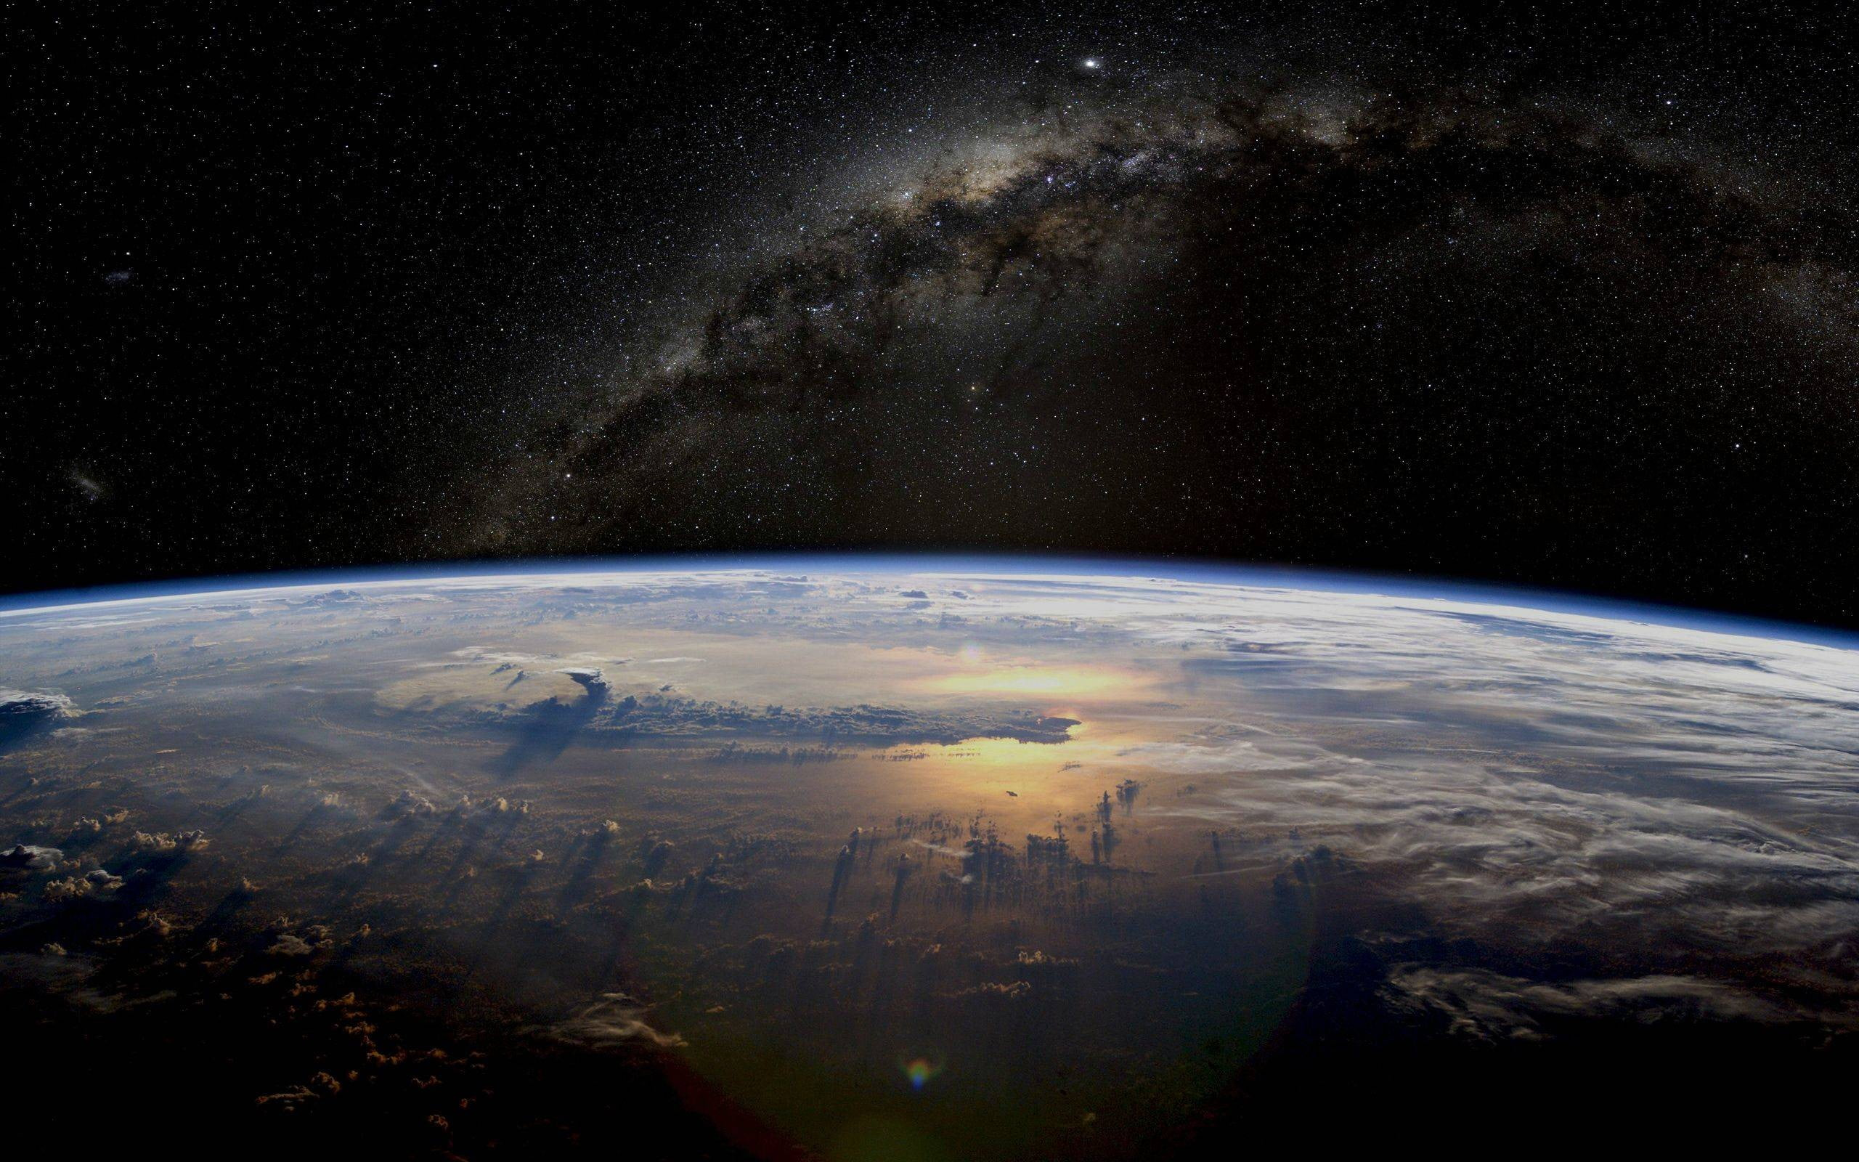

NATIONAL
Space
day
  National Space Day, celebrated on the first Friday in May, inspires interest in space exploration and STEM education. It honors the achievements in space science and encourages future generations to explore the cosmos.
August 23

