Slide 1
Brainz Parents Portal

Slide 2
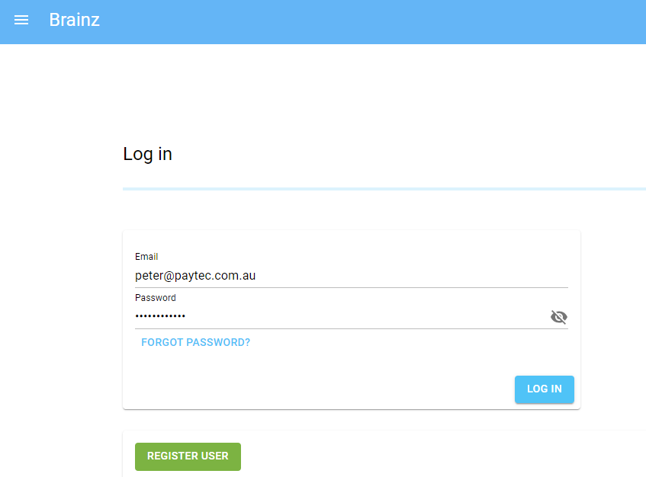
Log in

Slide 3
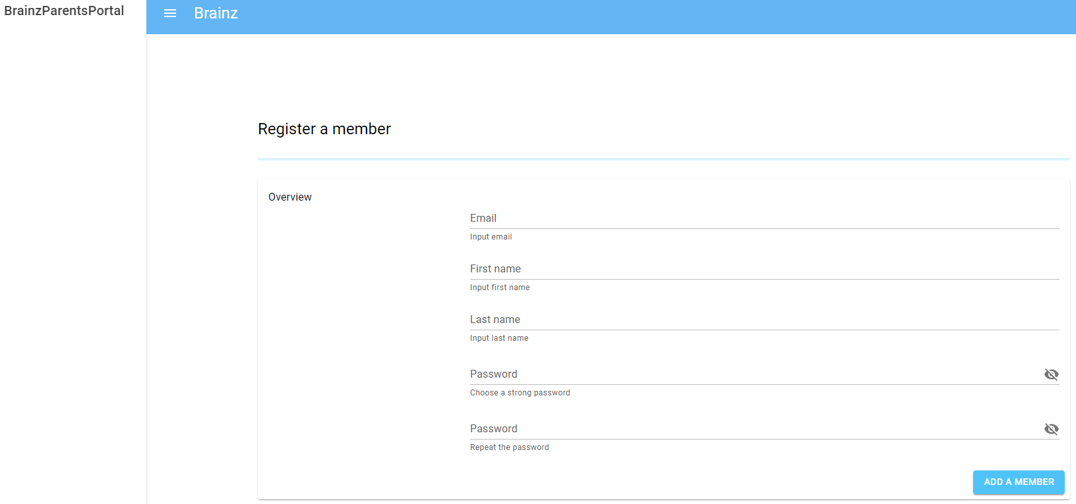
Register a member

Slide 4
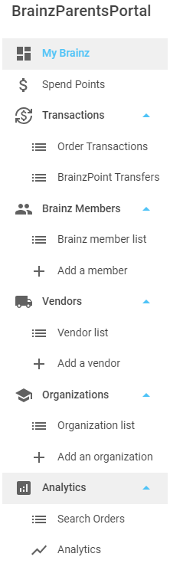
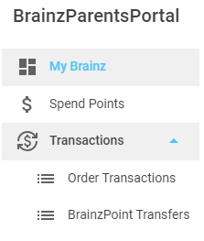
Menu
Admin
User

Slide 5
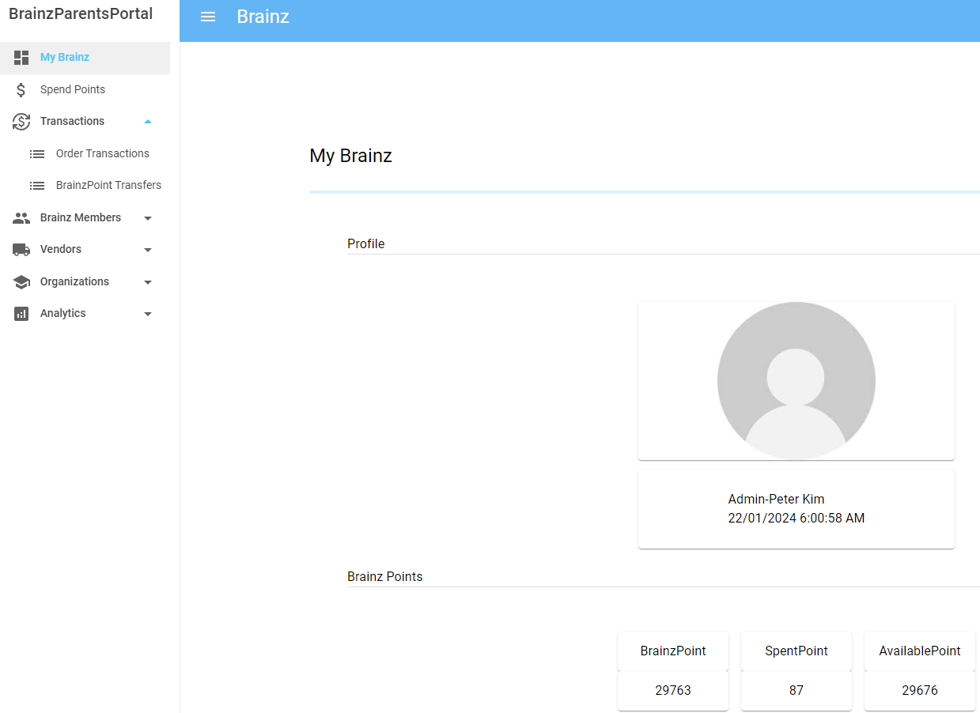
My Brainz

Slide 6
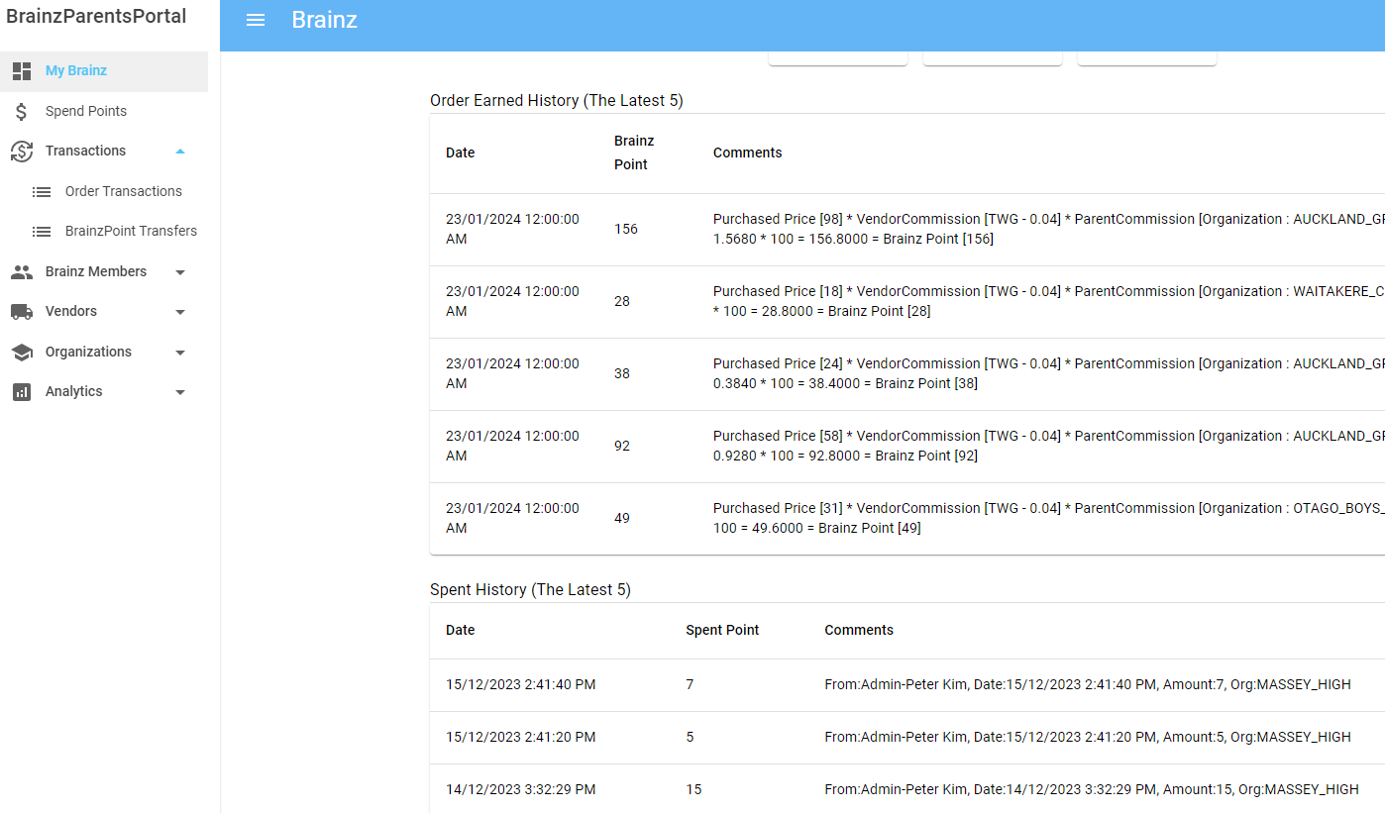
My Brainz

Slide 7
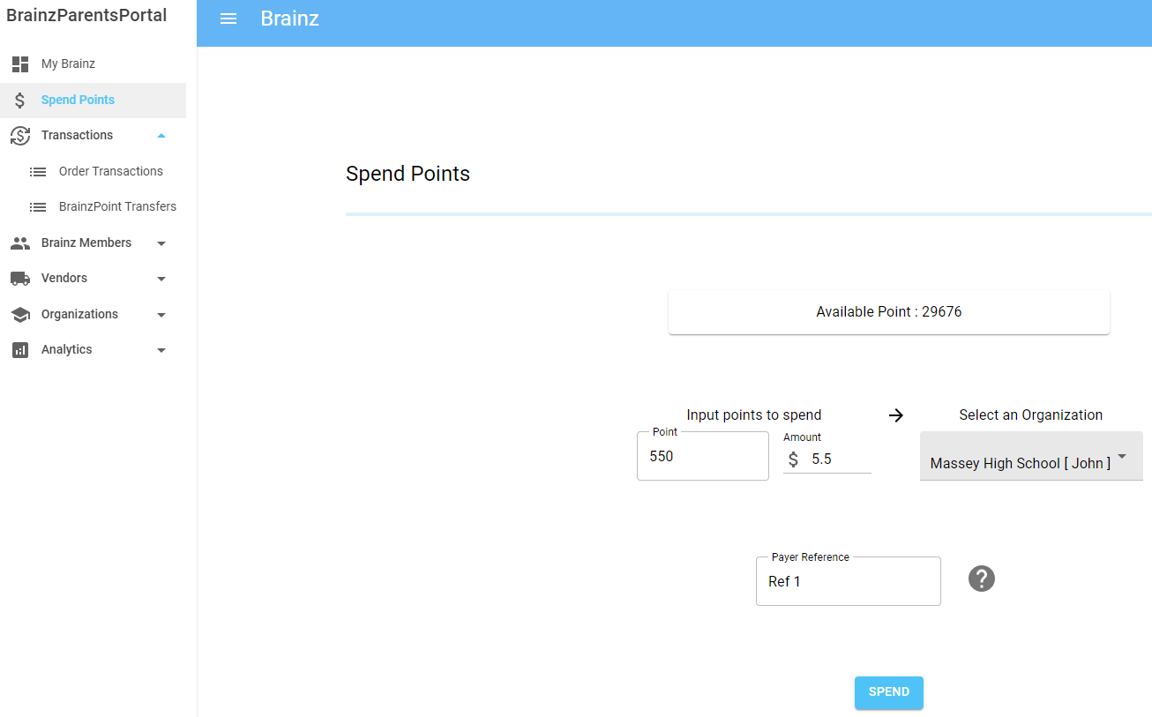
Spend Points

Slide 8
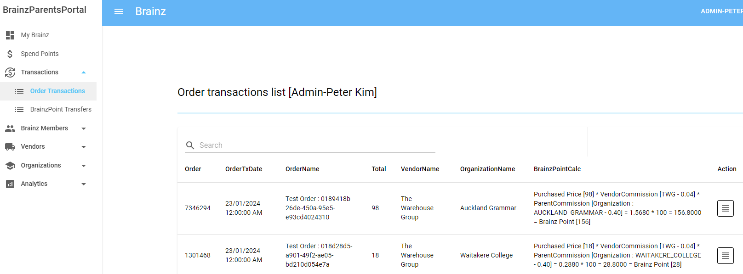
Transactions – Order Transactions

Slide 9
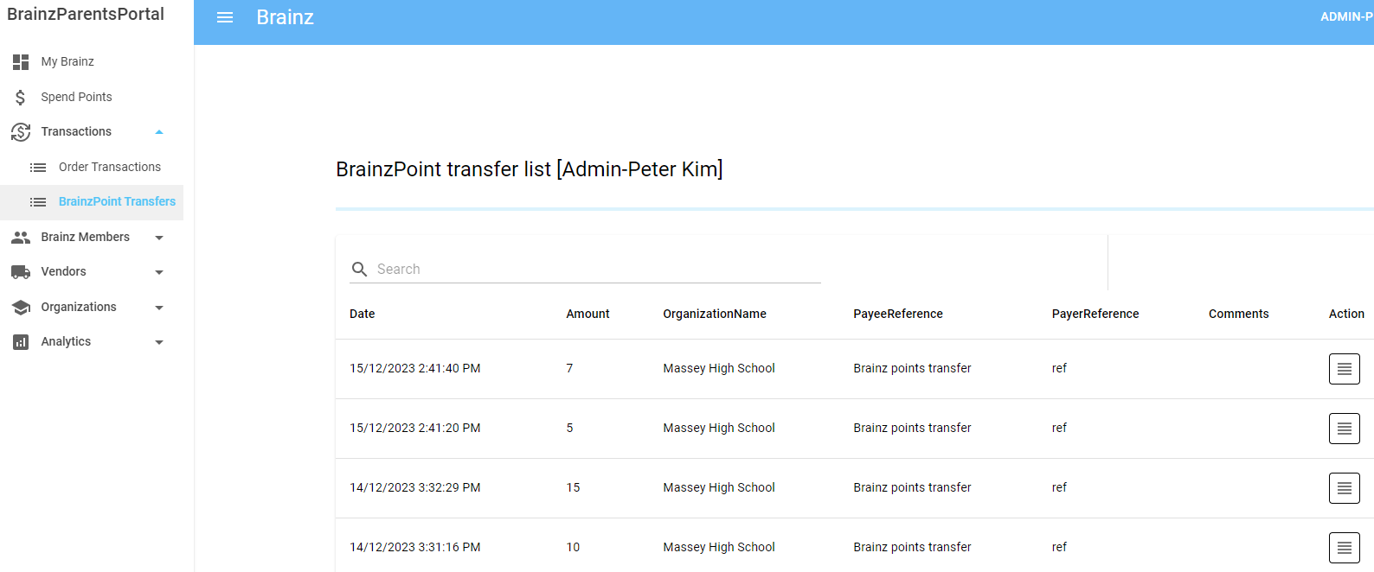
Transactions – BrainzPoint Transfers

Slide 10
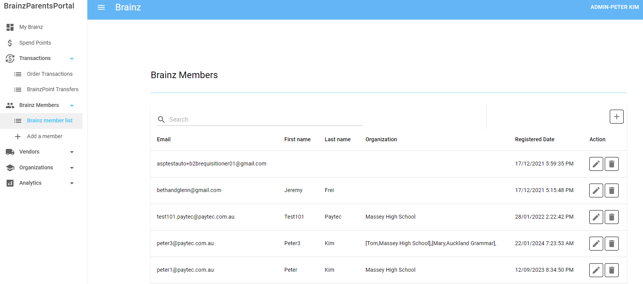
Brainz Members – Brainz member list

Slide 11
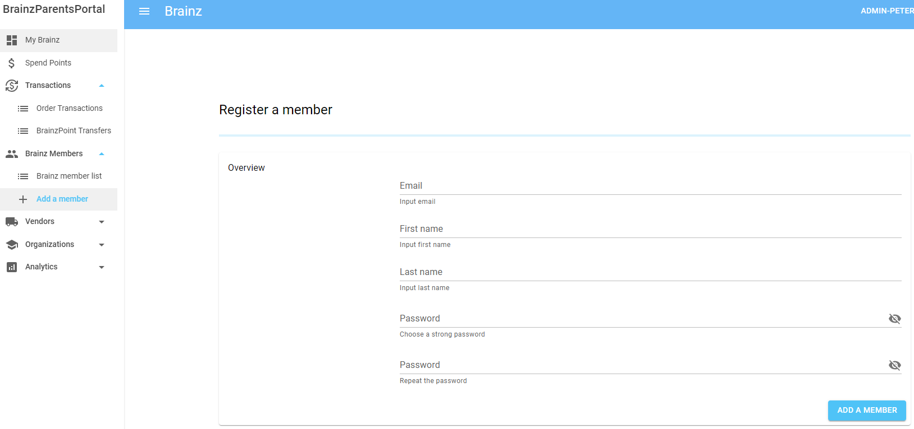
Brainz Members – Add a member

Slide 12
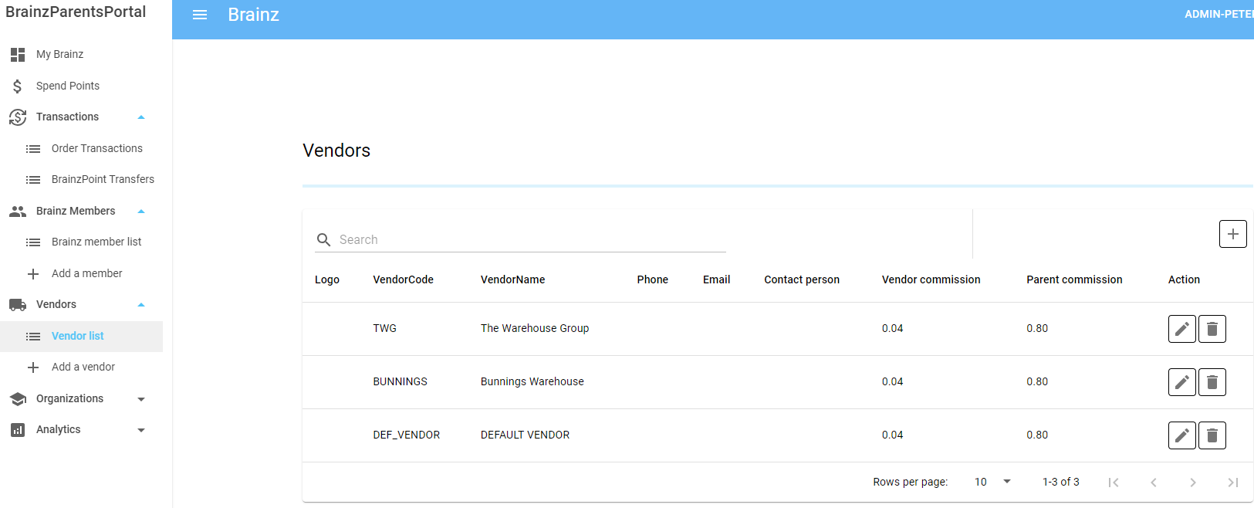
Vendors – Vendor list

Slide 13
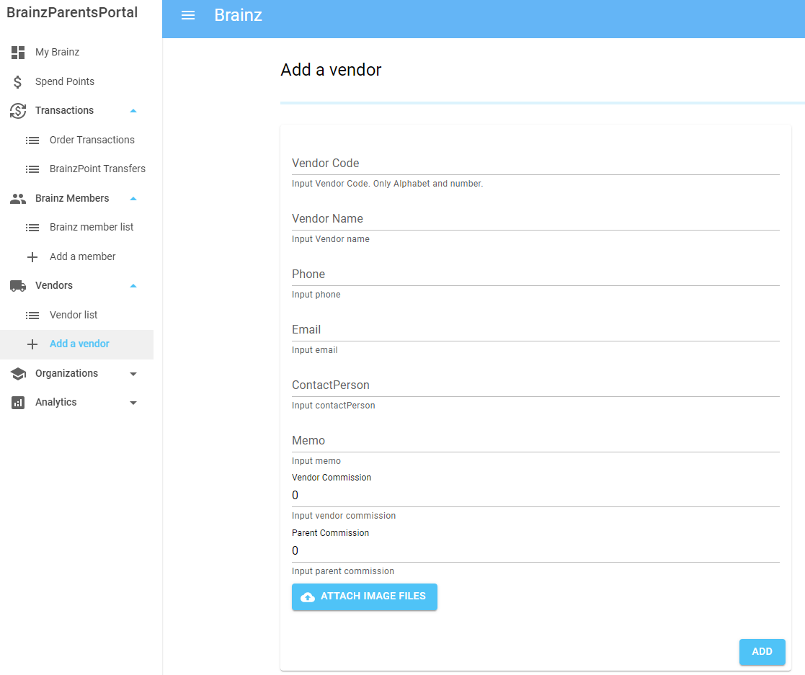
Vendors – Add a vendor

Slide 14
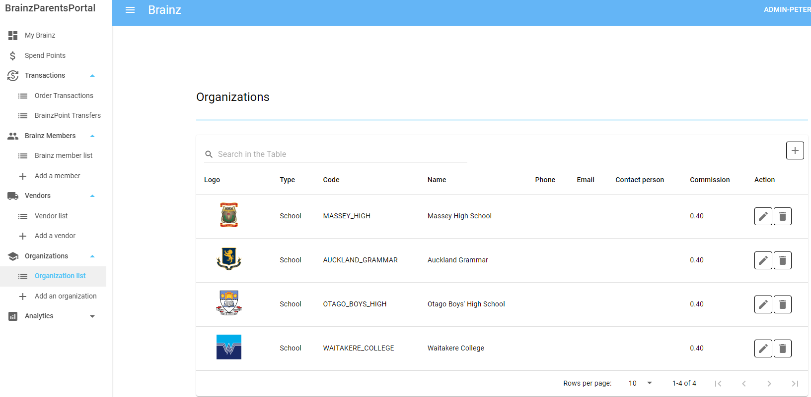
Organizations – Organization list

Slide 15
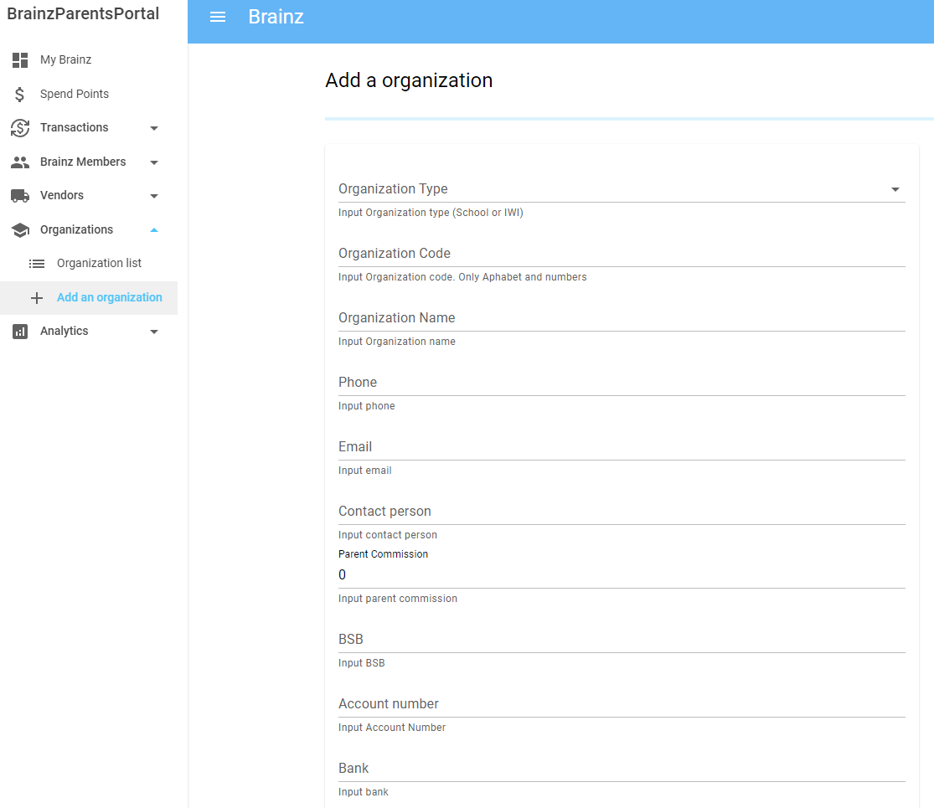
Organizations – Add an organization

