Slide 1
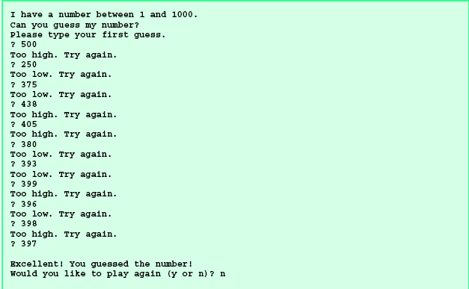
程式設計I Homework #4
猜數字(Guess a number)
寫一個程式，亂數產生一個介於1~1000的正整數來讓玩家猜。當玩家猜的數字大於被猜數，則提示Too high，反之提示Too low。一直到玩家猜到數字為止。執行範例如下：
(Write a program to generate a random number between 1 to 1000 and to allow the player to guess the number)

