Slide 1
Homework #5 Sales
Use a double-subscripted array to solve the following problem. A company has four salespeople (1 to 4) who sell five different products (1 to 5). Once a day, each salesperson passes in a slip for each different type of product sold. Each slip contains the following:
a) The salesperson number
b) The product number
c) The total dollar value of that product sold that day
Thus, each salesperson passes in between 0 and 5 sales slips per day. Assume that the information from all of the slips for last month is available. Write a program that will read all this information for last month’s sales and summarize the total sales by salesperson by product. All totals should be stored in the double-subscripted array sales. After processing all the information for last month, print the results in tabular format with each rows of the representing a particular salesperson and each of the columns representing a particular product. Cross total each column to get the total sales of each product for last month; cross total each row to get the total sales by salesperson for last month. Your tabular printout should include these cross totals to the right of the totaled rows and to the bottom of the totaled columns.

Slide 2
作業五:業績計算
使用二維陣列來解決以下問題。某家公司有四位銷售人員(編號1到4)，他們銷售五種不同產品(編號1到5)。每天一次，每位銷售員繳交便條紙，寫出當天售出不同產品的數量，每種產品一張便條紙。每張便條紙包含以下資料:
a) 銷售人員編號
b) 產品編號
c) 該產品總銷售金額
因此每位銷售員每天必須繳交0到5張關於各種產品銷售金額的便條紙。假設上個月的所有銷售便條紙已經收集完成。請撰寫一個程式，能夠輸入每張便條紙的銷售資訊，並按照每位銷售員和產品來統計銷售金額的總和。所有銷售金額必需存放在一個二維陣列中。處理完所有資料後，請將結果用表格形式顯示出來，每一列代表某個特定銷售員，而每一行代表某個特定產品。將每一行的值相加，可以得到該產品上個月的總銷售金額，將每一列的值相加，可以得到該銷售員上個月的銷售總額。在表格右方顯示銷售員的總金額，在表格下方顯示該產品的總金額。

Slide 3
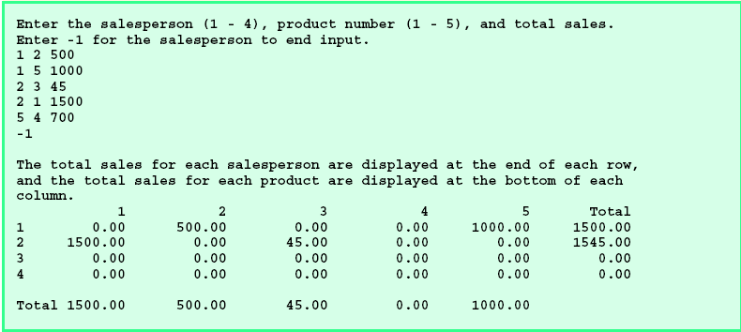
業績計算

