Slide 1
Assistive Technology:
Aiding Sensory-Seeking Children
Peter Traunfeld

Slide 2
What is Assistive Tech?
Objective: Help someone with disability or impairment

Slide 3
What kinds are there?
Mobility
Health care
Accessibility
Visual/Auditory/Motor assistance
Communication
Cognition

Slide 4
Aspects of Cognition
Attention
Memory and Planning
Sensory Integration
Emotional Regulation

Slide 5
Interactivity
Interactivity = level of interaction
Surface versus Deep
Constructivism
  Assimilation
  Accomidation
Notes:
Interaction is important because:
- engagement → learning
- keep attention on something
- sensory stimulation

Slide 6
Existing Tools: IWB
Interactive White Boards (IWB)
  Flexible
  Efficient
  Multimedia presentation/manipulation
  Easier to plan lessons
  Modeling Information Communication Tech Skills
  High level of interactivity

Slide 7
More Tools
1. Microsoft Kinect
2. Leap Motion
3. Philips Hue Lights

Slide 8
What is the Kinect?
Three-dimensional movement tracker
Originally for gaming with Xbox 360
Inexpensive (~100 USD for v1)
Portable

Slide 9
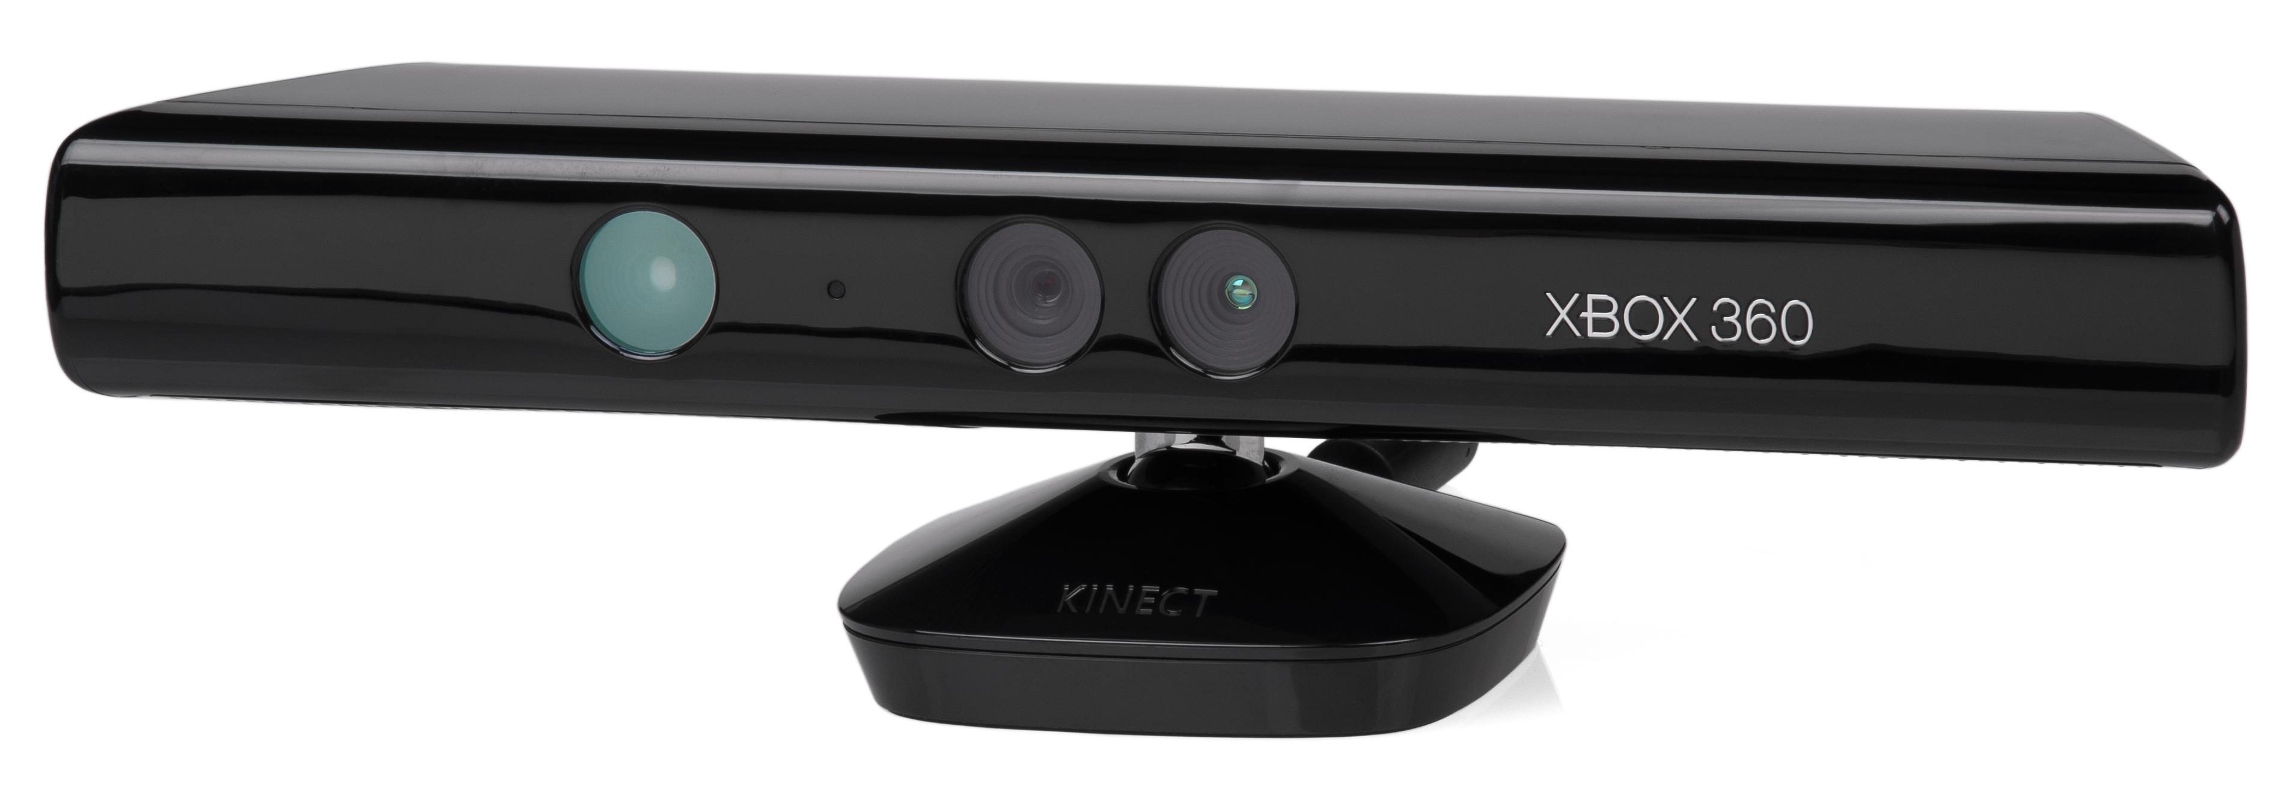
What is the Kinect?
Photo taken from en.wikipedia.org

Slide 10
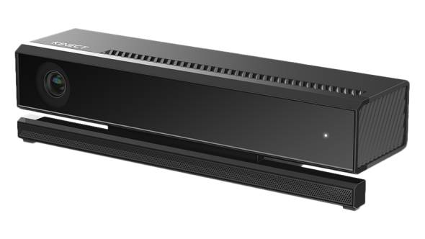
Kinect v2
Photo taken from microsoftstore.com

Slide 11
What is Leap Motion?
(Demonstration)

Slide 12
Philips Hue Lights
Programmable LEDs controlled by Wifi

Slide 13
Existing Applications
Kinect
    Evoluce - WinandI
    Team Aether
Leap Motion
  Form and Function 3D
  Molecules
Notes:
Need more specific examples

Slide 14
Our Goal
To Develop an inexpensive, portable, user-friendly application framework to create interactive spaces for sensory seeking children

Slide 15
Questions?

Slide 16
Works Cited
Hsu, Hui-Mei Justina. "The Potential of Kinect in Education." International Journal of Information and Education Technology 1.5 (2011): 365-70. Web. Sept. 2014.
Kennewell, S., H. Tanner, S. Jones, and G. Beauchamp. "Analysing the Use of Interactive Technology to Implement Interactive Teaching." Journal of Computer Assisted Learning 24.1 (2008): 61-73. Web. Sept. 2014.
https://www.ece.cmu.edu/~ece549/spring13/team14/specs.html

