Slide 1
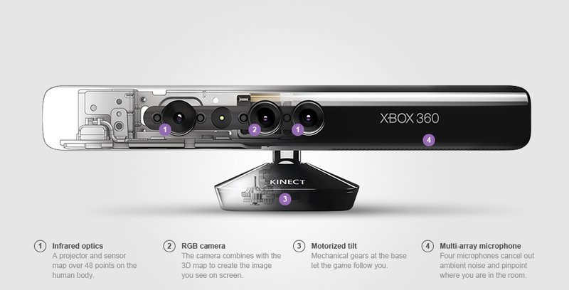
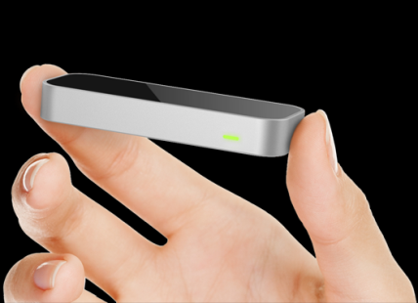
Interactive Spaces Peter Traunfeld Shannon Duvall
The hardware
Microsoft Kinect
Leap Motion
Introduction
The Leap is a device that tracks hands and other objects that can be used to point. It costs about 80 USD and can recognize hand gestures.
Children with a variety of cognitive, emotional, and other disabilities are motivated primarily by sensory input. Interactive spaces are areas in which children receive sensory information through movement and play. For instance, imagine a room in which a child can point to objects and hear the Spanish word for that object. Currently, these kinds of spaces exist only as exhibits in museums. The goal of this research is to utilize existing motion detection technology in order to create affordable, portable, easy-to-use interactive spaces for children with special needs.
A three-dimensional motion tracking device originally developed for gaming purposes, The Kinect is portable, approximately 100 USD, and is capable of recognizing voice commands and gestures.
The software
Musical Scale
Another example
Imagine playing a piano simply by pointing at the notes you want to play.
Foreign Language
Refs

