Slide 1
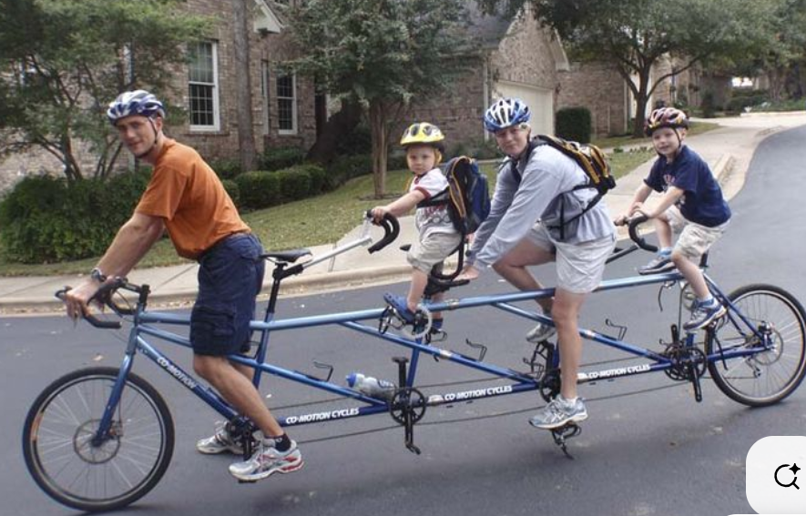
Challenges and opportunities for theorizing and implementing inquiry-based learning
van der Graaf et al.
Covic
Agesilaou & Kyza
Flegr & Kuhn
What can we learn looking at these studies in tandem?
First of all, I would like to thank the symposium organizers and presenters; the contributions provide an excellent overview of current approaches in IBL research and a strong basis for discussing where the field is standing and going next.
EARLI Conference 2025, Peter Edelsbrunner
Notes:
I focus on what the studies have not done; where may they go next?
I have taken notes on the individual studies that I would love to share with the authors;
But here, I zoom out to look at the question:
How do these studies – in tandem – provide a stepping stone for further research on IBL and its role in instructional arrangements?

Slide 2
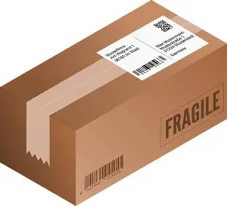
IBL
Notes:
What all these studies have in common that they aim at delivering an inquiry-based learning parcel

Slide 3
Real experiments & virtual reality experiments
IBL design to support privacy data literacy
van der Graaf et al.
Flegr & Kuhn
Covic
Agesilaou & Kyza
Teachers` knowledge and attitudes
Teachers` attitudes and intentions
IBL
IBL
IBL
IBL
Who can deliver the package?
Who wants to deliver the package?
Which package to deliver first?
What should the package contain?
Notes:
Who wants – and which structural circumstances correlate with this intention?

Slide 4
Should it always be inquiry-based learning?
IBL
How can we replace or combine the IBL package with other pedagogies to optimize learning and gather new insights about the studies‘ questions?

Slide 5
Composite instructional design
Loibl et a. (2024)
Intermediate knowledge
Virtual reality experiments
Real experiments
Real experiments & virtual reality experiments
Flegr & Kuhn
How and why should virtual and real experiments affect each other?
Intermediate knowledge
IBL
Real experiments
Virtual reality experiments
Which package to deliver first?
Notes:
IBL is in itself a multi-phase instructional approach – often using some variation of predict-observe-explain sequences.

Slide 6
Intermediate knowledge
Virtual reality experiments
Real experiments
Procedural knowledge about using the virtual platform
Procedural knowledge about conducting the experiments
Real experiments & virtual reality experiments
Flegr & Kuhn
Conceptual knowledge about the domain
Conceptual knowledge about the domain
Conceptual knowledge about the context
Conceptual knowledge about the context
Conceptual knowledge about the virtual representations
Conceptual knowledge about the analog representations
IBL
Intermediate knowledge
Which package to deliver first?
Real experiments
Virtual reality experiments

Slide 7
Intermediate knowledge
Virtual reality experiments
Real experiments
Procedural knowledge about using the virtual platform
Procedural knowledge about conducting the experiments
Real experiments & virtual reality experiments
Flegr & Kuhn
Conceptual knowledge about the domain
Conceptual knowledge about the domain
Package Knowledge integration
Conceptual knowledge about the context
Conceptual knowledge about the context
Conceptual knowledge about the virtual representations
Conceptual knowledge about the analog representations
IBL
IBL
Linking processes to build up
generalized knowledge structures
- Compare and contrast
- Expansive framing
- Building on activated CK (& gap awareness)
Edelsbrunner et al. (2024); Linn (2004); Loibl et al. (2024);
Schumacher & Stern (2022);
Which package to deliver first?
Notes:
Current implementation: Implicit transfer from one context to the other
These linking processes need carefully designed explicit instruction

Slide 8
van der Graaf et al.
Re-conceptualizing IBL as a curricular element of multi-phase instruction
Teachers` knowledge and attitudes
Covic:
„Only“ monthly or weekly use of E-IBL -> is this really so little?
We should consider quality instead of quantity
IBL
Who can deliver the package?
Active learning approaches such as IBL are good bad need to be carefully orchestated in the instructional process (ICAP; Chi & Wiley, 2014; Loibl et al., 2024)
Covic
Teachers` attitudes and intentions
van der Graaf et al.: Let`s measure more!
Teachers` intentions to consider use IBL as part of their learning sequences
Teachers` competencies and expreiences in implementing IBL as part of an instructional sequence
IBL/research center -> Instructional alignment and orchestration center
IBL
Who wants to deliver the package?

Slide 9
Such a beautiful two-study design approach!
Should the contents of the package be the same for everyone?
IBL design to support privacy data literacy
- Agesilaou & Kyza: Scaffolding
Agesilaou & Kyza
- How about removing IBL for some of the learners or phases?
- Adaptive teaching on the level of packages, not only package contents
IBL
Self-regulated learning materials
Direct instruction starting with caomputer-based materials
Flexible Think-pair-share phases
What should the package contain?

Slide 10
When and why should we use inquiry-based learning, and how should we combine it with other approaches and ensure that this combination supports learning?
IBL
What do you think about the contributions and where IBL research should go next?
Notes:
What all these studies have in common that they aim at delivering an inquiry-based learning parcel.
DO you have comments regarding a specific presentation, or is there something pressing about IBL in general that you would like to share with us and discuss?

Slide 11
Challenges and opportunities for theorizing and implementing inquiry-based learning
What can we learn from the common methodology and issues of these studies?

Slide 12
Challenges and opportunities for theorizing and implementing inquiry-based learning
Orchestration:
Agesilaou & Kyza: What about going a step back and asking not within the framework of IBL: How can we best design tasks and scaffold? But: For whom is IBL best, and in what amount?
Flegr and Kuhn: Sequences and orchestrations. Katharina Loibl – framework :)
Covic: Is it good that teachers use IBL often? Monthly to weekly does not seem so little to me. Depending on the learning goal:
We need more emphasis on the deep structure; first, within individual pedagogies – but, more importantly, second, on the level of the topical and curricular orchestration.
Mention: ICAP: We know that we want active – but how much, in which order, and how to connect active learning with other kinds of learning? -> Orchestration!

Slide 13
Agesilaou & Kyza
N = 63 5th- and 6th-graders
Inquiry-based learning
Critical data literacy
Understand personal data
Reflect upon personal data
Act on personal data

Slide 14
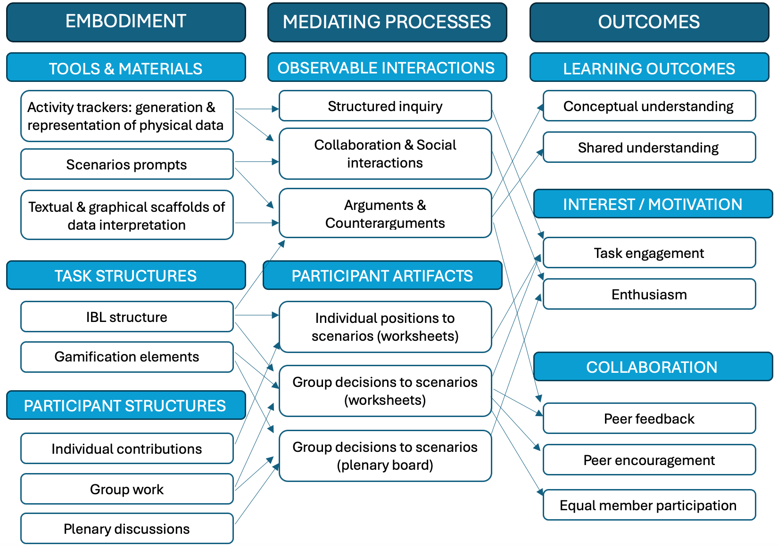
Agesilaou & Kyza
Conjecture map

Slide 15
Agesilaou & Kyza
My naïve methodologist`s view:
Sampling error and variability
Design adaptations based on qualitative case study 1:
Novelty effects – will they hold across samples/populations of learners?
-> Adaptive learning environment:
Adapt not only the scaffolds, but the design
Let`s adapt the (very) pedagogy!
e.g.,
Maybe even the focus in IBL/group discussion?
-> Some learners would benefit from more “think”,
Others from more “pair”, and other ones again from more “share”?
Discussions with LS…

Slide 16
Flegr & Kuhn
Learning with multiple representations:
Analog representation (Real Experiment)
Digital representation (Virtual Reality Experiment)
Key question:
What are the processes allowing a benefit?
My suggestion:
Integration processes
-> These need to be supported!
My assumption:
The real experiment is easier to digest when it comes second – higher extraneous cognitive load. When I have built up prior knowledge, the intrinsic and germane load may be lower -> I can concentrate more on handling the extraneous factors.
But, importantly:
There needs to be cognitive space and activation of integration processes across the two conditions!
Combine and contrast actitives:
Self-explanation prompts, Think-pair-share.
Allows inferrting the common underlying abstract conceptions.

Slide 17
Covic
Teachers`attitudes & beliefs about E-IBL, self-perceived ped. Competences, contextual factors (school provisions etc.)
N = 1061 teachers – representative? 99,2% female. Age?

Slide 18
Van der Graaf et al.
„Low reliability“ of the content knowledge test: Really? I don`t think so!.
Latent profile analysis:
Focus on AIC?

Slide 19

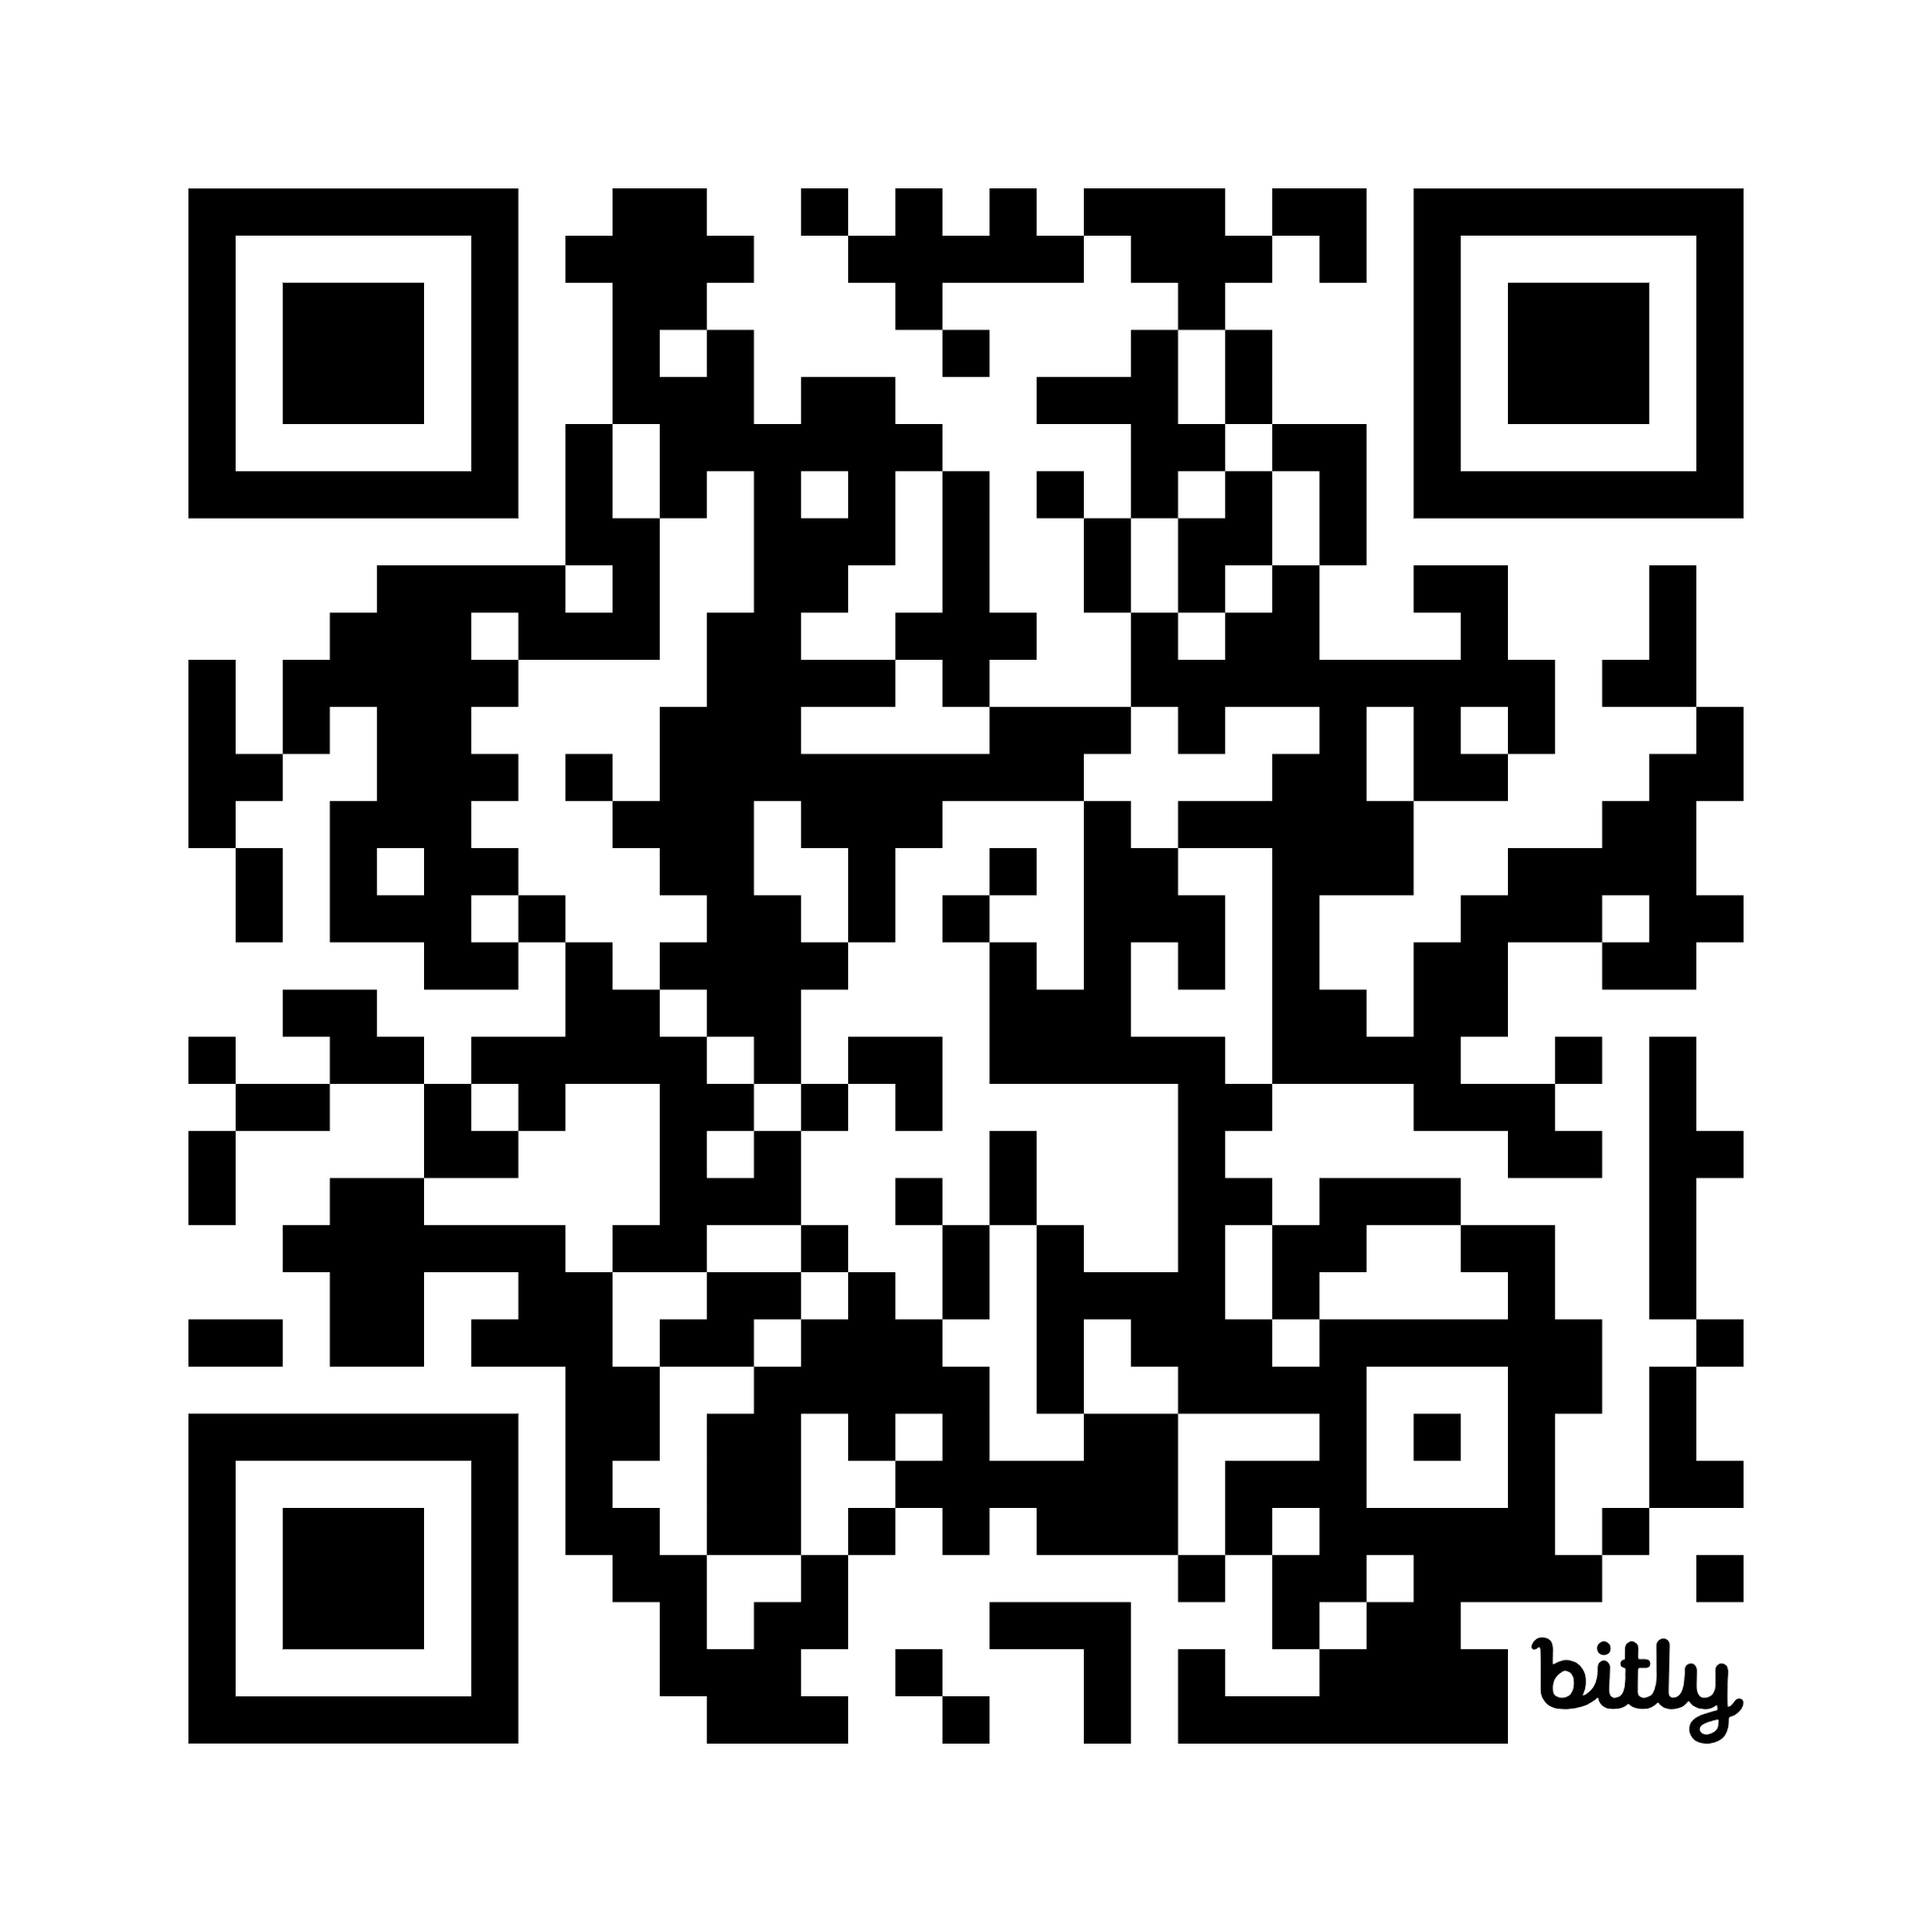
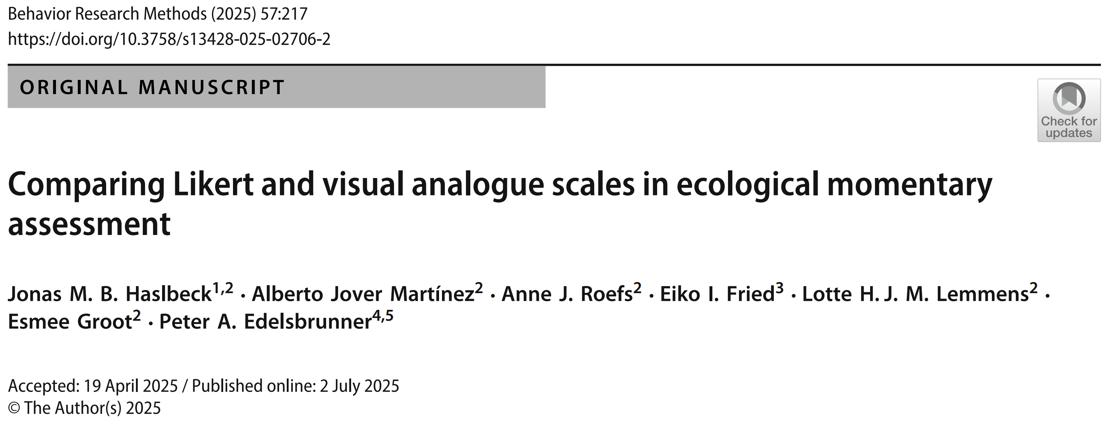
https://bit.ly/PeterE_presentations
https://link.springer.com/article/10.3758/s13428-025-02706-2
An Experimental Comparison of the Seven-Point- and Visual Analogue Scale in Intensive Assessment

Slide 20
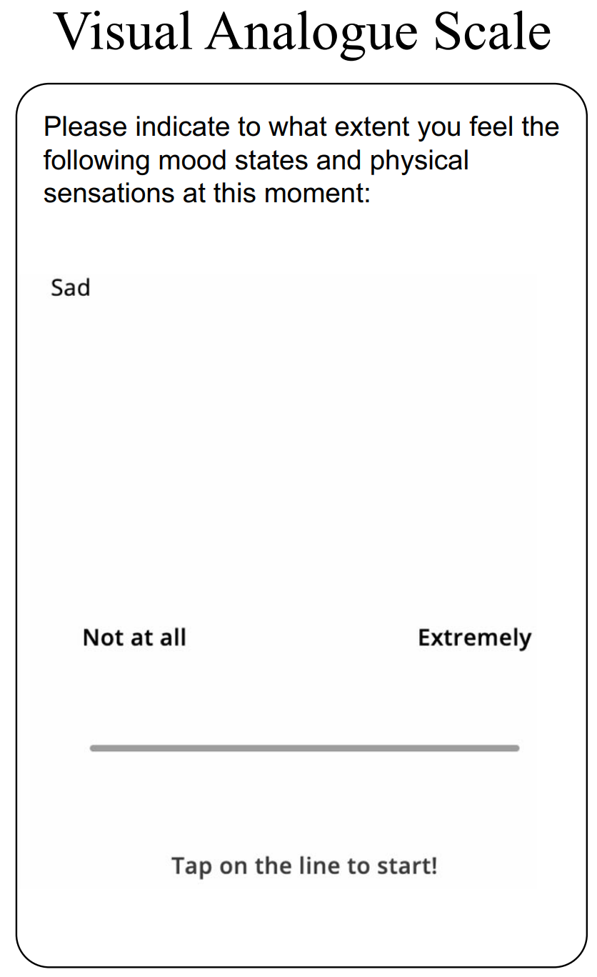
Idiography vs. & nomothetics
Molenaar & Valsiner, 2009
Within-person perspective
Blume et al., 2022; Blume & Schmiedek, 2024
Control of trait variation
Hamaker et al., 2007
Assessment of dynamics
Haslbeck & Ryan, 2022

Slide 21
Methodology: Commonly unjustified/intuitive
Haslbeck et al., 2023
Earlier studies: Mainly cross-sectional, increased reliability with > 4 response categories (see Simms et al., 2019; Fritz et al., 2024)
Research question:
How does the response scale affect…
Univariate statistics/distributions
2) Multivariate statistics/distributions
3) Relations with external covariates
4) Subjective ratings
Typical approach:
7-step Likert or visual analogue scale, linear mixed model or ML-SEM
Haslbeck et al., 2023

Slide 22
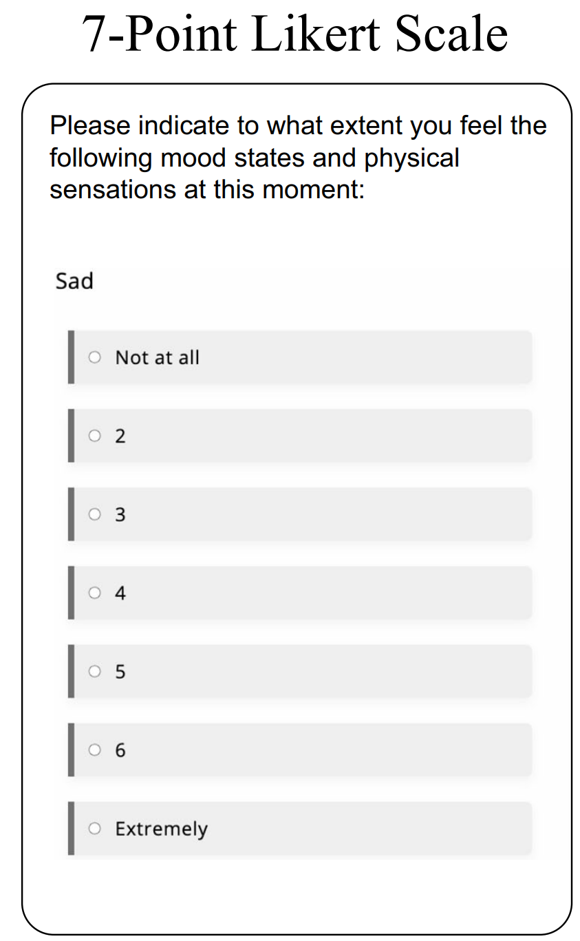
Often studied
Often studied
Often used
Context: Emotions, single items, university students (few clin. diagnoses)
Positive (happy, satisfied,…, 5 items) and negative (stressed, worried,… 9 items) valence
7-step response scale vs. visual analogue scale (101-step)
As far as possible parallel (e.g., only endlabels for 7-step scale)
App limitations:
7-step vertical, VAS horizontal
7-step = not at all, 2, 3, 4, 5, 6, extremely
Between-person (avoiding carry-over effects/reactance):
Two weeks, 3x daily, either always 7-step or VAS

Slide 23
n(Likert) = 63
n(VAS) = 56
M(age) = 22 (SD = 4)
Models:
Bayesian multilevel modeling in brms
0-1 normalization
Inter-individual distributions of descriptive statistics per person:
e.g. within-person means: Zero-one inflated beta
Fixed effects:
Response format (contrast coding, baseline = Likert),
valence (effects coding) + interaction
Random effects:
Intercept across persons, slopes across items
Full distributional models:
Fixed effects on all distributional parameters (zero- & one-shares, both beta-parameters)

Slide 24
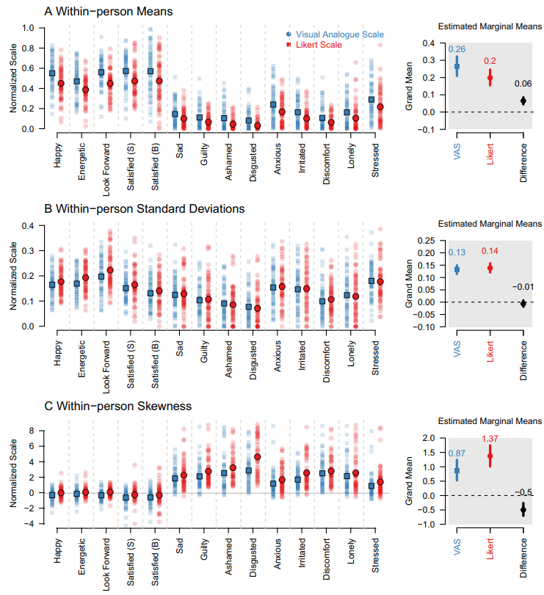
Results: Descriptive distributional parameters
7-step
Higher means
VAS
Lower skewnesses

Slide 25
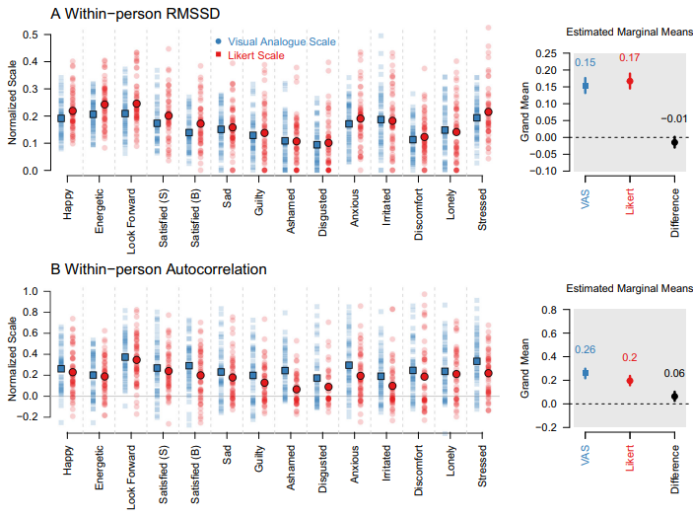
Results: Descriptive distributional parameters
7-step
VAS
Higher autocorrelations

Slide 26
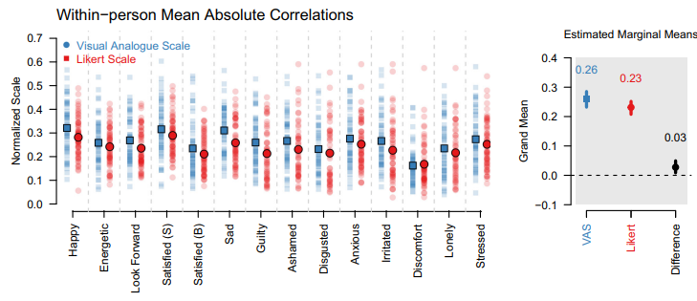
Results: Descriptive multivariate parameters
7-step
VAS
Slightly stronger within-person item correlations

Slide 27
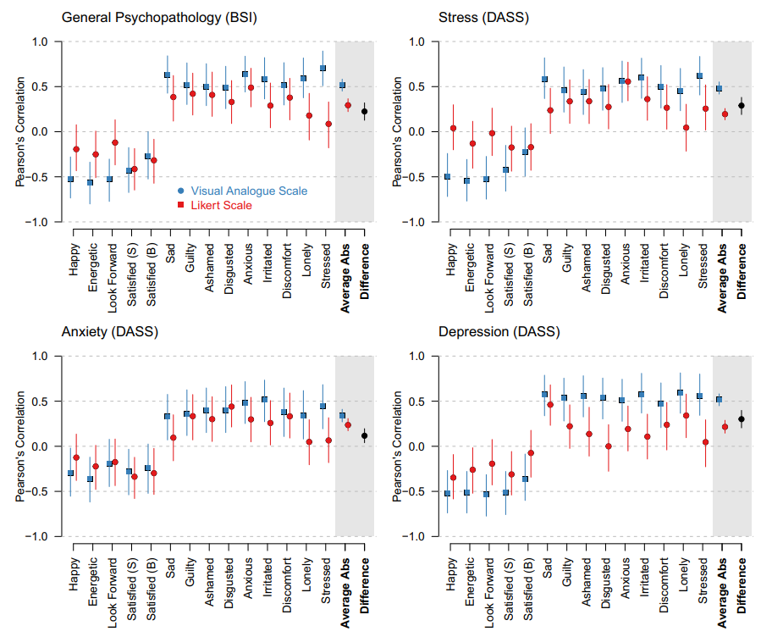
Results: Correlations with external criteria: General psychopathology and depression/anxiety/stress
7-step
VAS
Brutally stronger correlations

Slide 28
Results: Self-reports
Subjective ratings quite similar; descriptively, VAS slightly more exhausting and confusing
Little mutlimodality on both scales (Haslbeck et al., 2023)
Missing data and response times similar
No initial elevation bias (Shrout et al., 2018)
7-step
VAS

Slide 29
Results: Interpretations
- Our VAS captures more systematic ariation close to the scale minimum
(Higher means, lower skewness, higher correlations with external criteria) – preliminary support for VAS in similar studies and populations
Limitations:
- 7-step scale: Second category „1“ instead of „2“?
- Labels (e.g., mildly/very little)
- We need replications and factorial study designs (number response options, label positions & contents, horizontal vs. vertical, initial slider point on VAS) randomize at once (Baribault et al., 2018), potentially within-person
- We also need cognitive surveys and formal models (explore & model the latent response process)
- Multi-item scales
7-step
VAS

Slide 30
https://bit.ly/PeterE_presentations
https://link.springer.com/article/10.3758/s13428-025-02706-2
7-step
Baribault, B., Donkin, C., Little, D. R., Trueblood, J. S., Oravecz, Z., van Ravenzwaaij, D., White, C. N., De Boeck, P., & Vandekerckhove, J. (2018). Metastudies for robust tests of theory. Proceedings of the National Academy of Sciences, 115(11), 2607–2612. https://doi.org/10.1073/pnas.1708285114
Blume, F., Irmer, A., Dirk, J., & Schmiedek, F. (2022). Day-to-day variation in students’ academic success: The role of self-regulation, working memory, and achievement goals. Developmental Science, 25(6), e13301. https://doi.org/10.1111/desc.13301
Blume, F., & Schmiedek, F. (2024). It counts in every single lesson: Between-and within-person associations of teaching quality and student self-regulation. Learning and Instruction, 92, 101908.
Fritz, J., Piccirillo, M. L., Cohen, Z. D., Frumkin, M., Kirtley, O., Moeller, J., Neubauer, A. B., Norris, L. A., Schuurman, N. K., Snippe, E., & Bringmann, L. F. (2024). So You Want to Do ESM? 10 Essential Topics for Implementing the Experience-Sampling Method. Advances in Methods and Practices in Psychological Science, 7(3), 25152459241267912. https://doi.org/10.1177/25152459241267912
Hamaker, E. L., Nesselroade, J. R., & Molenaar, P. C. (2007). The integrated trait–state model. Journal of research in personality, 41(2), 295–315.Haslbeck, J. M. B., & Ryan, O. (2022). Recovering Within-Person Dynamics from Psychological Time Series. Multivariate Behavioral Research, 57(5), 735–766. https://doi.org/10.1080/00273171.2021.1896353
Haslbeck, J., Ryan, O., & Dablander, F. (2023). Multimodality and skewness in emotion time series. Emotion. https://psycnet.apa.org/record/2023-72233-001
Molenaar, P. C., & Valsiner, J. (2009). How generalization works through the single case: A simple idiographic process analysis of an individual psychotherapy. YIS: Yearbook of idiographic science, 1, 23–38.
Shrout, P. E., Stadler, G., Lane, S. P., McClure, M. J., Jackson, G. L., Clavél, F. D., Iida, M., Gleason, M. E. J., Xu, J. H., & Bolger, N. (2018). Initial elevation bias in subjective reports. Proceedings of the National Academy of Sciences, 115(1), E15–E23. https://doi.org/10.1073/pnas.1712277115
Simms, L. J., Zelazny, K., Williams, T. F., & Bernstein, L. (2019). Does the number of response options matter? Psychometric perspectives using personality questionnaire data. Psychological Assessment, 31(4), 557–566. https://doi.org/10.1037/pas0000648
VAS

