Slide 1
Physiological measures in research on higher education teaching and learning
An inspirational note by Peter Edelsbrunner
First of all, I would like to thank the organizers and presenters. The projects showcase the excellent theoretical and empirical level of HE research and they provide a coherent overview of the value of physiological measures in looking under the hood of learning processes.
Notes:
Stepping in for Uli Dettweilter who is saying hello, I congratulate in particular the doctoral researchers and their supervisors involved in these projects for developing and implementing such high-quality research projects.

Slide 2
Gijsen et al.
Bayesian multilevel modeling in brms
The power of the within-person experiment
Engagement
Alpha-/theta-oscillation
Note-taking
Outcome

Slide 3
Gijsen et al.
Bayesian multilevel modeling in brms
The power of the within-person experiment
Stable individual characteristics that affect alpha-/theta-oscillations
Statistical model:
Fixed/random intercepts per person
-> We control away stable individual characteristics
Intelligence,
neural efficiency,
working memory, brain characteristics, prior knowledge,
…
Alpha-/theta-oscillation
Person-specific mean
No note-taking
Hand note-taking
Computer note-taking
Statistical model:
Fixed intercepts per condition (cf. RMANOVA)
Can the condition explain variation in alpha-/theta-oscillations around the person-specific mean?

Slide 4
Gijsen et al.
Bayesian multilevel modeling in brms
The power of the within-person experiment
Mediation model:
Typically, we have a confounded path between the mediator and the outcome
Engagement
Within-person experiment:
We can correct this path for all stable person characteristics (i.e., between-person confounding)
Alpha-/theta-oscillation
Note-taking
Outcome
Suggestions:
Model alpha- and theta-mediation concurrently
Sample more learners (30-60)
Control for non-engagement alpha-/theta-oscillation in note-taking
Individual characteristics may affect condition effects (i.e., ATI effects)

Slide 5


Hartikainen et al.
Logstic multilevel modeling in lme4
The power of within-person intensive measurement
Inclusion of person means and learning event variation of each predictor
-> Mundlak-estimator
Learning mode (individual vs. peer vs. classroom)
We have to exclude the possibility of within-/between-person dynamics
(„That lecturer was horrible, I`ll rather learn from home the next weeks“)
Regression effect between individuals
Electroder-mal activity
Regression effect within individuals
Pre-learning event emotional valence
(Positve) post-learning event emotional valence
Suggestions:
I am impressed by the thorough tests of model assumptions!
Theoretically evaluate reciprocal effects; include/evaluate autoregression
Build latent factor/random variable across three EDA phases (random predictor slope(s)s)
Further random effects (e.g., EDA effect, correlated random effects) varying across learners?
Notes:
time-variant predictor variables were included in the models with centered within student (cwc) and centered between students (cbc) versions

Slide 6

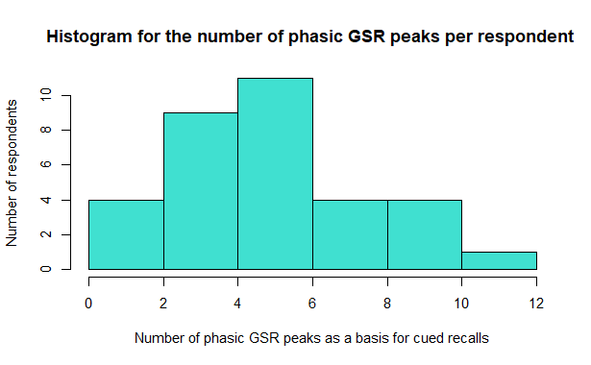
Van Tricht et al.
Comments by U. Dettweiler:
FIT questionnaire
Feedback processing
How might the interpretation of high arousal differ between teachers with varying levels of teaching experience or pedagogical training?
→ This invites discussion on whether physiological arousal is always a sign of stress or could also reflect engagement or flow in expert teachers.
To what extent can guided reflection on arousal episodes be integrated into professional development programs for higher education teachers?
→ This opens a conversation about the practical applications of the method beyond research.
Self-efficacy
Electrodermal activity
Emotion
(type, valence, arousal)
Figure 2 Histogram for the number of phasic GSR Peaks per respondent as a basis for cued recalls
Notes:
time-variant predictor variables were included in the models with centered within student (cwc) and centered between students (cbc) versions
Galvanic skin response peaks
Furthermore, based on the GSR- measures, namely the event-related phasic peaks, based on the faster changing elements which show a reactive response (Horvers et al., 2021; Potter & Bolls, 2012), specific parts of the feedback text were shown and the participants were asked to explain what they felt and thought while reading this particular part of the feedback report the instruction was “Please explain what you

Slide 7

Wallin et al.
Comments by U. Dettweiler
How does the self-assessment origin of the feedback (i.e., self-perception) influence the emotional validity of GSR peaks?
→ This question challenges the assumption that feedback is an external stimulus and probes the role of self-concept. -> Adapted theories of (internally gen.) feedback?
Could the emotional responses to feedback be used to personalize support systems in higher education, and if so, how?
→ This encourages thinking about adaptive learning environments and emotional analytics.
Arousal
Electrodermal activity
Teaching
Emotion
Notes:
time-variant predictor variables were included in the models with centered within student (cwc) and centered between students (cbc) versions
Galvanic skin response peaks
Furthermore, based on the GSR- measures, namely the event-related phasic peaks, based on the faster changing elements which show a reactive response (Horvers et al., 2021; Potter & Bolls, 2012), specific parts of the feedback text were shown and the participants were asked to explain what they felt and thought while reading this particular part of the feedback report the instruction was “Please explain what you

Slide 8

https://bit.ly/PeterE_presentations
What do you think?
Are the interpretations of the physiological measures and their underlying psychological states – corroborated by retrospective interviews - valid and informative?
methodological critique, encourages transparency in mixed-methods design, and opens space for discussing alternative or complementary approaches (e.g., facial expression analysis, heart rate variability, real-time self-report, etc.).
What are the theoretical and practical implications of these measurement technologies for higher education research and practice?
Keywords: privacy, interpretation limits, and the potential for misuse or overreach in emotion-sensitive education technologies
Notes:
Are th

