Slide 1


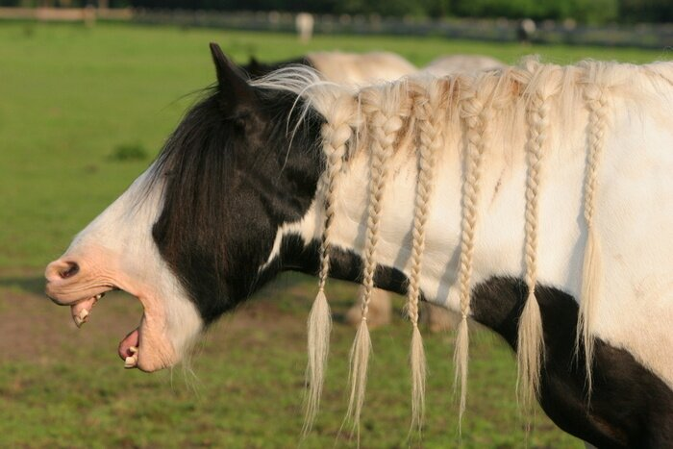


Hold your causal Horses!
derStandard.de
Instagram: hansepferd.hamburg
MyLoView.de
This is
Timssi
Quelle: Fit for Life
bit.ly/PeterE_presentations
Notes:
Eine sehr gute Arbeit würde beschreiben, wie ihr die Sitzung geplant und umgesetzt habt. Dazu würde in so einer Arbeit begründet werden (mit wissenschaftlichen Befunden), warum dies so gemacht wurde. Und dann würde ein Teil kommen in dem man reflektieren könnte, ob das denn so wie geplant gelaufen ist oder was man auch auf Basis eurer Erfahrungen anders machen könnte.

Slide 2
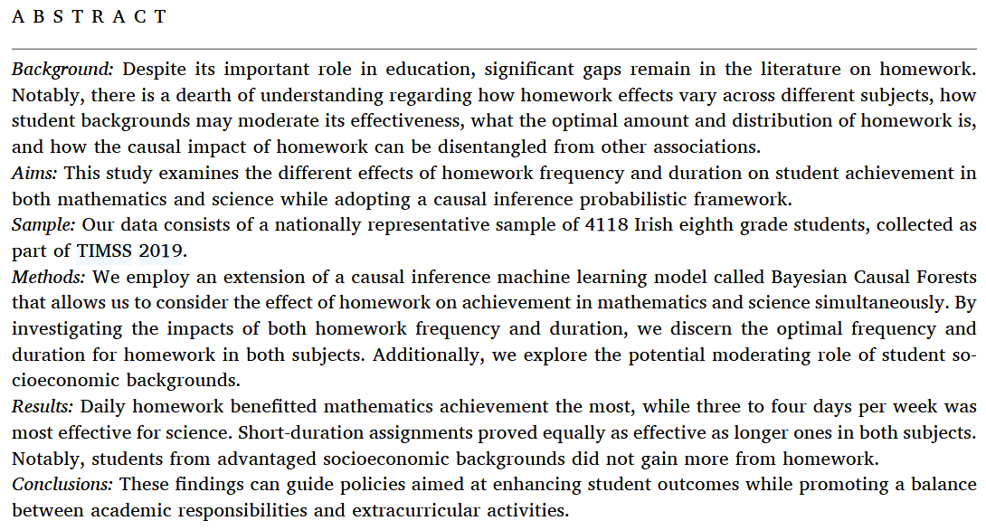
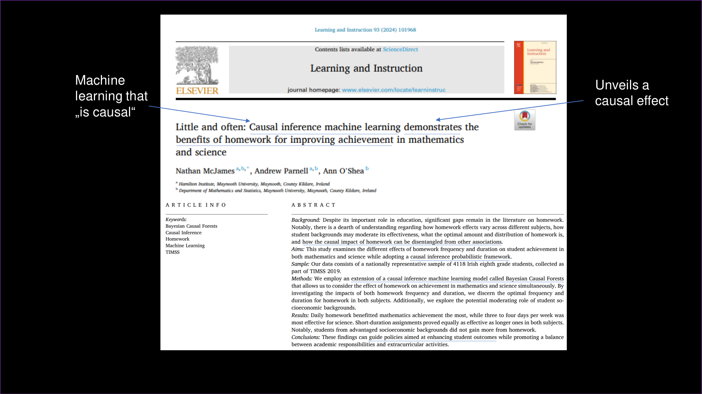
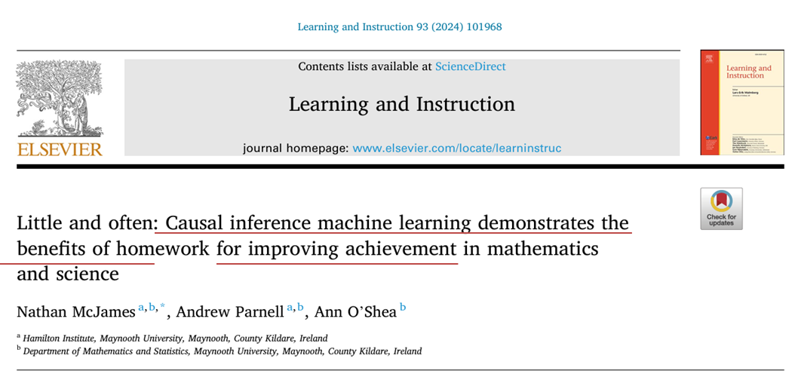

2024
TIMSS study (cross-sectional)
whuuuut?
socio-economic status
homework frequency
(how often)
Timssi, is this bullshit?
Science achievement
N = 4118 Irish 8th graders
Math achievement
homework duration (how long)
Notes:
Describe the TIMSS study.

Slide 3
2024
TIMSS study (cross-sectional)
whuuuut?
socio-economic status
homework frequency
(how often)
Timssi, is this bullshit?
Science achievement
N = 4118 Irish 8th graders
Math achievement
homework duration (how long)
Notes:
Describe the TIMSS study.

Slide 4
What I want from today
- I) Bring ourselves on the same page about causal machine learning (CML)
What is it; how does it differ from causal modeling without machine learning?
II) Outline one CML approach:
Bayesian causal forest (McJames et al., 2024)
III) Its uniqueness status regarding causal inference:
Which requirements are the same as in non-ML modeling for causal inference?
Which advantages does CML bring in comparison?
IV) Conclusions, Hypotheses, & Implications for our research fields:
Preventing bullshit
Supporting informative application
Notes:
The Bayesian causal forest appraoch encompasses many CML topics

Slide 5
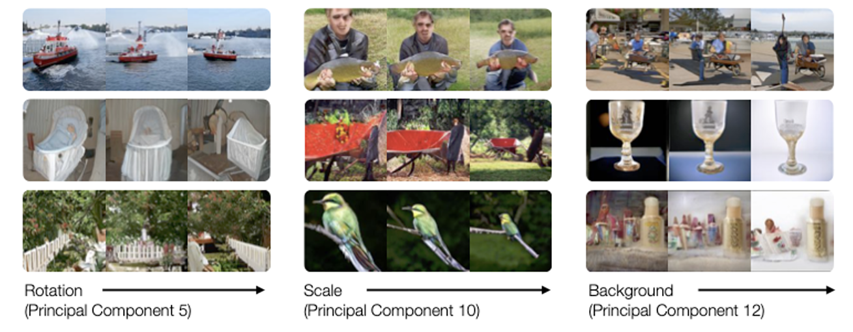
Part I
What is causal machine learning?
Causal inference
Machine learning
Determine the effect of one variable on another
Simplified causal modeling process (Auspurg & Brüderl, 2026; Petersen & van der Laan, 2014):
Learn from data to predict outcomes
Traditionally focuses on prediction (i.e., capturing correlative structure) rather than explanation (i.e., capturing causal effects; Yarkoni & Westfall, 2017)
Fuzzy boundary statistical modeling/ML; Molnar, 2022
Here: Introduces bias to increase predictive accuracy
Develop a causal model
Determine the identification conditions (necessary data) to estimate your effect of interest
Gather data for causal sufficiency
Estimate the effect using appropriate model
really?
not with me, baby!
I) What is CML?
II) The Bayesian causal forest
III) Uniqueness of CML
IV) Implications for our research
Notes:
Model representation of your assumptions about the causal system of interest
Derive necessary covariates to include or exclude in your model to be able to get an unbiased estimate
Bias is the death penalty of causal inference
More predictive accuracy = less variance through introducing bias

Slide 6
Part I
What is causal machine learning?
Causality-infused machine learning
Machine learning-infused causal modeling
for causal estimand estimation
Not so interesting for us; see Kaddour et al. (2025; ch. 11)
Causal inference
Machine learning
This is interesting for today
Do not confuse these and their literature; they both run under the term CML!
I) What is CML?
II) The Bayesian causal forest
III) Uniqueness of CML
IV) Implications for our research
Notes:
Causality-based data augmentation in machine learning
Next step:
Show the three main applications of CML for causal inference:
Double/debiased ML (Hamburg CML podcast ML researcher, CML book…)
Heterogeneous treatment effects (treatment outcome prediction; CATEs/GATEs/I ates .etc. … (Feuerriegel et al., 2024)
Causal discovery (learning) (Psych Methods thingie…)
Cherhoznukov et al., 2024 as the go-to for everything + Podcast :)

Slide 7
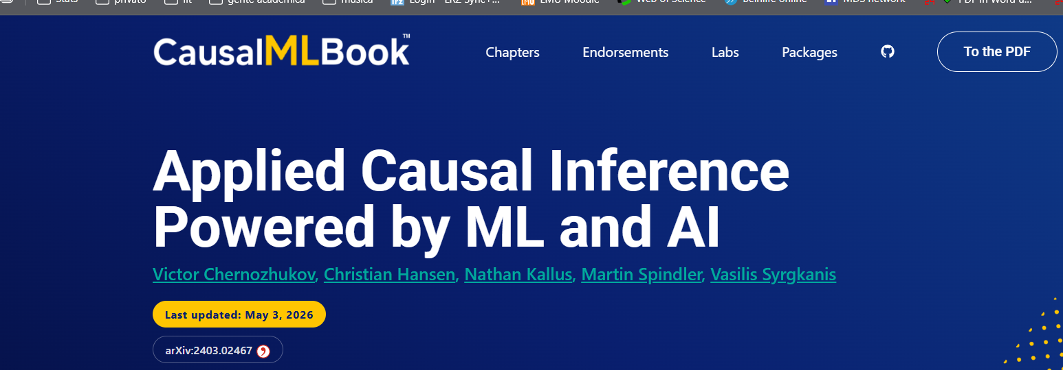
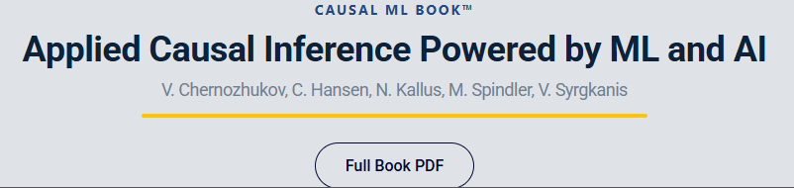
Three central applications of CML
I do this a lot, it`s more about AVE than CAVE
Double/debiased ML (bit similar: doubly robust est.)
Enables inference about uncertainty (e.g, CIs)
Debiases outcome and treatment estimates
Treatment outcome prediction
Focuses on heterogeneity in treatment effects
Conditional /group/individual average treatment effects (CATE)
Causal discovery (Kossakowski et al., 2021)
The autonomous (i.e., data-driven) car of causal machine learning
causalml-book.org
I) What is CML?
II) The Bayesian causal forest
III) Uniqueness of CML
IV) Implications for our research
Notes:
Double/debiased ML:
Predict treatment, use residuals from predicted treatment
Predict outcome, use residuals from predicted outcome
Correlate these residuals instead of using the full variation of the treatment and the outcome
That`s called „Neyman orthogonalization“
Plus cross-fitting:
You estimate the treatment or outcome model on one part of the data but predict the other (e.g., predicting 1/5from the other 4/5, five times) to avoid overfitting when computing the residuals. So that there`s more residual variation left and less overfitting (which go hand-in-hand).

Slide 8
II) The Bayesian causal forest
Double/debiased ML (debiased & uncertainty)
Treatment outcome prediction (treatment heterogeneity)
Causal discovery (data-driven causal learning)
?
Bayesian causal forest
?
I) What is CML?
II) The Bayesian causal forest
III) Uniqueness of CML
IV) Implications for our research
Notes:
Next step:
Show the four main applications of CML for causal inference:
Double/debiased ML (Hamburg CML podcast ML researcher, CML book…)
Heterogeneous treatment effects (treatment outcome prediction; CATEs/GATEs/I ates .etc. … (Feuerriegel et al., 2024)
Causal discovery (learning) (Psych Methods thingie…)
Cherhoznukov et al., 2024 as the go-to for everything + Podcast :)

Slide 9
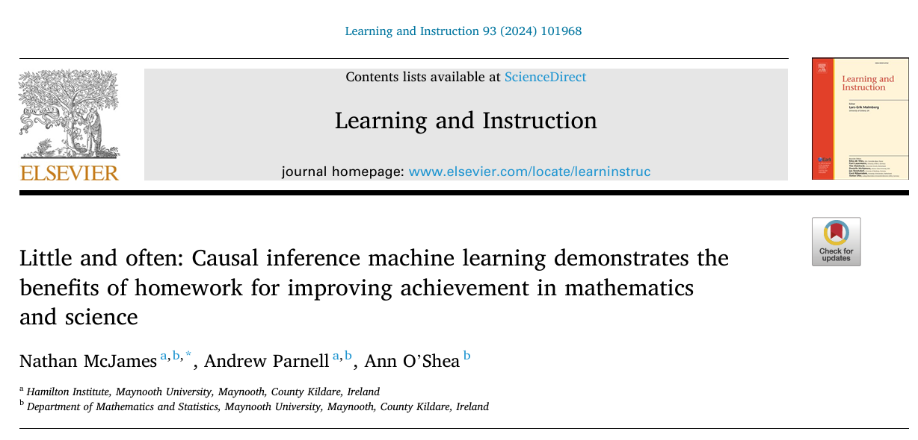
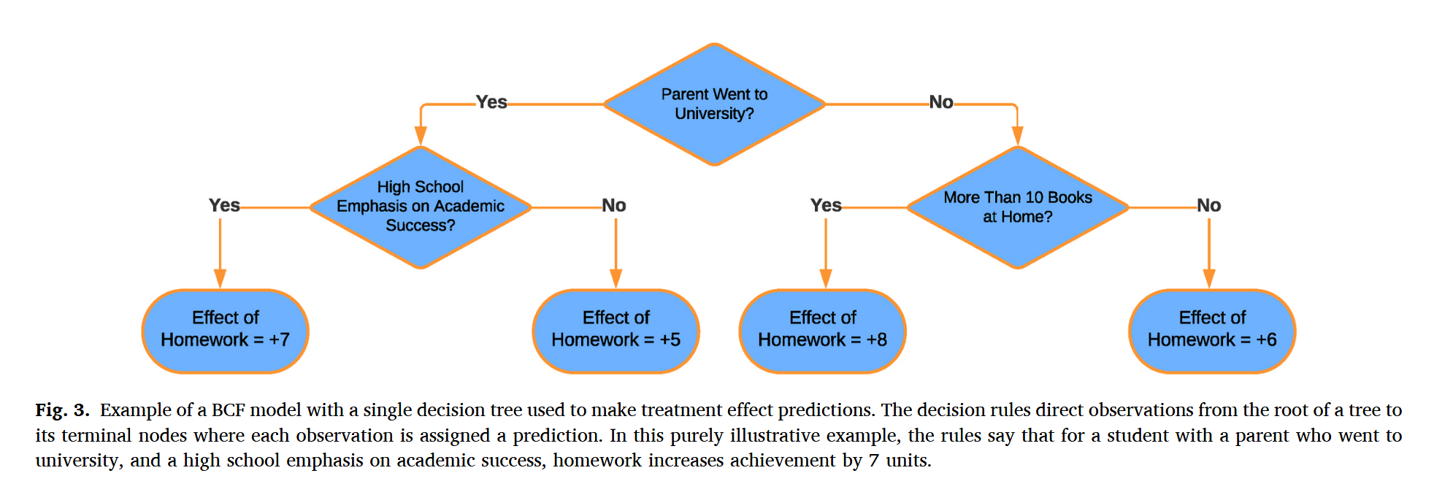
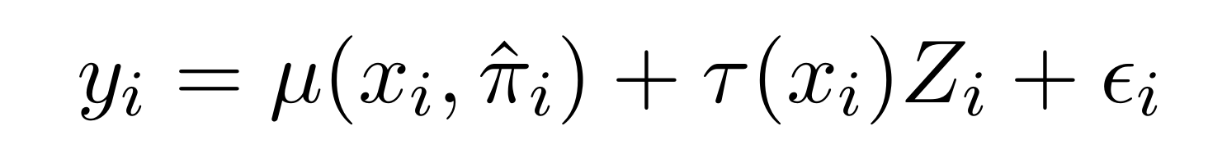
II) The Bayesian causal forest
Baseline/prognostic function
treatment function
treatment
„Intercept“ (but uses all data):
Baseline outcome surface given covariates
Mu and tau are functions:
Bayesian additive regression trees
Outcome at little homework (mu) resp. difference when there is homework (tau)
Many such trees, each with little predictive power, are added up for awesome predictive power
I) What is CML?
II) The Bayesian causal forest
III) Uniqueness of CML
IV) Implications for our research
Notes:
A Bayesian Causal Forest (BCF) model is a machine learning method used to estimate Heterogeneous Treatment Effects (HTE) from observational or experimental data. It separates the baseline outcome prediction from the causal effect itself, preventing bias and providing rigorous uncertainty estimates. [1, 2, 3, 4, 5]
Here is the step-by-step breakdown of how the BCF model works:
1. Model Formulation and Decomposition
BCF starts by splitting the observed outcome (\(Y_{i}\)) for individual (\(i\)) into two distinct, additive parts: \(Y_i = \mu(X_i) + \tau(X_i) \cdot W_i + \epsilon_i\) [1, 2]
\(Y_{i}\): The observed outcome.
\(X_{i}\): The vector of baseline covariates (control variables).
\(W_{i}\): The treatment assignment indicator (\(1\) for treated, \(0\) for control).
\(\mu(X_i)\): The prognostic function (baseline outcome for untreated individuals).
\(\tau(X_i)\): The treatment effect function (Conditional Average Treatment Effect - CATE).
\(\epsilon _{i}\): Normally distributed random error term (\(N(0, \sigma^2)\)). [1, 2, 3, 4, 5]
2. Propensity Score Estimation
Before fitting the tree ensembles, BCF usually requires an estimate of the propensity score, \(\hat{\pi}(X_i)\), which is the probability that an individual receives the treatment based on their covariates (\(X_{i}\)). [1, 2, 3]
This is typically calculated using a separate model (such as logistic regression or a random forest) prior to running the main BCF algorithm. [1]
3. Incorporating the Propensity Score into the Baseline
Unlike traditional Bayesian Additive Regression Trees (BART), BCF implicitly includes the estimated propensity score as a covariate in the prognostic function \(\mu(X_i, \hat{\pi}_i)\). [1, 2]
This step acts as a powerful confounding control, ensuring that differences in baseline characteristics between treatment groups are properly adjusted, thus preventing regularization-induced bias. [1]
4. Separate Tree Ensembles (BART Priors)
BCF fits separate BART (Bayesian Additive Regression Trees) ensembles for both the prognostic function (\(\mu \)) and the treatment effect function (\(\tau \)): [1, 2, 3, 4]
Prognostic Tree Ensemble (\(\mu \)): Learns how the baseline variables affect the overall outcome.
Treatment Effect Tree Ensemble (\(\tau \)): Learns how the treatment effect varies across different subgroups of covariates.
By enforcing separate Bayesian priors, the model can apply stricter regularization to the treatment effect, allowing the model to shrink estimates towards a homogeneous effect if data is sparse. [1, 2, 3]
5. Markov Chain Monte Carlo (MCMC) Sampling
BCF uses an MCMC algorithm (specifically, blockwise Bayesian backfitting) to estimate the parameters iteratively: [1, 2, 3]
Step A: The algorithm updates the tree structures and leaf parameters for the prognostic forest (\(\mu \)) by holding the treatment effect forest (\(\tau \)) constant.
Step B: It then updates the trees for the treatment effect forest (\(\tau \)) while holding the prognostic forest (\(\mu \)) constant.
This iterative backfitting process generates thousands of posterior draws of the trees, which together construct the model and its uncertainty. [1]
6. Posterior Inference and Uncertainty Quantification
Instead of outputting a single point estimate, BCF yields a full posterior distribution for the causal effect. [1, 2]
You can extract the Conditional Average Treatment Effect (CATE) for any individual \(i\) by taking the average of the posterior draws of \(\tau(X_i)\).
Because it outputs a distribution, you can easily calculate credible intervals (e.g., 95% intervals) to quantify uncertainty natively. [1, 2, 4, 5]
If you are planning to implement this, let me know:
What software or language you are using (e.g., R's bcf package or Python's stochtree)
Whether your treatment is binary or continuous
If you want to know how to interpret the outputted CATE
I can give you the specific code or analysis steps tailored to your environment.

Slide 10
II) The Bayesian causal forest
Strengths (comp. to GLM):
3) Mu function uses propensity score to avoid regularization-induced bias (tau absorbing higher treatment probability caused by Xi being predictive of low prognostic value)
1) Fully distinct functions (i.e., moderation) for mu (baseline/prognostic) and tau (intervention effect) parts of the model
4) The model is Bayesian, using priors:
Less informative (i.e., more flexible) for mu
More informative (regularizing) for tau
This is great for preventing overestimation of heterogeneity in treatment effects
And it provides full posteriors (i.e., inference – similar to double/debiased ML)
2) Both functions are highly flexible (Bayesian additive regression trees)
I) What is CML?
II) The Bayesian causal forest
III) Uniqueness of CML
IV) Implications for our research
Notes:
A Bayesian Causal Forest (BCF) model is a machine learning method used to estimate Heterogeneous Treatment Effects (HTE) from observational or experimental data. It separates the baseline outcome prediction from the causal effect itself, preventing bias and providing rigorous uncertainty estimates. [1, 2, 3, 4, 5]
Here is the step-by-step breakdown of how the BCF model works:
1. Model Formulation and Decomposition
BCF starts by splitting the observed outcome (\(Y_{i}\)) for individual (\(i\)) into two distinct, additive parts: \(Y_i = \mu(X_i) + \tau(X_i) \cdot W_i + \epsilon_i\) [1, 2]
\(Y_{i}\): The observed outcome.
\(X_{i}\): The vector of baseline covariates (control variables).
\(W_{i}\): The treatment assignment indicator (\(1\) for treated, \(0\) for control).
\(\mu(X_i)\): The prognostic function (baseline outcome for untreated individuals).
\(\tau(X_i)\): The treatment effect function (Conditional Average Treatment Effect - CATE).
\(\epsilon _{i}\): Normally distributed random error term (\(N(0, \sigma^2)\)). [1, 2, 3, 4, 5]
2. Propensity Score Estimation
Before fitting the tree ensembles, BCF usually requires an estimate of the propensity score, \(\hat{\pi}(X_i)\), which is the probability that an individual receives the treatment based on their covariates (\(X_{i}\)). [1, 2, 3]
This is typically calculated using a separate model (such as logistic regression or a random forest) prior to running the main BCF algorithm. [1]
3. Incorporating the Propensity Score into the Baseline
Unlike traditional Bayesian Additive Regression Trees (BART), BCF implicitly includes the estimated propensity score as a covariate in the prognostic function \(\mu(X_i, \hat{\pi}_i)\). [1, 2]
This step acts as a powerful confounding control, ensuring that differences in baseline characteristics between treatment groups are properly adjusted, thus preventing regularization-induced bias. [1]
4. Separate Tree Ensembles (BART Priors)
BCF fits separate BART (Bayesian Additive Regression Trees) ensembles for both the prognostic function (\(\mu \)) and the treatment effect function (\(\tau \)): [1, 2, 3, 4]
Prognostic Tree Ensemble (\(\mu \)): Learns how the baseline variables affect the overall outcome.
Treatment Effect Tree Ensemble (\(\tau \)): Learns how the treatment effect varies across different subgroups of covariates.
By enforcing separate Bayesian priors, the model can apply stricter regularization to the treatment effect, allowing the model to shrink estimates towards a homogeneous effect if data is sparse. [1, 2, 3]
5. Markov Chain Monte Carlo (MCMC) Sampling
BCF uses an MCMC algorithm (specifically, blockwise Bayesian backfitting) to estimate the parameters iteratively: [1, 2, 3]
Step A: The algorithm updates the tree structures and leaf parameters for the prognostic forest (\(\mu \)) by holding the treatment effect forest (\(\tau \)) constant.
Step B: It then updates the trees for the treatment effect forest (\(\tau \)) while holding the prognostic forest (\(\mu \)) constant.
This iterative backfitting process generates thousands of posterior draws of the trees, which together construct the model and its uncertainty. [1]
6. Posterior Inference and Uncertainty Quantification
Instead of outputting a single point estimate, BCF yields a full posterior distribution for the causal effect. [1, 2]
You can extract the Conditional Average Treatment Effect (CATE) for any individual \(i\) by taking the average of the posterior draws of \(\tau(X_i)\).
Because it outputs a distribution, you can easily calculate credible intervals (e.g., 95% intervals) to quantify uncertainty natively. [1, 2, 4, 5]
If you are planning to implement this, let me know:
What software or language you are using (e.g., R's bcf package or Python's stochtree)
Whether your treatment is binary or continuous
If you want to know how to interpret the outputted CATE
I can give you the specific code or analysis steps tailored to your environment.

Slide 11
II) The Bayesian causal forest
Gaussian error
Random classroom intercept
Prediction function independently of treatment (but impliticly defined as intercept; frequency < 3 times, duration < 15 min); uses pi (propensity score)
Treatment:
Duration above 15/above 30 minutes
Treatment:
Frequency 3/4 or 5 times per week
How mundane haha – but powerful!
I) What is CML?
II) The Bayesian causal forest
III) Uniqueness of CML
IV) Implications for our research
Notes:
Yes, it`s just a linear model of the treatment effect eventually!
A Bayesian Causal Forest (BCF) model is a machine learning method used to estimate Heterogeneous Treatment Effects (HTE) from observational or experimental data. It separates the baseline outcome prediction from the causal effect itself, preventing bias and providing rigorous uncertainty estimates. [1, 2, 3, 4, 5]
Here is the step-by-step breakdown of how the BCF model works:
1. Model Formulation and Decomposition
BCF starts by splitting the observed outcome (\(Y_{i}\)) for individual (\(i\)) into two distinct, additive parts: \(Y_i = \mu(X_i) + \tau(X_i) \cdot W_i + \epsilon_i\) [1, 2]
\(Y_{i}\): The observed outcome.
\(X_{i}\): The vector of baseline covariates (control variables).
\(W_{i}\): The treatment assignment indicator (\(1\) for treated, \(0\) for control).
\(\mu(X_i)\): The prognostic function (baseline outcome for untreated individuals).
\(\tau(X_i)\): The treatment effect function (Conditional Average Treatment Effect - CATE).
\(\epsilon _{i}\): Normally distributed random error term (\(N(0, \sigma^2)\)). [1, 2, 3, 4, 5]
2. Propensity Score Estimation
Before fitting the tree ensembles, BCF usually requires an estimate of the propensity score, \(\hat{\pi}(X_i)\), which is the probability that an individual receives the treatment based on their covariates (\(X_{i}\)). [1, 2, 3]
This is typically calculated using a separate model (such as logistic regression or a random forest) prior to running the main BCF algorithm. [1]
3. Incorporating the Propensity Score into the Baseline
Unlike traditional Bayesian Additive Regression Trees (BART), BCF implicitly includes the estimated propensity score as a covariate in the prognostic function \(\mu(X_i, \hat{\pi}_i)\). [1, 2]
This step acts as a powerful confounding control, ensuring that differences in baseline characteristics between treatment groups are properly adjusted, thus preventing regularization-induced bias. [1]
4. Separate Tree Ensembles (BART Priors)
BCF fits separate BART (Bayesian Additive Regression Trees) ensembles for both the prognostic function (\(\mu \)) and the treatment effect function (\(\tau \)): [1, 2, 3, 4]
Prognostic Tree Ensemble (\(\mu \)): Learns how the baseline variables affect the overall outcome.
Treatment Effect Tree Ensemble (\(\tau \)): Learns how the treatment effect varies across different subgroups of covariates.
By enforcing separate Bayesian priors, the model can apply stricter regularization to the treatment effect, allowing the model to shrink estimates towards a homogeneous effect if data is sparse. [1, 2, 3]
5. Markov Chain Monte Carlo (MCMC) Sampling
BCF uses an MCMC algorithm (specifically, blockwise Bayesian backfitting) to estimate the parameters iteratively: [1, 2, 3]
Step A: The algorithm updates the tree structures and leaf parameters for the prognostic forest (\(\mu \)) by holding the treatment effect forest (\(\tau \)) constant.
Step B: It then updates the trees for the treatment effect forest (\(\tau \)) while holding the prognostic forest (\(\mu \)) constant.
This iterative backfitting process generates thousands of posterior draws of the trees, which together construct the model and its uncertainty. [1]
6. Posterior Inference and Uncertainty Quantification
Instead of outputting a single point estimate, BCF yields a full posterior distribution for the causal effect. [1, 2]
You can extract the Conditional Average Treatment Effect (CATE) for any individual \(i\) by taking the average of the posterior draws of \(\tau(X_i)\).
Because it outputs a distribution, you can easily calculate credible intervals (e.g., 95% intervals) to quantify uncertainty natively. [1, 2, 4, 5]
If you are planning to implement this, let me know:
What software or language you are using (e.g., R's bcf package or Python's stochtree)
Whether your treatment is binary or continuous
If you want to know how to interpret the outputted CATE
I can give you the specific code or analysis steps tailored to your environment.

Slide 12
II) The Bayesian causal forest
~
✔
Double/debiased ML (debiased & uncertainty)
Treatment outcome prediction (treatment heterogeneity)
Causal discovery (data-driven causal learning)
~
Bayesian causal forest
-
I) What is CML?
II) The Bayesian causal forest
III) Uniqueness of CML
IV) Implications for our research
Notes:
Next step:
Show the four main applications of CML for causal inference:
Double/debiased ML (Hamburg CML podcast ML researcher, CML book…)
Heterogeneous treatment effects (treatment outcome prediction; CATEs/GATEs/I ates .etc. … (Feuerriegel et al., 2024)
Causal discovery (learning) (Psych Methods thingie…)
Cherhoznukov et al., 2024 as the go-to for everything + Podcast :)

Slide 13
III) The Uniqueness of CML
Non-linear versions of the same ol`BS?
Double/debiased ML (debiased & uncertainty)
Treatment outcome prediction (treatment heterogeneity)
Causal discovery (data-driven causal learning)
I) What is CML?
II) The Bayesian causal forest
III) Uniqueness of CML
IV) Implications for our research
Notes:
Next step:
Show the four main applications of CML for causal inference:
Double/debiased ML (Hamburg CML podcast ML researcher, CML book…)
Heterogeneous treatment effects (treatment outcome prediction; CATEs/GATEs/I ates .etc. … (Feuerriegel et al., 2024)
Causal discovery (learning) (Psych Methods thingie…)
Cherhoznukov et al., 2024 as the go-to for everything + Podcast :)

Slide 14
III) Uniqueness of CML
Causal inference
Machine learning
Determine the effect of one variable on another
Simplified causal modeling process (Auspurg & Brüderl, 2026; Petersen & van der Laan, 2014):
Develop a causal model
Determine the identification conditions (necessary assumptions) to estimate your effect of interest
Gather causally sufficient data
Estimate the effect using appropriate model
I) What is CML?
II) The Bayesian causal forest
III) Uniqueness of CML
IV) Implications for our research
Notes:
A Bayesian Causal Forest (BCF) model is a machine learning method used to estimate Heterogeneous Treatment Effects (HTE) from observational or experimental data. It separates the baseline outcome prediction from the causal effect itself, preventing bias and providing rigorous uncertainty estimates. [1, 2, 3, 4, 5]
Here is the step-by-step breakdown of how the BCF model works:
1. Model Formulation and Decomposition
BCF starts by splitting the observed outcome (\(Y_{i}\)) for individual (\(i\)) into two distinct, additive parts: \(Y_i = \mu(X_i) + \tau(X_i) \cdot W_i + \epsilon_i\) [1, 2]
\(Y_{i}\): The observed outcome.
\(X_{i}\): The vector of baseline covariates (control variables).
\(W_{i}\): The treatment assignment indicator (\(1\) for treated, \(0\) for control).
\(\mu(X_i)\): The prognostic function (baseline outcome for untreated individuals).
\(\tau(X_i)\): The treatment effect function (Conditional Average Treatment Effect - CATE).
\(\epsilon _{i}\): Normally distributed random error term (\(N(0, \sigma^2)\)). [1, 2, 3, 4, 5]
2. Propensity Score Estimation
Before fitting the tree ensembles, BCF usually requires an estimate of the propensity score, \(\hat{\pi}(X_i)\), which is the probability that an individual receives the treatment based on their covariates (\(X_{i}\)). [1, 2, 3]
This is typically calculated using a separate model (such as logistic regression or a random forest) prior to running the main BCF algorithm. [1]
3. Incorporating the Propensity Score into the Baseline
Unlike traditional Bayesian Additive Regression Trees (BART), BCF implicitly includes the estimated propensity score as a covariate in the prognostic function \(\mu(X_i, \hat{\pi}_i)\). [1, 2]
This step acts as a powerful confounding control, ensuring that differences in baseline characteristics between treatment groups are properly adjusted, thus preventing regularization-induced bias. [1]
4. Separate Tree Ensembles (BART Priors)
BCF fits separate BART (Bayesian Additive Regression Trees) ensembles for both the prognostic function (\(\mu \)) and the treatment effect function (\(\tau \)): [1, 2, 3, 4]
Prognostic Tree Ensemble (\(\mu \)): Learns how the baseline variables affect the overall outcome.
Treatment Effect Tree Ensemble (\(\tau \)): Learns how the treatment effect varies across different subgroups of covariates.
By enforcing separate Bayesian priors, the model can apply stricter regularization to the treatment effect, allowing the model to shrink estimates towards a homogeneous effect if data is sparse. [1, 2, 3]
5. Markov Chain Monte Carlo (MCMC) Sampling
BCF uses an MCMC algorithm (specifically, blockwise Bayesian backfitting) to estimate the parameters iteratively: [1, 2, 3]
Step A: The algorithm updates the tree structures and leaf parameters for the prognostic forest (\(\mu \)) by holding the treatment effect forest (\(\tau \)) constant.
Step B: It then updates the trees for the treatment effect forest (\(\tau \)) while holding the prognostic forest (\(\mu \)) constant.
This iterative backfitting process generates thousands of posterior draws of the trees, which together construct the model and its uncertainty. [1]
6. Posterior Inference and Uncertainty Quantification
Instead of outputting a single point estimate, BCF yields a full posterior distribution for the causal effect. [1, 2]
You can extract the Conditional Average Treatment Effect (CATE) for any individual \(i\) by taking the average of the posterior draws of \(\tau(X_i)\).
Because it outputs a distribution, you can easily calculate credible intervals (e.g., 95% intervals) to quantify uncertainty natively. [1, 2, 4, 5]
If you are planning to implement this, let me know:
What software or language you are using (e.g., R's bcf package or Python's stochtree)
Whether your treatment is binary or continuous
If you want to know how to interpret the outputted CATE
I can give you the specific code or analysis steps tailored to your environment.

Slide 15
III) Uniqueness of CML
Causal inference
Machine learning
Causal sufficiency:
We have measured all confounders
Correct model specification:
We have an appropriate parameterization of the relation of the confounders with the (propensity and) the outcome
I) What is CML?
II) The Bayesian causal forest
III) Uniqueness of CML
IV) Implications for our research
Notes:
A Bayesian Causal Forest (BCF) model is a machine learning method used to estimate Heterogeneous Treatment Effects (HTE) from observational or experimental data. It separates the baseline outcome prediction from the causal effect itself, preventing bias and providing rigorous uncertainty estimates. [1, 2, 3, 4, 5]
Here is the step-by-step breakdown of how the BCF model works:
1. Model Formulation and Decomposition
BCF starts by splitting the observed outcome (\(Y_{i}\)) for individual (\(i\)) into two distinct, additive parts: \(Y_i = \mu(X_i) + \tau(X_i) \cdot W_i + \epsilon_i\) [1, 2]
\(Y_{i}\): The observed outcome.
\(X_{i}\): The vector of baseline covariates (control variables).
\(W_{i}\): The treatment assignment indicator (\(1\) for treated, \(0\) for control).
\(\mu(X_i)\): The prognostic function (baseline outcome for untreated individuals).
\(\tau(X_i)\): The treatment effect function (Conditional Average Treatment Effect - CATE).
\(\epsilon _{i}\): Normally distributed random error term (\(N(0, \sigma^2)\)). [1, 2, 3, 4, 5]
2. Propensity Score Estimation
Before fitting the tree ensembles, BCF usually requires an estimate of the propensity score, \(\hat{\pi}(X_i)\), which is the probability that an individual receives the treatment based on their covariates (\(X_{i}\)). [1, 2, 3]
This is typically calculated using a separate model (such as logistic regression or a random forest) prior to running the main BCF algorithm. [1]
3. Incorporating the Propensity Score into the Baseline
Unlike traditional Bayesian Additive Regression Trees (BART), BCF implicitly includes the estimated propensity score as a covariate in the prognostic function \(\mu(X_i, \hat{\pi}_i)\). [1, 2]
This step acts as a powerful confounding control, ensuring that differences in baseline characteristics between treatment groups are properly adjusted, thus preventing regularization-induced bias. [1]
4. Separate Tree Ensembles (BART Priors)
BCF fits separate BART (Bayesian Additive Regression Trees) ensembles for both the prognostic function (\(\mu \)) and the treatment effect function (\(\tau \)): [1, 2, 3, 4]
Prognostic Tree Ensemble (\(\mu \)): Learns how the baseline variables affect the overall outcome.
Treatment Effect Tree Ensemble (\(\tau \)): Learns how the treatment effect varies across different subgroups of covariates.
By enforcing separate Bayesian priors, the model can apply stricter regularization to the treatment effect, allowing the model to shrink estimates towards a homogeneous effect if data is sparse. [1, 2, 3]
5. Markov Chain Monte Carlo (MCMC) Sampling
BCF uses an MCMC algorithm (specifically, blockwise Bayesian backfitting) to estimate the parameters iteratively: [1, 2, 3]
Step A: The algorithm updates the tree structures and leaf parameters for the prognostic forest (\(\mu \)) by holding the treatment effect forest (\(\tau \)) constant.
Step B: It then updates the trees for the treatment effect forest (\(\tau \)) while holding the prognostic forest (\(\mu \)) constant.
This iterative backfitting process generates thousands of posterior draws of the trees, which together construct the model and its uncertainty. [1]
6. Posterior Inference and Uncertainty Quantification
Instead of outputting a single point estimate, BCF yields a full posterior distribution for the causal effect. [1, 2]
You can extract the Conditional Average Treatment Effect (CATE) for any individual \(i\) by taking the average of the posterior draws of \(\tau(X_i)\).
Because it outputs a distribution, you can easily calculate credible intervals (e.g., 95% intervals) to quantify uncertainty natively. [1, 2, 4, 5]
If you are planning to implement this, let me know:
What software or language you are using (e.g., R's bcf package or Python's stochtree)
Whether your treatment is binary or continuous
If you want to know how to interpret the outputted CATE
I can give you the specific code or analysis steps tailored to your environment.

Slide 16
Causal sufficiency:
We have measured all confounders
Correct model specification:
We have an appropriate parameterization of the relation of the confounders with the (propensity and) the outcome
Let`s look into the advantages that Bayesian Causal Forests (and further CML techniques) (may) have in these situations
Effect of interest
„Main effect“ of treatment
Moderation of treatment effect
AVE - experimental
CAVE - experimental
Manipulation
AVE - observed
CAVE - observed
I) What is CML?
II) The Bayesian causal forest
III) Uniqueness of CML
IV) Implications for our research
Notes:
Up next:
Show what BCF and related stuff (debiased, discovery) can(not) do
Go back to example: Now we know that the identifiability issue is the same (causal sufficiency), let`s look into the example: See that they made mistakes.
Conclusions: It does not help with causal sufficiency
It helps with identification of the correct model (with data points in the 10,000s)
Hypothesis 1: Portraying a study as using CML as a tool that allows identifying causal effects increases the change that readers ausblenden the necessary preconditions for causal inference (dependent on how aware they are of them?)
Hypothesis 2: The same for moderation effects? Observed moderation misinterpreted as causal moderation? <- Overlooked?
Hypothesis 3: CML provides affordances regarding model identification that are currently overlooked (or disregarded) in applied research (such as soc or psych)
Implications:
A Bayesian Causal Forest (BCF) model is a machine learning method used to estimate Heterogeneous Treatment Effects (HTE) from observational or experimental data. It separates the baseline outcome prediction from the causal effect itself, preventing bias and providing rigorous uncertainty estimates. [1, 2, 3, 4, 5]
Here is the step-by-step breakdown of how the BCF model works:
1. Model Formulation and Decomposition
BCF starts by splitting the observed outcome (\(Y_{i}\)) for individual (\(i\)) into two distinct, additive parts: \(Y_i = \mu(X_i) + \tau(X_i) \cdot W_i + \epsilon_i\) [1, 2]
\(Y_{i}\): The observed outcome.
\(X_{i}\): The vector of baseline covariates (control variables).
\(W_{i}\): The treatment assignment indicator (\(1\) for treated, \(0\) for control).
\(\mu(X_i)\): The prognostic function (baseline outcome for untreated individuals).
\(\tau(X_i)\): The treatment effect function (Conditional Average Treatment Effect - CATE).
\(\epsilon _{i}\): Normally distributed random error term (\(N(0, \sigma^2)\)). [1, 2, 3, 4, 5]
2. Propensity Score Estimation
Before fitting the tree ensembles, BCF usually requires an estimate of the propensity score, \(\hat{\pi}(X_i)\), which is the probability that an individual receives the treatment based on their covariates (\(X_{i}\)). [1, 2, 3]
This is typically calculated using a separate model (such as logistic regression or a random forest) prior to running the main BCF algorithm. [1]
3. Incorporating the Propensity Score into the Baseline
Unlike traditional Bayesian Additive Regression Trees (BART), BCF implicitly includes the estimated propensity score as a covariate in the prognostic function \(\mu(X_i, \hat{\pi}_i)\). [1, 2]
This step acts as a powerful confounding control, ensuring that differences in baseline characteristics between treatment groups are properly adjusted, thus preventing regularization-induced bias. [1]
4. Separate Tree Ensembles (BART Priors)
BCF fits separate BART (Bayesian Additive Regression Trees) ensembles for both the prognostic function (\(\mu \)) and the treatment effect function (\(\tau \)): [1, 2, 3, 4]
Prognostic Tree Ensemble (\(\mu \)): Learns how the baseline variables affect the overall outcome.
Treatment Effect Tree Ensemble (\(\tau \)): Learns how the treatment effect varies across different subgroups of covariates.
By enforcing separate Bayesian priors, the model can apply stricter regularization to the treatment effect, allowing the model to shrink estimates towards a homogeneous effect if data is sparse. [1, 2, 3]
5. Markov Chain Monte Carlo (MCMC) Sampling
BCF uses an MCMC algorithm (specifically, blockwise Bayesian backfitting) to estimate the parameters iteratively: [1, 2, 3]
Step A: The algorithm updates the tree structures and leaf parameters for the prognostic forest (\(\mu \)) by holding the treatment effect forest (\(\tau \)) constant.
Step B: It then updates the trees for the treatment effect forest (\(\tau \)) while holding the prognostic forest (\(\mu \)) constant.
This iterative backfitting process generates thousands of posterior draws of the trees, which together construct the model and its uncertainty. [1]
6. Posterior Inference and Uncertainty Quantification
Instead of outputting a single point estimate, BCF yields a full posterior distribution for the causal effect. [1, 2]
You can extract the Conditional Average Treatment Effect (CATE) for any individual \(i\) by taking the average of the posterior draws of \(\tau(X_i)\).
Because it outputs a distribution, you can easily calculate credible intervals (e.g., 95% intervals) to quantify uncertainty natively. [1, 2, 4, 5]
If you are planning to implement this, let me know:
What software or language you are using (e.g., R's bcf package or Python's stochtree)
Whether your treatment is binary or continuous
If you want to know how to interpret the outputted CATE
I can give you the specific code or analysis steps tailored to your environment.

Slide 17
Causal sufficiency provided -> Bias of the estimator (i.e., finding the „correct“ causal estimate):
No advantage
Correct model specification provided -> Variance of the estimator: Potential improvement
Causal sufficiency:
We have measured all confounders
Correct model specification:
We have an appropriate parameterization of the relation of the confounders with the (propensity and) the outcome
AVE - experimental
CAVE - experimental
AVE - observed
CAVE - observed
I) What is CML?
II) The Bayesian causal forest
III) Uniqueness of CML
IV) Implications for our research
Notes:
Divorce only makes people happier if they already have a new lover.
- For people with a new lover, divorce may make them happier, bur organizing a new lover w
Up next:
Show what BCF and related stuff (debiased, discovery) can(not) do
Go back to example: Now we know that the identifiability issue is the same (causal sufficiency), let`s look into the example: See that they made mistakes.
Conclusions: It does not help with causal sufficiency
It helps with identification of the correct model (with data points in the 10,000s)
Hypothesis 1: Portraying a study as using CML as a tool that allows identifying causal effects increases the change that readers ausblenden the necessary preconditions for causal inference (dependent on how aware they are of them?)
Hypothesis 2: The same for moderation effects? Observed moderation misinterpreted as causal moderation? <- Overlooked?
Hypothesis 3: CML provides affordances regarding model identification that are currently overlooked (or disregarded) in applied research (such as soc or psych)
Implications:
A Bayesian Causal Forest (BCF) model is a machine learning method used to estimate Heterogeneous Treatment Effects (HTE) from observational or experimental data. It separates the baseline outcome prediction from the causal effect itself, preventing bias and providing rigorous uncertainty estimates. [1, 2, 3, 4, 5]
Here is the step-by-step breakdown of how the BCF model works:
1. Model Formulation and Decomposition
BCF starts by splitting the observed outcome (\(Y_{i}\)) for individual (\(i\)) into two distinct, additive parts: \(Y_i = \mu(X_i) + \tau(X_i) \cdot W_i + \epsilon_i\) [1, 2]
\(Y_{i}\): The observed outcome.
\(X_{i}\): The vector of baseline covariates (control variables).
\(W_{i}\): The treatment assignment indicator (\(1\) for treated, \(0\) for control).
\(\mu(X_i)\): The prognostic function (baseline outcome for untreated individuals).
\(\tau(X_i)\): The treatment effect function (Conditional Average Treatment Effect - CATE).
\(\epsilon _{i}\): Normally distributed random error term (\(N(0, \sigma^2)\)). [1, 2, 3, 4, 5]
2. Propensity Score Estimation
Before fitting the tree ensembles, BCF usually requires an estimate of the propensity score, \(\hat{\pi}(X_i)\), which is the probability that an individual receives the treatment based on their covariates (\(X_{i}\)). [1, 2, 3]
This is typically calculated using a separate model (such as logistic regression or a random forest) prior to running the main BCF algorithm. [1]
3. Incorporating the Propensity Score into the Baseline
Unlike traditional Bayesian Additive Regression Trees (BART), BCF implicitly includes the estimated propensity score as a covariate in the prognostic function \(\mu(X_i, \hat{\pi}_i)\). [1, 2]
This step acts as a powerful confounding control, ensuring that differences in baseline characteristics between treatment groups are properly adjusted, thus preventing regularization-induced bias. [1]
4. Separate Tree Ensembles (BART Priors)
BCF fits separate BART (Bayesian Additive Regression Trees) ensembles for both the prognostic function (\(\mu \)) and the treatment effect function (\(\tau \)): [1, 2, 3, 4]
Prognostic Tree Ensemble (\(\mu \)): Learns how the baseline variables affect the overall outcome.
Treatment Effect Tree Ensemble (\(\tau \)): Learns how the treatment effect varies across different subgroups of covariates.
By enforcing separate Bayesian priors, the model can apply stricter regularization to the treatment effect, allowing the model to shrink estimates towards a homogeneous effect if data is sparse. [1, 2, 3]
5. Markov Chain Monte Carlo (MCMC) Sampling
BCF uses an MCMC algorithm (specifically, blockwise Bayesian backfitting) to estimate the parameters iteratively: [1, 2, 3]
Step A: The algorithm updates the tree structures and leaf parameters for the prognostic forest (\(\mu \)) by holding the treatment effect forest (\(\tau \)) constant.
Step B: It then updates the trees for the treatment effect forest (\(\tau \)) while holding the prognostic forest (\(\mu \)) constant.
This iterative backfitting process generates thousands of posterior draws of the trees, which together construct the model and its uncertainty. [1]
6. Posterior Inference and Uncertainty Quantification
Instead of outputting a single point estimate, BCF yields a full posterior distribution for the causal effect. [1, 2]
You can extract the Conditional Average Treatment Effect (CATE) for any individual \(i\) by taking the average of the posterior draws of \(\tau(X_i)\).
Because it outputs a distribution, you can easily calculate credible intervals (e.g., 95% intervals) to quantify uncertainty natively. [1, 2, 4, 5]
If you are planning to implement this, let me know:
What software or language you are using (e.g., R's bcf package or Python's stochtree)
Whether your treatment is binary or continuous
If you want to know how to interpret the outputted CATE
I can give you the specific code or analysis steps tailored to your environment.

Slide 18
Causal sufficiency provided -> Bias of the estimator:
No advantage
Correct model specification: Strong ML-advantage
Causal sufficiency:
We have measured all confounders
Correct model specification:
We have an appropriate parameterization of the relation of the confounders with the (propensity and) the outcome
but don`t forget about causal moderation!
AVE - experimental
CAVE - experimental
Maybe overlooked : ML provides a flexible but bias-inducing moderation model
AVE - observed
CAVE - observed
I) What is CML?
II) The Bayesian causal forest
III) Uniqueness of CML
IV) Implications for our research
Notes:
Up next:
Show what BCF and related stuff (debiased, discovery) can(not) do
Go back to example: Now we know that the identifiability issue is the same (causal sufficiency), let`s look into the example: See that they made mistakes.
Conclusions: It does not help with causal sufficiency
It helps with identification of the correct model (with data points in the 10,000s)
Hypothesis 1: Portraying a study as using CML as a tool that allows identifying causal effects increases the change that readers ausblenden the necessary preconditions for causal inference (dependent on how aware they are of them?)
Hypothesis 2: The same for moderation effects? Observed moderation misinterpreted as causal moderation? <- Overlooked?
Hypothesis 3: CML provides affordances regarding model identification that are currently overlooked (or disregarded) in applied research (such as soc or psych)
Implications:
A Bayesian Causal Forest (BCF) model is a machine learning method used to estimate Heterogeneous Treatment Effects (HTE) from observational or experimental data. It separates the baseline outcome prediction from the causal effect itself, preventing bias and providing rigorous uncertainty estimates. [1, 2, 3, 4, 5]
Here is the step-by-step breakdown of how the BCF model works:
1. Model Formulation and Decomposition
BCF starts by splitting the observed outcome (\(Y_{i}\)) for individual (\(i\)) into two distinct, additive parts: \(Y_i = \mu(X_i) + \tau(X_i) \cdot W_i + \epsilon_i\) [1, 2]
\(Y_{i}\): The observed outcome.
\(X_{i}\): The vector of baseline covariates (control variables).
\(W_{i}\): The treatment assignment indicator (\(1\) for treated, \(0\) for control).
\(\mu(X_i)\): The prognostic function (baseline outcome for untreated individuals).
\(\tau(X_i)\): The treatment effect function (Conditional Average Treatment Effect - CATE).
\(\epsilon _{i}\): Normally distributed random error term (\(N(0, \sigma^2)\)). [1, 2, 3, 4, 5]
2. Propensity Score Estimation
Before fitting the tree ensembles, BCF usually requires an estimate of the propensity score, \(\hat{\pi}(X_i)\), which is the probability that an individual receives the treatment based on their covariates (\(X_{i}\)). [1, 2, 3]
This is typically calculated using a separate model (such as logistic regression or a random forest) prior to running the main BCF algorithm. [1]
3. Incorporating the Propensity Score into the Baseline
Unlike traditional Bayesian Additive Regression Trees (BART), BCF implicitly includes the estimated propensity score as a covariate in the prognostic function \(\mu(X_i, \hat{\pi}_i)\). [1, 2]
This step acts as a powerful confounding control, ensuring that differences in baseline characteristics between treatment groups are properly adjusted, thus preventing regularization-induced bias. [1]
4. Separate Tree Ensembles (BART Priors)
BCF fits separate BART (Bayesian Additive Regression Trees) ensembles for both the prognostic function (\(\mu \)) and the treatment effect function (\(\tau \)): [1, 2, 3, 4]
Prognostic Tree Ensemble (\(\mu \)): Learns how the baseline variables affect the overall outcome.
Treatment Effect Tree Ensemble (\(\tau \)): Learns how the treatment effect varies across different subgroups of covariates.
By enforcing separate Bayesian priors, the model can apply stricter regularization to the treatment effect, allowing the model to shrink estimates towards a homogeneous effect if data is sparse. [1, 2, 3]
5. Markov Chain Monte Carlo (MCMC) Sampling
BCF uses an MCMC algorithm (specifically, blockwise Bayesian backfitting) to estimate the parameters iteratively: [1, 2, 3]
Step A: The algorithm updates the tree structures and leaf parameters for the prognostic forest (\(\mu \)) by holding the treatment effect forest (\(\tau \)) constant.
Step B: It then updates the trees for the treatment effect forest (\(\tau \)) while holding the prognostic forest (\(\mu \)) constant.
This iterative backfitting process generates thousands of posterior draws of the trees, which together construct the model and its uncertainty. [1]
6. Posterior Inference and Uncertainty Quantification
Instead of outputting a single point estimate, BCF yields a full posterior distribution for the causal effect. [1, 2]
You can extract the Conditional Average Treatment Effect (CATE) for any individual \(i\) by taking the average of the posterior draws of \(\tau(X_i)\).
Because it outputs a distribution, you can easily calculate credible intervals (e.g., 95% intervals) to quantify uncertainty natively. [1, 2, 4, 5]
If you are planning to implement this, let me know:
What software or language you are using (e.g., R's bcf package or Python's stochtree)
Whether your treatment is binary or continuous
If you want to know how to interpret the outputted CATE
I can give you the specific code or analysis steps tailored to your environment.

Slide 19
Causal sufficiency not provided -> we`re fucked (i.e., biased); No advantage AT ALL!
Correct model specification: Likely ML-advantage
Causal sufficiency:
We have measured all confounders
Correct model specification:
We have an appropriate parameterization of the relation of the confounders with the (propensity and) the outcome
Maaaybe in rare cases causal discovery may reduce bias…
AVE - experimental
CAVE - experimental
AVE - observed
CAVE - observed
I) What is CML?
II) The Bayesian causal forest
III) Uniqueness of CML
IV) Implications for our research
Notes:
Up next:
Show what BCF and related stuff (debiased, discovery) can(not) do
Go back to example: Now we know that the identifiability issue is the same (causal sufficiency), let`s look into the example: See that they made mistakes.
Conclusions: It does not help with causal sufficiency
It helps with identification of the correct model (with data points in the 10,000s)
Hypothesis 1: Portraying a study as using CML as a tool that allows identifying causal effects increases the change that readers ausblenden the necessary preconditions for causal inference (dependent on how aware they are of them?)
Hypothesis 2: The same for moderation effects? Observed moderation misinterpreted as causal moderation? <- Overlooked?
Hypothesis 3: CML provides affordances regarding model identification that are currently overlooked (or disregarded) in applied research (such as soc or psych)
Implications:
A Bayesian Causal Forest (BCF) model is a machine learning method used to estimate Heterogeneous Treatment Effects (HTE) from observational or experimental data. It separates the baseline outcome prediction from the causal effect itself, preventing bias and providing rigorous uncertainty estimates. [1, 2, 3, 4, 5]
Here is the step-by-step breakdown of how the BCF model works:
1. Model Formulation and Decomposition
BCF starts by splitting the observed outcome (\(Y_{i}\)) for individual (\(i\)) into two distinct, additive parts: \(Y_i = \mu(X_i) + \tau(X_i) \cdot W_i + \epsilon_i\) [1, 2]
\(Y_{i}\): The observed outcome.
\(X_{i}\): The vector of baseline covariates (control variables).
\(W_{i}\): The treatment assignment indicator (\(1\) for treated, \(0\) for control).
\(\mu(X_i)\): The prognostic function (baseline outcome for untreated individuals).
\(\tau(X_i)\): The treatment effect function (Conditional Average Treatment Effect - CATE).
\(\epsilon _{i}\): Normally distributed random error term (\(N(0, \sigma^2)\)). [1, 2, 3, 4, 5]
2. Propensity Score Estimation
Before fitting the tree ensembles, BCF usually requires an estimate of the propensity score, \(\hat{\pi}(X_i)\), which is the probability that an individual receives the treatment based on their covariates (\(X_{i}\)). [1, 2, 3]
This is typically calculated using a separate model (such as logistic regression or a random forest) prior to running the main BCF algorithm. [1]
3. Incorporating the Propensity Score into the Baseline
Unlike traditional Bayesian Additive Regression Trees (BART), BCF implicitly includes the estimated propensity score as a covariate in the prognostic function \(\mu(X_i, \hat{\pi}_i)\). [1, 2]
This step acts as a powerful confounding control, ensuring that differences in baseline characteristics between treatment groups are properly adjusted, thus preventing regularization-induced bias. [1]
4. Separate Tree Ensembles (BART Priors)
BCF fits separate BART (Bayesian Additive Regression Trees) ensembles for both the prognostic function (\(\mu \)) and the treatment effect function (\(\tau \)): [1, 2, 3, 4]
Prognostic Tree Ensemble (\(\mu \)): Learns how the baseline variables affect the overall outcome.
Treatment Effect Tree Ensemble (\(\tau \)): Learns how the treatment effect varies across different subgroups of covariates.
By enforcing separate Bayesian priors, the model can apply stricter regularization to the treatment effect, allowing the model to shrink estimates towards a homogeneous effect if data is sparse. [1, 2, 3]
5. Markov Chain Monte Carlo (MCMC) Sampling
BCF uses an MCMC algorithm (specifically, blockwise Bayesian backfitting) to estimate the parameters iteratively: [1, 2, 3]
Step A: The algorithm updates the tree structures and leaf parameters for the prognostic forest (\(\mu \)) by holding the treatment effect forest (\(\tau \)) constant.
Step B: It then updates the trees for the treatment effect forest (\(\tau \)) while holding the prognostic forest (\(\mu \)) constant.
This iterative backfitting process generates thousands of posterior draws of the trees, which together construct the model and its uncertainty. [1]
6. Posterior Inference and Uncertainty Quantification
Instead of outputting a single point estimate, BCF yields a full posterior distribution for the causal effect. [1, 2]
You can extract the Conditional Average Treatment Effect (CATE) for any individual \(i\) by taking the average of the posterior draws of \(\tau(X_i)\).
Because it outputs a distribution, you can easily calculate credible intervals (e.g., 95% intervals) to quantify uncertainty natively. [1, 2, 4, 5]
If you are planning to implement this, let me know:
What software or language you are using (e.g., R's bcf package or Python's stochtree)
Whether your treatment is binary or continuous
If you want to know how to interpret the outputted CATE
I can give you the specific code or analysis steps tailored to your environment.

Slide 20
Causal sufficiency not provided -> we`re fucked (i.e., biased); No advantage AT ALL!
Correct model specification: Strong ML-advantage
Causal sufficiency:
We have measured all confounders
Correct model specification:
We have an appropriate parameterization of the relation of the confounders with the (propensity and) the outcome
Maaaybe in rare cases causal discovery may reduce bias…
AVE - experimental
CAVE - experimental
AVE - observed
CAVE - observed
I) What is CML?
II) The Bayesian causal forest
III) Uniqueness of CML
IV) Implications for our research
Notes:
Up next:
Show what BCF and related stuff (debiased, discovery) can(not) do
Go back to example: Now we know that the identifiability issue is the same (causal sufficiency), let`s look into the example: See that they made mistakes.
Conclusions: It does not help with causal sufficiency
It helps with identification of the correct model (with data points in the 10,000s)
Hypothesis 1: Portraying a study as using CML as a tool that allows identifying causal effects increases the change that readers ausblenden the necessary preconditions for causal inference (dependent on how aware they are of them?)
Hypothesis 2: The same for moderation effects? Observed moderation misinterpreted as causal moderation? <- Overlooked?
Hypothesis 3: CML provides affordances regarding model identification that are currently overlooked (or disregarded) in applied research (such as soc or psych)
Implications:
A Bayesian Causal Forest (BCF) model is a machine learning method used to estimate Heterogeneous Treatment Effects (HTE) from observational or experimental data. It separates the baseline outcome prediction from the causal effect itself, preventing bias and providing rigorous uncertainty estimates. [1, 2, 3, 4, 5]
Here is the step-by-step breakdown of how the BCF model works:
1. Model Formulation and Decomposition
BCF starts by splitting the observed outcome (\(Y_{i}\)) for individual (\(i\)) into two distinct, additive parts: \(Y_i = \mu(X_i) + \tau(X_i) \cdot W_i + \epsilon_i\) [1, 2]
\(Y_{i}\): The observed outcome.
\(X_{i}\): The vector of baseline covariates (control variables).
\(W_{i}\): The treatment assignment indicator (\(1\) for treated, \(0\) for control).
\(\mu(X_i)\): The prognostic function (baseline outcome for untreated individuals).
\(\tau(X_i)\): The treatment effect function (Conditional Average Treatment Effect - CATE).
\(\epsilon _{i}\): Normally distributed random error term (\(N(0, \sigma^2)\)). [1, 2, 3, 4, 5]
2. Propensity Score Estimation
Before fitting the tree ensembles, BCF usually requires an estimate of the propensity score, \(\hat{\pi}(X_i)\), which is the probability that an individual receives the treatment based on their covariates (\(X_{i}\)). [1, 2, 3]
This is typically calculated using a separate model (such as logistic regression or a random forest) prior to running the main BCF algorithm. [1]
3. Incorporating the Propensity Score into the Baseline
Unlike traditional Bayesian Additive Regression Trees (BART), BCF implicitly includes the estimated propensity score as a covariate in the prognostic function \(\mu(X_i, \hat{\pi}_i)\). [1, 2]
This step acts as a powerful confounding control, ensuring that differences in baseline characteristics between treatment groups are properly adjusted, thus preventing regularization-induced bias. [1]
4. Separate Tree Ensembles (BART Priors)
BCF fits separate BART (Bayesian Additive Regression Trees) ensembles for both the prognostic function (\(\mu \)) and the treatment effect function (\(\tau \)): [1, 2, 3, 4]
Prognostic Tree Ensemble (\(\mu \)): Learns how the baseline variables affect the overall outcome.
Treatment Effect Tree Ensemble (\(\tau \)): Learns how the treatment effect varies across different subgroups of covariates.
By enforcing separate Bayesian priors, the model can apply stricter regularization to the treatment effect, allowing the model to shrink estimates towards a homogeneous effect if data is sparse. [1, 2, 3]
5. Markov Chain Monte Carlo (MCMC) Sampling
BCF uses an MCMC algorithm (specifically, blockwise Bayesian backfitting) to estimate the parameters iteratively: [1, 2, 3]
Step A: The algorithm updates the tree structures and leaf parameters for the prognostic forest (\(\mu \)) by holding the treatment effect forest (\(\tau \)) constant.
Step B: It then updates the trees for the treatment effect forest (\(\tau \)) while holding the prognostic forest (\(\mu \)) constant.
This iterative backfitting process generates thousands of posterior draws of the trees, which together construct the model and its uncertainty. [1]
6. Posterior Inference and Uncertainty Quantification
Instead of outputting a single point estimate, BCF yields a full posterior distribution for the causal effect. [1, 2]
You can extract the Conditional Average Treatment Effect (CATE) for any individual \(i\) by taking the average of the posterior draws of \(\tau(X_i)\).
Because it outputs a distribution, you can easily calculate credible intervals (e.g., 95% intervals) to quantify uncertainty natively. [1, 2, 4, 5]
If you are planning to implement this, let me know:
What software or language you are using (e.g., R's bcf package or Python's stochtree)
Whether your treatment is binary or continuous
If you want to know how to interpret the outputted CATE
I can give you the specific code or analysis steps tailored to your environment.

Slide 21
TIMSS study (cross-sectional)
Timssi, is this bullshit?
I) What is CML?
II) The Bayesian causal forest
III) Uniqueness of CML
IV) Implications for our research
Notes:
Show three types of most important causal structures (mediator, confounder, collider), discuss whether all confounders may be present and no mediators or colliders included – no :(
Conclusion:
What CML helps with, what not – hypotheses etc.

Slide 22
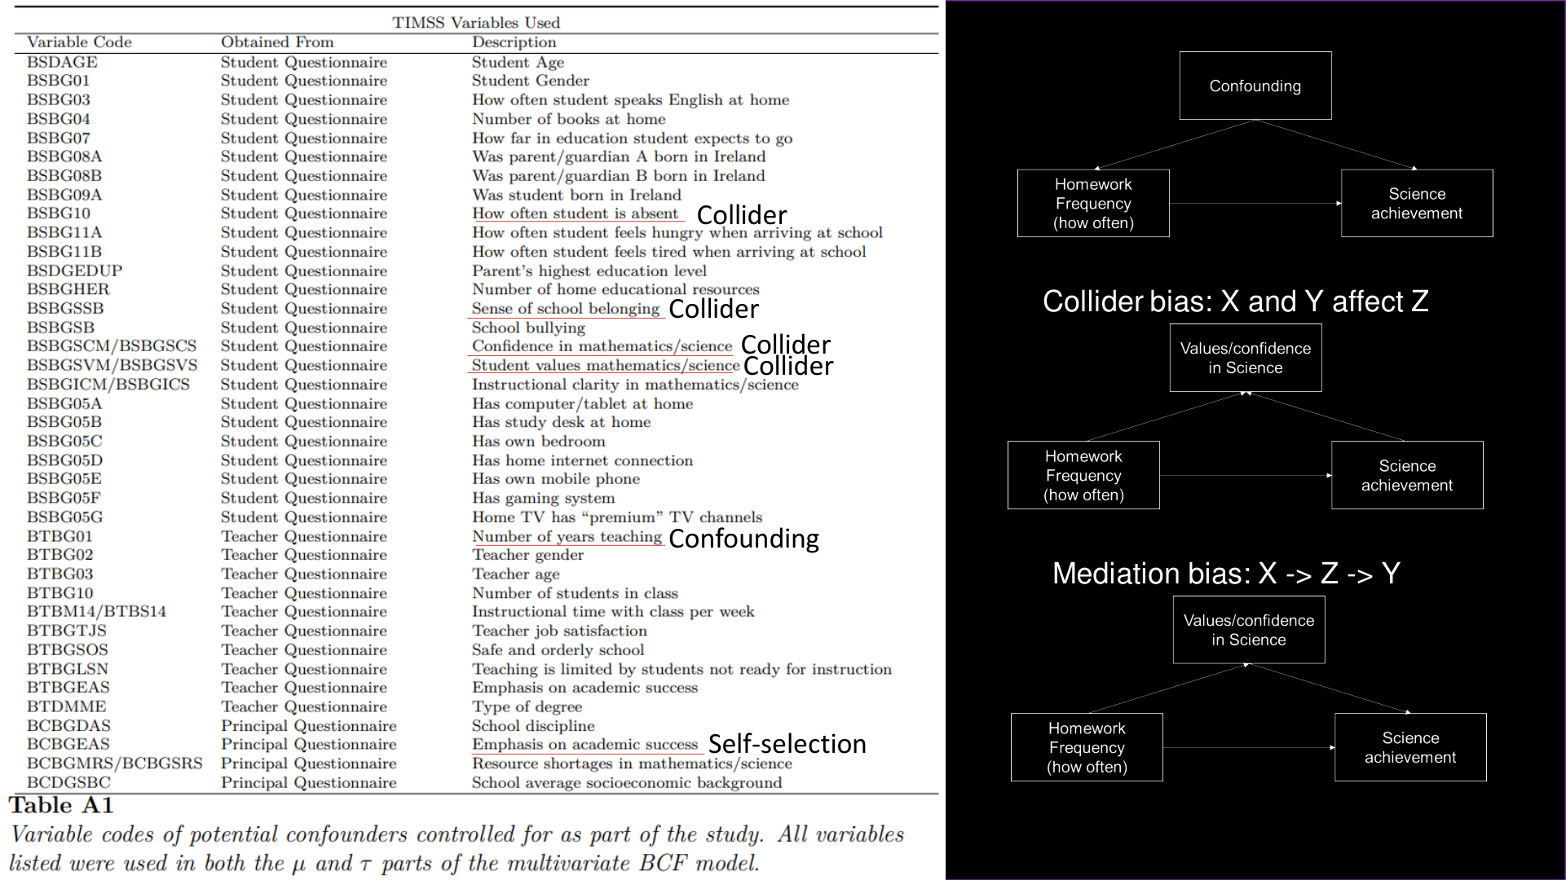
e.g., prior achievement, cognitive abilities, language competencies, … ?
Include?
SES
✔ (all!)
SES – Med
SES – Med
SES
SES – Med
x
SES – Med
x
SES – Med

Slide 23
TIMSS study (cross-sectional)
Causal ML encompasses innovative approaches that achieve greater flexibility to ensure the specification of correct models of the treatment and the outcome while making the same assumptions regarding identifiability and sufficiency (i.e., knowledge & data about the variables necessary for causal estimation) as non-ML methods.
These assumptions remain as hard to fulfill with observational data as with non-ML methods.
Timssi, is this bullshit?
yes!
I) What is CML?
II) The Bayesian causal forest
III) Uniqueness of CML
IV) Implications for our research
Notes:
Show three types of most important causal structures (mediator, confounder, collider), discuss whether all confounders may be present and no mediators or colliders included – no :(
Conclusion:
What CML helps with, what not – hypotheses etc.

Slide 24
Implications
Causal ML sufficiency fallacy: More powerful models lessen or even erase the requirements for causal estimation (e.g., if there is no causal effect, the CML model will correctly estimate it to be zero).
They don`t.
H1: Portraying a method as CML…
H1a: …misleadingly decreases the requirements for accepting estimates to be causal (authors, reviewers, readers)
H1b: …misleadingly decreases the requirements for accepting moderation to be interpreted as causal
H2: CML provides affordances regarding estimation that remain overlooked/disregarded in social science research
(esp./only with samples > 1,000/10,000; Speck et al., 2026)
Implication: We should…
…remain persistent about the limitations of CML
…be more open about the advantages of CML
…consider these points in teaching, review, and our own research
I) What is CML?
II) The Bayesian causal forest
III) Uniqueness of CML
IV) Implications for our research
Notes:
Show three types of most important causal structures (mediator, confounder, collider), discuss whether all confounders may be present and no mediators or colliders included – no :(
Conclusion:
What CML helps with, what not – hypotheses etc.

Slide 25

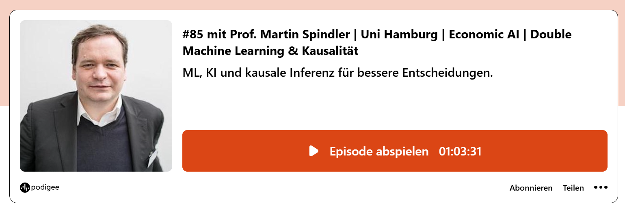
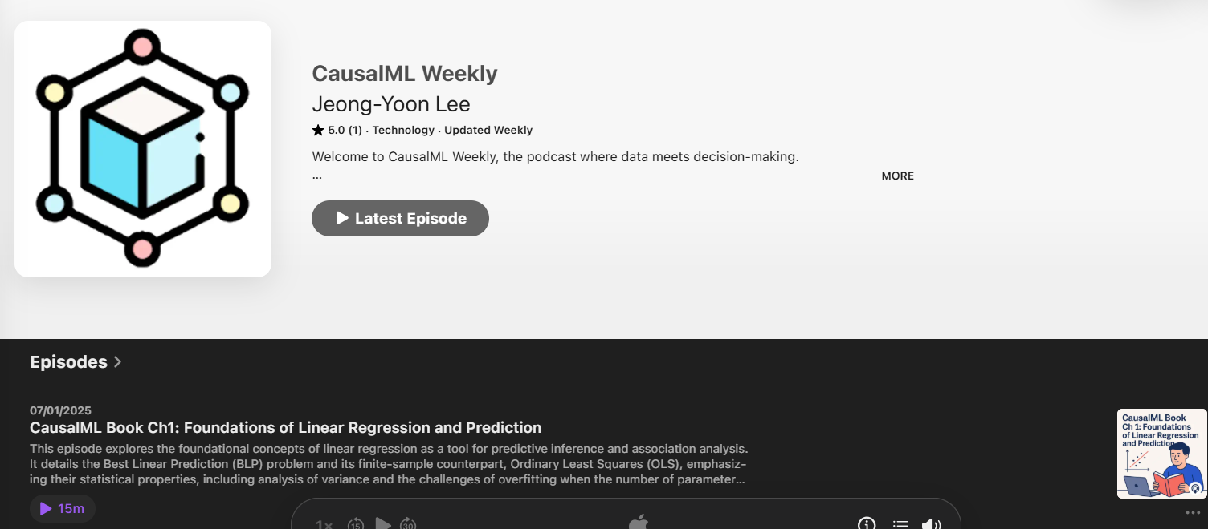
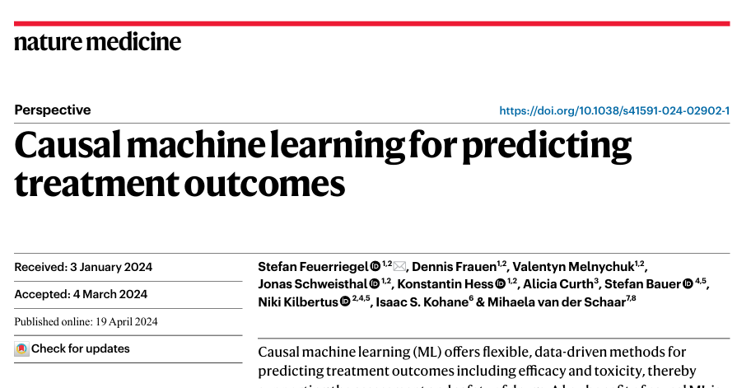
Thank you
bit.ly/PeterE_presentations
Podcast recommentations
Literature recommentations
References
Auspurg, K., & Brüderl, J. (2026). How (Not) to Fuck up Your Causal Analysis. Presentation at the Research Colloquium Analytical Sociology, LMU Munich, Germany.
Chernozhukov, V., Hansen, C., Kallus, N., Spindler, M., & Syrgkanis, V. (2024). Applied causal inference powered by ML and AI. arXiv preprint arXiv:2403.02467.
Kaddour, J., Lynch, A., Liu, Q., Kusner, M. J., & Ricardo, S. (2025). Causal machine learning: A survey and open problems. Foundations and Trends in Optimization, 9(1-2), 1-247.
Kossakowski, J. J., Waldorp, L. J., & van der Maas, H. L. J. (2021). The search for causality: A comparison of different techniques for causal inference graphs. Psychological Methods, 26(6), 719–742. https://doi-org.emedien.ub.uni-muenchen.de/10.1037/met0000390
Speck, K. L., Jankowsky, K., Scharf, F., & Schroeders, U. (2026). Beyond the hype: A simulation study evaluating the predictive performance of machine learning models in psychology. Psychological Methods.
Wiedermann, W., Kim, D., Sungur, E. A., & Eye, A. von. (2020). Direction Dependence in Statistical Modeling: Methods of Analysis. John Wiley & Sons.
Yarkoni, T., & Westfall, J. (2017). Choosing prediction over explanation in psychology: Lessons from machine learning. Perspectives on Psychological Science, 12(6), 1100-1122.

