Slide 1
Balancing Multiple Criteria to Improve Validity and Fairness in Educational Assessment

Slide 2
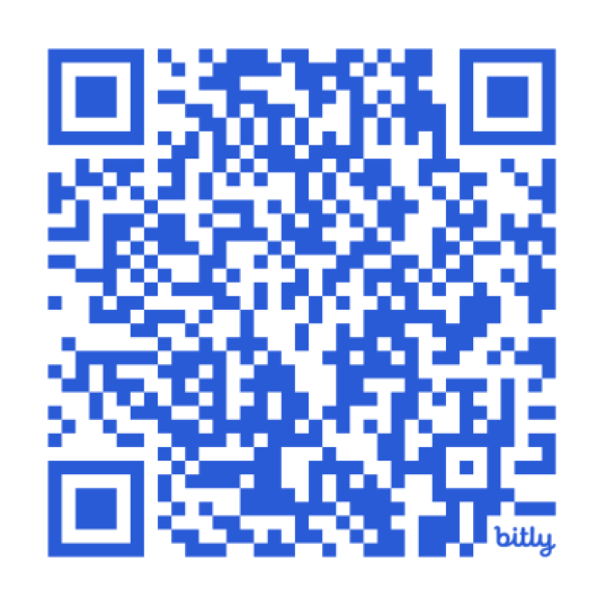
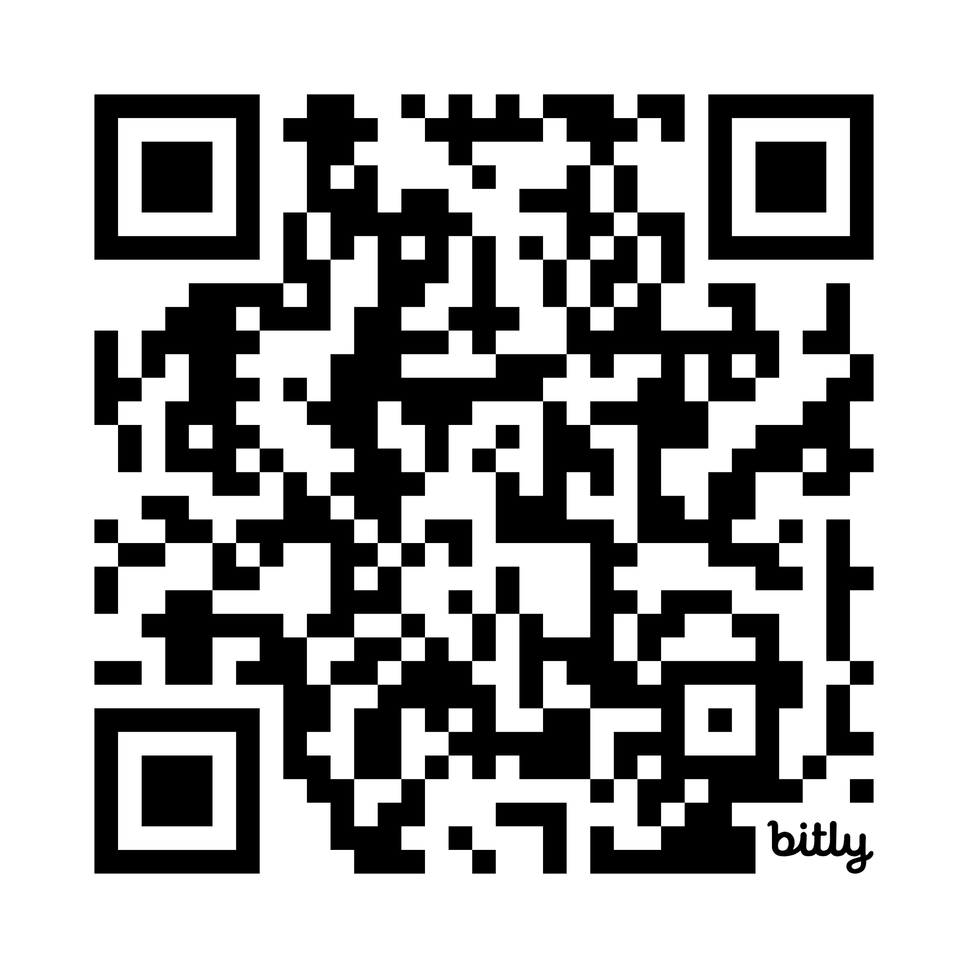
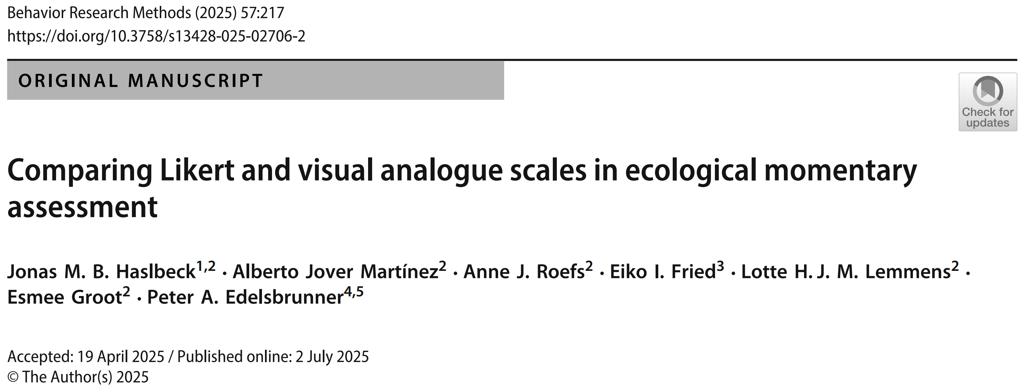
https://bit.ly/PeterE_presentations
https://link.springer.com/article/10.3758/s13428-025-02706-2
An Experimental Comparison of the Seven-Point- and Visual Analogue Scale in Intensive Assessment

Slide 3
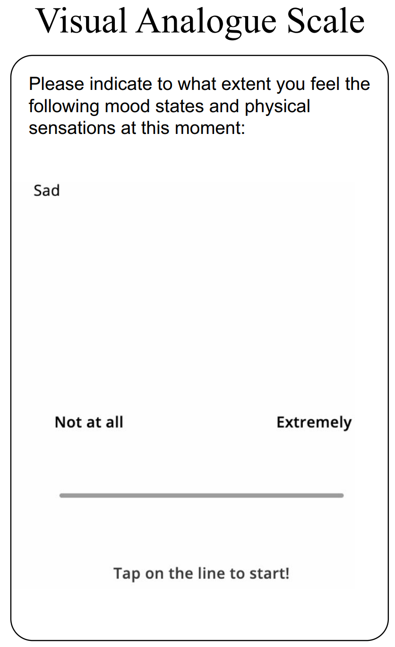
Idiography vs. & nomothetics
Molenaar & Valsiner, 2009
Within-person perspective
Blume et al., 2022; Blume & Schmiedek, 2024
Control of trait variation
Hamaker et al., 2007
Assessment of dynamics
Haslbeck & Ryan, 2022

Slide 4
Methodology: Commonly unjustified/intuitive
Haslbeck et al., 2023
Earlier studies: Mainly cross-sectional, increased reliability with > 4 response categories (see Simms et al., 2019; Fritz et al., 2024)
Research question:
How does the response scale affect…
Univariate statistics/distributions
2) Multivariate statistics/distributions
3) Relations with external covariates
4) Subjective ratings
Typical approach:
7-step Likert or visual analogue scale, linear mixed model or ML-SEM
Haslbeck et al., 2023

Slide 5
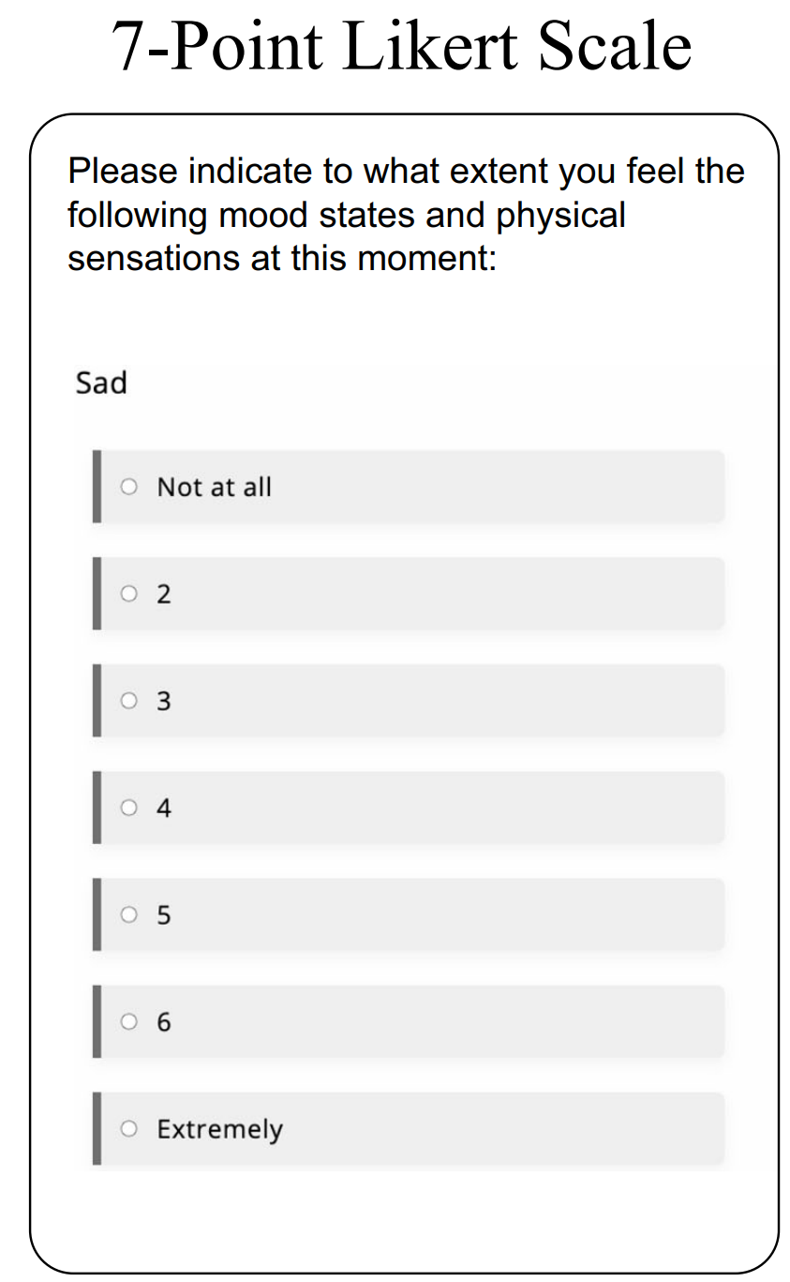
Often studied
Often studied
Often used
Context: Emotions, single items, university students (few clin. diagnoses)
Positive (happy, satisfied,…, 5 items) and negative (stressed, worried,… 9 items) valence
7-step response scale vs. visual analogue scale (101-step)
As far as possible parallel (e.g., only endlabels for 7-step scale)
App limitations:
7-step vertical, VAS horizontal
7-step = not at all, 2, 3, 4, 5, 6, extremely
Between-person (avoiding carry-over effects/reactance):
Two weeks, 3x daily, either always 7-step or VAS

Slide 6
n(Likert) = 63
n(VAS) = 56
M(age) = 22 (SD = 4)
Models:
Bayesian multilevel modeling in brms
0-1 normalization
Inter-individual distributions of descriptive statistics per person:
e.g. within-person means: Zero-one inflated beta
Fixed effects:
Response format (contrast coding, baseline = Likert),
valence (effects coding) + interaction
Random effects:
Intercept across persons, slopes across items
Full distributional models:
Fixed effects on all distributional parameters (zero- & one-shares, both beta-parameters)

Slide 7
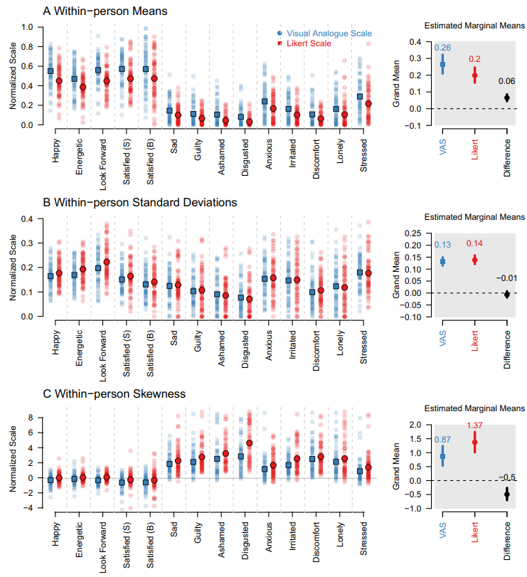
Results: Descriptive distributional parameters
7-step
Higher means
VAS
Lower skewnesses

Slide 8
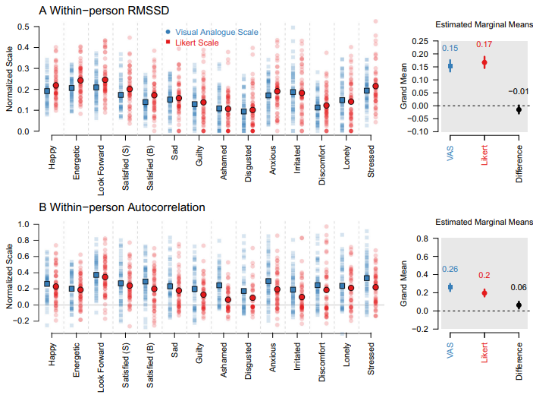
Results: Descriptive distributional parameters
7-step
VAS
Higher autocorrelations

Slide 9
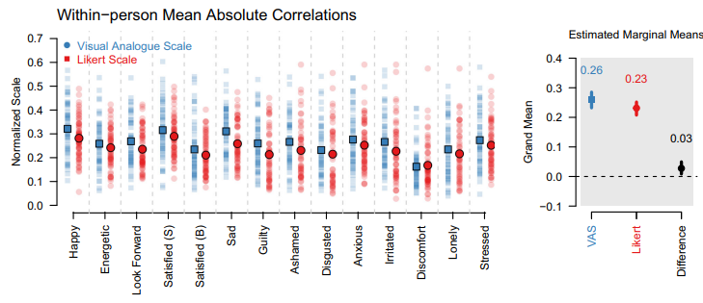
Results: Descriptive multivariate parameters
7-step
VAS
Slightly stronger within-person item correlations

Slide 10
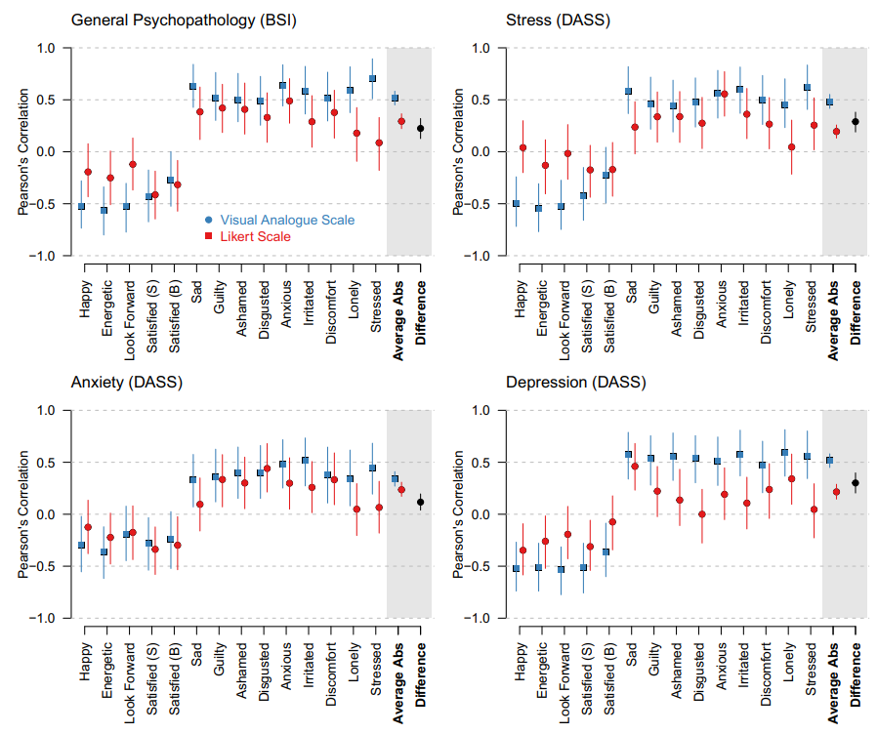
Results: Correlations with external criteria: General psychopathology and depression/anxiety/stress
7-step
VAS
Brutally stronger correlations

Slide 11
Results: Self-reports
Subjective ratings quite similar; descriptively, VAS slightly more exhausting and confusing
Little mutlimodality on both scales (Haslbeck et al., 2023)
Missing data and response times similar
No initial elevation bias (Shrout et al., 2018)
7-step
VAS

Slide 12
Results: Interpretations
- Our VAS captures more systematic ariation close to the scale minimum
(Higher means, lower skewness, higher correlations with external criteria) – preliminary support for VAS in similar studies and populations
Limitations:
- 7-step scale: Second category „1“ instead of „2“?
- Labels (e.g., mildly/very little)
- We need replications and factorial study designs (number response options, label positions & contents, horizontal vs. vertical, initial slider point on VAS) randomize at once (Baribault et al., 2018), potentially within-person
- We also need cognitive surveys and formal models (explore & model the latent response process)
- Multi-item scales
7-step
VAS

Slide 13
https://bit.ly/PeterE_presentations
https://link.springer.com/article/10.3758/s13428-025-02706-2
7-step
Baribault, B., Donkin, C., Little, D. R., Trueblood, J. S., Oravecz, Z., van Ravenzwaaij, D., White, C. N., De Boeck, P., & Vandekerckhove, J. (2018). Metastudies for robust tests of theory. Proceedings of the National Academy of Sciences, 115(11), 2607–2612. https://doi.org/10.1073/pnas.1708285114
Blume, F., Irmer, A., Dirk, J., & Schmiedek, F. (2022). Day-to-day variation in students’ academic success: The role of self-regulation, working memory, and achievement goals. Developmental Science, 25(6), e13301. https://doi.org/10.1111/desc.13301
Blume, F., & Schmiedek, F. (2024). It counts in every single lesson: Between-and within-person associations of teaching quality and student self-regulation. Learning and Instruction, 92, 101908.
Fritz, J., Piccirillo, M. L., Cohen, Z. D., Frumkin, M., Kirtley, O., Moeller, J., Neubauer, A. B., Norris, L. A., Schuurman, N. K., Snippe, E., & Bringmann, L. F. (2024). So You Want to Do ESM? 10 Essential Topics for Implementing the Experience-Sampling Method. Advances in Methods and Practices in Psychological Science, 7(3), 25152459241267912. https://doi.org/10.1177/25152459241267912
Hamaker, E. L., Nesselroade, J. R., & Molenaar, P. C. (2007). The integrated trait–state model. Journal of research in personality, 41(2), 295–315.Haslbeck, J. M. B., & Ryan, O. (2022). Recovering Within-Person Dynamics from Psychological Time Series. Multivariate Behavioral Research, 57(5), 735–766. https://doi.org/10.1080/00273171.2021.1896353
Haslbeck, J., Ryan, O., & Dablander, F. (2023). Multimodality and skewness in emotion time series. Emotion. https://psycnet.apa.org/record/2023-72233-001
Molenaar, P. C., & Valsiner, J. (2009). How generalization works through the single case: A simple idiographic process analysis of an individual psychotherapy. YIS: Yearbook of idiographic science, 1, 23–38.
Shrout, P. E., Stadler, G., Lane, S. P., McClure, M. J., Jackson, G. L., Clavél, F. D., Iida, M., Gleason, M. E. J., Xu, J. H., & Bolger, N. (2018). Initial elevation bias in subjective reports. Proceedings of the National Academy of Sciences, 115(1), E15–E23. https://doi.org/10.1073/pnas.1712277115
Simms, L. J., Zelazny, K., Williams, T. F., & Bernstein, L. (2019). Does the number of response options matter? Psychometric perspectives using personality questionnaire data. Psychological Assessment, 31(4), 557–566. https://doi.org/10.1037/pas0000648
VAS

