Slide 1

Modeling Knowledge
Peter Edelsbrunner
bit.ly/PeterE_presentations
Notes:
Don’t put statistics in the end
Don’t trust a single statistician
Don’t rely on p-values
Statistics matters after data collection -> From the beginning of study planning
Median split
Confirmatory vs. exploratory analyses
https://www.autodeskresearch.com/publications/samestats

Slide 2
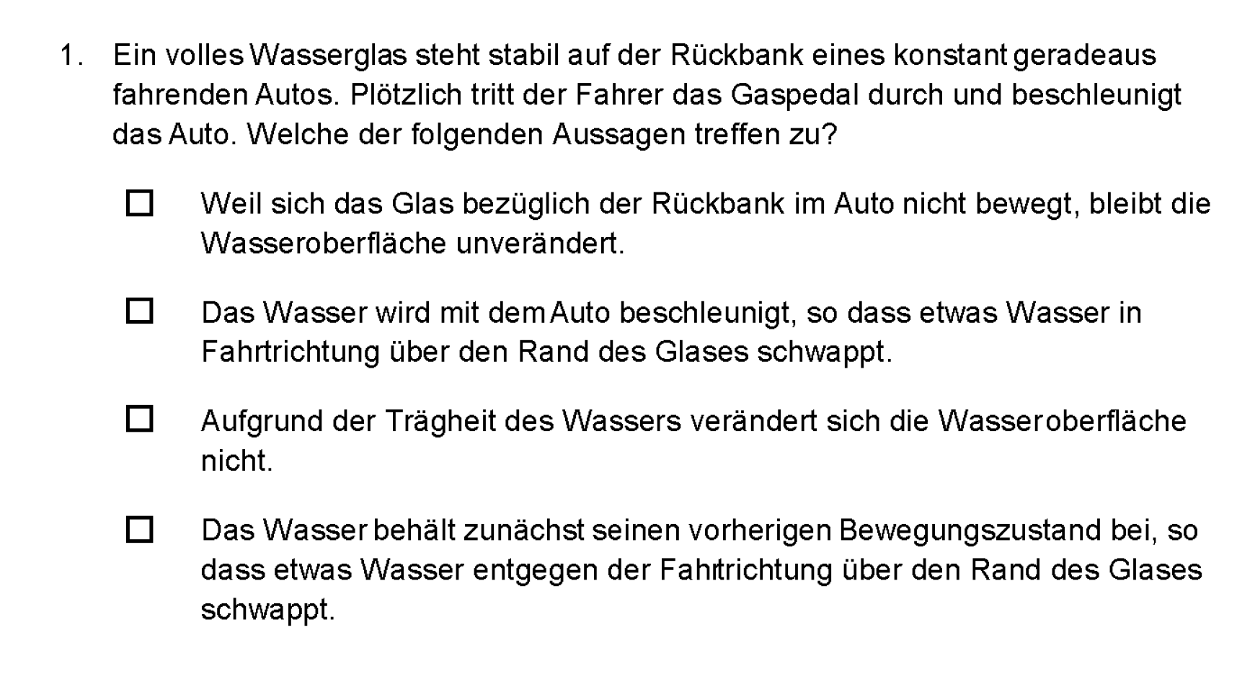
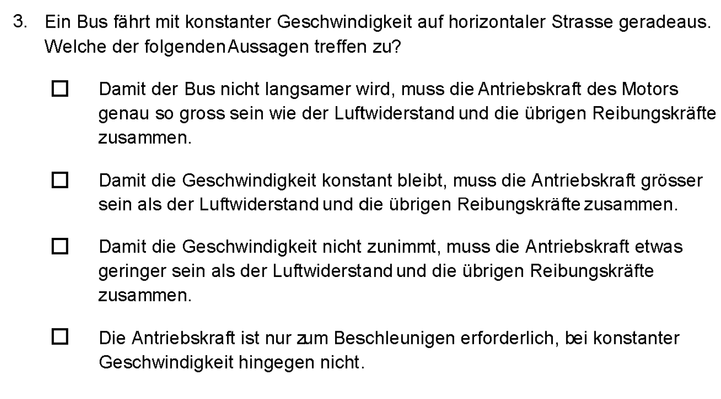
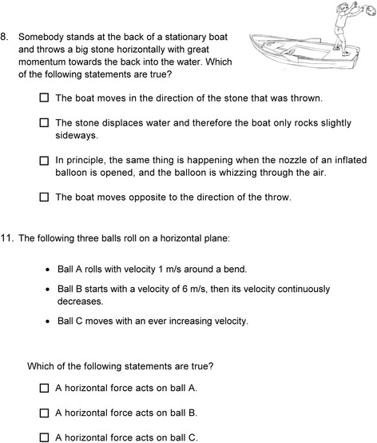
basic Mechanics Conceptual Understanding Test (Hofer, 2015)
Notes:
- What happens if you accelerate a car with a glass standing on ist back seat?
- Which magnitude must a bus engine`s propulsion force have to make it go faster, slower, or keep its current velocity?
What happens to a boat when I throw a stone into water?
Must horizontal force act on a rolling ball to make it go faster, slower, or keep its current velocity?
Of interest to me is how we score learners´ right or wrong answers on this test.

Slide 3
Option 1:
Option 2:
Sum/mean score
Factor analysis
Intervention/Pre- Post change
Item 1
Item 2
Item 3
Item 4
Determination of number of required sources of common variation (factors) to explain/model intercorrelations between items
Notes:
One option is to use the sum or mean score of all answers that they got correct.
We would then see how this sum or mean score changes from before to after instruction, or whether it changes differently in different intervention conditions.
A second option that educational researchers often use is so-called factor analysis.
Many of us get in contact with factor analysis during their PhD.
Factor analysis does the following:
It determines the number of required sources of common variation (so-called factors), to explain slash model intercorrelations between items.
In reality, students’ respones on the different items will often correlated:
Learners who get one item right also tend to get other items right.

Slide 4
Option 1:
Option 2:
Sum/mean score
Factor analysis
λ₁
λ₂
λ₃
λ₄
Intervention/Pre- Post change
Item 1
Item 2
Item 3
Item 4
Determination of number of required sources of common variation (factors) to explain/model intercorrelations between items
Estimation of strength, by which the common variance goes into each item (factor loading λ₁-λ₄)
Notes:
Don’t put statistics in the end
Don’t trust a single statistician
Don’t rely on p-values
Statistics matters after data collection -> From the beginning of study planning
Median split
Confirmatory vs. exploratory analyses
https://www.autodeskresearch.com/publications/samestats

Slide 5
Option 1:
Option 2:
Sum/mean score
Factor analysis
λ₁
Intervention/Pre- Post change
Item 1
Item 2
Item 3
Item 4
Items that show high intercorrelations with the other items
receive high factor loadings (strong indicators of common construct)
Estimation of strength, by which the common variance goes into each item (factor loading λ₁-λ₄)
Notes:
Don’t put statistics in the end
Don’t trust a single statistician
Don’t rely on p-values
Statistics matters after data collection -> From the beginning of study planning
Median split
Confirmatory vs. exploratory analyses
https://www.autodeskresearch.com/publications/samestats

Slide 6
Option 1:
Option 2:
Sum/mean score
Factor analysis
λ₁
λ₂
λ₃
λ₄
Intervention/Pre- Post change
Item 1
Item 2
Item 3
Item 4
As measurement model:
Examine whether the theoretically expected factor structure (number & loadings) is present
As scaling model:
Build estimated factor scores from measurement model
Notes:
Don’t put statistics in the end
Don’t trust a single statistician
Don’t rely on p-values
Statistics matters after data collection -> From the beginning of study planning
Median split
Confirmatory vs. exploratory analyses
https://www.autodeskresearch.com/publications/samestats

Slide 7
Option 1:
Option 2:
Sum/mean score
Factor score
λ₁
λ₂
λ₃
λ₄
Intervention/Pre- Post change
Item 1
Item 2
Item 3
Item 4
Factor score:
Weighted value by factor loading across items
As scaling model:
Build estimated factor scores from measurement model
Notes:
Don’t put statistics in the end
Don’t trust a single statistician
Don’t rely on p-values
Statistics matters after data collection -> From the beginning of study planning
Median split
Confirmatory vs. exploratory analyses
https://www.autodeskresearch.com/publications/samestats

Slide 8
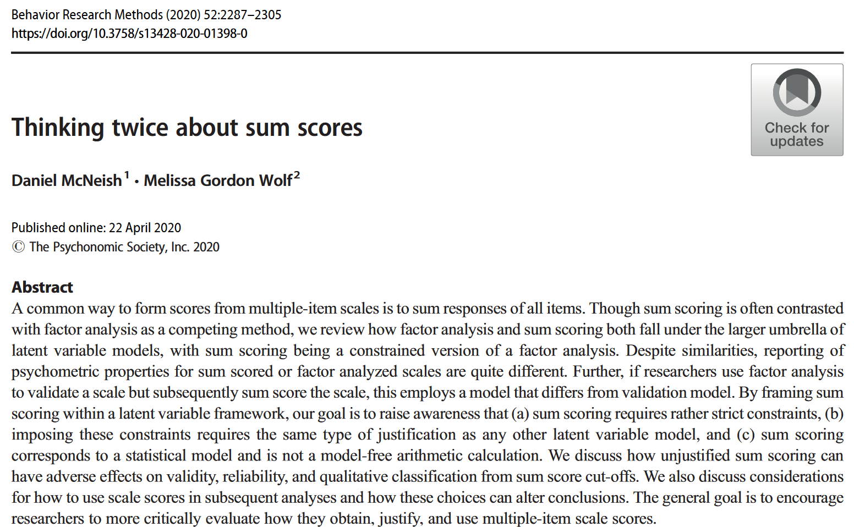

Option 1:
Option 2:
Sum/mean score
Factor- score
λ₁
λ₂
λ₃
λ₄
Item 1
Item 2
Item 3
Item 4
Criticism of Sum + Alpha
(+ factor analysis) - approach
Factor score:
Weighted value by factor loading across items
Notes:
Don’t put statistics in the end
Don’t trust a single statistician
Don’t rely on p-values
Statistics matters after data collection -> From the beginning of study planning
Median split
Confirmatory vs. exploratory analyses
https://www.autodeskresearch.com/publications/samestats

Slide 9
Option 1:
Option 2:
Sum/mean score
Factor-score
λ₁
λ₂
λ₃
λ₄
Item 1
Item 2
Item 3
Item 4
The sum score is a constrained version of factor analysis
(McNeish & Wolf, 2020)
Factor score:
Weighted value by factor loading across items
Notes:
Don’t put statistics in the end
Don’t trust a single statistician
Don’t rely on p-values
Statistics matters after data collection -> From the beginning of study planning
Median split
Confirmatory vs. exploratory analyses
https://www.autodeskresearch.com/publications/samestats

Slide 10
Option 1 =
Option 2:
Sum/mean score
Factor-score
λ₁
λ₂
λ₃
λ₄
λ₁
λ₁
λ₁
λ₁
Item 1
Item 2
Item 3
Item 4
Item 1
Item 2
Item 3
Item 4
The sum score is a constrained version of factor analysis
(McNeish & Wolf, 2020)
Factor score:
Weighted value by factor loading across items
All items are equally weighted
Implies the assumption of equal (std.) factor loadings
Notes:
Don’t put statistics in the end
Don’t trust a single statistician
Don’t rely on p-values
Statistics matters after data collection -> From the beginning of study planning
Median split
Confirmatory vs. exploratory analyses
https://www.autodeskresearch.com/publications/samestats

Slide 11
Option 1
Sum/mean score
Sum = 1*Item 1 + 1*Item 2 + 1*Item 3 + 1*Item 4
Mean = (1*Item 1 + 1*Item 2 + 1*Item 3 + 1*Item 4)
/ Number of items
0. Sum score implies the assumption of equal loadings
1. This assumption can be tested via factor analysis
2. Empirically this assumption is (almost) never given
3. Conclusion:
Instead of sum scores/means we should use factor scores/SEM
λ₁
λ₁
λ₁
λ₁
Item 1
Item 2
Item 3
Item 4
The sum score is a constrained version of factor analysis
(McNeish & Wolf, 2020)
(IRT/person estimtes)
All items are weighted equally
Implies the assumption of equal (std.) factor loadings
Notes:
Don’t put statistics in the end
Don’t trust a single statistician
Don’t rely on p-values
Statistics matters after data collection -> From the beginning of study planning
Median split
Confirmatory vs. exploratory analyses
https://www.autodeskresearch.com/publications/samestats

Slide 12
Should we generally use factor scores (or SEM/IRT) instead of sum/mean scores?
0. Sum score implies the assumption of equal loadings
1. This assumption can be tested via factor analysis
2. Empirically this assumption is (almost) never given
3. Conclusion:
Instead of sum scores/means we should use factor scores/SEM
Notes:
My further points:
Summenscores können auch aus anderen, sehr plausiblen Modellen generiert werden/sein.
Aus Sicht der Messtheorie machen variierened Faktorladungen keinen Sinn.
Summenscores und Faktorscores korrelieren häufig sehr hoch miteinander.
Deshalb meine Empfehlung:
Faktorscores nur, wenn ihr sicher seid, dass eure Items austauschbar sind (bzw. der Itemkontext konstruktirrelevant ist), ihr kauft, dass Ladungen variieren sollen und auch denkt, es ist ok, wenn nicht alles gleich stark in eurer Konstrukt eingeht.

Slide 13
Bullshit!
0. Sum score implies the assumption of equal loadings
1. This assumption can be tested via factor analysis
2. Empirically this assumption is (almost) never given
3. Conclusion:
Instead of sum scores/means we should use factor scores/SEM
Of course!
because
Yes!
Bullshit!
Notes:
Don’t put statistics in the end
Don’t trust a single statistician
Don’t rely on p-values
Statistics matters after data collection -> From the beginning of study planning
Median split
Confirmatory vs. exploratory analyses
https://www.autodeskresearch.com/publications/samestats

Slide 14
0. Sum score implies the assumption of a factor model with equal loadings
Factor-score
λ₁
λ₁
λ₁
λ₁
Item 1
Item 2
Item 3
Item 4
Error
Error
Error
Error
Notes:
Das Konstrukt entsteht aus UND erklärt die Interkorrelationen.
Nicht-korrelierte Varianz ist Konstruktirrelevant.
Die Items sind austauschbar, weil in jeder Korrelation dieselbe Korrelationsquelle drinsteckt. Bei homogenen Faktorladungen immer in demselben Ausmass.

Slide 15
0. Sum score implies the assumption of a composite model
Compo-site
β
β
β
β
Item 1
Item 2
Item 3
Item 4
Notes:
Das Konstrukt entsteht aus UND erklärt die Interkorrelationen.
Nicht-korrelierte Varianz ist Konstruktirrelevant.
Die Items sind austauschbar, weil in jeder Korrelation dieselbe Korrelationsquelle drinsteckt. Bei homogenen Faktorladungen immer in demselben Ausmass.

Slide 16
0. Sum score implies the assumption of a network model
r
r
r
r
Item 1
Item 2
Item 3
Item 4
Forces acting on glass
Forces acting on boat
Forces acting on accerlating vehicle
Forces acting on balls on horizontal plane
Notes:
Das Konstrukt entsteht aus UND erklärt die Interkorrelationen.
Nicht-korrelierte Varianz ist Konstruktirrelevant.
Die Items sind austauschbar, weil in jeder Korrelation dieselbe Korrelationsquelle drinsteckt. Bei homogenen Faktorladungen immer in demselben Ausmass.

Slide 17
Empirically (almost) indistinguishable (Edelsbrunner, 2022 for references)
Factor model
Composite model
Network model
r
r
r
r
Factor-score
Compo-site
Item 1
Item 2
Item 3
Item 4
Forces acting on glass
Forces acting on boat
Forces acting on accelerating vehicle
Forces acting on balls on horizontal plane
λ₁
λ₁
λ₁
λ₁
β
β
β
β
Item 1
Item 2
Item 3
Item 4
Item 1
Item 2
Item 3
Item 4
Error
Error
Error
Error
Notes:
Das Konstrukt entsteht aus UND erklärt die Interkorrelationen.
Nicht-korrelierte Varianz ist Konstruktirrelevant.
Die Items sind austauschbar, weil in jeder Korrelation dieselbe Korrelationsquelle drinsteckt. Bei homogenen Faktorladungen immer in demselben Ausmass.

Slide 18
Theoretical distinction possible (Edelsbrunner, 2022)
Factor model
Composite model
Network model
r
r
r
r
Factor-score
Compo-site
Item 1
Item 2
Item 3
Item 4
Forces acting on glass
Forces acting on boat
Forces acting on accelerating vehicle
Forces acting on balls on horizontal plane
λ₁
λ₁
λ₁
λ₁
β
β
β
β
Item 1
Item 2
Item 3
Item 4
Item 1
Item 2
Item 3
Item 4
Error
Error
Error
Error
Notes:
Das Konstrukt entsteht aus UND erklärt die Interkorrelationen.
Nicht-korrelierte Varianz ist Konstruktirrelevant.
Die Items sind austauschbar, weil in jeder Korrelation dieselbe Korrelationsquelle drinsteckt. Bei homogenen Faktorladungen immer in demselben Ausmass.

Slide 19
Correct if the items are interchangeable indicators of the same construct
Factor model
Composite model
Network model
r
r
r
r
Factor-score
Compo-site
Item 1
Item 2
Item 3
Item 4
Forces acting on glass
Forces acting on boat
Forces acting on accerlating vehicle
Forces acting on balls on horizontal plane
λ₁
λ₁
λ₁
λ₁
β
β
β
β
Item 1
Item 2
Item 3
Item 4
Item 1
Item 2
Item 3
Item 4
Error
Error
Error
Error
Notes:
Das Konstrukt entsteht aus UND erklärt die Interkorrelationen.
Nicht-korrelierte Varianz ist Konstruktirrelevant.
Die Items sind austauschbar, weil in jeder Korrelation dieselbe Korrelationsquelle drinsteckt. Bei homogenen Faktorladungen immer in demselben Ausmass.

Slide 20
Correct if each item adds an important part of the construct
Factor model
Network model
r
r
r
r
Factor-score
Compo-site
Item 1
Item 2
Item 3
Item 4
Forces acting on glass
Forces acting on boat
Forces acting on accerlating vehicle
Forces acting on balls on horizontal plane
λ₁
λ₁
λ₁
λ₁
β
β
β
β
Item 1
Item 2
Item 3
Item 4
Item 1
Item 2
Item 3
Item 4
Error
Error
Error
Error
Notes:
Das Konstrukt entsteht aus UND erklärt die Interkorrelationen.
Nicht-korrelierte Varianz ist Konstruktirrelevant.
Die Items sind austauschbar, weil in jeder Korrelation dieselbe Korrelationsquelle drinsteckt. Bei homogenen Faktorladungen immer in demselben Ausmass.

Slide 21
Correct if the different parts of the construct interact
Factor model
Network model
Network model
Composite model
r
r
r
r
Factor-score
Compo-site
Item 1
Item 2
Item 3
Item 4
Forces acting on glass
Forces acting on boat
Forces acting on accelerating vehicle
Forces acting on balls on horizontal plane
λ₁
λ₁
λ₁
λ₁
β
β
β
β
Item 1
Item 2
Item 3
Item 4
Item 1
Item 2
Item 3
Item 4
Error
Error
Error
Error
Notes:
Das Konstrukt entsteht aus UND erklärt die Interkorrelationen.
Nicht-korrelierte Varianz ist Konstruktirrelevant.
Die Items sind austauschbar, weil in jeder Korrelation dieselbe Korrelationsquelle drinsteckt. Bei homogenen Faktorladungen immer in demselben Ausmass.

Slide 22
Valid representation of specific concepts
(e.g., Newton's third law)
Valid representation of socially constructed concepts (e.g., Mechanics understanding, Math achievement, English comprehension, vocabulary)
r
r
r
r
Factor-score
Compo-site
Item 1
Item 2
Item 3
Item 4
Forces acting on glass
Forces acting on boat
Forces acting on accelerating vehicle
Forces acting on balls on horizontal plane
λ₁
λ₁
λ₁
λ₁
β
β
β
β
Valid representation of mutually dependent knowledge components (e.g., understanding glass -> understanding boat)
Item 1
Item 2
Item 3
Item 4
Item 1
Item 2
Item 3
Item 4
Error
Error
Error
Error
Notes:
Das Konstrukt entsteht aus UND erklärt die Interkorrelationen.
Nicht-korrelierte Varianz ist Konstruktirrelevant.
Die Items sind austauschbar, weil in jeder Korrelation dieselbe Korrelationsquelle drinsteckt. Bei homogenen Faktorladungen immer in demselben Ausmass.

Slide 23

High internal consistency is often asked for
e.g. Cronbach’s Alpha (or Omega) > .70
As indicator of reliability
Taber 2018 (& Stadler et al., 2021)
For knowledge tests capturing composite/network constructs:
Inadequate
Implication 2:
Should items intercorrelate?
Implication 1:
The theory defines the model, not the data
Notes:
Das Konstrukt entsteht aus UND erklärt die Interkorrelationen.
Nicht-korrelierte Varianz ist Konstruktirrelevant.
Die Items sind austauschbar, weil in jeder Korrelation dieselbe Korrelationsquelle drinsteckt. Bei homogenen Faktorladungen immer in demselben Ausmass.

Slide 24
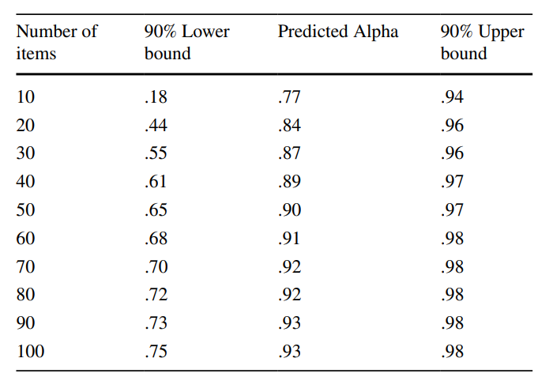
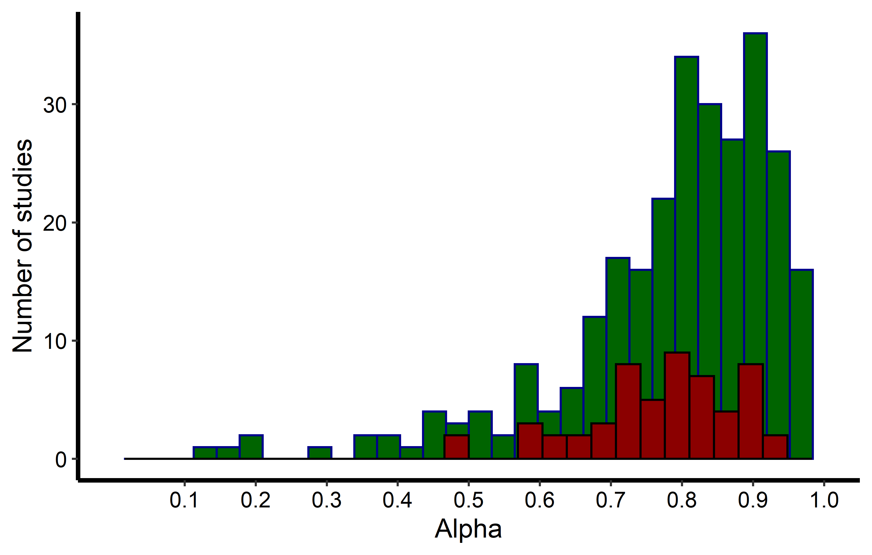
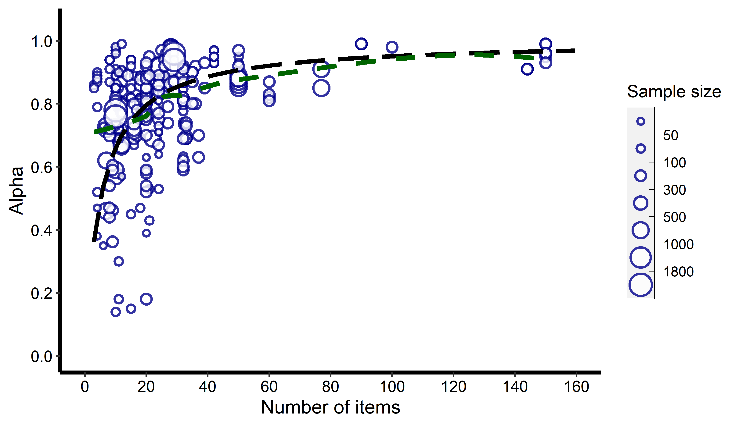
Meta-analysis:
285 Alphas from 52 studies examining learning across multiple time points.
Results: Average Alpha = .85.
Very large heterogeneity (98%): Broad prediction intervals. Publication bias.
Higher in younger age, after instruction, during development, in Math and Languages vs. Sciences.
Notes:
Als Instrument

Slide 25
Implication 2:
Only expect (or demand) high internal consistency (i.e., item intercorrelations) for constructs well-represented by the factor model.
Implication 1:
The theory defines the model, not the data
Implication 3:
Deliver other kinds of validity and reliability evidence (e.g., retest/parallel test reliability, cognitive interviews, expert ratings).
Implication 4:
If you find a strong model,
It must make strong assumptions.
Notes:
Implication 4:
Lastly, I am not here to tell you that factor analysis or any other statistical method is bullshit.
Learn factor analysis, learn any statistical model you can find out there.
But when someone tells you: «You must use this procedure, it’s a standard!», be cautious.
Whenever we use models, we should ensure that the theoretical assumptions the models make match our constructs.
In my opinion, this is one of the two prime competencies of statistical modeling. [the other being finding models that match our questions].
If we find a model that apparently allows strong inferennces, it can only be so because it makes strong assumptions.
We shouldn`t understand statistical models as useful procedues to reach an end. We have to understand the theoretical assumptions behind our models to be good modelers.
And now, I would love to hear your opinion and questions:
Do these thoughts make any sense, can you taky anything from them, can you think of examples of constructs from your research for these?
I’m looking forward to criticism, questions, and feedback.

Slide 26
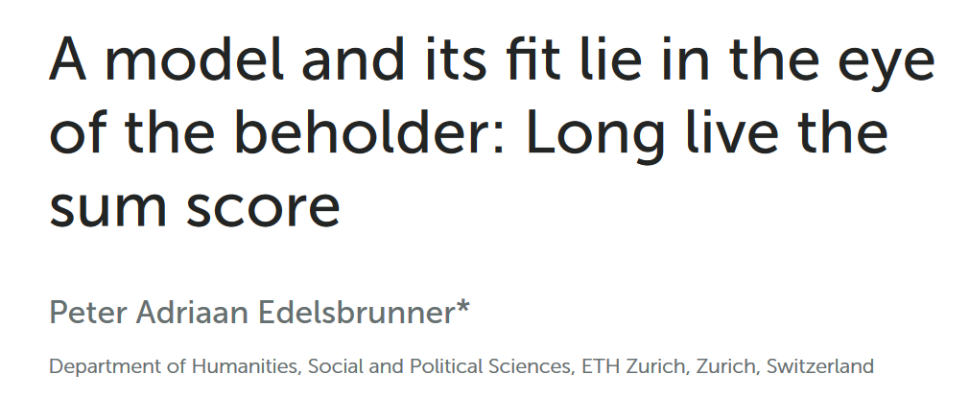

Thank you
https://www.frontiersin.org/articles/10.3389/fpsyg.2022.986767/pdf
https://osf.io/m8d7t/download
Get this presentation:
bit.ly/PeterE_presentations
Notes:
Don’t put statistics in the end
Don’t trust a single statistician
Don’t rely on p-values
Statistics matters after data collection -> From the beginning of study planning
Median split
Confirmatory vs. exploratory analyses
https://www.autodeskresearch.com/publications/samestats

Slide 27
 | CTT | Rasch | IRT | CFA | EFA | G-Theory | Network | Mokken scaling | LCA/ LPA
Reliability estimation | + | ~ | ~ | ~ | - | + | - | ~ | ~
Dimensiona-lity testing | - | ~ | ~ | + | + | - | ~ | + | ~
Global fit | - | ~ | ~ | + | - | - | - | - | -
Item/person fit |  | + | - | ~ |  | - | - |  | -
Bivariate dependencies |  |  | ~ | ~ | ~ |  | +
Non-linearity/subgroups |  |  |  |  |  |  |  | ~ | +
Deviations from assumptions |  |  |  |  |  |  |  | +
+ MDS,
Thurstonian Scaling,
Fechnerian Scaling,
Knowledge Space Theory,
Cognitive diagnosis modeling
Notes:
Don’t put statistics in the end
Don’t trust a single statistician
Don’t rely on p-values
Statistics matters after data collection -> From the beginning of study planning
Median split
Confirmatory vs. exploratory analyses
https://www.autodeskresearch.com/publications/samestats

