Slide 1
Time-economical assessment of intelligence as predictor variable for academic learning:
Is speeded reasoning enough? [hint: no!]
Peter Edelsbrunner
ETH Zurich
Notes:
We evaluated a three-minute speeded reasoning test as a screening of general cognitive abilities.
•The test showed an excellent reliability.
•Test performance was substantially related (r = 0.57) to general cognitive abilities.
•The association of test performance and g was explained by working memory capacity.
•The paper- and computer-based versions demonstrated scalar measurement invariance.
a substantial correlation with general cognitive abilities measured with a comprehensive test battery (r = 0.57; age-corrected r = 0.50), supporting its potential as a brief screening of cognitive abilities. Working memory capacity accounted for the majority (54%) of the association between test performance and general cognitive abilities, whereas individual differences in processing speed did not contribute to this relationship. Our results support the notion that the mini-q can be used as a brief, reliable, and valid assessment of general cognitive abilities.
both verbal, β = 0.33 (95% CI = [0.16; 0.50]), p < .001, and figural abilities, β = 0.26 (95% CI = [0.09; 0.42]), p < .001, contributed to mini-q performance. In contrast, numerical abilities did not contribute to mini-q performance, β = 0.01 (95% CI = [− 0.16; 0.18]), p = .909.
Parcels based on every third item…
Bis:
15 subtests in 45 minutes… :D
We are measuring Intelligence devoid of learning!
No new patterns to be found.
Measuring fluid intelligence and processing speed according to CHC?
No – speeded reasoning is a necessary but insufficient component of fluid reasoning.
There are always two peaks/modes -> different strategies? -> Validity issue? But maybe that’s the only intelligent process that’s in there – identifying and deciding for the better strategy? Meta-monitoring should be necessary for that :) so maybe intelligence is noise, not the signal :D

Slide 2
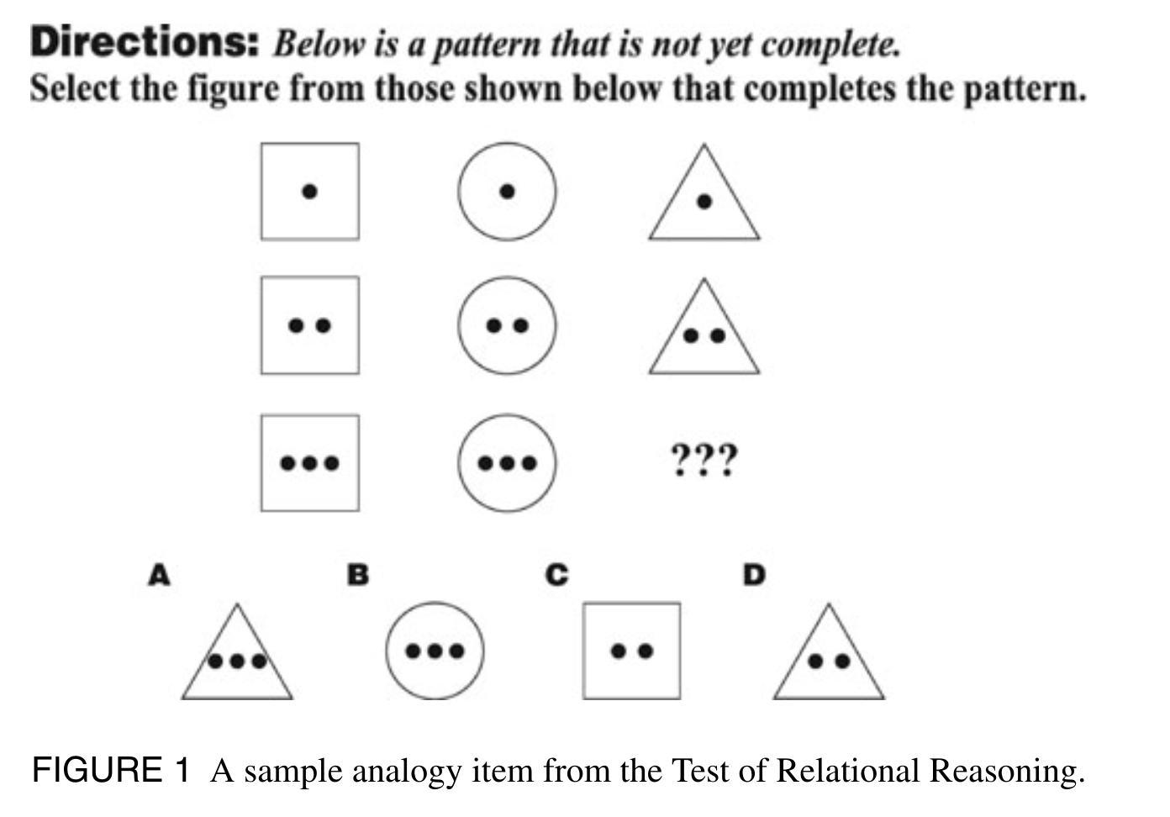
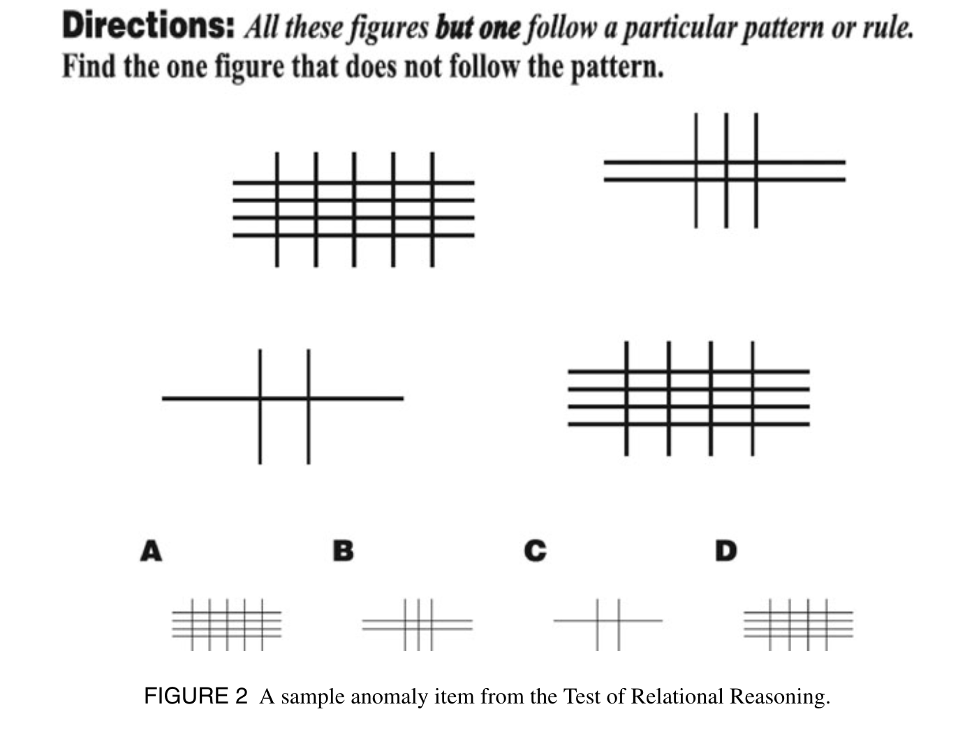
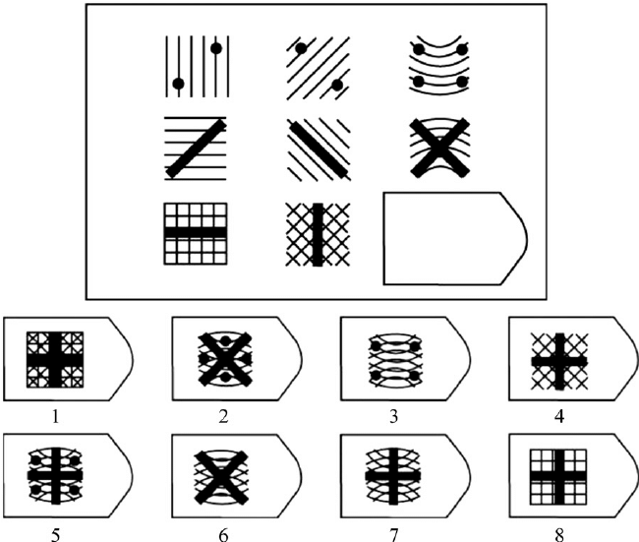

Test of Relational Reasoning (TORR)
Alexander, Dumas et al., 2015; Goldwater & Schalk, 2016; Holyoak & Lu, 2021;
Jastrzębski et al., 2023; Kalra & Richland, 2022
Analogy (10 min)
Anomaly (10 min)
Raven APM (40 min; 20 min; 7 min)
Hamel & Schmittmann, 2006; Poulton et al., 2022
KFT number series (10 min)
Heller & Perleth, 2000
Notes:
This type of reasoning has two basic prerequisites: the ability to form explicit representations of relations between entities, and the ability to make inferences by integrating multiple relations and comparing relations across domains. That is, the human brain enables a thinker to consider two or more relations together to assess what they jointly imply. By enabling inferences based on relations between entities, rather than solely on the entities themselves, the ability to generalize knowledge to new situations is dramatically increased.

Slide 3

mini-q
Baudson & Preckel (2015)
64 items
3 minutes
Speeded reasoning
TRUE FALSE
The triangle rejects the square
x
The circle prefers the triangle
x
There are no rules to be learned
Speeded reasoning (Baudson & Preckel, 2016)
Analogical mapping of figural and verbal relation
Does the figural relation match the verbal relation?
The square does not reject the triangle
x
But it’s really trivial!
This is also really trivial!
Notes:
We evaluated a three-minute speeded reasoning test as a screening of general cognitive abilities.
•The test showed an excellent reliability.
•Test performance was substantially related (r = 0.57) to general cognitive abilities.
•The association of test performance and g was explained by working memory capacity.
•The paper- and computer-based versions demonstrated scalar measurement invariance.
a substantial correlation with general cognitive abilities measured with a comprehensive test battery (r = 0.57; age-corrected r = 0.50), supporting its potential as a brief screening of cognitive abilities. Working memory capacity accounted for the majority (54%) of the association between test performance and general cognitive abilities, whereas individual differences in processing speed did not contribute to this relationship. Our results support the notion that the mini-q can be used as a brief, reliable, and valid assessment of general cognitive abilities.
both verbal, β = 0.33 (95% CI = [0.16; 0.50]), p < .001, and figural abilities, β = 0.26 (95% CI = [0.09; 0.42]), p < .001, contributed to mini-q performance. In contrast, numerical abilities did not contribute to mini-q performance, β = 0.01 (95% CI = [− 0.16; 0.18]), p = .909.
Parcels based on every third item…
Bis:
15 subtests in 45 minutes… :D
We are measuring Intelligence devoid of learning!
No new patterns to be found.
Measuring fluid intelligence and processing speed according to CHC?
No – speeded reasoning is a necessary but insufficient component of fluid reasoning.
There are always two peaks/modes -> different strategies? -> Validity issue? But maybe that’s the only intelligent process that’s in there – identifying and deciding for the better strategy? Meta-monitoring should be necessary for that :) so maybe intelligence is noise, not the signal :D

Slide 4
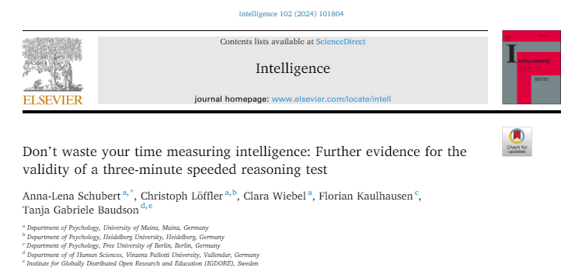

2 samples, N = 140/505, Age 18-60
«Excellent reliability» (.96-.99)
«Substantial correlation with general cognitive ablities» (r = .57)
«Working memory capacity accounted for the majority (54%) of the association between test performance and general cognitive abilities, whereas individual differences in processing speed did not contribute to this relationship»
«Supporting potential as brief assessment/screening of general cognitive abilities»
«Brief, reliable, valid measure of GCA»
There are no rules to be learned
Speeded reasoning (Baudson & Preckel, 2016)
Analogical mapping of figural and verbal relation
Does the figural relation match the verbal relation?
What is the mini-q used for?
Measure of fluid intelligence (Pollet & Schnell, 2017)
Measure of mental abilities (Baltes & Diehl, 2018)
Measure for cognitive abilities (Meuer & Imhoff, 2021)
Notes:
We evaluated a three-minute speeded reasoning test as a screening of general cognitive abilities.
•The test showed an excellent reliability.
•Test performance was substantially related (r = 0.57) to general cognitive abilities.
•The association of test performance and g was explained by working memory capacity.
•The paper- and computer-based versions demonstrated scalar measurement invariance.
a substantial correlation with general cognitive abilities measured with a comprehensive test battery (r = 0.57; age-corrected r = 0.50), supporting its potential as a brief screening of cognitive abilities. Working memory capacity accounted for the majority (54%) of the association between test performance and general cognitive abilities, whereas individual differences in processing speed did not contribute to this relationship. Our results support the notion that the mini-q can be used as a brief, reliable, and valid assessment of general cognitive abilities.
both verbal, β = 0.33 (95% CI = [0.16; 0.50]), p < .001, and figural abilities, β = 0.26 (95% CI = [0.09; 0.42]), p < .001, contributed to mini-q performance. In contrast, numerical abilities did not contribute to mini-q performance, β = 0.01 (95% CI = [− 0.16; 0.18]), p = .909.
Parcels based on every third item…
Bis:
15 subtests in 45 minutes… :D
We are measuring Intelligence devoid of learning!
No new patterns to be found.
Measuring fluid intelligence and processing speed according to CHC?
No – speeded reasoning is a necessary but insufficient component of fluid reasoning.
There are always two peaks/modes -> different strategies? -> Validity issue? But maybe that’s the only intelligent process that’s in there – identifying and deciding for the better strategy? Meta-monitoring should be necessary for that :) so maybe intelligence is noise, not the signal :D

Slide 5
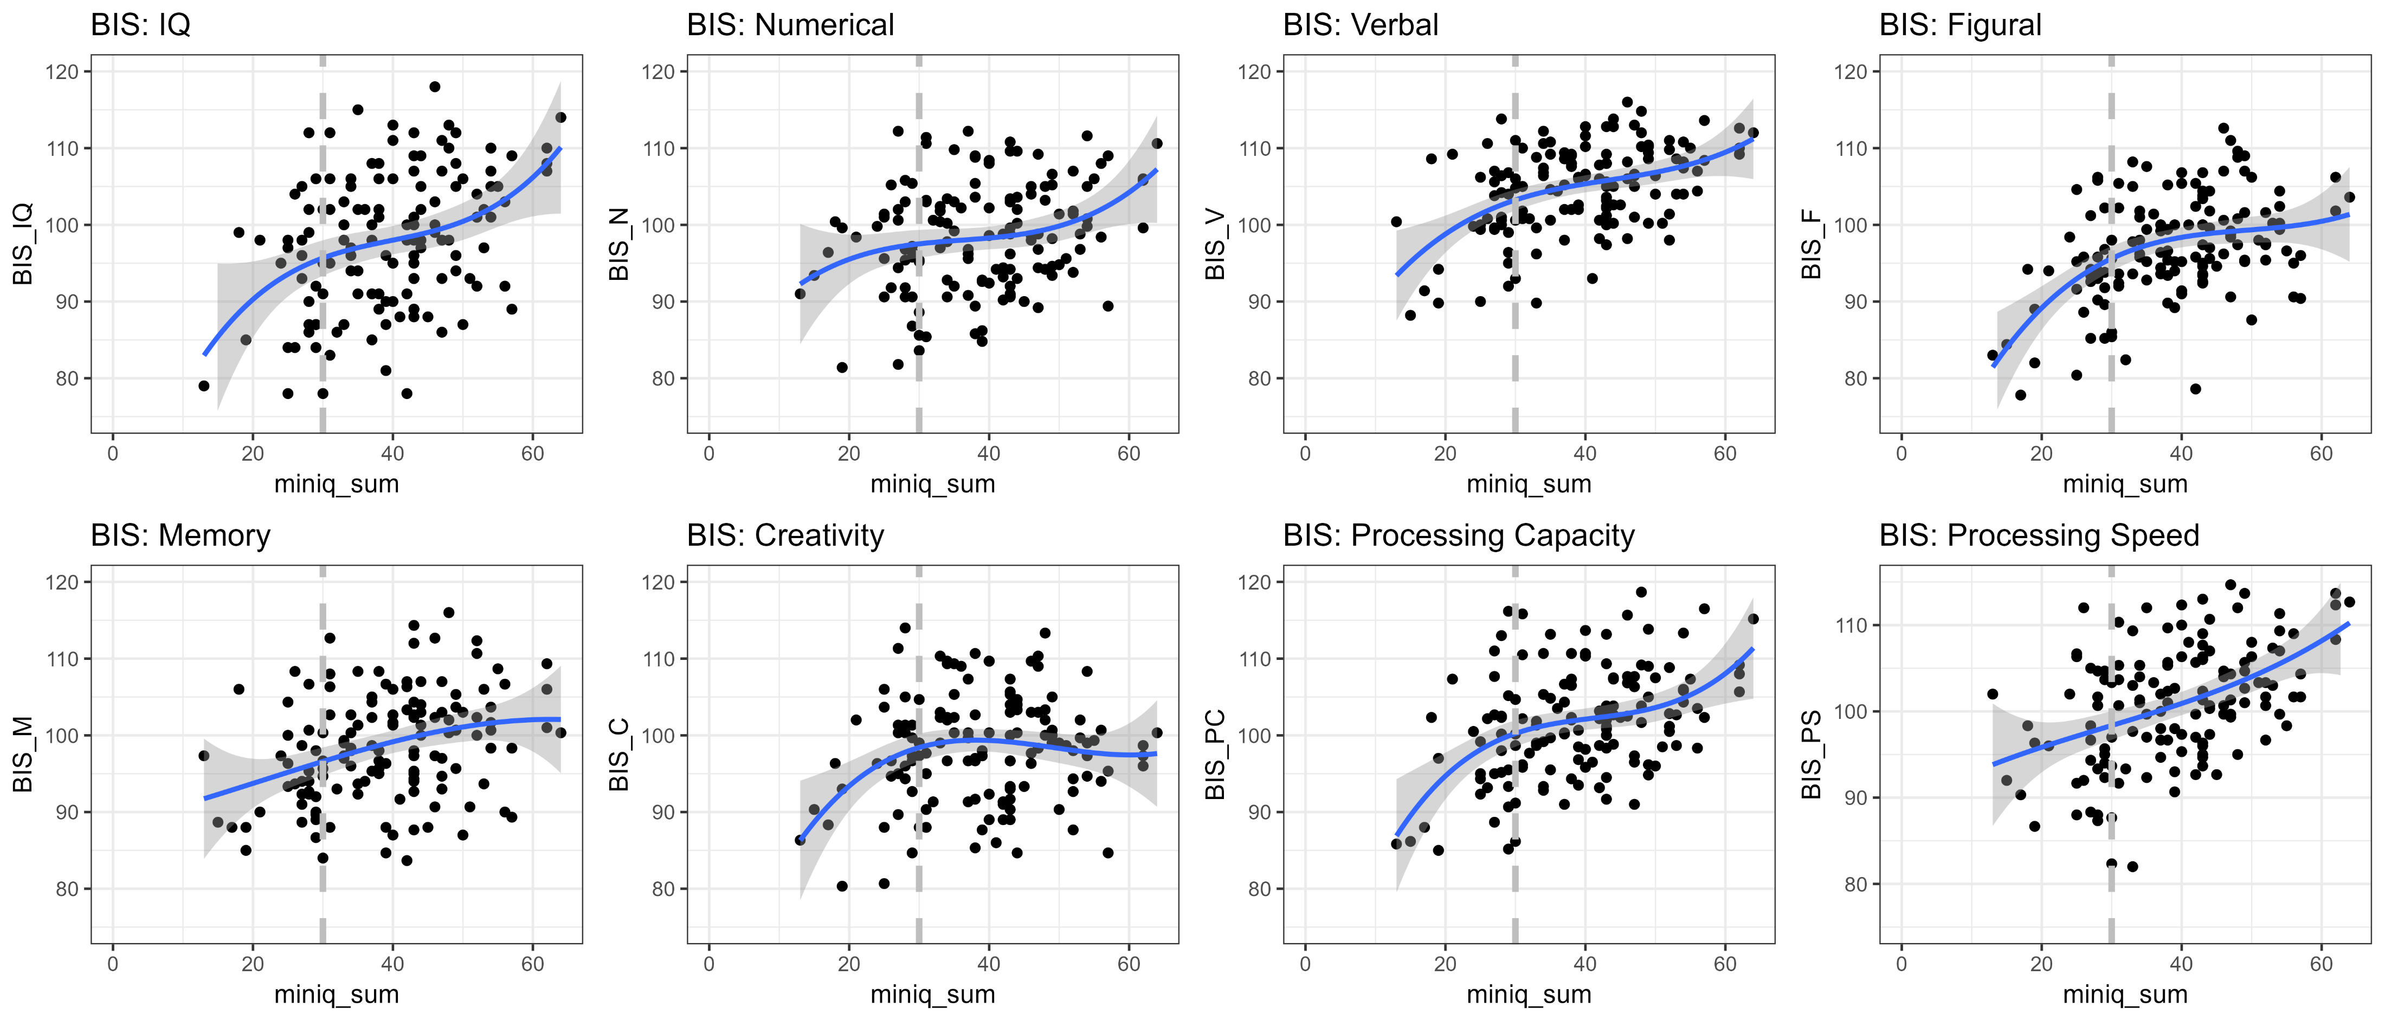
Relations with broad intelligence measures: Berlin Intelligence Structure Test (BIS)
Beauducel & Kersting, 2002
r = .57
r = .26
r = .45
r = .41
r = .33
r = .12
r = .41
r = .46
- Stronger figural and verbal than numerical components
- There are quadratic relations with most intelligence facets (but speed)
- Relations in the upper range are less pronounced
Notes:
We evaluated a three-minute speeded reasoning test as a screening of general cognitive abilities.
•The test showed an excellent reliability.
•Test performance was substantially related (r = 0.57) to general cognitive abilities.
•The association of test performance and g was explained by working memory capacity.
•The paper- and computer-based versions demonstrated scalar measurement invariance.
a substantial correlation with general cognitive abilities measured with a comprehensive test battery (r = 0.57; age-corrected r = 0.50), supporting its potential as a brief screening of cognitive abilities. Working memory capacity accounted for the majority (54%) of the association between test performance and general cognitive abilities, whereas individual differences in processing speed did not contribute to this relationship. Our results support the notion that the mini-q can be used as a brief, reliable, and valid assessment of general cognitive abilities.
both verbal, β = 0.33 (95% CI = [0.16; 0.50]), p < .001, and figural abilities, β = 0.26 (95% CI = [0.09; 0.42]), p < .001, contributed to mini-q performance. In contrast, numerical abilities did not contribute to mini-q performance, β = 0.01 (95% CI = [− 0.16; 0.18]), p = .909.
Parcels based on every third item…
Bis:
15 subtests in 45 minutes… :D
We are measuring Intelligence devoid of learning!
No new patterns to be found.
Measuring fluid intelligence and processing speed according to CHC?
No – speeded reasoning is a necessary but insufficient component of fluid reasoning.
There are always two peaks/modes -> different strategies? -> Validity issue? But maybe that’s the only intelligent process that’s in there – identifying and deciding for the better strategy? Meta-monitoring should be necessary for that :) so maybe intelligence is noise, not the signal :D

Slide 6
Validity: Correlations of the mini-q
Evidence from prior studies
Convergent:
Intelligence structure test: r = .25/.47 (Weise et al., 2024) <- less speeded measure
Complex problem solving: r = .18/.28 (Gigl et al., n.d.) <- power measure
GPA: r = .07/.25 [parallel version] (Weise et al., 2024) <- eat this! (Meta-analytic IQ/SA: r = .54; Roth et al., 2015)
Age: r = -.29/-.45/-.50 (e.g., Schubert et al., 2023)
Memory updating: r = .47 (Schubert et al., 2023) <- interesting! Makes sense – so many items in so little time!
Reaction time measures (working memory; Posner): r = -.35 - -.45 (Schubert et al., 2023) <- higher than with accuracy!
The mini-q measures a lot of processing speed, updating, attention, and rather little G, complex problem solving, or GPA-related abilities
Notes:
We evaluated a three-minute speeded reasoning test as a screening of general cognitive abilities.
•The test showed an excellent reliability.
•Test performance was substantially related (r = 0.57) to general cognitive abilities.
•The association of test performance and g was explained by working memory capacity.
•The paper- and computer-based versions demonstrated scalar measurement invariance.
a substantial correlation with general cognitive abilities measured with a comprehensive test battery (r = 0.57; age-corrected r = 0.50), supporting its potential as a brief screening of cognitive abilities. Working memory capacity accounted for the majority (54%) of the association between test performance and general cognitive abilities, whereas individual differences in processing speed did not contribute to this relationship. Our results support the notion that the mini-q can be used as a brief, reliable, and valid assessment of general cognitive abilities.
both verbal, β = 0.33 (95% CI = [0.16; 0.50]), p < .001, and figural abilities, β = 0.26 (95% CI = [0.09; 0.42]), p < .001, contributed to mini-q performance. In contrast, numerical abilities did not contribute to mini-q performance, β = 0.01 (95% CI = [− 0.16; 0.18]), p = .909.
Parcels based on every third item…
Bis:
15 subtests in 45 minutes… :D
We are measuring Intelligence devoid of learning!
No new patterns to be found.
Measuring fluid intelligence and processing speed according to CHC?
No – speeded reasoning is a necessary but insufficient component of fluid reasoning.
There are always two peaks/modes -> different strategies? -> Validity issue? But maybe that’s the only intelligent process that’s in there – identifying and deciding for the better strategy? Meta-monitoring should be necessary for that :) so maybe intelligence is noise, not the signal :D

Slide 7
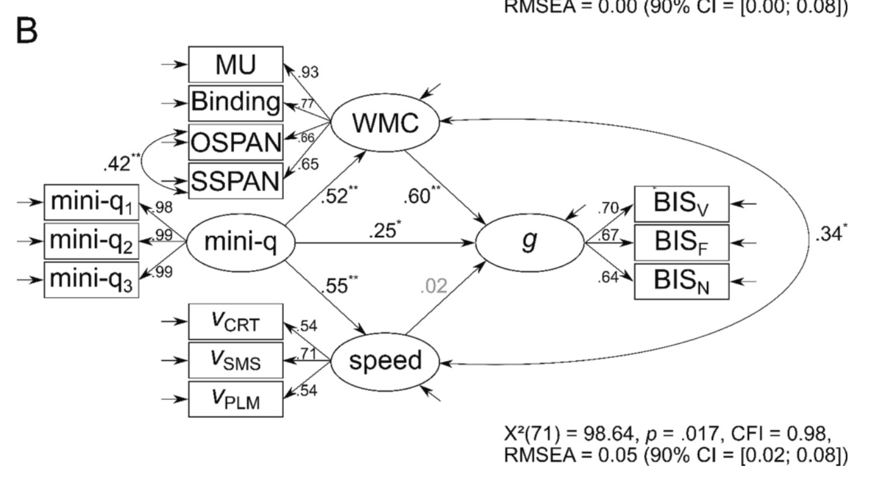
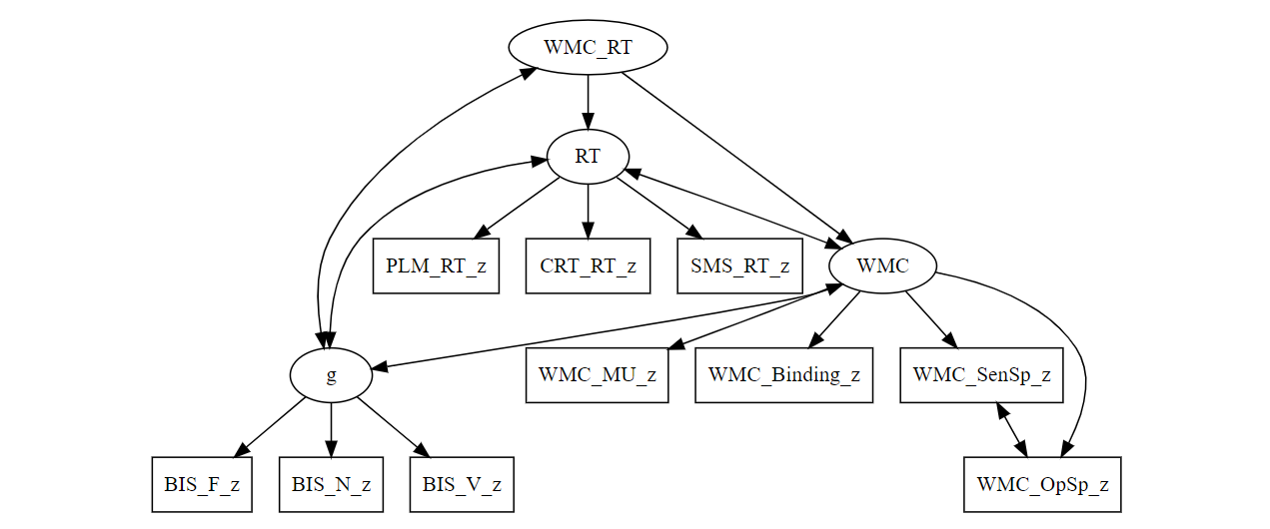
«Working memory capacity accounted for the majority (54%) of the association between test performance and general cognitive abilities, whereas individual differences in processing speed did not contribute to this relationship»
Re-analysis with common WMC/RT-factor:
«Working memory capacity and processing speed both together accounted for 44% for variation in cognitive abilities and had similar relations with the mini-q
.66
.06
0
.45
Notes:
We evaluated a three-minute speeded reasoning test as a screening of general cognitive abilities.
•The test showed an excellent reliability.
•Test performance was substantially related (r = 0.57) to general cognitive abilities.
•The association of test performance and g was explained by working memory capacity.
•The paper- and computer-based versions demonstrated scalar measurement invariance.
a substantial correlation with general cognitive abilities measured with a comprehensive test battery (r = 0.57; age-corrected r = 0.50), supporting its potential as a brief screening of cognitive abilities. Working memory capacity accounted for the majority (54%) of the association between test performance and general cognitive abilities, whereas individual differences in processing speed did not contribute to this relationship. Our results support the notion that the mini-q can be used as a brief, reliable, and valid assessment of general cognitive abilities.
both verbal, β = 0.33 (95% CI = [0.16; 0.50]), p < .001, and figural abilities, β = 0.26 (95% CI = [0.09; 0.42]), p < .001, contributed to mini-q performance. In contrast, numerical abilities did not contribute to mini-q performance, β = 0.01 (95% CI = [− 0.16; 0.18]), p = .909.
Parcels based on every third item…
Bis:
15 subtests in 45 minutes… :D
We are measuring Intelligence devoid of learning!
No new patterns to be found.
Measuring fluid intelligence and processing speed according to CHC?
No – speeded reasoning is a necessary but insufficient component of fluid reasoning.
There are always two peaks/modes -> different strategies? -> Validity issue? But maybe that’s the only intelligent process that’s in there – identifying and deciding for the better strategy? Meta-monitoring should be necessary for that :) so maybe intelligence is noise, not the signal :D

Slide 8
Reliability of the mini-q
Evidence from prior studies
Odd/even: r = .96/.99 (Weise et al., 2024)
Alpha = .94/.96 (Weise et al., 2024)
Alpha = .94/.95 (Wagner & Monzel, 2023)
For speeded tests, estimates of internal consistency are invalid and inflated (Anastasi & Drake, 1954)
Retest-reliability should be used for reliability estimation
Parallel test forms reliability: r = .76/.80 (Weise et al., 2024)
Notes:
We evaluated a three-minute speeded reasoning test as a screening of general cognitive abilities.
•The test showed an excellent reliability.
•Test performance was substantially related (r = 0.57) to general cognitive abilities.
•The association of test performance and g was explained by working memory capacity.
•The paper- and computer-based versions demonstrated scalar measurement invariance.
a substantial correlation with general cognitive abilities measured with a comprehensive test battery (r = 0.57; age-corrected r = 0.50), supporting its potential as a brief screening of cognitive abilities. Working memory capacity accounted for the majority (54%) of the association between test performance and general cognitive abilities, whereas individual differences in processing speed did not contribute to this relationship. Our results support the notion that the mini-q can be used as a brief, reliable, and valid assessment of general cognitive abilities.
both verbal, β = 0.33 (95% CI = [0.16; 0.50]), p < .001, and figural abilities, β = 0.26 (95% CI = [0.09; 0.42]), p < .001, contributed to mini-q performance. In contrast, numerical abilities did not contribute to mini-q performance, β = 0.01 (95% CI = [− 0.16; 0.18]), p = .909.
Parcels based on every third item…
Bis:
15 subtests in 45 minutes… :D
We are measuring Intelligence devoid of learning!
No new patterns to be found.
Measuring fluid intelligence and processing speed according to CHC?
No – speeded reasoning is a necessary but insufficient component of fluid reasoning.
There are always two peaks/modes -> different strategies? -> Validity issue? But maybe that’s the only intelligent process that’s in there – identifying and deciding for the better strategy? Meta-monitoring should be necessary for that :) so maybe intelligence is noise, not the signal :D

Slide 9

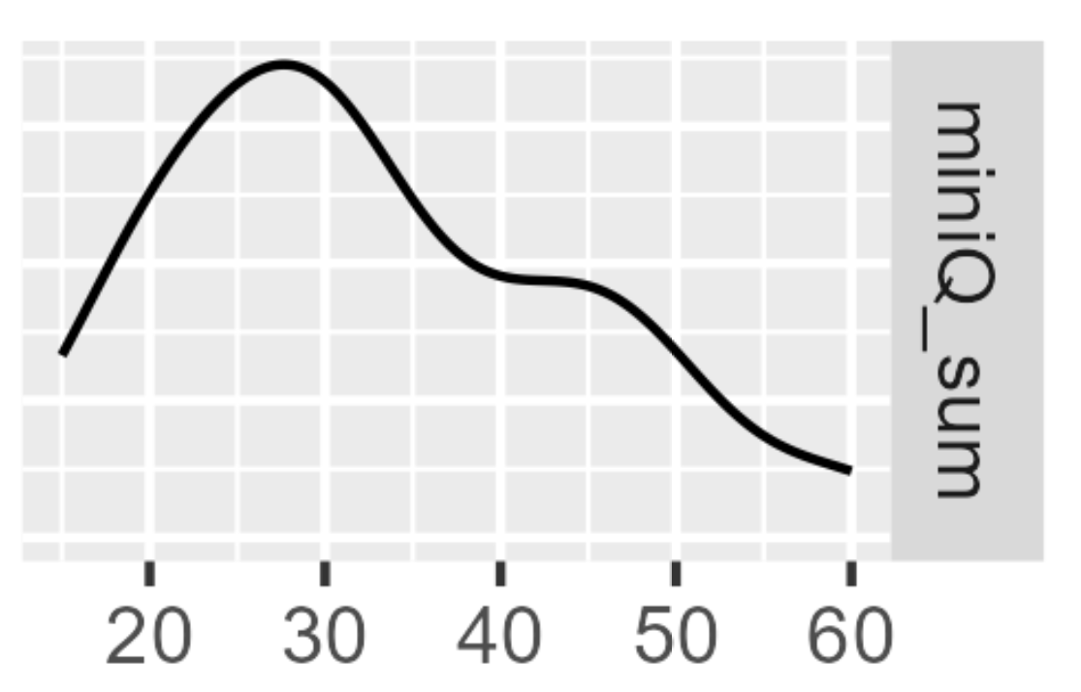
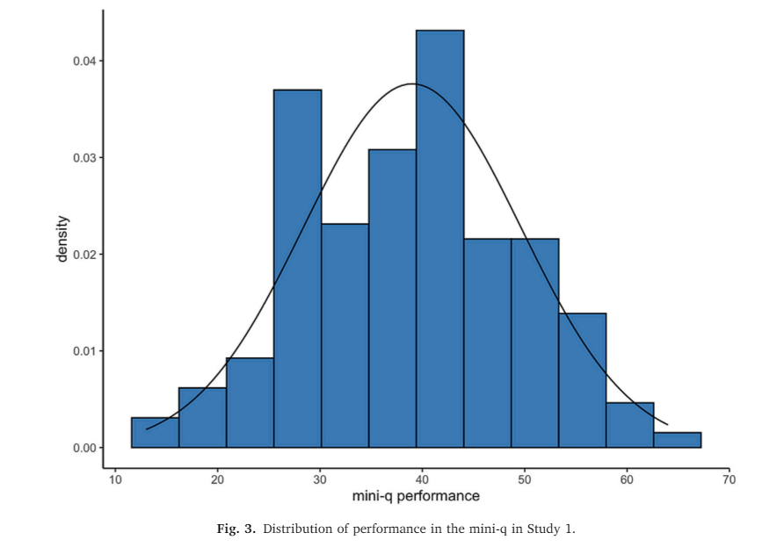
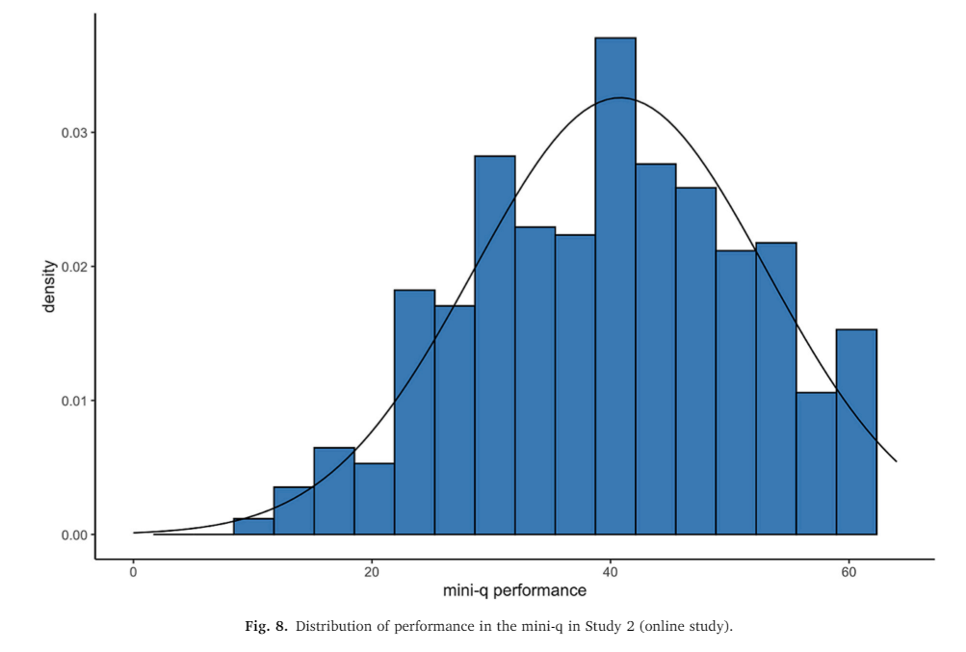
Relations with broad intelligence measures: Berlin Intelligence Structure Test (BIS)
Beauducel & Kersting, 2002
mini-q distributions in Schubert et al. (2023)
Bi-/multimodality: Breakdown after speed is the only factor? Item wording effects?
Different strategies? «I first looked at the figures, but for the later items I started with the sentences»
Notes:
We evaluated a three-minute speeded reasoning test as a screening of general cognitive abilities.
•The test showed an excellent reliability.
•Test performance was substantially related (r = 0.57) to general cognitive abilities.
•The association of test performance and g was explained by working memory capacity.
•The paper- and computer-based versions demonstrated scalar measurement invariance.
a substantial correlation with general cognitive abilities measured with a comprehensive test battery (r = 0.57; age-corrected r = 0.50), supporting its potential as a brief screening of cognitive abilities. Working memory capacity accounted for the majority (54%) of the association between test performance and general cognitive abilities, whereas individual differences in processing speed did not contribute to this relationship. Our results support the notion that the mini-q can be used as a brief, reliable, and valid assessment of general cognitive abilities.
both verbal, β = 0.33 (95% CI = [0.16; 0.50]), p < .001, and figural abilities, β = 0.26 (95% CI = [0.09; 0.42]), p < .001, contributed to mini-q performance. In contrast, numerical abilities did not contribute to mini-q performance, β = 0.01 (95% CI = [− 0.16; 0.18]), p = .909.
Parcels based on every third item…
Bis:
15 subtests in 45 minutes… :D
We are measuring Intelligence devoid of learning!
No new patterns to be found.
Measuring fluid intelligence and processing speed according to CHC?
No – speeded reasoning is a necessary but insufficient component of fluid reasoning.
There are always two peaks/modes -> different strategies? -> Validity issue? But maybe that’s the only intelligent process that’s in there – identifying and deciding for the better strategy? Meta-monitoring should be necessary for that :) so maybe intelligence is noise, not the signal :D

Slide 10
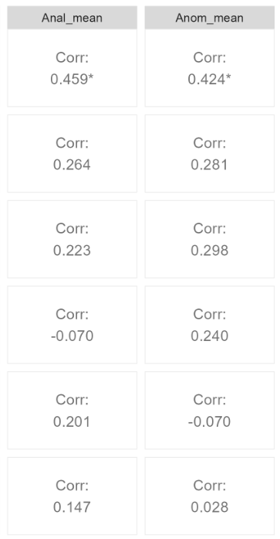
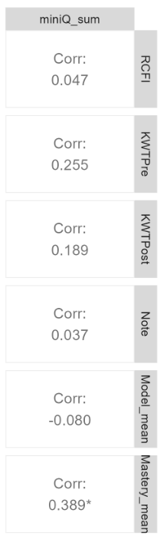
An alternative proposal: Test of Relational Reasoning (TORR; Alexander, Dumas et al., 2015)
N = 98 high school students
Representational competence
Conceptual
Knowledge
Mastery goal orientation
Analogy
Anomaly
It might be a worse indicator of academic learning than other short reasoning scales
It might draw more upon current achievement motivation (Freund et al., 2015)
Notes:
We evaluated a three-minute speeded reasoning test as a screening of general cognitive abilities.
•The test showed an excellent reliability.
•Test performance was substantially related (r = 0.57) to general cognitive abilities.
•The association of test performance and g was explained by working memory capacity.
•The paper- and computer-based versions demonstrated scalar measurement invariance.
a substantial correlation with general cognitive abilities measured with a comprehensive test battery (r = 0.57; age-corrected r = 0.50), supporting its potential as a brief screening of cognitive abilities. Working memory capacity accounted for the majority (54%) of the association between test performance and general cognitive abilities, whereas individual differences in processing speed did not contribute to this relationship. Our results support the notion that the mini-q can be used as a brief, reliable, and valid assessment of general cognitive abilities.
both verbal, β = 0.33 (95% CI = [0.16; 0.50]), p < .001, and figural abilities, β = 0.26 (95% CI = [0.09; 0.42]), p < .001, contributed to mini-q performance. In contrast, numerical abilities did not contribute to mini-q performance, β = 0.01 (95% CI = [− 0.16; 0.18]), p = .909.
Parcels based on every third item…
Bis:
15 subtests in 45 minutes… :D
We are measuring Intelligence devoid of learning!
No new patterns to be found.
Measuring fluid intelligence and processing speed according to CHC?
No – speeded reasoning is a necessary but insufficient component of fluid reasoning.
There are always two peaks/modes -> different strategies? -> Validity issue? But maybe that’s the only intelligent process that’s in there – identifying and deciding for the better strategy? Meta-monitoring should be necessary for that :) so maybe intelligence is noise, not the signal :D

Slide 11
Conclusions
- The mini-q correlates with intelligence only in the lower range; it is not a proxy of intelligence
The mini-q measures mostly processing speed, maybe attention, updating
Its reliability is maybe around .80 but yet unknown – retest-studies are required
Hypotheses for future research
The mini-q is multidimensional
The mini-q draws on different strategies
Selecting good strategies might be the only intelligent component
The mini-q draws on inhibition (inverse items) /updating
The mini-q draws on current achievement motivation
It might not be the right tool to get a reliable and valid covariate in predicting complex cognitive states and traits
Not everything that requires some kind of reasoning measures intelligence
Notes:
We evaluated a three-minute speeded reasoning test as a screening of general cognitive abilities.
•The test showed an excellent reliability.
•Test performance was substantially related (r = 0.57) to general cognitive abilities.
•The association of test performance and g was explained by working memory capacity.
•The paper- and computer-based versions demonstrated scalar measurement invariance.
a substantial correlation with general cognitive abilities measured with a comprehensive test battery (r = 0.57; age-corrected r = 0.50), supporting its potential as a brief screening of cognitive abilities. Working memory capacity accounted for the majority (54%) of the association between test performance and general cognitive abilities, whereas individual differences in processing speed did not contribute to this relationship. Our results support the notion that the mini-q can be used as a brief, reliable, and valid assessment of general cognitive abilities.
both verbal, β = 0.33 (95% CI = [0.16; 0.50]), p < .001, and figural abilities, β = 0.26 (95% CI = [0.09; 0.42]), p < .001, contributed to mini-q performance. In contrast, numerical abilities did not contribute to mini-q performance, β = 0.01 (95% CI = [− 0.16; 0.18]), p = .909.
Parcels based on every third item…
Bis:
15 subtests in 45 minutes… :D
We are measuring Intelligence devoid of learning!
No new patterns to be found.
Measuring fluid intelligence and processing speed according to CHC?
No – speeded reasoning is a necessary but insufficient component of fluid reasoning.
There are always two peaks/modes -> different strategies? -> Validity issue? But maybe that’s the only intelligent process that’s in there – identifying and deciding for the better strategy? Meta-monitoring should be necessary for that :) so maybe intelligence is noise, not the signal :D

Slide 12
Don’t Waste your Time Using the miniQ: It is not an Effective Proxy of Intelligence or Predictor of Academic Learning
Reaction time tasks: Obviously good correlations!
WMC and miniq still correlate .34 even after controlling for the miniq! And their combined variance (i.e., bifactorg-factor) probably explains some variation in the miniq!
The multiple regression «no explaantory power»-fallacy goes throughout the paper!
Lob:
Important, well-conducted study.
But I disagree with some interpretations for reasons.
First:
Second:
Third:
Scatter plots iwth BIS C and F: Wow! Extremely quadratic…
The non-linearity correlates extremely with the bimodal structure!
Where the first mode is, the association breaks – maybe after this mode, there are the actually intelligence individuals all using the same better strategy or smth?
Study 1, Hagen: Correlation up to 38 points ca.? -> That’s at the second mode!
Study 2: Up to 30 points ca -> that’s at the first mode.
In both studies, the modes are at about 30 and 40 points! Crazy :D
Make histograms with more bars to check for more modes…
Nothing with representational competence.
Moderate with conceptual knowledge – similar to anamolies and analogies.
But nothing with physics grade.
And the strongest association with mastery goal orientation!
So a stronger (current) achievement motivation component?
So many hypothèses for future studies!
RCFI: Distinguish between relational components (stronger relations with proper reasoning expected) and non-relational components (equal moderate relations with propoer reasoning expected)?
Quadratic relations because:
Speed is necessary but not sufficient for proper intelligence tests.
BIS has a speed component but if I’m right, then we’d see breakpoints or something like that.
And the reliability:
Yet has to be tested! :)
Strongly speeded tests:
We need to correlate speed across items, not ability! -> let’s do this? 1954 paper: Anastasi and Drake.
Notes:
We evaluated a three-minute speeded reasoning test as a screening of general cognitive abilities.
•The test showed an excellent reliability.
•Test performance was substantially related (r = 0.57) to general cognitive abilities.
•The association of test performance and g was explained by working memory capacity.
•The paper- and computer-based versions demonstrated scalar measurement invariance.
a substantial correlation with general cognitive abilities measured with a comprehensive test battery (r = 0.57; age-corrected r = 0.50), supporting its potential as a brief screening of cognitive abilities. Working memory capacity accounted for the majority (54%) of the association between test performance and general cognitive abilities, whereas individual differences in processing speed did not contribute to this relationship. Our results support the notion that the mini-q can be used as a brief, reliable, and valid assessment of general cognitive abilities.
both verbal, β = 0.33 (95% CI = [0.16; 0.50]), p < .001, and figural abilities, β = 0.26 (95% CI = [0.09; 0.42]), p < .001, contributed to mini-q performance. In contrast, numerical abilities did not contribute to mini-q performance, β = 0.01 (95% CI = [− 0.16; 0.18]), p = .909.
Parcels based on every third item…
Bis:
15 subtests in 45 minutes… :D
We are measuring Intelligence devoid of learning!
No new patterns to be found.
Measuring fluid intelligence and processing speed according to CHC?
No – speeded reasoning is a necessary but insufficient component of fluid reasoning.
There are always two peaks/modes -> different strategies? -> Validity issue? But maybe that’s the only intelligent process that’s in there – identifying and deciding for the better strategy? Meta-monitoring should be necessary for that :) so maybe intelligence is noise, not the signal :D

Slide 13
Short forms always been interest
Raven etc.
Or just a numeric scale (e.g., number series
Or just a spatial (rotation) or verbal (analogies) scale, or cubes or smth for fluid stuff mostly
Alternative approach/idea: Baddeley.
Mini-q:
Show 2 quick examples
What does this measure and what is it good for?
Overview of available studies: First studies did this and that.
Recent study: First bigger investigation into… [summarize]
Let’s see:
The aim is:
Control for intelligence
Use it as a predictor
Use it as a moderator variable? (diff. from predictor?)
«Screening»? No definition given what this should mean and be good for? 2-Stage: this is the first stage. Or should just be a proxy in a one-stage screening interpretation?
BIS strongly timed (i.e., speed-component laden) measure
Reaction time tasks: Obviously good correlations!
WMC and miniq still correlate .34 even after controlling for the miniq! And their combined variance (i.e., bifactorg-factor) probably explains some variation in the miniq!
The multiple regression «no explaantory power»-fallacy goes throughout the paper!
Lob:
Important, well-conducted study.
But I disagree with some interpretations for reasons.
First:
Second:
Third:
Scatter plots iwth BIS C and F: Wow! Extremely quadratic…
The non-linearity correlates extremely with the bimodal structure!
Where the first mode is, the association breaks – maybe after this mode, there are the actually intelligence individuals all using the same better strategy or smth?
Study 1, Hagen: Correlation up to 38 points ca.? -> That’s at the second mode!
Study 2: Up to 30 points ca -> that’s at the first mode.
In both studies, the modes are at about 30 and 40 points! Crazy :D
Make histograms with more bars to check for more modes…
Nothing with representational competence.
Moderate with conceptual knowledge – similar to anamolies and analogies.
But nothing with physics grade.
And the strongest association with mastery goal orientation!
So a stronger (current) achievement motivation component?
So many hypothèses for future studies!
RCFI: Distinguish between relational components (stronger relations with proper reasoning expected) and non-relational components (equal moderate relations with propoer reasoning expected)?
Quadratic relations because:
Speed is necessary but not sufficient for proper intelligence tests.
BIS has a speed component but if I’m right, then we’d see breakpoints or something like that.
And the reliability:
Yet has to be tested! :)
Strongly speeded tests:
We need to correlate speed across items, not ability! -> let’s do this? 1954 paper: Anastasi and Drake.
And the miniQ process of speeded reasoning:
It’s a proxy of very basic, speeded problem solving, not of learning
Martin Löf Test:
Significant, p < .001
Notes:
We evaluated a three-minute speeded reasoning test as a screening of general cognitive abilities.
•The test showed an excellent reliability.
•Test performance was substantially related (r = 0.57) to general cognitive abilities.
•The association of test performance and g was explained by working memory capacity.
•The paper- and computer-based versions demonstrated scalar measurement invariance.
a substantial correlation with general cognitive abilities measured with a comprehensive test battery (r = 0.57; age-corrected r = 0.50), supporting its potential as a brief screening of cognitive abilities. Working memory capacity accounted for the majority (54%) of the association between test performance and general cognitive abilities, whereas individual differences in processing speed did not contribute to this relationship. Our results support the notion that the mini-q can be used as a brief, reliable, and valid assessment of general cognitive abilities.
both verbal, β = 0.33 (95% CI = [0.16; 0.50]), p < .001, and figural abilities, β = 0.26 (95% CI = [0.09; 0.42]), p < .001, contributed to mini-q performance. In contrast, numerical abilities did not contribute to mini-q performance, β = 0.01 (95% CI = [− 0.16; 0.18]), p = .909.
Parcels based on every third item…
Bis:
15 subtests in 45 minutes… :D
We are measuring Intelligence devoid of learning!
No new patterns to be found.
Measuring fluid intelligence and processing speed according to CHC?
No – speeded reasoning is a necessary but insufficient component of fluid reasoning.
There are always two peaks/modes -> different strategies? -> Validity issue? But maybe that’s the only intelligent process that’s in there – identifying and deciding for the better strategy? Meta-monitoring should be necessary for that :) so maybe intelligence is noise, not the signal :D

Slide 14
Correlations of the mini-q
Evidence from prior studies
Divergent (Bertrams et al., 2024):
Social motivation: .06
Self-deceptive enhancement: .02
Mentalising: .02
Perspective taking: .02
Empathic concern: -.03
Communication and reciprocity: .11
Victim sensitivity: .20 (Meuer & Imhoff, 2021)
Moderately negative with (Pollet & Schnell, 2017):
Age, subjective well-being, religiosity, spirituality, practicality, harmony, self-compassion, demands and appreciation in school experience, meaningful work, joy of working
Notes:
We evaluated a three-minute speeded reasoning test as a screening of general cognitive abilities.
•The test showed an excellent reliability.
•Test performance was substantially related (r = 0.57) to general cognitive abilities.
•The association of test performance and g was explained by working memory capacity.
•The paper- and computer-based versions demonstrated scalar measurement invariance.
a substantial correlation with general cognitive abilities measured with a comprehensive test battery (r = 0.57; age-corrected r = 0.50), supporting its potential as a brief screening of cognitive abilities. Working memory capacity accounted for the majority (54%) of the association between test performance and general cognitive abilities, whereas individual differences in processing speed did not contribute to this relationship. Our results support the notion that the mini-q can be used as a brief, reliable, and valid assessment of general cognitive abilities.
both verbal, β = 0.33 (95% CI = [0.16; 0.50]), p < .001, and figural abilities, β = 0.26 (95% CI = [0.09; 0.42]), p < .001, contributed to mini-q performance. In contrast, numerical abilities did not contribute to mini-q performance, β = 0.01 (95% CI = [− 0.16; 0.18]), p = .909.
Parcels based on every third item…
Bis:
15 subtests in 45 minutes… :D
We are measuring Intelligence devoid of learning!
No new patterns to be found.
Measuring fluid intelligence and processing speed according to CHC?
No – speeded reasoning is a necessary but insufficient component of fluid reasoning.
There are always two peaks/modes -> different strategies? -> Validity issue? But maybe that’s the only intelligent process that’s in there – identifying and deciding for the better strategy? Meta-monitoring should be necessary for that :) so maybe intelligence is noise, not the signal :D

Slide 15
Don’t Waste your Time Using the mini-q: It is not an Effective Proxy of Intelligence or Predictor of Academic Learning
Peter Edelsbrunner
ETH Zurich
Notes:
We evaluated a three-minute speeded reasoning test as a screening of general cognitive abilities.
•The test showed an excellent reliability.
•Test performance was substantially related (r = 0.57) to general cognitive abilities.
•The association of test performance and g was explained by working memory capacity.
•The paper- and computer-based versions demonstrated scalar measurement invariance.
a substantial correlation with general cognitive abilities measured with a comprehensive test battery (r = 0.57; age-corrected r = 0.50), supporting its potential as a brief screening of cognitive abilities. Working memory capacity accounted for the majority (54%) of the association between test performance and general cognitive abilities, whereas individual differences in processing speed did not contribute to this relationship. Our results support the notion that the mini-q can be used as a brief, reliable, and valid assessment of general cognitive abilities.
both verbal, β = 0.33 (95% CI = [0.16; 0.50]), p < .001, and figural abilities, β = 0.26 (95% CI = [0.09; 0.42]), p < .001, contributed to mini-q performance. In contrast, numerical abilities did not contribute to mini-q performance, β = 0.01 (95% CI = [− 0.16; 0.18]), p = .909.
Parcels based on every third item…
Bis:
15 subtests in 45 minutes… :D
We are measuring Intelligence devoid of learning!
No new patterns to be found.
Measuring fluid intelligence and processing speed according to CHC?
No – speeded reasoning is a necessary but insufficient component of fluid reasoning.
There are always two peaks/modes -> different strategies? -> Validity issue? But maybe that’s the only intelligent process that’s in there – identifying and deciding for the better strategy? Meta-monitoring should be necessary for that :) so maybe intelligence is noise, not the signal :D

Slide 16
Raven APM (40 min; 20 min; 7 min)
Hamel & Schmittmann, 2006; Poulton et al., 2022
KFT number series (10 min)
Heller & Perleth, 2000
Notes:
We evaluated a three-minute speeded reasoning test as a screening of general cognitive abilities.
•The test showed an excellent reliability.
•Test performance was substantially related (r = 0.57) to general cognitive abilities.
•The association of test performance and g was explained by working memory capacity.
•The paper- and computer-based versions demonstrated scalar measurement invariance.
a substantial correlation with general cognitive abilities measured with a comprehensive test battery (r = 0.57; age-corrected r = 0.50), supporting its potential as a brief screening of cognitive abilities. Working memory capacity accounted for the majority (54%) of the association between test performance and general cognitive abilities, whereas individual differences in processing speed did not contribute to this relationship. Our results support the notion that the mini-q can be used as a brief, reliable, and valid assessment of general cognitive abilities.
both verbal, β = 0.33 (95% CI = [0.16; 0.50]), p < .001, and figural abilities, β = 0.26 (95% CI = [0.09; 0.42]), p < .001, contributed to mini-q performance. In contrast, numerical abilities did not contribute to mini-q performance, β = 0.01 (95% CI = [− 0.16; 0.18]), p = .909.
Parcels based on every third item…
Bis:
15 subtests in 45 minutes… :D
We are measuring Intelligence devoid of learning!
No new patterns to be found.
Measuring fluid intelligence and processing speed according to CHC?
No – speeded reasoning is a necessary but insufficient component of fluid reasoning.
There are always two peaks/modes -> different strategies? -> Validity issue? But maybe that’s the only intelligent process that’s in there – identifying and deciding for the better strategy? Meta-monitoring should be necessary for that :) so maybe intelligence is noise, not the signal :D

Slide 17
mini-q
Baudson & Preckel (2015)
64 items
3 minutes
Speeded reasoning
TRUE FALSE
The triangle rejects the square
x
The circle prefers the triangle
x
There are no rules to be learned
Speeded reasoning (Baudson & Preckel, 2016)
Analogical mapping of figural and verbal relation
Reasoning: Does the figural relation match the verbal relation?
The square does not reject the triangle
x
But it’s really trivial!
This is also really trivial!
Notes:
We evaluated a three-minute speeded reasoning test as a screening of general cognitive abilities.
•The test showed an excellent reliability.
•Test performance was substantially related (r = 0.57) to general cognitive abilities.
•The association of test performance and g was explained by working memory capacity.
•The paper- and computer-based versions demonstrated scalar measurement invariance.
a substantial correlation with general cognitive abilities measured with a comprehensive test battery (r = 0.57; age-corrected r = 0.50), supporting its potential as a brief screening of cognitive abilities. Working memory capacity accounted for the majority (54%) of the association between test performance and general cognitive abilities, whereas individual differences in processing speed did not contribute to this relationship. Our results support the notion that the mini-q can be used as a brief, reliable, and valid assessment of general cognitive abilities.
both verbal, β = 0.33 (95% CI = [0.16; 0.50]), p < .001, and figural abilities, β = 0.26 (95% CI = [0.09; 0.42]), p < .001, contributed to mini-q performance. In contrast, numerical abilities did not contribute to mini-q performance, β = 0.01 (95% CI = [− 0.16; 0.18]), p = .909.
Parcels based on every third item…
Bis:
15 subtests in 45 minutes… :D
We are measuring Intelligence devoid of learning!
No new patterns to be found.
Measuring fluid intelligence and processing speed according to CHC?
No – speeded reasoning is a necessary but insufficient component of fluid reasoning.
There are always two peaks/modes -> different strategies? -> Validity issue? But maybe that’s the only intelligent process that’s in there – identifying and deciding for the better strategy? Meta-monitoring should be necessary for that :) so maybe intelligence is noise, not the signal :D

Slide 18
2 samples, N = 140/505, Age 18-60
«Excellent reliability» (.96-.99)
«Substantial correlation with general cognitive ablities» (r = .57)
«Working memory capacity accounted for the majority (54%) of the association between test performance and general cognitive abilities, whereas individual differences in processing speed did not contribute to this relationship»
«Supporting potential as brief assessment/screening of general cognitive abilities»
«Brief, reliable, valid measure of GCA»
There are no rules to be learned
Speeded reasoning (Baudson & Preckel, 2016)
Analogical mapping of figural and verbal relation
Does the figural relation match the verbal relation?
What is the mini-q used for?
Measure of fluid intelligence (Pollet & Schnell, 2017)
Measure of mental abilities (Baltes & Diehl, 2018)
Measure for cognitive abilities (Meuer & Imhoff, 2021)
Notes:
We evaluated a three-minute speeded reasoning test as a screening of general cognitive abilities.
•The test showed an excellent reliability.
•Test performance was substantially related (r = 0.57) to general cognitive abilities.
•The association of test performance and g was explained by working memory capacity.
•The paper- and computer-based versions demonstrated scalar measurement invariance.
a substantial correlation with general cognitive abilities measured with a comprehensive test battery (r = 0.57; age-corrected r = 0.50), supporting its potential as a brief screening of cognitive abilities. Working memory capacity accounted for the majority (54%) of the association between test performance and general cognitive abilities, whereas individual differences in processing speed did not contribute to this relationship. Our results support the notion that the mini-q can be used as a brief, reliable, and valid assessment of general cognitive abilities.
both verbal, β = 0.33 (95% CI = [0.16; 0.50]), p < .001, and figural abilities, β = 0.26 (95% CI = [0.09; 0.42]), p < .001, contributed to mini-q performance. In contrast, numerical abilities did not contribute to mini-q performance, β = 0.01 (95% CI = [− 0.16; 0.18]), p = .909.
Parcels based on every third item…
Bis:
15 subtests in 45 minutes… :D
We are measuring Intelligence devoid of learning!
No new patterns to be found.
Measuring fluid intelligence and processing speed according to CHC?
No – speeded reasoning is a necessary but insufficient component of fluid reasoning.
There are always two peaks/modes -> different strategies? -> Validity issue? But maybe that’s the only intelligent process that’s in there – identifying and deciding for the better strategy? Meta-monitoring should be necessary for that :) so maybe intelligence is noise, not the signal :D

Slide 19
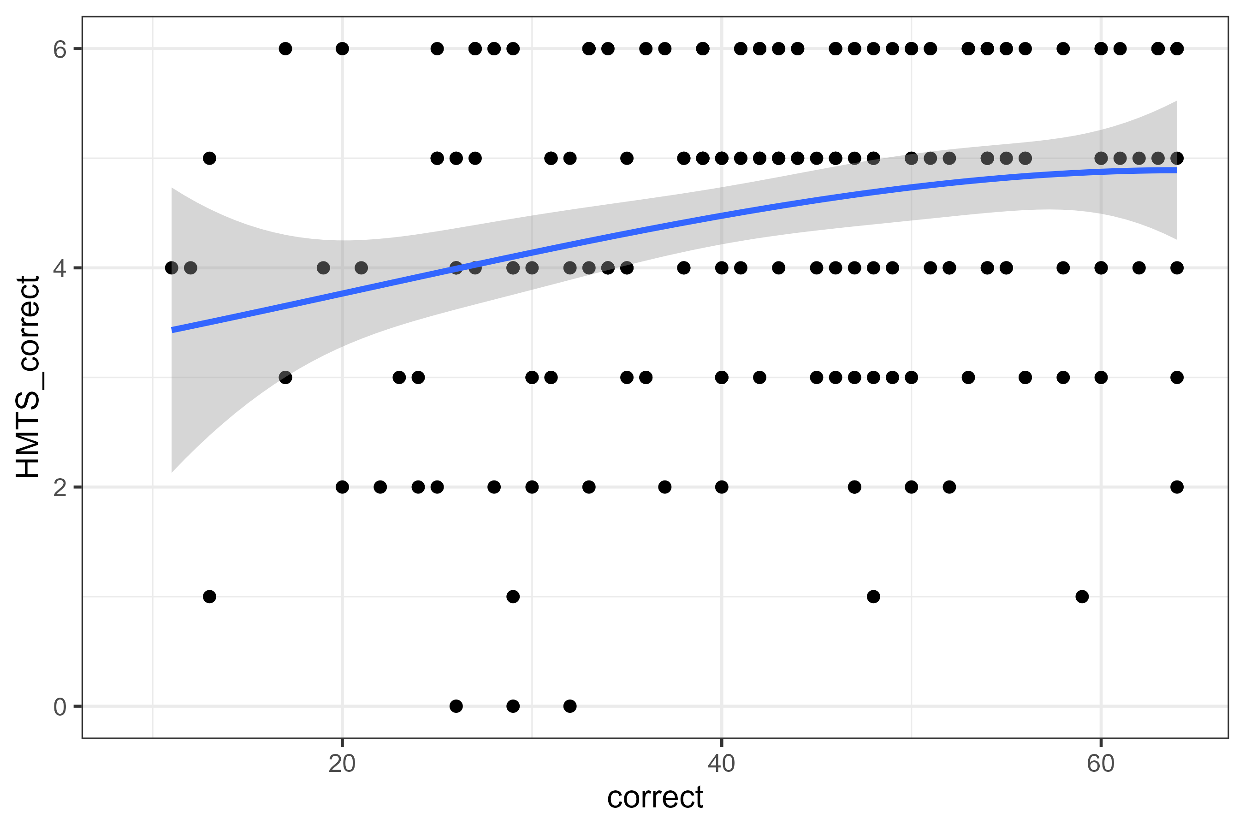
Relations with broad intelligence measures: Berlin Intelligence Structure Test (BIS)
Beauducel & Kersting, 2002
r = .57
r = .26
r = .45
r = .41
Relation with short-form of Hagen matrices test (six items)
Schubert et al. 2023
r = .33
r = .12
r = .41
r = .46
- Stronger figural and verbal than numerical components
- There are quadratic relations with most intelligence facets
- Relations in the upper range are less pronounced
Notes:
We evaluated a three-minute speeded reasoning test as a screening of general cognitive abilities.
•The test showed an excellent reliability.
•Test performance was substantially related (r = 0.57) to general cognitive abilities.
•The association of test performance and g was explained by working memory capacity.
•The paper- and computer-based versions demonstrated scalar measurement invariance.
a substantial correlation with general cognitive abilities measured with a comprehensive test battery (r = 0.57; age-corrected r = 0.50), supporting its potential as a brief screening of cognitive abilities. Working memory capacity accounted for the majority (54%) of the association between test performance and general cognitive abilities, whereas individual differences in processing speed did not contribute to this relationship. Our results support the notion that the mini-q can be used as a brief, reliable, and valid assessment of general cognitive abilities.
both verbal, β = 0.33 (95% CI = [0.16; 0.50]), p < .001, and figural abilities, β = 0.26 (95% CI = [0.09; 0.42]), p < .001, contributed to mini-q performance. In contrast, numerical abilities did not contribute to mini-q performance, β = 0.01 (95% CI = [− 0.16; 0.18]), p = .909.
Parcels based on every third item…
Bis:
15 subtests in 45 minutes… :D
We are measuring Intelligence devoid of learning!
No new patterns to be found.
Measuring fluid intelligence and processing speed according to CHC?
No – speeded reasoning is a necessary but insufficient component of fluid reasoning.
There are always two peaks/modes -> different strategies? -> Validity issue? But maybe that’s the only intelligent process that’s in there – identifying and deciding for the better strategy? Meta-monitoring should be necessary for that :) so maybe intelligence is noise, not the signal :D

Slide 20
Correlations of the mini-q
Evidence from prior studies
Convergent:
Intelligence structure test: r = .25/.47 (Weise et al., 2024) <- less speeded measure
Complex problem solving: r = .18/.28 (Gigl et al., n.d.) <- power measure
GPA: r = .07/.25 (Weise et al., 2024) <- eat this!
Age: r = -.29/-.45/-.50 (e.g., Schubert et al., 2023)
Memory updating: r = .47 (Schubert et al., 2023) <- interesting! Makes sense – so many items in so little time!
Reaction time measures (working memory; Posner): r = -.35 - -.45 (Schubert et al., 2023) <- higher than with accuracy!
The mini-q measures a lot of processing speed, updating, attention, and rather little
Notes:
We evaluated a three-minute speeded reasoning test as a screening of general cognitive abilities.
•The test showed an excellent reliability.
•Test performance was substantially related (r = 0.57) to general cognitive abilities.
•The association of test performance and g was explained by working memory capacity.
•The paper- and computer-based versions demonstrated scalar measurement invariance.
a substantial correlation with general cognitive abilities measured with a comprehensive test battery (r = 0.57; age-corrected r = 0.50), supporting its potential as a brief screening of cognitive abilities. Working memory capacity accounted for the majority (54%) of the association between test performance and general cognitive abilities, whereas individual differences in processing speed did not contribute to this relationship. Our results support the notion that the mini-q can be used as a brief, reliable, and valid assessment of general cognitive abilities.
both verbal, β = 0.33 (95% CI = [0.16; 0.50]), p < .001, and figural abilities, β = 0.26 (95% CI = [0.09; 0.42]), p < .001, contributed to mini-q performance. In contrast, numerical abilities did not contribute to mini-q performance, β = 0.01 (95% CI = [− 0.16; 0.18]), p = .909.
Parcels based on every third item…
Bis:
15 subtests in 45 minutes… :D
We are measuring Intelligence devoid of learning!
No new patterns to be found.
Measuring fluid intelligence and processing speed according to CHC?
No – speeded reasoning is a necessary but insufficient component of fluid reasoning.
There are always two peaks/modes -> different strategies? -> Validity issue? But maybe that’s the only intelligent process that’s in there – identifying and deciding for the better strategy? Meta-monitoring should be necessary for that :) so maybe intelligence is noise, not the signal :D

Slide 21
«Working memory capacity accounted for the majority (54%) of the association between test performance and general cognitive abilities, whereas individual differences in processing speed did not contribute to this relationship»
«Working memory capacity and processing speed both together accounted for 44% for variation in cognitive abilities and had similar relations with the mini-q
.66
.06
0
.45
Notes:
We evaluated a three-minute speeded reasoning test as a screening of general cognitive abilities.
•The test showed an excellent reliability.
•Test performance was substantially related (r = 0.57) to general cognitive abilities.
•The association of test performance and g was explained by working memory capacity.
•The paper- and computer-based versions demonstrated scalar measurement invariance.
a substantial correlation with general cognitive abilities measured with a comprehensive test battery (r = 0.57; age-corrected r = 0.50), supporting its potential as a brief screening of cognitive abilities. Working memory capacity accounted for the majority (54%) of the association between test performance and general cognitive abilities, whereas individual differences in processing speed did not contribute to this relationship. Our results support the notion that the mini-q can be used as a brief, reliable, and valid assessment of general cognitive abilities.
both verbal, β = 0.33 (95% CI = [0.16; 0.50]), p < .001, and figural abilities, β = 0.26 (95% CI = [0.09; 0.42]), p < .001, contributed to mini-q performance. In contrast, numerical abilities did not contribute to mini-q performance, β = 0.01 (95% CI = [− 0.16; 0.18]), p = .909.
Parcels based on every third item…
Bis:
15 subtests in 45 minutes… :D
We are measuring Intelligence devoid of learning!
No new patterns to be found.
Measuring fluid intelligence and processing speed according to CHC?
No – speeded reasoning is a necessary but insufficient component of fluid reasoning.
There are always two peaks/modes -> different strategies? -> Validity issue? But maybe that’s the only intelligent process that’s in there – identifying and deciding for the better strategy? Meta-monitoring should be necessary for that :) so maybe intelligence is noise, not the signal :D

Slide 22
Reliability of the mini-q
Evidence from prior studies
Parallel test forms reliability: r = .76/.80 (Weise et al., 2024)
Odd/even: r = .96/.99 (Weise et al., 2024)
Alpha = .94/.96 (Weise et al., 2024)
Alpha = .94/.95 (Wagner & Monzel, 2023)
For speeded tests, estimates of internal consistency are invalid and inflated (Anastasi & Drake, 1954)
Retest-reliability should be used for reliability estimation
Notes:
We evaluated a three-minute speeded reasoning test as a screening of general cognitive abilities.
•The test showed an excellent reliability.
•Test performance was substantially related (r = 0.57) to general cognitive abilities.
•The association of test performance and g was explained by working memory capacity.
•The paper- and computer-based versions demonstrated scalar measurement invariance.
a substantial correlation with general cognitive abilities measured with a comprehensive test battery (r = 0.57; age-corrected r = 0.50), supporting its potential as a brief screening of cognitive abilities. Working memory capacity accounted for the majority (54%) of the association between test performance and general cognitive abilities, whereas individual differences in processing speed did not contribute to this relationship. Our results support the notion that the mini-q can be used as a brief, reliable, and valid assessment of general cognitive abilities.
both verbal, β = 0.33 (95% CI = [0.16; 0.50]), p < .001, and figural abilities, β = 0.26 (95% CI = [0.09; 0.42]), p < .001, contributed to mini-q performance. In contrast, numerical abilities did not contribute to mini-q performance, β = 0.01 (95% CI = [− 0.16; 0.18]), p = .909.
Parcels based on every third item…
Bis:
15 subtests in 45 minutes… :D
We are measuring Intelligence devoid of learning!
No new patterns to be found.
Measuring fluid intelligence and processing speed according to CHC?
No – speeded reasoning is a necessary but insufficient component of fluid reasoning.
There are always two peaks/modes -> different strategies? -> Validity issue? But maybe that’s the only intelligent process that’s in there – identifying and deciding for the better strategy? Meta-monitoring should be necessary for that :) so maybe intelligence is noise, not the signal :D

Slide 23
Relations with broad intelligence measures: Berlin Intelligence Structure Test (BIS)
Beauducel & Kersting, 2002
mini-q distributions in Schubert et al. (2023)
Bi-/multimodality: Breakdown after speed is the only factor? Item wording effects?
Different strategies? «I first looked at the figures, but for the later items I started with the sentences»
Notes:
We evaluated a three-minute speeded reasoning test as a screening of general cognitive abilities.
•The test showed an excellent reliability.
•Test performance was substantially related (r = 0.57) to general cognitive abilities.
•The association of test performance and g was explained by working memory capacity.
•The paper- and computer-based versions demonstrated scalar measurement invariance.
a substantial correlation with general cognitive abilities measured with a comprehensive test battery (r = 0.57; age-corrected r = 0.50), supporting its potential as a brief screening of cognitive abilities. Working memory capacity accounted for the majority (54%) of the association between test performance and general cognitive abilities, whereas individual differences in processing speed did not contribute to this relationship. Our results support the notion that the mini-q can be used as a brief, reliable, and valid assessment of general cognitive abilities.
both verbal, β = 0.33 (95% CI = [0.16; 0.50]), p < .001, and figural abilities, β = 0.26 (95% CI = [0.09; 0.42]), p < .001, contributed to mini-q performance. In contrast, numerical abilities did not contribute to mini-q performance, β = 0.01 (95% CI = [− 0.16; 0.18]), p = .909.
Parcels based on every third item…
Bis:
15 subtests in 45 minutes… :D
We are measuring Intelligence devoid of learning!
No new patterns to be found.
Measuring fluid intelligence and processing speed according to CHC?
No – speeded reasoning is a necessary but insufficient component of fluid reasoning.
There are always two peaks/modes -> different strategies? -> Validity issue? But maybe that’s the only intelligent process that’s in there – identifying and deciding for the better strategy? Meta-monitoring should be necessary for that :) so maybe intelligence is noise, not the signal :D

Slide 24
An alternative proposal: Test of Relational Reasoning (TORR; Alexander, Dumas et al., 2015)
N = 98 high school students
Representational competence
Conceptual
Knowledge
Mastery goal orientation
Analogy
Anomaly
It might be a worse indicator of academic learning than other short reasoning scales
It might draw more upon current achievement motivation (Freund et al., 2015)
Notes:
We evaluated a three-minute speeded reasoning test as a screening of general cognitive abilities.
•The test showed an excellent reliability.
•Test performance was substantially related (r = 0.57) to general cognitive abilities.
•The association of test performance and g was explained by working memory capacity.
•The paper- and computer-based versions demonstrated scalar measurement invariance.
a substantial correlation with general cognitive abilities measured with a comprehensive test battery (r = 0.57; age-corrected r = 0.50), supporting its potential as a brief screening of cognitive abilities. Working memory capacity accounted for the majority (54%) of the association between test performance and general cognitive abilities, whereas individual differences in processing speed did not contribute to this relationship. Our results support the notion that the mini-q can be used as a brief, reliable, and valid assessment of general cognitive abilities.
both verbal, β = 0.33 (95% CI = [0.16; 0.50]), p < .001, and figural abilities, β = 0.26 (95% CI = [0.09; 0.42]), p < .001, contributed to mini-q performance. In contrast, numerical abilities did not contribute to mini-q performance, β = 0.01 (95% CI = [− 0.16; 0.18]), p = .909.
Parcels based on every third item…
Bis:
15 subtests in 45 minutes… :D
We are measuring Intelligence devoid of learning!
No new patterns to be found.
Measuring fluid intelligence and processing speed according to CHC?
No – speeded reasoning is a necessary but insufficient component of fluid reasoning.
There are always two peaks/modes -> different strategies? -> Validity issue? But maybe that’s the only intelligent process that’s in there – identifying and deciding for the better strategy? Meta-monitoring should be necessary for that :) so maybe intelligence is noise, not the signal :D

Slide 25
Conclusions
- The mini-q correlates with intelligence only in the lower range; it is not a proxy of intelligence
The mini-q measures mostly processing speed
Its reliability is maybe around .80 but yet unknown – retest-studies are required
Hypotheses for future research
The mini-q is multidimensional
The mini-q draws on different strategies
Selecting good strategies might be the only intelligent component
The mini-q draws on inhibition
The mini-q draws on current achievement motivation
It might not be the right tool to get a reliable and valid covariate in predicting complex cognitive states and traits
Not everything that requires some kind of reasoning measures intelligence
Notes:
We evaluated a three-minute speeded reasoning test as a screening of general cognitive abilities.
•The test showed an excellent reliability.
•Test performance was substantially related (r = 0.57) to general cognitive abilities.
•The association of test performance and g was explained by working memory capacity.
•The paper- and computer-based versions demonstrated scalar measurement invariance.
a substantial correlation with general cognitive abilities measured with a comprehensive test battery (r = 0.57; age-corrected r = 0.50), supporting its potential as a brief screening of cognitive abilities. Working memory capacity accounted for the majority (54%) of the association between test performance and general cognitive abilities, whereas individual differences in processing speed did not contribute to this relationship. Our results support the notion that the mini-q can be used as a brief, reliable, and valid assessment of general cognitive abilities.
both verbal, β = 0.33 (95% CI = [0.16; 0.50]), p < .001, and figural abilities, β = 0.26 (95% CI = [0.09; 0.42]), p < .001, contributed to mini-q performance. In contrast, numerical abilities did not contribute to mini-q performance, β = 0.01 (95% CI = [− 0.16; 0.18]), p = .909.
Parcels based on every third item…
Bis:
15 subtests in 45 minutes… :D
We are measuring Intelligence devoid of learning!
No new patterns to be found.
Measuring fluid intelligence and processing speed according to CHC?
No – speeded reasoning is a necessary but insufficient component of fluid reasoning.
There are always two peaks/modes -> different strategies? -> Validity issue? But maybe that’s the only intelligent process that’s in there – identifying and deciding for the better strategy? Meta-monitoring should be necessary for that :) so maybe intelligence is noise, not the signal :D

Slide 26
Don’t Waste your Time Using the miniQ: It is not an Effective Proxy of Intelligence or Predictor of Academic Learning
Reaction time tasks: Obviously good correlations!
WMC and miniq still correlate .34 even after controlling for the miniq! And their combined variance (i.e., bifactorg-factor) probably explains some variation in the miniq!
The multiple regression «no explaantory power»-fallacy goes throughout the paper!
Lob:
Important, well-conducted study.
But I disagree with some interpretations for reasons.
First:
Second:
Third:
Scatter plots iwth BIS C and F: Wow! Extremely quadratic…
The non-linearity correlates extremely with the bimodal structure!
Where the first mode is, the association breaks – maybe after this mode, there are the actually intelligence individuals all using the same better strategy or smth?
Study 1, Hagen: Correlation up to 38 points ca.? -> That’s at the second mode!
Study 2: Up to 30 points ca -> that’s at the first mode.
In both studies, the modes are at about 30 and 40 points! Crazy :D
Make histograms with more bars to check for more modes…
Nothing with representational competence.
Moderate with conceptual knowledge – similar to anamolies and analogies.
But nothing with physics grade.
And the strongest association with mastery goal orientation!
So a stronger (current) achievement motivation component?
So many hypothèses for future studies!
RCFI: Distinguish between relational components (stronger relations with proper reasoning expected) and non-relational components (equal moderate relations with propoer reasoning expected)?
Quadratic relations because:
Speed is necessary but not sufficient for proper intelligence tests.
BIS has a speed component but if I’m right, then we’d see breakpoints or something like that.
And the reliability:
Yet has to be tested! :)
Strongly speeded tests:
We need to correlate speed across items, not ability! -> let’s do this? 1954 paper: Anastasi and Drake.
Notes:
We evaluated a three-minute speeded reasoning test as a screening of general cognitive abilities.
•The test showed an excellent reliability.
•Test performance was substantially related (r = 0.57) to general cognitive abilities.
•The association of test performance and g was explained by working memory capacity.
•The paper- and computer-based versions demonstrated scalar measurement invariance.
a substantial correlation with general cognitive abilities measured with a comprehensive test battery (r = 0.57; age-corrected r = 0.50), supporting its potential as a brief screening of cognitive abilities. Working memory capacity accounted for the majority (54%) of the association between test performance and general cognitive abilities, whereas individual differences in processing speed did not contribute to this relationship. Our results support the notion that the mini-q can be used as a brief, reliable, and valid assessment of general cognitive abilities.
both verbal, β = 0.33 (95% CI = [0.16; 0.50]), p < .001, and figural abilities, β = 0.26 (95% CI = [0.09; 0.42]), p < .001, contributed to mini-q performance. In contrast, numerical abilities did not contribute to mini-q performance, β = 0.01 (95% CI = [− 0.16; 0.18]), p = .909.
Parcels based on every third item…
Bis:
15 subtests in 45 minutes… :D
We are measuring Intelligence devoid of learning!
No new patterns to be found.
Measuring fluid intelligence and processing speed according to CHC?
No – speeded reasoning is a necessary but insufficient component of fluid reasoning.
There are always two peaks/modes -> different strategies? -> Validity issue? But maybe that’s the only intelligent process that’s in there – identifying and deciding for the better strategy? Meta-monitoring should be necessary for that :) so maybe intelligence is noise, not the signal :D

Slide 27
Short forms always been interest
Raven etc.
Or just a numeric scale (e.g., number series
Or just a spatial (rotation) or verbal (analogies) scale, or cubes or smth for fluid stuff mostly
Alternative approach/idea: Baddeley.
Mini-q:
Show 2 quick examples
What does this measure and what is it good for?
Overview of available studies: First studies did this and that.
Recent study: First bigger investigation into… [summarize]
Let’s see:
The aim is:
Control for intelligence
Use it as a predictor
Use it as a moderator variable? (diff. from predictor?)
«Screening»? No definition given what this should mean and be good for? 2-Stage: this is the first stage. Or should just be a proxy in a one-stage screening interpretation?
BIS strongly timed (i.e., speed-component laden) measure
Reaction time tasks: Obviously good correlations!
WMC and miniq still correlate .34 even after controlling for the miniq! And their combined variance (i.e., bifactorg-factor) probably explains some variation in the miniq!
The multiple regression «no explaantory power»-fallacy goes throughout the paper!
Lob:
Important, well-conducted study.
But I disagree with some interpretations for reasons.
First:
Second:
Third:
Scatter plots iwth BIS C and F: Wow! Extremely quadratic…
The non-linearity correlates extremely with the bimodal structure!
Where the first mode is, the association breaks – maybe after this mode, there are the actually intelligence individuals all using the same better strategy or smth?
Study 1, Hagen: Correlation up to 38 points ca.? -> That’s at the second mode!
Study 2: Up to 30 points ca -> that’s at the first mode.
In both studies, the modes are at about 30 and 40 points! Crazy :D
Make histograms with more bars to check for more modes…
Nothing with representational competence.
Moderate with conceptual knowledge – similar to anamolies and analogies.
But nothing with physics grade.
And the strongest association with mastery goal orientation!
So a stronger (current) achievement motivation component?
So many hypothèses for future studies!
RCFI: Distinguish between relational components (stronger relations with proper reasoning expected) and non-relational components (equal moderate relations with propoer reasoning expected)?
Quadratic relations because:
Speed is necessary but not sufficient for proper intelligence tests.
BIS has a speed component but if I’m right, then we’d see breakpoints or something like that.
And the reliability:
Yet has to be tested! :)
Strongly speeded tests:
We need to correlate speed across items, not ability! -> let’s do this? 1954 paper: Anastasi and Drake.
And the miniQ process of speeded reasoning:
It’s a proxy of very basic, speeded problem solving, not of learning
Martin Löf Test:
Significant, p < .001
Notes:
We evaluated a three-minute speeded reasoning test as a screening of general cognitive abilities.
•The test showed an excellent reliability.
•Test performance was substantially related (r = 0.57) to general cognitive abilities.
•The association of test performance and g was explained by working memory capacity.
•The paper- and computer-based versions demonstrated scalar measurement invariance.
a substantial correlation with general cognitive abilities measured with a comprehensive test battery (r = 0.57; age-corrected r = 0.50), supporting its potential as a brief screening of cognitive abilities. Working memory capacity accounted for the majority (54%) of the association between test performance and general cognitive abilities, whereas individual differences in processing speed did not contribute to this relationship. Our results support the notion that the mini-q can be used as a brief, reliable, and valid assessment of general cognitive abilities.
both verbal, β = 0.33 (95% CI = [0.16; 0.50]), p < .001, and figural abilities, β = 0.26 (95% CI = [0.09; 0.42]), p < .001, contributed to mini-q performance. In contrast, numerical abilities did not contribute to mini-q performance, β = 0.01 (95% CI = [− 0.16; 0.18]), p = .909.
Parcels based on every third item…
Bis:
15 subtests in 45 minutes… :D
We are measuring Intelligence devoid of learning!
No new patterns to be found.
Measuring fluid intelligence and processing speed according to CHC?
No – speeded reasoning is a necessary but insufficient component of fluid reasoning.
There are always two peaks/modes -> different strategies? -> Validity issue? But maybe that’s the only intelligent process that’s in there – identifying and deciding for the better strategy? Meta-monitoring should be necessary for that :) so maybe intelligence is noise, not the signal :D

Slide 28
Correlations of the mini-q
Evidence from prior studies
Divergent (Bertrams et al., 2024):
Social motivation: .06
Self-deceptive enhancement: .02
Mentalising: .02
Perspective taking: .02
Empathic concern: -.03
Communication and reciprocity: .11
Victim sensitivity: .20 (Meuer & Imhoff, 2021)
Moderately negative with (Pollet & Schnell, 2017):
Age, subjective well-being, religiosity, spirituality, practicality, harmony, self-compassion, demands and appreciation in school experience, meaningful work, joy of working
Notes:
We evaluated a three-minute speeded reasoning test as a screening of general cognitive abilities.
•The test showed an excellent reliability.
•Test performance was substantially related (r = 0.57) to general cognitive abilities.
•The association of test performance and g was explained by working memory capacity.
•The paper- and computer-based versions demonstrated scalar measurement invariance.
a substantial correlation with general cognitive abilities measured with a comprehensive test battery (r = 0.57; age-corrected r = 0.50), supporting its potential as a brief screening of cognitive abilities. Working memory capacity accounted for the majority (54%) of the association between test performance and general cognitive abilities, whereas individual differences in processing speed did not contribute to this relationship. Our results support the notion that the mini-q can be used as a brief, reliable, and valid assessment of general cognitive abilities.
both verbal, β = 0.33 (95% CI = [0.16; 0.50]), p < .001, and figural abilities, β = 0.26 (95% CI = [0.09; 0.42]), p < .001, contributed to mini-q performance. In contrast, numerical abilities did not contribute to mini-q performance, β = 0.01 (95% CI = [− 0.16; 0.18]), p = .909.
Parcels based on every third item…
Bis:
15 subtests in 45 minutes… :D
We are measuring Intelligence devoid of learning!
No new patterns to be found.
Measuring fluid intelligence and processing speed according to CHC?
No – speeded reasoning is a necessary but insufficient component of fluid reasoning.
There are always two peaks/modes -> different strategies? -> Validity issue? But maybe that’s the only intelligent process that’s in there – identifying and deciding for the better strategy? Meta-monitoring should be necessary for that :) so maybe intelligence is noise, not the signal :D

