Slide 1

Modeling Knowledge
Yesterday
Today
Tomorrow
https://github.com/peter1328/presentations
Peter Edelsbrunner
Erfurt 2026
Notes:
Thank you for the introduction Xxx, welcome!
In the begining of my PhD, there was an epic battle in conceptual change research:

Slide 2

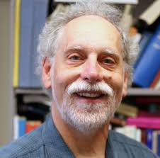

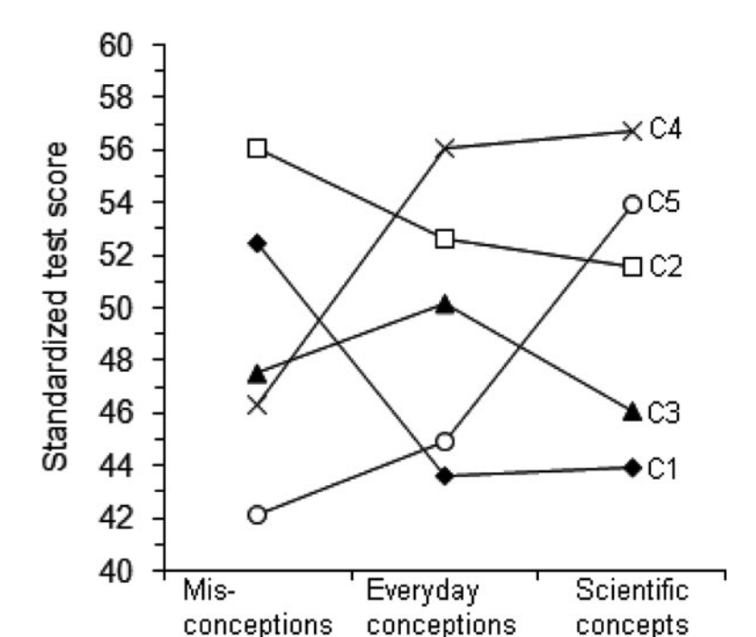
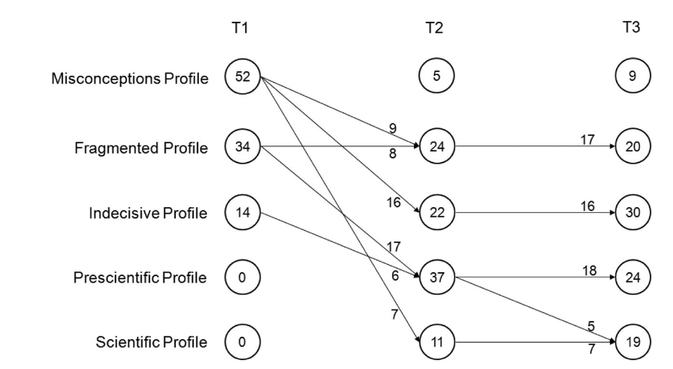
Stella, you are wrong! Children’s knowledge is not theory-like, it consists of many loose intuitions!
Obviously, children’s conceptual knowledge is structured like a coherent theory about a topic!
You are both right and wrong! It differs between children – there is heterogeneity!
M. Schneider
S.Vosniadou
Schneider & Hardy (2013)
Latent transition analysis
A. diSessa
Mixture modeling
Children develop through knowledge states
(e.g., fragmented -> coherent)
Notes:
Imagine a child experiencing a natural phenomenon, such as a stone sinking in water, the sun rising, or a blanket keeping you warm.
When a child tries to explain these phenomena, what does the resulting intuitive knowledge look like?
One major theory, by Stella Vosniadou, says that children`s intuitive knowledge is structured like a rudimentary yet coherent theory about the respective topic.
The other theory, by Andrea diSessa, says that children`s knowledge is not like a coherent theory, but like fragmented pieces of knowledge.
The most interesting phenomenon for me is seeing these two debate about their theories; I had the honor to experience it once and to this day, it has had a lasting impact on my mental development.
After arguing about which theory is correct for decades, Michael Schneider came up with a consense view:
Both are right, because chilren`s intuitive knowledge differs – for some children, Stella`s view is more fitting, and for other children, Andrea`s view.
This insight came to Michael through a statistical model, called the mixture model.
In the mixture model, we assume that not all data points we model have been created by the same process. Instead, there is systematic heterogeneity.
In this case, Michael analyzed data from an intervention teaching children about floating and sinking-phenomena. He and found that for some children, different beliefs about natural phenomena that are inconsistent with each other clearly co-exist; whereas for other children, the beliefs they hold are consistent.
You may or may not agree with Michael`s thinking, but one thing is clear:
In this case, a statistical model inspired a theoretical innovation.
Let`s dive deeper into this. I will start in th 1970s, showing how repeatedly, theoretical ideas about inquiry learning and conceptual change inspired statistical modeling, and the other way round.
I will argue for the following view:
Whenever theoretical ideas inspired statistical models, this led to novel and useful contributions to the field –
But whenever statistical modeling meant to dictate what educational researchers should be doing, this led to a destructive role of statistics.
I provide an explanation for this historical trend, resulting in five wishes and visions for future statistical modeling of learners` knowledge and its development.
Let`s start in the 1970s!

Slide 3
Part I
Theory
Model
Theory integration in statistical models
Part II
Model integration into educational research
Part III
Beyond traditional theory-model ontologies
Notes:
In the 70s, predominant theories of leaners` knowledge were still rooted in Piaget`s model of step-wise development and, similarly in Siegler`s rule-based assessment methodology.
In this approach, you determine children`s developmental stage by presenting different balance beam tasks to them:
The Western World is still recovering from the Sputnik shock, enjoying newfound psychedelic rock and economic prosperity, and investing a lot into Science Education Research to be able to keep up with the educational offspring of the Soviet Union. Science education research is in bloom.
Everyone seems in agreement that we have to move from rote learning of facts and procedures towards conceptual understanding of science, that this is best achieved via engaging learners in authentic inquiry, and, in the wake of Thomas Kuhn`s new philosophy of Science, conceptual change research is in its formation.
Three kinds of knowledge that educational research is especially interested in manifest: …
Content knowledge about Scientific concepts,
Process knowledge about scientific inquiry,
and
Epistemological knowledge about the nature of Science
With Inhelder, B., The Growth of Logical Thinking from Childhood to Adolescence (New York: Basic Books, 1958) [De la logique de l'enfant à la logique de l'adolescent (1955)].
In Genetics, back then research on the Drosophila – the Fruit Fly with its more than 15,00 genes distributed across only four chrososomes – allowed developmental genetics to bloom; geneticists could just change a gene and see what it does to the fly`s development.
In Science Education, we have similar things:
The drosophila of content knowledge may be floating and sinking phenomena such as buoyancy and density, which, inspired by Jean Piaget and Bärbel Inhelder`s work, educational researchers have been tried to train in intervention studies likely thousands of times.
Similarly, the control-of-variables strategy, denoting the understanding that to find something out, it often works best to change one thing at a time, likely is the most trained process skill. David Klahr famously, similar to Geneticists changing a gene at a time, basically varied a thing at a time trying how to best teach the CVS for the last five decades.
Regarding Nature of Science, epistemic beliefs, for example about knowledge being something that is fixed or something that can change and develop, are likely its most central facet in educational research, although they are famously difficult to measure and even more so to intervene on.
Let`s jump in now:
For the last fifty years, educational researchers have tried to examine how these aspects of learners` knowledge develop and how we can modify their development through educational interventions.
How did they try to measure and model the outcomes of these interventions, that is, learners` knoweldge of science contents, process skills, and the nature of science?
There are two preconditions for gauging the impact of development and targeted interventions on learners` knowledge:
We have to measure it, and model it, with these two things often being intertwined.
Let`s see how educational researchers have tried to model learners` knowledge since the 1970s, how this has changed since then, and what we may learn for future research regarding how to better model learners` knowledge.
In the last decades, there is a trend in educational research to focus on learners` competencies, motivation and emotions, self-regulation and meta-cognition, -
Inquiry learning and conceptual change research share a lot of views on learners` knowledge and how it develops.
Inquiry learning typically emphasizes a constructivist view, in which building up knowledge in ways similar as scientists do should help learners build up experience-based procedural and conceptual understanding.
Conceptual change enriches this view by emphasizing that building up knowledge is commonly not a simple adding piece-by-piece process, but a highly non-linear and individualistic process in which prior knowledge plays a much more complicated role than just representing the basis to which new pieses are added.
In both research areas, knowledge is a central construct that they believe is important both as a predictor and an outcome of learning.
What is knowledge? I don`t have a clue.
I`m quite sure it`s a cognitive representation, of facts, procedures, events, concepts, schemata, and other ontological categories. I like to see knowledge as measurement:
Our brains represents central characteristics of phenomena in the world to help us make it more predictable and give us agency – maybe that`s what knowledge is. (show: Measurement: represent differences in something that we care about, capturing relations in differences in this some-thing in numbers)
Although no one can define what knowledge is, we have many ontological categories assembled within this term – maybe around 120.
We can summarize these as types and qualities of knowledge…
In inquiry learning and conceptual change researc, a central concept of interest is knowledge.
There are various types of knowledge -

Slide 4
Part I
Theory
Model
Theory integration in statistical models
Part II
Model integration into educational research
Part III
Beyond traditional theory-model ontologies
Notes:
In the 70s, predominant theories of leaners` knowledge were still rooted in Piaget`s model of step-wise development and, similarly in Siegler`s rule-based assessment methodology.
In this approach, you determine children`s developmental stage by presenting different balance beam tasks to them:
The Western World is still recovering from the Sputnik shock, enjoying newfound psychedelic rock and economic prosperity, and investing a lot into Science Education Research to be able to keep up with the educational offspring of the Soviet Union. Science education research is in bloom.
Everyone seems in agreement that we have to move from rote learning of facts and procedures towards conceptual understanding of science, that this is best achieved via engaging learners in authentic inquiry, and, in the wake of Thomas Kuhn`s new philosophy of Science, conceptual change research is in its formation.
Three kinds of knowledge that educational research is especially interested in manifest: …
Content knowledge about Scientific concepts,
Process knowledge about scientific inquiry,
and
Epistemological knowledge about the nature of Science
With Inhelder, B., The Growth of Logical Thinking from Childhood to Adolescence (New York: Basic Books, 1958) [De la logique de l'enfant à la logique de l'adolescent (1955)].
In Genetics, back then research on the Drosophila – the Fruit Fly with its more than 15,00 genes distributed across only four chrososomes – allowed developmental genetics to bloom; geneticists could just change a gene and see what it does to the fly`s development.
In Science Education, we have similar things:
The drosophila of content knowledge may be floating and sinking phenomena such as buoyancy and density, which, inspired by Jean Piaget and Bärbel Inhelder`s work, educational researchers have been tried to train in intervention studies likely thousands of times.
Similarly, the control-of-variables strategy, denoting the understanding that to find something out, it often works best to change one thing at a time, likely is the most trained process skill. David Klahr famously, similar to Geneticists changing a gene at a time, basically varied a thing at a time trying how to best teach the CVS for the last five decades.
Regarding Nature of Science, epistemic beliefs, for example about knowledge being something that is fixed or something that can change and develop, are likely its most central facet in educational research, although they are famously difficult to measure and even more so to intervene on.
Let`s jump in now:
For the last fifty years, educational researchers have tried to examine how these aspects of learners` knowledge develop and how we can modify their development through educational interventions.
How did they try to measure and model the outcomes of these interventions, that is, learners` knoweldge of science contents, process skills, and the nature of science?
There are two preconditions for gauging the impact of development and targeted interventions on learners` knowledge:
We have to measure it, and model it, with these two things often being intertwined.
Let`s see how educational researchers have tried to model learners` knowledge since the 1970s, how this has changed since then, and what we may learn for future research regarding how to better model learners` knowledge.
In the last decades, there is a trend in educational research to focus on learners` competencies, motivation and emotions, self-regulation and meta-cognition, -
Inquiry learning and conceptual change research share a lot of views on learners` knowledge and how it develops.
Inquiry learning typically emphasizes a constructivist view, in which building up knowledge in ways similar as scientists do should help learners build up experience-based procedural and conceptual understanding.
Conceptual change enriches this view by emphasizing that building up knowledge is commonly not a simple adding piece-by-piece process, but a highly non-linear and individualistic process in which prior knowledge plays a much more complicated role than just representing the basis to which new pieses are added.
In both research areas, knowledge is a central construct that they believe is important both as a predictor and an outcome of learning.
What is knowledge? I don`t have a clue.
I`m quite sure it`s a cognitive representation, of facts, procedures, events, concepts, schemata, and other ontological categories. I like to see knowledge as measurement:
Our brains represents central characteristics of phenomena in the world to help us make it more predictable and give us agency – maybe that`s what knowledge is. (show: Measurement: represent differences in something that we care about, capturing relations in differences in this some-thing in numbers)
Although no one can define what knowledge is, we have many ontological categories assembled within this term – maybe around 120.
We can summarize these as types and qualities of knowledge…
In inquiry learning and conceptual change researc, a central concept of interest is knowledge.
There are various types of knowledge -

Slide 5
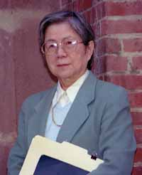
70s/80s
Theory
Model
Kikumi Tatsuoka (1983)
I`ve got an awesome idea!
Inhelder & Piaget`s Theory of stage-wise development (1958)
Mapping:
Solution pattern <-> cognitive rule (i.e., solution strategy)
Siegler`s (1976) ruled-based assessment methodology
e.g.
„011“ -> 80% prob. produced by misconception („bug“)
leading you to subtract -7 from -16
Latent variable model (cf. cognitive diagnosis model):
Bugs (i.e., misconceptions) as latent mental states
Each response pattern produced by each bug with specific probability
Emphasis on patterns across multiple items
Different strategies/misconceptions can lead to same (sum) score
Sato`s (1975) erroneous rules/bugs identification approach
Example subtraction items: -16 - (-7)
2 - 11
12 + (-3)
Solution patterns:
000
001
010
100
011
101
110
111
Notes:
In the 70s, predominant theories of leaners` knowledge were still rooted in Piaget`s model of step-wise development and, similarly in Siegler`s rule-based assessment methodology.
In this approach, you determine children`s developmental stage by presenting different balance beam tasks to them:
The Western World is still recovering from the Sputnik shock, enjoying newfound psychedelic rock and economic prosperity, and investing a lot into Science Education Research to be able to keep up with the educational offspring of the Soviet Union. Science education research is in bloom.
Everyone seems in agreement that we have to move from rote learning of facts and procedures towards conceptual understanding of science, that this is best achieved via engaging learners in authentic inquiry, and, in the wake of Thomas Kuhn`s new philosophy of Science, conceptual change research is in its formation.
Three kinds of knowledge that educational research is especially interested in manifest: …
Content knowledge about Scientific concepts,
Process knowledge about scientific inquiry,
and
Epistemological knowledge about the nature of Science
With Inhelder, B., The Growth of Logical Thinking from Childhood to Adolescence (New York: Basic Books, 1958) [De la logique de l'enfant à la logique de l'adolescent (1955)].
In Genetics, back then research on the Drosophila – the Fruit Fly with its more than 15,00 genes distributed across only four chrososomes – allowed developmental genetics to bloom; geneticists could just change a gene and see what it does to the fly`s development.
In Science Education, we have similar things:
The drosophila of content knowledge may be floating and sinking phenomena such as buoyancy and density, which, inspired by Jean Piaget and Bärbel Inhelder`s work, educational researchers have been tried to train in intervention studies likely thousands of times.
Similarly, the control-of-variables strategy, denoting the understanding that to find something out, it often works best to change one thing at a time, likely is the most trained process skill. David Klahr famously, similar to Geneticists changing a gene at a time, basically varied a thing at a time trying how to best teach the CVS for the last five decades.
Regarding Nature of Science, epistemic beliefs, for example about knowledge being something that is fixed or something that can change and develop, are likely its most central facet in educational research, although they are famously difficult to measure and even more so to intervene on.
Let`s jump in now:
For the last fifty years, educational researchers have tried to examine how these aspects of learners` knowledge develop and how we can modify their development through educational interventions.
How did they try to measure and model the outcomes of these interventions, that is, learners` knoweldge of science contents, process skills, and the nature of science?
There are two preconditions for gauging the impact of development and targeted interventions on learners` knowledge:
We have to measure it, and model it, with these two things often being intertwined.
Let`s see how educational researchers have tried to model learners` knowledge since the 1970s, how this has changed since then, and what we may learn for future research regarding how to better model learners` knowledge.
In the last decades, there is a trend in educational research to focus on learners` competencies, motivation and emotions, self-regulation and meta-cognition, -
Inquiry learning and conceptual change research share a lot of views on learners` knowledge and how it develops.
Inquiry learning typically emphasizes a constructivist view, in which building up knowledge in ways similar as scientists do should help learners build up experience-based procedural and conceptual understanding.
Conceptual change enriches this view by emphasizing that building up knowledge is commonly not a simple adding piece-by-piece process, but a highly non-linear and individualistic process in which prior knowledge plays a much more complicated role than just representing the basis to which new pieses are added.
In both research areas, knowledge is a central construct that they believe is important both as a predictor and an outcome of learning.
What is knowledge? I don`t have a clue.
I`m quite sure it`s a cognitive representation, of facts, procedures, events, concepts, schemata, and other ontological categories. I like to see knowledge as measurement:
Our brains represents central characteristics of phenomena in the world to help us make it more predictable and give us agency – maybe that`s what knowledge is. (show: Measurement: represent differences in something that we care about, capturing relations in differences in this some-thing in numbers)
Although no one can define what knowledge is, we have many ontological categories assembled within this term – maybe around 120.
We can summarize these as types and qualities of knowledge…
In inquiry learning and conceptual change researc, a central concept of interest is knowledge.
There are various types of knowledge -

Slide 6
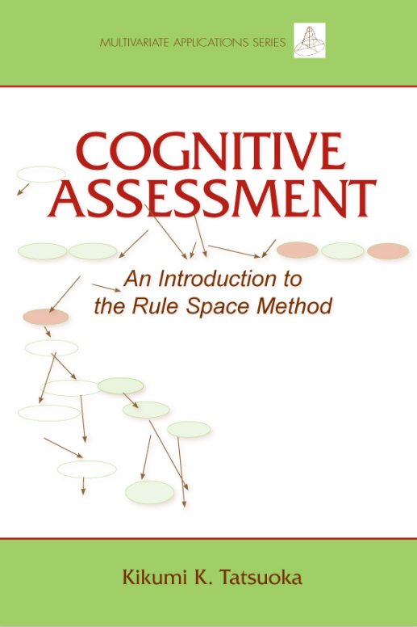
70s/80s
Theory
Model
Kikumi Tatsuoka (1983)
I`ve got an awesome idea!
Inhelder & Piaget`s Theory of stage-wise development (1958)
Mapping:
Solution pattern <-> cognitive rule (i.e., solution strategy)
Siegler`s (1976) ruled-based assessment methodology
Sato`s (1975) erroneous rules/bugs identification approach
Example subtraction items: -16 - (-7)
2 - 11
12 + (-3)
Solution patterns:
000
001
010
100
011
101
110
111
Notes:
In the 70s, predominant theories of leaners` knowledge were still rooted in Piaget`s model of step-wise development and, similarly in Siegler`s rule-based assessment methodology.
In this approach, you determine children`s developmental stage by presenting different balance beam tasks to them:
The Western World is still recovering from the Sputnik shock, enjoying newfound psychedelic rock and economic prosperity, and investing a lot into Science Education Research to be able to keep up with the educational offspring of the Soviet Union. Science education research is in bloom.
Everyone seems in agreement that we have to move from rote learning of facts and procedures towards conceptual understanding of science, that this is best achieved via engaging learners in authentic inquiry, and, in the wake of Thomas Kuhn`s new philosophy of Science, conceptual change research is in its formation.
Three kinds of knowledge that educational research is especially interested in manifest: …
Content knowledge about Scientific concepts,
Process knowledge about scientific inquiry,
and
Epistemological knowledge about the nature of Science
With Inhelder, B., The Growth of Logical Thinking from Childhood to Adolescence (New York: Basic Books, 1958) [De la logique de l'enfant à la logique de l'adolescent (1955)].
In Genetics, back then research on the Drosophila – the Fruit Fly with its more than 15,00 genes distributed across only four chrososomes – allowed developmental genetics to bloom; geneticists could just change a gene and see what it does to the fly`s development.
In Science Education, we have similar things:
The drosophila of content knowledge may be floating and sinking phenomena such as buoyancy and density, which, inspired by Jean Piaget and Bärbel Inhelder`s work, educational researchers have been tried to train in intervention studies likely thousands of times.
Similarly, the control-of-variables strategy, denoting the understanding that to find something out, it often works best to change one thing at a time, likely is the most trained process skill. David Klahr famously, similar to Geneticists changing a gene at a time, basically varied a thing at a time trying how to best teach the CVS for the last five decades.
Regarding Nature of Science, epistemic beliefs, for example about knowledge being something that is fixed or something that can change and develop, are likely its most central facet in educational research, although they are famously difficult to measure and even more so to intervene on.
Let`s jump in now:
For the last fifty years, educational researchers have tried to examine how these aspects of learners` knowledge develop and how we can modify their development through educational interventions.
How did they try to measure and model the outcomes of these interventions, that is, learners` knoweldge of science contents, process skills, and the nature of science?
There are two preconditions for gauging the impact of development and targeted interventions on learners` knowledge:
We have to measure it, and model it, with these two things often being intertwined.
Let`s see how educational researchers have tried to model learners` knowledge since the 1970s, how this has changed since then, and what we may learn for future research regarding how to better model learners` knowledge.
In the last decades, there is a trend in educational research to focus on learners` competencies, motivation and emotions, self-regulation and meta-cognition, -
Inquiry learning and conceptual change research share a lot of views on learners` knowledge and how it develops.
Inquiry learning typically emphasizes a constructivist view, in which building up knowledge in ways similar as scientists do should help learners build up experience-based procedural and conceptual understanding.
Conceptual change enriches this view by emphasizing that building up knowledge is commonly not a simple adding piece-by-piece process, but a highly non-linear and individualistic process in which prior knowledge plays a much more complicated role than just representing the basis to which new pieses are added.
In both research areas, knowledge is a central construct that they believe is important both as a predictor and an outcome of learning.
What is knowledge? I don`t have a clue.
I`m quite sure it`s a cognitive representation, of facts, procedures, events, concepts, schemata, and other ontological categories. I like to see knowledge as measurement:
Our brains represents central characteristics of phenomena in the world to help us make it more predictable and give us agency – maybe that`s what knowledge is. (show: Measurement: represent differences in something that we care about, capturing relations in differences in this some-thing in numbers)
Although no one can define what knowledge is, we have many ontological categories assembled within this term – maybe around 120.
We can summarize these as types and qualities of knowledge…
In inquiry learning and conceptual change researc, a central concept of interest is knowledge.
There are various types of knowledge -

Slide 7
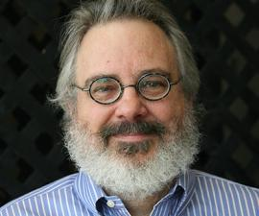
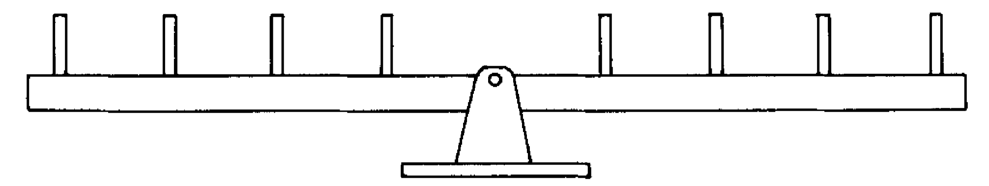
70s/80s
Theory
Model
Mark Wilson (1985/1989)
This is so cool, let`s model it!
Inhelder & Piaget`s Theory of stage-wise development (1958)
Siegler`s (1976) ruled-based assessment methodology
Consider (1) weight, (2) distance, (3) proportion of w/d
Extension of the Rasch model
Items have different difficulty but it depends on a person characteristic:
The cognitive rule (i.e., developmental stage)
Rule I (one-dimensional reasoning, e.g. weight)
…
Rule IV (proportional reasoning distance x weight)
Depending on rule person uses, specific items become easier (or harder)
Notes:
Rule: Strategy, procdure, skill, operation, hypothesis, conception, etc.

Slide 8
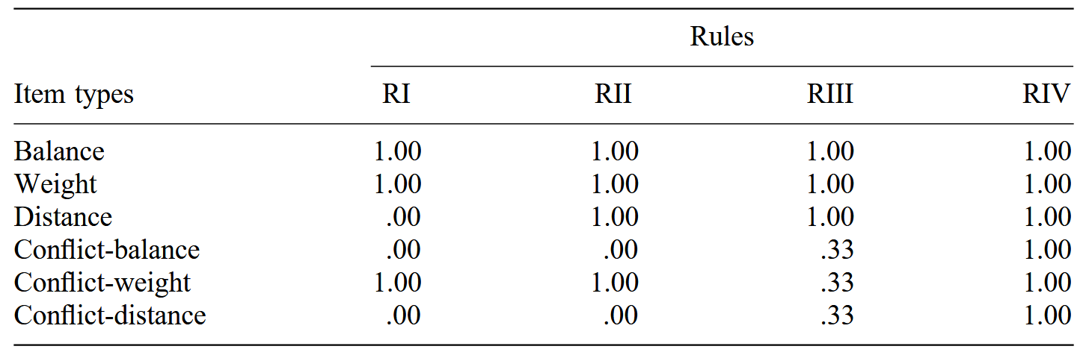
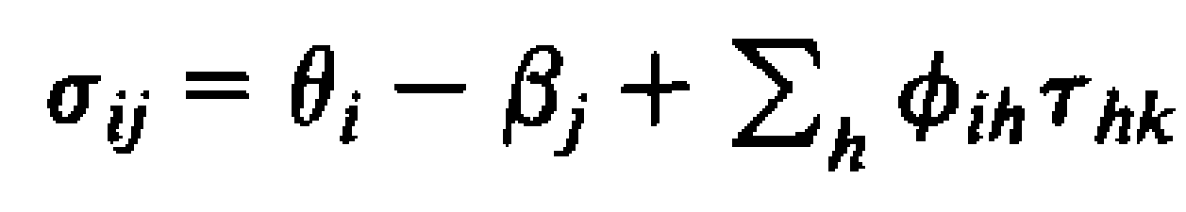
70s/80s
Theory
Model
Mark Wilson (1985/1989)
This is so cool, let`s model it!
Inhelder & Piaget`s Theory of stage-wise development (1958)
Siegler`s (1976) ruled-based assessment methodology
Consider (1) weight, (2) distance, (3) proportion of w/d
Extension of the Rasch model
The Saltus model
Each response pattern indicates the probability for each of the four latent mental states (Rule I – IV)
Notes:
E Equal problems (same values for both dominant (weight) and subordinate (distance) dimension
D Weight difference, same distance
S Distance difference, same weight
CD: Coflict-dominant: Weight and distance disagree, weight wins
CS: Conflict-subordinate: Disagreement, distance wins
CE: Conflict equal: Weight and distance disagree,

Slide 9
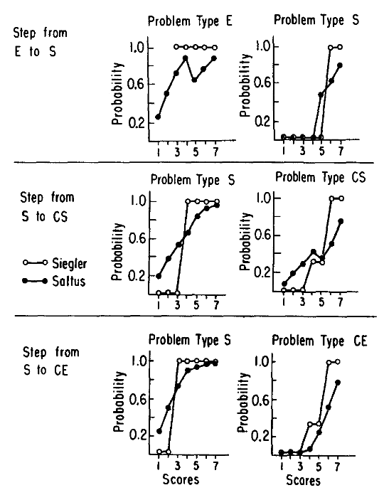
70s/80s
Theory
Model
Mark Wilson (1985/1989)
Inhelder & Piaget`s Theory of stage-wise development (1958)
Model showed deviations from some of Siegler`s predictions
Siegler`s (1976) ruled-based assessment methodology
Consider (1) weight, (2) distance, (3) proportion of w/d
- Difference between person ability and item difficulty determines solution probability
- Bonus/malus on solution probability depending on latent rule state
- Latent rule h differs across persons, bonus/malus τ across item groups k
Notes:
E Equal problems (same values for both dominant (weight) and subordinate (distance) dimension
D Weight difference, same distance
S Distance difference, same weight
CD: Coflict-dominant: Weight and distance disagree, weight wins
CS: Conflict-subordinate: Disagreement, distance wins
CE: Conflict equal: Weight and distance disagree,

Slide 10
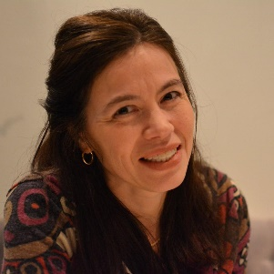

90s/2000s
Theory
Model
Jansen & van der Maas (1997, 2002)
Inhelder & Piaget`s Theory of stage-wise development (1958)
Constrained latent class analysis
Siegler`s (1976) ruled-based assessment methodology
Consider (1) weight, (2) distance, (3) proportion of w/d
Formalized further potential rules:
Random answer in case of balance
Balance in case of w/d conflict
Acknowledgment of large distances only
Restriction of known item solution probabilities for Siegler Rules I – IV
Notes:
E Equal problems (same values for both dominant (weight) and subordinate (distance) dimension
D Weight difference, same distance
S Distance difference, same weight
CD: Coflict-dominant: Weight and distance disagree, weight wins
CS: Conflict-subordinate: Disagreement, distance wins
CE: Conflict equal: Weight and distance disagree,

Slide 11
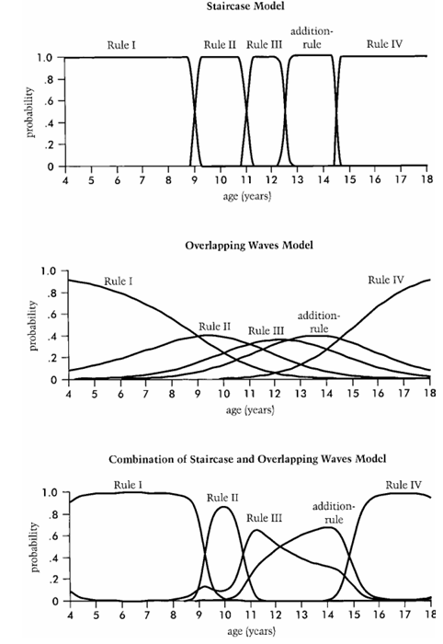
90s/2000s
Theory
Model
Jansen & van der Maas (1997, 2002)
Result: Integrative theoretical model of reasoning about the balance scale task
Constrained latent class analysis
Results
N = 484 7th- and 8th-graders:
Rules I and II very consistent, rules above partially
Further applications:
Rejection of connectonist models as rule-behaving
Modeling of rules in transition phases, differences across age and development
Notes:
E Equal problems (same values for both dominant (weight) and subordinate (distance) dimension
D Weight difference, same distance
S Distance difference, same weight
CD: Coflict-dominant: Weight and distance disagree, weight wins
CS: Conflict-subordinate: Disagreement, distance wins
CE: Conflict equal: Weight and distance disagree,

Slide 12

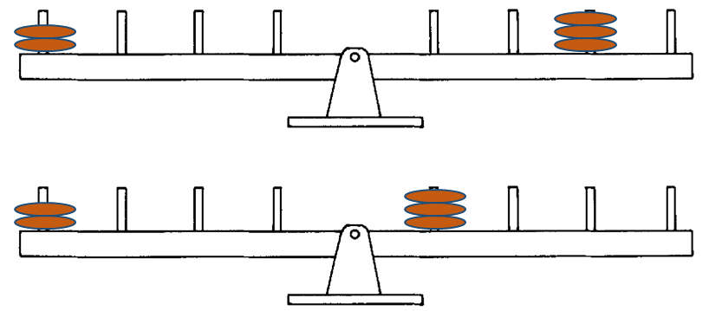
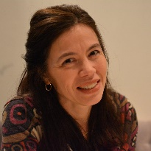

70s - 2000s
Theory
Model
Kikumi Tatsuoka (1983)
Mark Wilson (1985/1989)
Jansen & van der Maas (1997, 2002)
Modeling theoretical assumptions allowed:
Determining probabilistic misconception/rule use for each child
Estimating and comparing proportions of children showing each misconception/rule
Estímating effects of practice/interventions on misconceptions/rule use
Adaptive instruction (cf. Intelligent tutoring systems)
Comparing theoretical predictions with empirical model estimates; theory development
Notes:
E Equal problems (same values for both dominant (weight) and subordinate (distance) dimension
D Weight difference, same distance
S Distance difference, same weight
CD: Coflict-dominant: Weight and distance disagree, weight wins
CS: Conflict-subordinate: Disagreement, distance wins
CE: Conflict equal: Weight and distance disagree,

Slide 13
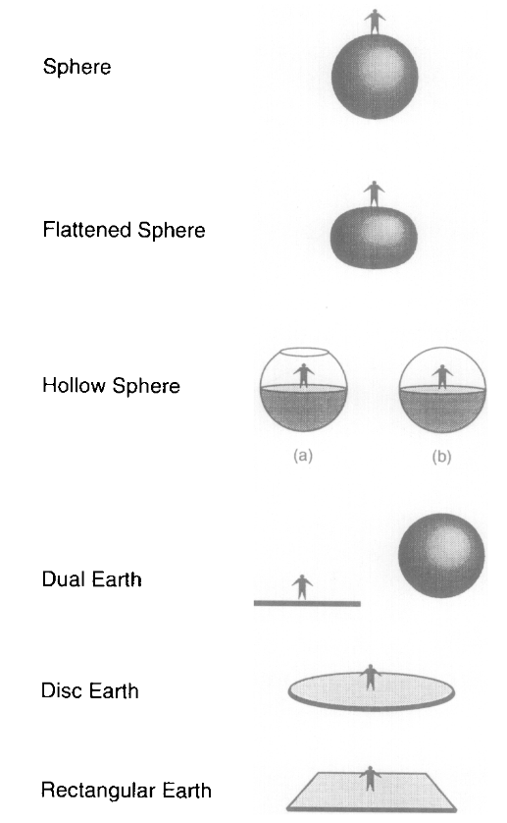
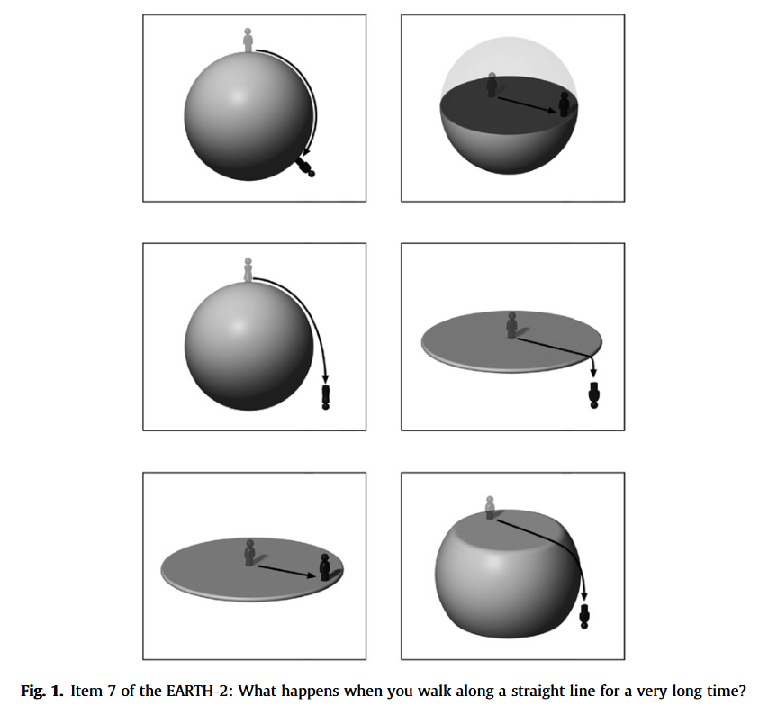
Conceptual Change
Theory
Model
Vosniadou & Brewer (1992)
Straatemeier, Jansen, & van der Maas (2008)
- Children are typically classified according to answers in interviews, drawing, or claying tasks
Arbitrary calssification cut-offs (e.g., > 80% in accordance with one predicted pattern), lack of possibility to identify unexpected patterns, no possibility to test goodness-of-fit (how well does our classification account for the observed data?)
Constrained latent class analysis using a new pen-and-paper test (EARTH-2; 8 items + Interviews)
Kindergarteners – 3rd grade
Notes:
3rd to 6th graders using semi-structured interviews and drawings to elucidate their mental models of the earth and orbs, and where humans live on the earth.
Raising hypotheses about how children develop synthetic models when information they learn in school disagrees with their prior intuitive conceptions.

Slide 14
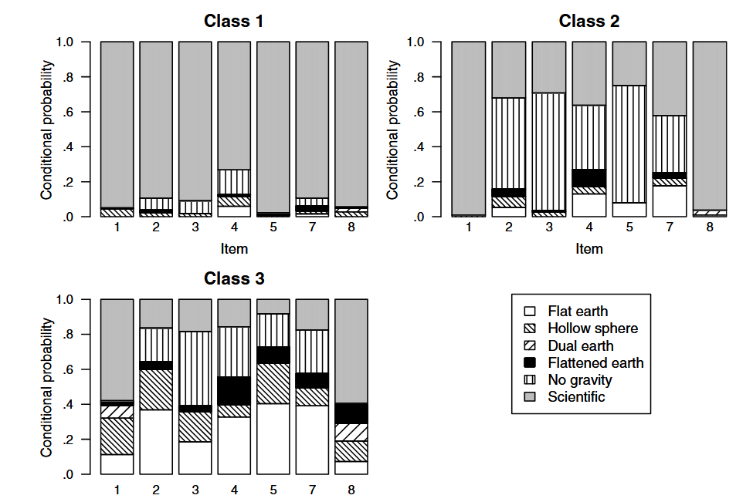
Conceptual Change
Theory
Model
Results
Vosniadou & Brewer (1992)
Straatemeier, Jansen, & van der Maas (2008)
Scientific concept
No gravity-conception
No gravity-/hollow sphere-conception
- Overall: Little evidence for coherent mental models, but also for fragmentation
Notes:
3rd to 6th graders using semi-structured interviews and drawings to elucidate their mental models of the earth and orbs, and where humans live on the earth.
Raising hypotheses about how children develop synthetic models when information they learn in school disagrees with their prior intuitive conceptions.

Slide 15
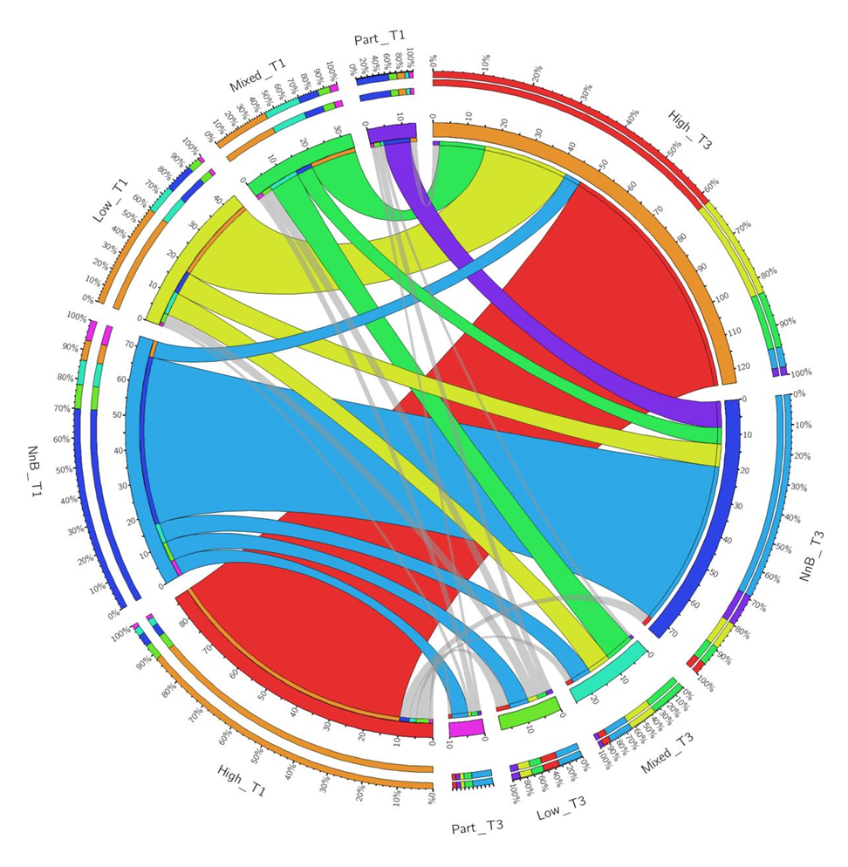
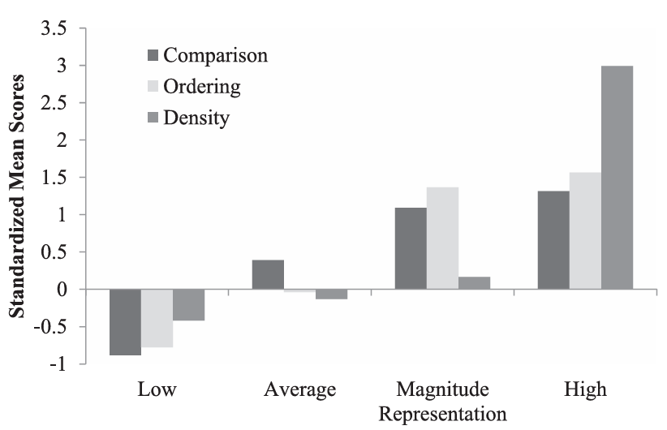
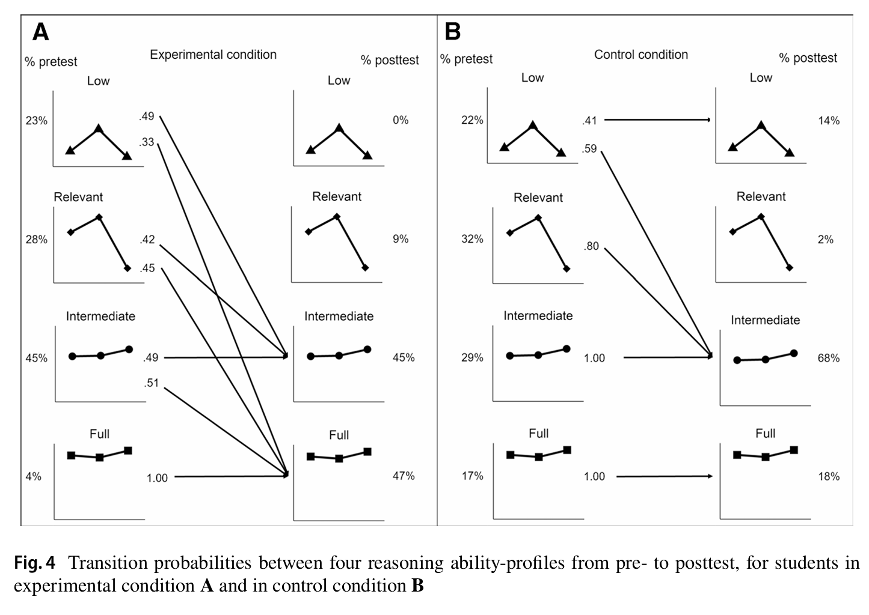
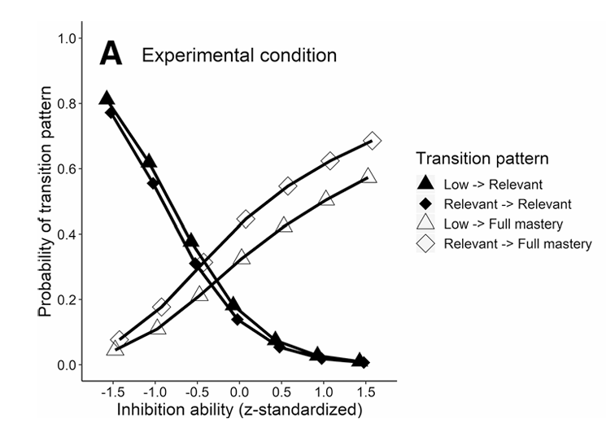
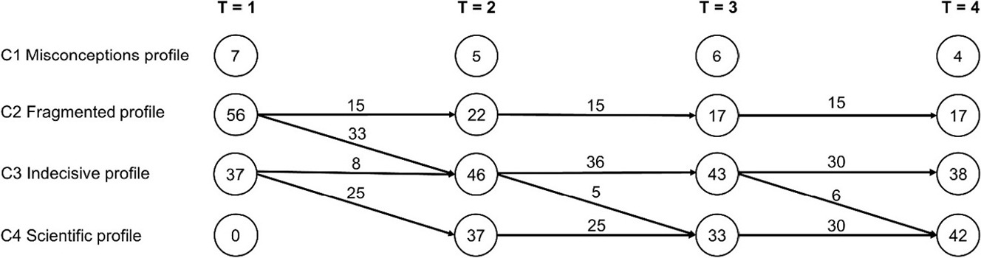
Conceptual Change
Theory
Model
Following up on Schneider & Hardy (2013)
Theoretical assumptions about:
Concepts about rational numbers
Training hypothetico-deductive reasoning in children
Higher education students` concepts of human memory
McMullen et al. (2015)
Edelsbrunner et al (2018)
Grimm et al. (2023)
Kainulainen et al. (2017)
…

Slide 16
Conceptual Change
Theory
Model
Following up on Schneider & Hardy (2013)
Novel theoretical insights:
Knowledge of magnitude representations is necessary, but not sufficient, for knowledge of density concepts
Inhibition predicts acquisition of concepts about insufficient evidence
Knowledge integration occurs during complex concept acquisition
McMullen et al. (2015)
Edelsbrunner et al (2018)
Grimm et al. (2023)
Kainulainen et al. (2017)
…

Slide 17
Conceptual Change
Theory
Model
Historical observations:
- Move away from theory-driven (i.e., confirmatory) modeling to data-driven (i.e., exploratory) modeling
- Integrations of educational theory into statistical models centers around qualitative individual differences (e.g., stages, strategies, schemas, misconceptions)
These individual differences are represented using mixture modeling
Mixture models allowed theory testing and supported theory refinement
Notes:
E Equal problems (same values for both dominant (weight) and subordinate (distance) dimension
D Weight difference, same distance
S Distance difference, same weight
CD: Coflict-dominant: Weight and distance disagree, weight wins
CS: Conflict-subordinate: Disagreement, distance wins
CE: Conflict equal: Weight and distance disagree,

Slide 18
Part I
Theory
Model
Theory integration in statistical models
Part II
Model integration into educational research
Part III
Beyond traditional theory-model ontologies
Notes:
In the 70s, predominant theories of leaners` knowledge were still rooted in Piaget`s model of step-wise development and, similarly in Siegler`s rule-based assessment methodology.
In this approach, you determine children`s developmental stage by presenting different balance beam tasks to them:
The Western World is still recovering from the Sputnik shock, enjoying newfound psychedelic rock and economic prosperity, and investing a lot into Science Education Research to be able to keep up with the educational offspring of the Soviet Union. Science education research is in bloom.
Everyone seems in agreement that we have to move from rote learning of facts and procedures towards conceptual understanding of science, that this is best achieved via engaging learners in authentic inquiry, and, in the wake of Thomas Kuhn`s new philosophy of Science, conceptual change research is in its formation.
Three kinds of knowledge that educational research is especially interested in manifest: …
Content knowledge about Scientific concepts,
Process knowledge about scientific inquiry,
and
Epistemological knowledge about the nature of Science
With Inhelder, B., The Growth of Logical Thinking from Childhood to Adolescence (New York: Basic Books, 1958) [De la logique de l'enfant à la logique de l'adolescent (1955)].
In Genetics, back then research on the Drosophila – the Fruit Fly with its more than 15,00 genes distributed across only four chrososomes – allowed developmental genetics to bloom; geneticists could just change a gene and see what it does to the fly`s development.
In Science Education, we have similar things:
The drosophila of content knowledge may be floating and sinking phenomena such as buoyancy and density, which, inspired by Jean Piaget and Bärbel Inhelder`s work, educational researchers have been tried to train in intervention studies likely thousands of times.
Similarly, the control-of-variables strategy, denoting the understanding that to find something out, it often works best to change one thing at a time, likely is the most trained process skill. David Klahr famously, similar to Geneticists changing a gene at a time, basically varied a thing at a time trying how to best teach the CVS for the last five decades.
Regarding Nature of Science, epistemic beliefs, for example about knowledge being something that is fixed or something that can change and develop, are likely its most central facet in educational research, although they are famously difficult to measure and even more so to intervene on.
Let`s jump in now:
For the last fifty years, educational researchers have tried to examine how these aspects of learners` knowledge develop and how we can modify their development through educational interventions.
How did they try to measure and model the outcomes of these interventions, that is, learners` knoweldge of science contents, process skills, and the nature of science?
There are two preconditions for gauging the impact of development and targeted interventions on learners` knowledge:
We have to measure it, and model it, with these two things often being intertwined.
Let`s see how educational researchers have tried to model learners` knowledge since the 1970s, how this has changed since then, and what we may learn for future research regarding how to better model learners` knowledge.
In the last decades, there is a trend in educational research to focus on learners` competencies, motivation and emotions, self-regulation and meta-cognition, -
Inquiry learning and conceptual change research share a lot of views on learners` knowledge and how it develops.
Inquiry learning typically emphasizes a constructivist view, in which building up knowledge in ways similar as scientists do should help learners build up experience-based procedural and conceptual understanding.
Conceptual change enriches this view by emphasizing that building up knowledge is commonly not a simple adding piece-by-piece process, but a highly non-linear and individualistic process in which prior knowledge plays a much more complicated role than just representing the basis to which new pieses are added.
In both research areas, knowledge is a central construct that they believe is important both as a predictor and an outcome of learning.
What is knowledge? I don`t have a clue.
I`m quite sure it`s a cognitive representation, of facts, procedures, events, concepts, schemata, and other ontological categories. I like to see knowledge as measurement:
Our brains represents central characteristics of phenomena in the world to help us make it more predictable and give us agency – maybe that`s what knowledge is. (show: Measurement: represent differences in something that we care about, capturing relations in differences in this some-thing in numbers)
Although no one can define what knowledge is, we have many ontological categories assembled within this term – maybe around 120.
We can summarize these as types and qualities of knowledge…
In inquiry learning and conceptual change researc, a central concept of interest is knowledge.
There are various types of knowledge -

Slide 19
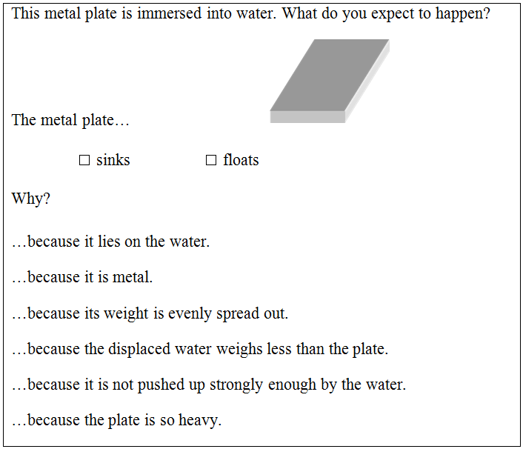
Model
Theory
Factor
Item 1
Item …
Item i
Notes:
E Equal problems (same values for both dominant (weight) and subordinate (distance) dimension
D Weight difference, same distance
S Distance difference, same weight
CD: Coflict-dominant: Weight and distance disagree, weight wins
CS: Conflict-subordinate: Disagreement, distance wins
CE: Conflict equal: Weight and distance disagree,

Slide 20
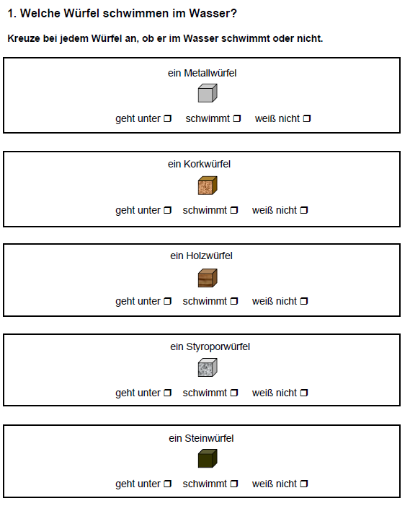
Model
Theory
Item 1
Item …
Item i
a metal cube
a cork cube
a wooden cube
sinks floats
sinks floats
sinks floats
Responses to items correlate with one another
Notes:
E Equal problems (same values for both dominant (weight) and subordinate (distance) dimension
D Weight difference, same distance
S Distance difference, same weight
CD: Coflict-dominant: Weight and distance disagree, weight wins
CS: Conflict-subordinate: Disagreement, distance wins
CE: Conflict equal: Weight and distance disagree,

Slide 21
Model
Theory
Know-ledge
Item 1
Item …
Item i
a metal cube
a cork cube
a wooden cube
sinks floats
sinks floats
sinks floats
Responses to items correlate with one another
Because of a common underlying factor –
Children`s knowledge
Notes:
E Equal problems (same values for both dominant (weight) and subordinate (distance) dimension
D Weight difference, same distance
S Distance difference, same weight
CD: Coflict-dominant: Weight and distance disagree, weight wins
CS: Conflict-subordinate: Disagreement, distance wins
CE: Conflict equal: Weight and distance disagree,

Slide 22
Model
Theory
Know-ledge
If we assume that all items measure knowledge about floating and sinking, then a factor model postulating one common factor must fit to our data
Item 1
Item …
Item i
90s:
Rule of factor analysis ritual
a metal cube
a cork cube
a wooden cube
sinks floats
sinks floats
sinks floats
(1) Develop (many) items
(2) Fit a (exploratory or confirmatory) factor analysis model
(3) Compare results to theory
(4) Remove items that do not fit model
Responses to items correlate with one another
Because of a common underlying factor –
Children`s knowledge
Notes:
E Equal problems (same values for both dominant (weight) and subordinate (distance) dimension
D Weight difference, same distance
S Distance difference, same weight
CD: Coflict-dominant: Weight and distance disagree, weight wins
CS: Conflict-subordinate: Disagreement, distance wins
CE: Conflict equal: Weight and distance disagree,

Slide 23
Model
Theory
Know-ledge
Epistemic beliefs about knowledge, its sources, and development (Perry, 1970)
Beliefed to affect learning strategies and outcomes
Item 1
Item …
Item i
90s:
Rule of factor analysis ritual
a metal cube
a cork cube
a wooden cube
sinks floats
sinks floats
sinks floats
(1) Develop (many) items
(2) Fit a (exploratory or confirmatory) factor analysis model
(3) Compare results to theory
(4) Remove items that do not fit model
Responses to items correlate with one another
Because of a common underlying factor –
Children`s knowledge
Notes:
E Equal problems (same values for both dominant (weight) and subordinate (distance) dimension
D Weight difference, same distance
S Distance difference, same weight
CD: Coflict-dominant: Weight and distance disagree, weight wins
CS: Conflict-subordinate: Disagreement, distance wins
CE: Conflict equal: Weight and distance disagree,

Slide 24
Model
Theory
Schommer (1990, 1993; 1994)
Simple
Epistemic beliefs about knowledge and knowing (Perry, 1970)
Beliefed to affect learning strategies and outcomes
Most words have one clear meaning
Being a good student generally involves memorising facts
Almost all information you can learn from a textbook you will get during the first reading
90s:
Rule of factor analysis ritual
(1) Develop (many) items
(2) Fit a (exploratory or confirmatory) factor analysis model
(3) Compare results to theory
(4) Remove items that do not fit model
Source: Omniscient authority <-> reasoned out Certainty: Absolute <-> evolving.
Organization: Compartmentalized <-> integrated
Control: determined <-> acquired
Speed: quick <-> gradual
Scientists can ultimately get to the truth
Notes:
E Equal problems (same values for both dominant (weight) and subordinate (distance) dimension
D Weight difference, same distance
S Distance difference, same weight
CD: Coflict-dominant: Weight and distance disagree, weight wins
CS: Conflict-subordinate: Disagreement, distance wins
CE: Conflict equal: Weight and distance disagree,

Slide 25
Model
Theory
Schommer (1990, 1993; 1994)
Simple
- Multiple new developments & revisions of epistemic belief questionnaires (Greene et al., 2010)
- Refinement of postulated dimensions and items (e.g., Chan & Elliott, 2004; Chai et al., 2006; Conley et al., 2004; Schiefer et al., 2022)
Most words have one clear meaning
Being a good student generally involves memorising facts
Almost all information you can learn from a textbook you will get during the first reading
90s – 2000s:
The rise of epistemic beliefs
(1) Develop (many) items
(2) Fit a (exploratory or confirmatory) factor analysis model
(3) Compare results to theory
(4) Remove items that do not fit model
Source: Omniscient authority <-> reasoned out Certainty: Absolute <-> evolving.
Organization: Compartmentalized <-> integrated
Control: determined <-> acquired
Speed: quick <-> gradual
Scientists can ultimately get to the truth
Notes:
E Equal problems (same values for both dominant (weight) and subordinate (distance) dimension
D Weight difference, same distance
S Distance difference, same weight
CD: Coflict-dominant: Weight and distance disagree, weight wins
CS: Conflict-subordinate: Disagreement, distance wins
CE: Conflict equal: Weight and distance disagree,

Slide 26
Model
Theory
- Criticisms of instable factor structures across samples, low internal consistencies (Cronbach`s Alpha; DeBacker et al., 2008), contextual dependence (Merk et al., 2018), interpretational multiplicity (Greene & Seung, 2014)
Simple
- Handbook of Epistemic Cognition: Nail in the coffin of epistemic beliefs research (e.g., Mason, 2016)
Most words have one clear meaning
Being a good student generally involves memorising facts
Almost all information you can learn from a textbook you will get during the first reading
2010s:
The downfall of epistemic beliefs
- Move towards epistemic cognition in action because you cannot measure what is not stable
- If responses do not correlate between items, you should not regard them as a unitary construct
(1) Develop (many) items
(2) Fit a (exploratory or confirmatory) factor analysis model
(3) Compare results to theory
(4) Remove items that do not fit model
Item 1
Item …
Item i
Notes:
Dictating factor analysis on all of us

Slide 27
Part I
Theory
Model
Theory integration in statistical models
Part II
Model integration into educational research
Part III
Beyond traditional theory-model ontologies
Notes:
In the 70s, predominant theories of leaners` knowledge were still rooted in Piaget`s model of step-wise development and, similarly in Siegler`s rule-based assessment methodology.
In this approach, you determine children`s developmental stage by presenting different balance beam tasks to them:
The Western World is still recovering from the Sputnik shock, enjoying newfound psychedelic rock and economic prosperity, and investing a lot into Science Education Research to be able to keep up with the educational offspring of the Soviet Union. Science education research is in bloom.
Everyone seems in agreement that we have to move from rote learning of facts and procedures towards conceptual understanding of science, that this is best achieved via engaging learners in authentic inquiry, and, in the wake of Thomas Kuhn`s new philosophy of Science, conceptual change research is in its formation.
Three kinds of knowledge that educational research is especially interested in manifest: …
Content knowledge about Scientific concepts,
Process knowledge about scientific inquiry,
and
Epistemological knowledge about the nature of Science
With Inhelder, B., The Growth of Logical Thinking from Childhood to Adolescence (New York: Basic Books, 1958) [De la logique de l'enfant à la logique de l'adolescent (1955)].
In Genetics, back then research on the Drosophila – the Fruit Fly with its more than 15,00 genes distributed across only four chrososomes – allowed developmental genetics to bloom; geneticists could just change a gene and see what it does to the fly`s development.
In Science Education, we have similar things:
The drosophila of content knowledge may be floating and sinking phenomena such as buoyancy and density, which, inspired by Jean Piaget and Bärbel Inhelder`s work, educational researchers have been tried to train in intervention studies likely thousands of times.
Similarly, the control-of-variables strategy, denoting the understanding that to find something out, it often works best to change one thing at a time, likely is the most trained process skill. David Klahr famously, similar to Geneticists changing a gene at a time, basically varied a thing at a time trying how to best teach the CVS for the last five decades.
Regarding Nature of Science, epistemic beliefs, for example about knowledge being something that is fixed or something that can change and develop, are likely its most central facet in educational research, although they are famously difficult to measure and even more so to intervene on.
Let`s jump in now:
For the last fifty years, educational researchers have tried to examine how these aspects of learners` knowledge develop and how we can modify their development through educational interventions.
How did they try to measure and model the outcomes of these interventions, that is, learners` knoweldge of science contents, process skills, and the nature of science?
There are two preconditions for gauging the impact of development and targeted interventions on learners` knowledge:
We have to measure it, and model it, with these two things often being intertwined.
Let`s see how educational researchers have tried to model learners` knowledge since the 1970s, how this has changed since then, and what we may learn for future research regarding how to better model learners` knowledge.
In the last decades, there is a trend in educational research to focus on learners` competencies, motivation and emotions, self-regulation and meta-cognition, -
Inquiry learning and conceptual change research share a lot of views on learners` knowledge and how it develops.
Inquiry learning typically emphasizes a constructivist view, in which building up knowledge in ways similar as scientists do should help learners build up experience-based procedural and conceptual understanding.
Conceptual change enriches this view by emphasizing that building up knowledge is commonly not a simple adding piece-by-piece process, but a highly non-linear and individualistic process in which prior knowledge plays a much more complicated role than just representing the basis to which new pieses are added.
In both research areas, knowledge is a central construct that they believe is important both as a predictor and an outcome of learning.
What is knowledge? I don`t have a clue.
I`m quite sure it`s a cognitive representation, of facts, procedures, events, concepts, schemata, and other ontological categories. I like to see knowledge as measurement:
Our brains represents central characteristics of phenomena in the world to help us make it more predictable and give us agency – maybe that`s what knowledge is. (show: Measurement: represent differences in something that we care about, capturing relations in differences in this some-thing in numbers)
Although no one can define what knowledge is, we have many ontological categories assembled within this term – maybe around 120.
We can summarize these as types and qualities of knowledge…
In inquiry learning and conceptual change researc, a central concept of interest is knowledge.
There are various types of knowledge -

Slide 28
Model
Theory
Know-ledge
Since 2010s
Questionnaire/test data often thrown away if this statistical assumption is not given
Extreme case:
Epistemic beliefs (construct)
Wide-spread criticism of studies not investigating MI (Maasen et al., 2025)
λ₁
λ₂
λ₃
Item 1
Item …
Item i
Since 1990s:
The factor structure (factor loadings etc.) must be the same across samples/ time points to be able to compare means, correlations, predictive strength (Meredith, 1993)
Measurement invariance

Slide 29
Model
Theory
Know-ledge
Alternative view
MI is not a prerequisite for any comparisons (Robitzsch & Lüdtke, 2023) because…
MI modeling decisions are arbitrary (Robitzsch & Lüdtke, 2023)
MI models error that we do not want in our model (cf. Boone & Staver, 2020)
«Violation» of MI can be…
Expected (cf. Conceptual change)
Interesting
λ₁
λ₂
λ₃
Item 1
Item …
Item i
Since 1990s:
The factor structure (factor loadings etc.) must be the same across samples/ time points to be able to compare means, correlations, predictive strength (Meredith, 1993)
Measurement invariance

Slide 30
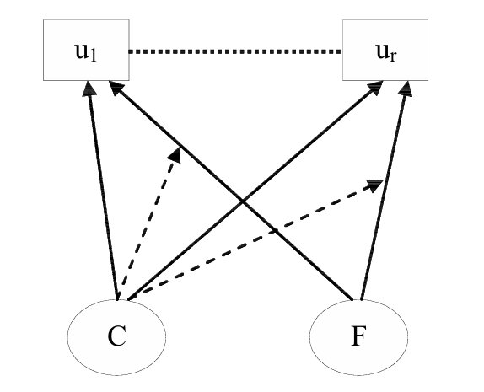
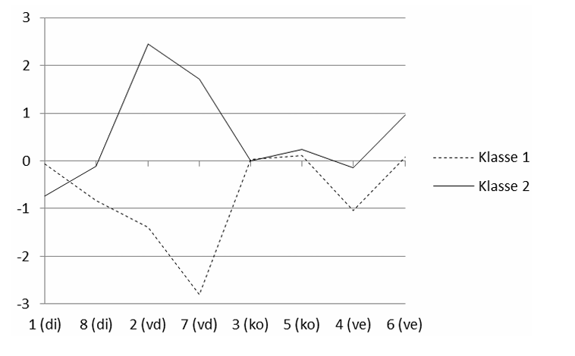
Model
Theory
Alternative view
MI is not a prerequisite for any comparisons (Robitzsch & Lüdtke, 2023) because…
MI modeling decisions are arbitrary (Robitzsch & Lüdtke, 2023)
MI models error that we do not want in our model (cf. Boone & Staver, 2020)
Analogy to moderation analysis:/causal inference A measurement model across groups is a marginal/average model
«Violation» of MI can be…
Expected (cf. Conceptual change)
Interesting
Example: Kleickmann (2011)
Factor-mixture modeling
Violation of MI becomes a feature
Groups with measurement differences represent knowledge restructuring
Children with same measurement properties regarding density, condensation, evaporation differ in displamement (cf. Wilson, 1993)

Slide 31
Model
Theory
Know-ledge
λ₁
λ₁
λ₁
Bullshit!
0. Sum/mean scores make the assumption of equal factor loadings
1. This assumption is testable via factor analysis
2. Empirically, this assumption rarely holds
3. Conclusion:
We should not use sum scores/means at all
Item 1
Item …
Item i
OFC!
The sum score is a constrained version of factor analysis
(McNeish & Wolf, 2020)
because
Yes!
- All items are equally weighted
Bullshit!
- Represents the implicit assumption of equal factor loardings

Slide 32
Model
Theory
Know-ledge
λ₁
λ₁
λ₁
0. Sum/mean scores make the assumption of equal factor loadings
1. This assumption is testable via factor analysis
2. Empirically, this assumption rarely holds
3. Conclusion:
We should not use sum scores/means at all
Item 1
Item …
Item i

Slide 33
Model
Theory
Know-ledge
as factor
λ₁
λ₁
λ₁
0. Sum/mean scores make the assumption of equal factor loadings
1. This assumption is testable via factor analysis
2. Empirically, this assumption rarely holds
3. Conclusion:
We should not use sum scores/means at all
Item 1
Item …
Item i
Know-ledge
as sum of its parts
β₁
β ₁
β ₁
Item 1
Item …
Item i

Slide 34
Model
Theory
Knowledge can be considered a formative or composite construct (Taber, 2018; Stadler et al., 2021; Edelsbrunner, 2022; Edelsbrunner et al., 2025)
We can use it as a functionally unidimensional construct (Baird et al., 2017)
No need for interitem correlations or high Cronbach`s Alphas (Edelsbrunner et al., 2025)
0. Sum/mean scores make the assumption of equal factor loadings
1. This assumption is testable via factor analysis
2. Empirically, this assumption rarely holds
3. Conclusion:
We should not use sum scores/means at all
Know-ledge
as sum of its parts
β₁
β ₁
β ₁
Item 1
Item …
Item i

Slide 35
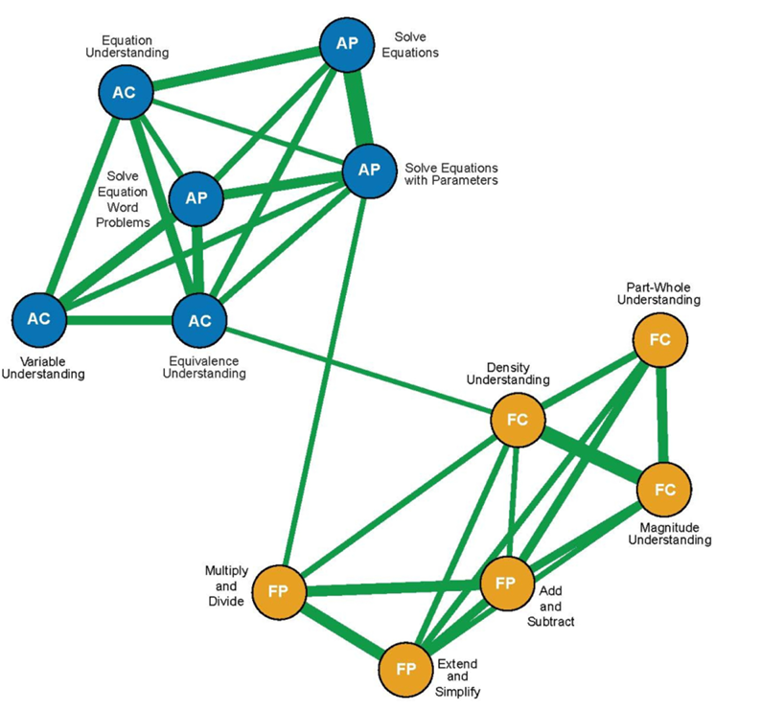
Model
Theory
- Mutual dependencies/ developmental effects between items (van der Maas et al., 2006; vanderWeele & Batty, 2023)
No latent variable
Unique (i.e., partial) correlations between items point to mutual dependencies/influences
Example: Forsmann et al. (2026)
Fraction density <-> algebraic equivalence
If responses do not correlate between items, you should not regard them as a unitary construct
0. Sum/mean scores make the assumption of equal factor loadings
We can choose from different ontologies (meta-theories) and theories to describe our construct of interest
as network
Item i
Item 1
Item …

Slide 36
Model
Theory
Know-ledge
as states
If responses do not correlate between items, you should not regard them as a unitary construct
λ₁
λ₁
λ₁
0. Sum/mean scores make the assumption of equal factor loadings
e.g., Kleickmann, 2011; Schneider & Hardy, 2013; Tasuoka, 1985; Wilson, 1989
We can choose from different ontologies (meta-theories) and theories to describe our construct of interest

Slide 37
Model
Theory
Know-ledge
as random effects
If responses do not correlate between items, you should not regard them as a unitary construct
Intervention
λ₁
λ₁
λ₁
0. Sum/mean scores make the assumption of equal factor loadings
Multilevel modeling
Items are treated as construct-relevant contexts (Donnellan et al., 2023)
Effects of interventions or development may systematically differ across items
Allows theoretical generalization across items (Yarkoni, 2020)
We can choose from different ontologies (meta-theories) and theories to describe our construct of interest

Slide 38
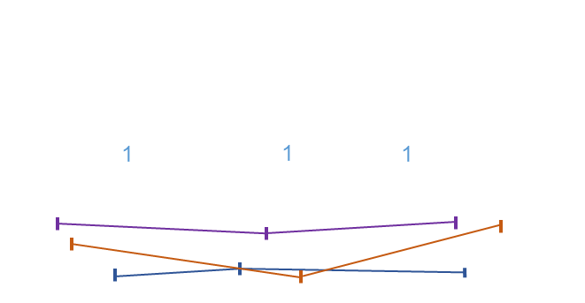





Model
Theory
If responses do not correlate between items, you should not regard them as a unitary construct
0. Sum/mean scores make the assumption of equal factor loadings
Group/time comparisons require measurement invariance
How?
We can choose from different ontologies (meta-theories) and theories to describe our construct of interest

Slide 39
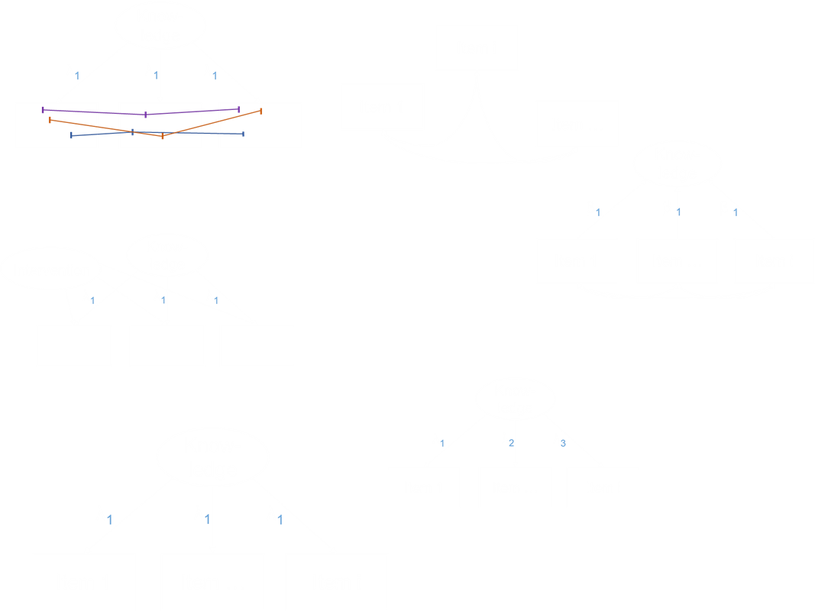
Model
Theory
Option 1: The empirical route
Statistical difference tests
between ontologies…
Factor vs. Mixture (e.g., DeBoeck & Wilson, 2005)
Factor vs. network (e.g., van Bork et al., 2021)
Factor vs. composite (e.g., Siegel et al., 2026)
…and theories (e.g., McNeish & Wolf, 2020)
We can choose from different ontologies (meta-theories) and theories to describe our construct of interest

Slide 40
Model
Theory
Option 2: The theoretical route
Step 1: Decide on your ontology
Factor vs. mixture vs. network…
Step 2: Decide on your theory
General vs. item-specific effects
We can choose from different ontologies (meta-theories) and theories to describe our construct of interest

Slide 41


Model
Theory
One of these is difficult…
One of these is futile…

Slide 42
Model
Theory
One of these is difficult…
One of these is futile…

Slide 43
Model
Theory
Beware of the inverse fallacy fit = theory (Edelsbrunner, 2022)
“Factor analysis may be useful in generating hypotheses about underlying causally efficacious univariate latent variables, but does nothing to establish this”
(vanderWeele, 2020)
Different ontologies typically predict the same means, variances, covariances (e.g., Marsman et al., 2018; Loken & Molenaar, 2007)
Difference tests make unrealistic assumptions (pure ontologies)
Theories are causal; assessment data observational (not experimental/“causal“);
Hidden causal modeling misattribution
One of these is futile…

Slide 44
Model
Theory
One of these is difficult…
Option 2: The theoretical route
Step 1: Decide on your ontology
Is your construct…
…continuous (more vs. less; e.g., factor/composite)
…categorical (qualitative differences; e.g., mixture)
…both (e.g., factor-mixture, mixture-network, hybrid SEM)?
Step 2: Decide on your theory
Are your items…
…construct relevant (all contributing; composite/ML)
…construct irrelevant (all capturing the same thing; factor)
…both (e.g., composite/reflective hybrid SEM)?
Step 3: What do you want?
…equal weights (e.g., sum score, Rasch)
…different weights (e.g., composite, factor
…both (ML)?
We can choose from different ontologies (meta-theories) to describe our construct of interest under theoretical justifications

Slide 45
Model
Theory
Option 2: The theoretical route
How can we get these?
We can choose from different ontologies (meta-theories) to describe our construct of interest under theoretical justifications
Theory-informed causal, formal, cognitive, & computational modeling

Slide 46
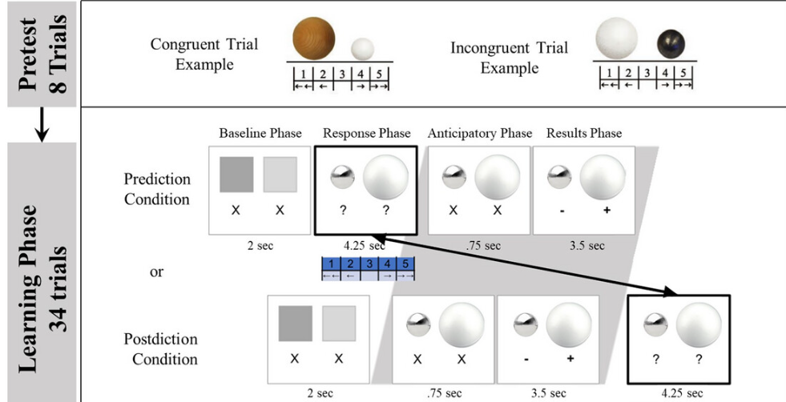
Model
Theory
Colantonio, … Brod, et al. (2024)
Bayesian computational models of belief updating about water displacement
«volume matters» vs. «material matters»
Knowledge tracing showing how predicting affects belief revision
We can choose from different ontologies (meta-theories) to describe our construct of interest under theoretical justifications

Slide 47
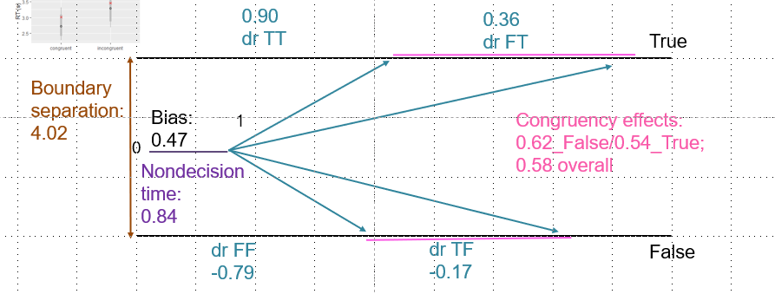
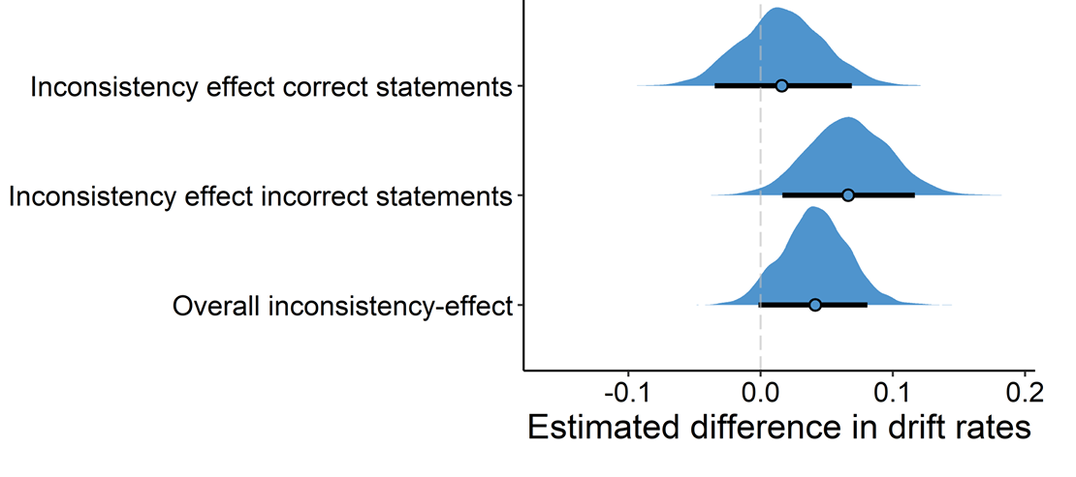
Model
Theory
Edelsbrunner & Singmann (2026)
Wiener Diffusion model about suppressing intuitive conceptions (Shtulman & Valcarcel, 2012)
«fires provide heat» vs. «coats provide heat»
Science expertise affects primarily correct statements
Longitudinal design:
No relation with inhibition
We can choose from different ontologies (meta-theories) to describe our construct of interest under theoretical justifications

Slide 48
Model
Theory
Back to (semi-) confirmatory modeling (e.g., Wilson, 1989)
Cognitive modeling
Computational modeling
Formal modeling
Causal inference
We can choose from different ontologies (meta-theories) to describe our construct of interest under theoretical justifications

Slide 49
Model
Theory
Specific wishes
- Multilevel modeling for hybrid overall/item-specific effects (Donnellan et al., 2023)
- Cognitive SEM hybrids (e.g., Rouder & Haaf, 2019)
Data-/GenAI-driven modeling (e.g., observational learning analytics) will be futile for causal aims (e.g., personalization)
Re-thinking of our field as a cognitive science that goes from the process of the individual to personalized learning and population development
The future is cognitive, formalized, computational, hierarchical, and causally informed (Robinaugh et al., 2021)
We can choose from different ontologies (meta-theories) to describe our construct of interest under theoretical justifications

Slide 50

thank you.
Baird, J.-A., Andrich, D., Hopfenbeck, T. N., & Stobart, G. (2017). Assessment and learning: Fields apart? Assessment in Education: Principles, Policy & Practice, 24(3), 317–350. https://doi.org/10.1080/0969594X.2017.1319337
Boone, W. J., & Staver, J. R. (2020). Advances in Rasch Analyses in the Human Sciences. Springer International Publishing. https://doi.org/10.1007/978-3-030-43420-5
Chai, C. S., Khine, M. S., & Teo, T. (2006). Epistemological beliefs on teaching and learning: A survey among pre‐service teachers in Singapore. Educational Media International, 43(4), 285–298. https://doi.org/10.1080/09523980600926242
Chan, K.-W., & Elliott, R. G. (2004). Relational analysis of personal epistemology and conceptions about teaching and learning. Teaching and teacher education, 20(8), 817–831.
Colantonio, J. A., Bascandziev, I., Theobald, M., Brod, G., & Bonawitz, E. (2024). Predicting Learning: Understanding the Role of Executive Functions in Children’s Belief Revision Using Bayesian Models. Topics in Cognitive Science, tops.12749. https://doi.org/10.1111/tops.12749
Conley, A. M., Pintrich, P. R., Vekiri, I., & Harrison, D. (2004). Changes in epistemological beliefs in elementary science students. Contemporary educational psychology, 29(2), 186–204.
De Boeck, P., Wilson, M., & Acton, G. S. (2005). A conceptual and psychometric framework for distinguishing categories and dimensions. Psychological Review, 112(1), 129.
DeBacker, T. K., Crowson, H. M., Beesley, A. D., Thoma, S. J., & Hestevold, N. L. (2008). The Challenge of Measuring Epistemic Beliefs: An Analysis of Three Self-Report Instruments. The Journal of Experimental Education, 76(3), 281–312. https://doi.org/10.3200/JEXE.76.3.281-314
Donnellan, E., Usami, S., & Murayama, K. (2023). Random item slope regression: An alternative measurement model that accounts for both similarities and differences in association with individual items. Psychological Methods. https://psycnet.apa.org/fulltext/2023-94082-001.html
Edelsbrunner, P. A. (2022). A model and its fit lie in the eye of the beholder: Long live the sum score. Frontiers in Psychology, 13, 986767.
Edelsbrunner, P. A., Schalk, L., Schumacher, R., & Stern, E. (2018). Variable control and conceptual change: A large-scale quantitative study in elementary school. Learning and Individual Differences, 66, 38–53.
Edelsbrunner, P. A., Simonsmeier, B. A., & Schneider, M. (2025). The Cronbach’s Alpha of Domain-Specific Knowledge Tests Before and After Learning: A Meta-Analysis of Published Studies. Educational Psychology Review, 37(1), 4. https://doi.org/10.1007/s10648-024-09982-y
Edelsbrunner, P., & Singmann, H. (2026). Interference Between Intuitive and Scientific Theories about the World: A Bayesian Hierarchical Diffusion Model [Artikel].
Forsmann, C. L., D’Erchie, M., Obersteiner, A., & Schneider, M. (2026). Connecting the dots: A psychometric network analysis of relations between students’ fraction and algebra knowledge. Learning and Individual Differences, 128, 102851.
Greene, J. A., & Seung, B. Y. (2014). Modeling and measuring epistemic cognition: A qualitative re-investigation. Contemporary Educational Psychology, 39(1), 12–28.
Grimm, H., Edelsbrunner, P. A., & Möller, K. (2023). Accommodating heterogeneity: The interaction of instructional scaffolding with student preconditions in the learning of hypothesis-based reasoning. Instructional Science, 51(1), 103–133. https://doi.org/10.1007/s11251-022-09601-9
Inhelder, B., & Piaget, J. (1958). The growth of logical thinking: From childhood to adolescence (S. xxvi, 378). Basic Books. https://doi.org/10.1037/10034-000
Jansen, B. R. J., & Van der Maas, H. L. J. (2001). Evidence for the Phase Transition from Rule I to Rule II on the Balance Scale Task. Developmental Review, 21(4), 450–494. https://doi.org/10.1006/drev.2001.0530
Jansen, B. R., & van der Maas, H. L. (1997). Statistical test of the rule assessment methodology by latent class analysis. Developmental Review, 17(3), 321–357.
Kainulainen, M., McMullen, J., & Lehtinen, E. (2016). Early developmental trajectories towards the concept of rational numbers. Cognition and Instruction. https://doi.org/10.1080/07370008.2016.1251287
Kleickmann, T., Hardy, I., Pollmeier, J., & Möller, K. (2011). Zur Struktur naturwissenschaftlichen Wissens von Grundschulkindern: Eine personen- und variablenzentrierte Analyse. Zeitschrift für Entwicklungspsychologie und Pädagogische Psychologie, 43(4), 200–212. https://doi.org/10.1026/0049-8637/a000053
Loken, E., & Molenaar, P. (2007). Categories or Continua?: The Correspondence Between Mixture Models and Factor Models. In G. R. Hancock & K. M. Samuelsen (Hrsg.), Advances in Latent Variable Mixture Models (S. 0). Emerald Publishing Limited. https://doi.org/10.1108/978-1-60752-634-620251015
Maassen, E., D’Urso, E. D., Van Assen, M. A., Nuijten, M. B., De Roover, K., & Wicherts, J. M. (2025). The dire disregard of measurement invariance testing in psychological science. Psychological Methods, 30(5), 966.
Marsman, M., Huth, K., Waldorp, L. J., & Ntzoufras, I. (2022). Objective Bayesian edge screening and structure selection for Ising networks. psychometrika, 87(1), 47–82.
Mason, L. (2016). Psychological perspectives on measuring epistemic cognition. In Handbook of epistemic cognition (S. 375–392). Routledge. https://api.taylorfrancis.com/content/chapters/edit/download?identifierName=doi&identifierValue=10.4324/9781315795225-28&type=chapterpdf
McMullen, J., Laakkonen, E., Hannula-Sormunen, M., & Lehtinen, E. (2015). Modeling the developmental trajectories of rational number concept(s). Learning and Instruction, 37, 14–20. https://doi.org/10.1016/j.learninstruc.2013.12.004
McNeish, D., & Wolf, M. G. (2020). Thinking twice about sum scores. Behavior Research Methods, 52(6), 2287–2305. https://doi.org/10.3758/s13428-020-01398-0
Merk, S., Rosman, T., Muis, K. R., Kelava, A., & Bohl, T. (2018). Topic specific epistemic beliefs: Extending the theory of integrated domains in personal epistemology. Learning and Instruction, 56, 84–97.
Robinaugh, D. J., Haslbeck, J. M. B., Ryan, O., Fried, E. I., & Waldorp, L. J. (2021). Invisible Hands and Fine Calipers: A Call to Use Formal Theory as a Toolkit for Theory Construction. Perspectives on Psychological Science, 16(4), 725–743. https://doi.org/10.1177/1745691620974697
Robitzsch, A., & Lüdtke, O. (2023). Why Full, Partial, or Approximate Measurement Invariance Are Not a Prerequisite for Meaningful and Valid Group Comparisons. Structural Equation Modeling: A Multidisciplinary Journal, 30(6), 859–870. https://doi.org/10.1080/10705511.2023.2191292
Sato, T. (1975). The construction and interpretation of SP tables. Tokyo: Meiji Tosho.
Schiefer, J., Edelsbrunner, P. A., Bernholt, A., Kampa, N., & Nehring, A. (2022). Epistemic Beliefs in Science—A Systematic Integration of Evidence From Multiple Studies. Educational Psychology Review, 34(3), 1541–1575. https://doi.org/10.1007/s10648-022-09661-w
Schneider, M., & Hardy, I. (2013). Profiles of inconsistent knowledge in children’s pathways of conceptual change. Developmental Psychology, 49(9), 1639–1649. https://doi.org/10.1037/a0030976
Schommer, M. (1990). Effects of beliefs about the nature of knowledge on comprehension. Journal of educational psychology, 82(3), 498.
Schommer, M. (1993). Epistemological development and academic performance among secondary students. Journal of educational psychology, 85(3), 406.
Schommer, M. (1994). Synthesizing epistemological belief research: Tentative understandings and provocative confusions. Educational Psychology Review, 6(4), 293–319. https://doi.org/10.1007/BF02213418
Siegel, D., Savalei, V., & Rhemtulla, M. (2026). Nested model comparisons between common factors and composites. Psychological Methods. https://psycnet.apa.org/record/2027-30455-001
Siegler, R. (1976). Three Aspects of Cognitive Development. Cognitive Psychology - COG PSYCHOL, 8, 481–520. https://doi.org/10.1016/0010-0285(76)90016-5
Stadler, M., Sailer, M., & Fischer, F. (2021). Knowledge as a formative construct: A good alpha is not always better. New Ideas in Psychology, 60, 100832.
Straatemeier, M., Van Der Maas, H. L. J., & Jansen, B. R. J. (2008). Children’s knowledge of the earth: A new methodological and statistical approach. Journal of Experimental Child Psychology, 100(4), 276–296. https://doi.org/10.1016/j.jecp.2008.03.004
Taber, K. S. (2018). The Use of Cronbach’s Alpha When Developing and Reporting Research Instruments in Science Education. Research in Science Education, 48(6), 1273–1296. https://doi.org/10.1007/s11165-016-9602-2
Tatsuoka, K. K. (1983). Rule Space: An Approach for Dealing with Misconceptions Based on Item Response Theory. Journal of Educational Measurement, 20(4), 345–354.
Van Bork, R., Rhemtulla, M., Waldorp, L. J., Kruis, J., Rezvanifar, S., & Borsboom, D. (2021). Latent Variable Models and Networks: Statistical Equivalence and Testability. Multivariate Behavioral Research, 56(2), 175–198. https://doi.org/10.1080/00273171.2019.1672515
Van Der Maas, H. L., Dolan, C. V., Grasman, R. P., Wicherts, J. M., Huizenga, H. M., & Raijmakers, M. E. (2006). A dynamical model of general intelligence: The positive manifold of intelligence by mutualism. Psychological review, 113(4), 842.
VanderWeele, T. J. (2022). Constructed Measures and Causal Inference: Towards a New Model of Measurement for Psychosocial Constructs. Epidemiology, 33(1), 141. https://doi.org/10.1097/EDE.0000000000001434
VanderWeele, T. J., & Batty, C. J. K. (2023). On the dimensional indeterminacy of one-wave factor analysis under causal effects. Journal of Causal Inference, 11(1), 20220074. https://doi.org/10.1515/jci-2022-0074
Vosniadou, S., & Brewer, W. F. (1992). Mental models of the earth: A study of conceptual change in childhood. Cognitive Psychology, 24(4), 535–585. https://doi.org/10.1016/0010-0285(92)90018-W
Wilson, M. (1989). Saltus: A psychometric model of discontinuity in cognitive development. Psychological Bulletin, 105(2), 276–289. https://doi.org/10.1037/0033-2909.105.2.276
Wilson, M., House, R., & Street, F. (o. J.). A Psychological Model of Hierarchical Development.
Yarkoni, T. (2020). The generalizability crisis. The Behavioral and brain sciences, 45, e1. https://doi.org/10.1017/S0140525X20001685
https://github.com/peter1328/presentations

Slide 51
Model
Theory
We can choose from different ontologies (meta-theories) to describe our construct of interest under theoretical justifications

Slide 52
Model
Theory
We need ways to test causal assumptions about our constructs of interest
…formal modeling
…computational modeling

Slide 53
90s/2000s
Theory
Model
Jansen & van der Maas (1997, 2002)
Inhelder & Piaget`s Theory of stage-wise development (1958)
Constrained latent class analysis
Siegler`s (1976) ruled-based assessment methodology
Consider (1) weight, (2) distance, (3) proportion of w/d
Formalized further potential rules:
Random answer in case of balance
Balance in case of w/d conflict
Acknowledgment of large distances only
Restriction of known item solution probabilities for Siegler Rules I – IV
Result: N = 484 7th- and 8th-graders:
Rules I and II very consistent, rules above partially
Notes:
E Equal problems (same values for both dominant (weight) and subordinate (distance) dimension
D Weight difference, same distance
S Distance difference, same weight
CD: Coflict-dominant: Weight and distance disagree, weight wins
CS: Conflict-subordinate: Disagreement, distance wins
CE: Conflict equal: Weight and distance disagree,

Slide 54
70s/80s
Theory
Model
Kikumi Tatsuoka (1983)
I`ve got an awesome idea!
Inhelder & Piaget`s Theory of stage-wise development (1958)
Siegler`s (1976) ruled-based assessment methodology
Consider (1) weight, (2) distance, (3) proportion of w/d
Notes:
In the 70s, predominant theories of leaners` knowledge were still rooted in Piaget`s model of step-wise development and, similarly in Siegler`s rule-based assessment methodology.
In this approach, you determine children`s developmental stage by presenting different balance beam tasks to them:
The Western World is still recovering from the Sputnik shock, enjoying newfound psychedelic rock and economic prosperity, and investing a lot into Science Education Research to be able to keep up with the educational offspring of the Soviet Union. Science education research is in bloom.
Everyone seems in agreement that we have to move from rote learning of facts and procedures towards conceptual understanding of science, that this is best achieved via engaging learners in authentic inquiry, and, in the wake of Thomas Kuhn`s new philosophy of Science, conceptual change research is in its formation.
Three kinds of knowledge that educational research is especially interested in manifest: …
Content knowledge about Scientific concepts,
Process knowledge about scientific inquiry,
and
Epistemological knowledge about the nature of Science
With Inhelder, B., The Growth of Logical Thinking from Childhood to Adolescence (New York: Basic Books, 1958) [De la logique de l'enfant à la logique de l'adolescent (1955)].
In Genetics, back then research on the Drosophila – the Fruit Fly with its more than 15,00 genes distributed across only four chrososomes – allowed developmental genetics to bloom; geneticists could just change a gene and see what it does to the fly`s development.
In Science Education, we have similar things:
The drosophila of content knowledge may be floating and sinking phenomena such as buoyancy and density, which, inspired by Jean Piaget and Bärbel Inhelder`s work, educational researchers have been tried to train in intervention studies likely thousands of times.
Similarly, the control-of-variables strategy, denoting the understanding that to find something out, it often works best to change one thing at a time, likely is the most trained process skill. David Klahr famously, similar to Geneticists changing a gene at a time, basically varied a thing at a time trying how to best teach the CVS for the last five decades.
Regarding Nature of Science, epistemic beliefs, for example about knowledge being something that is fixed or something that can change and develop, are likely its most central facet in educational research, although they are famously difficult to measure and even more so to intervene on.
Let`s jump in now:
For the last fifty years, educational researchers have tried to examine how these aspects of learners` knowledge develop and how we can modify their development through educational interventions.
How did they try to measure and model the outcomes of these interventions, that is, learners` knoweldge of science contents, process skills, and the nature of science?
There are two preconditions for gauging the impact of development and targeted interventions on learners` knowledge:
We have to measure it, and model it, with these two things often being intertwined.
Let`s see how educational researchers have tried to model learners` knowledge since the 1970s, how this has changed since then, and what we may learn for future research regarding how to better model learners` knowledge.
In the last decades, there is a trend in educational research to focus on learners` competencies, motivation and emotions, self-regulation and meta-cognition, -
Inquiry learning and conceptual change research share a lot of views on learners` knowledge and how it develops.
Inquiry learning typically emphasizes a constructivist view, in which building up knowledge in ways similar as scientists do should help learners build up experience-based procedural and conceptual understanding.
Conceptual change enriches this view by emphasizing that building up knowledge is commonly not a simple adding piece-by-piece process, but a highly non-linear and individualistic process in which prior knowledge plays a much more complicated role than just representing the basis to which new pieses are added.
In both research areas, knowledge is a central construct that they believe is important both as a predictor and an outcome of learning.
What is knowledge? I don`t have a clue.
I`m quite sure it`s a cognitive representation, of facts, procedures, events, concepts, schemata, and other ontological categories. I like to see knowledge as measurement:
Our brains represents central characteristics of phenomena in the world to help us make it more predictable and give us agency – maybe that`s what knowledge is. (show: Measurement: represent differences in something that we care about, capturing relations in differences in this some-thing in numbers)
Although no one can define what knowledge is, we have many ontological categories assembled within this term – maybe around 120.
We can summarize these as types and qualities of knowledge…
In inquiry learning and conceptual change researc, a central concept of interest is knowledge.
There are various types of knowledge -

Slide 55
70s/80s
Theory
Model
Kikumi Tatsuoka (1983)
I`ve got an awesome idea!
Inhelder & Piaget`s Theory of stage-wise development (1958)
Siegler`s (1976) ruled-based assessment methodology
Consider (1) weight, (2) distance, (3) proportion of w/d
Notes:
In the 70s, predominant theories of leaners` knowledge were still rooted in Piaget`s model of step-wise development and, similarly in Siegler`s rule-based assessment methodology.
In this approach, you determine children`s developmental stage by presenting different balance beam tasks to them:
The Western World is still recovering from the Sputnik shock, enjoying newfound psychedelic rock and economic prosperity, and investing a lot into Science Education Research to be able to keep up with the educational offspring of the Soviet Union. Science education research is in bloom.
Everyone seems in agreement that we have to move from rote learning of facts and procedures towards conceptual understanding of science, that this is best achieved via engaging learners in authentic inquiry, and, in the wake of Thomas Kuhn`s new philosophy of Science, conceptual change research is in its formation.
Three kinds of knowledge that educational research is especially interested in manifest: …
Content knowledge about Scientific concepts,
Process knowledge about scientific inquiry,
and
Epistemological knowledge about the nature of Science
With Inhelder, B., The Growth of Logical Thinking from Childhood to Adolescence (New York: Basic Books, 1958) [De la logique de l'enfant à la logique de l'adolescent (1955)].
In Genetics, back then research on the Drosophila – the Fruit Fly with its more than 15,00 genes distributed across only four chrososomes – allowed developmental genetics to bloom; geneticists could just change a gene and see what it does to the fly`s development.
In Science Education, we have similar things:
The drosophila of content knowledge may be floating and sinking phenomena such as buoyancy and density, which, inspired by Jean Piaget and Bärbel Inhelder`s work, educational researchers have been tried to train in intervention studies likely thousands of times.
Similarly, the control-of-variables strategy, denoting the understanding that to find something out, it often works best to change one thing at a time, likely is the most trained process skill. David Klahr famously, similar to Geneticists changing a gene at a time, basically varied a thing at a time trying how to best teach the CVS for the last five decades.
Regarding Nature of Science, epistemic beliefs, for example about knowledge being something that is fixed or something that can change and develop, are likely its most central facet in educational research, although they are famously difficult to measure and even more so to intervene on.
Let`s jump in now:
For the last fifty years, educational researchers have tried to examine how these aspects of learners` knowledge develop and how we can modify their development through educational interventions.
How did they try to measure and model the outcomes of these interventions, that is, learners` knoweldge of science contents, process skills, and the nature of science?
There are two preconditions for gauging the impact of development and targeted interventions on learners` knowledge:
We have to measure it, and model it, with these two things often being intertwined.
Let`s see how educational researchers have tried to model learners` knowledge since the 1970s, how this has changed since then, and what we may learn for future research regarding how to better model learners` knowledge.
In the last decades, there is a trend in educational research to focus on learners` competencies, motivation and emotions, self-regulation and meta-cognition, -
Inquiry learning and conceptual change research share a lot of views on learners` knowledge and how it develops.
Inquiry learning typically emphasizes a constructivist view, in which building up knowledge in ways similar as scientists do should help learners build up experience-based procedural and conceptual understanding.
Conceptual change enriches this view by emphasizing that building up knowledge is commonly not a simple adding piece-by-piece process, but a highly non-linear and individualistic process in which prior knowledge plays a much more complicated role than just representing the basis to which new pieses are added.
In both research areas, knowledge is a central construct that they believe is important both as a predictor and an outcome of learning.
What is knowledge? I don`t have a clue.
I`m quite sure it`s a cognitive representation, of facts, procedures, events, concepts, schemata, and other ontological categories. I like to see knowledge as measurement:
Our brains represents central characteristics of phenomena in the world to help us make it more predictable and give us agency – maybe that`s what knowledge is. (show: Measurement: represent differences in something that we care about, capturing relations in differences in this some-thing in numbers)
Although no one can define what knowledge is, we have many ontological categories assembled within this term – maybe around 120.
We can summarize these as types and qualities of knowledge…
In inquiry learning and conceptual change researc, a central concept of interest is knowledge.
There are various types of knowledge -

Slide 56
Take-home message
Theory
Model
Mark Wilson (1983)
This is so cool, let`s model it!
Causal modeling misattribution
Siegler`s (1976) ruled-based assessment methodology
Consider (1) weight, (2) distance, (3) proportion of w/d
Notes:
In the 70s, predominant theories of leaners` knowledge were still rooted in Piaget`s model of step-wise development and, similarly in Siegler`s rule-based assessment methodology.
In this approach, you determine children`s developmental stage by presenting different balance beam tasks to them:
The Western World is still recovering from the Sputnik shock, enjoying newfound psychedelic rock and economic prosperity, and investing a lot into Science Education Research to be able to keep up with the educational offspring of the Soviet Union. Science education research is in bloom.
Everyone seems in agreement that we have to move from rote learning of facts and procedures towards conceptual understanding of science, that this is best achieved via engaging learners in authentic inquiry, and, in the wake of Thomas Kuhn`s new philosophy of Science, conceptual change research is in its formation.
Three kinds of knowledge that educational research is especially interested in manifest: …
Content knowledge about Scientific concepts,
Process knowledge about scientific inquiry,
and
Epistemological knowledge about the nature of Science
With Inhelder, B., The Growth of Logical Thinking from Childhood to Adolescence (New York: Basic Books, 1958) [De la logique de l'enfant à la logique de l'adolescent (1955)].
In Genetics, back then research on the Drosophila – the Fruit Fly with its more than 15,00 genes distributed across only four chrososomes – allowed developmental genetics to bloom; geneticists could just change a gene and see what it does to the fly`s development.
In Science Education, we have similar things:
The drosophila of content knowledge may be floating and sinking phenomena such as buoyancy and density, which, inspired by Jean Piaget and Bärbel Inhelder`s work, educational researchers have been tried to train in intervention studies likely thousands of times.
Similarly, the control-of-variables strategy, denoting the understanding that to find something out, it often works best to change one thing at a time, likely is the most trained process skill. David Klahr famously, similar to Geneticists changing a gene at a time, basically varied a thing at a time trying how to best teach the CVS for the last five decades.
Regarding Nature of Science, epistemic beliefs, for example about knowledge being something that is fixed or something that can change and develop, are likely its most central facet in educational research, although they are famously difficult to measure and even more so to intervene on.
Let`s jump in now:
For the last fifty years, educational researchers have tried to examine how these aspects of learners` knowledge develop and how we can modify their development through educational interventions.
How did they try to measure and model the outcomes of these interventions, that is, learners` knoweldge of science contents, process skills, and the nature of science?
There are two preconditions for gauging the impact of development and targeted interventions on learners` knowledge:
We have to measure it, and model it, with these two things often being intertwined.
Let`s see how educational researchers have tried to model learners` knowledge since the 1970s, how this has changed since then, and what we may learn for future research regarding how to better model learners` knowledge.
In the last decades, there is a trend in educational research to focus on learners` competencies, motivation and emotions, self-regulation and meta-cognition, -
Inquiry learning and conceptual change research share a lot of views on learners` knowledge and how it develops.
Inquiry learning typically emphasizes a constructivist view, in which building up knowledge in ways similar as scientists do should help learners build up experience-based procedural and conceptual understanding.
Conceptual change enriches this view by emphasizing that building up knowledge is commonly not a simple adding piece-by-piece process, but a highly non-linear and individualistic process in which prior knowledge plays a much more complicated role than just representing the basis to which new pieses are added.
In both research areas, knowledge is a central construct that they believe is important both as a predictor and an outcome of learning.
What is knowledge? I don`t have a clue.
I`m quite sure it`s a cognitive representation, of facts, procedures, events, concepts, schemata, and other ontological categories. I like to see knowledge as measurement:
Our brains represents central characteristics of phenomena in the world to help us make it more predictable and give us agency – maybe that`s what knowledge is. (show: Measurement: represent differences in something that we care about, capturing relations in differences in this some-thing in numbers)
Although no one can define what knowledge is, we have many ontological categories assembled within this term – maybe around 120.
We can summarize these as types and qualities of knowledge…
In inquiry learning and conceptual change researc, a central concept of interest is knowledge.
There are various types of knowledge -

Slide 57
Modeling Knowledge
Yesterday
Today
Tomorrow
Notes:
Thank you for the introduction Xxx, welcome!
Let`s start in the 1970s.

Slide 58
Modeling Knowledge
Theory
Yesterday
Today
Tomorrow
Model
Peter Edelsbrunner
SIG3&20 Meeting Turku 2026
Notes:
Thank you for the kind introduction, Xxx, and
welcome!
Knowledge is generally considered to be a central outcome and powerful determinant of learning.
So let`s model it!
I will show how in educational research, theories have often inspired statistical models of knowledge, opening up new opportunities to put our theoretical assumptions to empirical testing.
Likewise, established statistical models have been imported into educational research to test assumptions about learners`knowledge.
I will argue that one of these two roads has worked better than the other and I developed an explanation for why this is so; that one generally works, whereas the other doesn`t. Using this explanation, I present predictions and wishes towards tomorrow`s statistical modeling of knowledge.
I will show how in the last decades, our theories of learners` knowledge have often been exported into methodological research, inspiring new ways how to model knowledge and enabling us to test our assumptions about it.
Likewise, established statistical modeling approaches have been imported into educational research aiming to model knowledge.
I will argue that one of these has been mostly a good idea, really allowing new insights for educational research, whereas the other one hasn`t .
Importantly, I demonstrate why in the mutual influence of our theories and statistical models of knowledge, one works, whereas the other one doesn`t, and how we can improve the latter one.
Finally, I will provide an educated guess, as to where our journey of the statistical modeling of learners` knowledge is going next.
Let`s start in the 70s!
Three wishes to future research on learners` knowledge:
Do not accept „prior knowledge“ as a powerful determinant of learning (-> find better ways to test this)
Develop interdisciplinary theories about interitem correlations :) („one level`s independence is the next level`s correlation“ :) )
- Computational modeling (further merging process with cognitive pscyhology/science)
Multilevel modeling: Combine marginal and individual item estimates :)
- Integrate ccogntivie processes, short-time dynamics, and long-term development
Contemporary educational research cares a lot about learners` competencies, emotions, motivation, aspirations, environmental behavior, self-regulation, meta-cognition, and health.
I don`t. I care about their knowledge. I consider knowledge to be a learner`s root cause for all of these; a necessary yet insufficient condition to be a competent, motivated, aspiring, self-regulated, and healthy learner.
Educational researchers are often interested in learners`knowledge:
Modeling Knowledge: Yesterday, Today, Tomorrow
Knowledge is a central predictor and outcome across a variety of educational contexts.
I discuss how knowledge has been represented and examined in statistical models throughout the last decades, connecting developments in statistical practices to theoretical developments in the fields of inquiry-based learning and conceptual change.
I argue that statistical modeling has served and will continue to serve as inspiration to educational theory in these areas, just as educational theory serves as inspiration for new modeling approaches that better represent our theoretical aims and assumptions.
Providing an overview of current modeling methodologies, such as factor analysis, multilevel-, mixture-, network-, and cognitive modeling and the role these play in current developments, I try engaging in informed clayrvoyance to show up future developments that may help us better represent the questions that we care about in statistical models of our learners` knowledge and its development.
I also argue that in translating our theories of knowledge into statistical models, our research aim is more important than rigid statistical rules. Based in multiple examples, I argue ways in which we can convince reviewers and colleagues that being guided by our theories or aims is generally more informative than being guided by data, but there may be boundaries to this perspective.
Learners` knowledge is a central predictor and outcome across a variety of educational contexts.
I discuss how knowledge has been represented and examined in statistical models throughout the last decades, connecting statistical developments to theoretical shifts in the fields of inquiry-based learning and conceptual change. Engaging in informed clairvoyance, I discuss future developments that may help us further refine our models for the questions that we care about. One principle I bring forward is that in setting up statistical models of knowledge, our theories and aims are generally more important than the details of empirical data, although there may be boundaries to this perspective – but where are these exactly?
I argue that statistical modeling has served and will continue to serve as inspiration to educational theory in these areas, just as educational theory serves as inspiration for new modeling approaches.
Providing an overview of current modeling approaches, such as factor analysis, multilevel-, mixture-, network-, and cognitive modeling and the role these play in current developments, I try engaging in informed clayrvoyance to show up future developments that may help us further refine our models for the questions that we care about. One principle I bring forward is that in setting up statistical models of knowledge, our theories and aims are generally more important than the details of empirical data, although there may be boundaries to this perspective – but where are these exactly?

Slide 59

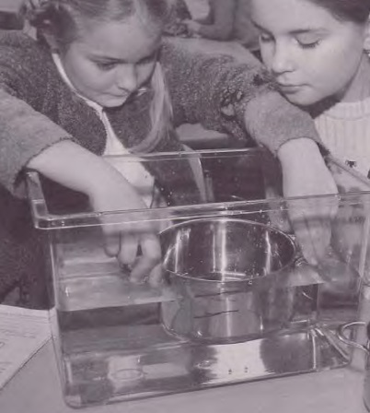
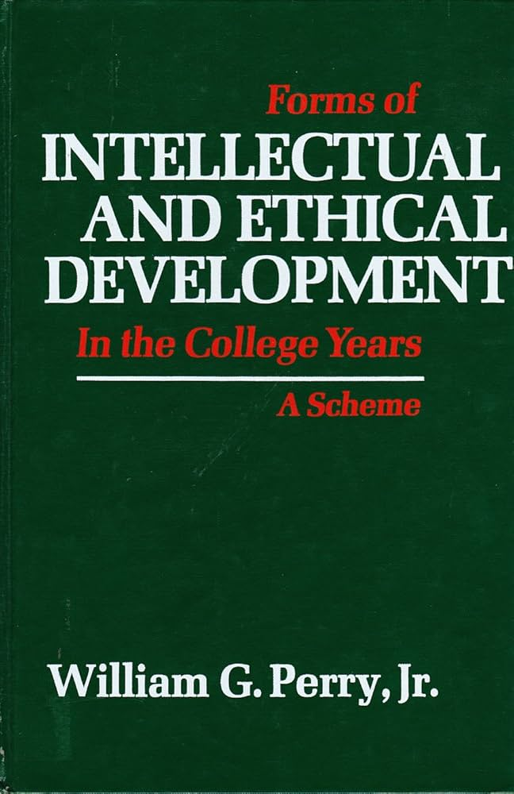
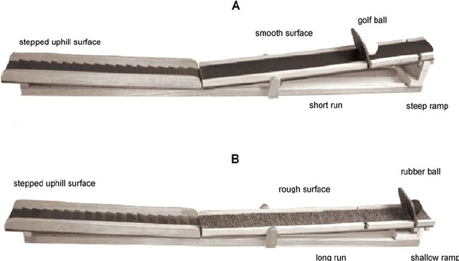
70s
Yesterday
Today
Tomorrow
Inquiry Learning & Conceptual Change
Genetics
Content knowledge
Process skills
Nature of Science
The Control-of-Variables Strategy
Epistemic Beliefs
The Drosophila
Floating and Sinking
Nüsslein-Volhard (1977)
Linn & Peterson (1973)
Hardy et al. (2006)
Schwichow & Zoupidis (2014)
Case & Fry (1973)
Siegler et al. (1973)
Klahr & Chen (1999)
Schwichow et al. (2016)
Perry (1970)
Schwartz et al. (2004)
Cartiff et al. (2021)
Notes:
The Western World is still recovering from the Sputnik shock, enjoying newfound psychedelic rock and economic prosperity, and investing a lot into Science Education Research to be able to keep up with the educational offspring of the Soviet Union. Science education research is in bloom.
Everyone seems in agreement that we have to move from rote learning of facts and procedures towards conceptual understanding of science, that this is best achieved via engaging learners in authentic inquiry, and, in the wake of Thomas Kuhn`s new philosophy of Science, conceptual change research is in its formation.
Three kinds of knowledge that educational research is especially interested in manifest: …
Content knowledge about Scientific concepts,
Process knowledge about scientific inquiry,
and
Epistemological knowledge about the nature of Science
In Genetics, back then research on the Drosophila – the Fruit Fly with ist more than 15,00 genes distributed between only four chrososomes – allowed developmental genetics to bloom; geneticists could just change a gene and see what it does to the fly`s development.
In Science Education, we have similar things:
The drosophila of content knowledge may be floating and sinking phenomena such as buoyancy and density, which, inspired by Jean Piaget and Bärbel Inhelder`s work, educational researchers have been tried to train in intervention studies likely thousands of times.
Similarly, the control-of-variables strategy, denoting the understanding that to find something out, it often works best to change one thing at a time, likely is the most trained process skill. David Klahr famously, similar to Geneticists changing a gene at a time, basically varied a thing at a time trying how to best teach the CVS for the last five decades.
Regarding Nature of Science, epistemic beliefs, for example about knowledge being something that is fixed or something that can change and develop, are likely its most central facet in educational research, although they are famously difficult to measure and even more so to intervene on.
Let`s jump in now:
For the last fifty years, educational researchers have tried to examine how these aspects of learners` knowledge develop and how we can modify their development through educational interventions.
How did they try to measure and model the outcomes of these interventions, that is, learners` knoweldge of science contents, process skills, and the nature of science?
We start with the control-
There are two preconditions for gauging the impact of development and targeted interventions on learners` knowledge:
We have to measure it, and model it, with these two things often being intertwined.
Let`s see how educational researchers have tried to model learners` knowledge since the 1970s, how this has changed since then, and what we may learn for future research regarding how to better model learners` knowledge.
In the last decades, there is a trend in educational research to focus on learners` competencies, motivation and emotions, self-regulation and meta-cognition, -
Inquiry learning and conceptual change research share a lot of views on learners` knowledge and how it develops.
Inquiry learning typically emphasizes a constructivist view, in which building up knowledge in ways similar as scientists do should help learners build up experience-based procedural and conceptual understanding.
Conceptual change enriches this view by emphasizing that building up knowledge is commonly not a simple adding piece-by-piece process, but a highly non-linear and individualistic process in which prior knowledge plays a much more complicated role than just representing the basis to which new pieses are added.
In both research areas, knowledge is a central construct that they believe is important both as a predictor and an outcome of learning.
What is knowledge? I don`t have a clue.
I`m quite sure it`s a cognitive representation, of facts, procedures, events, concepts, schemata, and other ontological categories. I like to see knowledge as measurement:
Our brains represents central characteristics of phenomena in the world to help us make it more predictable and give us agency – maybe that`s what knowledge is. (show: Measurement: represent differences in something that we care about, capturing relations in differences in this some-thing in numbers)
Although no one can define what knowledge is, we have many ontological categories assembled within this term – maybe around 120.
We can summarize these as types and qualities of knowledge…
In inquiry learning and conceptual change researc, a central concept of interest is knowledge.
There are various types of knowledge -

Slide 60
70s
Theory
Model
Inhelder & Piaget`s Theory of stage-wise development (1958)
Siegler`s (1958)
Notes:
In the 70s, predominant theories of leaners` knowledge were still rooted in Piaget`s model of step-wise development and, similarly in
The Western World is still recovering from the Sputnik shock, enjoying newfound psychedelic rock and economic prosperity, and investing a lot into Science Education Research to be able to keep up with the educational offspring of the Soviet Union. Science education research is in bloom.
Everyone seems in agreement that we have to move from rote learning of facts and procedures towards conceptual understanding of science, that this is best achieved via engaging learners in authentic inquiry, and, in the wake of Thomas Kuhn`s new philosophy of Science, conceptual change research is in its formation.
Three kinds of knowledge that educational research is especially interested in manifest: …
Content knowledge about Scientific concepts,
Process knowledge about scientific inquiry,
and
Epistemological knowledge about the nature of Science
With Inhelder, B., The Growth of Logical Thinking from Childhood to Adolescence (New York: Basic Books, 1958) [De la logique de l'enfant à la logique de l'adolescent (1955)].
In Genetics, back then research on the Drosophila – the Fruit Fly with its more than 15,00 genes distributed across only four chrososomes – allowed developmental genetics to bloom; geneticists could just change a gene and see what it does to the fly`s development.
In Science Education, we have similar things:
The drosophila of content knowledge may be floating and sinking phenomena such as buoyancy and density, which, inspired by Jean Piaget and Bärbel Inhelder`s work, educational researchers have been tried to train in intervention studies likely thousands of times.
Similarly, the control-of-variables strategy, denoting the understanding that to find something out, it often works best to change one thing at a time, likely is the most trained process skill. David Klahr famously, similar to Geneticists changing a gene at a time, basically varied a thing at a time trying how to best teach the CVS for the last five decades.
Regarding Nature of Science, epistemic beliefs, for example about knowledge being something that is fixed or something that can change and develop, are likely its most central facet in educational research, although they are famously difficult to measure and even more so to intervene on.
Let`s jump in now:
For the last fifty years, educational researchers have tried to examine how these aspects of learners` knowledge develop and how we can modify their development through educational interventions.
How did they try to measure and model the outcomes of these interventions, that is, learners` knoweldge of science contents, process skills, and the nature of science?
There are two preconditions for gauging the impact of development and targeted interventions on learners` knowledge:
We have to measure it, and model it, with these two things often being intertwined.
Let`s see how educational researchers have tried to model learners` knowledge since the 1970s, how this has changed since then, and what we may learn for future research regarding how to better model learners` knowledge.
In the last decades, there is a trend in educational research to focus on learners` competencies, motivation and emotions, self-regulation and meta-cognition, -
Inquiry learning and conceptual change research share a lot of views on learners` knowledge and how it develops.
Inquiry learning typically emphasizes a constructivist view, in which building up knowledge in ways similar as scientists do should help learners build up experience-based procedural and conceptual understanding.
Conceptual change enriches this view by emphasizing that building up knowledge is commonly not a simple adding piece-by-piece process, but a highly non-linear and individualistic process in which prior knowledge plays a much more complicated role than just representing the basis to which new pieses are added.
In both research areas, knowledge is a central construct that they believe is important both as a predictor and an outcome of learning.
What is knowledge? I don`t have a clue.
I`m quite sure it`s a cognitive representation, of facts, procedures, events, concepts, schemata, and other ontological categories. I like to see knowledge as measurement:
Our brains represents central characteristics of phenomena in the world to help us make it more predictable and give us agency – maybe that`s what knowledge is. (show: Measurement: represent differences in something that we care about, capturing relations in differences in this some-thing in numbers)
Although no one can define what knowledge is, we have many ontological categories assembled within this term – maybe around 120.
We can summarize these as types and qualities of knowledge…
In inquiry learning and conceptual change researc, a central concept of interest is knowledge.
There are various types of knowledge -

Slide 61
The foundations of educational research: Individual items and the sum score
Yesterday
Today
Tomorrow
70s-80s: Learners`progressions through individual items/tasks
Multiple items: Sum (or mean) score
Split-half reliability
Little validity evidence
Knowledge
Item response(s)
Notes:
The Western World is still recovering from the Sputnik shock, enjoying newfound psychedelic rock and economic prosperity, and investing a lot into Science Education Research to be able to keep up with the educational offspring of the Soviet Union. Science education research is in bloom.
Everyone seems in agreement that we have to move from rote learning of facts and procedures towards teaching conceptual understanding, that this is best achieved via engaging learners in authentic inquiry, and, in the wake of Thomas Kuhn`s new philosophy of Science, conceptual change research is in its formation.
Three kinds of knowledge that educational research is especially interested in manifest: …
Content knowledge about Scientific concepts,
Process knowledge about scientific inquiry,
and
Epistemological knowledge about the nature of Science
In Genetics, back then research on the Drosophila – the Fruit Fly – allowed developmental genetics to bloom; geneticists could just change a gene and see what it does to the fly`s development.
In Science Education, we have similar things:
The drosophila of content knowledge may be floating and sinking phenomena such as buoyancy and density, which, inspired by Jean Piaget and Bärbel Inhelder`s work, educational researchers have been tried to train in intervention studies likely thousands of times.
Similarly, the control-of-variables strategy, denoting the understanding that to find something out, it often works best to change one thing at a time, likely is the most trained process skill. David Klahr famously, similar to Geneticists changing a gene at a time, basically varied a thing at a time trying how to best teach the CVS for the last five decades.
Regarding Nature of Science, epistemic beliefs, for example about knowledge being something that is fixed or something that can change and develop, are likely its most central facet in educational research, although they are famously difficult to measure and even more so to intervene on.
Let`s jump in now:
For the last fifty years, educational researchers have tried to examine how these aspects of learners` knowledge develop and how we can affect their development through educational interventions. There are two preconditions for gauging the impact of development and targeted interventions on learners` knowledge:
We have to measure it, and model it, with these two things often being intertwined.
Let`s see how educational researchers have tried to model learners` knowledge since the 1970s, how this has changed since then, and what we may learn for future research regarding how to better model learners` knowledge.
In the last decades, there is a trend in educational research to focus on learners` competencies, motivation and emotions, self-regulation and meta-cognition, -
Inquiry learning and conceptual change research share a lot of views on learners` knowledge and how it develops.
Inquiry learning typically emphasizes a constructivist view, in which building up knowledge in ways similar as scientists do should help learners build up experience-based procedural and conceptual understanding.
Conceptual change enriches this view by emphasizing that building up knowledge is commonly not a simple adding piece-by-piece process, but a highly non-linear and individualistic process in which prior knowledge plays a much more complicated role than just representing the basis to which new pieses are added.
In both research areas, knowledge is a central construct that they believe is important both as a predictor and an outcome of learning.
What is knowledge? I don`t have a clue.
I`m quite sure it`s a cognitive representation, of facts, procedures, events, concepts, schemata, and other ontological categories. I like to see knowledge as measurement:
Our brains represents central characteristics of phenomena in the world to help us make it more predictable and give us agency – maybe that`s what knowledge is. (show: Measurement: represent differences in something that we care about, capturing relations in differences in this some-thing in numbers)
Although no one can define what knowledge is, we have many ontological categories assembled within this term – maybe around 120.
We can summarize these as types and qualities of knowledge…
In inquiry learning and conceptual change researc, a central concept of interest is knowledge.
There are various types of knowledge -

Slide 62
Conclusion 1:
Exporting theory into statistics:
Statistical models make psychological theories about educational phenomena testable; Wislon rejected clear separation of the Piaget stages (1985/1989 Saltus), Edelsbrunner rejects the inhibition-explanation of conceptual co-activation; Jansen/Visser did not find all rules by Siegler (?) but another one (?)
Future outlook:
- Stronger testability through formal and computational modeling
Conclusion 2:
If your model does not fit, your model may be wrong
Future outlook:
Intentional misspecification
Conclusion 3:
Item intercorrelations
Future outlook:
Develop and test theories about their occurrence
Statistical modeling testing our theories of knowledge
Yesterday
Today
Tomorrow
Piaget stages
Item response theory (Saltus, Wilson 1985/1989)
Continous knowledge scores
Siegler three stages
(Constrained) latent class analysis
Cognitive diagnosis modeling (Tasuoka, 1983 rule space)
Knowledge space theory (Falmagne, 1985)
Hidden markov models
Competence models
Rasch modeling
Vosniadou Framework theories
diSessa p-prims
Latent transition analysis
Scientific reasoning :(
Rasch modeling (FA)
Network modeling
Shtulman
Diffusion modeling
Bayesian modeling (Shtulman, Reinhold,…)
…knowledge tracing??
Factor analysis
The problem child… only meta-theory ever imported from stat methodlogy into educational research? Model fit Roberts Pashler, etc.
Sum score debate, Alpha debate,…

Slide 63
Educational research goes textbook: Cronbach`s Alpha and Factor analysis
Yesterday
Today
Tomorrow
70s-80s: Learners`progressions through individual items/tasks
Multiple items: Sum (or mean) score
Split-half reliability
Little validity evidence
Knowledge
Item response(s)
Notes:
The Western World is still recovering from the Sputnik shock, enjoying newfound psychedelic rock and economic prosperity, and investing a lot into Science Education Research to be able to keep up with the educational offspring of the Soviet Union. Science education research is in bloom.
Everyone seems in agreement that we have to move from rote learning of facts and procedures towards teaching conceptual understanding, that this is best achieved via engaging learners in authentic inquiry, and, in the wake of Thomas Kuhn`s new philosophy of Science, conceptual change research is in its formation.
Three kinds of knowledge that educational research is especially interested in manifest: …
Content knowledge about Scientific concepts,
Process knowledge about scientific inquiry,
and
Epistemological knowledge about the nature of Science
In Genetics, back then research on the Drosophila – the Fruit Fly – allowed developmental genetics to bloom; geneticists could just change a gene and see what it does to the fly`s development.
In Science Education, we have similar things:
The drosophila of content knowledge may be floating and sinking phenomena such as buoyancy and density, which, inspired by Jean Piaget and Bärbel Inhelder`s work, educational researchers have been tried to train in intervention studies likely thousands of times.
Similarly, the control-of-variables strategy, denoting the understanding that to find something out, it often works best to change one thing at a time, likely is the most trained process skill. David Klahr famously, similar to Geneticists changing a gene at a time, basically varied a thing at a time trying how to best teach the CVS for the last five decades.
Regarding Nature of Science, epistemic beliefs, for example about knowledge being something that is fixed or something that can change and develop, are likely its most central facet in educational research, although they are famously difficult to measure and even more so to intervene on.
Let`s jump in now:
For the last fifty years, educational researchers have tried to examine how these aspects of learners` knowledge develop and how we can affect their development through educational interventions. There are two preconditions for gauging the impact of development and targeted interventions on learners` knowledge:
We have to measure it, and model it, with these two things often being intertwined.
Let`s see how educational researchers have tried to model learners` knowledge since the 1970s, how this has changed since then, and what we may learn for future research regarding how to better model learners` knowledge.
In the last decades, there is a trend in educational research to focus on learners` competencies, motivation and emotions, self-regulation and meta-cognition, -
Inquiry learning and conceptual change research share a lot of views on learners` knowledge and how it develops.
Inquiry learning typically emphasizes a constructivist view, in which building up knowledge in ways similar as scientists do should help learners build up experience-based procedural and conceptual understanding.
Conceptual change enriches this view by emphasizing that building up knowledge is commonly not a simple adding piece-by-piece process, but a highly non-linear and individualistic process in which prior knowledge plays a much more complicated role than just representing the basis to which new pieses are added.
In both research areas, knowledge is a central construct that they believe is important both as a predictor and an outcome of learning.
What is knowledge? I don`t have a clue.
I`m quite sure it`s a cognitive representation, of facts, procedures, events, concepts, schemata, and other ontological categories. I like to see knowledge as measurement:
Our brains represents central characteristics of phenomena in the world to help us make it more predictable and give us agency – maybe that`s what knowledge is. (show: Measurement: represent differences in something that we care about, capturing relations in differences in this some-thing in numbers)
Although no one can define what knowledge is, we have many ontological categories assembled within this term – maybe around 120.
We can summarize these as types and qualities of knowledge…
In inquiry learning and conceptual change researc, a central concept of interest is knowledge.
There are various types of knowledge -

Slide 64
Beyond the textbook: Adapting models to theories
Yesterday
Today
Tomorrow
Abandoning Cronbach`s Alpha
Abandoning measurement invariance
Knowledge
Item response(s)
Notes:
The Western World is still recovering from the Sputnik shock, enjoying newfound psychedelic rock and economic prosperity, and investing a lot into Science Education Research to be able to keep up with the educational offspring of the Soviet Union. Science education research is in bloom.
Everyone seems in agreement that we have to move from rote learning of facts and procedures towards teaching conceptual understanding, that this is best achieved via engaging learners in authentic inquiry, and, in the wake of Thomas Kuhn`s new philosophy of Science, conceptual change research is in its formation.
Three kinds of knowledge that educational research is especially interested in manifest: …
Content knowledge about Scientific concepts,
Process knowledge about scientific inquiry,
and
Epistemological knowledge about the nature of Science
In Genetics, back then research on the Drosophila – the Fruit Fly – allowed developmental genetics to bloom; geneticists could just change a gene and see what it does to the fly`s development.
In Science Education, we have similar things:
The drosophila of content knowledge may be floating and sinking phenomena such as buoyancy and density, which, inspired by Jean Piaget and Bärbel Inhelder`s work, educational researchers have been tried to train in intervention studies likely thousands of times.
Similarly, the control-of-variables strategy, denoting the understanding that to find something out, it often works best to change one thing at a time, likely is the most trained process skill. David Klahr famously, similar to Geneticists changing a gene at a time, basically varied a thing at a time trying how to best teach the CVS for the last five decades.
Regarding Nature of Science, epistemic beliefs, for example about knowledge being something that is fixed or something that can change and develop, are likely its most central facet in educational research, although they are famously difficult to measure and even more so to intervene on.
Let`s jump in now:
For the last fifty years, educational researchers have tried to examine how these aspects of learners` knowledge develop and how we can affect their development through educational interventions. There are two preconditions for gauging the impact of development and targeted interventions on learners` knowledge:
We have to measure it, and model it, with these two things often being intertwined.
Let`s see how educational researchers have tried to model learners` knowledge since the 1970s, how this has changed since then, and what we may learn for future research regarding how to better model learners` knowledge.
In the last decades, there is a trend in educational research to focus on learners` competencies, motivation and emotions, self-regulation and meta-cognition, -
Inquiry learning and conceptual change research share a lot of views on learners` knowledge and how it develops.
Inquiry learning typically emphasizes a constructivist view, in which building up knowledge in ways similar as scientists do should help learners build up experience-based procedural and conceptual understanding.
Conceptual change enriches this view by emphasizing that building up knowledge is commonly not a simple adding piece-by-piece process, but a highly non-linear and individualistic process in which prior knowledge plays a much more complicated role than just representing the basis to which new pieses are added.
In both research areas, knowledge is a central construct that they believe is important both as a predictor and an outcome of learning.
What is knowledge? I don`t have a clue.
I`m quite sure it`s a cognitive representation, of facts, procedures, events, concepts, schemata, and other ontological categories. I like to see knowledge as measurement:
Our brains represents central characteristics of phenomena in the world to help us make it more predictable and give us agency – maybe that`s what knowledge is. (show: Measurement: represent differences in something that we care about, capturing relations in differences in this some-thing in numbers)
Although no one can define what knowledge is, we have many ontological categories assembled within this term – maybe around 120.
We can summarize these as types and qualities of knowledge…
In inquiry learning and conceptual change researc, a central concept of interest is knowledge.
There are various types of knowledge -

Slide 65
Beyond the textbook: Adapting models to theories
Yesterday
Today
Tomorrow
Abandoning Cronbach`s Alpha
Abandoning measurement invariance
Knowledge
Item response(s)
Notes:
The Western World is still recovering from the Sputnik shock, enjoying newfound psychedelic rock and economic prosperity, and investing a lot into Science Education Research to be able to keep up with the educational offspring of the Soviet Union. Science education research is in bloom.
Everyone seems in agreement that we have to move from rote learning of facts and procedures towards teaching conceptual understanding, that this is best achieved via engaging learners in authentic inquiry, and, in the wake of Thomas Kuhn`s new philosophy of Science, conceptual change research is in its formation.
Three kinds of knowledge that educational research is especially interested in manifest: …
Content knowledge about Scientific concepts,
Process knowledge about scientific inquiry,
and
Epistemological knowledge about the nature of Science
In Genetics, back then research on the Drosophila – the Fruit Fly – allowed developmental genetics to bloom; geneticists could just change a gene and see what it does to the fly`s development.
In Science Education, we have similar things:
The drosophila of content knowledge may be floating and sinking phenomena such as buoyancy and density, which, inspired by Jean Piaget and Bärbel Inhelder`s work, educational researchers have been tried to train in intervention studies likely thousands of times.
Similarly, the control-of-variables strategy, denoting the understanding that to find something out, it often works best to change one thing at a time, likely is the most trained process skill. David Klahr famously, similar to Geneticists changing a gene at a time, basically varied a thing at a time trying how to best teach the CVS for the last five decades.
Regarding Nature of Science, epistemic beliefs, for example about knowledge being something that is fixed or something that can change and develop, are likely its most central facet in educational research, although they are famously difficult to measure and even more so to intervene on.
Let`s jump in now:
For the last fifty years, educational researchers have tried to examine how these aspects of learners` knowledge develop and how we can affect their development through educational interventions. There are two preconditions for gauging the impact of development and targeted interventions on learners` knowledge:
We have to measure it, and model it, with these two things often being intertwined.
Let`s see how educational researchers have tried to model learners` knowledge since the 1970s, how this has changed since then, and what we may learn for future research regarding how to better model learners` knowledge.
In the last decades, there is a trend in educational research to focus on learners` competencies, motivation and emotions, self-regulation and meta-cognition, -
Inquiry learning and conceptual change research share a lot of views on learners` knowledge and how it develops.
Inquiry learning typically emphasizes a constructivist view, in which building up knowledge in ways similar as scientists do should help learners build up experience-based procedural and conceptual understanding.
Conceptual change enriches this view by emphasizing that building up knowledge is commonly not a simple adding piece-by-piece process, but a highly non-linear and individualistic process in which prior knowledge plays a much more complicated role than just representing the basis to which new pieses are added.
In both research areas, knowledge is a central construct that they believe is important both as a predictor and an outcome of learning.
What is knowledge? I don`t have a clue.
I`m quite sure it`s a cognitive representation, of facts, procedures, events, concepts, schemata, and other ontological categories. I like to see knowledge as measurement:
Our brains represents central characteristics of phenomena in the world to help us make it more predictable and give us agency – maybe that`s what knowledge is. (show: Measurement: represent differences in something that we care about, capturing relations in differences in this some-thing in numbers)
Although no one can define what knowledge is, we have many ontological categories assembled within this term – maybe around 120.
We can summarize these as types and qualities of knowledge…
In inquiry learning and conceptual change researc, a central concept of interest is knowledge.
There are various types of knowledge -

Slide 66
(1) What are the characteristics of learners` initial knowledge before they undergo instruction, learning, or development?
(2) How does learners` knowledge after instruction, learning, or development differ from their initial knowledge?
Pretest
Posttest
Change
(3) What are the mechanisms and processes characterizing change?
Carey (2011)
Notes:
Papers to mention:
Schneider & Hardy (Vorläufer: Jansen & van der Maas CLCA; d)
Kleickmann
Brod (Vorläufer: Microgenetic analysis -> Schauble 1996 oder 1990 mit CVS oder was das war; oder auch Chen & Klahr 1999? All other Things bein equal))
Math Network
Shtulman DiffMod (PE: Individual differences-paper, DiffMod-Paper, inhibition-paper); next steps: Considering the reliability paradox.
Multilevel vs. individual items (construct relevance vs. irrelevance)
Theoretical ideas to mention:
Humans as intuitive scientists as a perspective/theory:
Moderated factor analysis: Schwichow et al. (in press)
Theories typically start from one of the extremes:
Simplicity, or complexity.
I argue that both represent an initial state of ignorance. Of course, there are systematic pattern that moderate simple theories or make complex theories less complex.
Theory development is often about finding these structures/invariances.
In the last decades, there is a trend in educational research to focus on learners` competencies, motivation and emotions, self-regulation and meta-cognition, -
Inquiry learning and conceptual change research share a lot of views on learners` knowledge and how it develops.
Inquiry learning typically emphasizes a constructivist view, in which building up knowledge in ways similar as scientists do should help learners build up experience-based procedural and conceptual understanding.
Conceptual change enriches this view by emphasizing that building up knowledge is commonly not a simple adding piece-by-piece process, but a highly non-linear and individualistic process in which prior knowledge plays a much more complicated role than just representing the basis to which new pieses are added.
In both research areas, knowledge is a central construct that they believe is important both as a predictor and an outcome of learning.
What is knowledge? I don`t have a clue.
I`m quite sure it`s a cognitive representation, of facts, procedures, events, concepts, schemata, and other ontological categories. I like to see knowledge as measurement:
Our brains represents central characteristics of phenomena in the world to help us make it more predictable and give us agency – maybe that`s what knowledge is. (show: Measurement: represent differences in something that we care about, capturing relations in differences in this some-thing in numbers)
Although no one can define what knowledge is, we have many ontological categories assembled within this term – maybe around 120.
We can summarize these as types and qualities of knowledge…
In inquiry learning and conceptual change researc, a central concept of interest is knowledge.
There are various types of knowledge -

Slide 67
Level 1: The intuitive approach; sum-and-alpha
Level 2: The psychometric approach; factor analysis/IRT
Level 3: The theoretic approach
Carey (2011)
Notes:
Papers to mention:
Schneider & Hardy (Vorläufer: Jansen & van der Maas CLCA; d)
Kleickmann
Brod (Vorläufer: Microgenetic analysis -> Schauble 1996 oder 1990 mit CVS oder was das war; oder auch Chen & Klahr 1999? All other Things bein equal))
Math Network
Shtulman DiffMod (PE: Individual differences-paper, DiffMod-Paper, inhibition-paper); next steps: Considering the reliability paradox.
Multilevel vs. individual items (construct relevance vs. irrelevance)
Theoretical ideas to mention:
Humans as intuitive scientists as a perspective/theory:
Moderated factor analysis: Schwichow et al. (in press)
Theories typically start from one of the extremes:
Simplicity, or complexity.
I argue that both represent an initial state of ignorance. Of course, there are systematic pattern that moderate simple theories or make complex theories less complex.
Theory development is often about finding these structures/invariances.
In the last decades, there is a trend in educational research to focus on learners` competencies, motivation and emotions, self-regulation and meta-cognition, -
Inquiry learning and conceptual change research share a lot of views on learners` knowledge and how it develops.
Inquiry learning typically emphasizes a constructivist view, in which building up knowledge in ways similar as scientists do should help learners build up experience-based procedural and conceptual understanding.
Conceptual change enriches this view by emphasizing that building up knowledge is commonly not a simple adding piece-by-piece process, but a highly non-linear and individualistic process in which prior knowledge plays a much more complicated role than just representing the basis to which new pieses are added.
In both research areas, knowledge is a central construct that they believe is important both as a predictor and an outcome of learning.
What is knowledge? I don`t have a clue.
I`m quite sure it`s a cognitive representation, of facts, procedures, events, concepts, schemata, and other ontological categories. I like to see knowledge as measurement:
Our brains represents central characteristics of phenomena in the world to help us make it more predictable and give us agency – maybe that`s what knowledge is. (show: Measurement: represent differences in something that we care about, capturing relations in differences in this some-thing in numbers)
Although no one can define what knowledge is, we have many ontological categories assembled within this term – maybe around 120.
We can summarize these as types and qualities of knowledge…
In inquiry learning and conceptual change researc, a central concept of interest is knowledge.
There are various types of knowledge -

Slide 68
Never let a methodologist tell you what to do
Never let a methodologist tell you what to want
Carey (2011)
Notes:
Papers to mention:
Schneider & Hardy (Vorläufer: Jansen & van der Maas CLCA; d)
Kleickmann
Brod (Vorläufer: Microgenetic analysis -> Schauble 1996 oder 1990 mit CVS oder was das war; oder auch Chen & Klahr 1999? All other Things bein equal))
Math Network
Shtulman DiffMod (PE: Individual differences-paper, DiffMod-Paper, inhibition-paper); next steps: Considering the reliability paradox.
Multilevel vs. individual items (construct relevance vs. irrelevance)
Theoretical ideas to mention:
Humans as intuitive scientists as a perspective/theory:
Moderated factor analysis: Schwichow et al. (in press)
Theories typically start from one of the extremes:
Simplicity, or complexity.
I argue that both represent an initial state of ignorance. Of course, there are systematic pattern that moderate simple theories or make complex theories less complex.
Theory development is often about finding these structures/invariances.
In the last decades, there is a trend in educational research to focus on learners` competencies, motivation and emotions, self-regulation and meta-cognition, -
Inquiry learning and conceptual change research share a lot of views on learners` knowledge and how it develops.
Inquiry learning typically emphasizes a constructivist view, in which building up knowledge in ways similar as scientists do should help learners build up experience-based procedural and conceptual understanding.
Conceptual change enriches this view by emphasizing that building up knowledge is commonly not a simple adding piece-by-piece process, but a highly non-linear and individualistic process in which prior knowledge plays a much more complicated role than just representing the basis to which new pieses are added.
In both research areas, knowledge is a central construct that they believe is important both as a predictor and an outcome of learning.
What is knowledge? I don`t have a clue.
I`m quite sure it`s a cognitive representation, of facts, procedures, events, concepts, schemata, and other ontological categories. I like to see knowledge as measurement:
Our brains represents central characteristics of phenomena in the world to help us make it more predictable and give us agency – maybe that`s what knowledge is. (show: Measurement: represent differences in something that we care about, capturing relations in differences in this some-thing in numbers)
Although no one can define what knowledge is, we have many ontological categories assembled within this term – maybe around 120.
We can summarize these as types and qualities of knowledge…
In inquiry learning and conceptual change researc, a central concept of interest is knowledge.
There are various types of knowledge -

Slide 69
Initial knowledge
Knowledge development
Mechanisms of change
Genetics
Inquiry Learning & Conceptual Change
Balance Beam Task
Proportional Reasoning?
Content knowledge
Process skills
(Nature of Science)
The Control-of-Variables Strategy
(Epistemic Beliefs)
The Drosophila
Floating and Sinking
Schwichow et al. (2016); Schwichow & Zoupidis (2023)
Notes:
Plus epistemic beliefs/natur of science :)
Thank you for the introduction, welcome!
Educational researchers are often interested in examining learners` knoweldge as a predictor and outcome of learning processes.
I take you on a historical trip through the universe of conceptual change- and inquiry-based learning research to see you theoretical developments and statistical approaches to modeling knowledge have influenced each other over the last decades.
The aim is to enlighten:
What has been done in the statistical modeling of knowledge?
How has it changed, and why?
What can we learn from this for tomorrow – what are the necessary next steps to help our theoretical understanding of learning and our (statistical) models of learners` knowledge develop further?
In the last decades, there is a trend in educational research to focus on learners` competencies, motivation and emotions, self-regulation and meta-cognition, -
Inquiry learning and conceptual change research share a lot of views on learners` knowledge and how it develops.
Inquiry learning typically emphasizes a constructivist view, in which building up knowledge in ways similar as scientists do should help learners build up experience-based procedural and conceptual understanding.
Conceptual change enriches this view by emphasizing that building up knowledge is commonly not a simple adding piece-by-piece process, but a highly non-linear and individualistic process in which prior knowledge plays a much more complicated role than just representing the basis to which new pieses are added.
In both research areas, knowledge is a central construct that they believe is important both as a predictor and an outcome of learning.
What is knowledge? I don`t have a clue.
I`m quite sure it`s a cognitive representation, of facts, procedures, events, concepts, schemata, and other ontological categories. I like to see knowledge as measurement:
Our brains represents central characteristics of phenomena in the world to help us make it more predictable and give us agency – maybe that`s what knowledge is. (show: Measurement: represent differences in something that we care about, capturing relations in differences in this some-thing in numbers)
Although no one can define what knowledge is, we have many ontological categories assembled within this term – maybe around 120.
We can summarize these as types and qualities of knowledge…
In inquiry learning and conceptual change researc, a central concept of interest is knowledge.
There are various types of knowledge -

Slide 70
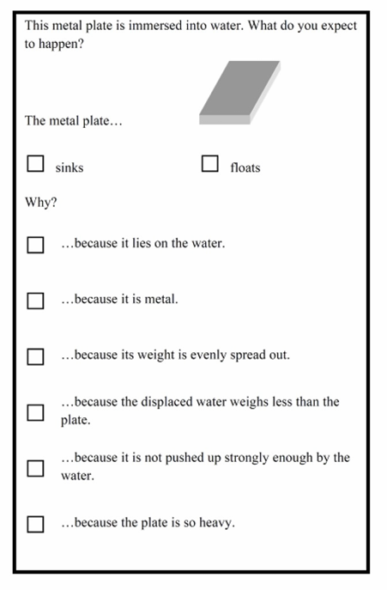
Initial knowledge
Knowledge development
Mechanisms of change
Content knowledge
Inquiry Learning & Conceptual Change
Process skills
(Nature of Science)
The Control-of-Variables Strategy
(Epistemic Beliefs)
Floating and Sinking
Schalk et al. (2018)
Notes:
Plus epistemic beliefs/natur of science :)
Thank you for the introduction, welcome!
Educational researchers are often interested in examining learners` knoweldge as a predictor and outcome of learning processes.
I take you on a historical trip through the universe of conceptual change- and inquiry-based learning research to see you theoretical developments and statistical approaches to modeling knowledge have influenced each other over the last decades.
The aim is to enlighten:
What has been done in the statistical modeling of knowledge?
How has it changed, and why?
What can we learn from this for tomorrow – what are the necessary next steps to help our theoretical understanding of learning and our (statistical) models of learners` knowledge develop further?
In the last decades, there is a trend in educational research to focus on learners` competencies, motivation and emotions, self-regulation and meta-cognition, -
Inquiry learning and conceptual change research share a lot of views on learners` knowledge and how it develops.
Inquiry learning typically emphasizes a constructivist view, in which building up knowledge in ways similar as scientists do should help learners build up experience-based procedural and conceptual understanding.
Conceptual change enriches this view by emphasizing that building up knowledge is commonly not a simple adding piece-by-piece process, but a highly non-linear and individualistic process in which prior knowledge plays a much more complicated role than just representing the basis to which new pieses are added.
In both research areas, knowledge is a central construct that they believe is important both as a predictor and an outcome of learning.
What is knowledge? I don`t have a clue.
I`m quite sure it`s a cognitive representation, of facts, procedures, events, concepts, schemata, and other ontological categories. I like to see knowledge as measurement:
Our brains represents central characteristics of phenomena in the world to help us make it more predictable and give us agency – maybe that`s what knowledge is. (show: Measurement: represent differences in something that we care about, capturing relations in differences in this some-thing in numbers)
Although no one can define what knowledge is, we have many ontological categories assembled within this term – maybe around 120.
We can summarize these as types and qualities of knowledge…
In inquiry learning and conceptual change researc, a central concept of interest is knowledge.
There are various types of knowledge -

Slide 71


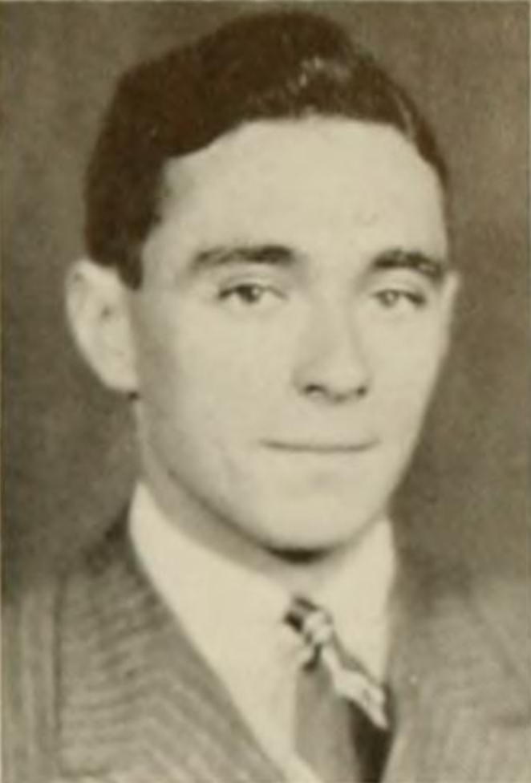
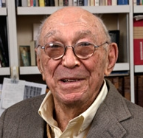
1957
1959
Woods Hole Conference at Cape Cod of Scientists, Scholars, and Educators
“Something new was stirring in the land.”
Spiral curriculum
Focus on (deep) structure and inquiry
Tutoring systems & feedback
Nature of Science
Bruner (1939); Wiki
Bruner (1916); APA
Sputnik 1 (PS-1 #1) - Gunter's Space Page
Bruner (1959). The Process of Education.
Notes:
In 1957, Sputnik-1 was shot into the earth`s orbit, initiating the space age and intensifying the cold war.
The Americans were in fear of having fallen behind the Soviets. As one measure to keep up, they initiated science education reforms.
“In September 1959 there gathered at Woods Hole on Cape Cod some thirty-five scientists, scholars, and educators to discuss how education in science might be improved in our primary and secondary schools”.

Slide 72
“Something new was stirring in the land.”
“Spiral curriculum, deep structure for learning transfer, warm aspects (i.e, motivational-affective factors); teaching general nature of science principles (e.g., taxonomization, measurement, modeling)
Bruner (1959). The Process of Education.
Notes:
What is most important for teaching basic concepts is that the child be helped to pass progressively from concrete thinking to the utilization of more conceptually adequate modes of thought. But it is futile to attem?t this by resentin formal explanations based on a 10 IC tfiat IS !Stant from t e c s manner of t" n e in its implicanons for hlffi. Much teaching ~mathematics is 0 this sort. The child learns not to under ~tand mathematical order but rat er to apply certain devices or reci es without understanding their signifi cance and connecte ness. ey are 0 trans ate mto IUs way of thinking. Given this inappropriate start, he is easily led to believe that the important thing is for him to be "accurate"-though accuracy has less to do with mathematics than with computation. Perhaps the most striking example of this type of thing is to be found in the manner in which the high school student meets Euclidian geometry for the first time, as a set of axioms and theorems, without having had some experience with simple geometric configuratiQllS- and the intuitive means whereby one deals with them. If the child were earlier given the concepts and strategies in the form of intuitive geometry at a level that he could easily follow, he might be far better able to grasp deeply the meaning of the theorems and axioms to which he is exposed later.
The complementary narure of inruitive and analytic thinking should, we think, be recognized.
The Soviet Union's conquests in space, its capability of producing not only powerful weapons but also an . effective industrial society, have shaken American com placency to a degree that, looking back, would have seemed inconceivable a decade ago.
"middle language" -class room discussions and textbooks that talk about the con clusions in a field of intellectual inquiry rather than cen tering upon the inquiry itself. Approached in that way, high school physics often looks very little like physics, social studies are removed from the issues of life and society as usually discussed, and school mathematics too often has lost contact with what is at the heart of the subject, the idea of order.
The principle of invariance is no a priori datum of the mind, nor is it the product of purely empirical observation. The child discovers invariance in a manner comparable to scientific discoveries generally. Grasping the idea of invariance is beset with difficulties for the child, often unsuspected by teachers.
The students are encouraged in class discussion to fignre out why this is the case and why it wonld be less likely for civilizations to start in mountainous coun try. The effect of this approach, essentially the tech nique of discovery, is that the child generates informa tion on his own, which he can then check or evaluate against the sources, getting more new information in the process. This obviously is one kind of learning epi sode, and doubtless it has limited applicability.

Slide 73
Theory of knowledge Our theoretical assumptions about learners` knowledge
Model of knowledge
Our statistical model
about learners` knowledge
Notes:
Learners` knowledge is a central predictor and outcome across a variety of educational contexts.
I discuss how knowledge has been represented and examined in statistical models throughout the last decades, connecting statistical developments such as factor-, mixture-, multilevel-, network- and cognitive modeling to theoretical shifts in the fields of inquiry-based learning and conceptual change. Engaging in informed clairvoyance, I discuss future developments that may help us further refine our models for the questions that we care about. One principle I bring forward is that in setting up statistical models of knowledge, our theories and aims are generally more important than the details of empirical data, although there may be boundaries to this perspective – but where are these exactly? Let`s discuss.
Reliability paradox

Slide 74
Theory of knowledge Our theoretical assumptions about learners` knowledge
Learners`mental representations of domain-specific contents
Model of knowledge
Our statistical model
about learners` knowledge
not domain-general reasoning (e.g., intelligence), motivational-affective factors, processes (e.g., self-regulation)
Notes:
Learners` knowledge is a central predictor and outcome across a variety of educational contexts.
I discuss how knowledge has been represented and examined in statistical models throughout the last decades, connecting statistical developments such as factor-, mixture-, multilevel-, network- and cognitive modeling to theoretical shifts in the fields of inquiry-based learning and conceptual change. Engaging in informed clairvoyance, I discuss future developments that may help us further refine our models for the questions that we care about. One principle I bring forward is that in setting up statistical models of knowledge, our theories and aims are generally more important than the details of empirical data, although there may be boundaries to this perspective – but where are these exactly? Let`s discuss.
Reliability paradox

Slide 75
Theory of knowledge Our theoretical assumptions about learners` knowledge
Learners` mental representations of domain-specific contents in long-term memory
Model of knowledge
Our statistical model
about learners` knowledge
not domain-general reasoning (e.g., intelligence), competencies, motivational-affective factors
Notes:
Learners` knowledge is a central predictor and outcome across a variety of educational contexts.
I discuss how knowledge has been represented and examined in statistical models throughout the last decades, connecting statistical developments such as factor-, mixture-, multilevel-, network- and cognitive modeling to theoretical shifts in the fields of inquiry-based learning and conceptual change. Engaging in informed clairvoyance, I discuss future developments that may help us further refine our models for the questions that we care about. One principle I bring forward is that in setting up statistical models of knowledge, our theories and aims are generally more important than the details of empirical data, although there may be boundaries to this perspective – but where are these exactly? Let`s discuss.
Reliability paradox

Slide 76
Skills
&
Competencies
Motivation
&
emotion
Knowledge
Self-regulation
&
meta-cognition
Notes:
In the last decades, there is a trend in educational research to focus on constructs such as skills and competencies, motivation and emotions, self-regulation, and meta-cognition.
Yet, what keeps it all together is Knowledge.
Inquiry learning and conceptual change research share a lot of views on learners` knowledge and how it develops.
Inquiry learning typically emphasizes a constructivist view, in which building up knowledge in ways similar as scientists do should help learners build up experience-based procedural and conceptual understanding.
Conceptual change enriches this view by emphasizing that building up knowledge is commonly not a simple adding piece-by-piece process, but a highly non-linear and individualistic process in which prior knowledge plays a much more complicated role than just representing the basis to which new pieses are added.
In both research areas, knowledge is a central construct that they believe is important both as a predictor and an outcome of learning.
What is knowledge? I don`t have a clue.
I`m quite sure it`s a cognitive representation, of facts, procedures, events, concepts, schemata, and other ontological categories. I like to see knowledge as measurement:
Our brains represents central characteristics of phenomena in the world to help us make it more predictable and give us agency – maybe that`s what knowledge is. (show: Measurement: represent differences in something that we care about, capturing relations in differences in this some-thing in numbers)
Although no one can define what knowledge is, we have many ontological categories assembled within this term – maybe around 120.
We can summarize these as types and qualities of knowledge…
In inquiry learning and conceptual change researc, a central concept of interest is knowledge.
There are various types of knowledge -

Slide 77
Modeling Knowledge
Knowledge
Yesterday
Today
Tomorrow
Model
Peter Edelsbrunner
SIG3&20 Meeting Turku 2026
Notes:
Thank you and welcome!
Educational researchers are often interested in learners`knowledge:
Modeling Knowledge: Yesterday, Today, Tomorrow
Knowledge is a central predictor and outcome across a variety of educational contexts.
I discuss how knowledge has been represented and examined in statistical models throughout the last decades, connecting developments in statistical practices to theoretical developments in the fields of inquiry-based learning and conceptual change.
I argue that statistical modeling has served and will continue to serve as inspiration to educational theory in these areas, just as educational theory serves as inspiration for new modeling approaches that better represent our theoretical aims and assumptions.
Providing an overview of current modeling methodologies, such as factor analysis, multilevel-, mixture-, network-, and cognitive modeling and the role these play in current developments, I try engaging in informed clayrvoyance to show up future developments that may help us better represent the questions that we care about in statistical models of our learners` knowledge and its development.
I also argue that in translating our theories of knowledge into statistical models, our research aim is more important than rigid statistical rules. Based in multiple examples, I argue ways in which we can convince reviewers and colleagues that being guided by our theories or aims is generally more informative than being guided by data, but there may be boundaries to this perspective.
Learners` knowledge is a central predictor and outcome across a variety of educational contexts.
I discuss how knowledge has been represented and examined in statistical models throughout the last decades, connecting statistical developments to theoretical shifts in the fields of inquiry-based learning and conceptual change. Engaging in informed clairvoyance, I discuss future developments that may help us further refine our models for the questions that we care about. One principle I bring forward is that in setting up statistical models of knowledge, our theories and aims are generally more important than the details of empirical data, although there may be boundaries to this perspective – but where are these exactly?
I argue that statistical modeling has served and will continue to serve as inspiration to educational theory in these areas, just as educational theory serves as inspiration for new modeling approaches.
Providing an overview of current modeling approaches, such as factor analysis, multilevel-, mixture-, network-, and cognitive modeling and the role these play in current developments, I try engaging in informed clayrvoyance to show up future developments that may help us further refine our models for the questions that we care about. One principle I bring forward is that in setting up statistical models of knowledge, our theories and aims are generally more important than the details of empirical data, although there may be boundaries to this perspective – but where are these exactly?

Slide 78
Knowledge
How do interventions affect it?
How does it affect learners‘ responses to interventions?
Interventions
Development
How does it develop?
Notes:
How does it develop, how do educational interventions affect it and how does it change the effects that interventions such as schooling have on learners?

Slide 79
Knowledge
Fact
Types
Vs.
Qualities
(Paas/Whoever/1998 or so)
Procedural
Conceptual
Declarative
?
Explicit
Implicit
Notes:
We have fuzzy conceptions such as procedural, conceptual, declarative, et.c knowledge.
And we have the general conception that knoweldge consists of nodes and edges – something we know and the relations between knowledge pieces.
My point: There is something missing in between – Paast had this very general distinction between types and qualities of knowledge, but the nodes-and-edges view is an untestable meta-theory, the other types are too untestable, because they are conceptions, not assumptions.
We need a „system“ in between that underlies all the different kinds and qualities of knowledge and allows testable predictions – a theory of knowledge?

Slide 80
Theory Knowledge
Statistical Model
Theory representation
Model representation
Theory representation
Peter Edelsbrunner
SIG3&20 Meeting Turku 2026
Notes:
To answer these questions, we often use statistical models that help us represent data about learners` knowledge.
We have a theory, or theoretical model, of knowledge.
Here, I distinguish between knowledge meta-theory and knowledge theory:
General characteristics of anything that falls within our definition of knowledge is our knowledge meta-theory.
Our knowledge theory:
Specific assumptions regarding knowledge and its characteristics within our research domain.
Pe: Domain meta-theory?

Slide 81
Knowledge
How do interventions affect it?
How does it affect the effects of interventions?
Intervention
Moderation
How does it develop?
Development
Ageing
Notes:
Thank you and welcome!

Slide 82
take home
1) Chocolate, because that’s always a great think to take home!
Think about your meta-theory
Are your Items interchangeable or not?
Construct relevance -> latent variable (theory/model)
Vs. models emphasizing the individual items (e.g., multilevel modeling -> see my approach)
Both?
Do both!
Notes:
Thank you and welcome!

Slide 83
central ideas and takes
Yesterday: Factor analysis, sum-and-alpha approach
Today: Mixture models, network models, CDM, IRT,…, debates on reflective vs. formative,…
Tomorrow:
Think about your meta-theory
Are your Items interchangeable or not?
Construct relevance -> latent variable (theory/model)
Vs. models emphasizing the individual items (e.g., multilevel modeling -> see my approach)
Both?
Do both!
Notes:
Thank you and welcome!

Slide 84
Integration a historical account of models that have been used to model knowledge with the research areas…
The result will be five conclusions for educational researchers who aim to model knowledge and learn the most about its nature and development.
1) ANOVA can be enough
2) Cronbach`s Alpha and factor analysis may lead us astray
3) Knowledge and its development can be modelled on multiple levels: Process (diffusion), components (items/elements and relations), construct (sum score,…), for individuals and across groups/populations. Variation across learner levels and construct levels (and process levels? -> diffusion, learning analytics/micro-genetic, developmental). Use Leos micro meso macro? Micro: On level of items (individual knowledge elements – although not always, an item may also capture a whole concept/multiple elements and/or relations), seconds; meso: On level of multiple knowledge elements, minutes/hours; macro: On level of the whole construct (e.g., topic/domain knowledge), days/weeks/months/years. Learning units: between meso and macro.
4) Our theoretical thinking can inspire statistical models
5) Statistical models can inspire our theoretical thinking
Final model:
Notes:
Introduction:
Knoweldge as still the major outcome among competencies, skills, etc.
What is knowledge?
Kinds of knowledge.
Characteristics of knowledge.
So, how do we model it?
Earlier investigations: More qualitative
Then: Experiments -> Quantitative
Sum scores -> Changes.
Yesterday:
We modelled sum scores.
(or scores on individual items?)
Today:
We do multilevel modeling:
Individual items, individual learners, averages across items and across learners.
We acknowledge heterogeneity -> in knowledge quality, quantity, and development.
We acknowledge not only learners, but also the knowledge, as heterogeneous (Alpha, formative, single-item random effects,…)
Tomorrow:
Dynamic system modeling:
From the response process -> e.g., diffusion.

Slide 85
Final model
Shows the mutual relation between theory about knowledge and its statistical representation.
Theory/model dimensions:
Individual elements (components or relations; intrinsic feature vs. external relation? PE: Intrinsic features categories: Fact knowledge – “IS” relation in knowledge network; external relation: No single “is” eventually? -> Is this correct?),
Granularity (sub-element, supra-element, construct); within-individual, between-individuals,… (Krammer,…)
Notes:
Introduction:
Knoweldge as still the major outcome among competencies, skills, etc.
What is knowledge?
Kinds of knowledge.
Characteristics of knowledge.
So, how do we model it?
Earlier investigations: More qualitative
Then: Experiments -> Quantitative
Sum scores -> Changes.
Yesterday:
We modelled sum scores.
(or scores on individual items?)
Today:
We do multilevel modeling:
Individual items, individual learners, averages across items and across learners.
We acknowledge heterogeneity -> in knowledge quality, quantity, and development.
We acknowledge not only learners, but also the knowledge, as heterogeneous (Alpha, formative, single-item random effects,…)
Tomorrow:
Dynamic system modeling:
From the response process -> e.g., diffusion.

Slide 86
Definition
Kinds/Types
Characteristics: Element knowledge, relational knowledge – different or just different hierarchical level? -> Lennart? Read his article and then ask him.
Conceptual change:
Susan Carey: What is it that changes? How does the change look like?
Development as modeling the world:
We have core knowledge
We have intelligence (& working memory?)
Intelligence is the engine that interacts with experience to fill our knowledge space beyond core knowledge -> Int connects core knowledge with experience to deduce – abductively – explanations (i.e., mental models/knowledge) through reasoning
Agency, numeracy, … + Intelligence :)
My aim is to portray how we can statistically model what the aims of inquiry learning and conceptual change research in this process are:
What are their assumptions about the processes of knowledge development that take place
How can we represent, describe (effect estimates), and test (hypothesis tests) these assumptions using statistical models?
Interest of inquiry research: Study how learners build knowledge through inquiry experience, and study how we can design and support the inquiry experience to moderate the knowledge construction process
Conceptual change research: Study the knowledge that learners bring into the inquiry process, how it changes therein – particularly when the prior knowledge is in contrast with the learning goal or outcome – then, we require conceptual change/non-linear, not typical additive constructivist (adding piece by piece) processes of knowledge restructuring
Distinguish between: Fact acquisition, Belief change/revision/updating, conceptual change
Accompanying paper in the educational psychologist:
Modeling knowledge
When we quantitatively study learners` knowledge and its development, a prime task is to translate our theoretical models of knowledge and development into statistical parameters that allow representing, describing, and testing our assumptions about these models.
Here, we describe central assumptions about knowledge and survey how these may be best represented in the statistical models we have available in educational research.
This is done from two perspectives.
First, we provide a historical account of how knowledge has been typically represented in statistical models throughout the decades.
Second, we survey available models to see and compare how they manage to represent theoretical assumptions about knowledge better or worse than others.
As a result, we provide implications for researchers that may help them select the best available models for their research question concerning knowledge at hand, as well as a potential future research agenda for applied methodological research aimed to help educational research in doing so.
Notes:
Introduction:
Knoweldge as still the major outcome among competencies, skills, etc.
What is knowledge?
Kinds of knowledge.
Characteristics of knowledge.
So, how do we model it?
Earlier investigations: More qualitative
Then: Experiments -> Quantitative
Sum scores -> Changes.
Yesterday:
We modelled sum scores.
(or scores on individual items?)
Today:
We do multilevel modeling:
Individual items, individual learners, averages across items and across learners.
We acknowledge heterogeneity -> in knowledge quality, quantity, and development.
We acknowledge not only learners, but also the knowledge, as heterogeneous (Alpha, formative, single-item random effects,…)
Tomorrow:
Dynamic system modeling:
From the response process -> e.g., diffusion.

Slide 87
MODELING KNOWLEDGE
Yesterday Today Tomorrow

Slide 88
Cognitive representations about the world stored in long-term memory
- Elements (e.g., fact, procedure, concept)
- Relations between elements
Wheel
Does
Is a part of
Movement
Used for
Bike
Flower
Cycling
Green
Is the color of

Slide 89
Cognitive representations about the world stored in long-term memory
- Elements (e.g., fact, procedure, concept)
- Relations between elements
Wheel
Does
Is a part of
Movement
Used for
Bike
Flower
Cycling
Green
Is the color of
Notes:
and the storry goes on...
and then we develop a test to measure knowledge.
define what we want to measure.
example:
Force? F&S?
different aspects
USE THE EXAMPLE OF AISH??
We have physical laws undertanding and we have superficial contexts.
In the 90s:
Develop many items. Use factor analyis. Remove very low/high difficulties and loadings.
Today:
Compare different factor models.
use factor scores?

Slide 90
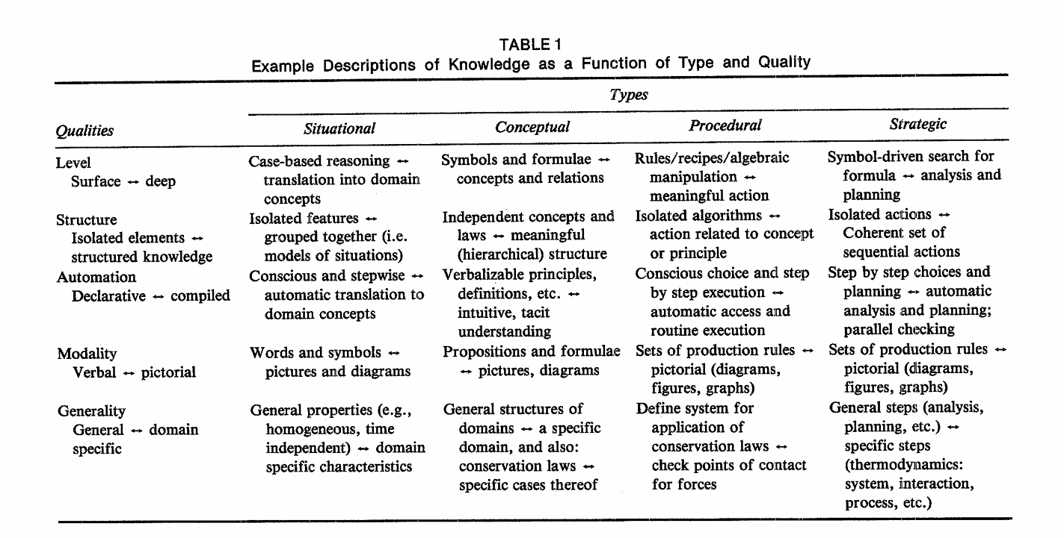

Slide 91
Modeling Knowledge
Yesterday
Today
Tomorrow
Notes:
Thank you for the introduction, welcome!
Educational researchers are often interested in examining learners` knoweldge as a predictor and outcome of learning processes.
I take you on a historical trip through the universe of conceptual change- and inquiry-based learning research to see you theoretical developments and statistical approaches to modeling knowledge have influenced each other over the last decades.
The aim is to enlighten:
What has been done in the statistical modeling of knowledge?
How has it changed, and why?
What can we learn from this for tomorrow – what are the necessary next steps to help our theoretical understanding of learning and our (statistical) models of learners` knowledge develop further?
In the last decades, there is a trend in educational research to focus on learners` competencies, motivation and emotions, self-regulation and meta-cognition, -
Inquiry learning and conceptual change research share a lot of views on learners` knowledge and how it develops.
Inquiry learning typically emphasizes a constructivist view, in which building up knowledge in ways similar as scientists do should help learners build up experience-based procedural and conceptual understanding.
Conceptual change enriches this view by emphasizing that building up knowledge is commonly not a simple adding piece-by-piece process, but a highly non-linear and individualistic process in which prior knowledge plays a much more complicated role than just representing the basis to which new pieses are added.
In both research areas, knowledge is a central construct that they believe is important both as a predictor and an outcome of learning.
What is knowledge? I don`t have a clue.
I`m quite sure it`s a cognitive representation, of facts, procedures, events, concepts, schemata, and other ontological categories. I like to see knowledge as measurement:
Our brains represents central characteristics of phenomena in the world to help us make it more predictable and give us agency – maybe that`s what knowledge is. (show: Measurement: represent differences in something that we care about, capturing relations in differences in this some-thing in numbers)
Although no one can define what knowledge is, we have many ontological categories assembled within this term – maybe around 120.
We can summarize these as types and qualities of knowledge…
In inquiry learning and conceptual change researc, a central concept of interest is knowledge.
There are various types of knowledge -

